Slide 1
CS301 - Algorithms
Week #2
Husnu Yenigun

Slide 2
BACKGROUND

Slide 3


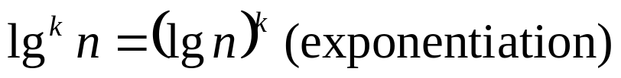

Logarithms
The following notations will be used:

Slide 4
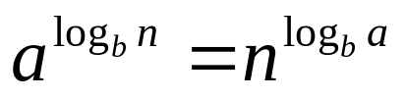
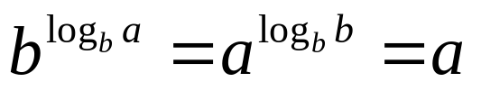
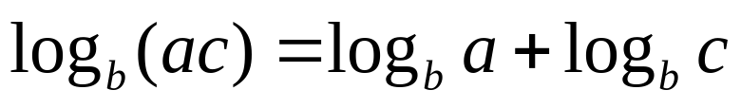
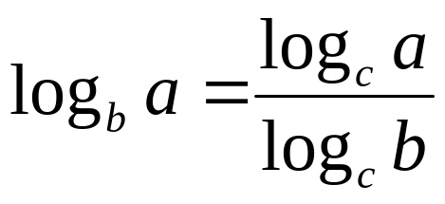
Logarithms

Slide 5
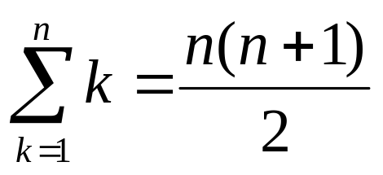
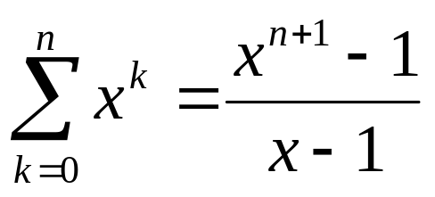
Summations

Slide 6
RECURRENCES

Slide 7
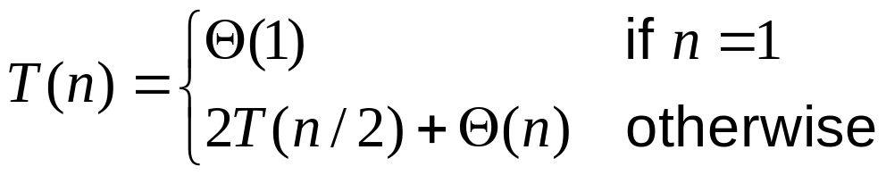
Recurrence
A recurrence is an equation or inequality that describes a function in terms of its value on smaller inputs.
When an algorithm contains a recursive call to itself (e.g. a divide and conquer algorithm), its running time can often be described as a recurrence.
We will see a number of methods to solve recurrences.

Slide 8

Recursive and Recursion Free Expressions
It can be very easy to write down the running time of a recursive algorithm by using a recurrence.
Merge-Sort(A,p,r) {
if (p < r) {
q = floor((p+r)/2);
Merge-Sort(A,p,q);
Merge-Sort(A,q+1,r);
Merge(A,p,q,r);
}
}
vs.
However, by looking at a recurrence, it may not be easy to understand the growth rate of the function.

Slide 9





Solution of a Recurrence
Solving a recurrence means, finding a recursion-free expression for the function.
For example, consider the recurrence:
The function is described in terms of itself. However, the same function could have been given as:
Sometimes, we don’t even need an exact solution to find asymptotic bounds on the solutions of recurrences

Slide 10
Technicalities
While solving recurrences, we will usually neglect some details.
We usually ignore the fact that the arguments of the running time functions should be integers.
We will also ignore the actual time required for small inputs, and assume that the algorithms require a constant time to finish on small inputs.
In fact we will assume that it takes constant time to execute any algorithm with a constant input size.

Slide 11
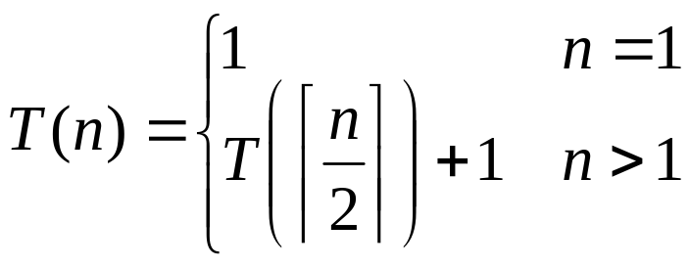

Why integer arguments are not important
Consider the following recurrence:
Let us first try to solve it for n=2^{k} (in this case T always get integer arguments)
Claim:

Slide 12

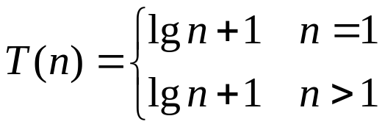
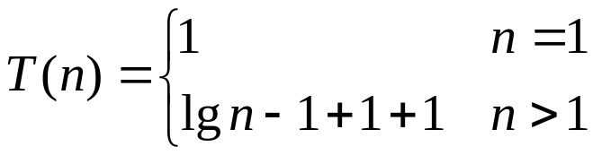
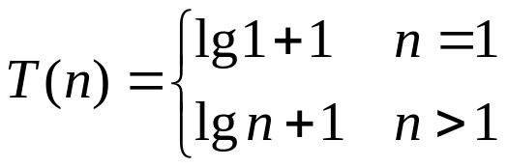
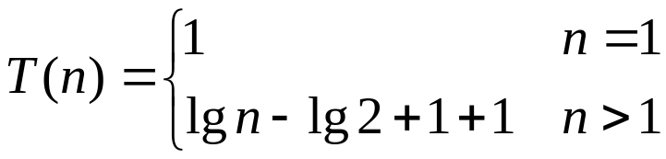
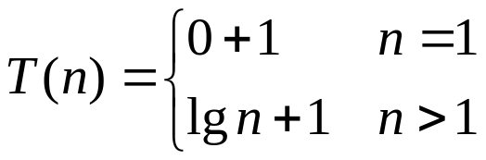
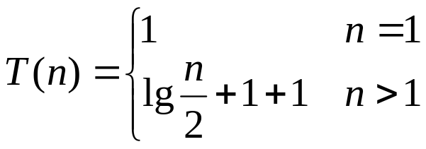
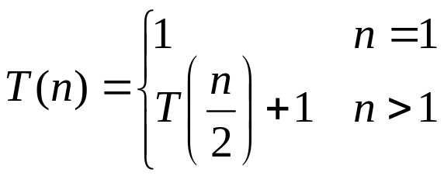
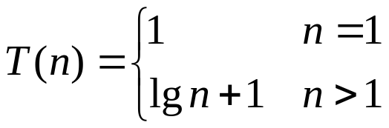
Why integer arguments are not important
So our claim is:
-1+1=0
n=1
1=lg2
lg1=0
lg n-lg 2=lg n/2
0+1=1
T(n/2)=lg n/2+1

Slide 13

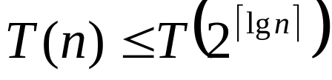
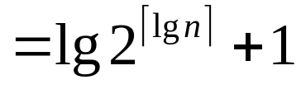

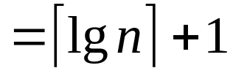


Why integer arguments are not important
When n is not an exact power of 2?
So, for asymptotic analysis, the floor and ceilings do not make a difference…
claim is shown
to be correct
for exact
powers of 2
T(.) is a
nondecreasing
function

Slide 14

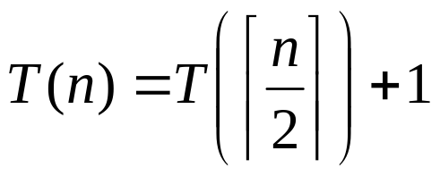
Why we can assume constant time on small inputs
Usually, instead of
or
We will write
skipping the boundary conditions

Slide 15






Why we can assume constant time on small inputs
When functions are polynomially bounded, the initial conditions (the value on small inputs) do not make a difference for the solution in asymptotic notations.

Slide 16
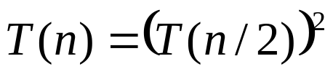



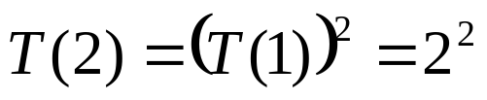
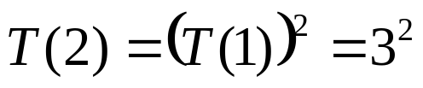
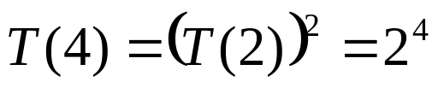
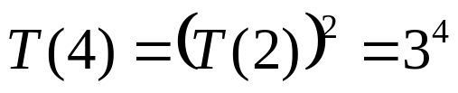

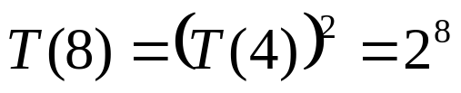
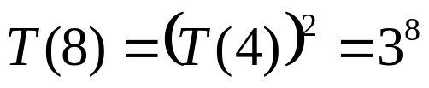


Does matter when exponentially bounded!!!
The initial conditions can make a difference, when the function is not polynomially bounded.
For example:
?

Slide 17
Paying attention to the technicalities
Therefore, the integer arguments and the initial conditions do not actually make a difference when we try to find asymptotic solutions to the recurrences.
However, it is important to know when these technicalities do make a difference on the result.
In general, go ahead and solve the recurrence. Then, check if it makes a difference or not.

Slide 18
SOLVING RECURRENCES

Slide 19
Method 1: The Substitution Method
Two step approach:
  Guess the solution
  Verify the solution
It is a very powerful method for showing upper and lower bounds (O and Ω)
Tight bounds can be shown by:

Slide 20
Method 1: The Substitution Method
The difficulty of the substitution method is to guess a solution.
  In general, there is no way to find a good guess.
  It requires experience and intuition to come up with good guesses.
  Usually try a loose bound first, and then try to improve and tighten it gradually.
The second step (verification step) requires to perform an induction proof.

Slide 21


Example for the substitution method
Let us try to find an asymptotic upper bound on the recurrence:
Step 1 (Guessing): Claim that
Step 2 (Verification): Use induction to prove
Note that, we would prove if we can show

Slide 22
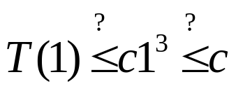


Example for the substitution method
Induction proof itself has two steps:
  Induction base:
  This is usually the case, and therefore we will skip the induction base step in the inductive proofs of the substitution method most of the time…
  Inductive step:
    Assume that:
    And show that:
we can always pick c big
enough to satisfy this
induction hypothesis

Slide 23
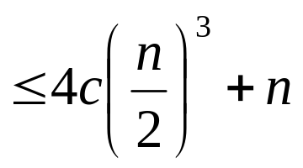
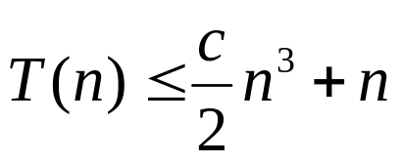
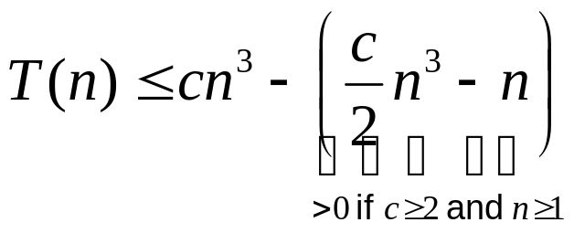
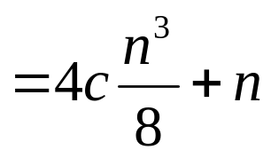

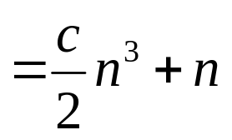

Example for the substitution method
trick is to try to write it as:
“what we want” – “something nonnegative”
induction
hypothesis
we want this to look like

Slide 24

Example for the substitution method
OK, we have shown that
However, this may be a loose upper bound.
Let us try to find a better upper bound.
New claim is:

Slide 25

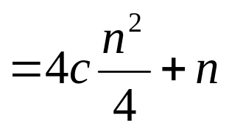



Example for the substitution method
We directly jump to the proof of inductive step:
induction
hypothesis
This is a usual mistake.
Be careful, while doing this inductive proof,
we are now trying to prove:
which will in turn give us

Slide 26

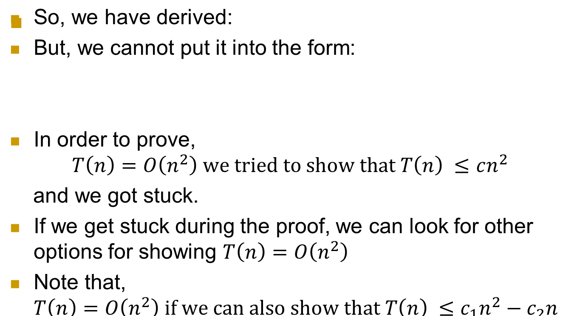
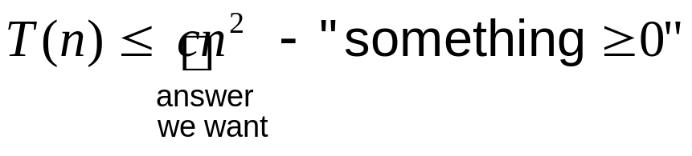
Example for the substitution method

Slide 27

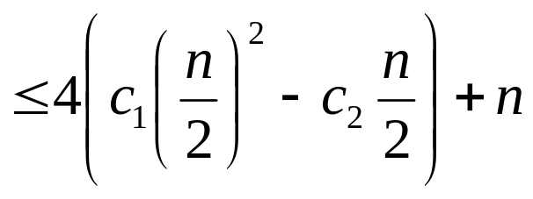

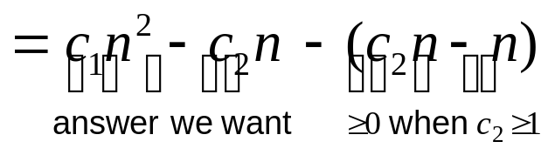

Example for the substitution method

Slide 28
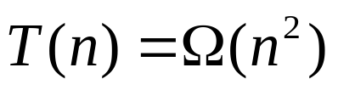
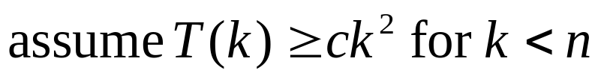
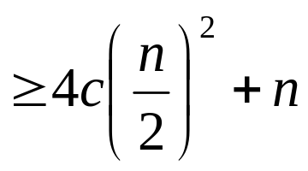

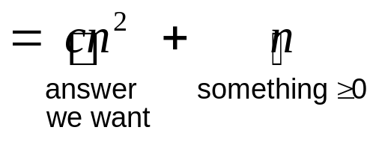
Showing lower bounds using the substitution method
Consider again:
Step1 (Guess and claim):
Step2 (prove by induction):

Slide 29
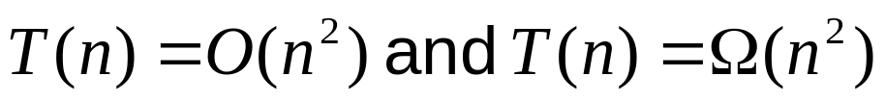
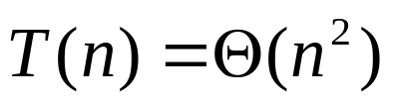
Showing tight bounds using the substitution method
Note that for
We have shown that:
Therefore:
To find tight bounds for recurrences using the substitution method, this is the way to follow.

Slide 30
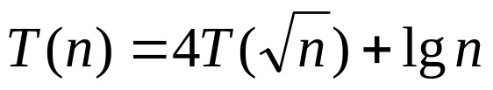
Method 2: Changing variables
A scary looking recurrence:
By making some algebraic manipulations, we can usually put such a recurrence into a form that is familiar to us, or that looks easier to solve…

Slide 31

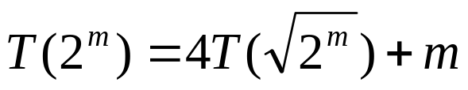












Method 2: Changing variables
For this recurrence, let us substitute:
Note that, the expression is a function in m, let us call it

Slide 32
Method 3: The iteration method
This method for solving recurrences based on the idea to iterate the recurrence a few times to come up with a summation that describes the recurrence.
It requires to know the rules and intuition for series.
The mathematics used can get messy and hard.
It is often used to generate good guesses for the substitution method.

Slide 33












Example for the iteration method
iteration level
grows as
grows as
grows as

Slide 34


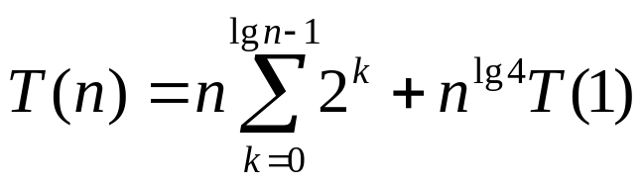
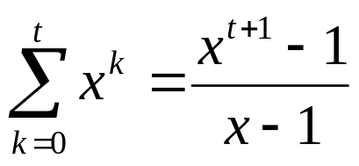
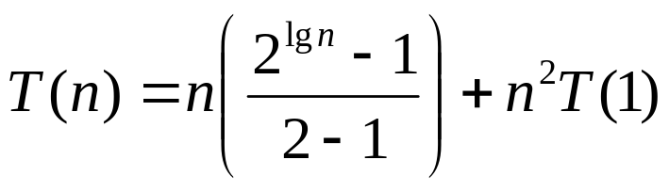


Example for the iteration method
Book keeping can be easier if we
use “recursion trees” to visualize
the iterations.

Slide 35



















Using Recursion Trees
total cost
of the level
recursion level
+

Slide 36
Using Recursion Trees
When we add the costs of all the levels, we get the same expression as before:

Slide 37

















Irregular RecursionTrees
total cost
of the level
recursion level
+

Slide 38

Method 4: The Master Method
The master method provides an easy way to solve recurrences that are in the following form:
It requires to remember 3 conditions.
When a condition is satisfied, you can directly write down the solution to the recurrence.
The method is based on the “Master Theorem”

Slide 39






The Master Theorem
Given
Case 1
Case 2
Case 3

Slide 40




Example for using the master method
- Case 1 applies, therefore

Slide 41




Example for using the master method

Slide 42








Example for using the master method

Slide 43















Proof sketch for the master theorem
total cost
of the level
recursion level
+

Slide 44

Proof sketch for the master theorem
So, the overall cost has two components:
The master theorem compares these two components.
If one of components is asymptotically larger than the other, then it dominates the overall cost (cases 1 and 3)
Otherwise, both components contribute to the result (case 2).

Slide 45






Proof of case 2:

Slide 46
SORTING ALGORITHMS REVISITED

Slide 47


Memory Usage of The Sorting Algorithms
An inplace sorting algorithm requires a constant amount of additional memory.
We have seen before insertion and merge sort algorithms as solutions to the sorting problem.
Insertion Sort:
Merge Sort:
Insertion sort is inplace (the numbers are shifted within the same array), however merge sort needs Θ(n) additional space.

Slide 48
Quick Sort
It is an inplace algorithm.
Worst case :
Average case:
(with small constant factors)
Like Merge Sort, Quick Sort also uses the divide and conquer approach.

Slide 49
Basic Idea of Quick Sort
Given an array A, pick an element z in the array as the pivot element:
Move all the elements smaller than or equal to z to the left of z.
Move all the elements greater than z to the right of z.
If we sort A₁ and A₂, then we will be sorting the entire array.
A:
z
≤z
>z
A’:
z
A₁
A₂

Slide 50
Pseudo code for Quick Sort
Quick-Sort(A,p,r) {
if (p<r) {
q=Partition(A,p,r); // index of the pivot is returned
Quick-Sort(A,p,q-1);
Quick-Sort(A,q+1,r);
}
}

Slide 51

Pseudo code for Partition
Partition(A,p,r) {
z=A[r]; // picks the last element as the pivot (any element is ok)
i=p-1; // the index of the last number seen which is ≤z
for (j=p; j <r; j++) { // go over every element (except pivot itself)
if (A[j] ≤ z) { // whenever we see a number ≤z
i++; // update i and
swap(A[i],A[j]); // move the number to the front
}
}
swap(A[i+1],A[r]); // move to the pivot right next to the last seen
return(i+1); // smaller number, and return the index of the
} // pivot
Consider application on the array: 8 9 3 7 6

Slide 52


Analysis of Quick Sort: best case
The best case of Quick Sort is when the partitioning produces balanced partitions at each recursion
Quick-Sort(A,p,r) {
if (p<r) {
q=Partition(A,p,r);
Quick-Sort(A,p,q-1);
Quick-Sort(A,q+1,r);
}
}

Slide 53


Analysis of Quick Sort: worst case
The worst case of Quick Sort occurs when the partitioning produces an empty partition at each recursion (the pivot selected happens to be the smallest or the largest element in the part of the array being handled)
Quick-Sort(A,p,r) {
if (p<r) {
q=Partition(A,p,r);
Quick-Sort(A,p,q-1);
Quick-Sort(A,q+1,r);
}
}

Slide 54
Analysis of Quick Sort: average case
The average case for Quick Sort (when the worst case does not occur) luckily has the same behavior as the best case.
Even if the partitioning does not produce equal partitions, as long as the size of the partitions are proportional, we will have the best case behavior.

Slide 55
LOWER BOUNDS FOR THE SORTING PROBLEM

Slide 56

Lower bounds for the sorting problem

Slide 57
Lower bounds for the sorting problem
Can we hope that, someday a brilliant person will be born, and she/he will find a more efficient comparison based sorting algorithm?
Or, is the merge sort an algorithm that can never be beaten?
Note that, not being able to find something, does not prove that what we are looking for does not exist.
So, may be someone wise enough will come up and show the world how to sort faster.
Or, may be not?

Slide 58

Lower bounds for the sorting problem

Slide 59

Lower bounds for the sorting problem

Slide 60

Lower bounds for the sorting problem

Slide 61











Lower bounds for the sorting problem
Using decision trees to visualize sorting:
(assume that we have three numbers to sort)
The leaves are the permutations of the input (n! leaves)
If any of the permutations are missing, then for an input whose result corresponds to that permutation, the algorithm will not work correctly.

Slide 62
Lower bounds for the sorting problem
Note that, as a comparison based sorting algorithm performs its comparisons and derives more and more information on the relative orders of the input numbers, it is actually following a path in the decision tree.

Slide 63
Lower bounds for the sorting problem
When we consider the worst case, even the most efficient comparison based sorting algorithm has to traverse the decision tree from the root to a deepest leaf, i.e. it needs to perform h comparisons where h is the height of the tree.

Slide 64
Lower bounds for the sorting problem
So if we find a lower bound on the depth of the decision tree, we will be able to find a lower bound on the comparison based sorting algorithms.

Slide 65









Lower bounds for the sorting problem
Note that, the decision tree is a binary tree.
For any binary tree with k leaves and of height h
For decision trees we know the number of leaves:
Stirling’s
approx.

Slide 66

Lower bounds for the sorting problem
Since the depth of a decision tree has a lower bound of
and any comparison based sorting algorithm (in its worst case) will have to traverse the longest path in the decision tree, is also a lower bound for the comparison based sorting algorithms.
Therefore, merge sort is asymptotically optimal.
So, do not try to find a more efficient comparison based sorting algorithm. There is none…

Slide 67
SORTING IN LINEAR TIME

Slide 68

No need to get confused…

Slide 69
Counting Sort
Assume that we are given n numbers in the range 1..k
Basic idea of counting sort is to count the number of times each element in the given sequence appear.
For example, consider the sequence [3,7,3,1,2] whose elements range in 1..9 (or to be more exact in 1..7)
In this sequence: 1,2, and 7 appear once; 3 appears twice.
After having this information, it is trivial to sort this sequence by simply generating: one 1, one 2, two 3’s, and one 7.

Slide 70
An implementation for Counting Sort
Counting-Sort(A,k) {
for (i=1; i <= k; i++) // initialize number counters to 0
times[i] = 0;
for (j=1; j <= length[A]; j++) // find out how many times each
times[A[j]]++; // number appears in the input
// form the sorted array
m=1; // the index of the next number to be placed in the output
for ( i=1; i <= k; i++) // consider each number in the range
for ( j=1; j <= times[ i ]; j++) { // generate that number in
A[m]=i; // the output as many times as
m++; // it occurs in the input
}
}

Slide 71
Running time of Counting Sort
The first for-loop:
It will surely iterate O(k) times.
The second for-loop:
It will surely iterate O(n) times.
for ( i=1; i <= k; i++) // initialize number counters to 0
times[ i ] = 0;
for ( j=1; j <= length[A]; j++) // decide how many times each
times[A[ j ]]++; // number appears in the input

Slide 72
Running time of Counting Sort
The third for-loop:
The outer for-loop iterates O(k) times
However, the inner for-loop iterates different number of times for each i.
A loose upper bound can be found by considering that the inner for-loop will iterate at most n times for each i.
In this case, the third for-loop will need O(nk) time.
However, we can perform a better analysis.
for ( i=1; i <= k; i++) // consider each number in the range
for ( j=1; j <= times[ i ]; j++) { // generate that number in
A[m]=i; // the output as many times as
m++; // it occurs in the input
}

Slide 73



Running time of Counting Sort
Let t_{i} denote the number of times the inner for-loop iterates for each i.
Note that, every time the inner for-loop iterates, we place a new number into its correct place in the output array.
Hence:
for (i=1; i <= k; i++) // consider each number in the range
for ( j=1; j <= times[ i ]; j++) { // generate that number in
A[m]=i; // the output as many times as
m++; // it occurs in the input
}

Slide 74

Running time of Counting Sort
Note that, the condition of the inner for-loop will be checked t_{i}+1 times for each i:
Hence, total number of times it will be checked is:

Slide 75



Running time of Counting Sort
Therefore:
Hence the total cost of the third loop is:
Therefore the total running time of Counting Sort is:
for (i=1; i <= k; i++) // consider each number in the range
for (j=1; j <= times[ i ]; j++) { // generate that number in
A[m]=i; // the output as many times as
m++; // it occurs in the input
}
cost of the 1st loop
cost of the 2nd loop
cost of the 3rd loop

Slide 76
Counting Sort is a linear time algorithm
Note that, running time of Counting Sort is linear in the number of elements we will sort.
When k=O(n), Counting Sort has O(k+n)=O(n) worst case running time, which is lower than the lower bound of Ω(n lg n) that we have found for comparison based sorting algorithms.
This is of course normal, since Counting Sort does not sort the numbers by comparing them, i.e. it is not a comparison based sorting algorithm.

Slide 77
Can we generalize the idea of Counting Sort?
We have considered the Counting Sort to solve a special case of the sorting problem, where we know the range of the numbers to be sorted.
Can we generalize the approach of counting sort so that it becomes a solution to the general sorting problem?
In other words, given a sequence of numbers whose range is not known, can we use counting sort as an intermediate step?

Slide 78
Using Counting Sort as a solution to the general sorting problem
Suppose that we use:
Note that both algorithms run in Θ(n) time.
GetMin(A) {
min = A[1];
for (i=2; i <= length[A]; i++)
if (min > A[i])
min=A[i];
return min;
}
GetMax(A) {
max = A[1];
for (i=2; i <= length[A]; i++)
if (max < A[i])
max=A[i];
return max;
}

Slide 79
Using Counting Sort as a solution to the general sorting problem
Then we can:
Note that the steps other than the counting sort take Θ(n) time. Hence the overall time is still O(n+k).
LinearSort (A) {
min = GetMin(A); // find minimum number
max = GetMax(A); // find maximum number
k = max – min + 1; // find the length of our range
subtract “min-1” from each number in A; // transfer the numbers
// into the range 1..k
Counting-Sort(A,k); // apply the counting sort
add “min-1” to each number in A; // transfer the numbers back
}

Slide 80
Practical applicability of Counting Sort
The counting based solution to the sorting problem seems to be better than the comparison based sorting problem, if we consider the fact that the running time is linear in the number of elements to be sorted.
However, we should not forget that there is another term in the running time expression of counting sort, which is k.
When k=O(n): O(k+n)=O(n), so using counting sort is a wise approach.
But, in practice k in O(k+n) can cause problems.

Slide 81
Practical applicability of Counting Sort
Assume that, we are trying to sort 32 bit numbers.
How many values can we represent using 32 bits:
2²x2¹⁰x2¹⁰x2¹⁰=4 giga
Even if we use 1 byte for each counter, we will need 4 giga bytes for the times array in counting sort.
Note that, we will need to initialize the times array (one of the reasons we have the term k in the running time expression of counting sort).
Therefore, the space and time requirement of counting sort may not always be practical.

