Slide 1
CS301 - Algorithms
Week #3
Husnu Yenigun

Slide 2
STABILITY OF SORTING ALGORITHMS

Slide 3
Stable sorting algorithms
Note that counting sort cannot handle sorting by using a constant amount of additional memory.
We have just seen that, the additional amount of memory used is one of the problems of its practical applicability.
So, counting sort is not an inplace sorting algorithm.
Another important property of sorting algorithms is their stability.
A sorting algorithm is stable iff the equal elements in the output sequence appear in the same order as they appear in the input sequence.

Slide 4
Stable sorting algorithms
Consider the sequence of input numbers [3,8,4,3,2,4]
Let us give some identification to these numbers:
[ 3ª, 8^{b}, 4^{c}, 3^{d}, 2e, 4^{f} ]
A sorting algorithm is not stable if it generates:
[ 2e, 3^{d}, 3ª, 4^{c}, 4^{f}, 8^{b}]
Note that, being a sorting algorithm, it correctly sorts the numbers. However, the first “3” in the input sequence is not the first “3” in the output sequence.
A stable sorting algorithm will always generate:
[ 2e, 3ª, 3^{d}, 4^{c}, 4^{f}, 8^{b}]
preserving the relative orders of equal numbers in the input

Slide 5
Stable sorting algorithms
Stability of sorting algorithms is important when there is a satellite data that is carried together with the elements being sorted.
We will see why stability is important for some applications soon.

Slide 6
An implementation for Counting Sort
Counting-Sort(A,k) {
for (i=1; i <= k; i++) // initialize number counters to 0
times[i] = 0;
for (j=1; j <= length[A]; j++) // decide how many times each
times[A[j]]++; // number appears in the input
// form the sorted array
m=1;
for ( i=1; i <= k; i++) // consider each number in the range
for ( j=1; j <= times[ i ]; j++) { // generate that number in
A[m]=i; // the output as many times as
m++; // it occurs in the input
}
}

Slide 7
A stable implementation of Counting Sort
The basic idea of stable implementation for counting sort is to find out the correct index for a number to satisfy the stability while collecting the information.
For example, consider again:
[ 3ª, 8^{b}, 4^{c}, 3^{d}, 2e, 4^{f} ]
The correct index for 4^{c} to guarantee stability can be found by counting the numbers that are smaller than 4, in the input.

Slide 8
A stable implementation of Counting Sort
Counting-Sort(A,B,k) { // A is the input, B is the output array
for (i=1; i <= k; i++) // initialize number counters
times[ i ] = 0;
for (j=1; j <= length[A]; j++) // decide how many times
times[A[ j ]]++; // each number appears
first[1] = 1; // decide the correct
for (i=2; i <= k; i++) // place for the first
first[ i ]=times[ i-1 ]+first[ i-1 ]; // occurrence of each number
for (j=1; j <= length[A]; j++) { // generate the output array
val = A[ j ]; // the value to be placed in output
pos = first[ val ]; // the position to be used in output
B[pos]=val; // put the value in its correct pos.
first[val]++; // prepare for the next occurrence of val
}
}

Slide 9
Running time of stable Counting Sort
Let us check if our modification in the code of Counting Sort to make it stable made any difference in the running time:
First “for loop”: O(k)
Second “for loop”: O(n)
Third “for loop”: O(k)
Fourth “for loop”: O(n)
So, nothing changed. Still O(k+n)

Slide 10
Another stable implementation of Counting Sort
The basic idea of stable implementation for counting sort is to find out the correct index for a number to satisfy the stability while collecting the information.
For example, consider again:
[ 3ª, 8^{b}, 4^{c}, 3^{d}, 2e, 4^{f} ]
The correct index for 4^{f} to guarantee stability can be found by counting the numbers that are smaller than 4, plus the number of 4’s that appear to the left of 4^{f} in the input.
Similarly, the correct index for 3^{d} is the number of elements that are smaller than 3, plus the number of 3’s that appear to the left of 3^{d} in the input.

Slide 11
Another stable implementation of Counting Sort
Counting-Sort(A,B,k) { // A is the input, B is the output array
for (i=1; i <= k; i++) { // initialize number counters and last to 0
times[ i ] = 0; last[i]=0; }
for (j=1; j <= length[A]; j++) // decide how many times
times[A[ j ]]++; // each number appears
last[1] = times[1]; // decide the correct
for (i=2; i <= k; i++) // place for the last
last[ i ]=times[ i ]+last[ i-1 ]; // occurrence of each number
for (j=length[A]; j >= 1; j--) { // generate the output array
B[last[A[ j ]]]=A[ j ]; // note that since we are going
last[A[ j ]]--; // downward in the input array,
// last[A[ j ]] is the correct index for A[ j ]
}
}

Slide 12
Running time of stable Counting Sort
Let us check if our modification in the code of Counting Sort to make it stable made any difference in the running time:
First “for loop”: O(k)
Second “for loop”: O(n)
Third “for loop”: O(k)
Fourth “for loop”: O(n)
So, nothing changed. Still O(k+n)

Slide 13
RADIX SORT

Slide 14
Basic Idea of Radix Sort
d digits
The first step:
0151
2306
n numbers
Separate wrt
most
significant
digit.
9898
bins yet to
be separated
0097
DS (Digit Sorter)
0
1
2
9
0151
2306
<
<
<
<
0097
9898

Slide 15
Basic Idea of Radix Sort
Overall separation process:
most significant digit
DS
0
9
2nd most significant digit
<
<
DS
DS
0
9
0
9
<
<
<
<
DS
DS
DS
DS
0
9
<
<
10^{d} piles at the leaves (d: the number of digits)

Slide 16
Basic Idea of Radix Sort
The last step to complete sorting: consider 10^{d} piles at the leaves
<
<
<
<
<
<
sorted numbers

Slide 17
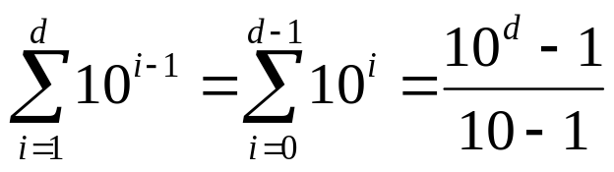
Running time of Radix Sort
# of times DS used
digit 1
DS
1
digit 2
DS
DS
10
digit 3
DS
DS
DS
DS
100
digit d
DS
DS
+
10^{d -1}
exponential in d

Slide 18
IBM’s approach for Radix Sort
separate wrt least
significant digit
separate wrt next
least significant digit
separate wrt most
significant digit
DS
DS
DS
0
1
8
9
0
1
8
9
0
1
8
9

Slide 19
Example run on IBM’s approach
separate wrt least
significant digit
separate wrt next
least significant digit
separate wrt most
significant digit
329
457
657
839
436
720
355
720
355
436
457
657
329
839
720
329
436
839
355
457
657
0
5
6
7
9
2
3
5
3
4
6
7
8
720
355
436
457
657
329
839
720
329
436
839
355
457
657
329
355
436
457
657
720
839
329 | 355 | 436 | 457 | 657 | 720 | 839

Slide 20
IBM’s approach for Radix Sort
The digit sorter is executed d times.
The pseudo code for this approach of radix sort:
Note that SomeSortingAlgorithm represents the separation of, and combining the intermediate piles.
Radix-Sort(A,d) {
for (i=d; i >= 1; i--) SomeSortingAlgorithm(A, on digit i);
}

Slide 21
IBM’s approach for Radix Sort
During a call to SomeSortingAlgorithm on digit i, the other digits are satellite information that will be carried with the number.
Further note that, SomeSortingAlgorithm must be a stable algorithm.
Otherwise the algorithm does not work.

Slide 22
Analysis of Radix Sort
The running time of radix sort depends on the intermediate sorting algorithm used.
Since a stable sorting algorithm is needed, let us suppose that Counting Sort is used as the intermediate sorting algorithm.
Suppose each digit is in the range 1..k
So each call to Counting Sort costs O(k+n)
Since, it will be called d times, the total running time is
O(d(k+n))

Slide 23
Correctness of Radix Sort
It can be shown by using induction on d.
When d=1, it is obvious:
single digit numbers
DS
0’s
0
1
8
9
9’s

Slide 24
Correctness of Radix Sort
Assume it is correct for m and show that it works for m+1

Slide 25
Example run on IBM’s approach
separate wrt least
significant digit
separate wrt next
least significant digit
separate wrt most
significant digit
329
457
657
839
436
720
355
720
355
436
457
657
329
839
720
329
436
839
355
457
657
329
355
436
457
657
720
839
0
5
6
7
9
2
3
5
3
4
6
7
8
720
355
436
457
657
329
839
720
329
436
839
355
457
657
329
355
436
457
657
720
839

Slide 26
Correctness of Radix Sort
Assume it is correct for m and show that it works for m+1
Let us consider two numbers in the bin after the first m passes:
last m digits
by induction hypothesis: x₁ ≤ x₂
(it has to sort m digit numbers correctly)
k₁
x₁
There can be 3 cases:
m+1st digit
k₁ = k₂
k₁ < k₂
k₁ > k₂
k₂
x₂

Slide 27
Correctness of Radix Sort
Case i: k₁=k₂ which means
k₁x₁ ≤ k₂x₂
DS will put them into the same bin
Since intermediate sorting
algorithm is stable,
k₁x₁ will appear before k₂x₂
in this common bin.
k₁
x₁
k₂
x₂
DS
k₁=k₂
k₁
x₁
k₂
x₂

Slide 28
Correctness of Radix Sort
Case ii: k₁ < k₂ which means
k₁x₁ < k₂x₂
DS will put them into different bins
The bin for k₁x₁ will be
to the left of the bin
for k₂x₂
When the piles are
combined, k₁x₁ will
appear before k₂x₂
k₁
x₁
k₂
x₂
DS
k₁
k₂
k₁
x₁
k₂
x₂

Slide 29
Correctness of Radix Sort
Case iii: k₁ > k₂ which means
k₁x₁ > k₂x₂
DS will put them into different bins
The bin for k₁x₁ will be
to the right of the bin
for k₂x₂
When the piles are
combined, k₁x₁ will
appear after k₂x₂
k₁
x₁
k₂
x₂
DS
k₂
k₁
k₂
x₂
k₁
x₁

Slide 30
Using radix sort
Suppose we want to sort b bit numbers.
A b bit number can be considered as b/r digit numbers where each digit is of length r bits.
b bits
0
1
1
0
0
0
1
1
n numbers
1
0
1
0
0
1
1
1
1
1
0
0
1
0
0
0
r bits

Slide 31
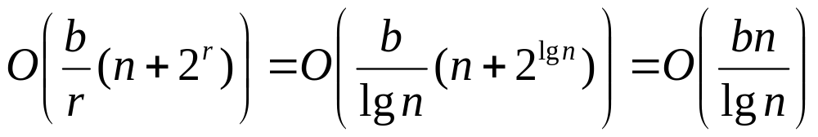
Using radix sort
For example, a b = 32 bit number can be considered as b/r = 4 digit number, where each digit is r = 8 bits.
Since each digit has r bits, it can range in 0 .. 2^{r}-1.
Each call to counting sort will take O(n+k)=O(n+2^{r})
The overall cost is: O(d(n+k))=O(b/r(n+2^{r}))
How should we chose r in practice?
Optimal solution is around r = lg n.

Slide 32
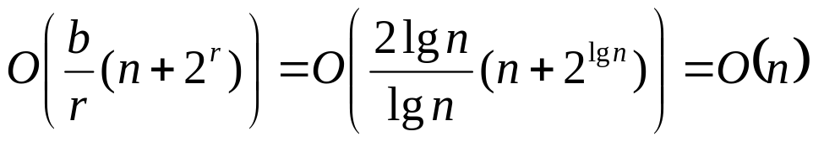
Using radix sort
Suppose we want to sort n numbers which range in 1..n²
(k=n²)
If we directly apply counting sort: O(k+n)=O(n²)
However, a number in the range 1..n² can be represented using lg n² = 2 lg n bits.
Assume we use r =lg n bit digits and apply radix sort:

Slide 33
MEDIANS
AND
ORDER STATISTICS

Slide 34
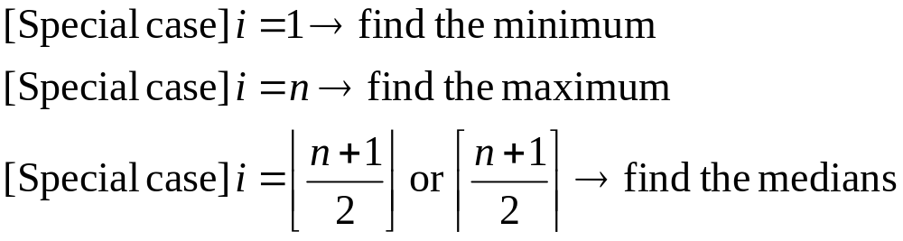
The Selection Problem
Definition: Given a set of n numbers,
i^{th} (1 ≤ i ≤ n) order statistics of the set of numbers
is the i^{th} smallest number in the set.
The selection problem:
Given n numbers and another number i (1 ≤ i ≤ n), find the i^{th} order statistics.

Slide 35
Minimum and Maximum
For the first two special cases, we have previously given the following linear time algorithms.
However, for the general problem of finding the i^{th} order statistic, such an efficient solution is not obvious.
FindMin(A) {
min = A[1];
for (i=2; i <= length[A]; i++)
if (min > A[i])
min=A[i];
return min;
}
FindMax(A) {
max = A[1];
for (i=2; i <= length[A]; i++)
if (max < A[i])
max=A[i];
return max;
}

Slide 36
A Naïve Approach to Selection Problem
A straightforward solution to Selection Problem:
If we use a general and efficient sorting algorithm as the intermediate step (such as MergeSort), the time required for the algorithm NaïveSelect will be: Θ(n lg n)
The first thing you should consider after a brute force approach is:
“Can we do better with a more clever algorithm?”
NaïveSelect (A,i) {
SomeSortingAlgorithm(A);
return A[i];
}

Slide 37
Basic idea for selection problem without sorting
Note that, when we sort the entire sequence to find an order statistics, we actually do some unnecessary work (like, transform the input into a form that is ready for finding any order statistics in constant time).
In other words, we do not actually need to sort the numbers. Suppose we have the following property:
≤ x
x ≤
looking for i^{th}
order statistics in
x
k numbers
(not sorted)
n-k-1 numbers
(not sorted)
- If i=k+1, the solution is x
- If i < k+1, the solution is the i^{th} order statistics of the left subarray
- If i > k+1, the solution is i-k-1st order statistics of the right subarray

Slide 38
Basic idea for selection problem without sorting
Can we use this observation to find a faster algorithm for the selection problem?
Can we always find such an x in the input?
Or, can we put the array into this form where there is such an x in the array?
How fast we can put our arrays into that special form?
Note that, the Partition algorithm we used in QuickSort performs exactly the transformation we need.
≤ x
x ≤
x

Slide 39

Pseudo code for Partition
Partition(A,p,r) {
z=A[r]; // picks the last element as the pivot (could be smthg else)
i=p-1; // the index of the last number seen which is ≤z
for (j=p; j <r; j++) { // go over every element (except pivot itself)
if (A[j] ≤z) { // whenever we see a number ≤z
i++; // update i and
swap(A[i],A[j]); // move the number to the front
}
}
swap(A[i+1],A[r]); // move to the pivot right next to the last seen
return(i+1); // smaller number, and return the index of the
} // pivot

Slide 40
Pseudo code for Selection algorithm
Select (A, first, last, i) {
// find i^{th} order statistics between first and last indices given
if (first == last)
return A[first]; // i=1 in this case
mid = Partition(A, first, last);
mid_and_less = mid – first + 1;
if (mid_and_less == i) // we may be lucky
return A[mid];
if (i < mid_and_less) // it is in the left subarray
return (Select(A, first, mid-1, i));
// it is in the right subarray
return (Select(A, mid+1, last, i-mid_and_less));
}
≤ x
x ≤
x
first
mid
last

Slide 41
Running time for the algorithm Select
Recall that the running time for Partition is O(n)
In the worst case, the Partition step will always generate:
Hence, T(n)=T(n-1)+O(n)=O(n²)
Worse than the naïve approach with sorting.
May be we can try to shuffle the input so that already sorted inputs do not elicit the worst case behavior.
< x
x <
x
or
x
mid
mid

Slide 42
Randomized Select
Shuffle the elements of the input, the last element (which we use as pivot for partitioning) is a random element.
However, this is equivalent to picking a random element as the pivot.
random shuffling:
a random index

Slide 43
Pseudo code for Randomized Select
RandomizedSelect (A, first, last, i) {
if (first == last)
return A[first]; // i=1 in this case
random_index = random(first, last); // returns a number first ≤ … ≤ last
swap(A[random_index], A[last]);
mid = Partition(A, first, last );
mid_and_less = mid – first + 1;
if (mid_and_less == i) // we may be lucky
return A[mid];
if (i < mid_and_less) // it is in the left subarray
return (Select(A, first, mid-1, i));
return (Select(A, mid+1, last, i-mid_and_less));
}

Slide 44
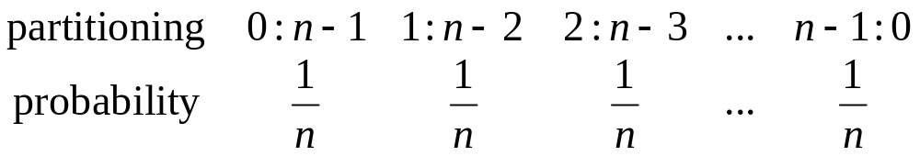
Analysis of Randomized Select
Note that we can still be extremely unlucky, and partition around the largest or smallest element in the subarray.
Hence, there is no change in the worst case behavior. It is still O(n²)
However, let’s have a look at the expected running time.
We have the following cases as the outcome of the partitioning step:

Slide 45
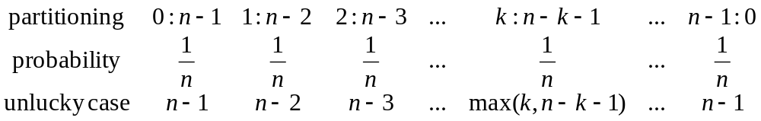
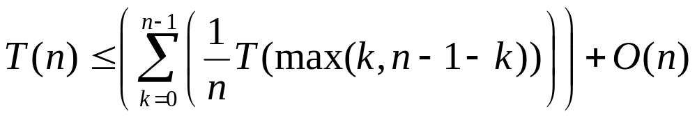
Analysis of Randomized Select
Suppose that, we always get unlucky, and recurse into the subarray that has greater number of elements.
The expected running time can be calculated as:

Slide 46
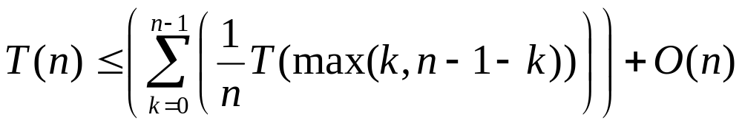
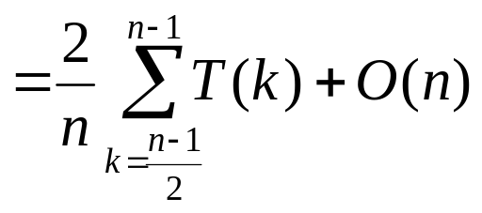
Analysis of Randomized Select
Consider the elements in the summation:
Hence the summation is equivalent to:
=
=
each term appears twice

Slide 47
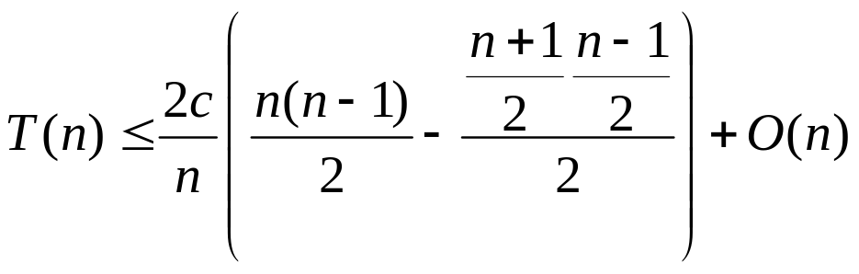
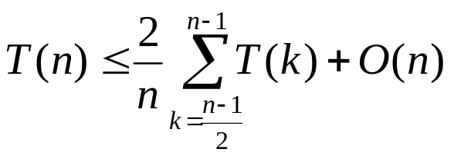
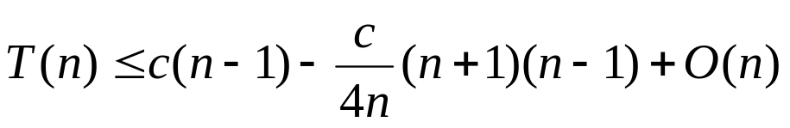
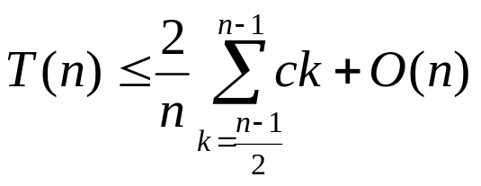
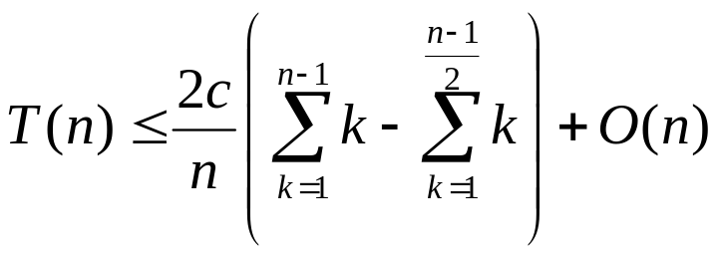
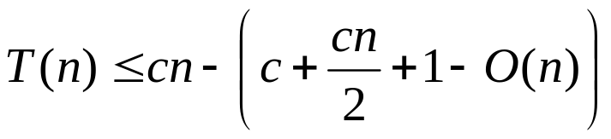

Analysis of Randomized Select
Let us solve the recurrence by substitution:
  Guess: T(n)=O(n)
  Verify: Show that T(n) ≤ cn
pick c big enough
to dominate const
factors in O(n)

Slide 48
Analysis of Randomized Select
Therefore, Randomized Select has linear expected time.
However, in the worst case, it is still quadratic.
Can we improve the worst case running time?

Slide 49


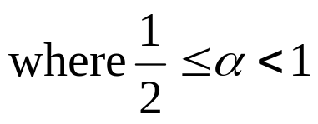

Selection in worst case linear time
Suppose that we somehow can guarantee a constant partitioning ratio at each level of recursion:
The recurrence for the worst case running time would then be:
x

Slide 50
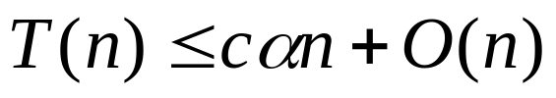
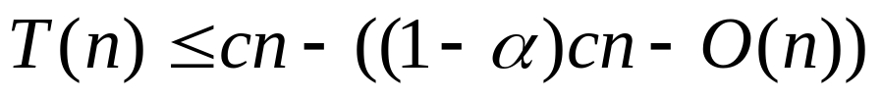
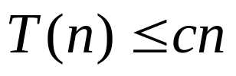
Selection in worst case linear time
Let us solve this recurrence by substitution:
  Guess: T(n)=O(n)
  Verify: Show that T(n) ≤ cn
So, we can achieve worst case linear time for selection, if we can guarantee a constant partitioning at each recursion.
pick c big enough
to dominate const
factors in O(n)

Slide 51
Selection in worst case linear time
WCL_Select (A, first, last, i) {
if (first == last)
return A[first]; // i=1 in this case
Divide n elements into groups of 5 elements; //g₁ g₂ … g_{n/5}
Find the median m_{i} each group g_{i};
Use WCL_Select to find the median m_{m} of the medians of all the groups;
mid = NewPartition(A, first, last, m_{m} ); // it partitions around m_{m}
mid_and_less = mid – first + 1;
if (mid_and_less == i) // we may be lucky
return A[mid];
if (i < mid_and_less) // it is in the left subarray
return (WCL_Select(A, first, mid-1, i));
return (WCL_Select(A, mid+1, last, i-mid_and_less));
}

Slide 52
Analysis of WCL_Select
Dividing the n elements into groups of 5 elements can be performed in O(n) time.
Finding medians of each group:
  Note that each group has a constant amount of elements. Hence the cost of finding the median of one group takes O(1) time. We may use insertion sort to sort each group, and find its median.
  Since we will find the median of n/5 groups, the total time needed to find the medians of all the groups is O(n).
We need to find the median of these n/5 medians. Since we will use WCL_Select recursively for this purpose, the total time spent in the step will be T(n/5).

Slide 53
Analysis of WCL_Select
The new partitioning algorithm is actually the same as the old one. It simply takes the pivot we show. We can even swap m_{m} with the last element of the input array, and use the old Partition algorithm.
Hence, the partitioning step again needs O(n) time.
The cost of the recursive calls at the end will depend on the partitions that will be generated.

Slide 54
Analysis of WCL_Select
Note that, m_{m} is the median of n/5 numbers (it is the median of the medians of 5 element groups).
Therefore, medians of n/10 groups (half of the groups) are smaller or equal to m_{m}.
These n/10 medians, are the medians of their corresponding group.
Since each group has 5 elements, there are two more numbers in each group that are smaller than or equal to their medians.
Hence, in total there are at least 3n/10 numbers in the input array that are smaller than equal to m_{m}.

Slide 55
Analysis of WCL_Select
Hence, when we partition our input array by taking m_{m} as the pivot, it is guaranteed that the left subarray will have at least 3n/10 element.
Or equivalently, it is guaranteed that the right subarray will have at most 7n/10 elements.
Therefore 3n/10 is a lower bound on the number of elements in the left subarray, and 7n/10 is an upper bound on the number of elements in the right subarray.
Note that, since we do not have an upper bound on the number of elements in the left subarray yet, in the worst case, the left subarray may simply have n-1 elements.

Slide 56
Analysis of WCL_Select
Such an upper bound on the number of elements of the left subarray can be found using a similar argument.
Consider the medians of n/10 groups which are greater or equal to m_{m}.
In each such group there are 2 more numbers greater than or equal to their medians.
Hence, in total there are at least 3n/10 numbers in the input array that are greater than equal to m_{m}.
Hence, there can be at most 7n/10 numbers that are smaller than or equal to m_{m}, which provides the upper bound we wanted on the size of the left subarray.

Slide 57
Analysis of WCL_Select
Having found these upper bounds on the size of the left and right subarrays in the outcome of the partitioning step, let us now go back to the worst case running time of the recursive steps at the end of the WCL_Select algorithm.
In the worst case, we may get unlucky and always recurse into the subarray with more number of elements.
However, we now know the size cannot be bigger than 7n/10.

Slide 58
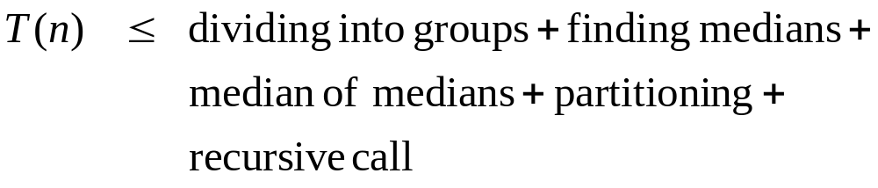
Analysis of WCL_Select
We can now derive a recurrence for the running time of WCL_Select.

Slide 59
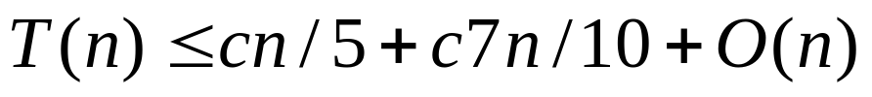
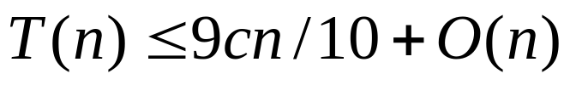
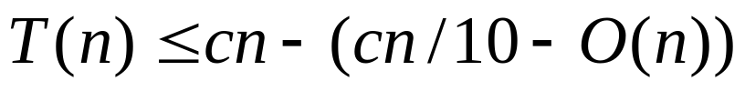
Analysis of WCL_Select
Let us solve this recurrence by substitution:
  Guess: T(n)=O(n)
  Verify: Show that T(n) ≤ cn
So, WCL_Select has linear worst case running time.
pick c big enough
to dominate const
factors in O(n)

