Slide 1
CS301 - Algorithms
Week #5
Husnu Yenigun

Slide 2
AUGMENTING DATA STRUCTURES

Slide 3
Augmenting Data Structures
In practice, for the problems we will encounter, it may be sufficient to use some text book data structure (queues, stacks, linked lists, etc.) and algorithms based on these data structures.
However in some cases, such a direct application of a text book data structure and algorithm will not be sufficient (efficient enough).
In such cases, usually, what it takes is to augment (add additional information to) the data structure elements such that:
  The additional fields help us to compute more efficiently; and
  The additional fields can be maintained within a reasonable time

Slide 4
An Example: Dynamic Order Statistics
In fact, Red-Black Tree is an augmentation of another data structure (Binary Search Tree).
We will see another example of augmentation, together with an explicit need calling for this augmentation.
Suppose we want to keep a dynamic set.
However, suppose that besides the usual dynamic set operations, we want to support the following operations as well:
  Find the rank of an element (i.e. the position of the element if the set is ordered)
  Find the i^{th} order statistics

Slide 5
Let’s think for a while…
We want to support dynamic set operations…
We have seen that using Red-Black Trees, we can perform the typical dynamic set operations quite efficiently.
What about the new operations (find the rank of an element and find the i^{th} order statistics)?
How efficiently we can support them if we use Red-Black trees?
Let us give it a try…

Slide 6


Finding Rank of an element in a RBT
Given an RBT T, and a node x in T, find the rank of the key of x (how many keys in T are smaller than key[ x ]?)
Consider a RBT and a node x in it:
All the nodes in the left subtree have keys smaller than key[ x ].
x
So, we need to compute the node count in the left subtree.
What other nodes in T have keys smaller than key[ x ]?

Slide 7
Finding Rank of an element in a RBT
Consider the path from the root to x (assume all the keys are distinct):
Since x is in the right subtree of the root, all the nodes in the left subtree of the root are also smaller than key[ x ].
root
w
y
Since x is in the left subtree of w, we do not need to know the number of elements in the right subtree of w (they have keys greater than key[ x ]).
z
x
Since x is in the right subtree of y, …

Slide 8
Finding Rank of an element in a RBT
We can trace the path from the root to x backwards, by following the parent field (pointer) in RBT nodes starting from x.
root
As we go up in the tree, whenever we see that the current node is in the right subtree of its parent (means x is in the right subtree as well), we count the number of elements in the left subtree of the parent).
w
y
z
x

Slide 9
Finding Rank of an element in a RBT
RBT_Rank (T, x) { // T: the tree, x: a node
rank = CountNodes (left[ x ]) + 1; // # of elements in left subtree of x + x itself
y = parent[ x ];
z = x; // y -> z is an edge in the path from x to root
while (y != NULL) { // until we reach to the root
if (right[ y ] == z) { // if x is in the right subtree of y
// then all the keys in the left subtree of y, and the key at y
// are smaller than key[ x ]
rank = rank + CountNodes(left[ y ]) + 1;
}
z = y;
y = parent[ z ]; // go one level up in the tree
}
return rank;
}
root
x

Slide 10
Finding Rank of an element in a RBT
CountNodes (x) { // x: a node
if (x == RBT_Leaf) // the special RBT leaf node we have used
return 0;
// otherwise find # of nodes in the left and right subtree
return (1 + CountNodes(left[ x ]) + CountNodes(right[ x ]));
}
root
What is the worst case running time of RBT_Rank?
In the worst case, x could have the maximum key in the tree, and we may have to count all the nodes in the tree…
x
Hence, worst case running time is O(n)

Slide 11
CountNodes is the most expensive step…
Note that, the body of RBT_Rank climbs up in the tree.
Hence, the main loop in RBT_Rank will iterate at most O(h) time (recall h=O(lg n) in RBT).
However within each iteration, it may perform a call to CountNodes.
It is this call to CountNodes that takes the most of the computation time.
If we can increase the performance of CountNodes, then we can increase the performance of RBT_Rank.
Any idea???

Slide 12
A more efficient way of counting nodes
A more efficient way of counting the nodes in a subtree is to remember the number of the nodes in the subtree.
Let us store the number of nodes in a subtree at the root node of that subtree.
size = # of nodes
in the subtree
rooted at this
node
A memory/speed
trade off…
A normal RBT node
A RBT node with the
proposed augmentation
parent
parent
size
color
color
left
right
left
right
key
key

Slide 13
Example RBT with augmented nodes
We use letters as keys and numbers as the size fields in this example.
M
Note that the size at an internal
node = 1 + sizes of its children.
8
C
P
5
2
A
F
Q
1
3
1
D
H
1
1
Special RBT leaf nodes will have their size fields set to 0.

Slide 14
Finding rank in augmented RBT
AugmentedRBT_Rank (T, x) { // T: the tree, x: a node
rank = size (left[ x ]) + 1; // # of elements in left subtree of x & x itself
y = parent[ x ];
z = x; // y -> z is an edge in the path from x to root
while (y != NULL) { // until we reach to the root
if (right[ y ] == z) { // if x is in the right subtree of y
// then all the keys in the left subtree of y, and the key at y
// are smaller than key[ x ]
rank = rank + size(left[ y ]) + 1;
}
z = y;
y = parent[ z ]; // go one level up in the tree
}
return rank;
}

Slide 15
Finding rank in augmented RBT
Note that, AugmentedRBT_Rank and RBT_Rank have almost the same code.
The only difference is that, CountNodes subroutine is replaced by references to size fields (reducing the time requirement for these calls to a constant time).
Since the algorithm climbs up in the tree in each iteration, we will be traversing a path from a node to the root.
In the worst case, this path could be the longest path: The worst case running time is O(h)=O(lg n).

Slide 16
Finding order statistics augmented RBT
Recall that i^{th} order statistics of a set is the i^{th} smallest number in the set.
Before we have seen that, given an unordered set, we can find any order statistics in linear time (WCL_Select algorithm).
When we use a search tree (like RBT or augmented RBT), since the elements of the set are more structured rather than being completely unordered, we may hope to find a more efficient algorithm.

Slide 17
Finding order statistics augmented RBT
When looking for the i^{th} smallest number in the subtree rooted at x:
Case 1: i = size(y)+1 → key[ x ]
Case 2: i ≤ size(y) → i^{th} smallest number in the subtree rooted at y
Case 3: i > size(y)+1 → i – (size(y)+1)^{th} smallest number in the subtree rooted at z
Recall & Note:
The keys are already partitioned. We don’t
need to spend time
for partitioning.
x
size
y
z
size
size

Slide 18
Finding order statistics augmented RBT
AugmentedRBT_Select (x, i) { // x: a node, i: looking for i^{th} order statistics
// we assume size(x) ≥ i
left&self = size (left[ x ]) + 1; // # of elements in left subtree of x & x itself
if (i == left&self) // case 1
return (key[ x ]);
if (i < left&self) // case 2
return (AugmentedRBT_Select(left[ x ], i));
//case 3
return (AugmentedRBT_Select(right[ x ], i - left&self ));
}
In the worst case, we will be traversing a path from the root to a leaf (we recurse only in one of the subtrees): O(h)=O(lg n)

Slide 19
Where did we start, where are we now…
We wanted to support the dynamic set operators, and order statistics, and rank operations.
We augmented the RBT data structure with an additional field (size).
And, we have shown that order statistics and rank operations can be implemented in O(lg n) time.
What about the dynamic set operations?
(e.g. Search, Minimum, Maximum, Insert, Delete, etc.)
Can we still support them in O(lg n) time (as in the case of RBT before the augmentation)?

Slide 20
Where did we start, where are we now…
Note that the size fields are not assigned by an oracle automagically.
We need to take care of this additional field and maintain the correct size information.
Since dynamic set operations such as search, predecessor and successor do not modify the data structure, there is no modification required for them.
Furthermore, we can still execute such operations in O(lg n) time, since our augmented data structure is still a RBT.

Slide 21
What about insert and delete operations?
Since insert and delete operations modify the tree, we need to guarantee correct assignment to the size fields after these operations are executed on the augmented RBT.
Also of extreme importance, we need to be able to perform the assignments in a time that would not increase the worst case running time of the original insert and delete operations.

Slide 22
Insert operation on augmented RBT
An insert operation will place one more element into the tree.
Hence, some nodes will have an
additional element in the subtree
rooted at them, meaning we need
to increment size fields of these
nodes by 1.

Slide 23
Insert operation on augmented RBT
We will use the almost the same code in RBT_Insert (i.e. the one on the original RBT).
RBT_Insert (T, x) { // T: the tree, x: a new node to be inserted
color[ x ] = RED; // the new node will be red
BST_Insert(T, x); // insert as if we were using an ordinary BST
FixColoring(T, x); // fix the “red-red” coloring problem if exists
}
AugmentedRBT_Insert (T, x) { // T: the tree, x: a new node to be inserted
color[ x ] = RED; // the new node will be red
AugmentedBST_Insert(T, x); // insert as if we were using an ordinary BST
AugmentedFixColoring(T, x); // fix the “red-red” coloring problem if exists
}

Slide 24
Increment the nodes we visit while inserting
AugmentedBST_Insert (T, x) { // T: the tree, x: a new node to be inserted
BST_Insert(T,x); // insert as if it is normal BST
size[ x ] = 1; // assign the size field of x
// Any node along the path from the root to x will
// have one more element under it. Increment their size field by 1.
tmp = parent[ x ];
while (tmp != NULL) {
size[ tmp ] = size[ tmp ] + 1;
tmp = parent[ tmp ];
}
In the worst case, we will be traversing a path from the root to a leaf. Therefore: O(h)=O(lg n)

Slide 25





AugmentedFixColoring
Case 1 and Case 1 symmetric:
g
push black color of g
down onto p and u
g
p
u
p
u
x
x
Only the color of the nodes are modified.
The nodes still have the same amount of nodes under them.
No assignment is needed for the size fields.

Slide 26
AugmentedFixColoring
Case 2 and Case 3 (and their symmetric cases) will perform either left or right rotations.
Note that rotations will modify the number of elements that appear in the subtrees of the nodes.
How can we maintain the size fields after rotations?

Slide 27


Maintaining size fields after right rotation
z
z
RIGHT_ROTATE(T,y)
y
x
x
y
Number of nodes under z does not change.
Number of nodes in the subtrees α, β, and λ do not change.
After rotation:
  size[ y ] = size(β) + size(λ) + 1
  size[ x ] = size(β) + size(λ) + size(α) + 2

Slide 28
Maintaining size fields after left rotation
z
z
LEFT_ROTATE(T,x)
y
x
x
y
Number of nodes under z does not change.
Number of nodes in the subtrees α, β, and λ do not change.
After rotation:
  size[ x ] = size(α) + size(β) + 1
  size[ y ] = size(α) + size(β) + size(λ) + 2

Slide 29
Running time of AugmentedRBT_Insert
For rotations in both direction, we will need to fix the size field of a constant number nodes.
For each rotation, we need a constant number of additional assignments.
Hence we are introducing a constant amount of additional work for maintaining the size fields at each rotation.
Therefore, the running time of AugmentedRBT_Insert is O(lg n).

Slide 30
Delete operation on augmented RBT
Although we will not go into the details of the delete operation, it can be shown that a constant amount of additional work will be required to maintain the additional size fields in this case as well.
Hence, the delete operation can also be performed on the augmented RBTs in O(lg n) time.
As a result: All the basic dynamic set operations, and the new functionality (finding rank and order statistics) can be implemented on augmented RBTs in O(lg n) time.

Slide 31
General Approach
Augmenting an existing data structure to support additional functionality is a usual practice.
Although the following is not a strict procedure to augment a data structure, it gives a general outline of the process.
  Pick an underlying data structure (RBT in our example).
  Determine the additional information to be maintained on the chosen data structure (e.g. we added the “size” info).
  Verify that additional info can be maintained efficiently (e.g. we showed after insert, delete, search, etc. the additional info can be preserved efficiently).
  Implement new operations on the augmented data structure (we implemented finding the rank of a key and finding any order statistics on the tree).

Slide 32
A possibly inefficient augmentation example
Consider our previous example for finding the rank and finding order statistics in addition to dynamic set operations.
Previously we have decided to keep the number of nodes on a subtree in the root of that subtree.
We can actually support the finding the rank of a node much faster, if we simply keep the rank of the keys of the nodes at the nodes.

Slide 33
A possibly inefficient augmentation example
Note that finding the rank of a key of a node will take constant time [instead of O(lg n) time].
M
6
However inserting a key smaller than all the existing keys, or deleting the minimum key in the tree will cost O(n) time…
C
P
2
7
A
F
Q
1
4
8
D
H
3
5
Why do we say “possibly” inefficient?

Slide 34
Another example for augmenting RBTs
Our new problem now is to maintain a set of intervals:
We want to support:
  insert and delete operations
  Search an overlapping interval with a given interval
7
10
5
11
17
19
21
23
4
8
15
18
1
2
3
4
5
6
7
8
9
10
11
12
13
14
15
16
17
18
19
20
21
22
23

Slide 35
Overlapping intervals
For example:
  Given the search interval [14,16]
  →
  should find the overlapping interval [15,18]
by “overlapping” we mean “non-empty intersection”
14
16
7
10
5
11
17
19
21
23
4
8
15
18
1
2
3
4
5
6
7
8
9
10
11
12
13
14
15
16
17
18
19
20
21
22
23

Slide 36
Overlapping intervals
For example:
  Given the search interval [10,12]
  →
  should find either [7,10] or [5,11] as an overlapping interval
intersection at one point only is sufficient to be overlapping
10
12
if there are multiple overlapping intervals, finding one is sufficient
7
10
5
11
17
19
21
23
4
8
15
18
1
2
3
4
5
6
7
8
9
10
11
12
13
14
15
16
17
18
19
20
21
22
23

Slide 37
Overlapping intervals
For example:
  Given the search interval [13,14]
  →
  should return NULL (no overlapping interval)
13
14
7
10
5
11
17
19
21
23
4
8
15
18
1
2
3
4
5
6
7
8
9
10
11
12
13
14
15
16
17
18
19
20
21
22
23

Slide 38
What should we use, what should we use ?..
We will maintain a set of intervals.
It may be a good idea to use a data structure which has a good performance for representing sets.
Do we know any such data structure???
Yes. We have been examining Red Black Trees which can support set operations in O(lg n) time.
However, direct application of RBTs is not possible, since we keep a single number at RBT nodes.
We will need to augment RBT node data structure.

Slide 39
Using RBTs for keeping a set of intervals
Step 1: We picked RBT to represent a set of intervals
Step 2: We should decide how to augment RBT data structure to represent a set of intervals.
low: the left boundary of the interval
high: the right boundary of the interval
max: the maximum high value at the nodes
within the subtree.
max[x] = maximum { max[left[ x ]],
  max[right[ x ]],
  high[ x ] }
key: will be taken as the left boundary
(hence ‘key’ will always be = to the ‘low’ field)
A RBT node with the
proposed augmentation
parent
max
low
high
color
left
child
right
child
key
(low)

Slide 40
Example set of intervals on augmented RBT
[17,19]
23
[5,11]
[21,23]
18
23
[4,8]
[15,18]
8
18
[7,10]
10

Slide 41
Maintaining the new form of the data structure
Step 3: We need make sure that the additional fields can be maintained in an efficient way.
Since we use the “low” (the left boundary of intervals) as the key values, the intervals will be placed into the tree according to their low fields.
IntervalRBT_Insert (T, x) { // T: the tree, x: a new interval node to be inserted
color[ x ] = RED; // the new node will be red
IntervalBST_Insert(T, x); // insert as if we were using an ordinary BST
IntervalFixColoring(T, x); // fix the “red-red” coloring problem if exists
}

Slide 42
Maintaining the new form of the data structure
Insert as if it were a normal BST
Then fix the max fields in related nodes
Note that the related nodes can only be the nodes that we visit while finding the correct place for the new node.
IntervalRBT_Insert (T, x) { // T: the tree, x: a new interval node to be inserted
BST_Insert(T,x); // insert as if it were normal BST
max[ x ] = high[ x ]; // assign the max field of x (no internal nodes below)
// Any node along the path from the root to x that has a max
// field smaller than high[ x ] should be fixed.
tmp = parent[ x ];
while (tmp != NULL) {
if (max[ tmp ] < high[ x ]) max[ tmp ] = high[ x ];
tmp = parent[ tmp ];
}

Slide 43
Maintaining the new form of the data structure
[17,19]
23
Insert [8,19]
[5,11]
[21,23]
18
23
[4,8]
[15,18]
8
18
[7,10]
10

Slide 44
Maintaining the new form of the data structure
[17,19]
23
Insert [8,19]
[5,11]
[21,23]
18
23
[4,8]
[15,18]
8
18
[7,10]
10
[8,19]
19

Slide 45
Maintaining the new form of the data structure
[17,19]
23
Insert [8,19]
[5,11]
[21,23]
19
23
[4,8]
[15,18]
8
19
[7,10]
19
[8,19]
19

Slide 46
Maintaining the new form of the data structure
Since we will traverse a path to fix the max fields after the insertion, this step can take at most O(lg n) time.
Are we finished?
What about the IntervalFixColoring step?
IntervalRBT_Insert (T, x) { // T: the tree, x: a new interval node to be inserted
color[ x ] = RED; // the new node will be red
IntervalBST_Insert(T, x); // insert as if we were using an ordinary BST
IntervalFixColoring(T, x); // fix the “red-red” coloring problem if exists
}

Slide 47
Maintaining the new form of the data structure
Recall that, to fix the coloring errors, we will hit either case 1, case 2, or case 3 (or the symmetric versions of these cases).
Let us examine these cases one by one, and try to understand how we can maintain the additional information kept at the nodes during the operations performed by these cases.

Slide 48
Maintaining the new form of the data structure
Case 1 and Case 1 symmetric:
g
push black color of g
down onto p and u
g
p
u
p
u
x
x
Only the color of the nodes are modified.
The nodes still have the same low and high fields, hence the max right boundary
below a node does not change.
No assignment is needed for the max fields.

Slide 49
Maintaining the new form of the data structure
Case 2 and Case 3 (and their symmetric cases) will perform either left or right rotations.
Note that rotations will modify the set of nodes under a given node, and hence may require an update on the max fields.
How can we maintain the max fields after rotations?

Slide 50
Maintaining the new form of the data structure
z
z
RIGHT_ROTATE(T,y)
y
x
x
y
The set of nodes under z does not change, hence its max field stays the same.
The set of nodes in the subtrees α, β, and λ do not change, hence the max
fields of the roots of these subtrees also stay the same.
After rotation:
  1. max[ y ] = maximum { max[ root of β ], max[ root of λ ], high[ y ] }
  2. max[ x ] = maximum { max[ root of α ], max[ y ], high[ x ] }

Slide 51
Maintaining the new form of the data structure
z
z
LEFT_ROTATE(T,x)
y
x
x
y
The set of nodes under z does not change, hence its max field stays the same.
The set of nodes in the subtrees α, β, and λ do not change, hence the max
fields of the roots of these subtrees also stay the same.
After rotation:
  1. max[ x ] = maximum { max[ root of α ], max[ root of β ], high[ x ] }
  2. max[ y ] = maximum { max[ root of λ ], max[ x ], high[ y ] }

Slide 52
Maintaining the new form of the data structure
For rotations in both direction, we will need to fix the max field of a constant number nodes.
For each rotation, we need a constant number of additional assignments.
Hence we are introducing only a constant amount of additional work for maintaining the max fields for each rotation.
Note that, the low and high fields of the nodes never change.
Therefore, the running time of IntervalRBT_Insert is
O(lg n).

Slide 53
Implement the additional operations
Step 4: After showing that the additional information we introduced can be maintained in an efficient way (it does not increase the running time of the original operations), we now can make use of these additional information to implement our new operations efficiently.
The additional operation we needed was: Given an interval tree T and an interval [l, h], find an interval in T that overlaps (intersects) with [l, h].
Our algorithm will return a node x in T such that the interval [low[ x ], high[ x ]] overlaps with [l, h] if such a node x exists in T.
Otherwise, it will return NULL.

Slide 54
Implement the additional operations
IntervalRBT_Search (T, l, h) { // T: the tree, [l, h]: the search interval
x = root[ T ]; // start from the root the tree
while ( (x != NULL) and ( [l, h] does not intersect with [low[ x ], high[ x ]] )) {
if ( (left[ x ] != NULL) and max[ left[ x ] ] ≥ l) )
x = left[ x ]; // if an overlapping interval exists, it is in the left subtree
else
x = right[ x ]; // if an overlapping interval exists, it is in the right subtree
}
return x;
}
Running time: In the worst case, we will traverse a path from the root to a leaf
Hence: O(lg n)

Slide 55
IntervalRBT_Search example
x
[17,19]
23
[5,11]
[21,23]
18
23
[4,8]
[15,18]
Search for [14, 16]
8
18
…
if ( (left[ x ] != NULL) and max[ left[ x ]] ≥ l) )
x = left[ x ];
else
x = right[ x ];
…
[7,10]
10

Slide 56
IntervalRBT_Search example
x
[17,19]
23
[5,11]
[21,23]
18
23
[4,8]
[15,18]
Search for [14, 16]
8
18
…
if ( (left[ x ] != NULL) and max[ left[ x ]] ≥ l) )
x = left[ x ];
else
x = right[ x ];
…
[7,10]
10

Slide 57
IntervalRBT_Search example
x
[17,19]
23
[5,11]
[21,23]
18
23
[4,8]
[15,18]
Search for [14, 16]
8
18
…
if ( (left[ x ] != NULL) and max[ left[ x ]] ≥ l) )
x = left[ x ];
else
x = right[ x ];
…
[7,10]
10

Slide 58
IntervalRBT_Search example
x
[17,19]
23
[5,11]
[21,23]
18
23
[4,8]
[15,18]
Search for [12, 14]
8
18
…
if ( (left[ x ] != NULL) and max[ left[ x ]] ≥ l) )
x = left[ x ];
else
x = right[ x ];
…
[7,10]
10

Slide 59
IntervalRBT_Search example
x
[17,19]
23
[5,11]
[21,23]
18
23
[4,8]
[15,18]
Search for [12, 14]
8
18
…
if ( (left[ x ] != NULL) and max[ left[ x ]] ≥ l) )
x = left[ x ];
else
x = right[ x ];
…
[7,10]
10

Slide 60
IntervalRBT_Search example
x
[17,19]
23
[5,11]
[21,23]
18
23
[4,8]
[15,18]
Search for [12, 14]
8
18
…
if ( (left[ x ] != NULL) and max[ left[ x ]] ≥ l) )
x = left[ x ];
else
x = right[ x ];
…
[7,10]
10

Slide 61
IntervalRBT_Search example
x
[17,19]
23
[5,11]
[21,23]
18
23
[4,8]
[15,18]
Search for [12, 14]
8
18
…
if ( (left[ x ] != NULL) and max[ left[ x ]] ≥ l) )
x = left[ x ];
else
x = right[ x ];
…
[7,10]
10

Slide 62
Correctness of IntervalRBT_Search
IntervalRBT_Search considers one subtree only.
If there does not exist an overlapping interval in the subtree that we chose to follow, how can we guarantee that there does not exist an overlapping interval in the subtree that we skip.
IntervalRBT_Search (T, l, h) {
x = root[ T ];
while ( (x != NULL) and ( [l, h] does not intersect with [low[ x ], high[ x ]] ) {
if ( (left[ x ] != NULL) and max[ left[ x ]] ≥ l) )
x = left[ x ];
else
x = right[ x ];
}
return x;
}

Slide 63
Correctness of IntervalRBT_Search
Case 1: Suppose at a node x, we follow the right subtree:
If we go to the right subtree and find an overlapping interval there, we are happy. No problem in this case.
However, if go to the right subtree, and fail to find an overlapping interval there, how can we be sure that there were no overlapping intervals in the left subtree?
Hence, when we go to the right subtree, we must show that:
  if there is no overlapping interval in the right subtree, then there cannot be an overlapping interval in the left subtree.
…
if ( (left[ x ] != NULL) and max[ left[ x ]] ≥ l) )
x = left[ x ];
else
x = right[ x ];
…
Hence we must have:
either
left[ x ] == NULL
or
max[ left [ x ] ] < l

Slide 64
Correctness of IntervalRBT_Search
Case 1 (continued): Suppose we follow the right subtree, but it turns out that there is no interval in the right subtree that overlaps with our interval:
The condition for proceeding with the the right subtree:
left[ x ] == NULL or max[ left [ x ] ] < l
x
There is no node in the
left subtree, hence
nothing could possibly
overlap.
l
h
max[ left [ x ] ]
Hence, in either case, we cannot have an overlapping interval in the left subtree.

Slide 65
Correctness of IntervalRBT_Search
Case 2: Suppose at a node x, we follow the left subtree:
If we go to the left subtree and find an overlapping interval there, we are happy. No problem in this case.
However, if go to the left subtree, and fail to find an overlapping interval there, how can we be sure that there were no overlapping intervals in the right subtree?
Hence, when we go to the left subtree, we must show that:
  if there is no overlapping interval in the left subtree, then there cannot be an overlapping interval in the right subtree.
…
if ( (left[ x ] != NULL) and max[ left[ x ]] ≥ l) )
x = left[ x ];
else
x = right[ x ];
…
Hence we must have:
left[ x ] != NULL
and
max[ left [ x ] ] ≥ l

Slide 66
Correctness of IntervalRBT_Search
Case 2 (continued): Suppose we follow the left subtree, but it turns out that there is no overlapping interval in the left subtree. Could there be an overlapping interval in the right subtree?
Condition for following the left subtree:
left[ x ] != NULL and max[ left [ x ] ] ≥ l
h < j (since no interval in the left
subtree overlaps with [l,h])
(note that l > k is not possible)
j ≤ low[x]
(since [j,k] is in the left subtree of x)
Consider any interval [p,q] in the
right subtree: low[x] ≤ p
(since [p,q] is in the right subtree of x)
Using 1,2, and 3: h < p
x
low [ x ]
let [p,q] be an
interval in the
right subtree
let [j,k] be the interval
in the left subtree with
the largest high value
p
q
l
h
[l,h] is our
search interval
j
k = max[ left [ x ] ]
If h < p, then [l,h] cannot overlap with
[p,q]. Therefore no interval in the right
subtree can overlap with [l,h].
[l,h] & [j,k] do not overlap
(since there are no overlapping intervals in the left subtree)

Slide 67
DYNAMIC PROGRAMMING

Slide 68
What is dynamic programming?
Dynamic programming is not an algorithm.
It is a meta-technique that can be used to design algorithms.
Have we seen any other meta-technique before?
Yes: “Divide and Conquer”
Dynamic programming approach actually is quite similar to the divide and conquer approach:
In both “divide and conquer” and “dynamic programming” techniques, we divide the original problem into smaller subproblems.
What is the difference?

Slide 69
“Divide and Conquer” vs “Dynamic Programming”
Basic idea of a divide and conquer algorithm was to solve the subproblems first, and then combine the solutions of these small subproblems to form the solution of the original problem.
P
P₁
P₂
P₁₁
P₁₂
P₂₁
P₂₂
solve
solve
solve
solve

Slide 70
“Divide and Conquer” vs “Dynamic Programming”
If some of subproblems turn out to be the same instance, then we will be solving the same problem multiple times and performing the same job multiple times.
Dynamic programming avoids unnecessary duplication of work by solving each subproblem only once.
P
P₁
P₂
P₁₁
P₁₂
=
P₂₁
P₂₂
solve
solve
solve
solve

Slide 71
Typical applications for dynamic programming
Dynamic programming typically applied to optimization problems.
Optimization problems have multiple solutions.
Each solution has a value associated with it.
We want to find a solution with an optimal (minimum or maximum) value.
Such a solution is called an optimal solution, rather than the optimal solution.

Slide 72
A guide for dynamic programming algorithms
Like divide and conquer algorithms, dynamic programming algorithms also have a recipe:
  Characterize the structure of an optimal solution
  (optimal substructure property)
  Recursively define the value of an optimal solution
  (requires to set up a recurrence)
  Compute the value of an optimal solution in a bottom-up fashion
  If required, construct an optimal solution from the computed information
  Step 4 can be omitted if only the value of the optimal solution is required, but the optimal solution itself is not needed.

Slide 73
A dynamic programming algorithm: first example
Suppose that we are given a list (chain) of matrices
[ A¹, A², A³, …, A^{n} ]
and we want to compute
A¹ × A² × A³ × … × A^{n}

Slide 74
Multiplying 2 matrices
Given two matrices A_{p×q} and B_{q×r}, we can use the standard matrix multiplication algorithm:
Matrix_Multiply (A_{p×q} , B_{q×r}) {
for (i=1; i ≤ p; i++) // for each row of A
for (j=1; j ≤ r; j++) { // for each column of B
C[ i, j ] = 0;
for (k=1; k ≤ q; k++) // compute the value of C[ i, j ]
C[ i, j ] = C[ i, j ] + ( A[ i, k ] × B[ k, j] );
}
}
p.q.r
Total number of “scalar” multiplications:

Slide 75
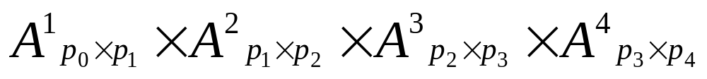
Matrix chain multiplication problem
Consider now multiplication of four matrices
We can multiply these four matrices in five different ways thanks to the associativity of the matrix multiplication operation.

Slide 76
Matrix chain multiplication problem
What is the difference between these different ways of multiplication?
The number of scalar multiplications may change:
Consider a case where p₀=5, p₁=10, p₂=50, p₃=100, p₄=20 :
scalar multiplications
37,500
65,000
71,000
111,000
107,500

Slide 77
Matrix chain multiplication problem
Therefore, the order in which we perform the multiplication, may change the speed of our matrix chain multiplication.
Matrix chain multiplication problem:
Given a chain of matrices to be multiplied
fully parenthesize this multiplication expression so that the number of scalar multiplications are minimized.

Slide 78

A naïve approach to matrix chain multiplication problem
A naïve approach could be to try out every possible parenthesization and find the number of scalar multiplications needed for each them.
Let P(n) be the number of possible parenthesizations of a matrix chain multiplication for n matrices.
Let us denote by A^{j..k} (where j ≤ k) the value of the matrix chain multiplication from A^{j} to A^{k}, i.e.
The top level parenthesization will show us how to compute A^{1..n} as multiplication of two matrices A^{1..k} and A^{k+1..n} for some k<n.

Slide 79



A naïve approach to matrix chain multiplication problem
For our previous example, the corresponding reductions to two matrix multiplication are given below:
Note that, in order to evaluate A^{j..k} we have P(k-j+1) possible parenthesizations.

Slide 80
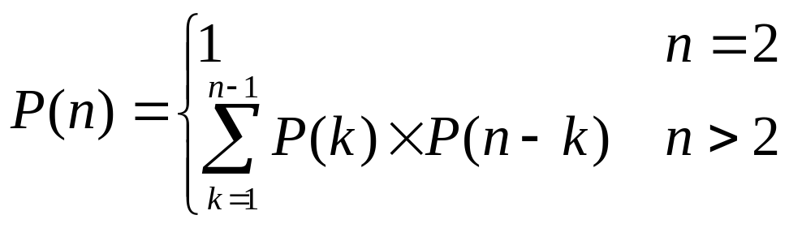
A naïve approach to matrix chain multiplication problem
Therefore at the top level, when A^{1..n} is calculated as A^{1..k} multiplied by A^{k+1..n}, we will have P(k)×P(n-k) possible parenthesizations.
However, k can be any number between 1 and n-1.
Hence, we will have the following recurrence for the number of possible parenthesizations to consider:

Slide 81
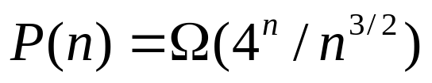
A naïve approach to matrix chain multiplication problem
Solution of the recurrence can be shown to be:
This means that we have an exponential number of possible parenthesizations for n matrices in the chain.
Hence, trying out every possible parenthesization is not a practical solution.
Let us try to develop a dynamic programming algorithm for this problem.

Slide 82
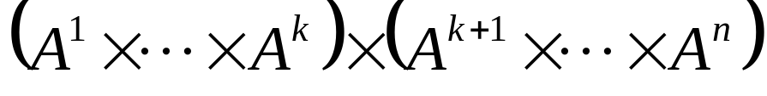
Dynamic programming approach to matrix chain multiplication problem
Step 1: Characterize the structure of an optimal solution
Suppose that we know an optimal solution, and it divides the chain at index k at the top level.
In other words, it tells us to first calculate A^{1..k} and A^{k+1..n}, then multiply A^{1..k} and A^{k+1..n} to find A^{1..n}

Slide 83
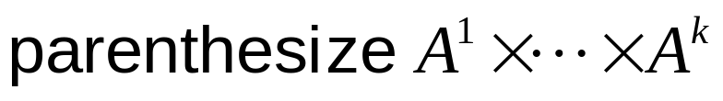
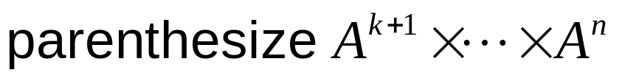
Dynamic programming approach to matrix chain multiplication problem
Then whatever the parenthesization given for A^{1..k}, it must also be an optimal solution for the instance of the matrix chain multiplication problem:
Similarly whatever the parenthesization given for A^{k+1..n}, it must also be an optimal solution for the instance of the matrix chain multiplication problem:

Slide 84
Dynamic programming approach to matrix chain multiplication problem
Recall our previous example:
This optimal solution (parenthesization) tells us to compute A^{1..3} first, and provides a parenthesization for it as well.
Is this parenthesization for A^{1..3} an optimal parenthesization for it?
p₀=5, p₁=10, p₂=50, p₃=100, p₄=20

Slide 85
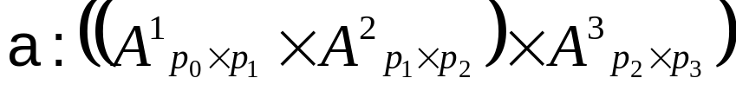
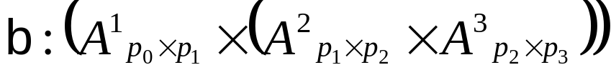
Dynamic programming approach to matrix chain multiplication problem
Let us consider possibilities for A^{1..3}
p₀=5, p₁=10, p₂=50, p₃=100
needs 27,500 scalar multiplications
needs 55,000 scalar multiplications

Slide 86
Dynamic programming approach to matrix chain multiplication problem
In fact, if (b) were cheaper, then
would be cheaper than
since in both cases A^{1..3} is multiplied by A^{4..4}, and the only difference would be in the calculation of A^{1..3}.
However, we already know (assumed) that
is an optimal solution.

Slide 87
Dynamic programming approach to matrix chain multiplication problem
In general, we have to make the following observation in order to be able to apply dynamic programming:
An optimal solution to the problem
contains optimal solutions to the
subproblem instances.
--
An optimal solution to the problem
can be derived from optimal solutions to the
subproblem instances.

Slide 88

Dynamic programming approach to matrix chain multiplication problem
Step 2: Recursively define the value of an optimal solution.
Let m[ i, j ] (for i ≤ j) denote the minimum number of scalar multiplications required to compute
Hence, we actually want to calculate m[ 1, n ].
We now need to define m[ i, j ] recursively.

Slide 89
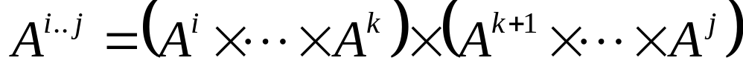

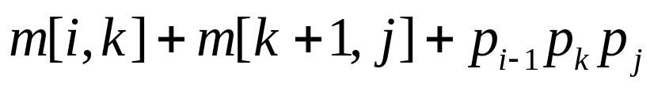
Dynamic programming approach to matrix chain multiplication problem
For i = j (which corresponds to the case where we have only one matrix in the chain), m[ i, j ] = 0.
For i < j, we can define m[ i, j ] recursively as follows:
Suppose that an optimal parenthesization splits the product after A^{k} for some i ≤ k < j.
From step 1, we know that parenthesization of the first and second components at this level must also be optimal.
Hence computing in this way will require
many scalar multiplications.

Slide 90
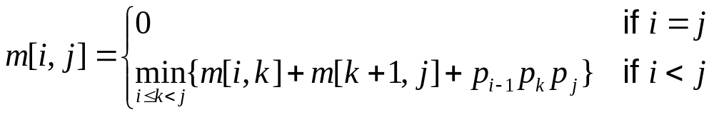
Dynamic programming approach to matrix chain multiplication problem
However, k can be any value between i (including) and j (excluding)
Therefore, we need to consider each k as a possible splitting point and take the minimum:

Slide 91
Dynamic programming approach to matrix chain multiplication problem
Step 3: Compute the value of an optimal solution in a bottom up fashion.
Having defined m[ i, j ] recursively, we can actually write a divide and conquer algorithm to compute m[ 1, n ].
m[1,4]
m[1,1]
m[2,4]
m[1,2]
m[3,4]
m[1,3]
m[4,4]
m[2,2]
m[3,4]
m[2,3]
m[4,4]
m[1,1]
m[2,2]
m[3,3]
m[4,4]
m[1,1]
m[2,3]
m[1,2]
m[3,3]
m[3,3]
m[4,4]
m[2,2]
m[3,3]
m[2,2]
m[3,3]
m[1,1]
m[2,2]

Slide 92
Dynamic programming approach to matrix chain multiplication problem
Note that, some of the values will be calculated multiple times.
A dynamic programming algorithm should try to avoid the calculation of the same values multiple times.
m[1,4]
m[1,1]
m[2,4]
m[1,2]
m[3,4]
m[1,3]
m[4,4]
m[2,2]
m[3,4]
m[2,3]
m[4,4]
m[1,1]
m[2,2]
m[3,3]
m[4,4]
m[1,1]
m[2,3]
m[1,2]
m[3,3]
m[3,3]
m[4,4]
m[2,2]
m[3,3]
m[2,2]
m[3,3]
m[1,1]
m[2,2]

Slide 93
Dynamic programming approach to matrix chain multiplication problem
The repeated subproblems is the second key observation that would give us a clue that we can apply a dynamic programming solution.
Note that, for each m[ i, j ] we can calculate the value when it is first needed, write it down after calculating its value, and whenever we need it again, we can simply look it up.
This is called “memoization”.

Slide 94
Dynamic programming approach to matrix chain multiplication problem
We want to calculate this cell
j
1
2
…
n
i
1
0
 | 0
 |  |  | 0
2
m[ i, j ]
…
n

Slide 95
Dynamic programming approach to matrix chain multiplication problem
j
Note that, in order to calculate m[ i, j ], we
need to know the values of all the cells
On the same row and to the left of m[ i, j ]
On the same column and below of m[ i, j ]
i

Slide 96
Dynamic programming approach to matrix chain multiplication problem
Initially, we know only the values at the diagonal entries : 0
0
 | 0
 |  | 0
 |  |  |  | 0
 |  |  |  |  | 0
Then we can calculate the values at the
next diagonal entries.
Then the values at the next diagonal
entries can be computed…
At the last step, we will be able to
calculate the value at m[1, n].

Slide 97
Dynamic programming approach to matrix chain multiplication problem
1
n
1
0
 | 0
 |  | 0
 |  |  |  | 0
 |  |  |  |  | 0
We need to compute n²/2 values (cells).
We need to consider at most n different
parenthesizations to calculate the value
at a cell (see the recurrence below).
Hence we can fill in the table in O(n³) time.
n

Slide 98
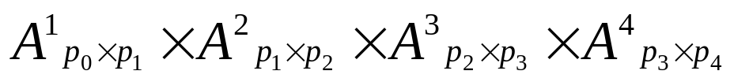

Example on dynamic programming approach to matrix chain multiplication problem
1
2
3
4
p₀=5, p₁=10, p₂=50, p₃=100, p₄=20
0 | 2,5K
 | 0 | 50K
 |  | 0 | 100K
 |  |  | 0
1
2
3
4

Slide 99
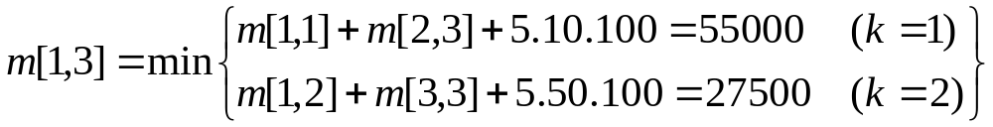
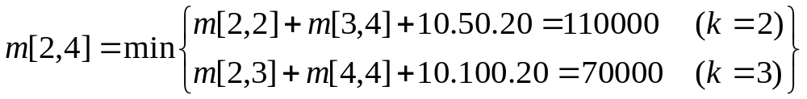
Example on dynamic programming approach to matrix chain multiplication problem
1
2
3
4
p₀=5, p₁=10, p₂=50, p₃=100, p₄=20
0 | 2,5K | 27,5K
 | 0 | 50K | 70K
 |  | 0 | 100K
 |  |  | 0
1
2
3
4

Slide 100
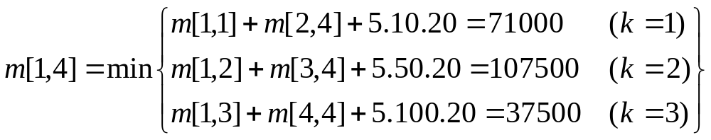
Example on dynamic programming approach to matrix chain multiplication problem
1
2
3
4
p₀=5, p₁=10, p₂=50, p₃=100, p₄=20
0 | 2,5K | 27,5K | 37,5K
 | 0 | 50K | 70K
 |  | 0 | 100K
 |  |  | 0
1
2
3
4

Slide 101
Example on dynamic programming approach to matrix chain multiplication problem
If only the optimal value (the minimum number of scalar multiplications
required to calculate the chain matrix multiplication) is needed, m[ 1, n ]
gives this answer.
However, if we need also the parenthesization that achieves this optimal
value, then we need to do an additional book keeping.
Let us also fill in a table s[ i, j ]. The value at a cell of s[ i, j ] will keep the
value k that minimizes m[ i, j ].
Note that, the parenthesization makes sense only we have three or more
matrices. Therefore, only the cells of the table s for i+1 < j are meaningful
(we have two or more matrices for these cases).

Slide 102
Example on dynamic programming approach to matrix chain multiplication problem
m[ i, j ]
1
2
3
4
s[ i, j ]
1
2
3
4
0 | 2,5K | 27,5K
 | 0 | 50K | 70K
 |  | 0 | 100K
 |  |  | 0
 |  | 2
 |  |  | 3
1
1
2
2
3
3
4
4

Slide 103
Example on dynamic programming approach to matrix chain multiplication problem
m[ i, j ]
1
2
3
4
s[ i, j ]
1
2
3
4
0 | 2,5K | 27,5K | 37,5K
 | 0 | 50K | 70K
 |  | 0 | 100K
 |  |  | 0
 |  | 2 | 3
 |  |  | 3
1
1
2
2
3
3
4
4

Slide 104

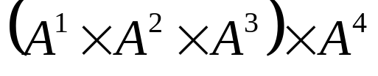
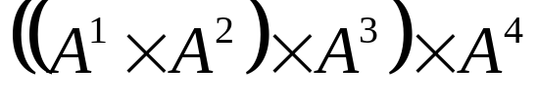
Example on dynamic programming approach to matrix chain multiplication problem
We can then use s[ i, j ] to parenthesize the chain matrix multiplication.
s[ i, j ]
1
2
3
4
 |  | 2 | 3
 |  |  | 3
1
Use s[ 1, 4 ] to decide
parenthesization of A¹ … A⁴
2
3
Use s[ 1, 3 ] to decide
parenthesization of A¹ … A³
4

Slide 105
Pseudo code for matrix chain multiplication problem
FindMinimumScalarMultiplications (p) {
// e.g. p=array[p0=5, p1=10, p2=50, p3=100, p4=20]
for (i=1; i ≤ n; i++)
m[i,i] = 0; // initialize the first diagonal to 0
for (d=2; d ≤ n; d++) // for all the diagonals
for (e=1; e ≤ n-d+1; e++) { // for each element on the diagonal
i = e-1;
j = e+1; // i and j values for the e^{th} element of the diagonal
m[ i, j ] = ∞; // initialize m[ i, j ] to a sentinel value
for (k=i; k < j; k++) // try each possible k
if (m[ i, k] + m[ k+1, j] + p_{i-1} . p_{k} . p_{j} < m[ i, j] )
m[ i, j] = m[ i, k] + m[ k+1, j] + p_{i-1} . p_{k} . p_{j} ; // this k is best so far
}
return m[ 1, n]; // m[1, n] keeps the minimum # of scalar mult. needed
}

Slide 106
Pseudo code for matrix chain multiplication problem
The code on the previous slide tries to traverse the cells in the order that they can be calculated.
We can also apply the idea of memoization, and develop an easier (to write and understand) code.
The idea is to attempt to calculate a cell value.
  If it is calculated before, simply look up its value.
  If it is not calculated before, calculate it.

Slide 107
Pseudo code for matrix chain multiplication problem – memoization approach
FindMinimumScalarMultiplications-Memoization (p) {
// e.g. p=array[p0=5, p1=10, p2=50, p3=100, p4=20]
for (i=1; i ≤ n; i++) // for each row
for (j=i; j ≤ n; i++) // for each column that will be used in this row
m[ i, j ] = ∞; // initialize the cells to a sentinel value to mark
// that the cell value is not calculated yet
// then lookup and return the desired cell value
return LookUp (1,n,p);
}`

Slide 108
Pseudo code for matrix chain multiplication problem – memoization approach
LookUp (i, j, p) { // m[i,j] is being looked up
// e.g. p=array[p0=5, p1=10, p2=50, p3=100, p4=20]
if (m[ i, j ] ≠ ∞) // it is calculated before
return (m[ i, j ]); // simply return it
// otherwise we need to calculate it now
for (k=i; k < j; k++) // try each possible k
if (LookUp(i,k,p) + LookUp(k+1, j,p) + p_{i-1}*p_{k} * p_{j} < m[ i, j] )
m[ i, j] = LookUp( i,k,p)+ LookUp(k+1, j,p) + p_{i-1}*p_{k} * p_{j} ;
// this k is best so far
// Now we can return it. Any further consultations will immediately
// return this calculated value.
return m[ i, j ];
}`

