Slide 1
CS301 - Algorithms
Week #7
Husnu Yenigun

Slide 2
AMORTIZED ANALYSIS

Slide 3
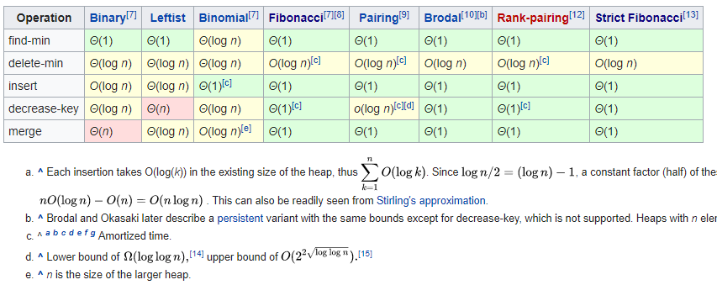
Amortized Analysis

Slide 4
Amortized Analysis
Suppose that we have a set of operations:
op₁, op₂, …, op_{k}
And an algorithm works by simply performing n steps where each step is a call to one of these operations:
(c_{i} can be any of the operations op_{j})
Also suppose that, we know the worst case running time of each type of operation.
op₁: O(f₁), op₂: O(f₂), …, op_{k}: O(f_{k})
How can we analyze such an abstract algorithm?
c₁
c₂
c₃
c_{n}

Slide 5
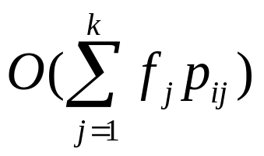
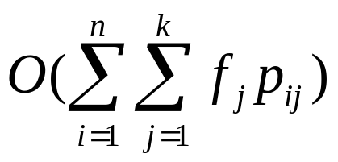
Amortized Analysis
One way is to apply a probabilistic analysis if we also know the probability for each c_{i} being an operation op_{j}.
In other words, let p_{ij} be the probability of having the i^{th} step as the operation op_{j}.
So the expected cost of the step c_{i} is
Therefore the expected running time of the entire algorithm is:
c₁
c₂
c₃
c_{n}
op₁: O(f₁), op₂: O(f₂), …, op_{k}: O(f_{k})

Slide 6
Amortized Analysis
However, this is only a probabilistic analysis, and does not provide a guarantee on the worst case running time of the algorithm.
Another approach can be to consider to worst case of the worst cases (even if we know such a worst of worst case would not be possible in practice).
In other words, in order to provide an upper bound on the running time of the algorithm, we may assume that each step executes the most expensive operation.

Slide 7
Amortized Analysis
So, when we have the operations:
Let us assume that op_{m} is the most expensive operation.
In other words, for all 1 ≤ j ≤ k, f_{j} = O(f_{m}).
Then an upper bound for the running time of the algorithm can be given as:
O(n f_{m})
c₁
c₂
c₃
c_{n}
op₁: O(f₁), op₂: O(f₂), …, op_{m}: O(f_{m}), …, op_{k}: O(f_{k})

Slide 8
We did a similar analysis before:
Running time of Counting Sort
The outer for-loop iterates O(k) times
However, the inner for-loop iterates different number of times for each i. [ op₁: O(f₁), op₂: O(f₂), …, op_{k}: O(f_{k}) ]
An upper bound can be found by considering that the inner for-loop will iterate at most n times for each i.
In this case, the third for-loop will need O(nk) time.
However, we can perform a better analysis.
for ( i=1; i <= k; i++) // consider each number in the range
for ( j=1; j <= times[ i ]; j++) { // generate that number in
A[m]=i; // the output as many times as
m++; // it occurs in the input
}

Slide 9
Amortized Analysis
Considering the most expensive operation as in the previous slide does provide a correct upper bound for the algorithm.
However, it is probably not a good upper bound, since we assume worst of the worst case.
In this part of the course, we will see 3 different methods called “amortized analysis” that can be used to find better bounds for such algorithms:
  The aggregate method
  The accounting method
  The potential method

Slide 10
The aggregate method
Given a sequence of n operations, the aggregate method tries to find an upper bound on the running time by performing a better analysis.
Instead of concentrating on the cost of each step, we try to find a bound on the overall execution time.
When the overall execution time is found, say T(n), then the amortized cost of each step is taken to be T(n)/n.
Even if different operations are used at each step, the amortized cost T(n)/n is used as the actual cost of each step.

Slide 11
Stack example
Consider the following situation:
  We have a stack implemented with the usual POP & PUSH operations.
  POP & PUSH each takes O(1) time to execute.
PUSH(S,5)
PUSH(S,7)
POP(S)
7
7
5
5
5
S
S
S
S

Slide 12
Stack example
Consider the following program:
What is the running time of ManipulateStack?
ManipulateStack (n) {
S = empty stack; // we start with an empty stack
for (i=1; i <= n; i++) { // iterate n time
GetCommand(cmd, par); // get a command from the user
// a command can either be a POP or a PUSH
if (cmd == “POP”) // the user wants to pop
POP(S);
else // the user wants to push (par gives the number to be pushed)
PUSH(S, par);
}
}

Slide 13
Stack example
It is easy for this example.
Since each operation can either be a POP or a PUSH, and since each of there operations costs O(1) time, the total running time of “ManipulateStack” is O(n).
Let us consider a little bit more complicated stack, which also provides a multipop operation.
MultiPOP (S,k) {
while (S is not empty and k > 0) {
POP(S);
k--;
}
}

Slide 14
MultiPOP Stack example
Note that a MultiPOP operation attempts to pop k items from the stack.
Let the number of elements in the stack S be |S|.
If there are k or more items in the stack, i.e. k ≤ |S|, then MultiPOP will iterate k times.
However, if k > |S|, then MultiPOP will iterate only |S| times.
Hence the running time of MultiPOP is O(min(k, |S|)).

Slide 15
MultiPOP Stack example
Now let us consider the following program:
ManipulateMultiPOPStack (n) {
S = empty stack; // we start with an empty stack
for (i=1; i <= n; i++) { // iterate n time
GetCommand(cmd, par); // get a command from the user
// a command can either be a POP, or a PUSH, or a MultiPOP
if (cmd == “POP”) // the user wants to pop
POP(S);
else if (cmd == “PUSH”) // the user wants to push (push par)
PUSH(S, par);
else // the user wants a MultiPOP (par gives the # of items to pop)
MultiPOP (S, par);
}
}

Slide 16
MultiPOP Stack example
Analyzing the running time of ManipulateMultiPOPStack is not as easy as the analysis of ManipulateStack.
Each operation can either be POP, PUSH, or a MultiPOP.
However, the cost of a MultiPOP will depend on the user parameter, and also on the number of items currently on the stack.
How can we analyze worst case performance of ManipulateMultiPOPStack?

Slide 17
MultiPOP Stack example
We may argue as follows:
  The stack can have at most n elements at any time (since we will perform n operations, and in the worst case they can all be PUSH operations).
  Since POP and PUSH only cost O(1) time, in the worst case assume that each operation is a MultiPOP (since it is the most expensive of among all the operations).
  The worst case running time of MultiPOP is O(n) (e.g. n-1 pushes followed by a MultiPOP of these n-1 items).
  Hence the overall running time is n×O(n) = O(n²) since in the worst case each MultiPOP can cost O(n) time (even if we know it is not possible in practice).
This is a valid argument, and it really provides an upper bound on the running time of ManipulateMultiPOPStack.
However, it is not a tight bound. We can perform a better analysis and find a better upper bound.

Slide 18
MultiPOP Stack example
We know that a PUSH operation runs in O(1) time.
We know that a POP operation runs in O(1) time.
And these are obviously tight bounds.
What we cannot decide is a realistic tight upper bound for MultiPOP
In other words, the number of iterations of the while loop in MultiPOP for an individual call to MultiPOP cannot be decided (to be safe we assumed it iterates O(n) times in each call to MultiPOP).

Slide 19
MultiPOP Stack example
However, rather than concentrating on the cost of a single call to MultiPOP, it may help to consider the cost of all calls to MultiPOP.
In other words, rather than asking the question
“How many times the while loop of MultiPOP
iterates in a call to MultiPOP?”
ask the question
“How many times the while loop of MultiPOP
iterates overall, during the execution of operations?”
Answer is
O(n)

Slide 20
MultiPOP Stack example
Why O(n)?
Because an iteration of the while loop of MultiPOP, pops an element from the stack.
An element must be pushed before, in order to be POPped.
What is the maximum number of elements that can be PUSHed? n.
So, the cost of all MultiPOP operations is O(n).
Since the cost of other operations are also O(n), the worst case running time of ManipulateMultiPOPStack is T(n)=O(n).

Slide 21
The aggregate method
In the aggregate method, after finding the running time T(n) of the algorithm, T(n)/n gives the amortized cost (in a sense it is the average cost) of each step of the algorithm.
So, for ManipulateMultiPOPStack algorithm, the amortized cost of each step is T(n)/n = O(n)/n = O(1).
The aggregate method assigns a uniform amortized cost to each step of the algorithm, even if they are different operations.
In the other two amortized analysis techniques, we will assign different amortized costs to different operations.

Slide 22
The accounting method
Let us consider a computer as a vending machine that requires us to pay some money to perform a task.
When we want to do some computation on such a computer, we pay some money to get that computation done.
In fact, we do pay our computers to get a job done!.. What currency/unit do we pay in???
We pay in “time” units to a computer for our computations.
However, in the case of the accounting method, it is better understood if we consider the cost of a computation as money.

Slide 23
The accounting method
The computer is fair and charges only in proportion with the running time of our computation.
The computer does not perform a job if its money is not paid.
However, we are free to overpay for a computation. In such a case, the computer will store the additional money we pay, and use it to compensate any underpayments in the future.
Normally, POP and PUSH operations cost 1 TL.
And MULTIPOP operation costs min(q,k) TL.

Slide 24
The accounting method
Suppose that we pay
  2 TL for a PUSH operation
  0 TL for a POP operation
  0 TL for a MULTIPOP operation
So when we PUSH a new element, we will pay 2 TL.
1 TL of this 2 TL will be used by the computer as the cost of the PUSH operation.
The remaining 1 TL of this 2 TL will be attached to the element that we insert, and will stay with it.
And we tell to the computer to use that remaining 1 TL when an element is popped (either by an individual POP or by a MULTIPOP).

Slide 25
The accounting method
Note that, each element can be popped exactly once.
And when it is popped, the computer will find 1 TL attached to the element, and will use this 1 TL for the cost of the pop operation.
Hence we will never owe money to the computer.
Since we already paid the money for pop operations, we do not need to pay an additional money for POP and MULTIPOP operations. Hence we can consider their cost as 0.

Slide 26
The accounting method
Now we ask: What is the maximum amount of money that we have to pay for n consecutive (PUSH, POP, MULTIPOP) operations?
In the worst case, they can all be PUSH operations (since PUSH is the most expensive operation now).
Hence we may need to pay 2n TL to the computer.
Recall that, the money we pay for an operation is proportional to the time it takes to perform that operation.
Hence, in the worst case the running time is O(2n)=O(n).

Slide 27
The potential method
It is similar to the accounting method.
It depends on depositing a prepaid credit for operations.
In the accounting method, we attach a credit with specific objects in our data structure (e.g. we associated a credit with the individual items in the stack in the MultiPOP stack example).
However, in the potential method, we associate a credit with the entire data structure.
This prepaid work is named as “potential energy” or simply as “potential”, which is released to pay further operations.

Slide 28
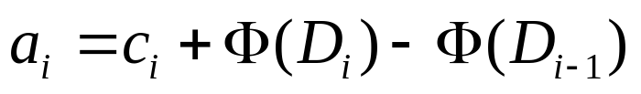
The potential method
Let D₀ denote the initial form of our data structure (e.g. the empty stack at the beginning).
At each step i (1 ≤ i ≤ n), we perform an operation op_{j}
(1 ≤ j ≤ k) on the data structure D_{i-1} and get to the data structure D_{i}.
We use a potential function Φ from D_{i}’s to real numbers, giving the potential associated with the data structure D_{i}.
Let c_{i} be the actual cost of the operation at step i.
The amortized cost of a_{i} is defined as:
The increase
in potential

Slide 29
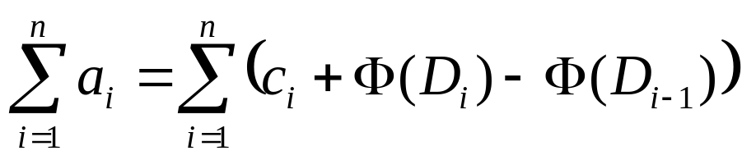
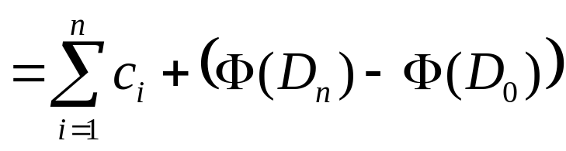
The potential method
Since we have n operations, let us calculate the overall amortized cost:
telescopic
total actual cost

Slide 30
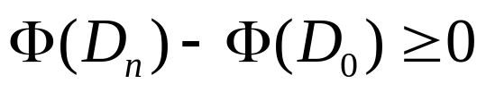
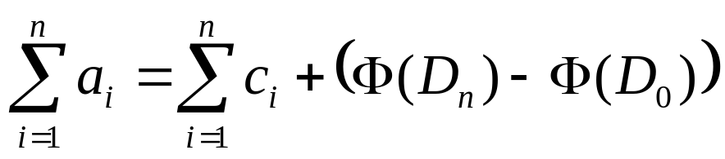
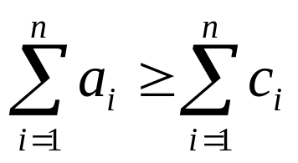
The potential method
Note that, when
from
we have
Hence, the amortized cost becomes an upper bound on the actual cost.
total amortized cost
total actual cost

Slide 31
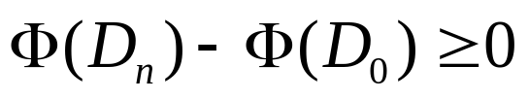
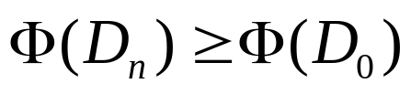
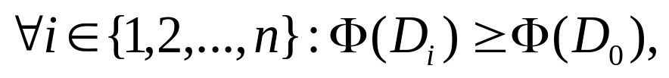
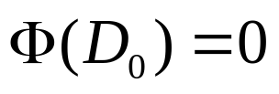
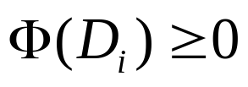
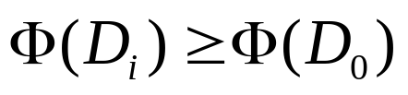
The potential method
Hence we need to pick the potential function so that,
or equivalently
However, we will be also safe if we pick
since n is not known in advance.
It is convenient to define and show that
which guarantees

Slide 32
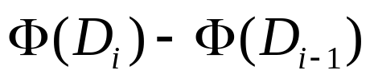
The potential method
Note that can be negative or positive.
  When it is positive: Then a_{i} is overcharge, and the potential is increased by the i ^{th} operation (We are over paying to compensate for later operations)
  When it is negative: Then a_{i} is an undercharge, and the potential is decreased by the i^{th} operation (We are using from the credit we have accumulated so far)

Slide 33
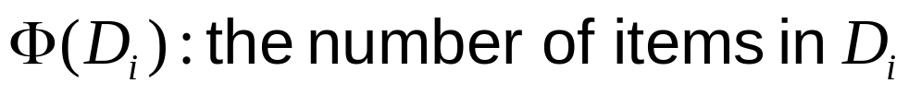
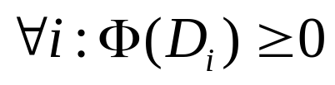
Application of the potential method : MultiPOP stack example
Let us use the potential function which is defined as:
Hence, we have:
So, the conditions are satisfied with this selection of the potential function.
Now we can calculate the total amortized cost, by finding the amortized cost for each type of operation.

Slide 34
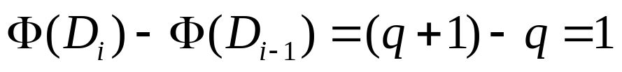
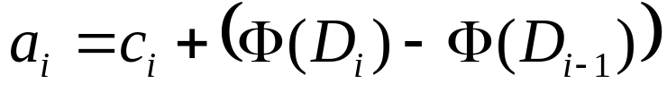
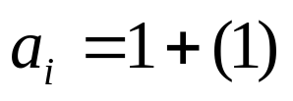
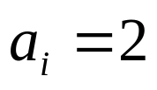
Application of the potential method : MultiPOP stack example
Consider PUSH operation performed at a step i. Suppose that we have q items in the stack before the push operation:
Then the amortized cost of PUSH operation can be found as:

Slide 35
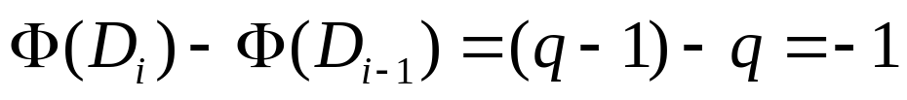
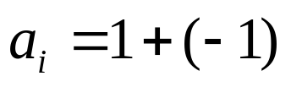
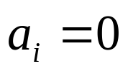
Application of the potential method : MultiPOP stack example
Consider POP operation performed at a step i. Suppose that we have q items in the stack before the push operation:
Then the amortized cost of POP operation can be found as:

Slide 36
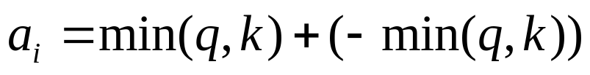
Application of the potential method : MultiPOP stack example
Consider MultiPOP(S,k) operation performed at a step i. Suppose that we have q items in the stack before the push operation:
Then the amortized cost of MultiPOP(S,k) operation can be found as:

Slide 37
Application of the potential method : MultiPOP stack example
Note that
  POP → constant amortized cost
  PUSH → constant amortized cost
  MultiPOP → constant amortized cost
Hence, if we perform n of these operations, then the total amortized cost is O(n).

