Slide 1
CS301 - Algorithms
Week #9
Husnu Yenigun

Slide 2
SHORTEST PATH PROBLEMS

Slide 3
Shortest path problems
The second problem that we will consider on graphs is the shortest path problem.
However, before formally defining the problem, let us give some definitions.
Given a digraph G=(V,E), a sequence of nodes p=<v₀,v₁,v₂,…,v_{k}> is said to be a path from v₀ to v_{k} in G if (v_{i},v_{i+1}) ∈ E for all 0 ≤ i < k.
If there is a path p from v₀ to v_{k} in G, then we also write (v₀, p, v_{k}), and v_{k} is said to be reachable from v₀
v₀
v₁
v₂
v₃
V_{k-1}
v_{k}

Slide 4
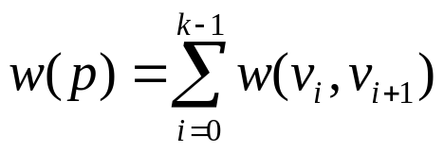
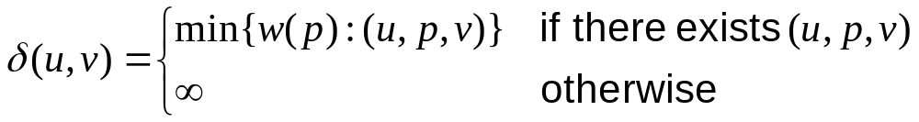
Weight (length) of a path, and a shortest path
Given a digraph G=(V,E) and a weight function w:E→R, the weight (or equivalently length) of a path p=<v₀,v₁,v₂,…,v_{k}> in G is
Let us define the length shortest path length from u to v as:
Note that, a node is reachable from itself by an empty path, hence δ(u,u) = 0 for all u.
If (v₁,p₁₂,v₂) and (v₂,p₂₃,v₃) then w(p₁₂.p₂₃)=w(p₁₂)+w(p₂₃)

Slide 5
Variants of shortest path problems
Given a directed graph G=(V,E) and a weight function w:E→R,
Single source shortest path problem:
  Given a source node s ∈ V, for all (destination) nodes d ∈ V, find a shortest path from s to d.

Slide 6
Variants of shortest path problems
Given a directed graph G=(V,E) and a weight function w:E→R,
Single pair shortest path problem:
  Given a source node s ∈ V, and a destination node d ∈ V, find a shortest path from s to d.
  Note that, an algorithm that solves the “single source shortest path problem”, also solves the “single pair shortest path problem”.
  There is no known algorithm for the “single pair shortest path problem” which runs asymptotically faster than an algorithm for the “single source shortest path problem”.

Slide 7
Variants of shortest path problems
Given a directed graph G=(V,E) and a weight function w:E→R,
Single destination shortest path problem:
  Given a destination node d ∈ V, for all (source) nodes s ∈ V, find a shortest path from s to d.

Slide 8
Variants of shortest path problems
Given a directed graph G=(V,E) and a weight function w:E→R,
All pairs shortest path problem:
  For all the nodes s,d ∈ V, find a shortest path from s to d.
  We can solve “single source shortest path” problem for each (source) node s ∈ V, but there are more efficient algorithms.

Slide 9
Optimal substructure property of shortest paths
Let (v₁,p₁₂,v₂)(v₂,p₂₃,v₃)(v₃,p₃₄,v₄) be a shortest path from v₁ to v₄. Then (v₂, p₂₃, v₃) is a shortest path from v₂ to v₃.
Proof: Suppose not.
  Then there exists another, shorter path from v₂ to v₃,
  say (v₂, p’₂₃, v₃).
  Then consider the path (v₁,p₁₂,v₂)(v₂,p’₂₃,v₃)(v₃,p₃₄,v₄), which is a path from v₁ to v₄.
  However, the path (v₁,p₁₂,v₂)(v₂,p’₂₃,v₃)(v₃,p₃₄,v₄) must be a shorter path than (v₁,p₁₂,v₂)(v₂,p₂₃,v₃)(v₃,p₃₄,v₄) , which is a contradiction.

Slide 10
We should not have negative cycles in G
Note that w:E→R, hence the weight of an edge can be negative.
Therefore the weight of a cycle (when we add up the weights of the edges along the cycle) can also be negative. In such a case, the shortest path may not be well defined.
Suppose, (v₁,p₁₂,v₂)(v₂,p₂₂,v₂)(v₂,p₂₃,v₃) and the weight of the path p₂₂ is negative.
p₂₂
p₁₂
p₂₃
v₁
v₂
v₃

Slide 11
We should not have negative cycles in G
Then the weight of (v₁,p₁₂,v₂)(v₂,p₂₂,v₂) (v₂,p₂₂,v₂)(v₂,p₂₃,v₃) is less.
Then the weight of (v₁,p₁₂,v₂)(v₂,p₂₂,v₂) (v₂,p₂₂,v₂) (v₂,p₂₂,v₂)(v₂,p₂₃,v₃) is even less.
Then the weight of …
Hence we can reduce the length of the path indefinitely by using the path p₂₂ as many times as we want.
Therefore, there should not exist a negative cycle, or at least it should not be reachable on the paths from source to the destination.

Slide 12
We cannot have cycles in shortest paths
If there is no negative cycle in G that is reachable from the source node s, and if (s,p,d) is a shortest path from s to d, then
  p does not contain any cycles
  p has at most |V|-1 edges.
p does not contain any cycles: Suppose p contains a cycle: (s,p₁,u)(u,p₂,u)(u,p₃,d). Since we do not have any negative cycles reachable from s, weight of p₂ is not negative. Then (s,p₁,u)(u,p₃,d) is at most as long as the path (s,p₁,u)(u,p₂,u)(u,p₃,d), hence it is also a shortest path from s to d.
p₂
p₁
p₃
p₁
p₃
s
u
d
s
u
d

Slide 13
We cannot have cycles in shortest paths
A simple path (a path that does not contain any cycle) in G can have at most |V|-1 edges.
|V| nodes, hence |V|-1 edges
u₁
u₂
u₃
u₄
u_{|V|-1}
u_{|V|}
?
Can’t be u₁
Can’t be u₁, u₂
Can’t be u_{1,} u₂, u₃
Must be one of
the previous nodes
Can’t be u_{1,} u₂, …, u_{|V|-2}
Can’t be u_{1,} u₂, …, u_{|V|-1}

Slide 14
Shortest path trees
Given a directed graph G=(V,E) and a weight function w:E→R, and a source node s ∈ V, a subgraph G’=(V,E’) of G is a shortest path tree of G for s if
  G’ is a tree with root s
  For all d ∈ V, the unique path from s to d in G’ is a shortest path from s to d in G.
Hence, we will find the shortest paths from s to all the nodes (destinations) in V.

Slide 15
Shortest path trees vs Minimum Spanning Trees
A shortest path tree is also a spanning tree (it is in fact a rooted spanning tree).
However:
  a shortest path tree is not necessarily a minimum spanning tree
  a minimum spanning tree is not necessarily a shortest path tree
minimum spanning tree
(rooted)
source node : A
shortest path tree
A
A
A
3
3
3
2
1
2
B
B
B
1
2
2
1
2
C
D
C
D
C
D

Slide 16
Relaxation over an edge
A shortest path algorithms start with an overestimation of the shortest path lengths
  Initially assume that shortest path from the source to a node is infinite
Then, shortest path estimation is improved by using egde relaxation:
If currently:
then we know
a shorter path to C
In general:
[ d(.) : current estimate for the
length of the shortest path ]
A
A
9
6
7
if d(C) > d(B) + w(B,C)
then there is a shorter path.
6
1
B
1
C
B
C
relaxation over the edge (B,C)

Slide 17
Keeping the paths in the shortest path trees
We will grow a shortest path tree.
It is sufficient to remember only the parents of the nodes in the tree.
shortest path tree
A
A
3
3
2
1
2
B
B
1
2
2
C
D
C
D

Slide 18
Bellman-Ford algorithm
Bellman-Ford (G, w, s) { // G=(V,E), w:E→R, s ∈ V
∀ v ∈ V { // initialization phase
d(v) = ∞; // d(v) : current shortest path estimate from s to v
p(v) = NULL; // parent of v in the shortest path tree
}
d(s) = 0; // s is reachable from itself using no edges
for (i=1; i < |V|; i++) { // iterate |V|-1 times
∀ (u,v) ∈ E { // edge relaxation phase
if (d(v) > d(u) + w(u,v)) { // reaching to u first and using (u,v) to
d(v) = d(u)+w(u,v); p(v)=u; // reach v is shorter than current info
}
∀ (u,v) ∈ E { // convergence checking phase
if (d(v) > d(u) + w(u,v)) // if we can still find a shorter path
announce negative cycle; // it is due to a negative cycle
}

Slide 19
Example
A
 | A | B | C | D | E
d | 0 | ∞ | ∞ | ∞ | ∞
-1
4
B
 | A | B | C | D | E
p | NIL | NIL | NIL | NIL | NIL
3
2
C
2
1
E
5
-3
D
Iteration 1: (A,B):(A,C):(B,C):(B,D):(B,E):(D,B):(D,C):(E,D)
Iteration 2: (A,B):(A,C):(B,C):(B,D):(B,E):(D,B):(D,C):(E,D)
Iteration 3: (A,B):(A,C):(B,C):(B,D):(B,E):(D,B):(D,C):(E,D)
Iteration 4: (A,B):(A,C):(B,C):(B,D):(B,E):(D,B):(D,C):(E,D)

Slide 20
Example
A
 | A | B | C | D | E
d | 0 | -1 | 2 | -2 | 1
B
 | A | B | C | D | E
p | NIL | A | B | E | B
C
E
D

Slide 21
Correctness of Bellman-Ford algorithm
Suppose that s=v₀ → v₁ → v₂ → …. → v_{k} = d is a shortest path from s to d in G.
Let d(v_{i}^{j}) be the value of d(v_{i}) after the j^{th} pass.
Then d(v_{i}^{i}) = δ(s, v_{i})
[i.e. if a node v is i steps away from s in the shortest path tree, then the shortest path to v is correctly calculated after the i^{th} iteration of the algorithm]
Proof: By induction on k.
For k=0, Then d(v₀⁰) = δ(s, v₀) = δ(s, s) = 0

Slide 22
Correctness of Bellman-Ford algorithm
Assume it is correct for i-1, i.e. d(v_{i-1}^{i-1}) = δ(s, v_{i-1})
And show that it is also correct for i.
During the i^{th} pass, when the edge (v_{i-1},v_{i}) is considered
if (d(v_{i}^{i-1}) > d(v_{i-1}^{i-1}) + w(v_{i-1}, v_{i})); or equivalently
if (d(v_{i}^{i-1}) > δ(s, v_{i-1}) + w(v_{i-1}, v_{i}))
Since v₀ → v_{i-1} → v_{i} is a shortest path,
δ(s, v_{i-1}) + w(v_{i-1}, v_{i}) = δ(s, v_{i})
If we really have d(v_{i}^{i-1}) > d(v_{i-1}^{i-1}) + w(v_{i-1}, v_{i}), then d(v_{i}^{i}) will be assigned to
d(v_{i-1}^{i-1}) + w(v_{i-1}, v_{i}) = δ(s, v_{i-1}) + w(v_{i-1}, v_{i}) = δ(s, v_{i}).
If we have d(v_{i}^{i-1}) = d(v_{i-1}^{i-1}) + w(v_{i-1}, v_{i}) [it cannot be smaller], no assignment will be made and we will have d(v_{i}^{i}) = δ(s, v_{i}) again.

Slide 23
Correctness of Bellman-Ford algorithm
Therefore, after the i^{th} iteration, we are sure that the shortest path tree will be correctly formed upto depth i.
What is the maximum possible depth of the shortest path tree?
It is equal to the maximum number of edges we can have in a simple path (i.e. a path with no cycles).
What is the maximum number of edges in a simple path?
We have shown previously that it is |V|-1.
Therefore, iterating |V|-1 times is enough to completely and correctly form the shortest path tree.

Slide 24
Performance of Bellman-Ford
Bellman-Ford (G, w, s) { // G=(V,E), w:E→R, s ∈ V
∀ v ∈ V { // initialization phase
d(v) = ∞; // d(v) : current shortest path estimate from s to v
p(v) = NULL; // parent of v in the shortest path tree
}
d(s) = 0; // s is reachable from itself using no edges
for (i=1; i < |V|; i++) { // iterate |V|-1 times
∀ (u,v) ∈ E { // edge relaxation phase
if (d(v) > d(u) + w(u,v)) { // reaching to u first and using (u,v) to
d(v) = d(u)+w(u,v); p(v)=u; // reach v is shorter than current info
}
∀ (u,v) ∈ E { // convergence checking phase
if (d(v) > d(u) + w(u,v)) // if we can still find a shorter path
announce negative cycle; // it is due to a negative cycle
}
  Iterates V-1 times.
  In each iteration, every edge is considered
  Hence it’s running time is O(VE)

Slide 25
Dijsktra’s algorithm (non-negative weights only)
Dijkstra (G, w, s) { // G=(V,E), w:E→R⁺, s ∈ V
∀ v ∈ V { // initialization phase
d(v) = ∞; // d(v) : current shortest path estimate from s to v
p(v) = NILL; // parent of v in the shortest path tree
}
d(s) = 0; // s is reachable from itself using no edges
C = V; // nodes to be covered C : initially all the nodes
while ( C ≠ ∅ ) {
let u be a vertex such that d(u) = min{ d(v) : v ∈ C}
C = C \ { u };
∀ (u,v) ∈ E { // edge relaxation phase
if (d(v) > d(u) + w(u,v)) { // passing over u is better
d(v) = d(u)+w(u,v); p(v)=u; // pass over u
} // if
} // for all
} // while
}

Slide 26
Example
A
0, NIL
C={A,B,C,D,E}
1
4
B
∞, NIL
3
2
∞, NIL
C
2
1
E
∞, NIL
5
3
D
∞, NIL

Slide 27
Example
A
0, NIL
C={B,C,D,E}
1
4
B
∞, NIL
1, A
3
2
∞, NIL
C
2
1
E
∞, NIL
4, A
5
3
D
∞, NIL

Slide 28
Example
A
0, NIL
C={C,D,E}
1
4
B
∞, NIL
1, A
3
2
∞, NIL
C
2
1
E
∞, NIL
4, A
3, B
5
3
D
∞, NIL
3, B

Slide 29
Example
A
0, NIL
C={C,E}
1
4
B
∞, NIL
1, A
3
2
∞, NIL
C
2
1
E
∞, NIL
4, A
3, B
5
3
D
∞, NIL
3, B

Slide 30
Example
A
0, NIL
C={C}
1
4
B
∞, NIL
1, A
3
2
∞, NIL
C
2
1
E
∞, NIL
4, A
3, B
5
3
D
∞, NIL
3, B

Slide 31
Example
A
0, NIL
C= ∅
1
4
B
∞, NIL
1, A
3
2
∞, NIL
C
2
1
E
∞, NIL
4, A
3, B
5
3
D
∞, NIL
3, B

Slide 32
Example
A
0, NIL
1
A shortest path tree rooted at A is:
4
B
1, A
A
0
3
2
4, A
C
2
1
E
3, B
B
1
5
3
D
4
C
E
3
3, B
D
3

Slide 33
Negative edges are problematic for Dijkstra’s algorithm
0, NIL
A
0, NIL
A
0, NIL
A
1
4
1
4
1
4
B
-5
C
B
-5
C
B
-5
C
∞, NIL
∞, NIL
∞, NIL
∞, NIL
∞, NIL
∞, NIL
1, A
4, A
1, A
4, A
2
D
2
D
2
D
∞, NIL
0, NIL
A
∞, NIL
0, NIL
A
∞, NIL
3, B
1
4
1
4
B
-5
C
B
-5
C
∞, NIL
∞, NIL
∞, NIL
∞, NIL
1, A
4, A
1, A
4, A
2
D
-1, C
2
D
∞, NIL
∞, NIL
3, B
3, B

Slide 34
Performance of Dijkstra
Dijkstra (G, w, s) { // G=(V,E), w:E→R⁺, s ∈ V
∀ v ∈ V { // initialization phase
d(v) = ∞; // d(v) : current shortest path estimate from s to v
p(v) = NILL; // parent of v in the shortest path tree
}
d(s) = 0; // s is reachable from itself using no edges
C = V; // nodes to be covered C : initially all the nodes
while ( C ≠ ∅ ) {
let u be a vertex such that d(u) = min{ d(v) : v ∈ C}
C = C \ { u };
∀ (u,v) ∈ E { // edge relaxation phase
if (d(v) > d(u) + w(u,v)) { // passing over u is better
d(v) = d(u)+w(u,v); p(v)=u; // pass over u
} // if
} // for all
} // while
}
  Initialization phase:
    V x insertions
  While loop
  (aggregate analysis)
    V x find min
    V x extract min
    E x update a node

Slide 35
Performance of Dijkstra
Simple array
V x Θ(1) + V x O(V) + V x Θ(1) + E x Θ(1) = O(V²+E)
  Initialization phase:
    V x insertions
  While loop
  (aggregate analysis)
    V x find min
    V x extract min
    E x update a node
Balanced Search Tree (e.g. RBT)
V x O(lg V) + V x O(lg V) + V x O(lg V) + E x O(lg V)
= O(V lg V + E lg V) = O((V+E) lg V) = O(E lg V)
Binary Heap
V x O(lg V) + V x Θ(1) + V x O(lg V) + E x O(lg V)
= O(V lg V + E lg V) = O((V+E) lg V) = O(E lg V)
Assuming that E ≥ V-1
(since every node is reachable from the source node)
Fibonacci Heap
V x Θ(1) + V x Θ(1) + V x O(lg V) + E x Θ(1) = O(V lg V + E)
 | Insert | Find min | Extract Min | Update [Decrease Key]
Simple Array | Θ(1) | O(n) [linear scan] | Θ(1) [mark node handled] | Θ(1)
Balanced Search Tree (e.g. RBT) | O(lg n) | O(lg n) | O(lg n) | O(lg n) [delete and insert]
Binary Heap | O(lg n) | Θ(1) | O(lg n) | O(lg n)
Fibonacci Heap | Θ(1) | Θ(1) | O(lg n) | Θ(1)

Slide 36
Comparison of Bellman-Ford and Dijkstra
Bellman-Ford:
  running time is O(VE)
  can be applied to general graphs
Dijkstra:
  running time in O(V lg V + E) [ by using Fibonacci Heaps ]
  can only be applied to graphs with nonnegative edges

Slide 37
Shortest path problem on DAGs
A directed graph is called as a Directed Acyclic Graph (DAG) if it contains no cycles.
Sometimes when we know some additional information about the input, we can attack the problem with more specific and more efficient algorithms. Knowing that the graph is a DAG, can we find a better algorithm for shortest path problem?
Let v₁ < v₂ < …< v_{n} be a topological sort of V.
We can find a topological sort for V in O(V+E) time
[e.g. by DFS finish times]

Slide 38
Topological sort example
A
A
<
B
<
E
<
D
<
C
-1
4
B
3
2
C
1
E
Note that all the edges are from left to right.
5
-3
D
4
3
A
-1
B
2
E
-3
D
5
C
1

Slide 39
Shortest path algorithm on DAGs
DAG-Shortest-Path (G, w, s) { // G=(V,E), w:E→R, s ∈ V
∀ v ∈ V { // initialization phase
d(v) = ∞; // d(v) : current shortest path estimate from s to v
p(v) = NILL; // parent of v in the shortest path tree
}
d(s) = 0; // s is reachable from itself using no edges
topologically sort V;
∀ u ∈ V, by considering them in the topological order {
∀ (u,v) ∈ E { // edge relaxation phase
if (d(v) > d(u) + w(u,v)) { // passing over u is better
d(v) = d(u)+w(u,v); p(v)=u; // pass over u
} // if
} // for all edges
} // for all nodes
}

Slide 40
Example
4
3
A
-1
B
2
E
-3
D
5
C
1
0, NIL
∞, NIL
∞, NIL
∞, NIL
∞, NIL
4
3
A
-1
B
2
E
-3
D
5
C
1
0, NIL
∞, NIL
∞, NIL
∞, NIL
∞, NIL
-1, A
4, A

Slide 41
Example
4
3
A
-1
B
2
E
-3
D
5
C
1
0, NIL
∞, NIL
∞, NIL
∞, NIL
∞, NIL
-1, A
1, B
0, B
4, A
2, B
4
3
A
-1
B
2
E
-3
D
5
C
1
0, NIL
∞, NIL
∞, NIL
∞, NIL
∞, NIL
-1, A
1, B
0, B
4, A
-2, E
2, B

Slide 42
Example
4
3
A
-1
B
2
E
-3
D
5
C
1
0, NIL
∞, NIL
∞, NIL
∞, NIL
∞, NIL
-1, A
1, B
0, B
4, A
-2, E
2, B
We don’t need to consider the last node. We know that it has no
outgoing edges. So, the shortest path tree rooted at A is:
3
A
-1
B
2
E
-3
D
C
0, NIL
-1, A
1, B
-2, E
2, B

Slide 43
Shortest path algorithm on DAGs
DAG-Shortest-Path (G, w, s) { // G=(V,E), w:E→R, s ∈ V
∀ v ∈ V { // initialization phase
d(v) = ∞; // d(v) : current shortest path estimate from s to v
p(v) = NILL; // parent of v in the shortest path tree
}
d(s) = 0; // s is reachable from itself using no edges
topologically sort V;
∀ u ∈ V, by considering them in the topological order {
∀ (u,v) ∈ E { // edge relaxation phase
if (d(v) > d(u) + w(u,v)) { // passing over u is better
d(v) = d(u)+w(u,v); p(v)=u; // pass over u
} // if
} // for all edges
} // for all nodes
}
O(V)
O(V+E)
O(V+E)
(using aggregate analysis)

Slide 44
Shortest path algorithm on DAGs
Initialization phase: O(V)
Topological sort: O(V+E)
For each node, and for each edge leaving that node: O(V+E)
Hence the total running time is O(V+E).
Better than applying
  Bellman-Ford [ O(VE) ], or
  Dijkstra [ O(V lg V + E) ]

Slide 45
An application of shortest path problem
A system of difference constraints is a set of inequalities in the form
x_{i} – x_{j} ≤ b_{k}
where x_{i} and x_{j} are variables and b_{k} is a constant.
For example:
x₂ – x₁ ≤ 5
x₃ – x₁ ≤ 3
x₃ – x₂ ≤ -5
x₄ – x₂ ≤ 0

Slide 46
A feasible solution for a system of difference constraints
A feasible solution for a system of difference constraints is an assignment of values to the variables that satisfy all the inequalities in the system simultaneously.
With these assignments to the variables:
0 – 0 ≤ 5
-5 – 0 ≤ 3
-5 – 0 ≤ -5
0 – 0 ≤ 0
A feasible solution is:
x₁ = 0
x₂ = 0
x₃ = -5
x₄ = 0
For example, for:
x₂ – x₁ ≤ 5
x₃ – x₁ ≤ 3
x₃ – x₂ ≤ -5
x₄ – x₂ ≤ 0

Slide 47
How to check if there exists a feasible solution and how to find a feasible solution
Note that, not all systems of difference constraints have a feasible solution.
E.g. consider
x₂ – x₁ ≤ 0
x₁ – x₂ ≤ -1
This system has no feasible solution, i.e. we cannot find values for x₁ and x₂ satisfying these two inequalities.
So our problem is two fold. Given a system of difference constraints:
  Check if a feasible solution exists.
  If exists, find a feasible solution.

Slide 48
How to check if there exists a feasible solution and how to find a feasible solution
We will solve these problems by a graph algorithm.
Given a system of difference constraints with variables x₁, x₂, …, x_{n}, we first build the following constraint graph G=(V,E), where
  V = { v₀, v₁, v₂, …, v_{n} }
  For each variable x_{i}, we have a corresponding node v_{i} in V. Additionally, we have v₀.
  E = { (v_{i}, v_{j}) : x_{j} – x_{i} ≤ b_{k} is an inequality in the system } U
  { (v₀, v_{i}) : v_{i} is a node in V corresponding to variable x_{i} }
We also assign weights to the edges as:
  For each inequality x_{j} – x_{i} ≤ b_{k} : w(v_{i}, v_{j}) = b_{k}
  For each edge of the form (v₀, v_{i}) : w(v₀, v_{i}) = 0

Slide 49
Example
System of
difference
constraints
Corresponding constraint graph
v₀
0
0
0
x₂ – x₁ ≤ 5
x₃ – x₁ ≤ 3
x₃ – x₂ ≤ -5
x₄ – x₂ ≤ 0
0
v₁
5
3
v₄
v₂
v₃
0
-5

Slide 50
Using single source shortest path algorithms for solving systems of difference constraints
Theorem: Given a system of difference constraints with variables x₁, x₂, …, x_{n}, let G=(V,E) be the corresponding constraint graph and w be the corresponding weight function.
  If G has a negative cycle, then the system of difference constraints has no solution.
  If G has no negative cycles, then x_{i} = δ(v₀,v_{i}) is a solution for the system of difference constraints [ where δ(v₀,v_{i}) is the length of the shortest path from v₀ to v_{i} in G]

Slide 51
Using single source shortest path algorithms for solving systems of difference constraints
Proof: (b) If G has no negative cycles, then x_{i} = δ(v₀,v_{i}) is a solution for the system of difference constraints.
Note that, for all v_{i}, we have v₀ ⇝ v_{i}
(at least, we have the edge v₀ → v_{i})
For any inequality of the form: x_{j} – x_{i} ≤ b_{k}, we have the edge v_{i} → v_{j} as well, with weight w(v_{i},v_{j})=b_{k}
When we take x_{i}= δ(v₀,v_{i}), then x_{j} – x_{i} ≤ b_{k}, can be rewritten as δ(v₀,v_{j}) – δ(v₀,v_{i}) ≤ w(v_{i},v_{j})
Or equivalently as: δ(v₀,v_{j}) ≤ δ(v₀,v_{i}) + w(v_{i},v_{j})

Slide 52
Using single source shortest path algorithms for solving systems of difference constraints
Proof: (b) [continued]
However, we know that the inequality
δ(v₀,v_{j}) ≤ δ(v₀,v_{i}) + w(v_{i},v_{j})
always hold.
It is simply saying:
  The length of the shortest path to v_{j} cannot be more than the length of the shortest path to v_{i} plus the weight of the edge (v_{i},v_{j})

Slide 53
Using single source shortest path algorithms for solving systems of difference constraints
Proof: (a) If G has a negative cycle, then no solution.
Without loss of generality [we can always rename the variables], let the edges along this negative cycle be (note that v₀ cannot be in a cycle):
(v₁,v₂)(v₂,v₃)(v₃,v₄)…(v_{k},v₁)
These edges exist due to the following inequalities in the system of difference constraints.
x₂ – x₁ ≤ w(v₁,v₂)
x₃ – x₂ ≤ w(v₂,v₃)
…
x₁ – x_{k} ≤ w(v_{k},v₁)

Slide 54
Using single source shortest path algorithms for solving systems of difference constraints
Proof: (a) [continued]
Add these inequalities side by side:
x₂ – x₁ ≤ w(v₁,v₂)
x₃ – x₂ ≤ w(v₂,v₃)
…
+ x₁ – x_{k} ≤ w(v₁,v₂)
0 ≤ “something negative” (since the sum of the weights along the cycle is negative)
So, the system of difference constraints is inconsistent,
and hence cannot have a solution.

Slide 55
Which shortest path algorithm to use?
We want to be able to understand if there exists a negative cycle or not, and we may have negative edges. So, use Bellman-Ford.
Recall that Bellman-Ford algorithm had O(VE) running time.
However, our original problem is given a system of difference constraints, in the form of m inequalities using n variables.
We need to give the running time of the algorithm in terms of the input size of the original problem of the system of difference constraints.

Slide 56
Running time in terms of size of the system
If we have n variables and m inequalities, then we will have
  n+1 nodes in the graph (one for each variable, and plus another node as v₀)
  m+n edges (m edges due to the inequalities, n edges from v₀ to the nodes corresponding to the variables)
Since Bellman-Ford algorithm had O(VE) running time, when we use Bellman-Ford algorithm for this problem, the running time is O((n+1)(n+m))=O(n²+nm)

Slide 57
Example
System of
difference
constraints
Constraint graph
Shortest path tree
v₀
v₀
0, NIL
0
0
0
0
0
x₂ – x₁ ≤ 5
x₃ – x₁ ≤ 3
x₃ – x₂ ≤ -5
x₄ – x₂ ≤ 0
0
v₁
0
v₁
0, v₀
5
3
v₄
v₂
v₃
v₄
v₂
v₃
0
-5
-5
0, v₀
0, v₀
-5, v₂
A feasible solution is:
With these assignments to the variables,
all the inequalities are satisfied:
x₁ = δ(v₀, v₁) = 0
x₂ = δ(v₀, v₂) = 0
x₃ = δ(v₀, v₃) = -5
x₄ = δ(v₀, v₄) = 0
x₂ – x₁ ≤ 5
x₃ – x₁ ≤ 3
x₃ – x₂ ≤ -5
x₄ – x₂ ≤ 0
0 – 0 ≤ 5
-5 – 0 ≤ 3
-5 – 0 ≤ -5
0 – 0 ≤ 0
0 ≤ 5
-5 ≤ 3
-5 ≤ -5
0 ≤ 0

Slide 58
A note on the feasible solutions
Note that, if a system of difference constraints has a feasible solution, then it has infinitely many feasible solutions.
In order to see this, let us assume that, the assignments x_{i} = c_{i} (where c_{i} is a constant) for the variables x₁,x₂,…,x_{n} is a feasible solution.
Then for any constant d, x_{i}=c_{i}+d is also a feasible solution.

Slide 59
All pairs shortest path problem
Given a digraph G=(V,E) and a weight function w:E→R, for all nodes u,v ∈ V, find a shortest path from u to v.
In order to solve this problem, we may apply a single source shortest path algorithm by taking all the nodes as the source one by one.
  Bellman-Ford [O(VE)] : V.O(VE) = O(V²E)
  Dijkstra [O(VlgV+E)] : V. O(VlgV+E) = O(V²lgV+VE)

Slide 60
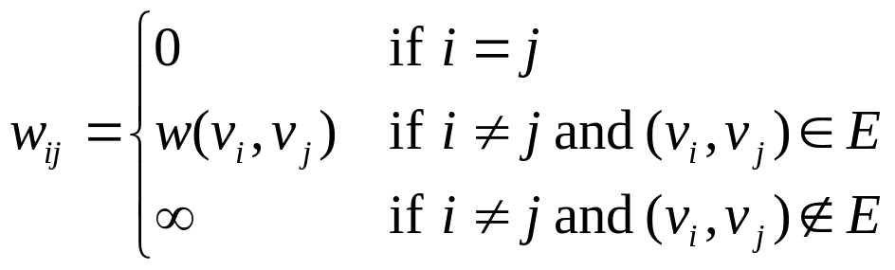

All pairs shortest path problem
Given a digraph G=(V,E) and a weight function w:E→R, let us define w_{ij} as follows:
We can represent G using the adjacency matrix

Slide 61
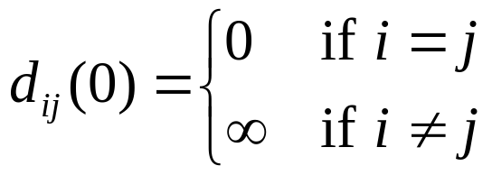
All pairs shortest path problem
Let d_{ij}(m) be the weight of a shortest path from v_{i} to v_{j} that contains at most m edges.
Note that for m=0, we have:
For m ≥ 1, d_{ij}(m) can be computed based on d_{ij}(m-1) & W

Slide 62
Computing d_{ij}(m)
Note that
  d_{ij}(m) is the min weight path from v_{i} to v_{j} with at most m edges
  d_{ij}(m-1) is the min weight path from v_{i} to v_{j} with at most m-1 edges
  d_{ik}(m-1) is the min weight path from v_{i} to v_{k} with at most m-1 edges
In order to find a min weight path from v_{i} to v_{j}, for each node v_{k} such that we have an edge (v_{k},v_{j}), consider if it would be cheaper to arrive to v_{k} in m-1 and edges, and then follow this edge to v_{j}.
Min weight path from v_{i} to v_{k} with at most m-1 edges: d_{ik}(m-1)

Slide 63
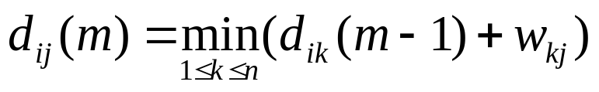
Computing d_{ij}(m)
So, for each v_{k} such that (v_{k},v_{j}) ∈ E, compute
d_{ik}(m-1)+w_{kj}, and take the minimum of these.
On the other hand, if (v_{k},v_{j}) ∉ E then w_{kj} = ∞.
Hence we can safely consider v_{k} to be any node, since when (v_{k},v_{j}) ∉ E, it will have no chance of winning the minimum competition.
Hence d_{ij}(m) can be computed as:

Slide 64
Finding δ(v_{i},v_{j}) based on d_{ij}(m)
Recall that a shortest path from v_{i} to v_{j} can have at most n-1 edges (where n=|V|).
Therefore, δ(v_{i},v_{j}) = d_{ij}(n-1).
Let D(m) be the matrix [d_{ij}(m)]_{nxn}
In order to find the weight of the shortest paths between all pairs of nodes, we actually want to calculate D(n-1) = [d_{ij}(n-1)]_{nxn}
Note that, D(1)=W= [w_{ij}]_{nxn}
The following algorithm can be used to compute D(m) from
D(m-1) and W.

Slide 65
Finding shortest paths between all pairs of nodes
ExtendShortestPath (D(m-1)_{nxn}, W_{nxn}) { // computes D(m) from D(m-1)
for (i=1; i ≤ n; i++) // for all source nodes
for (j=1; j ≤ n; j++) { // for all destination nodes
d_{ij}(m) = ∞; // initially assume shortest path has infinite weight
for (k=1; k ≤ n; k++) // for all the nodes
d_{ij}(m) = min {d_{ij}(m), d_{ik}(m-1)+w_{kj} };// what happens if v_{k} is used
}
return D(m); // return weights of the shortest paths w/ max m edges
}
AllPairsShortestPath (W_{nxn}) {
D(1) = W; // weights of the shortest paths with max 1 edge
for (m=2; m < n; m++) // iterates n-2 times
D(m) = ExtendShortestPath (D(m-1), W); // extends the length of
return D(n-1); // the shortest paths
}

Slide 66
Running time of AllPairsShortestPath
Triple nested loop in ExtendShortestPath
Another loop in AllPairsShortestPath
Hence the running time is : O(V⁴)

Slide 67
A faster implementation of AllPairsShortestPath
ExtendShortestPath (D(m-1)_{nxn}, W_{nxn}) { // computes D(m) from D(m-1)
for (i=1; i ≤ n; i++) // for all source nodes
for (j=1; j ≤ n; j++) { // for all destination nodes
d_{ij}(m) = ∞; // initially assume shortest path has infinite weight
for (k=1; k ≤ n; k++) // for all the nodes
d_{ij}(m) = min {d_{ij}(m), d_{ik}(m-1)+w_{kj} };// what happens if v_{k} is used
}
return D(m); // return weights of the shortest paths w/ max m edges
}
Note that, the usage of W (1 step shortest path information) as the second argument of ExtendShortestPath causes to extend the knowledge of shortest path in m-1 steps to m steps.
What would happen if we pass as W, a matrix that has 2 step shortest paths information?

Slide 68
A faster implementation of AllPairsShortestPath
ExtendShortestPath (D(m-1)_{nxn}, W_{nxn}) { // computes D(m) from D(m-1)
for (i=1; i ≤ n; i++) // for all source nodes
for (j=1; j ≤ n; j++) { // for all destination nodes
d_{ij}(m) = ∞; // initially assume shortest path has infinite weight
for (k=1; k ≤ n; k++) // for all the nodes
d_{ij}(m) = min {d_{ij}(m), d_{ik}(m-1)+w_{kj} };// what happens if v_{k} is used
}
return D(m); // return weights of the shortest paths w/ max m edges
}
In that case, we would get D(m+1) from D(m-1) directly.
What would happen if we pass as matrix W, a matrix that has k step shortest paths information?
In that case, we would get D(m-1+k) from D(m-1) directly.

Slide 69
A faster implementation of AllPairsShortestPath
Suppose we use ExtendShortestPath as follows:
After the 1st iteration we will get D(2) (using D(1) and D(1))
After the 2nd iteration we will get D(4) (using D(2) and D(2))
After the 3rd iteration we will get D(8) (using D(4) and D(4))
…
After the ⌈lg(n-1)⌉^{th} iteration, we will get D(2 ^{⌈lg(n-1)⌉})=D(n-1), since 2^{⌈lg(n-1)⌉} ≥n-1
Since ExtendShortestPath uses O(V³) time, the total time for FasterAllPairsShortestPath is O(V³lgV).
FasterAllPairsShortestPath (W_{nxn}) {
D(1) = W; // weights of the shortest paths w/ max 1 edge
for (m=2; m < n; m = 2 * m) // iterates ⌈lg(n-1)⌉ times
D(m) = ExtendShortestPath (D(m/2), D(m/2)); // extends the length
return D(n-1); // of the shortest paths
}

Slide 70
A faster implementation of AllPairsShortestPath
The running time for FasterAllPairsShortestPath is O(V³lgV).
Compare it to:
  Using Bellman-Ford for each node separately: O(V²E)
  Using Dijkstra for each node separately: O(V²lgV+VE)

Slide 71
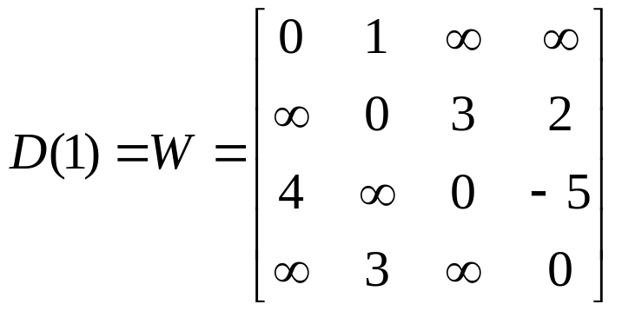
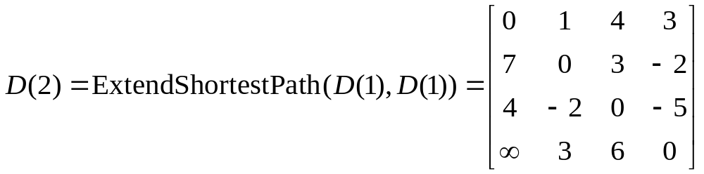
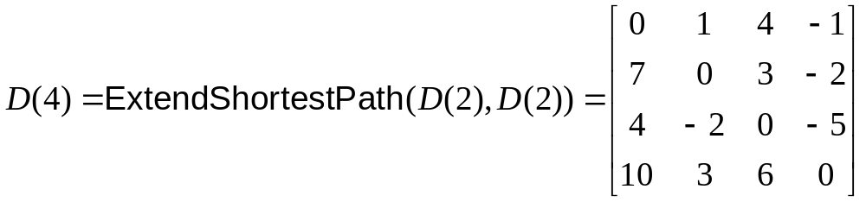
Example
v₁
1
v₂
4
3
2
3
v₃
v₄
-5

Slide 72
Floyd-Warshall algorithm for all pairs shortest path problem
We have seen an algorithm for all pairs shortest path problem.
The key definition was the following:
  d_{ij}(m): the shortest path from vertex i to vertex j among the paths that has at most m edges.
Why it was a good definition?
  Because, it formalizes the solution.
  [ We want to find d_{ij}(n-1) since any shortest path can have at most n-1 edges.]
  Because, d_{ij}(k) was known for some k
  [ In fact we knew d_{ij}(0) and d_{ij}(1)]
  Because, it was easy to calculate d_{ij}(m) based on d_{ij}(m-1)
  [ Hence, we can reach to d_{ij}(n-1) by starting from d_{ij}(0) or d_{ij}(1)]

Slide 73
Floyd-Warshall algorithm for all pairs shortest path problem
We will now see an algorithm for all pairs shortest path problem, which is based on a similar definition.
Let us call the nodes visited along a path (excluding the start and the end nodes) as intermediate nodes.
p_{ij}(m): the shortest path from node i to node j among the paths that has intermediate nodes with indices at most m.
v₁
v₂
v₃
V_{k-1}
v_{k}
start node
intermediate nodes
end node

Slide 74
Floyd-Warshall algorithm for all pairs shortest path problem
In p_{ij}(m), we do not consider the top path, since it passes through a node with index k which is greater than m.
all vertices
are in {1,…,m-1}
v_{k>m}
all vertices
are in {1,…,m-1}
v_{i}
v_{j}
all vertices
are in {1,…,m-1}
all vertices
are in {1,…,m-1}
v_{m}
all vertices
are in {1,…,m-1}

Slide 75
Floyd-Warshall algorithm for all pairs shortest path problem
Is p_{ij}(m) a good definition?
What is the actual p_{ij}(.) value that we want to calculate?
Note that, we want to compute p_{ij}(n), since in that case the definition reduces to:
  p_{ij}(n): the shortest path from node i to node j among the paths that has intermediate nodes with indices at most n (hence all the nodes are allowed in these paths).
Do we know p_{ij}(k) for some k? I.e. can we start the computation of p_{ij}(.) values?
Yes, we know p_{ij}(0). Note that, p_{ij}(0) is the shortest path from node i to node j among the paths that has intermediate nodes with indices at most 0 (hence no intermediate node, hence single edge paths).

Slide 76
Floyd-Warshall algorithm for all pairs shortest path problem
Hence, p_{ij}(0)=w(i,j) if (v_{i},v_{j}) ∈ E, and p_{ij}(0)= ∞ otherwise.
And finally, can we compute p_{ij}(k) based on some other p_{ij}(m) such that k > m.
Note that if we know p_{ij}(m-1) for all i,j in {1,2,…,n} then we can calculate p_{ij}(m) as:
all vertices
are in {1,…,m-1}
v_{m}
all vertices
are in {1,…,m-1}
v_{i}
v_{j}
all vertices
are in {1,…,m-1}

Slide 77
Floyd-Warshall algorithm for all pairs shortest path problem
The running time is O(V³)
Floyd-Warshall (W) { // W: adjacency matrix using weights
for (i=1; i ≤ |V|; i++) // iterates |V| times
for (j = 1; j ≤ |V|; j++) // iterates |V| times
p_{ij}(0) = (v_{i},v_{j}) ∈ E ? w(i,j) : ∞; // initial p_{ij} values based on the edges
for (m=1; m ≤ |V|; m++) // iterates |V| times
for (i=1; i ≤ |V|; i++) // iterates |V| times
for (j = 1; j ≤ |V|; j++) // iterates |V| times
p_{ij}(m) = min { p_{ij}(m-1), p_{im}(m-1)+p_{mj}(m-1) }; // next p_{ij} values
}

Slide 78
Transitive closure of a digraph
Now we will see an application of the all pairs shortest path problem.
Given a digraph G=(V,E), the transitive closure of G is another digraph G*=(V,E*) such that (u,v) in E* iff either
  u=v; or
  there exists a path from u to v in G
Problem: Given a digraph G=(V,E), find the transitive closure G* of G.
Note that, the graph is not weighted.
We can solve this problem by applying Floyd-Warshall algorithm.

Slide 79
Transitive closure of a digraph
TransitiveClosure (G=(V,E)) { // G is a digraph (no weight)
for (i=1; i ≤ |V|; i++) // iterates |V| times
for (j = 1; j ≤ |V|; j++) // iterates |V| times
if ((i==j) || ((v_{i},v_{j}) is in E))
t_{ij}(0)=1; // assign 1 as weight
else
t_{ij}(0)=∞; // ∞ weight
for (m=1; m ≤ |V|; m++) // iterates |V| times
for (i=1; i ≤ |V|; i++) // iterates |V| times
for (j = 1; j ≤ |V|; j++) // iterates |V| times
t_{ij}(m) = min { t_{ij}(m-1), t_{im}(m-1)+t_{mj}(m-1) };
}
When the algorithm terminates, if t_{ij}(|V|) is finite, then (v_{i},v_{j}) is in E*.

Slide 80
Transitive closure of a digraph
EasierTransitiveClosure (G=(V,E)) { // G is a digraph (no weight)
for (i=1; i ≤ |V|; i++) // iterates |V| times
for (j = 1; j ≤ |V|; j++) // iterates |V| times
if ((i==j) || ((v_{i},v_{j}) is in E))
t_{ij}(0)= true; // (v_{i},v_{j}) is in E*
else
t_{ij}(0)=false; // instead of t_{ij}(0)=∞
for (m=1; m ≤ |V|; m++) // iterates |V| times
for (i=1; i ≤ |V|; i++) // iterates |V| times
for (j = 1; j ≤ |V|; j++) // iterates |V| times
// instead of t_{ij}(m) = min { t_{ij}(m-1), t_{im}(m-1)+t_{mj}(m-1) };
t_{ij}(m) = t_{ij}(m-1) || ( t_{im}(m-1) && t_{mj}(m-1) );
}
When the algorithm terminates, if t_{ij}(|V|)=true (instead of finite), then (v_{i},v_{j}) is in E*.

