Slide 1
CS301 - Algorithms
Week #10
Husnu Yenigun

Slide 2
MAXIMUM FLOW IN FLOW NETWORKS

Slide 3
Maximum flow problem explained intuitively
v₁
12 lt/sec
v₂
20 lt/sec
16 lt/sec
s
10 lt/sec
4 lt/sec
t
9 lt/sec
7 lt/sec
13 lt/sec
v₃
v₄
14 lt/sec
4 lt/sec
We have a source node (s) at which we have infinite amount of water supply.
We have a target node (t) at which which we can store an infinite amount of water.
We have a set of connection points (v_{i}’s) which are connected to each other with
water pipes.
Each pipe has a certain capacity, and we cannot push more water than the capacity.
No water is generated/lost/stored at connection points.
Question: What is the maximum amount of water that we can push from s?

Slide 4
Definition of a flow network
A flow network is a tuple G=(V,E,s,t,c) where
  V [the set of nodes]
  E subset of V×V [the set of directed edges]
  s in V [a distinguished source node]
  t in V [a distinguished target vertex different from s]
  c: V×V→R₀⁺ [a nonnegative capacity function (!!!not on E!!!)]
With the following constraints:
  If (u,v) is in E, then c(u,v) > 0
  If (u,v) is not in E, then c(u,v) = 0
  For all v in V, there exists a path from s to v, and there exists a path from v to t.
Note that, s can have incoming edges and t may have outgoing edges.

Slide 5


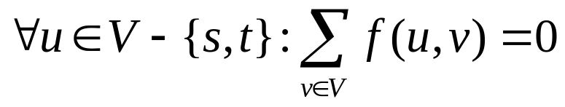
Definition of a flow on a flow network
Let G=(V,E,s,t,c) be a flow network. A flow on G is a real valued function f : V×V→R with the following properties (note that f is defined on V×V, not on E and the range is R not R⁺):
  Capacity constraint (the flow from node u to node v cannot be larger than the capacity of the edge from node u to node v):
  Symmetry constraint (when there is flow of x amount from node u to node v, we can consider it as a flow of –x amount from node v to node u)
  Flow conservation (except for s and t, incoming flow of a node should be equal to the outgoing flow of the node)

Slide 6
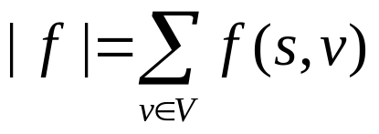
Definition of maximum flow problem
f(u,v) is called the net flow from u to v
(can be positive or negative)
The value of a flow f: V×V→R is defined as
i.e. total net flow leaving the source node.
Maximum flow problem: Given a flow network G=(V,E,s,t,c), find a flow f*: V×V→R, such that |f*| is maximized.

Slide 7
Some properties of flows
f(u,u) = 0.
By symmetry condition: f(u,u) = -f(u,u). Hence f(u,u)=0.
If (u,v) and (v,u) are not in E, then f(u,v)=f(v,u)=0.
c(u,v) = 0 c(v,u)=0
f(u,v) ≤ c(u,v) = 0 f(v,u) ≤ c(v,u) = 0
f(u,v)=-f(v,u)
f(u,v)=f(v,u)=0
by definition
by definition
by capacity constraint
by capacity constraint
by definition

Slide 8
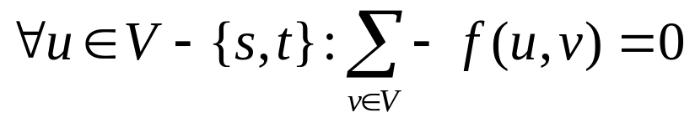
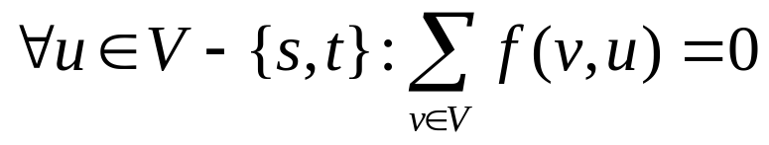
Some properties of flows
Note that the flow conservation property:
actually tells that, the total outgoing net flow of a node sums up to 0.
We can view it, as the total incoming net flow of a node sums up to 0:
multiply both
sides by -1
symmetry
constraint

Slide 9
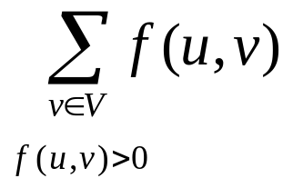
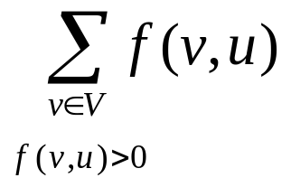
Some properties of flows
Another way of looking at the flow conservation property:
The total positive outgoing flow of u must be equal to the total positive incoming flow of u.
We will use the notation
to give an edge with capacity b, and a flow of a.
total positive outgoing flow of u
total positive incoming flow of u
u
a / b
v

Slide 10
Example of a flow on a flow network
v₁
12/12
v₂
15/20
Note that, some edges are using their maximum capacity.
However, we may still push more from s (s, v₃, v₄, t).
Therefore, this is not a maximum flow.
11/16
1/4
s
0/9
3/7
t
7/13
v₃
v₄
6/14
3/4

Slide 11
Maximum flow may not be unique
Note that, the flow networks on the left and on the right are the same.
However, we have different flows.
Both of these flows are maximum flows, since we cannot push more from s to t.
Therefore, maximum flow may not be unique.
However, the value of the maximum flow is unique.
v₁
v₁
5/9
5/7
4/9
4/7
s
v₃
10/10
t
s
v₃
10/10
t
5/8
v₂
5/6
6/8
v₂
6/6

Slide 12
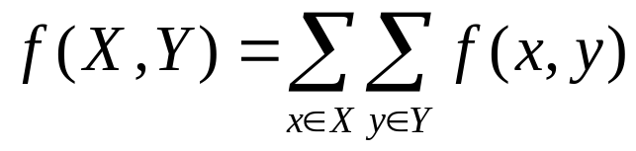
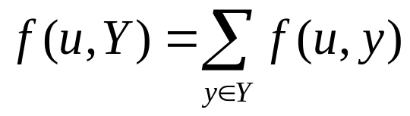
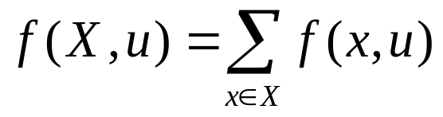
Implicit summation notation
Suppose X,Y subsets of V, and u is a node in V.
We will use the following notations:

Slide 13

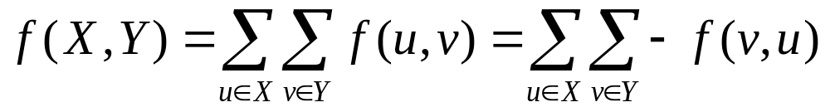
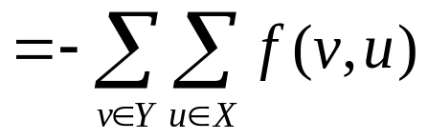


Some more properties of flows

Slide 14


Some more properties of flows

Slide 15
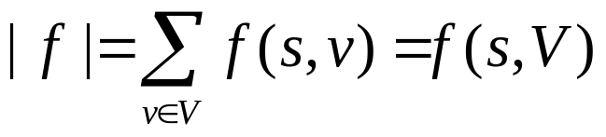





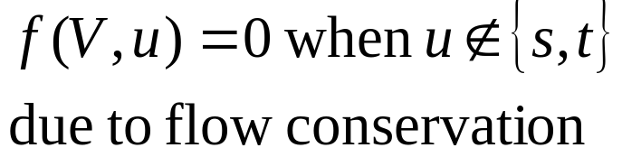

Some more properties of flows
The value of a flow was defined as the net flow leaving the source node.
The value of a flow is also equal to the net incoming flow to the target node.

Slide 16
An easy flow assignment
Note that f(u,v)=0 is a legitimate flow assignment.
If f(u,v)=0, then
  capacity constraint
  symmetry constraint
  flow conservation constraint
are all satisfied.
However f(u,v)=0 is usually not a maximum flow.
Ford-Fulkerson method:
  Start with the flow f(u,v)=0
  Iteratively improve the flow (push more and more) until we reach to the maximum flow.

Slide 17


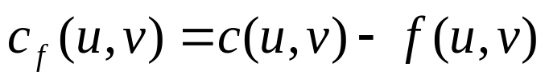
How much more we can push along an edge
Suppose we have:
We can push c(u,v)-k more flow from u to v
[ c(u,v)-f(u,v) ]
We can push k+c(v,u) = c(v,u)-(-k) more from v to u
[ c(v,u)-f(v,u) ]
The residual capacity from a node u to a node v:
k/c(u,v)
u
v
???/c(v,u)

Slide 18
Residual network
Given a flow network G=(V,E,s,t,c) and a flow f:V×V→R on G, the residual network of G and f is another flow network given as G_{f}=(V,E_{f},s,t,c_{f}), where
  c_{f}(u,v) = c(u,v) – f(u,v)
  E_{f} = { (u,v) ∈ V×V | c_{f}(u,v) > 0 }
Note that even if (u,v) is not in E, we may have (u,v) in E_{f}.
Note that even if (u,v) is in E, we may have (u,v) not in E_{f}.
v₁
v₁
2
2
8
2/9
2/7
7
5
s
v₃
t
s
v₃
t
6/8
6/6
8/9
2
1
v₂
6
v₂
6
G and f
G_{f}

Slide 19
How do we use the residual network?
Lemma A: Let G be a flow network and f be a flow in G. Let G_{f} be the residual network obtained from G and f, and f’ be a flow in G_{f}. Then
  (a) (f+f’) [ defined as (f+f’)(u,v) = f(u,v)+f’(u,v) ] is a flow in G.
  (b) |(f+f’)| = |f| + |f’|.
Proof of Lemma A-(a): In order to show that (f+f’) is flow in G, we need to show that (f+f’) satisfies:
  (i) The capacity constraint
  (ii) The symmetry constraint
  (iii) The flow conservation constraint

Slide 20
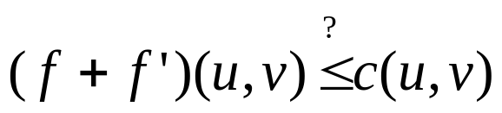

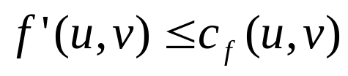
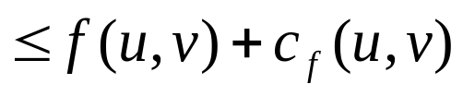


Proof of Lemma A-(a)-i
Does (f+f’) satisfy the capacity constraint?
f’ is a flow in G_{f}: Hence it
must satisfy the capacity
constraint in G_{f}

Slide 21
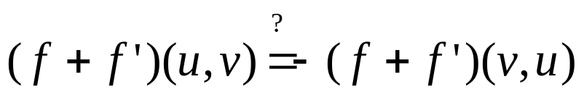





Proof of Lemma A-(a)-ii
Does (f+f’) satisfy the symmetry constraint?
f & f’ are flows in G & G_{f}:
Hence they must individually
satisfy the
symmetry constraint

Slide 22

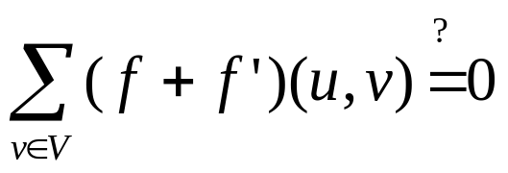
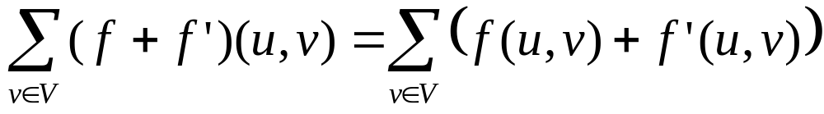
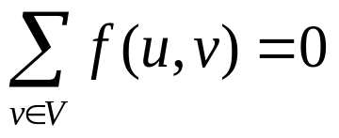
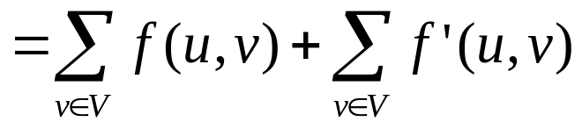
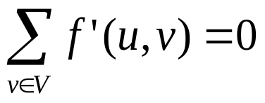

Proof of Lemma A-(a)-iii
Does (f+f’) satisfy the flow conservation constraint?
f & f’ are flows in G & G_{f}:
Hence they must
individually satisfy
the flow conservation
constraint

Slide 23
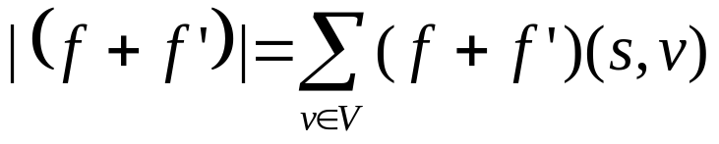
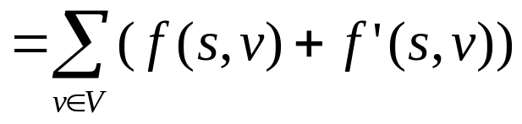
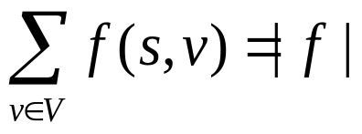
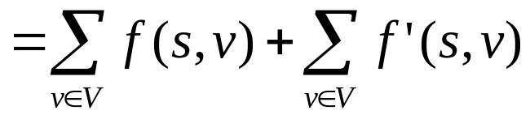
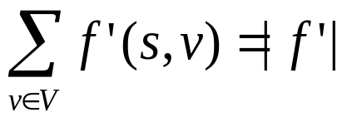

Proof of Lemma A-(b)
|(f+f’)| = |f| + |f’|

Slide 24



Application of Lemma A
v₁
v₁
2
2
5
2/9
2/7
7
5
s
v₃
t
s
v₃
t
3/8
3/6
5/8
5
3
3
v₂
3
v₂
3
G and f
G_{f}
v₁
v₁
0/2
0/2
0/5
1/7
1/5
3/9
3/7
s
v₃
t
s
v₃
t
2/5
2/3
3/3
5/8
5/6
8/8
0/3
v₂
0/3
v₂
G_{f} and f’
G and f+f’

Slide 25
Incremental flows
Note that, based on Lemma A, the basic idea of our algorithm to find a maximum flow is becoming clear.
We will start from the empty flow [for all u, v: f(u,v)=0].
Then for each flow f we find in G, we will form the residual network G_{f}.
We will then find a flow f’ in G_{f}.
Then we are guaranteed that (f+f’) is a better flow in G.
We will repeat this iteration until we can no longer improve f in G.
We need to find out how to easily form a flow in G_{f}.

Slide 26
Augmenting path and residual capacity of a path
Definition: Let us call a simple path (a path without a cycle) from s to t as an augmenting path.
Definition: Given an augmenting path p=<s,v₁,v₂,…,v_{k},t>, the residual capacity c_{f}(p) of the path p is the capacity of a minimum capacity edge along p.
[ For example, for the augmenting path p=<s,v₂,v₃,t>, c_{f}(p)=3. ]
v₁
2
2
5
7
5
s
v₃
t
5
3
3
3
v₂
3

Slide 27
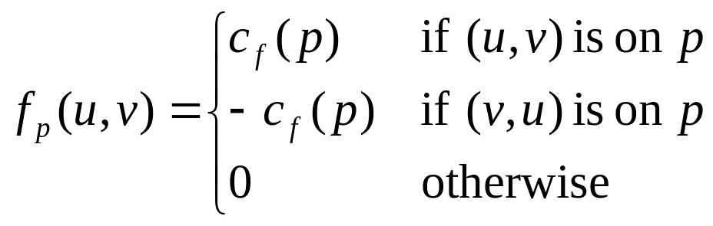
How to easily find a flow in residual networks…
Lemma B: Let G be a flow network, f be a flow in G, G_{f} be the residual network of G and f, and p be an augmenting path in G_{f}. Let f_{p}:V×V→R be defined as:
Then f_{p} is a flow in G_{f} and |f_{p}|=c_{f}(p) > 0.

Slide 28
How to easily find a flow in residual networks…
Proof of Lemma B:
  Symmetry holds by definition:
  f_{p}(u,v)=0 f_{p}(u,v)=c_{f}(p) f_{p}(u,v)= - c_{f}(p)
  f_{p}(v,u)=0 f_{p}(v,u)= - c_{f}(p) f_{p}(v,u)= c_{f}(p)
  Capacity constraint holds because we use the minimum capacity edge along the path.
  Flow conservation: For all the nodes u ∈ V-{s,t}, if u is on the path p, there is a single incoming edge and a single outgoing edge with flow c_{f}(p). The flows on all the other edges are 0.
v
u
s
t

Slide 29
How to easily find a flow in residual networks…
Proof of Lemma B:
  Symmetry holds by definition:
  f_{p}(u,v)=0 f_{p}(u,v)=c_{f}(p) f_{p}(u,v)= - c_{f}(p)
  f_{p}(v,u)=0 f_{p}(v,u)= - c_{f}(p) f_{p}(v,u)= c_{f}(p)
  Capacity constraint holds because we use the minimum capacity edge along the path.
  Flow conservation: For all the nodes u ∈ V-{s,t}, if u is on the path p, there is a single incoming edge and a single outgoing edge with flow c_{f}(p). The flows on all the other edges are 0.
v
s
t
u

Slide 30
How to easily find a flow in residual networks…
Proof of Lemma B:
  Symmetry holds by definition:
  f_{p}(u,v)=0 f_{p}(u,v)=c_{f}(p) f_{p}(u,v)= - c_{f}(p)
  f_{p}(v,u)=0 f_{p}(v,u)= - c_{f}(p) f_{p}(v,u)= c_{f}(p)
  Capacity constraint holds because we use the minimum capacity edge along the path.
  Flow conservation: For all the nodes u ∈ V-{s,t}, if u is on the path p, there is a single incoming edge and a single outgoing edge with flow c_{f}(p). The flows on all the other edges are 0.
v
s
t
u

Slide 31
How to easily find a flow in residual networks…
Proof of Lemma B:
  Symmetry holds by definition:
  f_{p}(u,v)=0 f_{p}(u,v)=c_{f}(p) f_{p}(u,v)= - c_{f}(p)
  f_{p}(v,u)=0 f_{p}(v,u)= - c_{f}(p) f_{p}(v,u)= c_{f}(p)
  Capacity constraint holds because we use the minimum capacity edge along the path.
  Flow conservation: For all the nodes u ∈ V-{s,t}, if u is on the path p, there is a single incoming edge and a single outgoing edge with flow c_{f}(p). The flows on all the other edges are 0.
s
u
v
t

Slide 32
How to easily find a flow in residual networks…
Proof of Lemma B:
  Symmetry holds by definition:
  f_{p}(u,v)=0 f_{p}(u,v)=c_{f}(p) f_{p}(u,v)= - c_{f}(p)
  f_{p}(v,u)=0 f_{p}(v,u)= - c_{f}(p) f_{p}(v,u)= c_{f}(p)
  Capacity constraint holds because we use the minimum capacity edge along the path.
  Flow conservation: For all the nodes u ∈ V-{s,t}, if u is on the path p, there is a single incoming edge and a single outgoing edge with flow c_{f}(p). The flows on all the other edges are 0.
s
v
u
t

Slide 33
How to easily find a flow in residual networks…
Proof of Lemma B:
  |f_{p}| = c_{f}(p) > 0
  The total net flow leaving s is c_{f}(p).
  Since c_{f}(p) is the capacity of an edge (see its definition), it must be a positive number.
0/…
0/…
s
u
t
c_{f}(p)/…
0/…
0/…

Slide 34
How to increment a flow in a network…
Lemma C: Let G be a flow network, f be a flow in G, G_{f} be the residual network of G and f, p be an augmenting path in G_{f}, and f_{p} be a flow as defined in Lemma B. Then (f+f_{p})is a flow in G, and |(f+f_{p}) | > |f|
Proof of Lemma C:
  (i) By Lemma B: f_{p} is a flow in G_{f} & |f_{p}| > 0
  (ii) By Lemma A: (f+f_{p}) is a flow in G & |(f+f_{p})| = |f|+|f_{p}|
  (iii) By (i) and (ii), |(f+f_{p})| = |f|+|f_{p}| > |f|
So, if we know a flow f in G, this is how we can find another flow f’ in G such that |f’| > |f|.

Slide 35
When to stop incrementing…
If we keep finding augmenting paths, and keep incrementing the value of flows in G, it seems that we will never be able to stop.
In fact, we will stop at some point. We will stop when we cannot find an augmenting path in the residual network.
So, if we stop at such a flow f (a flow such that G_{f} has no augmenting path), then how do we know that the flow f is a maximum flow for G?
OK, let’s prove it.

Slide 36
When to stop incrementing…
Theorem D: Given a flow network G and a flow f in G, f is a maximum flow in G if and only if G_{f} has no augmenting path.
Proof of Theorem D:
  (=>) If f is a maximum flow in G, then G_{f} has no augmenting path.
    Assume f is a maximum flow, and assume G_{f} has an augmenting path p.
    Then, we can define f_{p} in G_{f}.
    By Lemma C, (f+f_{p}) is a flow in G, and |(f+f_{p})| > |f|
    (a contradiction since f is a maximum flow in G).
  (<=) If G_{f} has no augmenting path, then f is a maximum flow in G.
    On the next page…

Slide 37
When to stop incrementing…
Theorem D: Given a flow network G and a flow f in G, f is a maximum flow in G if and only if G_{f} has no augmenting path.
Proof of Theorem D:
  (<=) If G_{f} has no augmenting path, then f is a maximum flow in G.
    Assume G_{f} has no augmenting path, and assume that f is not a maximum flow in G.
    Since f is not a maximum flow, it means we can push more flow from s to t, by passing the flow over a sequence of nodes and edges in G.
    When we consider this sequence of edges along this path from s to t, the capacities of these edges are not fully used.
    Hence in G_{f}, these edges will form an augmenting path
    (a contradiction with our initial assumption that G_{f} did not have an augmenting path).

Slide 38
Finally, the algorithm
Ford-Fulkerson (G) { // G=(V,E,s.t,c) : a flow network
∀(u,v) in E {
f(u,v) = f(v,u) = 0; // start with 0 flow
}
while (there exists an augmenting path p in G_{f}) {
// try to find an augmenting path
c_{f}(p) = min { c_{f}(u,v) : (u,v) in p }; // find minimum capacity edge on p
∀(u,v) along p { // we only need to update the flows on these edges
f(u,v) = f(u,v) + c_{f}(p); // add f_{p} to f
f(v,u) = - f(u,v); // guarantee symmetry
}
}
}

Slide 39
Analysis of Ford-Fulkerson
We know that in each iteration, the value of the flow will increase.
However, do we guarantee that the algorithm eventually terminates?
Actually no…
For irrational capacity values, we may keep incrementing the flow, but may not converge to a maximum flow value within a finite number of iterations (i.e. the algorithm may not terminate).
Let us consider a simple case, where we have integer capacities only.

Slide 40
Analysis of Ford-Fulkerson when capacities are integer
When we have only integer capacity values:
  We will start from f(u,v)=0.
  The first residual network will have integer capacity values.
  The first augmenting path will have an integer residual capacity.
  Hence the second flow in G will be integer valued.
  Then, the second residual network will again have integer capacities.
  …
  The second flow that we find in G will again be integer valued.
  …
  All the flows we find in G will be integer valued.
  Let |f*| be the value of maximum flow.
  |f*| will be an integer (and of course it is finite).

Slide 41
Analysis of Ford-Fulkerson when capacities are integer
When we have only integer capacity values:
  …
  Note that we start from |f|=0.
  In each iteration we increment |f| by an integer (assuming the worst case, in each iteration we increase |f| by 1)
  Hence, in the worst case, we will iterate |f*| times.
  Here is an example for this worst case:
v₁
10
10
s
1
t
10
v₂
10

Slide 42
Analysis of Ford-Fulkerson when capacities are integer
1st iteration
2nd iteration
Flow
Res. nw & aug. path
Flow
Res. nw & aug. path
v₁
v₁
v₁
1
v₁
0/10
0/10
10
10
1/10
0/10
9
10
s
0/1
t
s
1
t
s
1/1
t
s
1
t
v₂
10
v₂
10
v₂
10
v₂
9
0/10
0/10
0/10
1/10
1
3rd iteration
4th iteration
Flow
Res. nw & aug. path
Flow
Res. nw & aug. path
v₁
1
v₁
1
v₁
2
v₁
1
1/10
1/10
9
9
2/10
1/10
8
9
s
0/1
t
s
1
t
s
1/1
t
s
1
t
v₂
9
v₂
9
v₂
9
v₂
8
1/10
1/10
1
1
1/10
2/10
1
2

Slide 43
Recall the algorithm
Ford-Fulkerson (G) { // G=(V,E,s.t,c) : a flow network
∀(u,v) in E {
f(u,v) = f(v,u) = 0; // start with 0 flow
}
while (exists an augmenting path p in G_{f}) { // try to find …
c_{f}(p) = min { c_{f}(u,v) : (u,v) in p }; // find minimum …
∀(u,v) along p { // we only need to update …
f(u,v) = f(u,v) + c_{f}(p); // add f_{p} to f
f(v,u) = - f(u,v); // guarantee symmetry
}
}
}
O(E)
iterates
O(|f*|)
times
in each iteration:
- find augmenting
path
- pass over the
augmenting
path (twice)

Slide 44
Analysis of Ford-Fulkerson when capacities are integer
Finding an augmenting path
  It can be performed by a Depth First Search (DFS) in the network’s graph.
  DFS normally takes O(V+E) time.
  However, we have the restriction that for all v ∈ V, v can be reached from s, and t can be reached from v.
  Hence, every node has at least one edge.
  Therefore |E| > |V|.
  Therefore, DFS takes O(E) time.
The longest path can use all the edges, hence O(E) time needed to pass over an augmenting path.

Slide 45
Analysis of Ford-Fulkerson when capacities are integer
Therefore, when the capacities are integers, the overall time needed by Ford-Fulkerson is O(E |f*|).
Note that, it is the first time that we express the running time not as a function of the size of input only.
|f*| is not an input parameter, but instead an output parameter.
In such a case, we cannot say that the algorithm is polynomial (although the running time expression is a polynomial).
An algorithm is said to be polynomial, if the running time is polynomial in the size of the input parameters.

Slide 46
Analysis of Ford-Fulkerson when capacities are rational
When the capacities are rational, we can convert the problem into an equivalent integer capacity form.
Simply multiply the capacity of all the edges by a constant c that would make the capacities integers.
Then, solve the problem in O(E |f*|) time.
Then, divide flow by c.
Therefore, when we have rational capacities, the algorithm is guaranteed to terminate, it runs in O(E |f*|) time.

Slide 47
MAXIMUM BIPARTITE MATCHING

Slide 48
Problem explained intuitively
Suppose that you are a manager of a company.
There are 4 new projects that are about to start in your company, P = { p₁, p₂, p₃, p₄ }.
To each project, you need to assign a project manager.
There are 5 project managers M = { m₁, m₂, m₃, m₄, m₅ } that are available and can be assigned to these projects.
However, the project topics are quite diverse, and the background and experience of the project managers are also different.

Slide 49
Problem explained intuitively
Hence, you can not assign any manager to any project, there are some constraints (manager must already be familiar with the project topic).
The diagram below shows which managers can be assigned to which projects.
A manager can be assigned to at most one project, and a project can have at most one manager.
m₁
m₂
m₃
m₄
m₅
p₁
p₂
p₃
p₄

Slide 50
Problem explained intuitively
If you cannot find a manager for a project, then you will have to hire a new project manager to do the job.
How can you find the assignment of managers to these projects so that you will need minimum number of new project managers to hire?

Slide 51
Problem defined formally
Definition: Given an undirected graph G=(V,E), G is a bipartite graph if there exists a cut (P:M)
[hence V = P U M ] such that all the edges in E crosses this cut.
Definition: In an undirected graph G=(V,E), and edge e is incident on a vertex v in V, if either e=(u,v) or e=(v,u) for some u in V.
The blue edge is incident
on the blue nodes

Slide 52
Problem defined formally
Definition: A matching in an undirected graph G=(V,E) is a subset of the edges E’’ such that for all the nodes v in V, there exists at most one edge e in E’’ such that e is incident on v.
No two edges in E’’ will be incident on the same node.
Not a matching
A matching

Slide 53
Problem defined formally
Problem: Given an undirected bipartite graph G=(V,E), find a maximum matching in G (maximum bipartite matching)
Note the similarity to the manager-project problem.
  The graph is bipartite (Projects:Managers),
  Every edge crosses this cut (no edges between managers, or between projects)
  We want to find maximum project-manager matching

Slide 54
Conversion into a flow problem
We can convert the maximum bipartite matching problem into a max-flow problem.
Given an undirected bipartite graph G=(M U P, E), let G’=(V’,E’,s,t,c) be the flow network defined as:
  V’ = M U P U { s, t } : s and t
  E’ = { (s,m) : m in M } U
  { (p,t) : p in P } U
  { (m,p) : m in M, p in P, (m,p) in E }
  c(u,v) = 1 for all (u,v) in E’
M
P
1
1
1
1
1
1
1
s
1
1
t
1
1
1
1
1
1
1

Slide 55
Conversion into a flow problem
We will now show that the solution of max-flow problem on this flow network will give us the solution of maximum bipartite matching problem.

Slide 56
Showing the equivalence of the problems
Definition: Let G’=(V’,E’,s,t,c) be a flow network. A flow f on G’ is said to be an integer valued flow if for all edges in E’, f(u,v) is an integer.
Normally, we may have non-integer valued flows in a flow network even when the capacities are integers:
However for our current purposes, such flows are meaningless, and we will try to avoid them.
0.3/1
0.3/1
1/1
s
t
0.7/1
0.7/1

Slide 57
Showing the equivalence of the problems
Lemma A: Let G=(V,E) be a bipartite graph and G’=(V’,E’,s,t,c) be the corresponding flow network.
  If E’’ is a matching in G, then there is an integer valued flow f in G’ such that |f| = |E’’|.
  If f is an integer valued flow in G’, then there exists a matching E’’ in G with cardinality |E’’| = |f|.
If we can prove this lemma, then the following corollary will show the equivalence of the problems.
Corollary B: The cardinality of a maximum matching in a bipartite graph G is the value of a maximum flow in its corresponding flow network G’.

Slide 58
Proof of Lemma A (part a)
Let E’’ be a matching in G, let us define f as follows:
  If (m,p) is in E’’: f(s,m) = f(m,p) = f(p,t) = 1
  f(m,s) = f(p,m) = f(t,p) = -1
  If (m,p) is not in E’’:
  f(s,m) = f(m,p) = f(p,t) = f(m,s) = f(p,m) = f(t,p) = 0
s
t
Colored edges have
flow 1, black edges
have flow 0
Red edges
are in E’’

Slide 59
Proof of Lemma A (part a)
Is f a flow?
  Symmetric?: yes, symmetrically assigned as given above
  Capacity constraints?: yes, maximum flow on an edge is 1, and the capacities of all the edges are defined as 1.
  Flow conservation?: let’s check…

Slide 60
Proof of Lemma A (part a)
For flow conservation, we need to check internal nodes only (for s and t, flow need not be conserved).
For M nodes, we have a single incoming edge from s with capacity 1, and several outgoing edges (to some of the nodes in P) each with capacity 1.
Note that, either f₀ = 0 or f₀ = 1.
- If f₀=0, then none of (m,p_{i}) was in E’’.
Hence, f_{i}=0. Flow is conserved…
- If f₀=1, then there exists p_{i} such that (m,p_{i}) is in E’’.
But, then for no other p_{j} we have (m,p_{j}) in E’’ (since
otherwise both (m,p_{i}) and (m,p_{j}) would be incident
on m in G). Therefore the flow 1 coming in from s,
leaves m by following (m,p_{i}), and all the other flows
on (m,p_{j}) are 0, hence flow is conserved…
f₁/1
p₁
f₀/1
m
f₂/1
s
p₂
f_{k}/1
p_{k}

Slide 61
Proof of Lemma A (part a)
For P nodes, we have a single outgoing edge to t with capacity 1, and several incoming edges (from some of the nodes in M) each with capacity 1.
Since the flow is conserved, f is a flow in G’.
Note that, either f₀ = 0 or f₀ = 1.
- If f₀=0, then none of (m_{i},p) was in E’’.
Hence, f_{i}=0. Flow is conserved…
- If f₀=1, then there exists m_{i} such that (m_{i},p) is in E’’.
But, then for no other m_{j} we have (m_{j},p) in E’’ (since
otherwise both (m_{i},p) and (m_{j},p) would be incident
on m in G). Therefore the flow 1 going out to t,
comes into p by following (m_{i},p), and all the other flows
on (m_{j},p) are 0, hence flow is conserved…
m₁
f₁/1
p
f₂/1
f₀/1
m₂
t
f_{k}/1
m_{k}

Slide 62
Proof of Lemma A (part a)
We need to also show that |f| = |E’’| for part a.
|f| = f(s, V’- {s}) // sum of all flows going out from s
= f(s, M U P U { t } ) // since V - {s} = M U P U { t }
= f(s,M) + f(s,P) + f(s,{t}) // since M,P,{t} are disjoint
= f(s,M) // since there’s no edge from s to P, from s to t
= |E’’| // since for each edge in E’’ we put an outgoing
// flow of 1 from s
This completes the proof of part a.

Slide 63
Proof of Lemma A (part b)
Let f be an integer valued flow in G’.
Since each edge in G’ has capacity 1, and f is integer valued, a flow on an edge is either 0 or 1.
Let us take E’’ as E’’ = { (m,p) : f(m,p) = 1 }
s
t
Red edges have
flow 1, black edges
have flow 0
Red edges
are in E’’

Slide 64
Proof of Lemma A (part b)
For each m in M, there is a single incoming edge from s, but there are multiple outgoing edges to the nodes in P, and the capacities of all these edges are 1.
Since f is integer valued, we have either f₀ = 0 or f₀ = 1.
- If f₀=0, then f₁, f₂, ..., f_{k} must all be 0 (flow conservation)
- If f₀=1, then since f is integer valued, there must exist
a unique p_{i} such that f_{i} = 1, and all other f_{j}’s must be 0.
- Since for each m, there exists at most one p_{i} with
f(m,p_{i}) = 1, no two edges in E’’ are incident on m.
f₁/1
p₁
f₀/1
m
f₂/1
s
p₂
f_{k}/1
p_{k}

Slide 65
Proof of Lemma A (part b)
For each p in P, there is a single outgoing edge to t, but there are multiple incoming edges from the nodes in M, and the capacities of all these edges are 1.
Hence E’’ is a matching in G.
m₁
f₁/1
Since f is integer valued, we have either f₀ = 0 or f₀ = 1.
- If f₀=0, then f₁, f₂, ..., f_{k} must all be 0 (flow conservation)
- If f₀=1, then since f is integer valued, there must exist
a unique m_{i} such that f_{i} = 1, and all other f_{j}’s must be 0.
- Since for each p, there exists at most one m_{i} with
f(m_{i},p) = 1, no two edges in E’’ is incident on p.
p
f₂/1
f₀/1
m₂
t
f_{k}/1
m_{k}

Slide 66
Proof of Lemma A (part b)
We also need to show that |E’’| = f.
|E’’| = f(M,P) // for each edge (m,p) in G’ with f(m,p)=1 // we add the edge (m,p) in E’’.
= f(M,V’ – (M U { s } U { t })) //since P=V’-(MU{s}U{t})
= f(M,V’) – f(M,M) – f(M,s) – f(M,t) // since M,{s},{t} // are disjoint
= - f(M,s) // f(M,V’)=0 : since f(X,V’) is always 0
// f(M,M)=0: since f(X,X) is always 0
// f(M,t)=0:since there’s no edge from M to t
= f(s,M) // since f(X,Y) = - f(Y,X)
= |f| // since it is the sum of all outgoing flows from s.

Slide 67
Reconsidering the results of Lemma A
Lemma A tells us that, given G=(V,E) we can produce a flow network G’.
For any matching E’’ in G, we can find a flow f in G’ such that |E’’|=|f|.
However, it does not tell us explicitly the relation between a maximum matching in G and a maximum flow in G’.
The following corollary gives this relation.
Corollary B: The cardinality of a maximum matching in a bipartite graph G is the value of a maximum flow in its corresponding flow network G’.

Slide 68
Proof of Corollary B:
Suppose that f is a maximum flow in G’, but the corresponding E’’ is not a maximum matching in G. Then there must exist a matching E’’’ such that |E’’’| > |E’’|.
Consider the flow f’ corresponding to E’’’ in G’. By Lemma A, |f’| = |E’’’| > |E’’| = |f|, and this contradicts with the fact that f is a maximum flow in G’.
Similarly, if E’’ is a maximum matching in G, but the corresponding flow f in G’ is not a maximum flow in G’, then there must exist a flow f’ with |f’| > |f|.
Considering the matching E’’’ induced by f’, by Lemma A, |E’’’|=|f’| > |f| = |E’’|, contradicting with the fact that E’’ is a maximum matching.

Slide 69
What does Corollary B tell us?
Given an undirected bipartite graph G=(V,E), in order to find a maximum matching in G:
  Form the corresponding flow network G’=(V’,E’,s,t,c)
  Solve max-flow problem in G’
  The value of the max-flow in G’ will give you the cardinality of the maximum matching in G.
  E’’ can be constructed from max-flow f as proposed by Lemma A.
However, we need to produce an integer valued flow in G’ in order to be able to Lemma A.

Slide 70
Producing integer valued flows
Note that G’ corresponding to a bipartite graph have integer capacities.
If we apply Ford-Fulkerson method, the flow will start from 0, and in each iteration the value of the flow will be incremented by the residual capacity of some edge.
The flows will all be integers.
Hence we can apply Ford-Fulkerson method to produce an integer valued flow in G’.
The running time: O(E’ |f*|) = O(E V)
since maximum matching cannot be greater than |V|.

Slide 71
Example
Consider our example at the beginning with managers and projects.
Bipartite graph
Corresponding flow network
s
m₁
m₂
m₃
m₄
m₅
m₁
m₂
m₃
m₄
m₅
p₁
p₂
p₃
p₄
p₁
p₂
p₃
p₄
t
All edge capacities are 1.

Slide 72
Example
The result of application of Ford-Fulkerson on the corresponding flow network, and the matching implied by this result.
Result of Ford-Fulkerson
Corresponding matching
In the bipartite graph.
s
m₁
m₂
m₃
m₄
m₅
m₁
m₂
m₃
m₄
m₅
p₁
p₂
p₃
p₄
p₁
p₂
p₃
p₄
Red edges are in E’’
t
Flow on a red edge is 1, Flow on a black edge is 0

