Slide 1
CS 408
Computer Networks
Text: Computer Networks with Internet Technology
by William Stallings
Chapter 1 - Data Networks and
The Internet

Slide 2
Announcements
The labs will start in the third week (on Oct. 2 and 3).
  The lab web site is at https://su-cs408.github.io/ and there is a link to this site from the course website. TA office hours are also there.
SUCourse is active
  but we will use it only for some homework/lab submissions and grade posting. Other details will be on the web site.
  Course website: http://people.sabanciuniv.edu/levi/cs408
  There is a link to the course website at SUCourse
E-mail list
  We will use SUCourse email list
  I will make announcements using email, so check your sabanciuniv.edu emails.
Midterm Exam is on Monday Nov. 18, 8:40 – 10:30 (week 10)
  Lecture hour, so no objections! Places will be announced later.

Slide 3
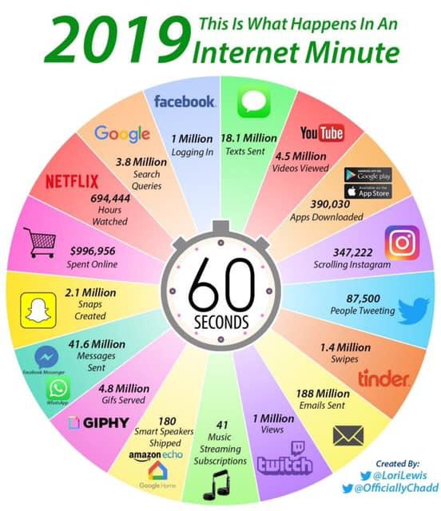
About Computer Networking
Basis of the Internet and Internet is (from regular user point of view):

Slide 4
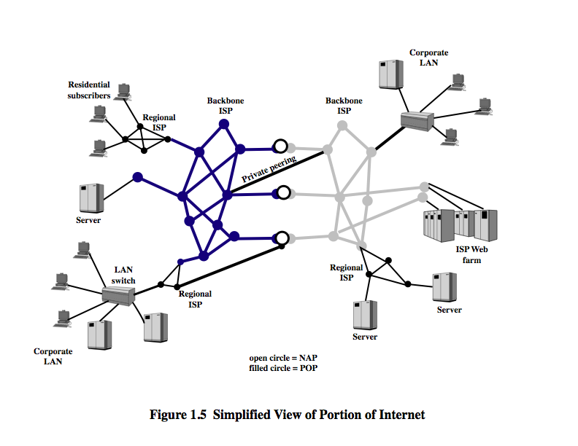
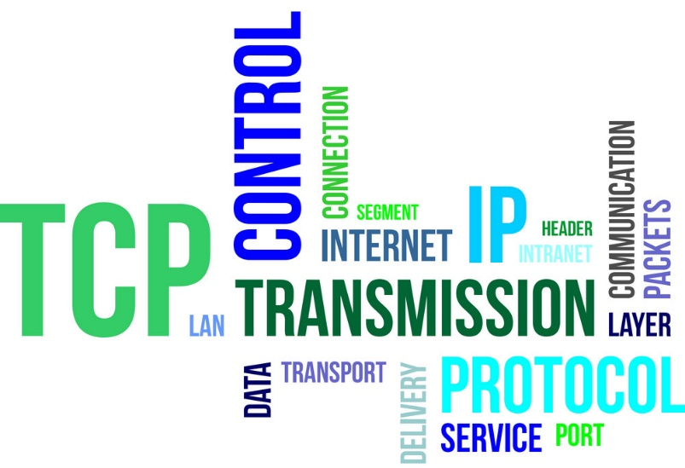
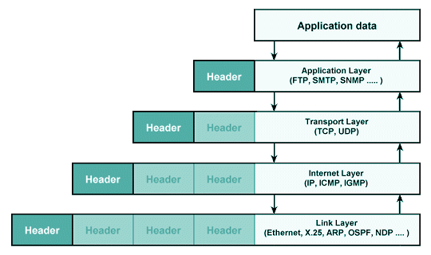
About Computer Networking
Basis of the Internet and Internet is (from engineering point of view):

Slide 5
About CS408
CS oriented computer networks course
  Application-focused
  TCP/IP protocol stack + Data Link Layer from OSI + LAN protocols and MAC layer
  Well, there is some math (mostly probability related)
  Some people say that this is a verbal ("sözel" in Turkish) course
    I agree that this is a conceptual course, but this is not history, literature or SPS type of verbalism.
    There are lots of definitions, concepts, acronyms, etc. However, all of them are technical
    And there are also math and algorithmic parts as well
  The main problem of people in this course is absenteeism and leaving the studying to the exams to the last minute
    Due to large amount of topics and concepts skimming does not bring success in this course’s exams.

Slide 6
About CS408
Labs are for practical aspects of Computer Networking
  Packet capture and analysis
  Socket programming
  Subnetting and LAN design
  Server configurations
Labs DO NOT support lectures and they are kind of independent
Labs are NOT recitations; DO NOT expect any exam help in the labs
There is PROGRAMMING (~22% of the grades)
  Socket-based client-server or peer-to-peer programming
    Java or C# or Python
    Technically challenging, not too much algorithmically challenging
    Basics will be given in labs, but do not expect something like CS201 or CS204
      Learn how to learn!!!

Slide 7
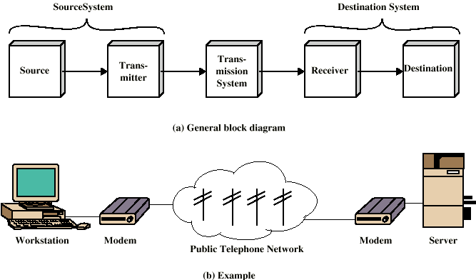
A Simple (and Old-fashioned) Point-to-Point Communications Model

Slide 8
Networking
What happens if we have a large set of entities to connect each other?
  Point to point communication not usually practical
    Devices may be too far apart
    Large set of devices would need impractical number of connections
Solution is a data network
The meaning of “network” according to Merriam-Webster dictionary
  “an interconnected or interrelated chain, group, or system”

Slide 9
Data Networks
In the wide area, data are switched from one node to another towards the destination
  These nodes (switching nodes) are not interested in the data
  Main purpose is switching: relaying the data from one node to another until it reaches the destination
Alternative technologies for wide area switched networks
  Circuit switching
  Packet switching

Slide 10
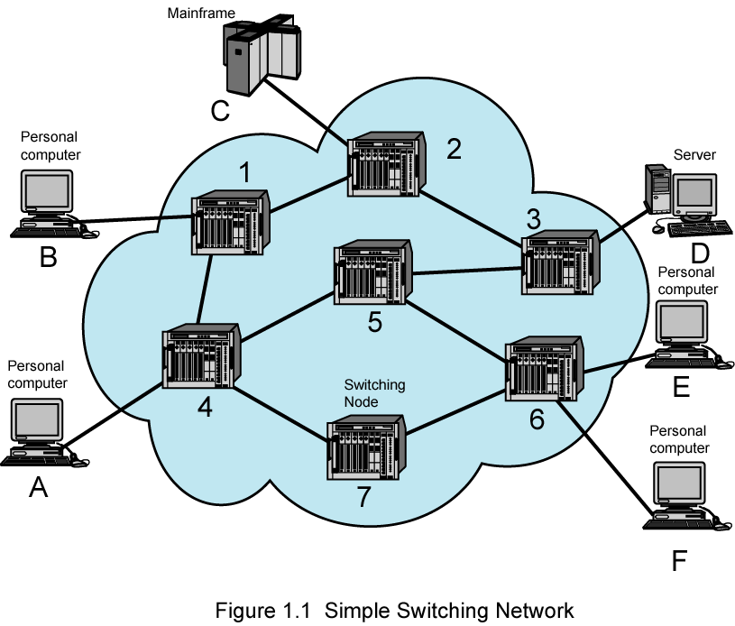
Simple Switching Network
WAN (Wide Area Network)

Slide 11
Circuit Switching
Dedicated communication path between two stations
  Connected sequence of links between nodes
  each link on the path
    must reserve enough capacity for the connection
  each node
    must have intelligence to work out routing
    must have capacity for internal switching
      What does it mean?
Three phases of communication
  Circuit establishment
    Establishment of end to end path
  Data transfer
  Circuit disconnect
Typical example: Telephone Network

Slide 12
Circuit Switching – Pros and Cons
Once connected, transfer is at fixed rate with almost no delay (other than propagation delay)
  perfect match for voice communication
Delay prior to transfer for call establishment
Capacity dedicated for duration of connection even if no data are being transferred
  may cause low utilization (especially for data transfer)
  that is why it is not a good idea to use circuit switching for data transfer

Slide 13
Can we use circuit switching for data transfer?
Not a good idea, mainly due to two reasons
  path will mostly be idle
    low utilization of network resources
  Data rate is fixed
    Both ends must operate at the same rate
    Limits the utility of high-speed stations
So what?
  Packet Switching!

Slide 14
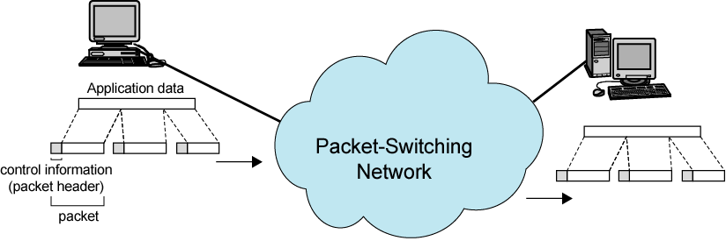
Packet Switching –
Basic Operation
Data are transmitted in short blocks, called packets
  data + header with control info (that includes destination station address)
  At each node, packet is received, stored briefly, and passed on to the next node (called store-and-forward technique)
Packets sent to node to which sending station attaches
Node stores packet briefly, determines next leg of route, and queues packet to go out on that link
  When link is available, packet is transmitted to next node

Slide 15
Packet Switching –
Advantages
Line efficiency
  No dedicated capacity
  Single node-to-node link can be shared by packets of many end to end connections over time
Data rate conversion
  Each station connects to the local node at its own speed
  Receiving nodes buffer data, if needed
Packets are accepted even when the network is busy
  Packets wait in queues
  Delivery may slow down

Slide 16
Packet Switching –
Disadvantages
Delay
  Transmission delay = length of packet divided by channel rate
    Actually this delay also exists in circuit switching but in total, packet switching causes more transmission delay (will see later)
  Variable delay due to processing and queuing
    No such delay in circuit switching
Overall packet delay can vary substantially (a.k.a. jitter)
  Packets may vary in length
  May take different routes
  May be subject to varying delays in switching nodes
  Not so good for real-time applications
Header overhead
  Header transferred but does not contain user (application) data
More processing required at switching nodes (as compared to Circuit Switching)

Slide 17
Two Packet Switching Techniques
Datagram approach
Virtual circuit approach

Slide 18
Datagram
Each packet is treated independently
Packets can take any practical route
Packets may arrive out of order
Packets may go missing
Receiver is responsible to re-order packets and recover from missing packets

Slide 19
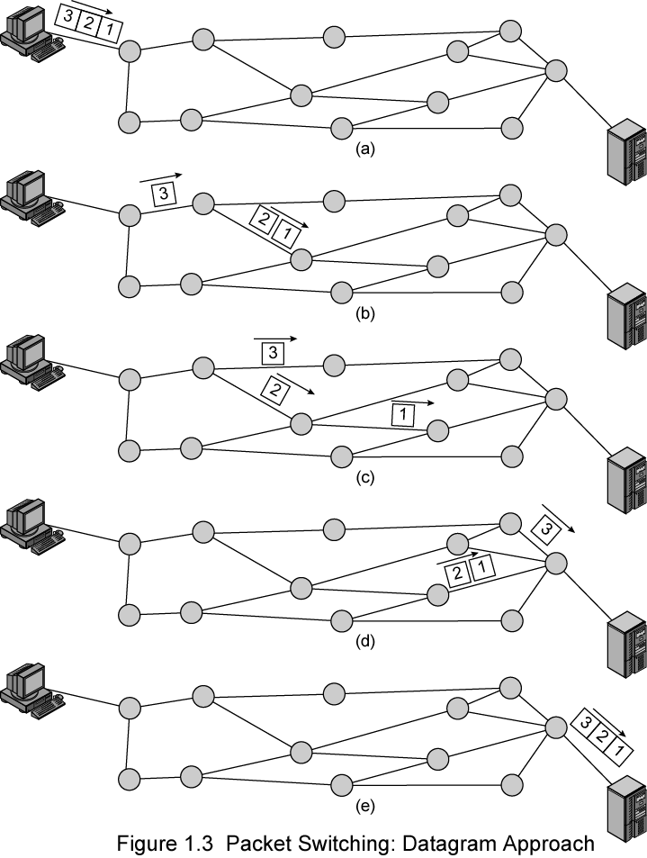
Datagram
Approach

Slide 20
Virtual Circuit
Preplanned route established before any packets sent
  all packets follow the same route
  there is a connection establishment (like circuit switching)
  but that connection is not a dedicated one (unlike circuit switching); i.e. no capacity is reserved for connections.
Each packet contains a virtual circuit identifier instead of destination address
  No routing decisions required for each packet
Packets are still buffered at the switching nodes and queued for output
  That means, there is still “store, process and forward”, but the processing is faster as compared to datagram approach

Slide 21
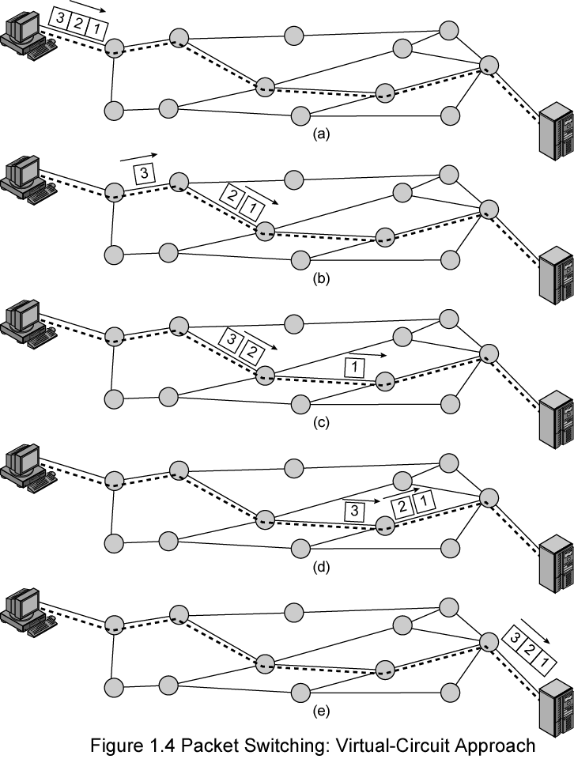
Virtual-Circuit
Approach

Slide 22
Virtual Circuits vs. Datagram
Virtual circuits
  Network can provide sequencing and error control
  Packets are forwarded more quickly
    No routing decisions to make
  Less reliable, less flexible
    Loss of a node looses all circuits through that node
    Not responsive to congestion
Datagram
  No call setup phase
    Better if few packets
  More reliable and flexible
    In case of a node failure, alternate routes could be found
    Routing can be used to avoid congested parts of the network
Notes:
Sequencing: same route means sending order and the receiving order are the same
Error control: sequencing + if a packet is damaged or lost, it is retransmitted

Slide 23
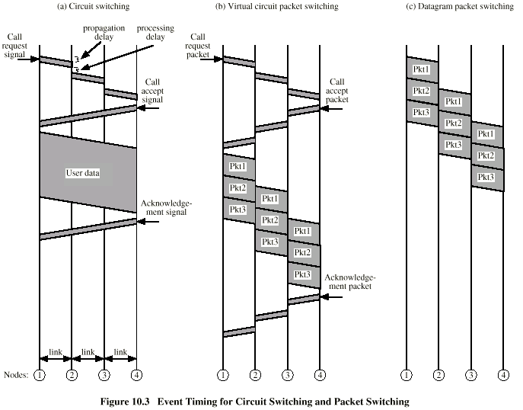
Circuit vs. Packet Switching
transmission delay
time

Slide 24
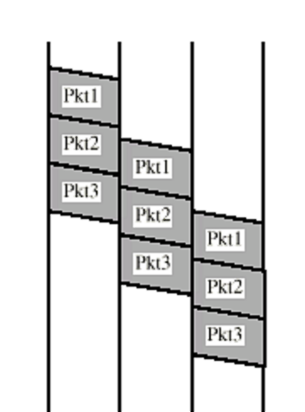
More on Delays
propagation
transmission
processing
propagation
transmission
processing
propagation
transmission
transmission
transmission

Slide 25
More on Delays and Performance Metrics (from Ch. 5)
Delays
  Transmission delay: Time for transmitter to send all bits of packet. Determined by the length of data / the transmission rate (in bps, Kbps, Gbps, etc.) of the sender.
  Propagation delay: Time for one bit to travel from source to destination. Determined by the length of channel / the propagation speed of the medium.
  Processing delay: Time required to process packet at source prior to sending, at any intermediate router or switch prior to forwarding, and at destination prior to delivering to application
  Queuing delay: Time spent for waiting in queues (will see later)
Total Delay and Round-trip time/delay (RTT)
  Total delay is the time needed for data to go from the sender to the receiver
    Generally sum of all applicable delays
  RTT is total delay + time needed for the acknowledgment to be received by the sender

Slide 26
Example 1
First, a real world example
Passengers step on an escalator with a rate of 0.5 passenger/sec. Escalator trip takes 15 seconds. There are 100 passengers. How long does it take for all passengers to finish their trips?
See the solution on the board!

Slide 27
Example 2
1-megabit file across USA (4800km)
  using fiber optic link: Propagation speed is the speed of light (approximately 3 × 10⁸ m/s)
  Transmission rate is 64 Kbps (Kbits per second)
    Transmission rate is sometimes called as "capacity of channel"
Propagation delay
  (4800×10³)/(3×10⁸) = 0.016 s
Transmission delay
  (10⁶)/(64 × 10³) = 15.625 s
Time to transmit file is Transmission delay plus propagation delay = 15.641 s

Slide 28
Example 3
Same example but different transmission rate: 1-megabit file across USA (4800km)
  using fiber optic link: Propagation speed is the speed of light (approximately 3 × 10⁸ m/s)
  Transmission rate is now 1 Gbps (Gbits per second)
Propagation delay is still the same
(4800×10³)/(3×10⁸) = 0.016 s
Transmission delay
  (10⁶)/(10⁶ × 10³) = 0.001 s
Total time to transmit file 0.017 s

Slide 29
Performance Metrics
Throughput
  Effective capacity of the data bits (generally in "bits per second" unit)
  Effective capacity → reduced by protocol overhead
    Header bits: TCP and IPv4, at least 40 bytes
    Control overhead: e.g. acknowledgements
Utilization
  A related issue
  The ratio of the time that the channel is actually used for effective data bits (no unit)
    Need to consider idle time of the channel, propagation time and the overheads
Sorry! No single formula for these metrics. You need to consider the characteristics of the model
  Let's see two examples on the board

Slide 30
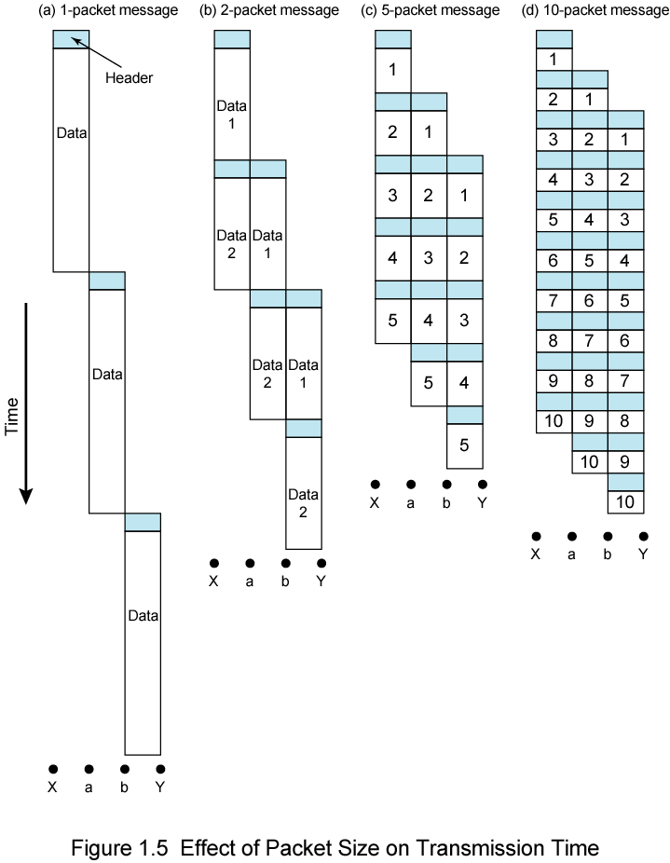
Effect of
Packet Size on
Transmission
Time
Assumptions for this figure
No propagation delay
No processing delay

Slide 31
Another Basic Issue: Routing
Adaptive routing
  Routing decisions should change as conditions on network change
Potential problems that may yield a route change are
  Failure of a switching node
  Congestion
    AIM: Route around congestion
Requires exchange of network state information
  Tradeoff between quality of information and overhead

Slide 32
Local Area Networks (LAN)
Smaller scope (as compared to WANs)
  Building or small campus
Usually owned by same organization as attached devices
  requires set up and maintenance
Data rates higher than WANs (Wide Area Networks)
Traditionally LANs were broadcast systems
But nowadays, most common LANs are switched LANs and wireless LANs

Slide 33
The Internet
What does it mean to be on the Internet?
In order to be considered on the Internet, your host machine should
  run TCP/IP protocol stack
  have (public or private) IP address
    In case of private IP address, this address must change to a public one when the packet goes out of local network
  be able to send IP packets to other machines on the Internet
The Internet is a collection of different networks that run TCP/IP protocols suite
Unusual system
  not planned and not controlled (maybe somehow regulated by IETF)

Slide 34
The Internet History
Evolved from ARPANET (1969)
  sponsored by Advanced Research Projects Agency (ARPA), U.S. Department of Defense
  research began in late 1950s
  motivation was “cold war”
  was a military project
First operational packet-switching network
Began in four locations: UCLA, University of California at Santa Barbara, the University of Utah, and SRI (Stanford Research Institute)
Today over one billion of hosts
All around the world

Slide 35
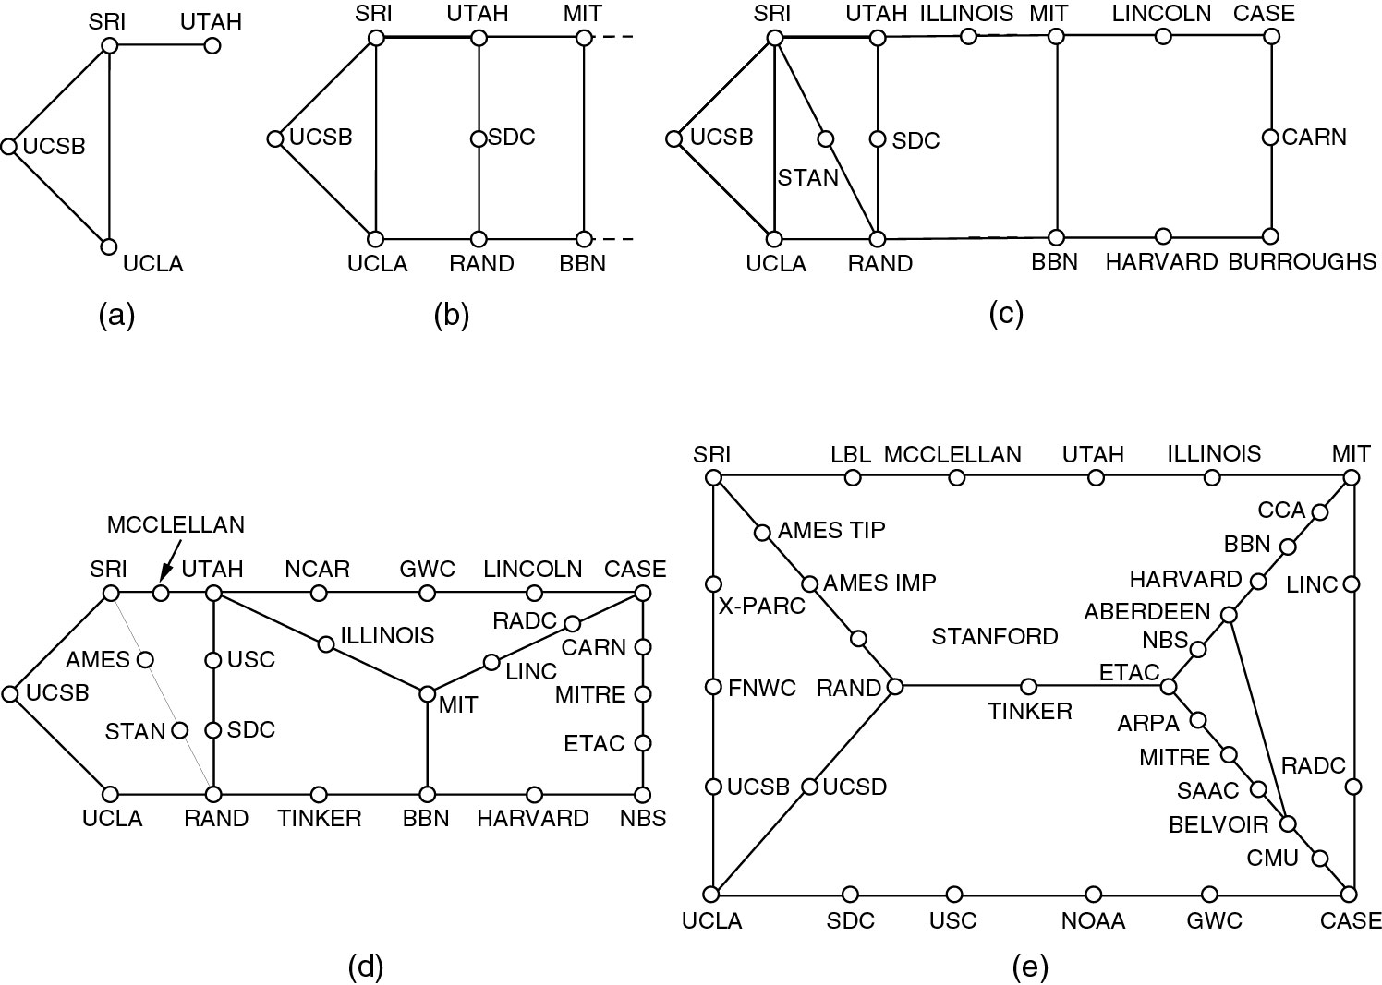
Growth of the ARPANET
(a) December 1969. (b) July 1970.
(c) March 1971. (d) April 1972. (e) September 1972.

Slide 36
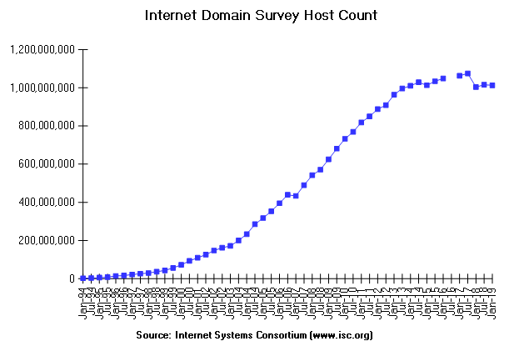
Number of
Internet Hosts (in the DNS)
More History
08/1981 213
08/1983 562
10/1985 1,961
11/1986 5,089
12/1987 28,174
01/1989 80,000
10/1990 313,000
10/1991 617,000
01/1993 1,313,000
2,217,000
The drop is due to IPv4 to IPv6 transition
Notes:
Explanation of drop (taken from https://www.isc.org/network/survey/ on Sept. 20, 2019): “Data for January 2018 is flawed and is included here for amusement purposes only. The survey collected information about IPv4 only, and we felt it was increasingly misleading for that reason. We tentatively believe that it is the result of some ISPs moving their customers to IPv6.”

Slide 37
The Internet History – TCP/IP
Until 1974, ARPANET protocols were not supporting internetworking of different packet switching networks
Vint Cerf and Bob Kahn of ARPA developed protocols for communicating across arbitrary, multiple, packet-switched networks (internetting)
  May 1974 - Transmission Control Protocol (TCP)
  Refined by ARPANET community
  Leading to TCP and IP
Software support from UC Berkeley by incorporating TCP/IP within Berkeley UNIX
1982-1983, ARPANET switched to TCP/IP
Many networks connected using TCP/IP

Slide 38
The Internet History – National Science Foundation (NSF) vision
Use of ARPANET restricted to ARPA contractors
1986, NSF sponsored extended Internet support to general research and education community
  NSFNET backbone
  connected to ARPANET, since both are based on TCP/IP
Regional packet switched networks across USA interconnected through NSF backbone
  with no commercial activity due to NSF policies

Slide 39
The Internet History – Privatization
In many countries (including United States until 1995) national governments subsidized the Internet backbone
1991, U.S. government said it would no longer subsidize Internet after 1995
  Mandated network access points (NAP)
    to ensure the connectedness of different networks
After 1995, Internet is opened to commercial activities
  Before that commercial activities were not allowed due to NSF's acceptable use policies

Slide 40
The Internet History - Applications
Remote Login
  First, telnet and rlogin
  now we use SSH (Secure Shell) which is secure
File Transport Protocol (FTP)
  transfer of files from one computer to another
  an early ARPANET application
First “killer app” was electronic mail
  1972, Ray Tomlinson of Bolt, Beranek and Newman (BBN)
  In 1973 three quarters of all ARPANET traffic was e-mail

Slide 41
The World Wide Web (WWW)
Spring 1989, at CERN (the European Laboratory for Particle Physics)
  Tim Berners‑Lee proposed a distributed hypermedia technology to exchange research findings over Internet
In 1991, prototype World Wide Web (WWW or the Web) developed at CERN
  Distributed collection of multimedia files
    stored at servers
    accessed by users (via browsers)
End of 1991, limited release of line-oriented browser
Explosive growth came with first graphical browser, Mosaic, 1993
  At University of Illinois by Mark Andreasson and others
  Two million copies delivered over Internet
  later Netscape, then Mozilla (base of Firefox)

Slide 42
The World Wide Web (WWW)
Communication protocol is HTTP
  HyperText Transfer Protocol
The language that browsers and web servers speak is HTML (HyperText Markup Language)
  although current browsers are capable of process other type of files
  dynamic pages and web-database connectivity are also possible
  Today, many applications, including social media, work over HTTP protocol

Slide 43
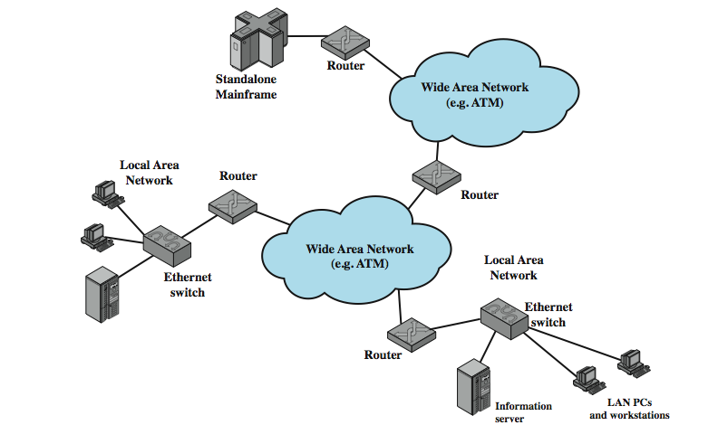
Internet Elements
Notes:
Stallings DCC8e Figure 1.4 illustrates the key elements that comprise the Internet, whose purpose is to interconnect end systems, called hosts; including PCs, workstations, servers, mainframes, and so on. Most hosts that use the Internet are connected to a network, such as a local area network (LAN) or a wide area network (WAN). These networks are in turn connected by routers.

Slide 44
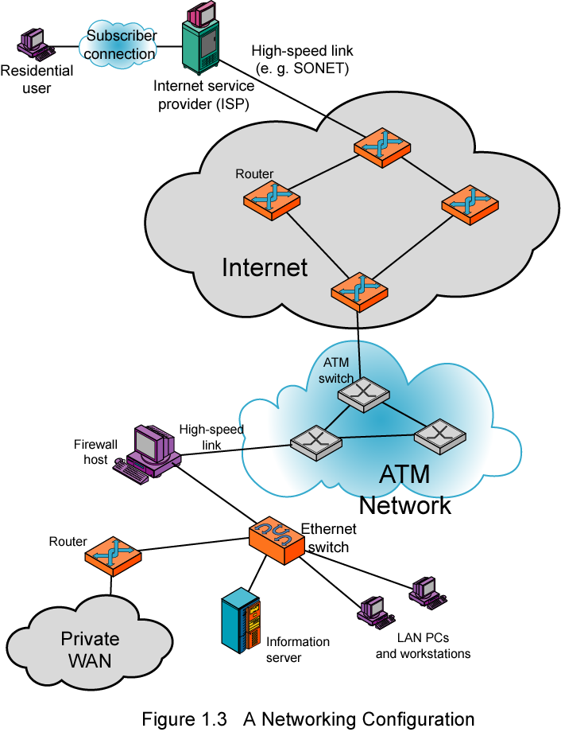
Example Configuration
Notes:
Stallings DCC8e Figure 1.6 illustrates some of the typical communications and network elements in use today. In the upper-left-hand portion of the figure, we see an individual residential user connected to an Internet service provider (ISP) through some sort of subscriber connection. The Internet consists of a number of interconnected routers that span the globe. The routers forward packets of data from source to destination through the Internet. The lower portion shows a LAN implemented using a single Ethernet switch. This is a common configuration at a small business or other small organization.

Slide 45
Internet Architecture
Notes:
The Internet today is made up of thousands of overlapping hierarchical networks, an overview of the common, general characteristics can be made. Stallings DCC8e Figure 1.5 illustrates this. See hosts grouped into LANs, linked to an an Internet service provider (ISP) through a point of presence (POP). The connection is made in a series of steps starting with the customer premises equipment (CPE). ISPs can be classified as regional or backbone, with peering links between.

Slide 46
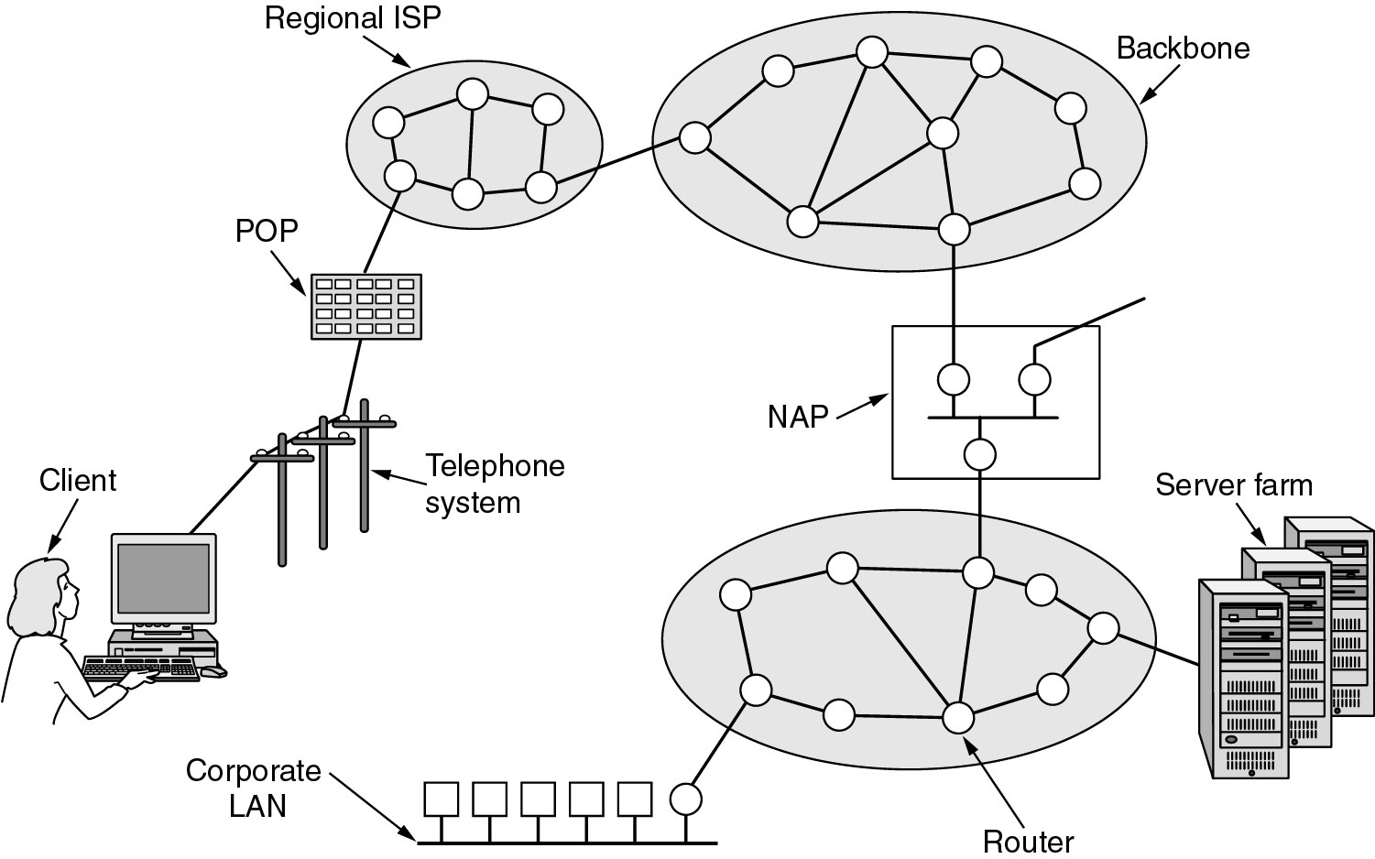
Architecture of the Internet
point of presence

Slide 47
Intranets
Basically speaking, an intranet is an internal network that uses Internet technologies
  suitable for corporate networks
  not intended to be open to the global Internet
    If connected, through firewalls
    Connection from outside for local users may be possible after proper authentication
  does Sabanci University have one?
Advantages
  can be implemented easily
  assuming that everybody is familiar with Internet services and user interfaces, no training required
  open architecture; add-on applications available

