Slide 1
CS 408
Computer Networks
Congestion Control (from Chapter 05)

Slide 2
Performance Metrics
2 important performance measures
Throughput
  Effective capacity (data rate) in bps reduced by protocol overhead (trans. delay for non-data bits, propagation, queueing and processing delays)
Delay
  Transmission delay
    Time for transmitter to send all bits of packet
  Propagation delay
    Time for one bit to transit from source to destination
  Processing delay
    Time required to process packet at source prior to sending, at any intermediate router or switch, and at destination prior to delivering to application
We discussed these. What we did not discuss is
  Queuing delay: Time spent while waiting in queues

Slide 3
Queuing Delays
Queuing delays are significant in performance of communications networks
  Grow dramatically as system approaches to capacity
In shared facilities (e.g., network, transmission line, road network, checkout lines, ...) performance typically worsens exponentially as the demand approaches to the capacity
Queuing theory explains everything
  See some basic formulations on the board
  These are included in the exam (if you were absent in this lecture, please obtain the notes from a friend)

Slide 4
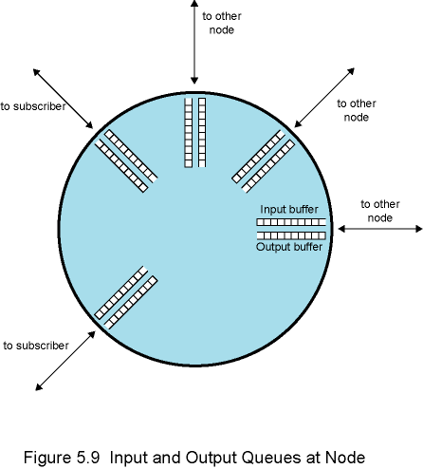
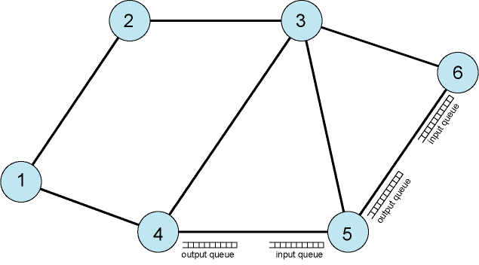
What Is Congestion? -1
Data network is a network of queues
Congestion occurs when the number of packets being transmitted through the network approaches the packet handling capacity of the network
Input and Output Queues at a Network Node

Slide 5
What Is Congestion? - 2
If the arrival rate is larger than the transmission rate, queues grow to infinity → unresolvable congestion
If the arrival rate is smaller than the transmission rate
  queues grow and congestion starts as the arrival rate approaches to the transmission rate (i.e. number of packets being transmitted through the network approaches the packet handling capacity of the network)
  Generally 80% utilization is critical
  growth in queue = more delay
  queues may overflow since it is of finite capacity
Congestion control aims to keep the number of packets below the level at which performance starts to degrade dramatically

Slide 6
Effects of Congestion
Arriving packets are stored at input buffers
Routing decision made
Packet moves to appropriate output buffer
Packets queued for output are transmitted as fast as possible
If packets
  arrive too fast to be processed/ routed, input buffers will fill up
  arrive faster than that can be transmitted, output buffers will fill up
Precautions
  discard packets
  flow control over neighbors

Slide 7
Effects of Congestion
Flow control can propagate congestion through network

Slide 8
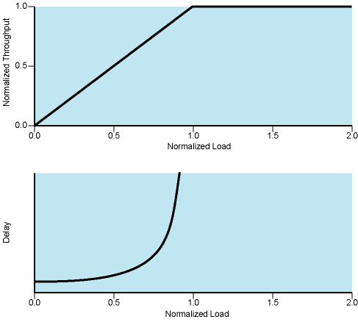
Ideal Network Performance
Performance under the assumptions of infinite buffers (queues) and zero overhead for congestion control

Slide 9
Practical Performance
Ideal case assumes infinite buffers and no overhead
However in real life:
  Buffers are finite
  Overheads occur in exchanging congestion control messages

Slide 10
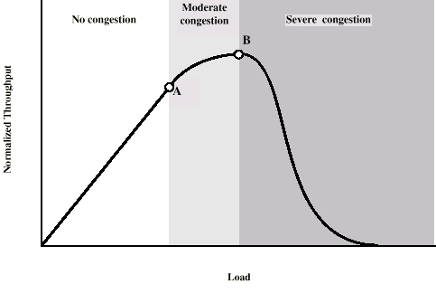
Practical Performance
Point A:
  Packet discard starts at heavily congested nodes
  re-routing and congestion control messages cause extra overhead
Point B: PANIC
  More buffers overflow
  Retransmission of discarded packets causes heavier traffic
  delays increase
  even successfully delivered packets are retransmitted due to timeout

Slide 11
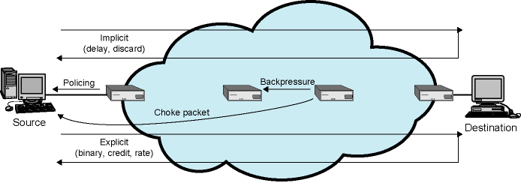
Mechanisms for Congestion Control

Slide 12
Backpressure
If node becomes congested, it can slow down or halt flow of packets from its neighbors
That may cause longer queues at neighbors and they do the same
Propagates back to source
Used in connection oriented networks that allow hop by hop flow control (e.g. X.25)

Slide 13
Choke Packet
Control packet
  Generated at congested node
  Sent to source node
  e.g. ICMP source quench
    From router or from destination
    Source cuts back until no more source quench messages
    Sent for every discarded packet, or when congestion is anticipated
  Not a sophisticated method, but applicaple for IP

Slide 14
Implicit Congestion Signaling
With congestion
  Delay may increase
  Packets may not be acknowledged during timeout period
Source can detect these as implicit indications of congestion and reduces the flow
  Intermediate systems do not need to take any action
Useful on connectionless (datagram) networks, e.g. IP based
  For which there is no link-based flow control
In TCP/IP, logical connection is established at TCP level
  TCP has acknowledgment and flow control mechanisms that help implicit congestion signalling (will see the details of how these help congestion control later)

Slide 15
Explicit Congestion Signaling
Network alerts end systems of increasing congestion
End systems take actions to reduce the load
Backward
  notifies the source about congestion
Forward
  notifies the destination about congestion
Notification information is added to data packets

Slide 16
Categories of Explicit Signaling
Binary
  A bit set in a packet indicates congestion
  When received, source reduces traffic
Credit based
  Indicates how many packets source may send
  Common for end-to-end flow control, but also used for congestion control
Rate based
  Explicit data rate limit is supplied to the source
Implementation of Explicit Congestion Signaling and Control in TCP/IP will be discussed later

Slide 17
Traffic Management Issues Related to Congestion Control
Fairness
  “discard the last received” is not fair
  A fair approach: multiple queues for multiple source-destination socket pairs (logical connections); all equal length
Quality of service
  different priorities for different connection types (voice, video, email, network management, etc.)
  Some types of traffic are less important than the others in the case of congestion
Reservations
  congestion avoidance mechanism
  traffic contract between user and network
  network makes necessary reservations to keep its promise
  user tries not to overuse the reserved capacity
    Traffic policing: compares the actual traffic with the one in contract
  Integral part of RSVP protocol of IP-based internets

