Slide 1
CS 408
Computer Networks
Chapter 11: Routing in IP
Notes:
Interior Routing Protocols
Chapter 15

Slide 2
Introduction
Routers forward IP datagrams from one router to another on the path from source towards destination
Routing protocols
  To decide on routes to be taken
Routers must have idea of topology of internet in order to pick best route to take
  It is an optimization problem. Decisions are based on some least cost criteria
  May depend on the current conditions

Slide 3
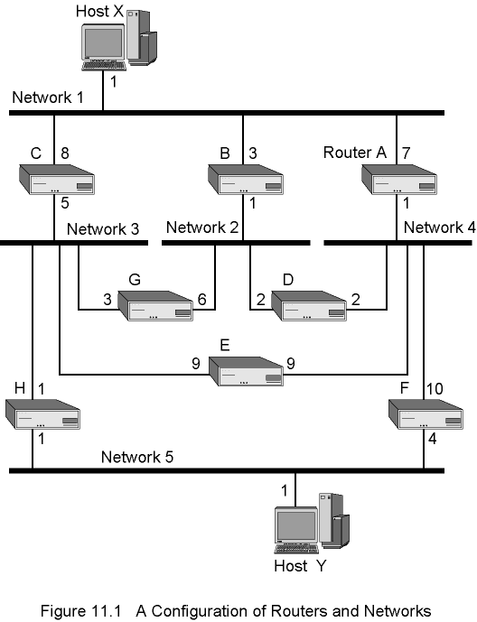
A Sample Configuration of Routers and Networks
Link costs are at the output of the links
There is cost of putting data to the network
There is no cost of getting data from the network
  For example, the cost of the path X→ A → F → Y is 1+1+4=6

Slide 4
Routing Table
One routing table is needed for each router
One entry for each destination network
  Not for each destination host
  Once datagram reaches router attached to destination network, that router can deliver to host
Each entry shows next node on the route to destination
  Not whole route
Routing tables may also exist in hosts
  If multiple routers attached to network, host needs table saying which to use
  If the attached network has single router, then routing table is not needed
    All traffic must go through that router (called the gateway)

Slide 5
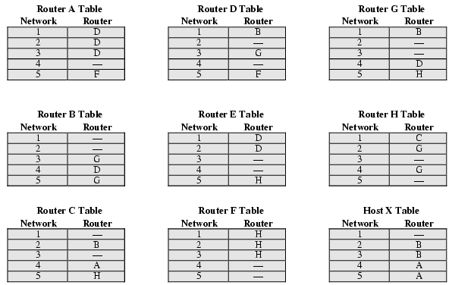
Example Routing Tables

Slide 6
Fixed Routing
Single permanent route configured for each source-destination pair
  Routes are fixed
  May change when topology changes (not so often)
    Mostly manual
    No dynamic updates

Slide 7
Adaptive Routing
As conditions on internetwork change, routes may change
  Failure
    of routers or networks
  Congestion
    If a particular section of the network is heavily congested, it is better not to use that part and change the route

Slide 8
Adaptive Routing - Challenges
Complex routing decisions
  Router processing increases
Depends on information collected in one place but used in another
  More information exchange improves the quality of routing decisions, but also increases overhead
May react too fast
  causing congestion through oscillation (fluttering)
May react too slow
  By the time routing decision changes, the network conditions may be much more different

Slide 9
Adaptive Routing - Challenges
Looping
  Packet forwarded by a router eventually returns to the same router
  May occur when changes in connectivity are not propagated fast enough to all other routers
  An important pathology that must be prevented in routing algorithms
Despite all challenges, adaptive routing prevails due to its flexibility

Slide 10
Classification of Adaptive Routing Strategies
Based on information sources
  Local
    E.g. route each datagram to network with shortest queue
      Balance loads on outgoing networks
      May not be heading in correct direction
    Rarely used
  Adjacent nodes
    Delay and outage info from adjacent nodes
    Distance vector algorithms
      Discussed later
  All nodes
    Link-state algorithms
      Discussed later

Slide 11
Flooding
No network info required
Packet sent by node to every neighbor
Incoming packets retransmitted on every link except incoming link
Eventually a number of copies will arrive at destination
Each packet is uniquely numbered, so duplicates can be discarded at destination

Slide 12
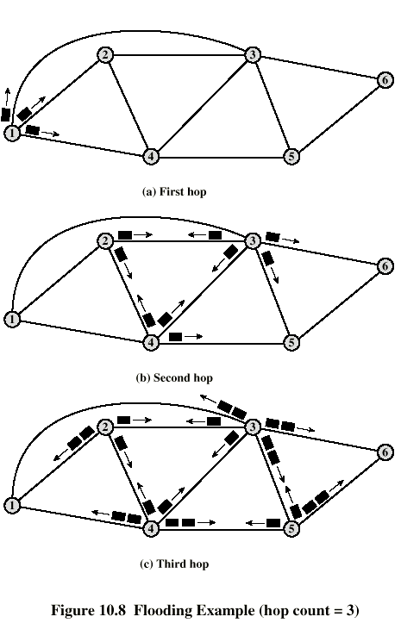
Flooding
Example

Slide 13
Flooding- Improvements
Precautions against unlimited grow in circulation
  Nodes can remember packets already forwarded to keep network load within allowed limits
    called "Restricted Flooding"
  Include a hop count in packets.
    Set to a maximum value
    Decrease one at each hop
    Discard when 0

Slide 14
Properties of Flooding
All possible routes are tried
  very robust
  can be used for emergency messaging
At least one packet will use minimum hop count route
  Can be used once to set up a route
All nodes are visited
  Useful to distribute information (e.g. routing info)

Slide 15
Random Routing
Node selects one outgoing path for retransmission of incoming packet
Selection is at random
  equally likely
    all outgoing links are utilized equally in the long-run
  can select outgoing path based on a probability
    e.g. probability based on data rate
      good traffic distribution
No network info needed
Route is typically neither least cost nor minimum hop

Slide 16
Autonomous Systems (AS)
An important concept for TCP/IP routing in IP layer
AS is defined as set of routers and networks managed by single organization (e.g. an ISP – Internet Service Provider)
  Exchange routing information in itself
  Common routing protocol
An AS must be connected in itself
  There is at least one route between any pair of nodes and networks

Slide 17
Interior Routing Protocol (IRP)
Exterior Routing Protocol (ERP)
(not actually protocols, just concepts)
IRP passes routing information between routers within AS
  Need exchange of info among the routers only in AS
  Different autonomous systems may have different IRP mechanisms
Autonomous systems need to talk to each other
  A few routers in each AS must talk with other AS
  Use Exterior Routing Protocol (ERP)
    Again, a concept
  ERP does not deal with details within source and target AS

Slide 18
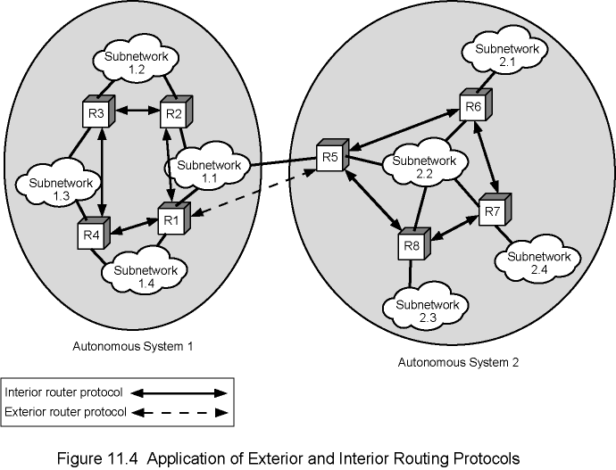
Application of Exterior and Interior Routing Protocols

Slide 19
Approaches to Routing –
Distance-vector
Each router exchange information with neighboring routers
  Definition: Two nodes/routers are said to be neighbors if both are directly connected to each other or to the same network
Each node keeps a Routing Table
  distance vector and next-hop vector
    One entry for each destination network
  a vector of link costs for each directly attached network
Requires transmission of information by each router to all neighbors
  Distance vector that contains estimated path costs for all destination networks
  Changes may take long time to propagate
First generation routing algorithm for ARPANET
Used by Routing Information Protocol (RIP)
  will see later

Slide 20
Approaches to Routing –
Link-state
Designed to overcome drawbacks of distance-vector
When router initialized, it determines link cost on each interface
Advertises set of link costs to all other routers in topology
  Not just neighboring routers
After that, each router monitors its link costs
  If significant change, router advertises new set of link costs
In this way, each router builds up a picture of the entire topology
  Can calculate shortest path to each destination
  Use an algorithm to determine shortest paths
    In practice, Dijkstra's algorithm
Router constructs routing table, listing first hop to each destination
Second generation routing algorithm for ARPANET
Open shortest path first (OSPF) protocol uses link-state routing.

Slide 21
Distance-vector and Link State
Both of them is suitable for IRP, not ERP
Several reasons. Some of them:
  Both require homogenous metrics that may be the case within an AS, but we cannot assume then same for different AS systems
  Flooding the link state information across multiple AS systems is not scalable

Slide 22
Approaches to Routing –
Path-vector
Suitable approach for Exterior Router Protocols
Provide information about which networks can be reached by a given router and Autonomous Systems crossed to get there
  Does not include distance or cost estimate
BGP (Border Gateway Protocol) is an example to path-vector routing protocol

Slide 23
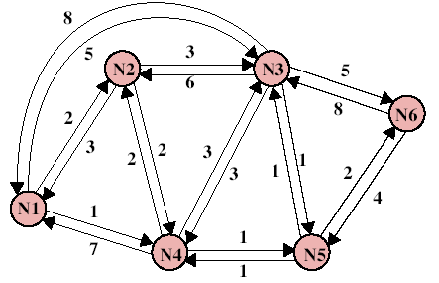
Least Cost Algorithms
Routing decision is based on some least-cost criteria (minimization problem)
  To minimize number of hops, link cost is simply assumed to be 1
  Link cost may be inversely proportional to capacity, proportional to current load (queue length), or some combination
  May be different in two directions (e.g. if cost is queue length)
More formal problem definition
  For each pair of nodes,
  find the least cost path
  Cost of path between two nodes
  is sum of costs of links traversed
Dijkstra's algorithm
Bellman-Ford algorithm

Slide 24
Dijkstra's Algorithm
Find shortest paths from a given node to all other nodes, by developing paths in the order of increasing path length (and increasing cost)
Proceeds in stages
  At each stage shortest path from source to one node is determined
  The nodes for which shortest path determined are kept in a set called T
  At each iteration, node not in T but has the shortest path from source is added to T
  As each node added to T, path from source to the nodes not in T are checked to see whether there is a better path through this newly added node

Slide 25
Dijkstra's Algorithm –
Formal (1)
N = set of nodes in the network
s = source node
T = set of nodes so far incorporated (shortest path found)
w(i, j) = link cost from node i to node j
  w(i, i) = 0
  w(i, j) = ∞ if nodes not directly connected
  w(i, j) ≥ 0 if nodes are directly connected
L(n) = cost of current least-cost path from s to n
  At the end of algorithm (actually as soon as n is added to T), L(n) is the cost of least-cost path from s to n

Slide 26
Dijkstra's Algorithm –
Formal (2)
[Initialization]
T = {s}
  i.e. set of nodes so far incorporated consists of only source node
L(n) = w(s, n) for all n ≠ s
  i.e. initial path costs to neighboring nodes are link costs

Slide 27
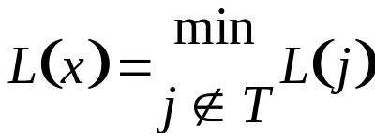
Dijkstra's Algorithm –
Formal (3)
Repeat
[Get Next Node]
  Find neighboring node not in T with least-cost path from s
Find x ∉ T such that
Add x to T. L(x) is the shortest path from s to x.
[Update Least-Cost Paths]
L(n) = min[L(n), L(x) + w(x, n)] for all n ∉ T
If the latter term is the minimum, the path from s to n is now
the path from s to x concatenated with the edge from x to n.
Until all nodes are in T

Slide 28
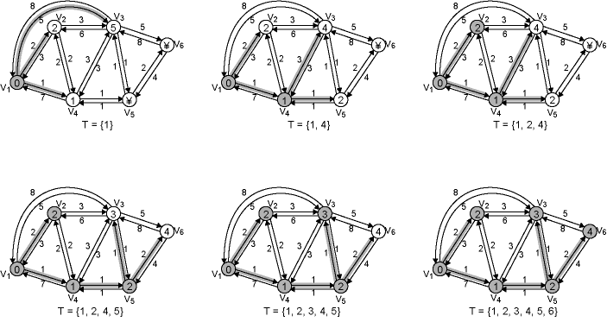
Dijkstra’s Algorithm – Example
See Table 11.1a for the Trace

Slide 29
Bellman-Ford Algorithm
Iterative
  find the shortest paths from a source to all possible destinations using only one link
  then using max. two links by adding appropriate links to the paths of step 1
  then using max. 3 links on top of paths with two links
  so on .. until no improvement is gained by adding more links

Slide 30
Bellman-Ford Algorithm – Formal (1)
s = source node
w(i, j) = link cost from node i to node j
  w(i, i) = 0
  w(i, j) = ∞ if nodes are directly connected
  w(i, j) ≥ 0 if nodes directly connected
h = maximum number of links in path at current stage
L_{h}(n) =cost of least-cost path from s to n such that path contains no more than h links

Slide 31
Bellman-Ford Algorithm – Formal (2)
[Initialization]
L₀(n) = ∞, for all n ≠ s
h=0

Slide 32
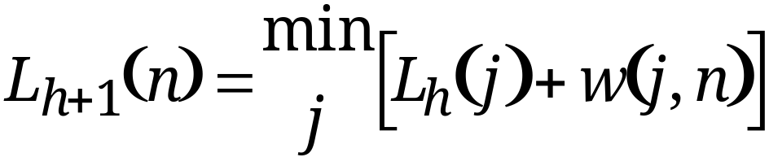
Bellman-Ford Algorithm – Formal (3)
[Update]
Loop until no more improvements
For each n ≠ s, compute
If s-to-n cost reduced, then path also changes to s -…- j - n
h=h+1

Slide 33
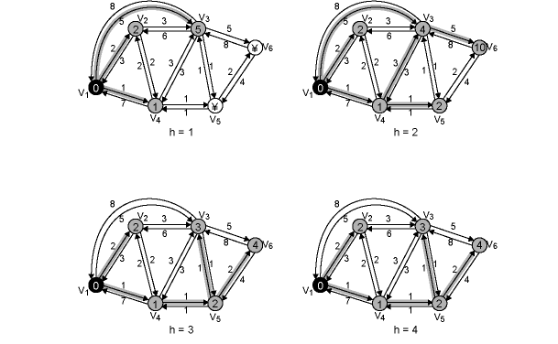
Bellman-Ford Algorithm – Example
See Table 11.1b for the Trace

Slide 34
RIP (Routing Information Protocol)
Uses Distance Vector Routing approach
  Each node exchanges information with neighbors
  Neighbor = Directly connected via same network
Each node maintains three vectors
  Link cost
    One entry for each network it attaches
  Distance vector (metric column in the next slide)
    Current cost of route from the node to each destination network in the configuration
  Next hop vector (Next router column in the next slide)
    The next router for each destination network in the configuration
Every 30 seconds, exchange distance vector with neighbors
Use distance vectors received from neighbors to update distance and next hop vector
  Similar to Bellman-Ford algorithm.
Routing table

Slide 35
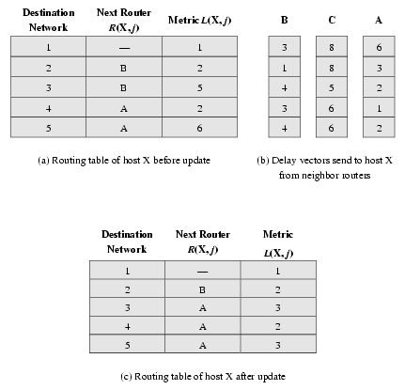
Distance Vector Algorithm Applied to Figure 11.1

Slide 36
RIP Details –
Incremental Update
Previous algorithm implies that all distance vector updates arrive within a small window of time
  Not correct, because (i) no synchronization, (ii) RIP uses UDP that means no reliability.
Actually RIP is designed to operate incrementally.
  Tables are updated after receipt of individual distance vector

Slide 37
RIP Details –
Topology Change
If no updates are received from a router within 180 seconds, mark the connection as invalid
  Assumes router crash or network connection unstable
  Set distance value to infinity
    Actually 16. Why? See next.

Slide 38
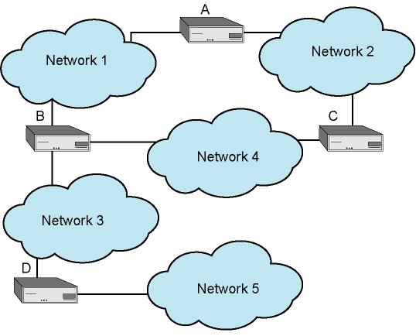
Counting to Infinity Problem (1)
A problem of RIP is slow convergence to a change in topology
Consider the example network below with all link costs 1
  The distance of B to network 5 is 2, next hop is D
  A and C have distances of 3 and next hop is B

Slide 39
Counting to Infinity Problem (2)
Suppose router D fails:
  B determines network 5 no longer reachable via D
    Sets distance to 4 based on report from A or C
  At next update, B tells A and C this new distance to network 5
  A and C receive this and increment their network 5 distance to 5
    4 from B, plus 1 to reach B
  B receives distance count 5 and assumes network 5 is 6 unit cost away
  Repeat until reach infinity (16)
  Update interval is 30 seconds, so reaching 16 takes several minutes. If infinity is larger, then convergence would take longer.

Slide 40
Split Horizon Rule
Counting to infinity problem is caused by misunderstanding between B and A, and between B and C
  Each thinks it can reach network 5 via the other
Split Horizon rule says “do not send information about a route back in the direction it came from”
  Router sending information is nearer to the destination than you are
  Don't teach your grandma how to suck eggs! ☺
Erroneous route now eliminated within time out period (180 seconds)

Slide 41
Read from book (page 404 – 405) – not responsible
RIP Packet Format

Slide 42
Open Shortest Path First (OSPF)
RIP has limitations in large internets
  Convergence problem that was just discussed
  RIP metrics are very simple and might cause suboptimal routes to be formed
OSPF is preferred interior routing protocol for TCP/IP based internets
Link state routing used

Slide 43
Link State Routing
When initialized, router determines link cost on each interface
Router advertises these costs to all other routers in topology
Router monitors its costs
  When changes occur, costs are re-advertised
Each router constructs topology and calculates shortest path to each destination network
  Can use any algorithm, but in practice Dijkstra is used

Slide 44
OSPF Overview
Router maintains the state of local links
Transmits updated state information to all routers in AS or in area (see later)
Router receiving update must acknowledge
Each router maintains a database that reflects the topology
  Directed graph
  And then generates a spanning tree and routing table

Slide 45
Router Database Graph
Vertices (nodes)
  Routers
  Networks
Edges
  Connecting two routers
  Connecting router to network

Slide 46
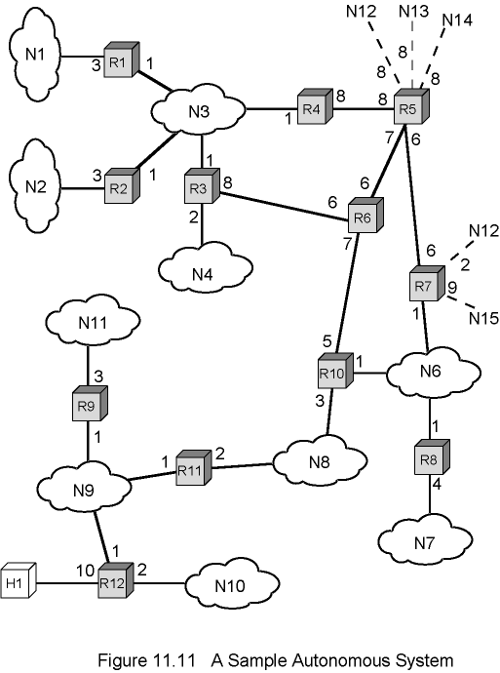
Sample Autonomous System

Slide 47
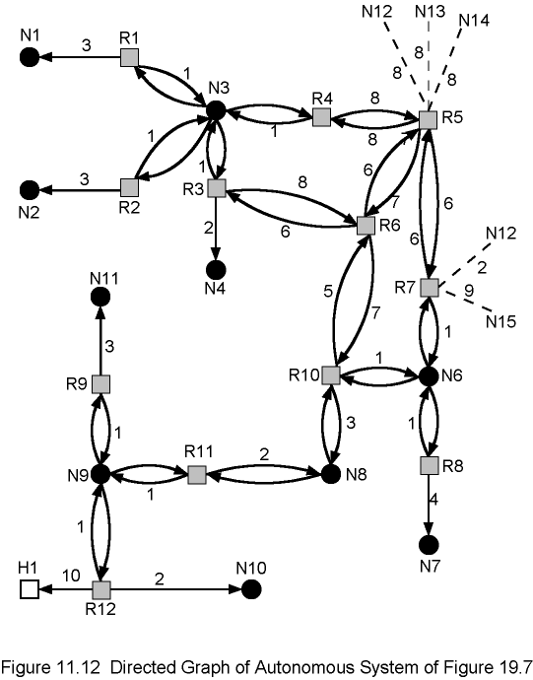
Directed Graph of Sample Autonomous System
Each router applies Dijkstra algorithm on this graph to find out minimum path to each destination network

Slide 48
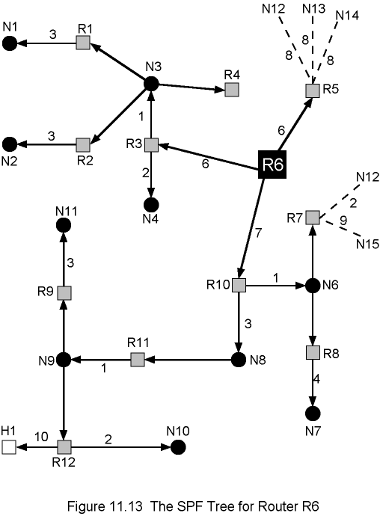
Example: The Spanning Tree for Router R6

Slide 49
Link Costs
Cost of each hop in each direction is called routing metric
OSPF provides flexible metric scheme based on type of service
  Normal
    Default metric assigned by administrators
    Typically 1 for minimum hop routing
  Monetary cost
  Reliability
    E.g. based on recent history of outages
  Throughput
    Inversely proportional to data rate
  Delay
    Based on propagation and queueing delays for each interface of the routers
Each router generates 5 spanning trees and 5 routing tables

Slide 50
Areas
Make large autonomous systems more manageable
Configured as a backbone and multiple areas
Area – Collection of contiguous networks and hosts plus routers connected them
  Not so different from AS, but smaller
Backbone – networks and routers that connect multiple areas as a central hub
  Like a star topology

Slide 51
Operation of Areas
Each area runs a separate copy of the link state algorithm
  Topological database and graph of just that area
  Link state information broadcast to other routers in area
  Reduces traffic
  Intra-area (within area) routing relies solely on local link state information

Slide 52
Inter-Area Routing
Path consists of three legs
  Within source area
    Intra-area
    Delivers to the backbone
  Through backbone
    Has properties of an area
    Uses link state routing algorithm
    Delivers to the destination area
  Within destination area
    Intra-area
    Delivers to recipient

Slide 53
OSPF Packet Format
Read from book (pages 412 – 413)
Not responsible

Slide 54
Border Gateway Protocol (BGP)
For use with TCP/IP internets
Preferred ERP of the Internet
Allows routers (gateways) in different Autonomous Systems to exchange routing information
Current version is BGP-4
  RFC 4271
No time to cover
  See the book for details (in Chapter 12)
  Not responsible

