Slide 1
CS 408
Computer Networks
Data Transmission Basics
Not in the text book
Excerpts from Chapter 3, 4 and 6 of Stallings, Data and Computer Communications, 6th ed.

Slide 2
Data Transmission
Converting into Electromagnetic (EM) signals
Transmitting those signals through medium
Medium
  Guided medium
    e.g. twisted pair, optical fiber
  Unguided medium
    e.g. air, water

Slide 3
Spectrum & Bandwidth
Spectrum
  range of frequencies contained in signal
bandwidth
  width of spectrum

Slide 4
Data Rate and Bandwidth
A perfect square wave has infinite bandwidth
  cannot be transmitted over a medium due to medium/pyhsical restrictions
  Fourier series of a periodic function
    (infinite) sum of sines and cosines (terms)
    more terms → more frequencies (bandwidth) → better square-like shape
  more bandwidth
    less distortions
    expensive
  less bandwidth
    more distortions ==> more errors
    cheap
Higher bandwidth = higher data rate

Slide 5
Transmission Media
Guided
  Twisted pair
  Coaxial cable
  Optical fibers
Unguided
  radio
  microwave
  infrared

Slide 6
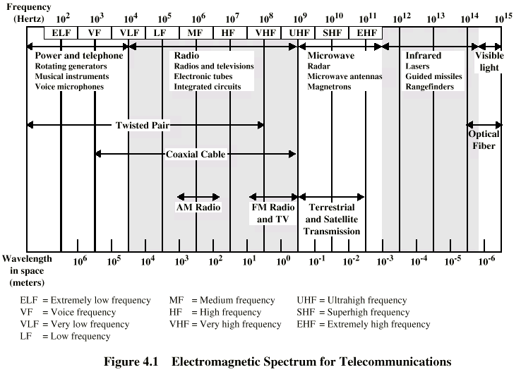
Electromagnetic Spectrum

Slide 7
Magnetic/Optic Media
Write/burn the data and transmit via courier service
Can give good data rate
Sometimes the best way :)
  especially for large volume of data transfer

Slide 8
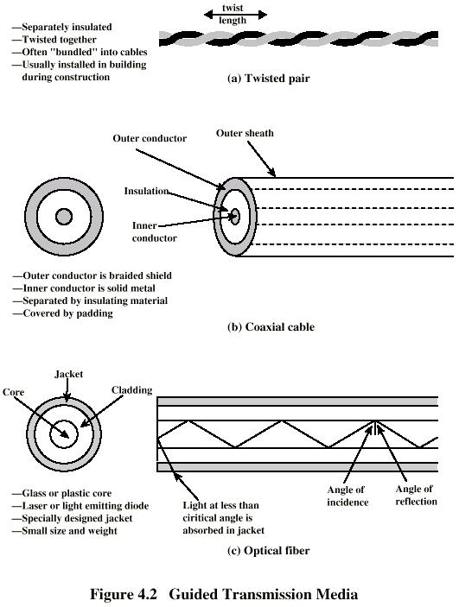
Twisted Pair

Slide 9
Twisted Pair - Applications
Most common medium
Telephone network
  Between house and local exchange (subscriber loop)
Within buildings
  To private branch exchange (PBX)
For local area networks (LAN)
  Ethernet

Slide 10
Twisted Pair - Pros and Cons
Cheap
Easy to work with
Short range
Our book says "Low data rate"
  But nowadays it is possible to go 40 Gbps with Cat 7 cables

Slide 11
Unshielded and Shielded TP
Shielded Twisted Pair (STP)
  Metal braid or sheathing that reduces interference
  More expensive
  Harder to handle (thick, heavy)
  Not so economical for low rates, but a good alternative for higher rates
  IBM invention
Unshielded Twisted Pair (UTP)
  Ordinary telephone wire, but can be used for data as well
  Cheaper
  Easier to install
  Suffers from external EM (Electromagnetic) interference, so insulation is important.

Slide 12
UTP Categories
Cat 3
  up to 16MHz
  Voice grade
  Very old technology, generally in old offices
  Twist length of 7.5 cm to 10 cm
Cat 5
  data grade
  up to 100MHz
  Commonly pre-installed in office buildings
  Twist length 0.6 cm to 0.85 cm
Cat 6, 6a
  Up to 500 MHz and 10 Gbps Ethernet
Cat 7, 7a
  Up to 1000 MHz and 40 Gbps Ethernet (and maybe beyond)
Cat 8, 8.1, 8.2
  Up to 2000 MHz and 40 Gbps Ethernet (and maybe beyond)

Slide 13
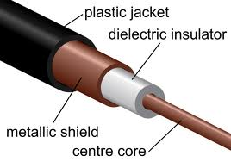
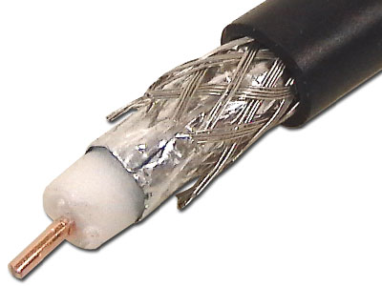
Coaxial Cable
For transmission

Slide 14
Coaxial Cable Applications
Most versatile medium
Television distribution
  Aerial antenna to TV
  Cable TV
Long distance telephone transmission
  Can carry 10,000 voice calls simultaneously
  Mostly replaced by fiber optic
Cable Internet
Local area networks (old technology)

Slide 15
Coaxial Cable - Transmission Characteristics
Less vulnerable to interference and crosstalk (than twisted pair)
  due to concentric structure
Periodic amplifiers/repeaters are needed

Slide 16
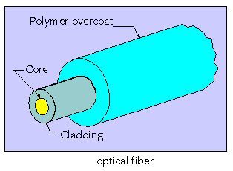
Optical Fiber / Fiber Optic
Core: thin fiber (8 - 100 micrometers), plastic or glass
Cladding: Glass or plastic coating of fiber. Specially designed with a lower index of refraction. Thus it acts as a reflector.
Overcoat (Jacket): plastic layer to protect against environmental dangers

Slide 17
Optical Fiber - Benefits
Greater capacity
  Data rates of hundreds of Gbps
Smaller size & weight
  easy installation, less physical space needed in ducts
Lower attenuation
  less repeaters needed (one in approx. every 50 kms)
Electromagnetic isolation
  no interference
  no crosstalk
  securer

Slide 18
Optical Fiber - Applications
Long distance communication lines
Subscriber loops
LANs

Slide 19
Wireless Transmission
Unguided media
Transmission and reception via antenna
Directional
  Focused beam
  Careful alignment required
    Line-of-sight needed
Omnidirectional
  Signal spreads in all directions
  Can be received by many antennas

Slide 20
Frequencies
1GHz to 40GHz
  referred as microwave frequencies
  Highly directional
  Point to point
  Satellite
30MHz to 1GHz
  Omnidirectional
  Broadcast radio

Slide 21
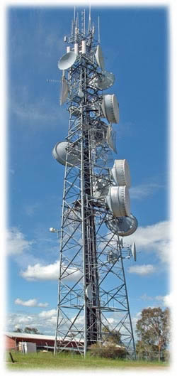
Terrestrial Microwave
Typical antenna is a parabolic dish mounted on a tower
Focused beam
Line-of-sight transmission
Long haul telecommunications
  voice and video
  what are the advantages/disadvantages of using microwave by a long-distance telephone company?
    no right-of-way needed
    No long distance cabling
    need to buy frequency band
    needs periodic towers
    sensitive to atmospheric conditions – e.g. multipath fading
  alternative: fiber optic – needs right-of-way and cabling

Slide 22
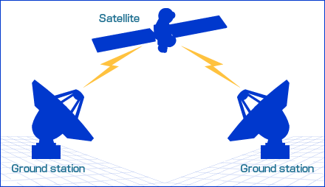
Satellite Microwave
Satellite is a relay station
Satellite receives on one frequency, amplifies or repeats signal, and transmits on another frequency
  transponder = frequency channel
may also broadcast
  TV
Requires geo-stationary orbit
Applications
  Television
  Long distance telephone
  Private business networks

Slide 23
Asynchronous and Synchronous Transmission on Direct Links
Problem: SYNCHRONIZATION
  Sender and receiver must cooperate
  must know when to start and stop sampling
  must know the rate of data
Two solutions
  Asynchronous
  Synchronous

Slide 24
Asynchronous Transmission
Data transmitted one character at a time
  generally 7- 8 bits per character
Prior communication, both parties must
  agree on the data rate
  agree on the character length in bits
But parties do not need to agree on starting and stopping time prior to communication (they exchange starting and stopping time info during tranmission)
  No common clock signal needed
  That is why this is asynchronous

Slide 25
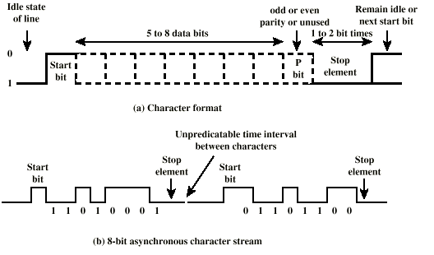
Asynchronous Transmission

Slide 26
Asynchronous Transmission - Behavior
In idle state, receiver looks for 1 to 0 transition
Then samples next “character length” intervals
Then looks for next 1 to 0 for next char
Stop bit is used to make sure a 1 to 0 transition for the next character
Overhead is 2, 3 or 4 bits per char (start, stop and/or parity bits)

Slide 27
Synchronous Transmission
Block of data transmitted without start or stop bits
No overhead (except error detection/correction codes)
Common clock signal
  clock starts ==> data starts
  clock stops ==> data stops
  generally sender-generated
  data is sampled once per clock cycle
  no further synchronization needed for short distance and point to point communication

