Slide 1
DTN Protocol Implementation
Hüseyin Ergin

Slide 2
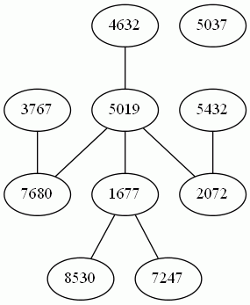
Overall Structure
We have a bunch of clients
Each one may run on different machines
We have a server
As an oracle for connection information
Every client is connected to
Used for log purposes
Message trace
SERVER

Slide 3
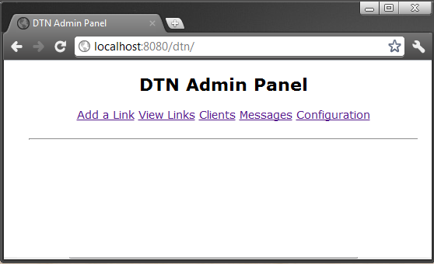
Server
A Tomcat application
Add/Remove links
See all messages
Configuration
TTL
Routing Algorithm

Slide 4
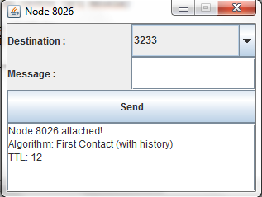
Clients
Destination field
List of all nodes in DTN
Message field
Log area
Log of all events occured in the node

Slide 5
Algorithms
First Contact (with History)
Message sent to the first client that is contacted with current node.
Do not send to a node which is already in the history of the message
First Contact (without History)
Epidemic
Like brute force
Send message to all connected nodes

