Slide 1
Programming Concepts
Focused on Object-oriented Programming

Slide 2
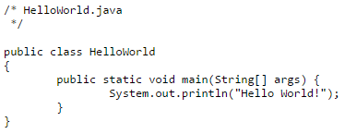
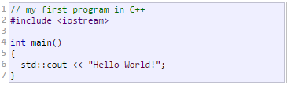

Programming
Just writing some text in a specific format
There are thousands of programming languages!

Slide 3
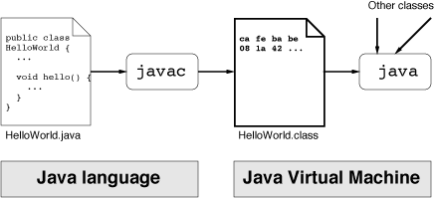
So, what is the trick here?
A compiler/interpreter does the actual job!
Read text file, interpret the contents, output another file more understandable by machines, less understandable by us ☺

Slide 4
Modern IDEs
Previous slide is not a modern day practice.
At least only computer engineers should do it.
Now we have IDEs (Integrated Development Environment)
Providing
Text editors
Compilers
And many other useful features

Slide 5
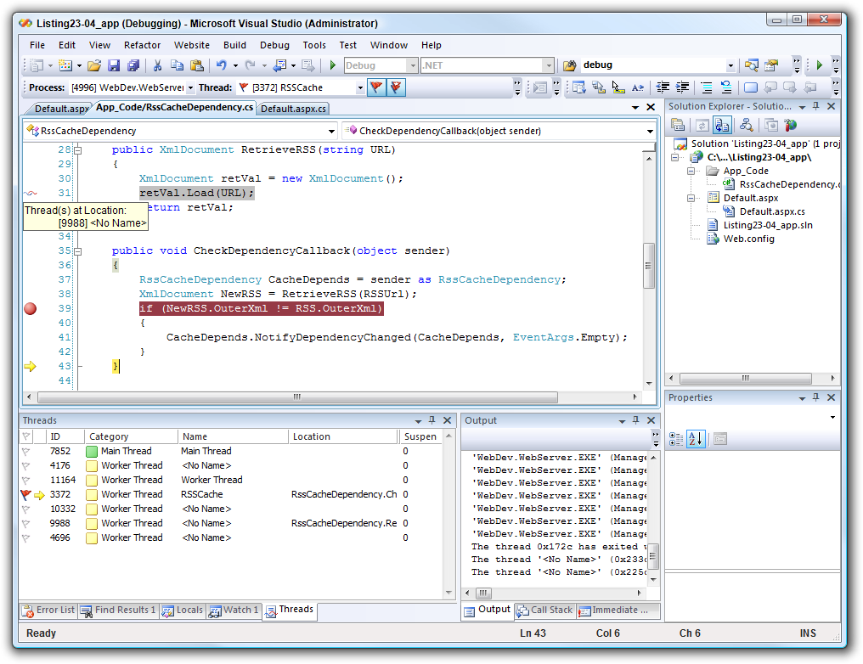
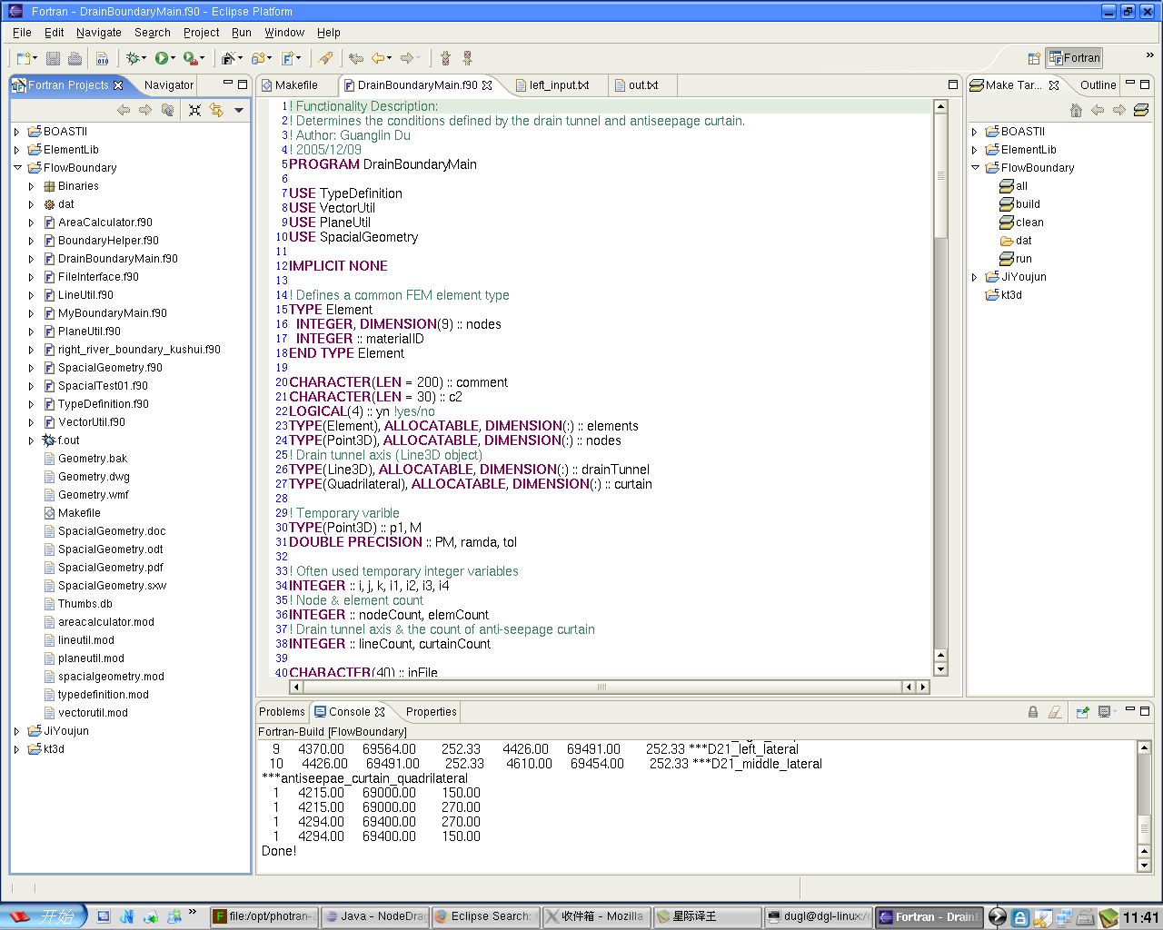
IDE Samples

Slide 6

What is a program?
Just some sequential lines to instruct the computer what to do!

Slide 7
What is a programming language?
Provides the developer useful constructs
Defining variables
Looping
Conditionals
Many more…
And advanced constructs
Data management
Memory management
Networking
Scheduling

Slide 8
Of course…
The programs are not small any more!
Chrome browser: 17 millions LOC (lines of code)
Office 2013: 45 millions LOC
Facebook: 60 millions LOC
You can’t just put all the lines sequentially and expect someone to understand!
Of course we needed extra structures to handle the complexity

Slide 9
Down to actual examples
Lets see some code in action
DogV1.py
Sequential
DogV2.py
Functional
Exact level of functional details
AreaV1.py
AreaV2.py
AreaV3.py
AreaV4.py

Slide 10
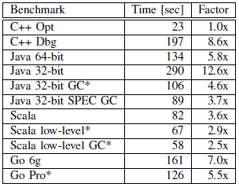
Which language to choose?
According to Google*:
The fastest language is C++
BUT
If you don’t optimize your code, you may end up slower than other languages
See C++ Dbg vs other languages
*Loop Recognition in C++/Java/Go/Scala by Robert Hundt - Google

Slide 11
Why did I choose Python?
Fast to develop a program
Really fast, no chit-chat
Lightweight IDE
Dynamic typing
I didn’t need to write the type of my variables
Either it is integer, string or any other things
Flexible

Slide 12
Parameters, parameters…
DogV3.py
More parameters mean more generalization of that function
AreaV5.py

Slide 13
How about storing some information?
AreaV6.py
Hiding some information inside of the function
AreaV7.py
More information hidden inside.

Slide 14
Next?
If I can store some information inside a function,
Why not there is a special construct for these kind of scenarios?
There is one already!
Classes

Slide 15
Object-oriented Programming
A.k.a.
Object-oriented paradigm
Object-oriented design
Object-oriented methodology

Slide 16
Wouldn’t it be nice…
If there are specialized Rectangle element that
Knows how many sides are there.
Knows how to calculate its own area.
Whenever I need a Rectangle, I just use this element only.
Whenever I ask for its information, it answers itself.
Side = 4
Area = side*side
Height
Base
Area = (height*base)/2
height
Side
base

Slide 17
Objects
Side = 4
Area = side*side
Height
Base
Area = (height*base)/2
height
Side
base
So everything we infer to have its own properties, methods etc. should be an object

Slide 18
Objects
Car, glass, bike, bus
All objects
Dog, cat, person, laptop
Again objects
Running, walking etc… ?
Nop, these are not objects!
These are actions (methods) that can be done by an object
Like a Rectangle can compute its own area
A people can run.
Side, height, numberOfLegs etc… ?
Nop
These are properties (attributes) that can be owned by an object
Like side of a Rectangle.
Numberoflegs of a Person.

Slide 19
Everything can be an object!
It just depends on the context!
Distance between two cities can be an object
If it is the main focus of the problem.
Relationship between two people can be an object
If we are solving a problem about this.

Slide 20
Let’s identify objects!
Company XYZ is a manufacturing company that produces cartoon action figures for big entertainment companies.
This company is using an inventory and tracking system.
The inventory system keeps track of how many of each figurine is stored in each warehouse.
Figures are stored in cases.
Clients order the figurines and the cases are eventually shipped to clients.

Slide 21
Objects Identified
Company XYZ is a manufacturing company that produces cartoon action figurines for big entertainment companies.
This company is using an inventory and tracking system.
The inventory system keeps track of how many of each figurine is stored in each warehouse.
Figures are stored in cases.
Clients order the figurines and the cases are eventually shipped to clients.

Slide 22
Any more?
Company XYZ is a manufacturing company that produces cartoon action figurines for big entertainment companies.
This company is using an inventory and tracking system.
The inventory system keeps track of how many of each figurine is stored in each warehouse.
Figures are stored in cases.
Clients order the figurines and the cases are eventually shipped to clients.

Slide 23
Identify on another example!
An ATM needs to allow a customer to identify themselves
Each customer has a debit card and PIN
Customers should be presented with some kind of menu to help direct them.
Customers can perform two actions:
They should be able to deposit funds
They should be able to withdraw funds upto $200
These funds must be withdrawn in units of $20
The ATM should tell some banking software to update the customers’ account at the end of transaction
The ATM should also give the customer some record of the transaction.

Slide 24
Objects identified
An ATM needs to allow a customer to identify themselves
Each customer has a debit card and PIN
Customers should be presented with some kind of menu to help direct them.
Customers can perform two transactions:
They should be able to deposit funds
They should be able to withdraw funds upto $200
These funds must be withdrawn in units of $20
The ATM should tell some banking software to update the customers’ account at the end of transaction
The ATM should also give the customer some record of the transaction.

Slide 25
Something unnecessary here
PIN can be a property of either the customer of the debit card!

Slide 26
Object-oriented Languages
Most modern language now supports object-orientation
Java
C++ (C with Classes)
C#
Python
And many more

Slide 27
UML Class Diagrams
Now we know objects, we need a way to design an object-oriented system
This system should be independent from any programming language.
UML is here.
Unified Modeling Language

Slide 28
Basic UML concepts
Classes
Objects
Associations
Relations between objects
Attributes
Properties of an object

Slide 29
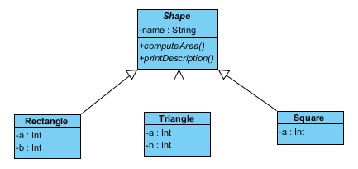
Shape System
Abstract class
Abstract method
Generalization
Attributes
Specific to some classes or general for all
Methods

Slide 30
Shape System (Code)
ShapeV1.py
Implementation of Shape and Square
Constructors
ShapeV2.py
Addition of Triangle to the system

Slide 31
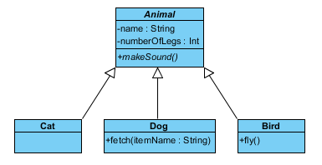
Let’s draw our animal system
Specific methods to some classes
According to their abilities

Slide 32
Animal System (Code)
AnimalV1.py
Implementation with Animal, Dog and Cat

Slide 33
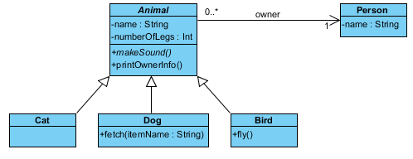
Let’s add some spice
An animal has an owner
Association
And multiplicities
Exact read is in arrow direction
0 or more animals can have 1 owner
But vice-versa is also ok
1 person can have 0 or more dogs
See the new method in Animal class

Slide 34
Animal System with Owner (Code)
AnimalV2.py
Implementation with Animal, Dog, Cat and Person

Slide 35
Class vs Object
What is the relation between this Person and Huseyin?
Person is a class
Huseyin is an object (conforming to Person class)
Meaning Huseyin is a runtime element
In UML there is a separate diagram for this
Object diagram

Slide 36
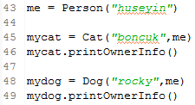
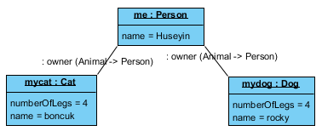
Object Diagram
Class Diagram
Code
Object Diagram

Slide 37
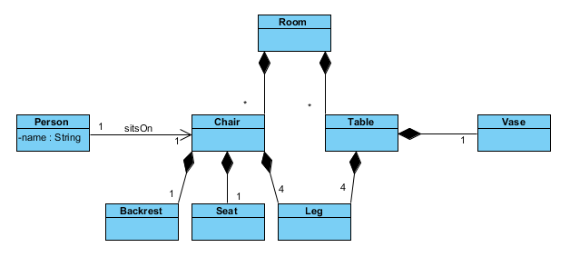
More spice for class diagram
Compositions
A room is composed of many chairs and many tables etc. etc.
Code is same as “association”

Slide 38
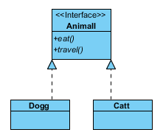
A little more spice
Interfaces
A blueprint of the implementing classes.
So Dogg should implement these methods
Eat and Travel
Code is same as “abstract” classes.
Animal.java
Implementation of Animal, Dog and Cat

Slide 39
Fundamental Principles of Object-oriented Design
Encapsulation
Inheritance
Abstraction
Polymorphism
Cohesion
Coupling

Slide 40
Encapsulation
Information hiding.
Hide unnecessary information from the public.
EncapsulationV1.java
Public and private methods!

Slide 41
Inheritance
We already see in Animal or Shape system.
Dog inherits methods/attributes of Animal.

Slide 42
Abstraction
Working with something we know how to use but we don’t know how it works internally.
We know animals make sounds and we know how to call it, but we don’t know internals.
Internals defined later on Dog, Cat or Bird classes.

Slide 43
Polymorphism
Having more than one form.
We don’t know how to compute the areas of each shape, but we know it will have different forms in each of the subclasses.

Slide 44
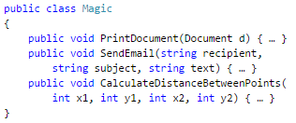
Cohesion
To what degree, a program’s various tasks and responsibilities are related to one another.
Strong cohesion means responsibilities are related to one another.
For example Math class in Java:
It does sin(), cos(), asin(), sqrt(), power(), exp()
It has constants like PI, E etc.
So this class performs only one task: math-related computation
If a class has:
Methods to print something,
Sending an email,
Working with trigonometric functions
How should we name it? Complicated, right?
Strong cohesion helps to build quality code.

Slide 45
Coupling
The extent to which components/classes depend on one another.
CouplingV1.java
Loose coupling
CouplingV2.java
Tight coupling
Loose coupling helps to build quality code!

Slide 46
Advanced Object-oriented Design Principles
S.O.L.I.D.
Single responsibility principle
Open-closed principle
Liskov substitution principle
Interface segregation principle
Dependency inversion principle
Principles by Robert Martin
A known software engineer and pioneer

Slide 47
Single responsibility principle
A class should have one and only one reason to change.
A class should have one job!
SRPv1.java
Problems:
Area calculator is doing so many jobs
Computing areas, printing in some format
It should only sum the areas of the shapes, nothing more.
SRPv2.java
Solution to the printing problem
The logic to print in some different style in handled in a new class

Slide 48
Open-closed principle
Objects should be open to extension, but close to modification
Basically, the classes should be easily extendable without modifying the inner structure.
OCPv1.java
Violation of the principle
OCPv2.java
Now we don’t need to modify sum method each time we add a new shape.

Slide 49
Liskov substitution principle
Every subclass should be substitutable for their parent class.
We should use Dog class instead of Animal class whenever needed.
LSPv1.java
Added a new calculator by extending old one.
We can input this one wherever old one is asked.

Slide 50
Interface segregation principle
A client should never be forced to implement an unnecessary method.
ISPv1.java
Forcing Square to implement volume method, which it doesn’t have.
ISPv2.java
Segregating Shape interface into two to satisfy principle.

Slide 51
Dependency inversion principle
Entities must depend on abstractions/interfaces rather than actual classes.
So that they can be decoupled.
Other definitions:
High-level modules shouldn’t depend on low-level modules. Both should depend on abstractions.
Abstractions should not depend on details, details should depend on abstractions.
DIPv1.java
Manager depends on Worker, and SuperWorker is just sitting there.
DIPv2.java
Now Manager can manage any guy that CanWork.

Slide 52
Principles are done
Now let’s see how we can proceed.

Slide 53
Now the real deal
How will learning object-orientation help me write better codes?
First of all, your code will be more readable
Therefore, more maintainable
As a result, more understandable by “you” later on!
Especially, if you design your UML diagrams with your code too.
Second, is the design patterns.

Slide 54
Design Patterns
People solved same problems for years
And collected good solutions as a collection of something called Design Patterns
First and most famous software related design patterns are in this book:
Design Patterns: Elements of Reusable Object-oriented Software
Erich Gamma, Richard Helm, Ralph Johnson, John Vlissides

Slide 55
A couple of them
Let’s apply some of the design patterns in real problems and see how it improves our performance or solve our problems.
We will see the structure in UML class diagram.
And see how it works in code.

Slide 56
Chain of Responsibility
Design Patterns

Slide 57
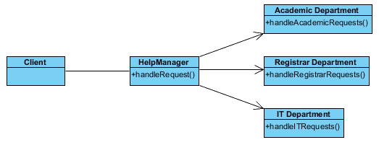
Chain of Responsibility Design Pattern
Scenario:
Any people sends help emails to help.desk@ua.edu
Any questions are welcome and it will be redirected to correct department
Intuitive solution:
A central help manager that has associations to all departments.

Slide 58
Any principles violated?
What if I want to add more departments?
Open-closed principle
Other problems?
Workload of the help manager?

Slide 59
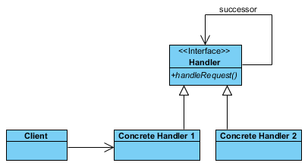
Chain of Responsibility Structure
Handlers connected with successor links.
The request will be sent to first handler, then follows successors.

Slide 60
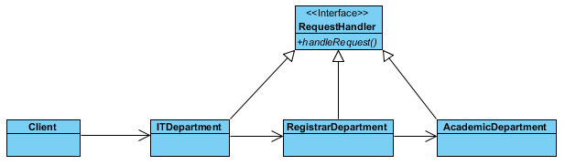
New solution after design pattern
Order the departments with respect to the most workload to the least.
A new department can be added easily to the end.

Slide 61
Code example for Chain of Responsibility
CheckAuthority.java
Purchase requests to be approved by:
Manager (upto 5000)
Director (upto 10000)
Vice-president (upto 20000)
President (upto 30000)
Rest needs a board meeting
It starts from manager and to upper level officials.

Slide 62
Flyweight
Design Patterns

Slide 63

Flyweight Design Pattern
Scenario:
Creating a forest of trees
Lots and lots of them
Intuitive solution

Slide 64
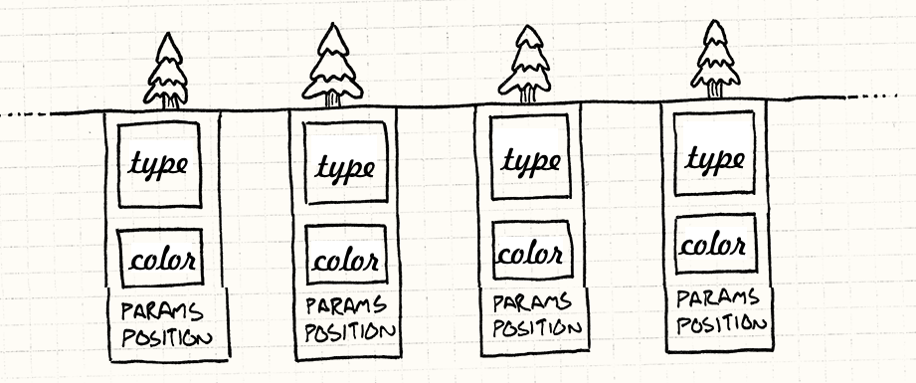
Any problems?
What happens if I create millions?
Lots of objects, probably some of the attributes are same.
For example color: Green will probably be 95% of the object pool.

Slide 65
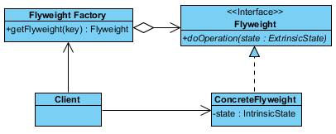
Solution: Flyweight Pattern
Structure
Extrinsic states are properties that can be store in client and used as parameter
Like position.
Intrinsic states are stored in flyweight itself.
Like type, color.

Slide 66
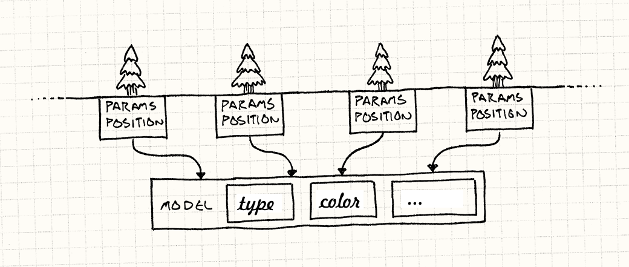
New solution after Flyweight
Now we have less TreeModel.
And the position is passed as parameter

Slide 67
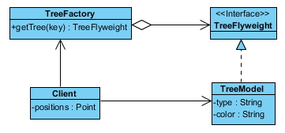
New class diagram
FlyweightV1.java
FlyweightV2.java
These are other circle drawing examples, but see the time difference between two implementations.

Slide 68
Conclusion
This was the important parts of object-oriented programming.
Of course, there is a lot more when you dive into different problems.
Just take advantage of these principles and structures.
DON’T FORGET: If you don’t optimize, the fastest language may be slowest.

Slide 69

Questions?

Slide 70
References:
http://www.introprogramming.info/english-intro-csharp-book/read-online/chapter-20-object-oriented-programming-principles/
https://scotch.io/bar-talk/s-o-l-i-d-the-first-five-principles-of-object-oriented-design
http://gameprogrammingpatterns.com/flyweight.html

