Slide 1
Instructor-formed Capstone Teams Based On Interest and Technical Experience: The Road to Success
Huseyin Ergin, Ph.D.
http://www.cs.bsu.edu/~hergin

Slide 2
TL;DR
Adopted as much scientific ways as possible to form Capstone Teams.
  Modified a little bit to better combine them.
Teams can do better under:
  Homogeneous interest and Heterogeneous technical skill.
Results found satisfying by real clients.
Report only one year of Capstone as starter.
Notes:
This is the summary of all the paper for those of you wondering how this presentation will end and don’t want to read the paper ☺

Slide 3
Details
“The devil is in the detail!”

Slide 4
Self-formed or student-formed
Students’ not selecting diverse teams
They focus on people like them.
They don't learn to work with unfamiliar people.
Left-over students
Notes:
Another item we can think of is left-over students in a team forming process.
You know the point where all of the friends formed teams but there are students socially awkward or new to the cohort and don't have too many friends.

Slide 5
Instructor-formed based on what criteria
Some possible factors:
  Academic strength (GPA)
  Interest in the project
  Work experience
  Personality
  Diversity elements
Notes:
When instructor-formed teams approach is chosen, one big decision to make:
Based on what we arrange the teams?
All of these have studies related to their effect, but I believe in standardization in these kinds of studies.

Slide 6
Instructor-formed based on what criteria
Brickel et al., Assigning Students to Groups of Engineering Design Projects: A Comparison of Five Methods
  Airforce Academy in Colorado Springs
  442 students in 24 sections by 8 different instructors
  5 different teams approaches
    Heterogeneous GPA and heterogenous interest
    Heterogeneous GPA and homogeneous interest
    Homogenous GPA and heterogeneous interest
    Homogeneous GPA and homogeneous interest
    Self-select
  Instructors were aware of the study, students were not
    Heterogeneous GPA and homogeneous interest
Notes:
One study earned my interest more than others.
Result was homogeneous interest and heteregeneous GPA teams are most successful concerning team grades and attitudes about the course.

Slide 7
Our team formation approach
We adopted heterogeneous GPA and homogeneous interest.
  Instead of GPA, we used technical skill.
  In the paper, the interest is defined as their majors.
We tweaked a little bit.
  Ensuring there is at least one high-skilled student in each team.
Notes:
We have decided to use this approach.
Instead of GPA, we have used technical skill level as a replacement. I don't believe GPA is the perfect indicator of how some students can success in a software project.
In the paper, the interest is defined as their majors. We took similar interest as the interest to the project.

Slide 8
Ensuring one high-skilled student in each team
Webb et al., Equity Issues in Collaborative Group Assessment: Group Composition and Performance
  “The team performance is correlated to the team member with the highest ability.”
  Possible disadvantage:
    “Heterogeneous groups provide a greater benefit for below-average students than they impose a detriment on high-ability students.”
Notes:
We have tweaked this approach a little bit by ensuring there is at least one high-skilled student in each team.
In other words, we sacrifice the high-skill student for the sake of the group in total. We see this is a better approach for the low-skilled students. Because high-skilled students will eventually make it.

Slide 9
Understanding technical skill
By a survey asking:
  Programming experience
  Top PL, IDE
  Internship/work experience
Classify them as High, Medium, Low skill.
Notes:
This year, I tweaked it a little bit to better understand technical skill by assigning one individual and one random-team based programming assignment.

Slide 10
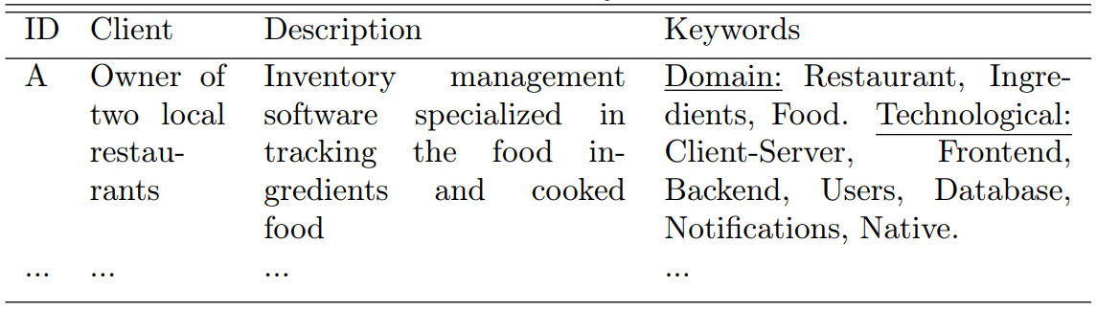
Understanding project interest
Notes:
We just showed them keywords from projects. Like below:
Our purpose was not to reveal the whole project and eliminate the students' showing interest in only some good ones.

Slide 11
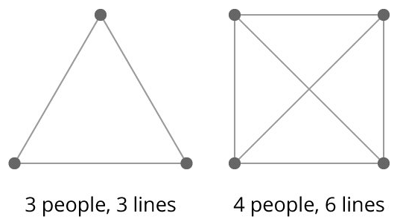
Setting the right team size
Debbie Richards, Designing Project-based Courses with a Focus on Group Formation and Assessment
  Teams of 3 often delivers better solutions.
  They work harder and better.
  "Perhaps" suffering less from the communication lines issue.
Frederick P. Brooks Jr., The Mythical Man Month and Other Essays on Software Engineering
  “Number of communication lines hinder the success of the projects.”
Notes:
A counter argument to 3 is they offer less of a "group" experience.
In my personal experience, more than 3-member teams:
Other than core 2-3 students, remaining drops the towels easier, thinking that someone is working on the project.
They divide themselves into subgroups, which makes the communication tricky among these subgroups.

Slide 12
Choosing the development methodology
Nature of class suggests waterfall.
Bertrand Meyer, The Ugly, the Hype and the Good: An assessment of the Agile Approach
  Leaving out the upfront design in Agile is a mistake!
An agile approach with upfront design in the first semester, 3 iterations in the second semester.
Notes:
Nature of the class suggests waterfall, designed by traditional software faculty.
It is not the reality in the industry though. Now most of the companies use Agile.
Therefore, we didn't skip the upfront design and spent the first semester on requirements, design, prototyping etc.
Then, we completed the projects in the second semester in 3 iterations.
This year, we have also updated it to be 5 iterations and spend 2 months on the requirements and background training of the students.

Slide 13
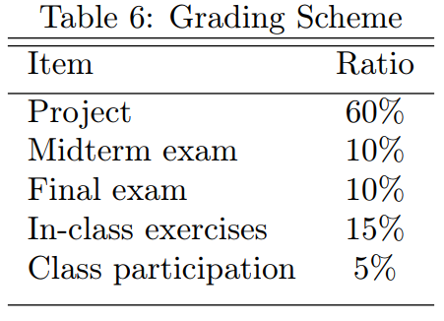
Personal Contribution Weight
Traditional grading scheme
Notes:
We have adopted a system called Personal Contribution Weight (PCW) to the project grade here.

Slide 14
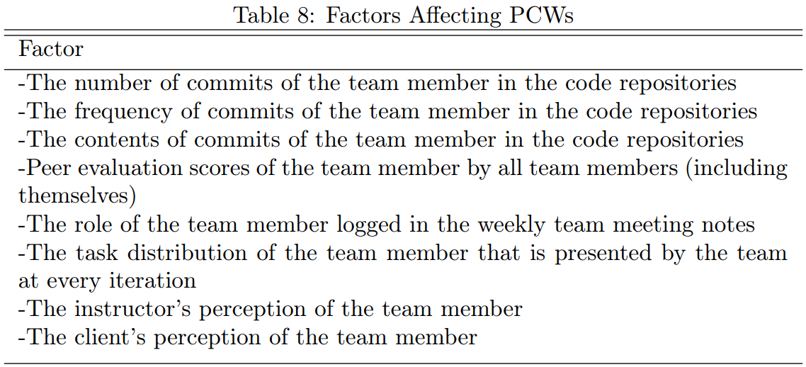
Personal Contribution Weight
A number from 0.0 to 1.0
The purpose is to better assign an individual grade for the team members.
Notes:
We have adopted a system called Personal Contribution Weight (PCW) to the project grade here.
It is a number from 0.0 to 1.0 and directly multiplied by the project grade at every iteration.
Peer evaluations seem to be a popular approach to understand the contribution of the peer.
But we already have access to more data to understand the contribution of a team member

Slide 15
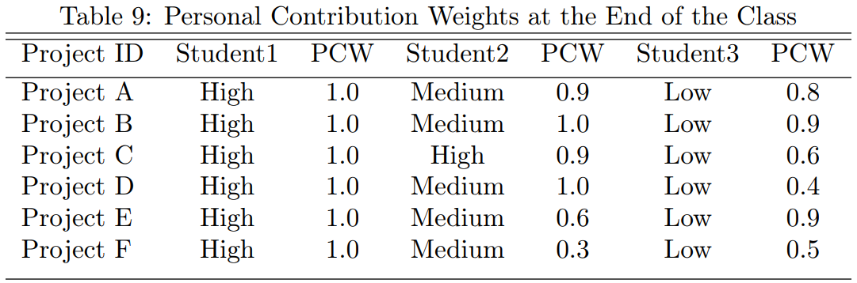
Results
High skilled students are really doing the most contribution to the project.

Slide 16
Results
High skilled students receive higher grades from other team members in peer evaluations.
They are praised as:
  "doing good job to keep the team on track"
  "enjoyable to work with positive attitudes"
  "considered very valuable to the team"

Slide 17
Results
Some high skilled students are too "high" skilled.
  They can not stop themselves from contributing to the project.
  That leads to other team members feeling their work is worthless.
Some high skilled students complain about their low-skilled peers.
  Our advice is usually to try triaging tasks instead of losing hope and giving up on them.

Slide 18
Results
High skilled students feel they are the driving force in the team.
They shared these comments:
  "I feel as though a lot of pressure for our project has fell on my shoulders."
  "I sometimes have doubts if the team would do anything unless I asked first."
  "I do feel like I carry this team a little too hard at times and organize everything."
We already know high-skilled students are affected for the greater good of the team.
  How powerful the effect of this on high-skilled students? Another study.

Slide 19

What’s next?
www.capstoneconnector.com
Notes:
As mentioned in the conclusion of our paper, here is the final situation.
Explain as much as possible if there is time.
Focus on distinction from other centers.
This one is in the heart of the community, rather than in the university.

Slide 20
Instructor-formed Capstone Teams Based On Interest and Technical Experience: The Road to Success
Huseyin Ergin, Ph.D.
http://www.cs.bsu.edu/~hergin
Questions?

