Slide 1
A Study of Modeling Perception in a First-Time Modeling Class
Huseyin Ergin, Isaac L. Walling, Kate P. Rader, D. Joshua Dobbs
http://www.cs.bsu.edu/~hergin

Slide 2
Outline
Motivation
Background
Course Lectures & Tools
Study Structure
Results
Conclusion

Slide 3
Motivation
There is still not a standard structure for a modeling course.
  This paper is a small experiential addition to the efforts of MBSWEBOK by Ciccozzi et al. to see the proposed topics in practice.
To see how “modeling” perception, the way we (people here) understands it, changes in a class.

Slide 4
Background
This is not a first “first-time modeling class” in an undergraduate-heavy institution (Rapos Study)
  Most related and recent study.
  Focus on grades and their correlation with the understanding of the topic.
  We have adopted to:
    Use any tool in the course before assigning in a project.
  No model transformation!
Our course:
  Last 1/3 of the course is about Model Transformation.
  Focus on the change throughout the semester.

Slide 5
Background
How do we teach Modeling and Model-Driven Engineering: A Survey by Ciccozzi et al.
  We have adopted:
    Hands-on approaches are more effective.
    Code generation helps students see a direct benefit.
    Start from simple and progressively make it complex.
Our course:
  Every week: 1 hour of lab session with a tool before assignment.
  Code generation is included as a step to Model Transformation.
  From simple to complex:
    Use editor for a statechart, then create a modeling environment for it, then use code generation to produce statechart.

Slide 6
Course Structure
50 mins every Monday-Wednesday-Friday
  Monday – Wednesday: Lecture
  Friday: In-class exercise

Slide 7
Course Lectures
UML
Statecharts
  To teach abstraction. Separation of dynamic and static aspects.
Domain-specific languages
Modeling
Metamodeling
Code generation (Model-to-text transformation)
  A step towards general model transformation.
Model transformation
  “Heart and soul of model-driven software development”
  A modeling class is missing a core without MT.
Notes:
Some are pretty standard.

Slide 8
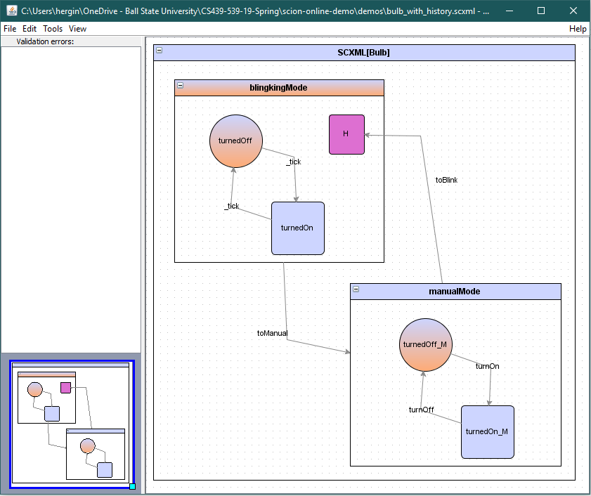
Tools
SCXML-GUI
  A small visual tool for statechart design in scxml format
Notes:
We design statecharts visually and the tool saves them in SCXML textual standard format.

Slide 9
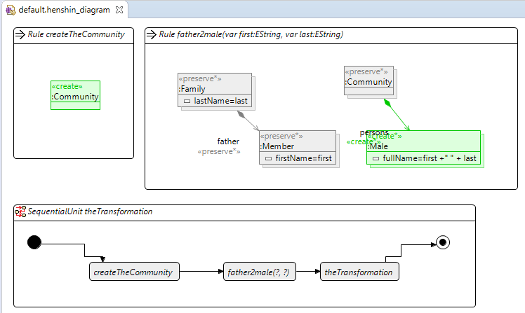
Tools
EMF
  Metamodeling
  Henshin
Notes:
We are all aware of the infamous EMF.
We have used Henshin for model transformation of EMF models.

Slide 10
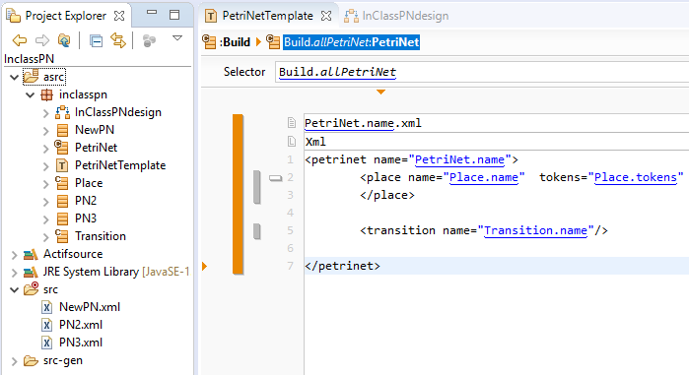
Tools
Actifsource
  Code generation
Notes:
We have used this for code generation.
Basically, we can create a metamodel, sample models and an XPAND like template and code is generated automatically.

Slide 11
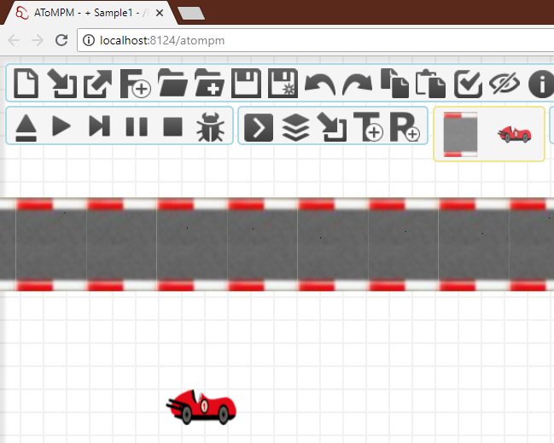
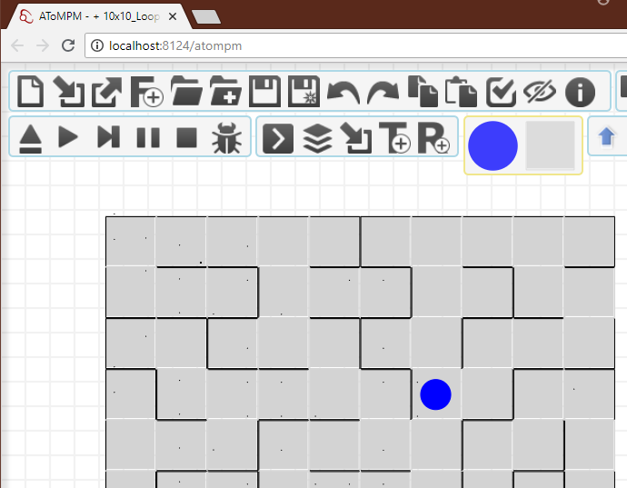
Tools
AToMPM
  Multi-Paradigm Modeling
Notes:
Metamodeling, model creation and Model transformation, all visually.

Slide 12
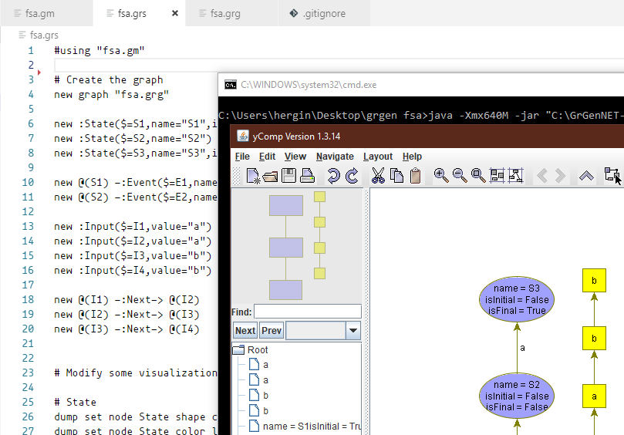
Tools
GrGen.NET
  Graph transformation
Notes:
This is to show there are also textual languages to do graph/model transformation.

Slide 13
Study Structure
Our single main Research Question:
  How has the modeling perception been changing throughout the semester for the first-time learners?
3 graduate students conducted the study on 11 undergraduate students.
3 surveys:
  Distributed at the beginning, middle, and end of the semester.
All the questions are in the paper.
  Generally:
    Modeling definition, Challenging topics, Difficulty of the tools.

Slide 14
Results: Modeling Background
All have taken CS222 – Advanced Programming
  But very little mention of modeling or UML in this class.
4/11 have taken CS 495 – Software Engineering
  UML, OOP etc.
  However, 6/11 say they had used UML before.
How useful is modeling?
  3.5/5 in average (5 is the most useful)
All traditional modeling.
  Not aware of the modeling in the way we understand it.

Slide 15
Results: Modeling Perception
We have asked them to define “modeling” in each survey.
  To analyze how they change.
Next page is the whole answers.

Slide 16
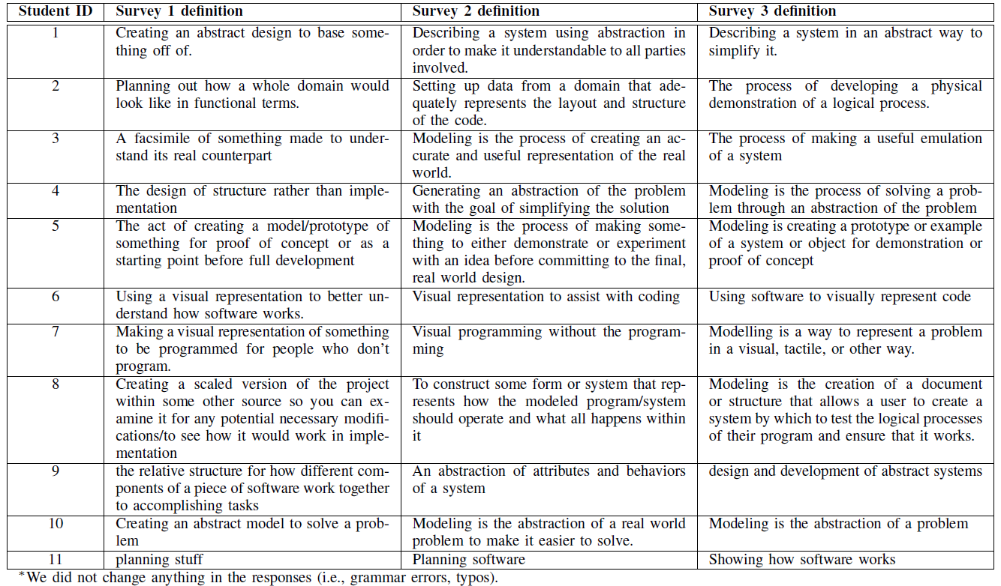

Notes:
Number 4 is the utopian change in the perception. [You can read definitions of number 4]
Of course, this depends on which modeling definition we take into account. In the literature, there are many definitions. We tried to adopt the one from Kuhne “an abstraction of a (real or language-based) system allowing predictions or inferences to be made”

Slide 17
Notes:
Number 5 and 10 are already to the point from the first survey.
We checked the background of the best perception changes and we couldn’t come up with significant statistics like their previous modeling topics etc were not consistent.

Slide 18
Notes:
Number 7 and 8 were showing some change but they are not becoming more precise. This might be due to the tools becoming challenging at some point.

Slide 19
Notes:
Number 6 and 9 show some change but they were not becoming the best definition of modeling at the end of course.

Slide 20
Notes:
Then, there was a student like number 11 ☺
Who did not care about the study probably.

Slide 21
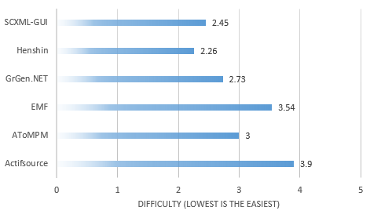
Results: Difficulty of Tools
Notes:
This, I didn’t expect. Especially, Henshin’s being easier than EMF, given that they have to create the henshin metamodels in EMF.
Then, there were some shockers for me. I was thinking ActifSource is a pretty easy tool. Obviously not for the students.

Slide 22
Results: Lecture Structure
The most challenging topic was: Model-to-text
  One possible reason: A step to model transformation.
  Actifsource found to be the hardest tool.
One quote:
  “This class is pretty cool. It is a class that has actually provided a unique and useful outlook on a topic in computer science that isn’t focused around programming, but still applies its principles in programming examples, much like cs124 or 224”

Slide 23
Threats to Validity
Population: 11 students.
Uninformed graduate students conducting the study.

Slide 24
Conclusion
This class is an addition to how should we teach modeling.
  Trying to structure materials in a specific order.
Not all students perception might change regardless of the tools/topics.
When it comes to modeling tools, “easy-to-use” is pretty subjective.
Maturity and difficulty of the tools are affecting the perception.

Slide 25
A Study of Modeling Perception in a First-Time Modeling Class
Huseyin Ergin, Isaac L. Walling, Kate P. Rader, D. Joshua Dobbs
http://www.cs.bsu.edu/~hergin
Notes:
Any questions?

