Slide 1


Model Transformation Design Patterns
Hüseyin Ergin
Software Modeling Lab
Software Engineering Group
Department of Computer Science
College of Engineering
University of Alabama

Slide 2
Introduction to Model Transformation
Components of a Model Transformation Language
  Transformation Rules
  Scheduling
Design Patterns
Model Transformation Design Patterns
Conclusion & Future work

Slide 3
Models & Model Transformation
In MDE, models are first class citizens.
  A model captures some characteristics of the system and provides knowledge about it.
Each model conforms to a metamodel.
  Metamodel is the essence of a modeling language.
Model transformation: An automated manipulation of models according to a specific intent^{[1]}.
  Intent is the description of the goal behind the model transformation and the reason for using it.
[1]: Amrani, M., Dingel, J., Lambers, L., Lucio, L., Salay, R., Selim, G., Syriani, E., and Wimmer, M. (2012) Towards a model transformation intent catalog.

Slide 4
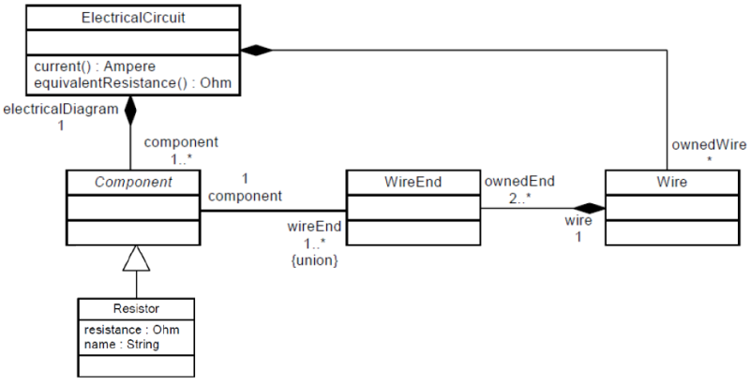
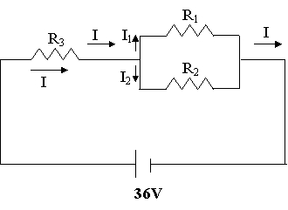
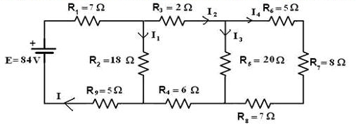
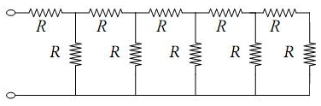
Illustration
Notes:
These are electrical circuit examples. And actually they are models.
And this is the metamodel of Electrical circuits[1]. The elements, the connections, the figures are all defined here.
[1]: CS691 Model-Based Design Slides

Slide 5
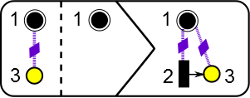
COMPONENTS of MODEL TRANSFORMATION: Transformation RULES
Transformation rule is the smallest unit of a model transformation.
A description that:
  Takes element from source language
  Transforms them to elements in target language
Usually represented as LHS, RHS and optional NACs.
      NAC LHS RHS
Notes:
A description of how one or more constructs in source language can be transformed into one or more constructs in target language
LHS: Left hand side, matcher will try to find this pattern
RHS: Right hand side, executor will apply this pattern to the model
NAC: Negative application condition, Some patterns prevent rule to be applied

Slide 6

COMPONENTS of MODEL TRANSFORMATION: SCHEDULING
Basically the order in which the rules will be applied.
In ideal case^{[1]}:
[1]: Syriani, E. & Vangheluwe, H. A Modular Timed Model Transformation Language , Journal on Software and Systems Modeling, 2011, 11, 1-28
Notes:
In ideal case,
each rule may be put in any order, and we can say what happens when the rules fail or succeed.

Slide 7

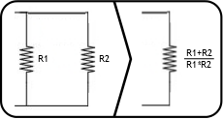
Illustration
A model transformation to find the equivalent resistance
Rule 1 for serial resistors:
Rule 2 for parallel resistors:
Scheduling:
  Apply one by one in a loop until no more match is found.
Notes:
Two simple rules! It is that easy!

Slide 8
DESIGN PATTERNS
Everyone knows design patterns!
They help us do things quick, painless and effective.
Why are they so useful?
  Well studied on more and more systems.
  Proved to be the optimized solution to a specific problem.
  Mostly derived from real time problems.
Notes:
Since everyone knows at least something about design patterns, I will pass quickly.

Slide 9
Model Transformation Design Patterns
There are common solutions to common model transformation problems.
This leads us to find design patterns for model transformation.
Some published works and design patterns in the literature. [Agrawal2005, Iacob2008]
Some of the patterns are:
  The mapping pattern
  The refinement pattern
  The node abstraction pattern
  The flattening pattern
Notes:
I will explain one of them with a few slides to get the idea. (mapping pattern)

Slide 10
The mapping Pattern
Goal:
  One-to-one relations between elements from source and target metamodels.
Motivation:
  This can be used when source and target models express more or less the same semantics, but in different syntax.
Structure:
  The rules generally have single element from source metamodel in LHS and from target metamodel in RHS.
  Scheduling is straight forward, order is not important. (there may be exceptions)
Example:
  Model transformation from JSON formatted data to XML formatted data.

Slide 11
Model transformation has two important components:
  Transformation rules
  Scheduling
We can easily design a model transformation.
Design patterns can be applied to model transformation.
As future work:
  Existing design patterns for model transformations will be reviewed in details.
  New design patterns will be identified either from existing model transformations or from real world.
  A catalogue will be created for model transformation design patterns.

Slide 12
References
[Agrawal2005] Agrawal, A. (2005) Reusable Idioms and Patterns in Graph Transformation Languages. International Workshop on Graph-Based Tools, Rome, March, ENTCS, 127, pp. 181192. Elsevier.
[Iacob2008] Iacob, M.-E., Steen, M. W. A., and Heerink, L. (2008) Reusable Model Transformation Patterns. Proceedings of the Enterprise Distributed Object Computing Conference Workshops, Munich, September, pp. 110. IEEE Computer Society.

