Slide 1


Evaluation of Modeled vs. Traditionally Developed Project Management Tools
Huseyin Ergin
Advisor: Dr. Eugene Syriani
Software Modeling Lab
Software Engineering Group
Department of Computer Science
College of Engineering
University of Alabama

Slide 2
Introduction
Project Management Tools
Plan
Evaluation
Results
Conclusion & Future work

Slide 3
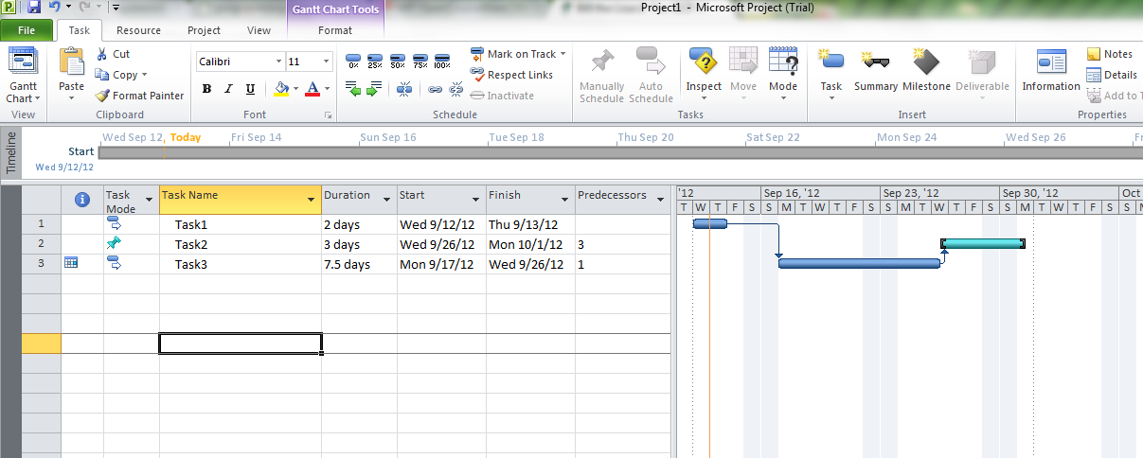
Introduction
Current Project Management Tools
  MS Project
    Commercial, native, traditionally developed, lots of human resources etc.
Notes:
……Abstraction To bridge the gap between problem……
These abstractions are models.
This metamodel defines the elements and relations between these elements.
Manipulation: a simple atomic operation on a model
Restrictive query: for some information about a model
Optimization: Improving operational qualities of model
SYRIANI: Literature identified 20 intents.
Metamodel of a modeling language is like the grammar of programming languages. It defines the syntax (abstract syntax) and static semantics of the language. We traditionally define a metamodel usiing UML class diagrams.

Slide 4
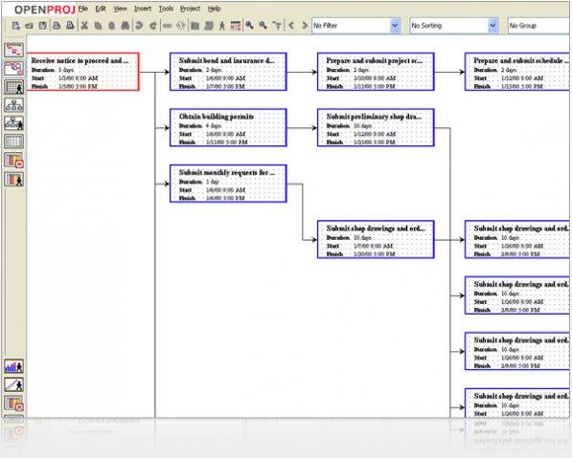
Introduction – cont’d
Current Project Management Tools
  OpenProj
    OpenSource, native, traditionally developed, etc.
    Not so many human resources, but still more.
Notes:
……Abstraction To bridge the gap between problem……
These abstractions are models.
This metamodel defines the elements and relations between these elements.
Manipulation: a simple atomic operation on a model
Restrictive query: for some information about a model
Optimization: Improving operational qualities of model
SYRIANI: Literature identified 20 intents.
Metamodel of a modeling language is like the grammar of programming languages. It defines the syntax (abstract syntax) and static semantics of the language. We traditionally define a metamodel usiing UML class diagrams.

Slide 5
Current project tools
Resources
  Humans, materials
  Assigned to tasks
Use different style of representation
  Gantt chart
  Network graph

Slide 6
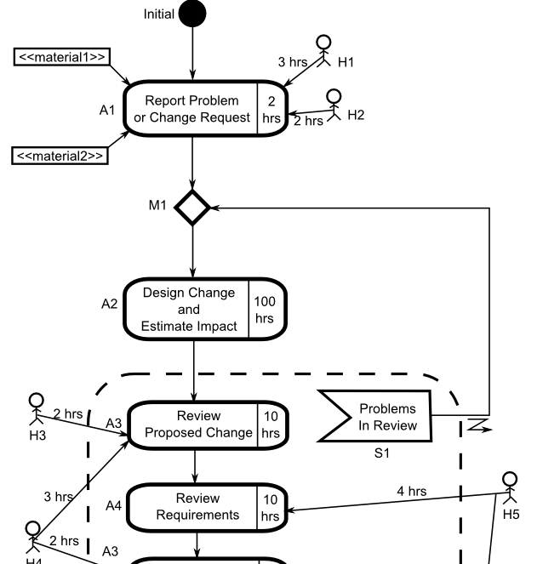
What I did?
Use activity diagram representation.
Model the tool, instead of developing it by code.
  Next slides
Evaluate the tool with another project management tool
  MS Project
  With real users

Slide 7
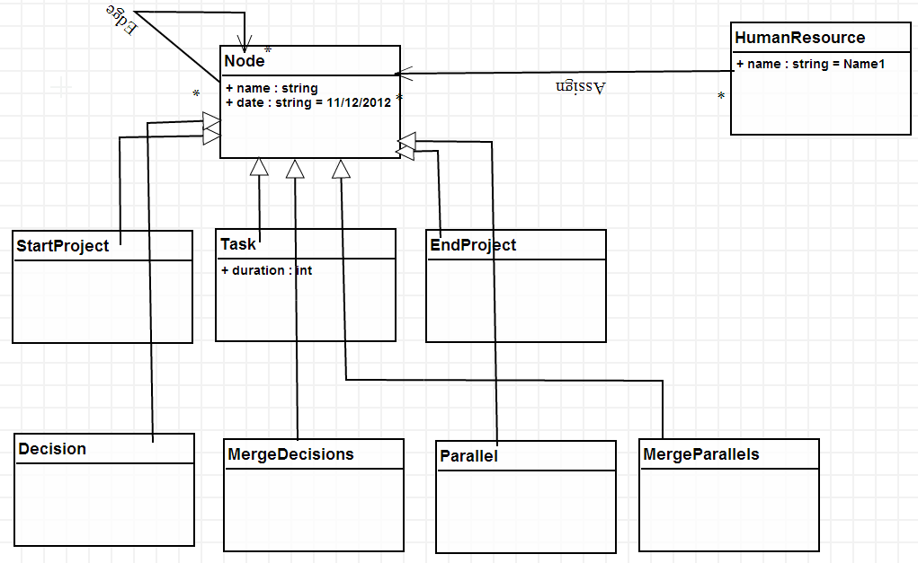
MODELPROJ
Modeled Project Management Tool in AToMPM*
Metamodel defines elements/connections of the tool (Abstract Syntax)
*http://syriani.cs.ua.edu/atompm/atompm.htm

Slide 8
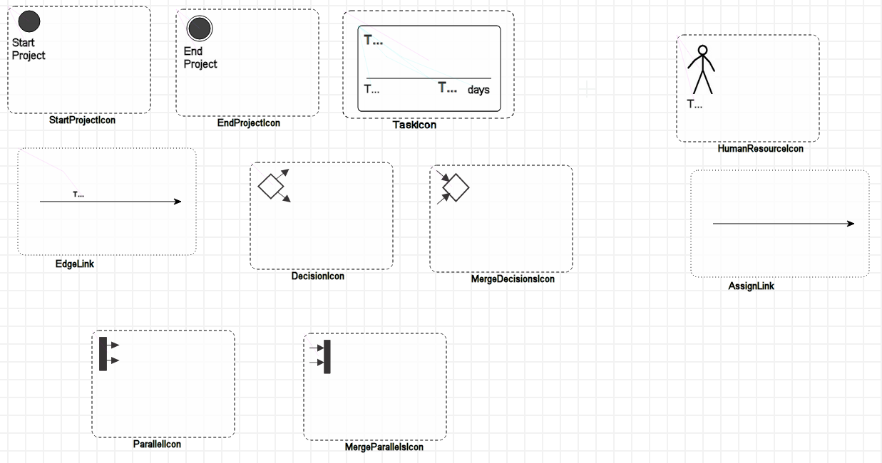
MOdelproj
The icons of each element in the metamodel (Concrete Syntax)

Slide 9
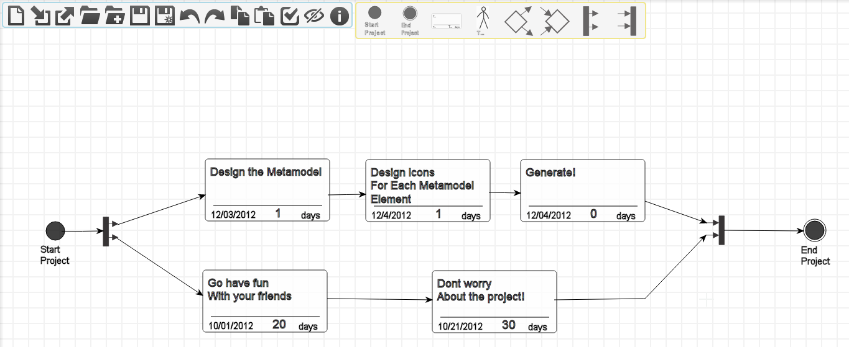
modelproj
Now we have metamodel and icons, we can generate our project management environment automatically

Slide 10
Details of evaluation
With real users
  Grad students
Users are requested to do some simple jobs in both tools.
  Half of the users (first MS Project, then ModelProj)
  Other half is vice-versa
Their screens are recorded to measure
  Duration
  Number of clicks
At the end, they fill out a survey
10 users are planned, 2 of them are not included in the results (pilot study)
Start the project
Create a task
Assign resource
Create another task
Schedule tasks
Decision task
Parallel tasks
Create another task
Reallocate resource
End the project

Slide 11
The results
Survey Results (8 users)
5 out of 8 users said they may reuse ModelProj again instead of MS Project

Slide 12
The results – cont’d
Most of the time, tasks in MS Project last shorter
Most of the tasks are intuitive, but some tasks need to be mentioned
  Task 6 is a decision task and advanced task and MS Project doesn’t support this feature.
  Task 7 is parallel task, and it was for users to do that in MS Project
In general, it is expected (why is in conclusion)

Slide 13
The results – cont’d
ModelProj needs more click counts in general
  Because of graphical nature of the tool

Slide 14
conclusion
I did this study to compare two tool that have different development methodology.
  MS Project: Lots of developers, resources, time, lots of regular coding.
    In addition lots of features that may be useful to only advanced users
  ModelProj: Single developer, one afternoon, only modeling.
    Focus on general functionalities, not going too deeper (but can be extended)
Modeling is a solution oriented methodology
  Means trying to give Project Management users what they need.

Slide 15
Conclusion – cont’d
The empirical experiments showed that
  Users like to have a simple and clear tool
    Even though they make more mistakes in that tool
  If the tool doesn’t look complicated, they tend to override the errors/duration they spent to be positive.
  Throwing lots of advanced features to the user can complicate even simple jobs.
  ModelProj must be improved to prevent errors from users.
    Mostly because of the underlying modeling environment.

Slide 16
Future work
Improving ModelProj, so that it has more ‘simple’ features.
  More features
  Adoption of model transformation
    Calculating the total time of the project.
    Analyzing the bottlenecks of the project
    All of them again with only designing, less coding.
  Improving the underlying modeling environment, so that the tools it generates will become more useful.

Slide 17

Questions?
Thanks for listening!

