Slide 1


Identification and Application of a Model Transformation Design Pattern
Huseyin Ergin and
Eugene Syriani
Software Modeling Lab
Software Engineering Group
Department of Computer Science
College of Engineering
University of Alabama

Slide 2
Introduction
Running Example
  LCA Problem
  Analysis
Similar Problems
  Equivalent Resistance
  Dijkstra’s Shortest Path Algorithm
Fixed-point Iteration Design Pattern
Related Work
Conclusion & Future work

Slide 3
Introduction
MDE is software development approach that uses abstraction between problem and software implementation
Models are first class citizens.
  A model captures some characteristics of the system and provides knowledge about it.
Each model conforms to a metamodel.
  Metamodel represents the essence of a modeling language.
Model transformation: An automated manipulation of models according to a specific intent ^{[1]}.
  Intent is the description of the goal behind the model transformation and the reason for using it.
  Some intents: Manipulation, Restrictive query, Optimization etc.
[1] Amrani, M.; Dingel, J.; Lambers, L.; Lucio, L.; Salay, R.; Selim, G.; Syriani, E. & Wimmer, M. Towards a Model Transformation Intent Catalog MoDELS workshop on Analysis of model Transformation, 2012
Notes:
……Abstraction To bridge the gap between problem……
These abstractions are models.
This metamodel defines the elements and relations between these elements.
Manipulation: a simple atomic operation on a model
Restrictive query: for some information about a model
Optimization: Improving operational qualities of model
SYRIANI: Literature identified 20 intents.
Metamodel of a modeling language is like the grammar of programming languages. It defines the syntax (abstract syntax) and static semantics of the language. We traditionally define a metamodel usiing UML class diagrams.

Slide 4
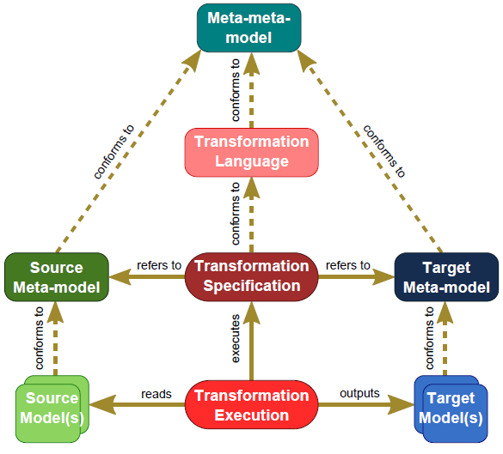
Introduction – cont’d
Model transformation schema in MDE ^{[2]}
[2] Eugene Syriani, Jeff Gray and Hans Vangheluwe. Modeling a Model Transformation Language. Domain Engineering: Product Lines, Conceptual Models, and Languages (2012)
Notes:
We have source models which have their own metamodels.
Target models which have their own metamodels.
And in the middle we have a transformation which conforms to a transformation language.
The transformation reads the source model and outputs the target model.
Therefore refers to both source and target metamodels.
SYRIANI: Transformation defined in metamodel level but executed on instance level.
We only write a transformation once for a pair of domains and this will fit for all instances.

Slide 5
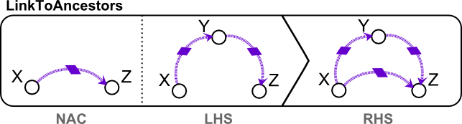
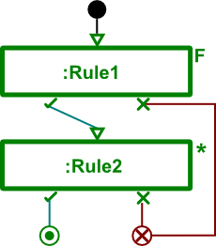
Introduction – cont’d
MoTif: Rule-based transformation language ^{[3]}
Graphical transformation rules
Explicit rule scheduling
[3] E. Syriani and H. Vangheluwe, “A Modular Timed Model Transformation Language,” Journal on Software and Systems Modeling, vol. 11, pp. 1–28, June 2011.
Notes:
Other types are template based, functional (Kermeta), imperative (Java).
Transformation rules are the smallest unit of a model transformation.
LHS: match the pre-condition pattern in the input model
RHS: replace/modify match to post-condition pattern
NAC: optional pre-condition pattern that inhibits the application of the rule
Scheduling is basically the order of the rules.
And it represents the control flow.
Rules can be represented with an F which means for all matches.
Asterisk (*) which means as long as it is applicable
Question mark (?) which means a query

Slide 6
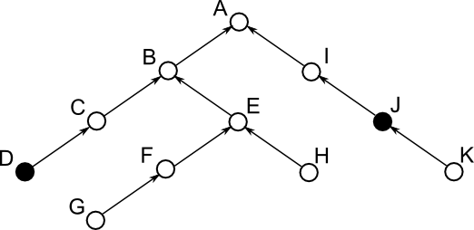
Running example
Lowest Common Ancestor Problem ^{[4]}:
  In a tree structure find the lowest common ancestor of two given nodes.
  Solution using a naïve approach
[4] A. V. Aho, J. E. Hopcroft, and J. D. Ullman, “On finding lowest common ancestors in trees,” in Proceedings of the fifth annual ACM symposium on Theory of computing, ser. STOC ’73. New York, NY, USA: ACM, 1973, pp. 253–265.
Notes:
A tree structure may be like that or with only child links downwards.
An example may be node D and node J.
And lowest common ancestor of node D and node J is node A in this case.
Now we will solve this problem step by step using MDE approach.

Slide 7
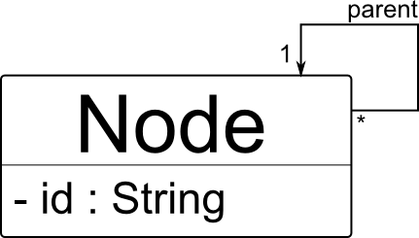
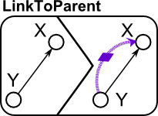
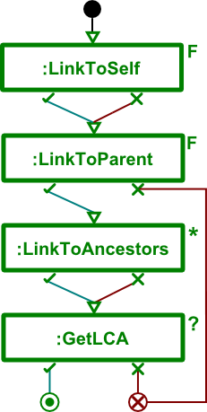

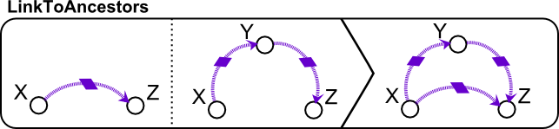
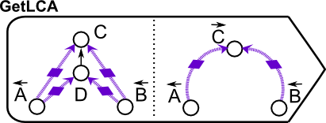
Running example – cont’d
A metamodel for such a tree:
Rules for naïve solution Scheduling
Notes:
First we have to create a metamodel. All we need is a node element with parent link.
After metamodel, we have also our environment by generating (Most tools support this: Eclipse EMF, AtomPM etc).
Now to solve the question we will write our necessary rules.
Then we need the scheduling of these rules which is basically the order of rules.
SYRIANI: ANCESTOR LINKS instead of generic or temporary links

Slide 8

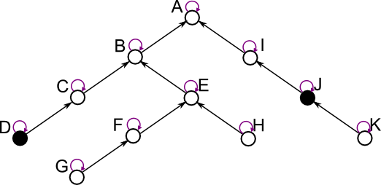
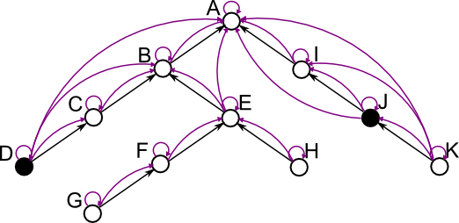
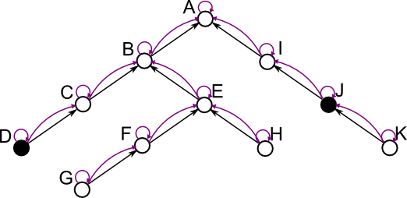
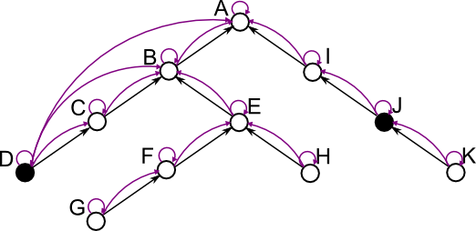
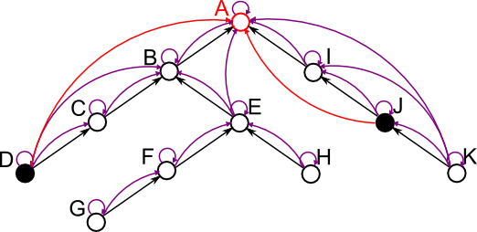
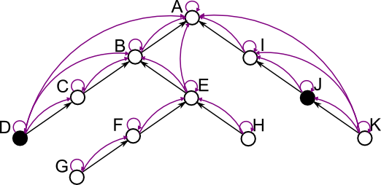
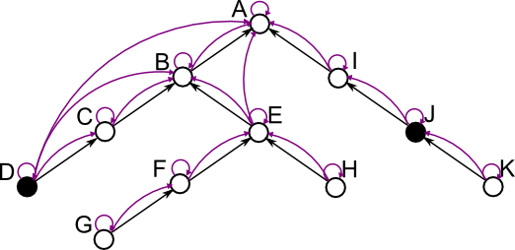
Illustration
Notes:
The solution of the problem by applying the rules are here. Step by step.

Slide 9
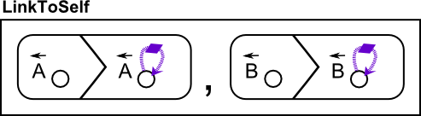
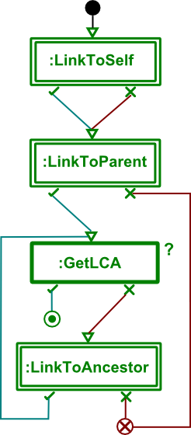
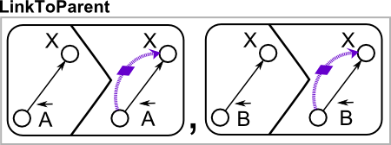
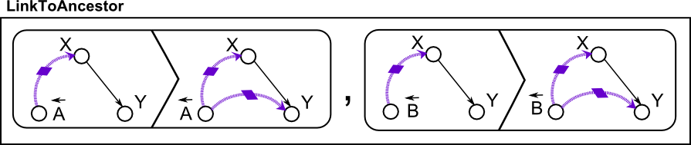
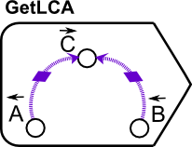
Running example – improved solution
Now this solution uses ‘locality’
Focus in the area of input nodes, and check for a solution in every step
Rules Scheduling

Slide 10
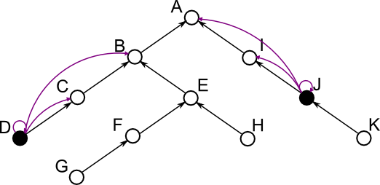
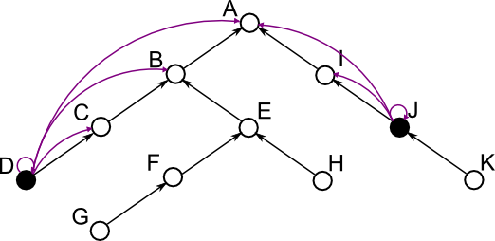
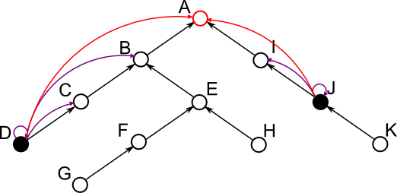
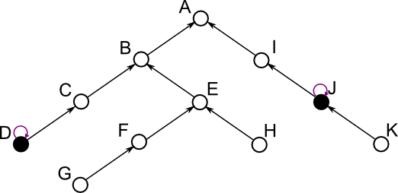
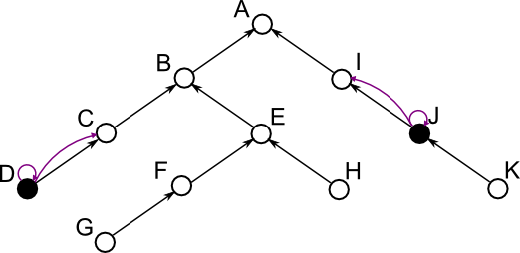
illustration
Notes:
Now the strategy is changed and we will check in every step for a solution
And if we cant find a solution, we will do one more step that will make us close to a solution and check again.

Slide 11
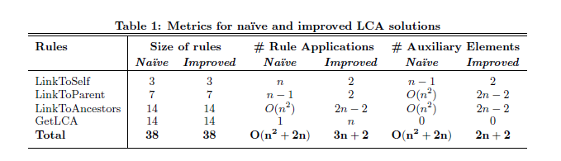
Analysis
n = number of nodes
Notes:
The metrics for both solutions are in table.
We can see the improvement in all three metrics.
Size of rules: the count of entities.
Number of auxiliary elements created: is the ancestor links (purple)

Slide 12
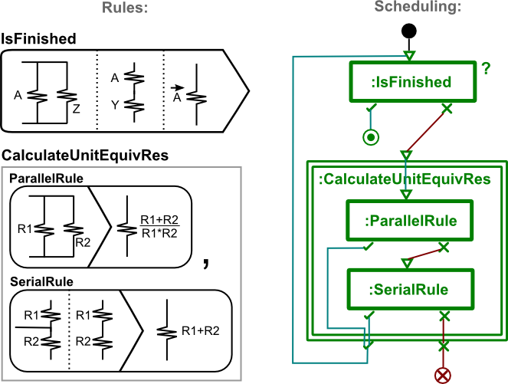
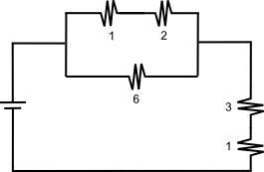
Equivalent Resistance
Finding the equivalent resistance in an electrical circuit

Slide 13
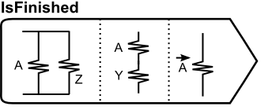
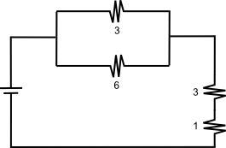
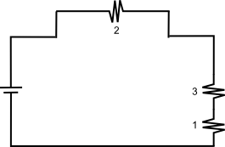
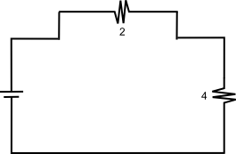
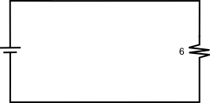
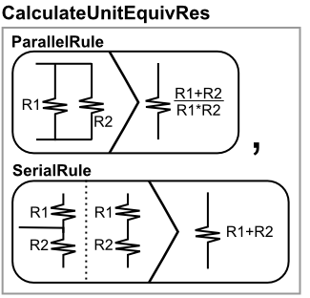
Illustration

Slide 14
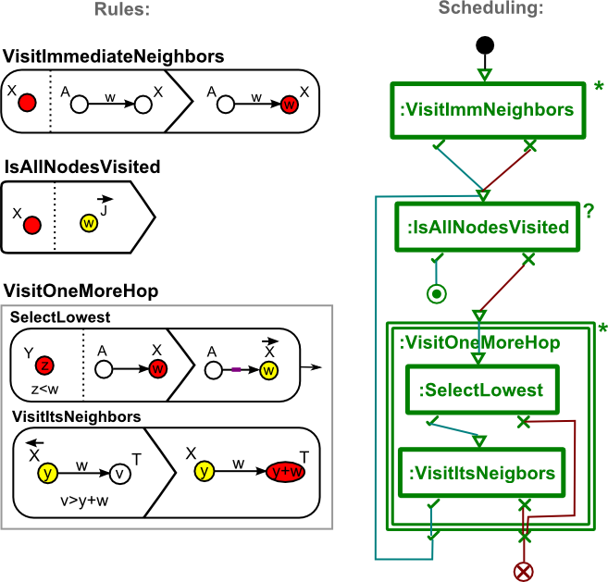
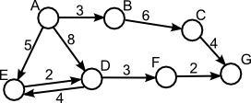
Dijkstra’s shortest path algorithm
Find the shortest path in a given directed tree

Slide 15
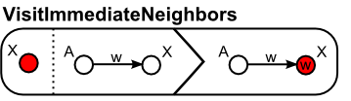
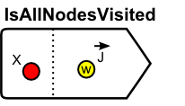
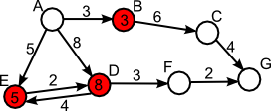
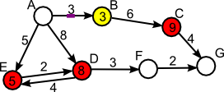
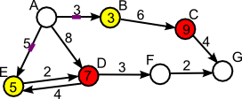
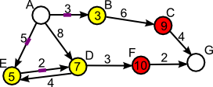
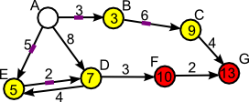
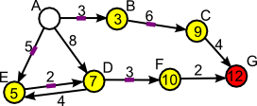
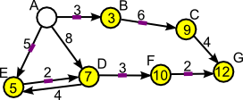
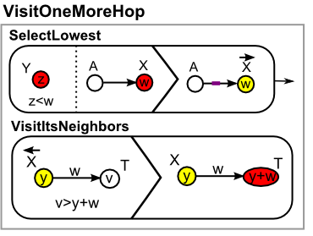
Illustration
Notes:
From this three application, we present a design pattern.

Slide 16
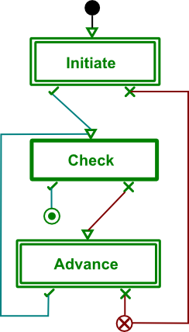
Details of the pattern
Name: Fixed-point iteration design pattern
Problem: Applicable when the problem can be solved stepwise
Solution: Has three phases
  Initialize: Necessary setup or
  an initial step towards solution
  Check: Check if the intermediate
  form has a solution
  Advance: Iterate the intermediate
  form one step closer to a solution
Structure:
Notes:
Generic, rules to be specified
Alternatives:
- Initiate and Advance can be more than one rule
- Check can be query (no side effect) or a rule with side effect

Slide 17
Related Work
Agrawal et al. ^{[5]} has presented three model transformation design patterns
  Leaf collector, Transitive closure, Proxy generator idiom
Iacob et al. ^{[6]} has presented five model transformation design patterns
  Mapping pattern, Refinement pattern, Node abstraction pattern, Duality pattern, Flattening pattern
These patterns are not analyzed in terms of quality
No standard formalism to display the structure of the pattern.
[5] A. Agrawal, “Reusable Idioms and Patterns in Graph Transformation Languages,” in International Workshop on Graph-Based Tools, ser. ENTCS, vol. 127. Rome: Elsevier, March 2005, pp. 181–192
[6] M.-E. Iacob, M. W. A. Steen, and L. Heerink, “Reusable Model Transformation Patterns,” in Proceedings of the Enterprise Distributed Object Computing Conference Workshops. Munich: IEEE Computer Society, Setpember 2008, pp. 1–10.

Slide 18
We have identified a model transformation design pattern by drawing conclusion from solutions of three problems.
We gave the details about the Fixed-point iteration design pattern.
We used the representation of the language we used.
  The representation looks suitable but needs refinement to support more design patterns from other languages also.
We showed some metrics to compare solutions.
  We plan to identify more metrics to be measured.

