Slide 1


Towards a Language for Graph-based Model Transformation Design Patterns
Huseyin Ergin and
Eugene Syriani
Notes:
Talk intro here. Say everyone here knows MDE and MT, so I will directly go into the subject.

Slide 2
problem
Development of model transformation is still an error-prone and hard task.
One reason is the lack of a development process. ^{[1]}
  Design it before implement it.
Software developers have been designing using UML.
  With help of GoF design patterns.
Main goal is:
Helping model transformation developers in the design of model transformation through the use of design patterns.
[1] Guerra, E., de Lara, J., Kolovos, D., Paige, R., and dos Santos, O. (2013) Engineering model transformations with transML. Software and Systems Modeling, 12, 555–577.
Notes:
Refer to the implementation at the beginning.
Rule of thumb here is: “Design it before implement it”

Slide 3
Problem
Helping the model transformation developers in the design of model transformation through the use of design patterns
Solution:
Finding the appropriate language to define model transformation design patterns.
Validating the language by redefining existing design patterns and implementing them.
Notes:
Now I will explain what I did in order to reach these goals.
STEP 2: I validated the language by redefining 4 known model trafo design patterns in the language and implemented in 5 MTLs. ENUMERATE MTLS.
MoTif, GrGen.NET, Henshin, Viatra2, AGG

Slide 4
Related work
Existing model transformation design patterns.
  Agrawal et al.^{[1]}: transitive closure, leaf collector, proxy generator in GReAT.
  Iacob et al.^{[2]}: mapping, refinement, flattening, duality, node abstraction in QVT-R.
  Bezivin et al.^{[3]}: transformation parameters, multiple matching in ATL.
  Levendovszky et al.^{[4]}: helper constructs, optimized transitive closure in VMTS.
Design patterns vs reusable idioms.
Implementation in specific languages
[1] Agrawal, A. (2005) Reusable Idioms and Patterns in Graph Transformation Languages. International Workshop on Graph-Based Tools, ENTCS, 127, pp. 181–192. Elsevier.
[2] Iacob, M.-E., Steen, M. W. A., and Heerink, L. (2008) Reusable Model Transformation Patterns. EDOC Workshops, September, pp. 1–10. IEEE Computer Society.
[3] Bézivin, J., Jouault, F., and Paliès, J. (2005) Towards model transformation design patterns. Proceedings of the First European Workshop on Model Transformations (EWMT 2005).
[4] Levendovszky, T., Lengyel, L., andMészáros, T. (2009) Supporting domain-specific model patterns with metamodeling. Software & Systems Modeling, 8, 501–520.
Notes:
They are not actually design patterns. But most of them are idioms within that language, therefore can’t be generalized to other MTLs.

Slide 5
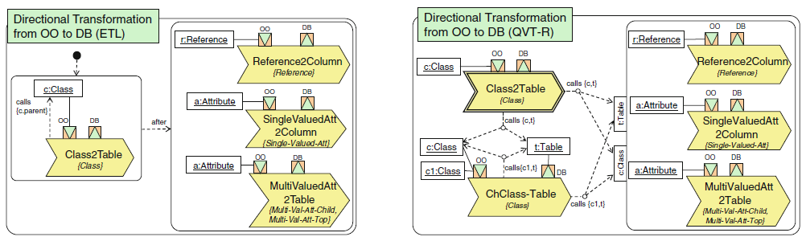
Related work
Language for Model Transformation Design Patterns.
  Lano et al.^{[1]}: used UML class diagrams and OCL constraints.
    Hinders the understandability of the patterns.
    Implementation is hard other than UML-RSDS language.
  Guerra et al.^{[2]}: proposed Rule Diagrams.
    Aims generating transformations.
    Each MTL needs its own Rule Diagram.
[1] Kevin Lano and Shekoufeh Kolahdouz Rahimi (2013) Constraint-based specification of model transformations. Journal of Systems and Software, 86, 412–436.
[2] Guerra, E., de Lara, J., Kolovos, D., Paige, R., and dos Santos, O. (2013) Engineering model transformations with transML. Software and Systems Modeling, 12, 555–577.

Slide 6
Finding the appropriate language to define model transformation design patterns.

Slide 7
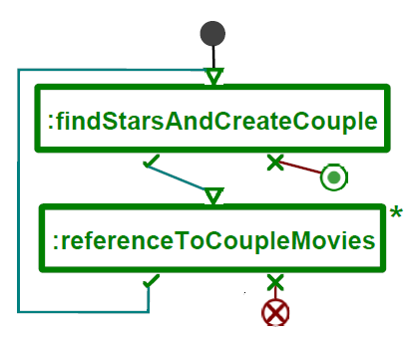
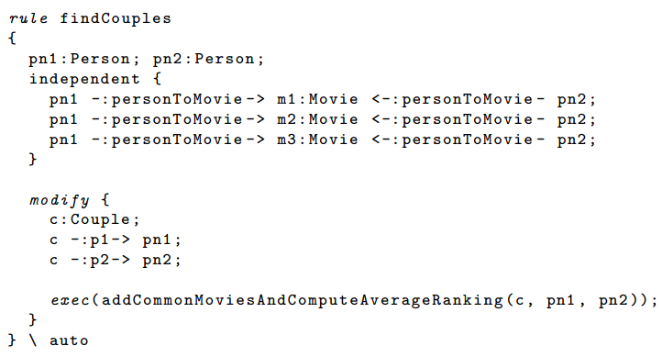
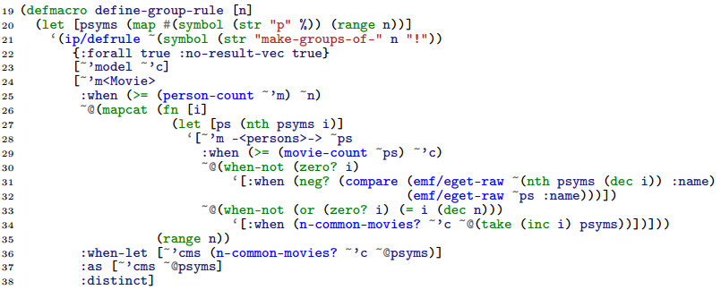
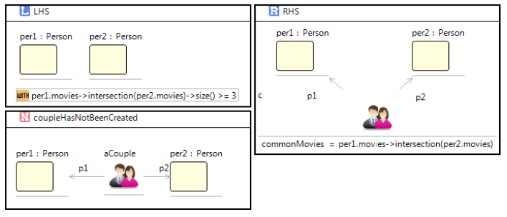
Notes:
With a lot of diverse MTLs, development is not an easy task in model transformation.

Slide 8
DelTa
A language to express model transformation design patterns.
Features:
  Facilitate, reason, understand, document in a standard way^{[1]}
  Independent from existing model transformation languages (MTL).
  Play the role of UML for model transformation design patterns.
DelTa (Design pattern language for model Transformation)
  Offers concepts from existing MTLs.
  Abstracts away MTL specific concepts.
  Expresses design patterns rather than model transformations.
[1] Syriani, E. and Gray, J. (2012) Challenges for Addressing Quality Factors in Model Transformation. Software Testing, Verification and Validation, apr ICST’12, pp. 929–937. IEEE.
Notes:
Now, first I designed a language to express model transformation design patterns.
I could have used an existing MTL as a notation, however this can lead developers to think
the language itself is a transformation language and executable.

Slide 9
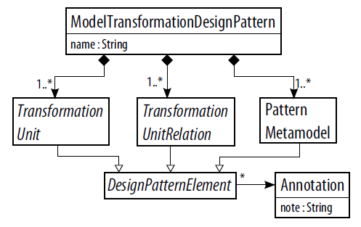
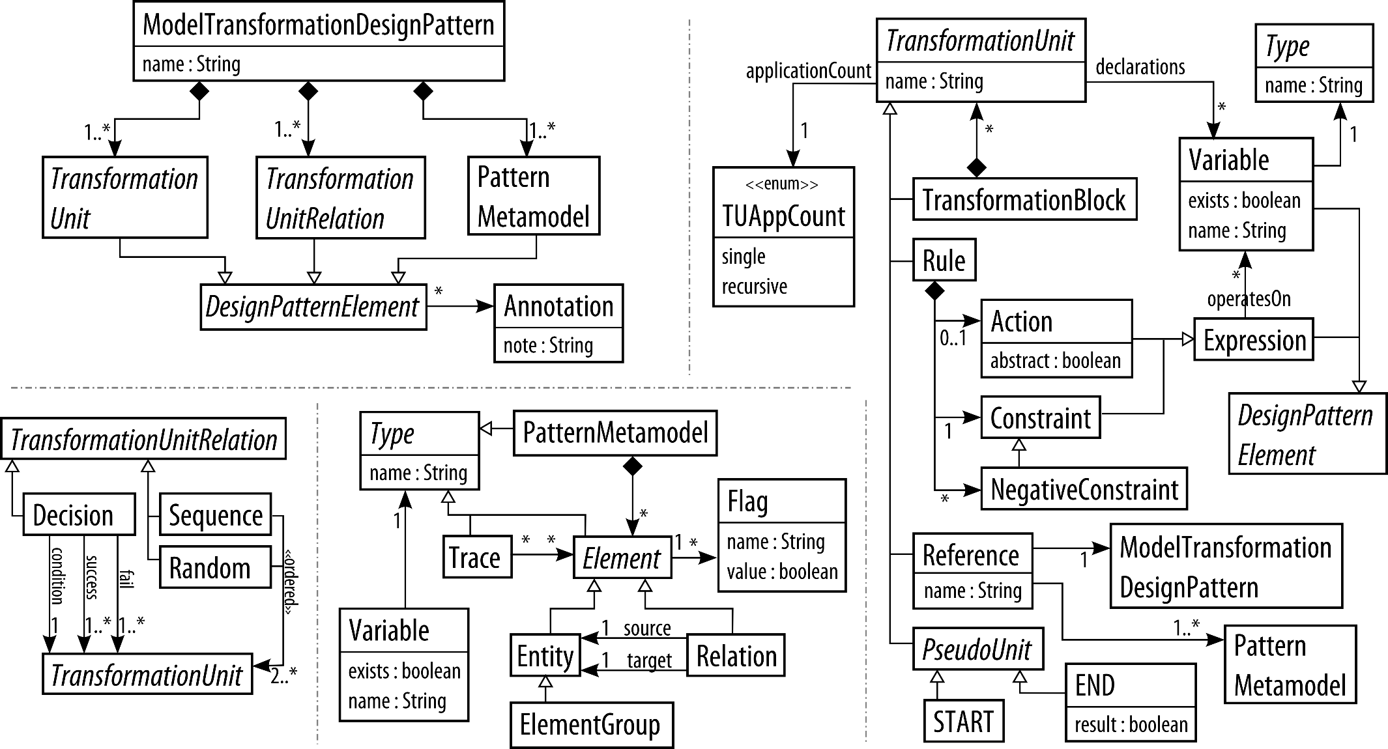
Delta metamodel
Notes:
What do we need for a model transformation design pattern? (like questions to self)
Just give concepts and give in details in concrete syntax.

Slide 10
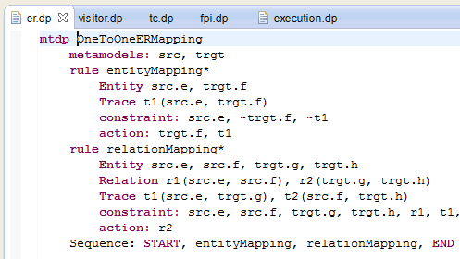
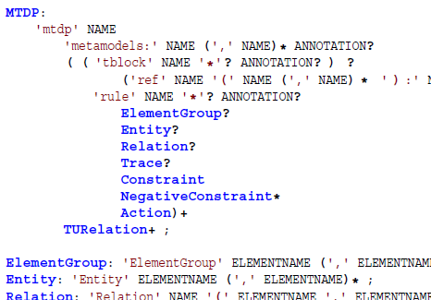
Delta textual syntax
A textual development environment for DelTa in Eclipse using Xtext
Notes:
Describe the textual syntax, sections etc.

Slide 11
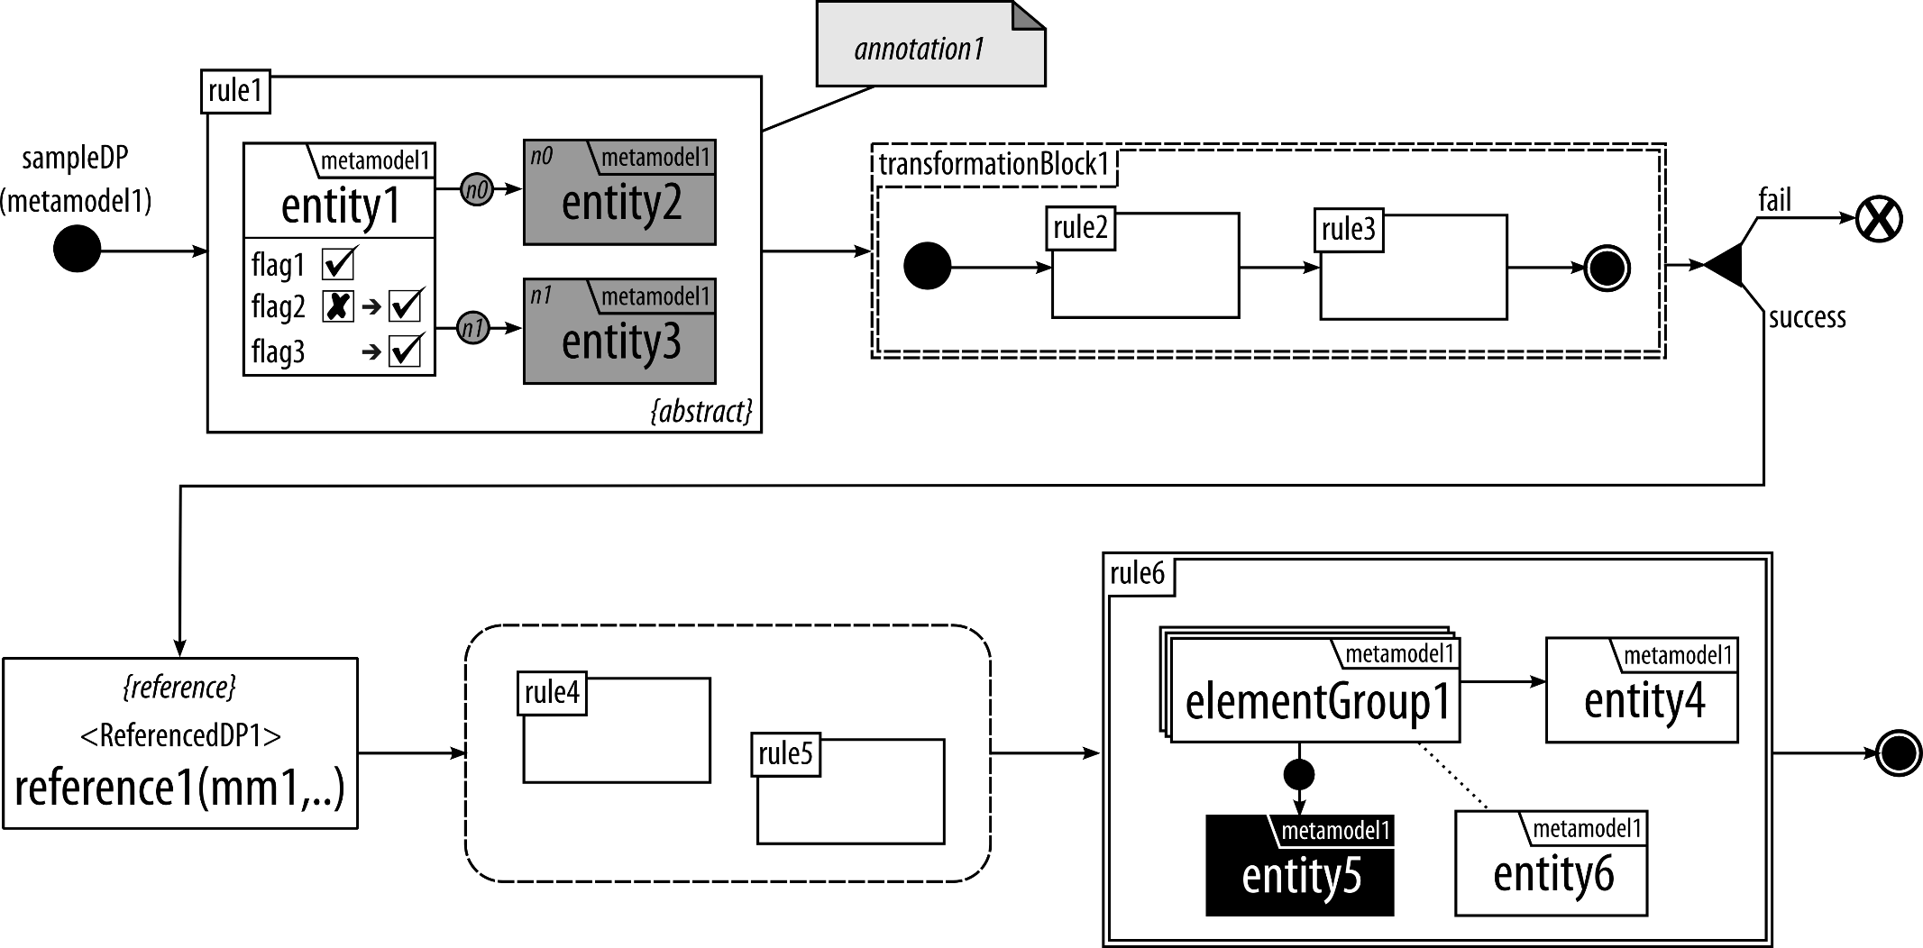
DelTa graphical syntax
Notes:
At the time of the paper we have textual syntax, but we have feedbacks from user and reviewers and we came up with a GRAPHICAL syntax. Equally expressive.
_______________________________________________________
JUST READ THE RULES, not explain elements.
--------------------------------------------------
Explain the design pattern elements. And control flow. SEMANTICS.
Constraint of a rule is maximal. Give definition and in practice it is like a contravariance. (MAYBE make them show like popup while explaining)
Action of a rule is minimal.
Gray to be created
Black to be deleted.
More explanations here:
IMPORTANT: this is not model transformation.

Slide 12
(Informal) semantics
Conceptually
  Constraint ^ ~neg1 ^ ~neg2 ^ … → action.
Constraint is maximal
  Adding more make it find less matches.
Action is minimal
  Transformation developer is supposed to add more actions.
Abstract rules.
  The details are left to the developer.

Slide 13
Identifying design patterns from existing transformation solutions.
Notes:
I have shown how to identify a model transformation design pattern in the report in section 6.
Here I give the collection of MT design patterns, I have identified or redefined from existing studies.

Slide 14
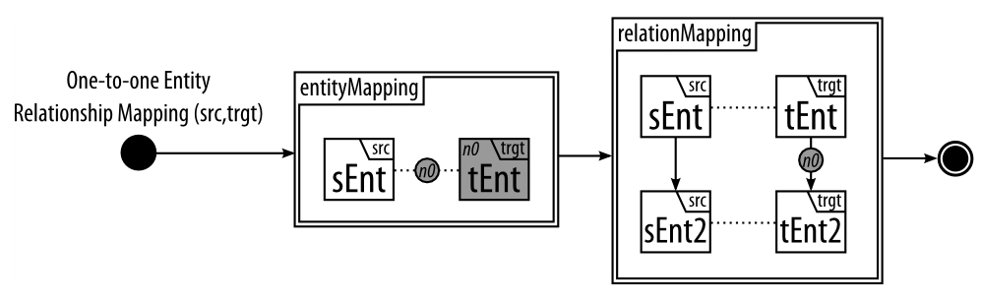
MT Design patterns
Entity Relation Mapping
  Motivation: The most commonly used pattern for exogenous transformations and creates corresponding elements of a source language in a target language with traceability links.
  Applicability: Usually when a transformation from one metamodel to a different metamodel.
  Structure in DelTa:
  Example: Class diagram to relational database diagram.
Notes:
READ THE RULES…

Slide 15
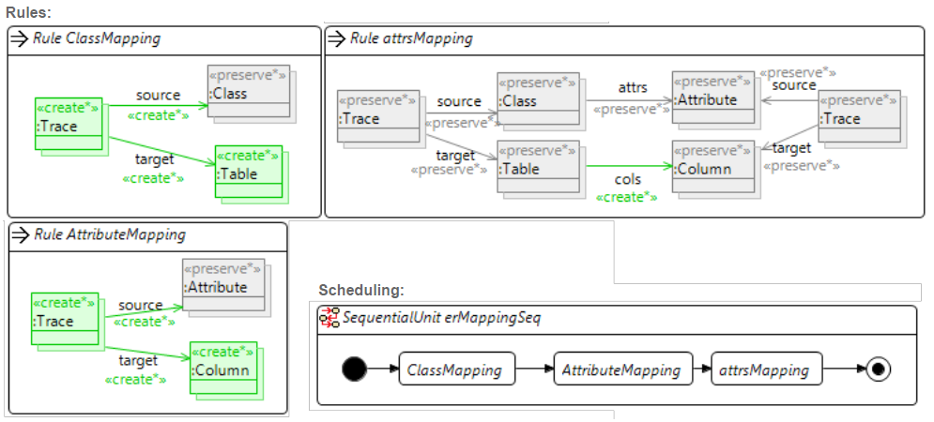
MT Design patterns
Entity Relation Mapping
  Variations: The mapping can be one-to-many, many-to-many or many-to-one.
  Implementation:
    Henshin^{[1]}
[1] Arendt, T., Biermann, E., Jurack, S., Krause, C., and Taentzer, G. (2010) Henshin: Advanced Concepts and Tools for In-Place EMF Model Transformations. MODELS 2010, LNCS, 6394, pp. 121–135. Springer.

Slide 16
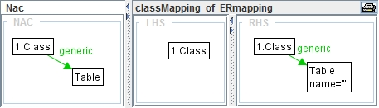
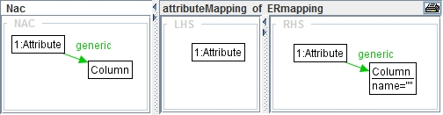
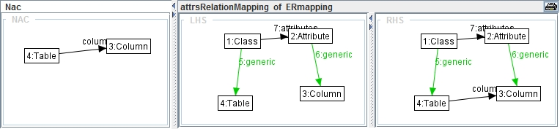
MT Design patterns
Entity Relation Mapping
  Implementation:
    AGG^{[1]}
[1] Taentzer, G. (2004) AGG: A graph transformation environment for modeling and validation of software. AGTIVE, pp. 446–453. Springer.

Slide 17
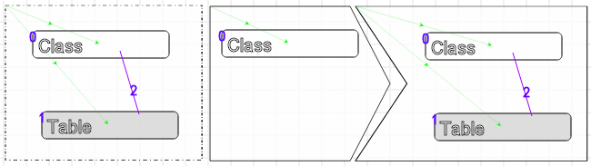
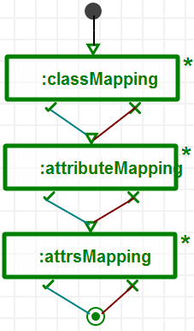
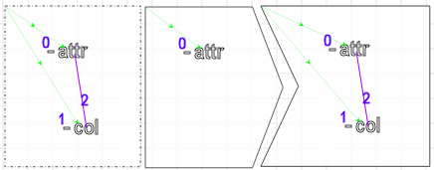
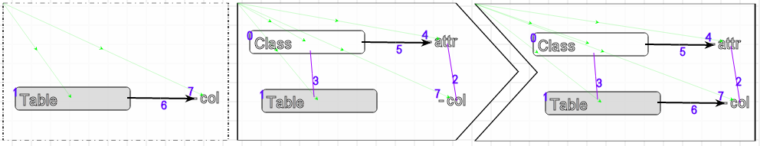
MT Design patterns
Entity Relation Mapping
  Implementation:
    MoTif

Slide 18
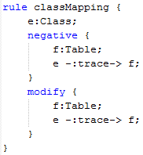
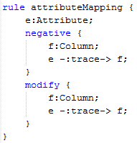
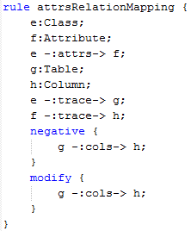

MT Design patterns
Entity Relation Mapping
  Implementation:
    GrGen.NET^{[1]}
[1] Geiß, R. and Kroll, M. (2008) GrGen. net: A fast, expressive, and general purpose graph rewrite tool. Applications of Graph Transformations with Industrial Relevance, pp. 568–569. Springer.

Slide 19
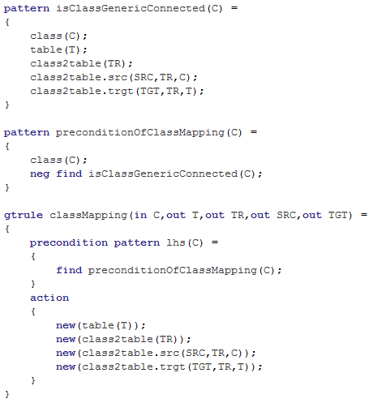
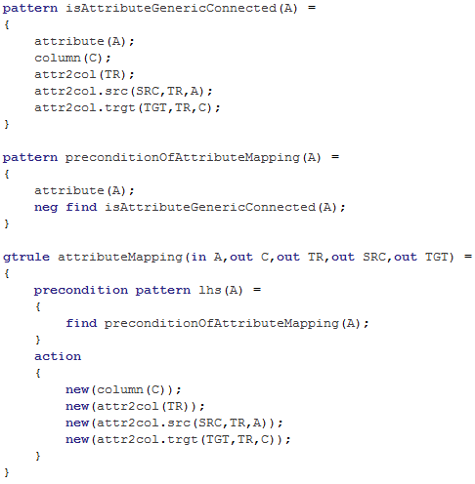
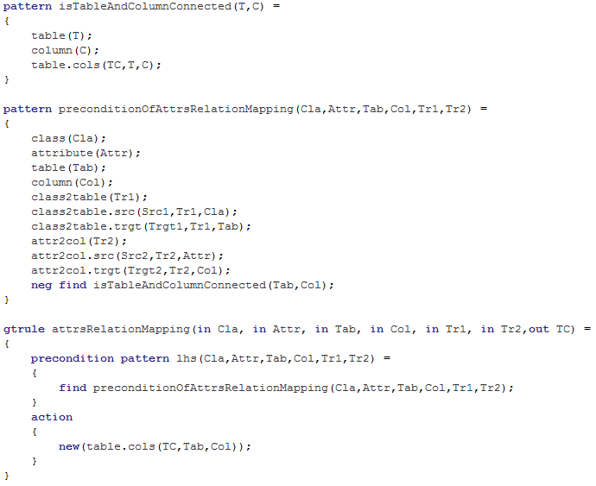
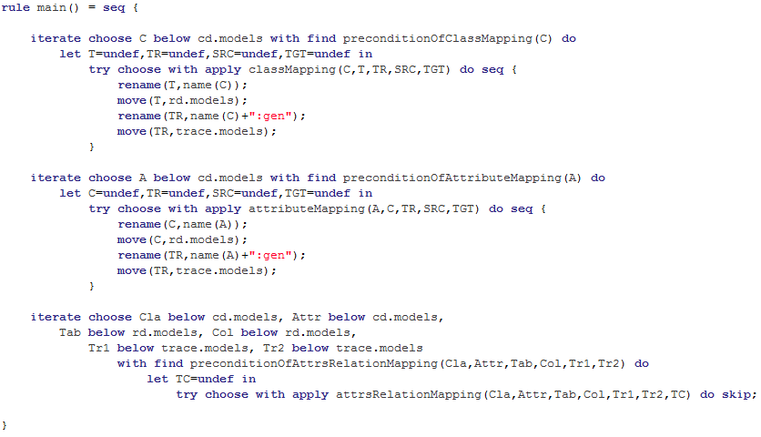
MT Design patterns
Entity Relation Mapping
  Implementation:
    Viatra2^{[1]}
[1] Varró, D., Balogh, A.: The model transformation language of the VIATRA2 framework. Science of Computer Programming 68(3) (2007) 214–234

Slide 20
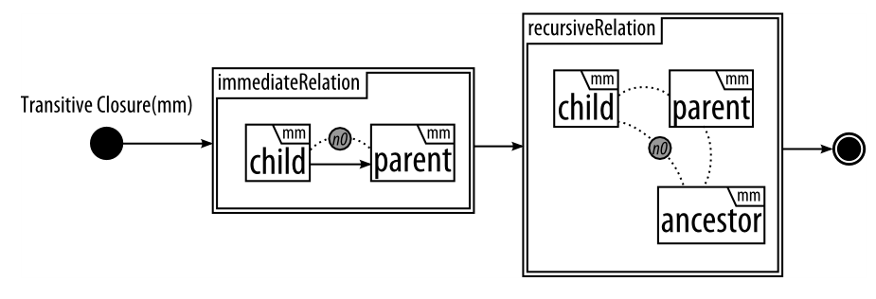
Mt design patterns
Transitive Closure
  Motivation: Analyzing reachability related problems with an inplace transformation.
  Applicability: The metamodels in the domain have a structure that can be considered as a directed tree.
  Structure in DelTa:
  Example: Helps finding the lowest common ancestor or finding all superclasses of a class in UML class diagram.

Slide 21
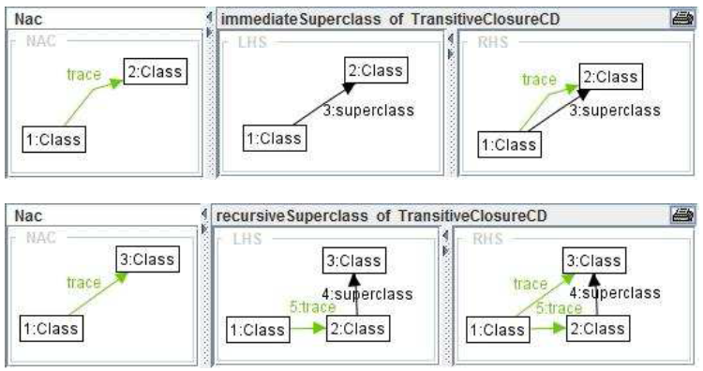
Mt design patterns
Transitive Closure
  Implementation:
    AGG^{[1]}
[1] Taentzer, G. (2004) AGG: A graph transformation environment for modeling and validation of software. AGTIVE, pp. 446–453. Springer.

Slide 22
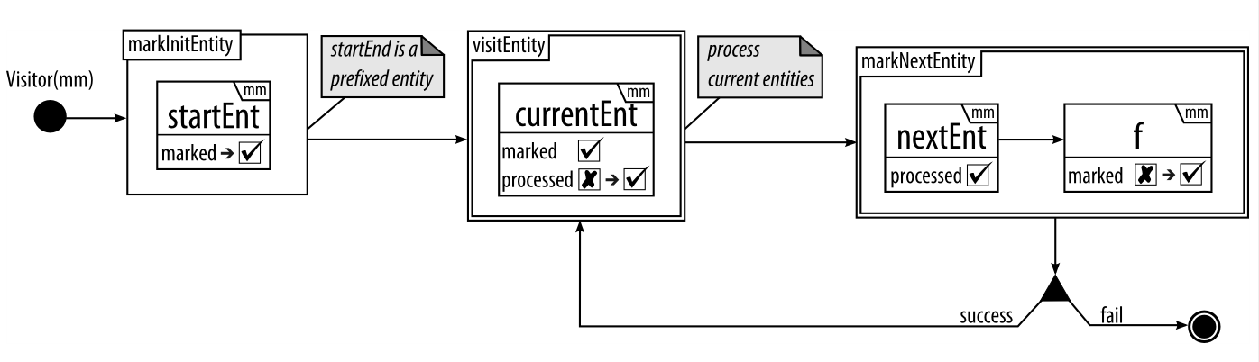
Mt design patterns
Visitor
  Motivation: Traversing all the nodes in a graph and processing each entity individually in a breadth-first fashion.
  Applicability: Problems that consist of or can be mapped to any kind of graph structure.
  Structure in DelTa:
  Example: Computing the depth level of each class in a class diagram hierarchy

Slide 23
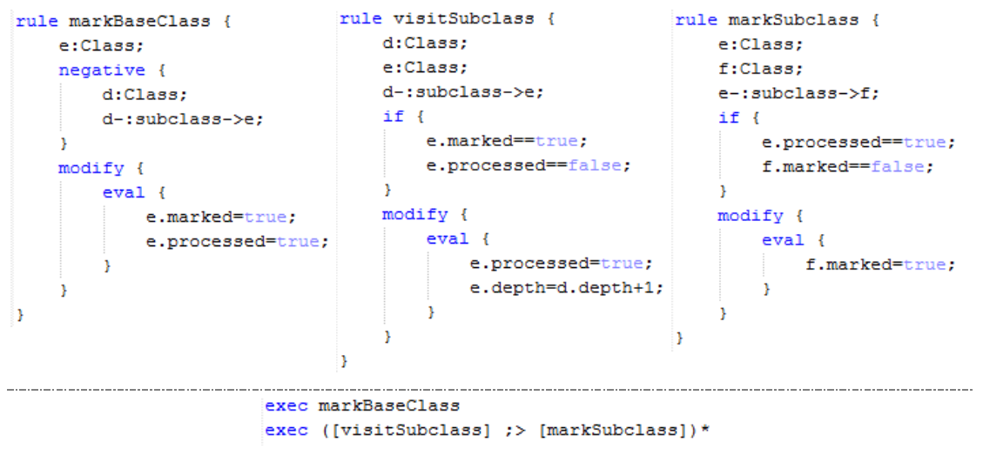
Mt design patterns
Visitor
  Implementation:
    GrGen.NET
  Variations: It is possible to change the traversal order.

Slide 24
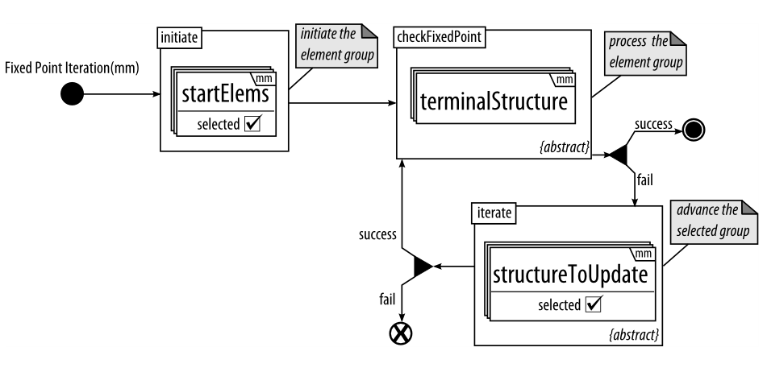
Mt design patterns
Fixed Point Iteration
  Motivation: Represents a “do-until” loop for model transformations.
  Applicability: When the problem can be solved iteratively until a fixed point is reached.
  Structure in DelTa:
  Examples: Finding lowest common ancestor, calculating equivalent resistance in an electrical circuit.

Slide 25
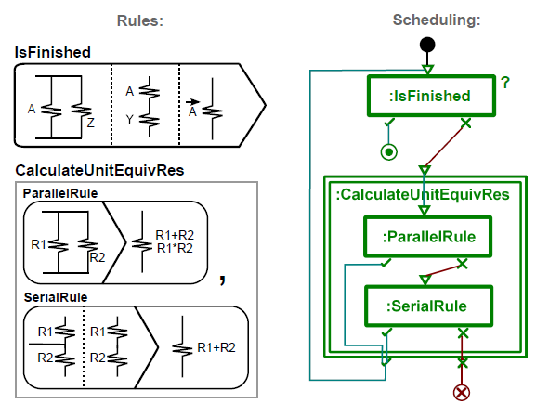
MT design patterns
Fixed Point Iteration
  Implementation:
    MoTif
  Variations: Initiate rule can be omitted if there is no initialization at the beginning.

Slide 26
Discussions & future work
Each MTL offers some specialized structures
  Which sometimes makes it hard to directly implement the design pattern.
We try to make the language understandable and easily implementable by transformation developers
  Therefore, no complex notations or formal specifications.
Future work
  Generating and detecting design patterns instances for a specific model transformation language.
  Identifying more design patterns
  Empirical validation with user studies for usability and understandability of DelTa

Slide 27
conclusion
Model transformation development is a hard task.
  And will be better with help of design patterns.
To help model transformation developers in the design phase, I have:
  Created DelTa: A language for model transformation design patterns
  Populated an initial collection of model transformation design patterns
  Been working on how to automatically generate transformation by DelTa specifications.

Slide 28

Questions
Thanks for listening…

Slide 29
Bonus Slides
MDE in Action

Slide 30
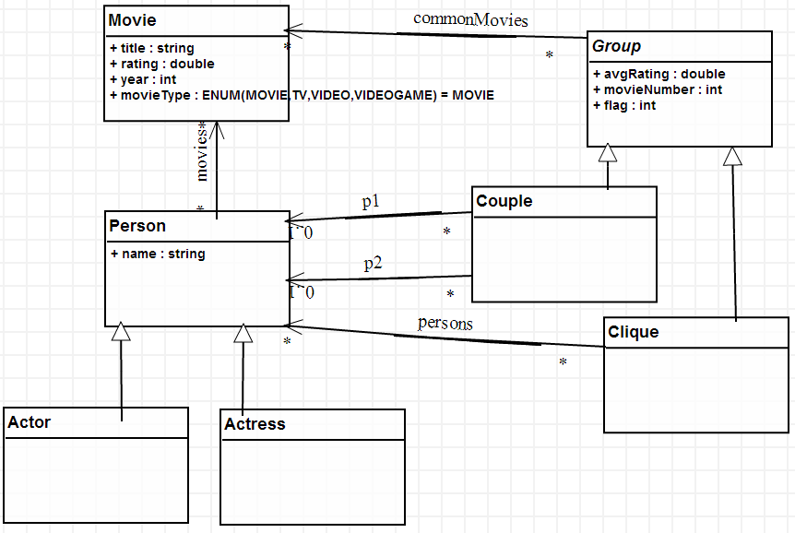
MDE in action
The problem (from TTC 2014):
  Write a transformation that works on IMDb as a model and identify all actor or actress couples which perform together in a set of at least three movies.^{[1]}
Step 1: Choose the modeling
environment.
  Environment: AToMPM^{[2]}
  MTL: MoTif^{[3]}
Step 2: Design a metamodel.
[1] http://www.transformation-tool-contest.eu/solutions/movie/ttc2014_submission_20.pdf
[2] Syriani, E., Vangheluwe, H., Mannadiar, R., Hansen, C., Van Mierlo, S., and Ergin, H. (2013) Atompm: A web-based modeling environment. MODELS’13: Invited Talks, Demos, Posters, and ACM SRC. CEUR-WS.org.
[3] Syriani, E. and Vangheluwe, H. “A Modular Timed Model Transformation Language,” Journal on Software and Systems Modeling, vol. 11, pp. 1–28, June 2011.

Slide 31
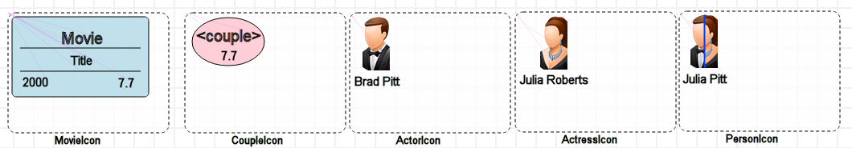
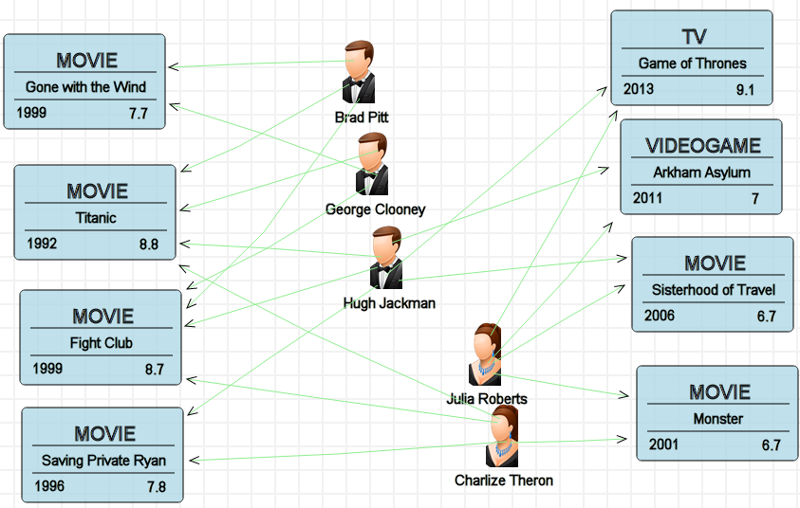
MDE IN ACTION
Step 3: Assign concrete syntax to elements.
Step 4: Create models.

Slide 32
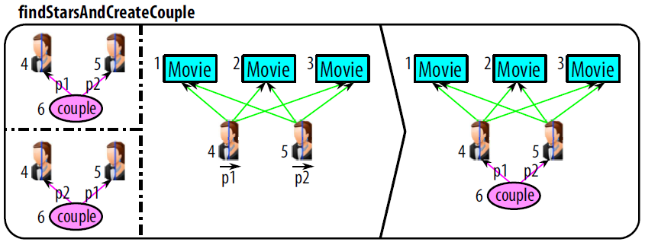
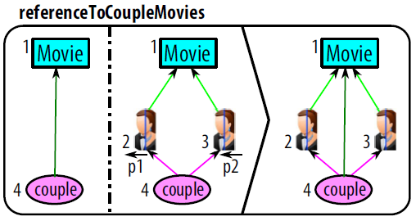
MDE IN ACTION
Step 5: Design rules to solve the problem.
Step 6: Design the scheduling
of the rules.
NAC
LHS
RHS
Notes:
Explaining the rule:
READ each rule as a sentence.
TRACEs in the “referenceToCoupleMovies” rule.
LHS: match the pre-condition pattern in the input model
RHS: replace/modify match to post-condition pattern
NAC: optional pre-condition pattern that inhibits the application of the rule
Scheduling is basically the order of the rules executed.
And it represents the control flow.

Slide 33
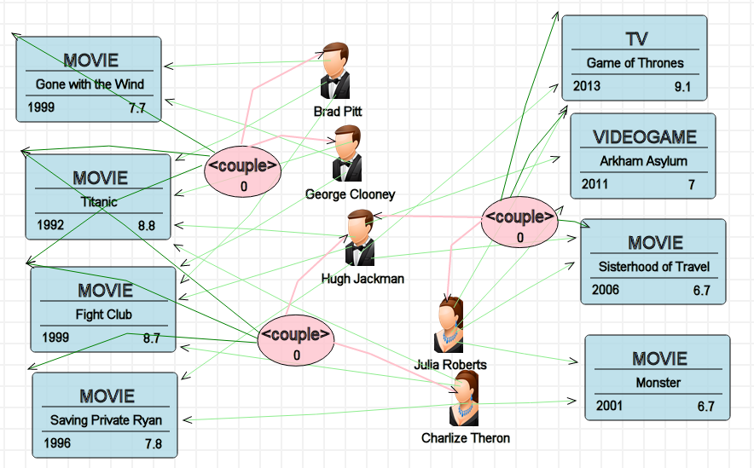
MDE IN ACTION
Step 7: Execute the transformation on the model.

Slide 34
MDE IN ACTION
Excerpts from solutions in other MTLs.
  GrGen.NET^{[1]} FunnyQT^{[2]}
  e-Motions^{[3]}
[1] Geiß, R. and Kroll, M. (2008) GrGen. net: A fast, expressive, and general purpose graph rewrite tool. Applications of Graph Transformations with Industrial Relevance, pp. 568–569. Springer.
[2] Tassilo Horn. Model querying with funnyqt - (extended abstract). In Keith Duddy and Gerti Kappel, editors, ICMT, volume 7909 of Lecture Notes in Computer Science, pages 56–57. Springer, 2013.
[3] Rivera, J.E., Dur´an, F., Vallecillo, A.: On the behavioral semantics of real-time domain speciﬁc visual languages. In: WRLA. pp. 174–190 (2010)
Notes:
Explain it is not trivial to come up with these solutions

Slide 35
Bonus Slides
Future Work:
Generating and Detecting

Slide 36
Generating and detecting design patterns instances for a specific model transformation language.
Notes:
I have shown how to identify a model transformation design pattern in the report in section 6.
Here I give the collection of MT design patterns, I have identified or redefined from existing studies.

Slide 37
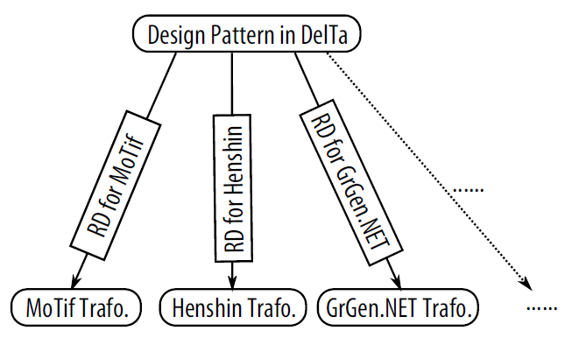
Future work
Uses of DelTa
  The main question is how to auto-generate transformations using DelTa.
  MTLs are really diverse so DelTa is very abstract.
  I will try to use Rule Diagrams.

Slide 38
Future work
Detection of DelTa Design Patterns
  Automatic detection of DelTa design patterns in existing model transformation solutions.
  Inputs: The model transformation and list of DelTa Design Patterns.
  Output: List of DelTa Design Patterns found in the input model.
  DelTa is a DSL.
    Therefore, detection will be a model transformation itself.

Slide 39
Bonus Slides
In Progress:
Identification of New Design Patterns

Slide 40
IN Progress
Identification of New Design Patterns
  Systematic literature review of model transformation intents.
  All the papers that have model transformation case studies, examples, demonstrations between 2003-2013.
  Help me see how problems are solved in different languages and settings.
  Identification can be done in two methods:
    Solving different problems and coming up with a common solution.
    Analyzing existing examples.
  With more design patterns, classification is next.

