Slide 1


Model Transformation Design Patterns
Huseyin Ergin
Advisor: Eugene Syriani
Software Modeling Lab
Software Engineering Group
Department of Computer Science
College of Engineering
University of Alabama

Slide 2
Introduction
Problem
Related Work
Proposed Solution
  Design pattern language
  Evaluation framework
Current Status & Plan
Conclusion

Slide 3
Introduction
MDE is software development approach that uses abstraction between problem and software implementation
  Models
  Transformations
MDE solutions often involve a series of model transformations.
Model transformation: “automatic manipulation of input models to produce output models, that conforms to a specification and has a specific intent” ^{[1]}.
  Intent is the description of the goal behind the model transformation and the reason for using it.
  Some intents: Model Editing, Query, Translation, Optimization etc.
[1] Amrani, M.; Dingel, J.; Lambers, L.; Lucio, L.; Salay, R.; Selim, G.; Syriani, E. & Wimmer, M. Towards a Model Transformation Intent Catalog MoDELS workshop on Analysis of model Transformation, 2012
Notes:
……Abstraction To bridge the gap between problem……
These abstractions are models.
This metamodel defines the elements and relations between these elements.
Metamodel of a modeling language is like the grammar of programming languages. It defines the syntax (abstract syntax) and static semantics of the language. We traditionally define a metamodel usiing UML class diagrams.
SYRIANI: Literature identified 20 intents.

Slide 4
Problem
Model transformations conform to specific model transformation languages.
  Main components: Rules and scheduling
Developing a model transformation requires designing rules and identifying scheduling between them.
Problematic:
Optimize the design of model transformations in a reusable way.
  Not only efficiency, but also readability, understandability, etc.
In object-oriented community, design patterns are typically used.
  I think design pattern concept can fit to model transformation too.
Notes:
Because Model Transformation is “Heart” and “soul” of model driven development. Selic

Slide 5
Related Work
Agrawal et al. ^{[2]} has presented three model transformation design patterns
  Leaf collector, Transitive closure, Proxy generator idiom
Iacob et al. ^{[3]} has presented five model transformation design patterns
  Mapping pattern, Refinement pattern, Node abstraction pattern, Duality pattern, Flattening pattern
Common properties of these studies:
  These patterns are not analyzed in terms of quality
  No standard language to display the structure of the pattern.
Patterns for designing models and metamodels.
[2] A. Agrawal, “Reusable Idioms and Patterns in Graph Transformation Languages,” in International Workshop on Graph-Based Tools, ser. ENTCS, vol. 127. Rome: Elsevier, March 2005, pp. 181–192
[3] M.-E. Iacob, M. W. A. Steen, and L. Heerink, “Reusable Model Transformation Patterns,” in Proceedings of the Enterprise Distributed Object Computing Conference Workshops. Munich: IEEE Computer Society, Setpember 2008, pp. 1–10.

Slide 6
Preliminary study
We have identified a model transformation design pattern and applied it to three different problems to show its usability^{[4]}.
The Fixed Point Iteration Design Pattern is applicable when iterating over small local changes to an intermediate structure on the input model helps until a solution to the problem is reached.
We have applied it:
  To find the lowest common ancestor
  To compute the equivalent resistance
  To find the shortest path by using Dijkstra’s shortest path algorithm
We have implemented it using the MoTif^{[5]} transformation language.
[4] Hüseyin Ergin and Eugene Syriani. Identification and Application of a Model Transformation Design Pattern. ACM Southeast Conference, ACMSE'13. ACM, Savannah GA, U.S.A., April (2013)
[5] Eugene Syriani and Hans Vangheluwe. A Modular Timed Model Transformation Language. Journal on Software and Systems Modeling, 12, no. 2, pp. 387-414 jun (2011).
Notes:
Prelim study that motivated me to realize that we need design patterns for MT.
BEFORE NEXT SLIDE:
I will illustrate now how I come up with this design pattern candidate.
And my running example will be LCA problem.

Slide 7
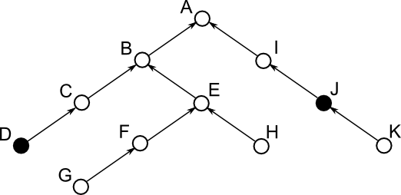
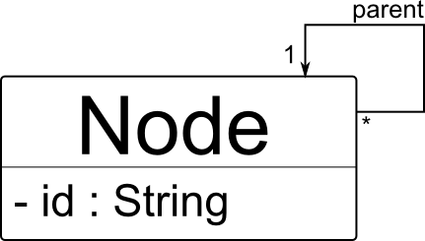
Running example
Lowest Common Ancestor Problem ^{[6]}:
  In a tree structure find the lowest common ancestor of two given nodes.
  Solution using a naïve approach
A metamodel for such a tree:
[6] A. V. Aho, J. E. Hopcroft, and J. D. Ullman, “On finding lowest common ancestors in trees,” in Proceedings of the fifth annual ACM symposium on Theory of computing, ser. STOC ’73. New York, NY, USA: ACM, 1973, pp. 253–265.
Notes:
A tree structure may be like that or with only child links downwards.
An example may be node D and node J.
And lowest common ancestor of node D and node J is node A in this case.
Now we will solve this problem step by step using MDE approach.

Slide 8

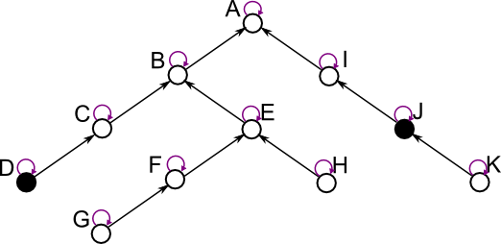
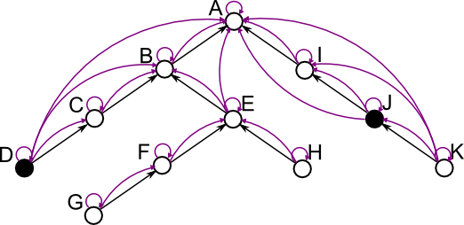
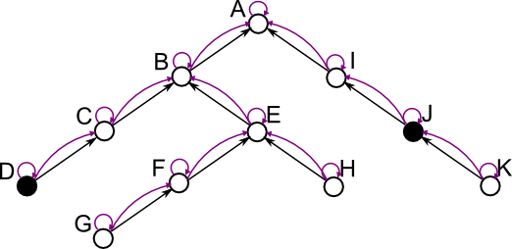
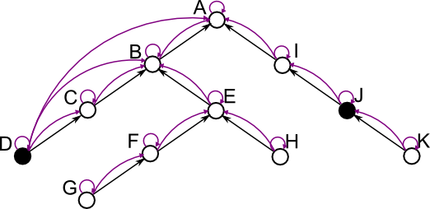
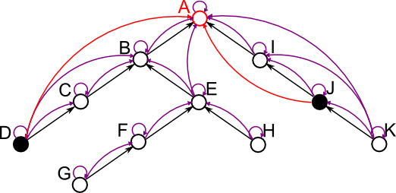
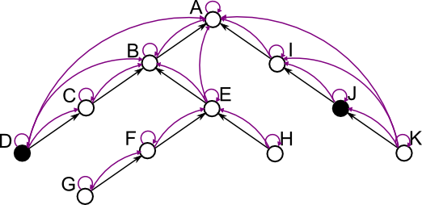
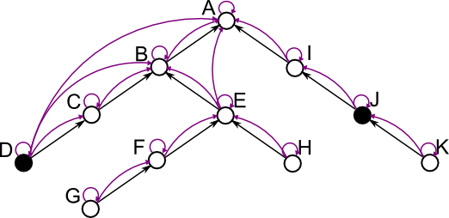

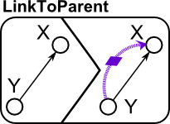
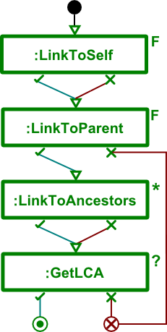
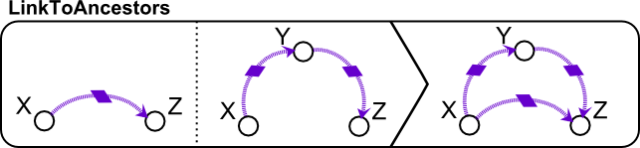
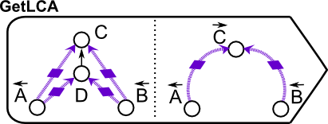
Illustration
Notes:
The solution of the problem by applying the rules are here. Step by step.
We are actually calculating transitive closure with linkToAncestors rule!!! RECURSIVE RULE.
EXPLAIN RULES AND SCHEDULING WORKS HERE.
BEFORE NEXT SLIDE:
Our purpose is to optimize so I solve the same problem with another but this time improved solution.

Slide 9
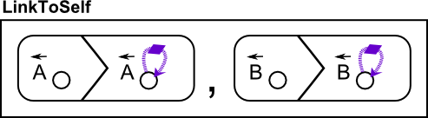
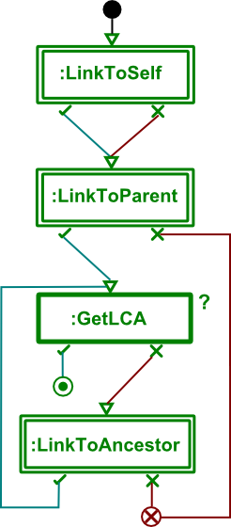
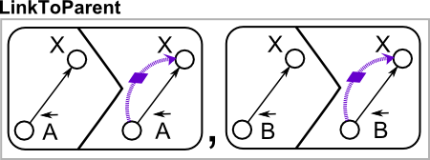
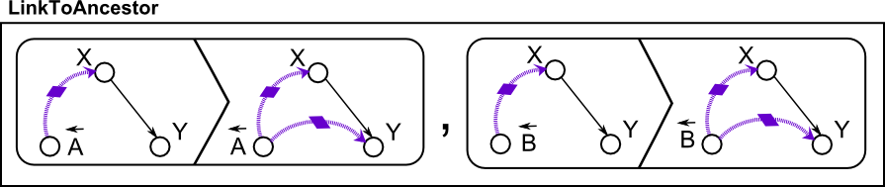
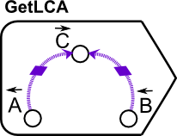
Running example – improved solution
Now this solution uses ‘locality’
Focus in the area of input nodes, and check for a solution in every step
Rules Scheduling

Slide 10
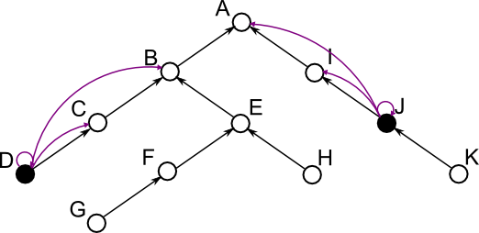
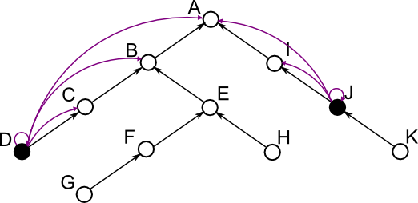
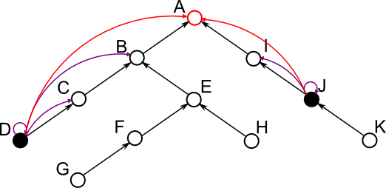
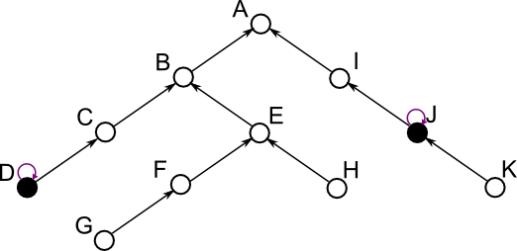
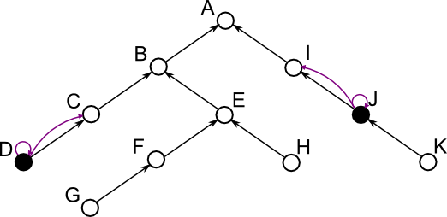
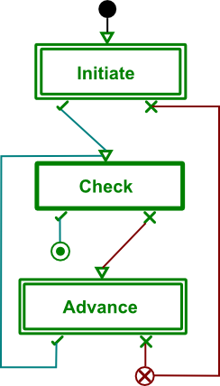
illustration
Notes:
Now the strategy is changed and we will check in every step for a solution
And if we cant find a solution, we will do one more step that will make us close to a solution and check again.
BEFORE NEXT SLIDE:
I want to reuse that optimized solution in other problems too so I want this design pattern and others transformation language independent and I created this design pattern language.

Slide 11
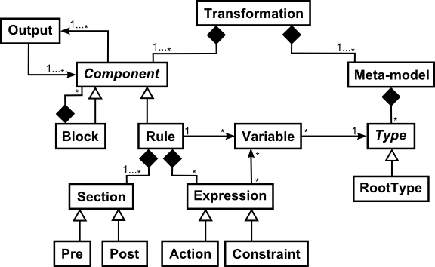
Design pattern Language
Transformation-language independent
Notation MTL independent
Abstraction of individual MTL from structural point of view
Notes:
The language I am actively using is MoTif, so DP language is motif like, which eventual purpose is to make it more generic to support other popular languages.
The DP language gives syntactic meaning and with the help of output class it provides the semantics.
Each design pattern is actually a smaller subset of a transformation.

Slide 12
DESIGN PATTERN INSTANCE
Different textual syntaxes of the design pattern language.
We are still investing for the most appropriate design pattern language and its concrete syntax
Transformation FixedPointIteration
Meta-model “any”
<start>Block “initiate”
Output “success” to “check”
Rule “check”
Output “success” to END_SUCCESS
Output “fail” to “advance”
Block “advance”
Output “success” to “check”
Output “fail” to END_FAIL
Notes:
BEFORE NEXT SLIDE:
Now I know how to represent my design pattern, next is how to discover new design patterns.

Slide 13
Discovery of design patterns
TTC: Transformation Tool Contest
  Many solutions in different MTLs for same problem
ATL Transformation Zoo
  Same language, many problems
Transformations case studies found in the literature
  Conferences (MODELS, ICMT, ECMFA, ICGT, FASE …) and Journals (SoSym …)
Two methods for now:
  Given a problem, evaluate existing solutions to deduce a design pattern
  Focus on single problem at a time and solve it using different approaches
Notes:
I have some venues to mine for design pattern discovery.
BEFORE NEXT SLIDE:
After discovery, comes the evaluation.

Slide 14
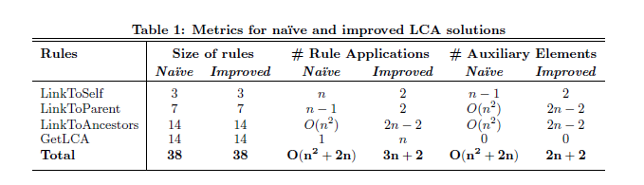
EVALUATION
A design pattern should optimize at least one quality criteria
I have analyzed the design pattern we introduced in terms of three metrics (Efficiency point of view)
Following table is a starting point of how a design pattern can be evaluated.
Notes:
BEFORE NEXT SLIDE:
Now comes the full evaluation framework.

Slide 15
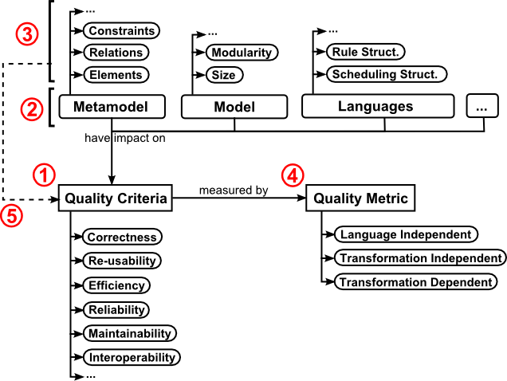
Evaluation framework
I created the following evaluation framework inspired from [7].
[7] P. Mohagheghi and V. Dehlen, “Developing a Quality Framework for Model-Driven Engineering,” in Models in Software Engineering, ser. Lecture Notes in Computer Science, H. Giese, Ed. Springer Berlin Heidelberg, 2008, vol. 5002, pp. 275–286
Notes:
This framework defines the quality step by step.
1- identify quality criteria
2- identify target objects that have impact on these criteria (all concepts related to model transformation)
3- identify properties of target objects
4- Specify how to evaluate criteria (a.k.a. specify metrics)
5- Specify links between criteria and properties (which property effects which criteria, how)
6-execute and evaluate metrics

Slide 16
metrics for model transformation languages
Metrics are always necessary for assessing the quality.
Divided into three categories^{[8]}.
Language independent metrics
  Related with core model transformation components
  Example: Size of rules, number of rule applications etc.
Transformation independent metrics
  Focus on specific model transformation languages
  Example for QVT: number of enforced domains, number of ‘when’ predicates etc.
Transformation dependent metrics
  Specific to particular model transformation problems
  Example: In Dijkstra, some restrictions on the solution.
Measuring these metrics can be done statically (as we did for LCA) or dynamic or empirically
[8] M. Amrani, L. Lucio, G. Selim, B. Combemale, J. Dingel, H. Vangheluwe, Y. Le Traon, and J. Cordy, “A Tridimensional Approach for Studying the Formal Verification of Model Transformations,” in Software Testing, Verification and Validation (ICST), 2012 IEEE Fifth International Conference on, april 2012, pp. 921 –928.
Notes:
In three categories.
Language independent: general software metrics such as Execution time, memory constraint can also be here.

Slide 17
Quality criteria for model transformation
These are the standard quality criteria from software engineering (e.g. ISO 9006)
Adapting them to model transformation.
Correctness:
  Output of the transformation must conform to metamodel
Re-usability:
  Unit rules or other reusable structures in a language
Efficiency:
  Underlying graph transformation, pattern matching make this criterion a must-to-satisfy
Some others: reliability, maintainability, interoperability etc.
Notes:
These are some of the quality criteria with respect to model transformation.
Quality criteria are the standard for software engineering
This is just adapting them to model transformation.

Slide 18
USER STUDIES IN EVALUATION
Predefined experiments with different scenarios
Application of these experiments on targeted users
  In our case, they will be model transformation developers
Users are requested to solve problems with no prior design pattern information
  Then design patterns are introduced.
The results will be analyzed.
  It can be supported with questionnaires and surveys at the end\beginning.

Slide 19
current status & plan
We are adding new features to our modeling and transformation tool, AToMPM^{[9]}.
Improvement of the design pattern language (Fall 2013)
  The current structure shows similarities to our model transformation language.
  Support for other popular model transformation languages
    Starting from ATL and QVT
  Each language has its own characteristics
    So the DP language should be as abstract as possible
[9] E. Syriani, H. Vangheluwe, R. Mannadiar, C. Hansen, S. Van Mierlo and H. Ergin. AToMPM: A Web-based Modeling Environment. MODELS'13 Demonstrations. CEUR, Miami, October (2013)

Slide 20
current status & plan – cont’d
Identification of New Design Patterns (Fall 2013 – Spring 2014)
  So far, we have identified one model transformation design pattern.
  Model transformation problems should be investigated carefully to see similarities and lacks.
    With the methods I mention previously
  Categorization with respect to intents will help to reduce the size.
  Evaluation with respect to quality framework

Slide 21
current status & plan – cont’d
Adapting existing design patterns (Fall 2013)
  Existing design patterns will be adapted to fit in new DP language
  Respective authors call “reusable idioms or patterns”
  They should be analyzed in terms of my quality framework.
Application & Generation (Spring 2013 – Spring 2014)
  An IDE that design patterns can be inserted automatically
  Generation in a specific model transformation language to be a part of a larger model transformation solution

Slide 22
Conclusion
Design patterns are proven approach for reusability (in object-oriented community)
I believe model transformation design patterns will lead developers to increase effectiveness and decrease time and cost required to solve a model transformation problem.
The DP language will be useful if I can make it to support as many transformation languages as possible.

Slide 23
FROM REVIEWERS
Example of new formalism (now language).
  An instance is given. It is still evolving according to new design patterns and model transformation languages.
What differs my work from existing works?
  Existing works neither analyzed their design pattern nor provided a generic representation of them.
  I will try to do the both in my dissertation.
Description of a design pattern
  Exactly same as in object-oriented community.
  A design pattern describes a problem which occurs over and over again and then describes the core of the solution in such a way that you can use million times^{[10]}.
[10] Erich Gamma, Richard Helm, Ralph Johnson, John Vlissides, Design Patterns Elements of Reusable Object-Oriented Software, 1996

Slide 24
From reviewers
Characteristic of a good/bad design pattern
  It totally depends on the problem. I will analyze them and identify quality properties but this is not a verdict. It is just a suggestion on the consequences of this pattern.
Formalism name is not appropriate
  I decided it is another DSL so I changed it to Design Pattern Language
To be discussed
  Design patterns or reusable idioms?

Slide 25

QuESTIONS?
Thanks for listening…

