Slide 1



Evaluating the Cloud Architecture of AToMP
Jonathan Corley, Eugene Syriani, Huseyin Ergin

Slide 2
Outline
Collaborative Modeling
Cloud Architecture of AToMPM
Evaluation
Conclusions & Future Work

Slide 3


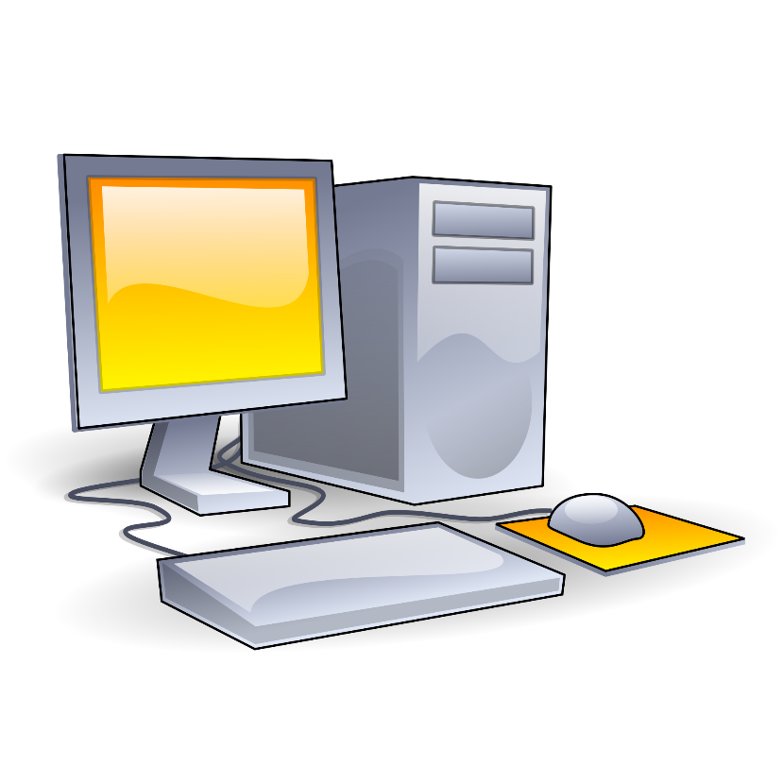

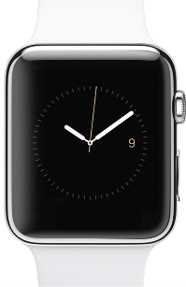
Ubiquitous Networked Computing
Notes:
Pervasive presence of networked devices
Ubiquitous computing
Digital workspace
So, you know…everybody has computers with internet access, and phones, and watches…

Slide 4





Collaborative Environments
Growth of online collaborative environments
Similar trend for software development tools

Slide 5
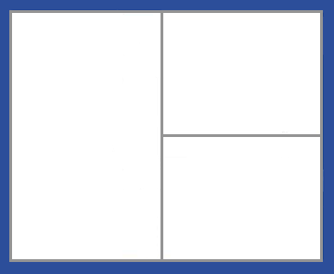
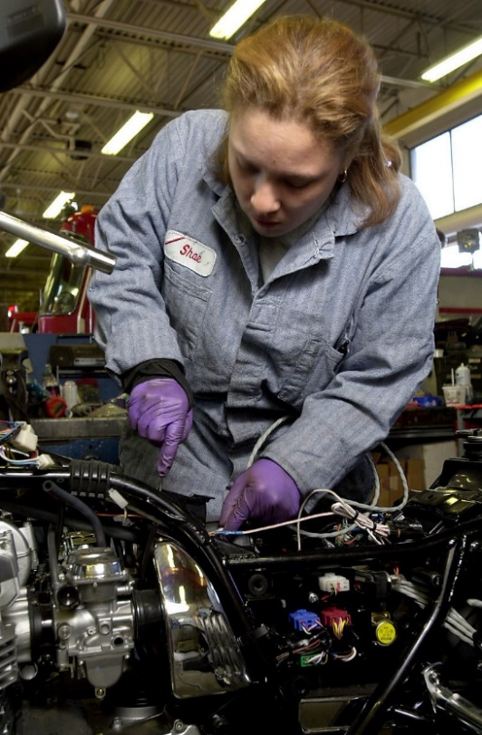


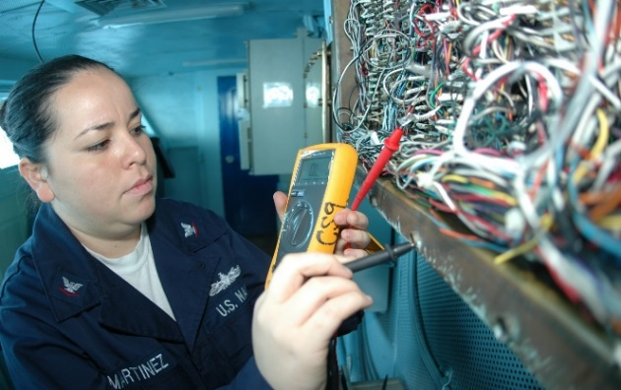
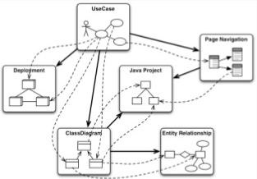
Collaborative Modeling Environments
MPM
Stakeholders should not be walled off from each other.
Notes:
Projects have many stakeholders.
Stakeholders for the same project may exist across many domains.
Multi-paradigm modeling, GEMOC initiative, Megamodeling; all incorporate distinct stakeholder groups within a common modeling environment.
We hope to integrate the concerns of many stakeholders of distinct domains within a consistent cloud-based modeling environment.

Slide 6
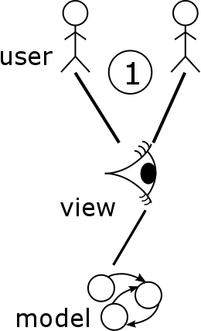
Multi-View, Multi-User Modeling
Model - represents some abstract concepts of a given domain
Concrete Syntax – defines visualization
  Text
  Graphical
View – combination of set of model elements and concrete syntax
Multi-View modeling supports many distinct views (whole or partial) of the model

Slide 7
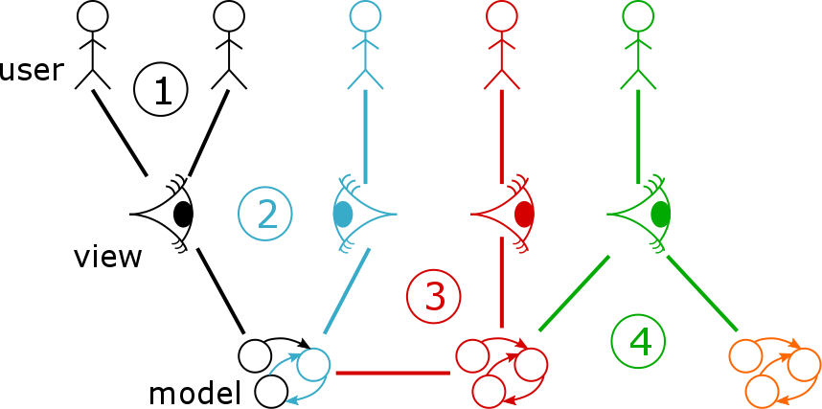
Collaborative Modeling Scenarios
  Multi-User Single-View
  Multi-View Single-Model
  Multi-View Multi-Model
  Single-View Multi-Model
J. Corley, E. Syriani, H. Ergin and S. Van Mierlo. Cloud-based Multi-View Modeling Environments. Modern Software Engineering Methodologies for Mobile and Cloud Environments. IGI Global, pp. 120-139 (2015).
Notes:
(1) two users are working on the exact same artifact simultaneously
(2) two users are working on different parts of the same artifact
(3) Two users with different expertise are working on distinct artifacts that, together, compose the overall system
(4) one user is working on a view that projects two models, while another user is working on a view of one of these models

Slide 8
Client independent – Modeling-as-a-Service
Scalable system
  load balancing – Supercontroller distributes Model Controllers across active nodes
  add nodes dynamically – forwarders avoid dynamic discovery issue
Live/Centralized System
  Model Controllers manage all active models/views
  Modelverse Krenel (MvK) provides long term storage and (currently) CRUD processing
Notes:
The system is design to be client agnostic
- forwarders separate clients from the distributed processing system, providing consistent interface to client side
- clients may be many different types of system/device (e.g., a browser-based model editor vs. a mobile game using models behind the scenes)
System is designed to manage scale by being
- flexible: add nodes dynamically
- balanced: SuperController automatically balances load
* current load balancing uses a primitive round-robin approach, future research can investigate more appropriate measures
* current load balancing does not re-evaluate load balancing based on reduced or increased stress for a specific node/model controller
We favor a live system with immediate response and conflict resolution
Currently the MvK is a simple single threaded implementation, but future work will improve this system by either:
- leaving the MvK as a separate distributed system with multi-threaded/distributed processing of requests.
- integrating the MvK processing system at the Model Controller level, but leaving long-term storage as a separate distributed network.

Slide 9
Ensuring Consistency
  Multi-User Single-View
    Managed by Model Controller
  Multi-View Single-Model
    Managed by Model Controller
  Multi-View Multi-Model
    Managed by MvK: no updates
    Managed by Client: multiple subscribe
  Single-View Multi-Model
    Not directly supported
    Can be refactored to scenario 3
Notes:
1 – a model controller manages all requests for a given model ensuring consistency
2 – a model controller also manages the views associated with a given model again ensuring consistency
3 – the third scenario is indirectly supported through links within the MvK, but this layer does not support automatic updates. Thus, to ensure consistency, clients must subscribe to all relevant views.
4 – this scenario is not supported nor planned to be supported, but the scenario could be refactored to have a single conglomerate model related to all other models and a single view for the conglomerate model. Thus, this scenario can be refactored to a special case of scenario 3.

Slide 10
Evaluating Performance
Supercontroller, MSG Forwarder,
& Resp Forwarder
  1X dual-core, 3.33 GHz, 4GB RAM
MvK
  1X quad-core, 3.1 GHz, 8GB RAM
Node & Model Controllers
  3x dual-core, 3.33GHz, 4GB RAM
  1X quad-core, 3.1 GHz, 8GB RAM
Client (1,25,…,200 concurrent users)
  2X dual-core, 3.33 GHz, 4GB RAM
  1X quad-core, 2.4 GHz, 8GB RAM
Focus on Create (most expensive) and Load (scales with model size)
Notes:
Total of 9 machines used to simulate a distributed processing network and a distributed set of clients. (Originally 10, but one machine was timing out and going to sleep during experiments despite all setting being configured properly)
Supercontroller, Msg Forwarder, Response Forwarder, MvK are each a single process
One node controller process per machine
50 model controller processes per (node controller) machine; after warm-up preloads model controllers
Clients
- 50 client processes per dual-core machine
- 100 client processes on the quad-core machine
- performance for the clients on the dual-core and clients on the quad-core were observed to be similar, but not reported separately in the paper

Slide 11
Experiment 1
Each User Connects to the Same View of the Same Model (Controller)
Notes:
Matching Scenario 1.

Slide 12
Experiment 1 - Create
Distribution grows as # users increases
MCtrlr & MvK create a bottle neck (MvK more significant delay)
First request is processed quickly, but last request must wait for all prior requests.
No significant growth due to model size variance
Model size is not varied significantly due to technical limitations at the MvK level
Each User Connects to the Same View of the Same Model

Slide 13
Experiment 1 - Load
Similar results to Create.
Each User Connects to the Same View of the Same Model
Notes:
20 % faster

Slide 14
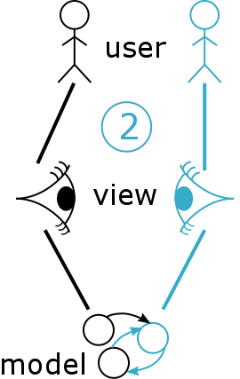
Experiment 2
Each User Connects to a Distinct View of the Same Model (Controller)
Notes:
Matching Scenario 2.

Slide 15
Experiment 2 - Create
Increased scaling compared to Experiment 1 due to additional view processing.
MCtrlr scales more poorly than Experiment 1.
Model size has no effect, only # users
Each User Connects to a Distinct View of the Same Model

Slide 16
Experiment 2 - Load
Similar results to Create.
Each User Connects to a Distinct View of the Same Model

Slide 17
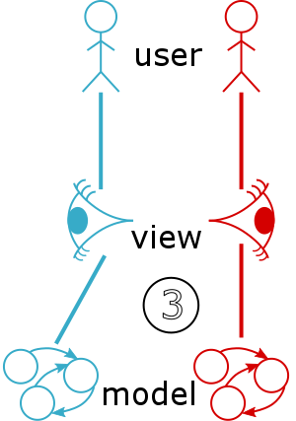
Experiment 3
Each User Connects to a Distinct View of a Distinct Model (Controller)
Notes:
Not quite a perfect match for Scenario 3.

Slide 18
Experiment 3 - Create
Significantly increased scaling compared to Experiment 1 due to MvK handling distributed clients as well as concurrent messages.
Otherwise similar to Experiment 1.
Each User Connects to a Distinct View of a Distinct Model

Slide 19
Experiment 3 - Load
Results able to be processed directly by Model Controller cache.
Scaling is significantly improved compared to Experiments 1 & 2.
Each User Connects to a Distinct View of a Distinct Model

Slide 20

Conclusion
Summary of results
  Controllers working as expected (targeting experiment 3)
  As expected, MvK needs to be improved to manage distributed load
Future work
  Two strategies to improve the MvK
    leave as a separate distributed system with multi-threaded/distributed processing of requests.
    integrate the processing with the Model Controllers and leave long-term storage separate.
  Evaluate strategies to balance the load of model controllers dynamically
Notes:
Evaluating load balancing strategies
- Direct empirical evaluation
- Case studies to ascertain applicability to real world scenarios or possible heuristics to improve performance
Compare with other tools, but not available then.

