Slide 1

Operational Semantics of UML Activity Diagram:
An Application in Project Management
Eugene Syriani and
Huseyin Ergin
Software Modeling Lab
Software Engineering Group
Department of Computer Science
College of Engineering
University of Alabama

Slide 2
Context
UML Activity Diagram & Petrinet
  Metamodels
  Rules for Model Transformation
Application in Project Management
Conclusion
Notes:
From the beginning, say that many people have looked at this problem (have some references)
However they do not cover the full AD meta-model.
In this work, we have defined the mapping to PN of the full latest AD meta-model from UML v2.4
The novelty of the approach is that we have modeled explicitly that mapping with rule-based model transformation.
This provides a declarative description of the mapping using the AD & PN notations.
This helps non-experts understand the behavior of AD, instead of going through the complications of the UML specs.
This also formalizes the mapping.
As a consequence, a second contribution is to apply the AD to PN trafo to a DSL for project management.

Slide 3
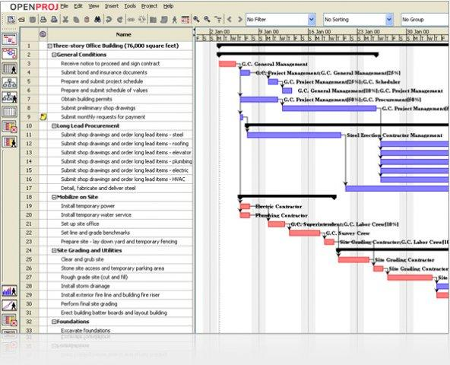
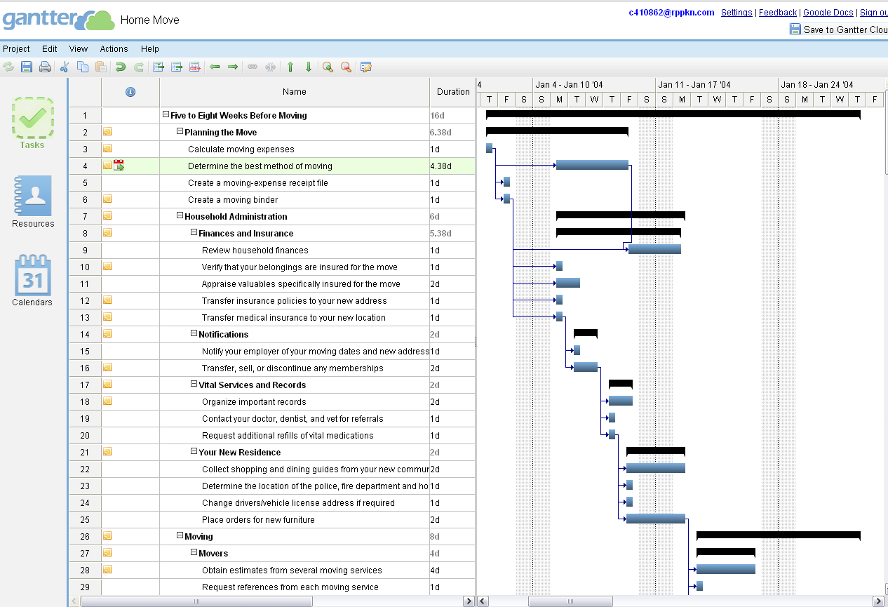
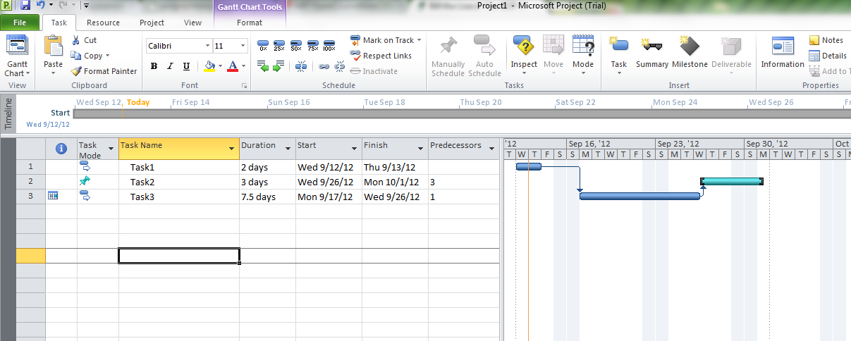
CONTEXT
[1] http://www.microsoft.com/project [2] http://www.serena.com/products/openproj/ [3] http://gantter.com/
Notes:
Project management tools; just a bunch of tasks in table format.
Existing gantt chat based tools are good for monitoring but not good enough for planning.
These tools are used for planning and monitoring but not ideal for planning.

Slide 4
Context
What we need?
a Domain Specific Language (DSL) that supports
basic project management (PM) features:
-Tasks
-Schedule
-Staff
-Time/Duration
We also need:
A new tool driven by requirements from project managers.
Interruption
Decisions
Loop structures
Notes:
After interviewing with some project managers, a new tool must be created driven by requirements from PMs.

Slide 5
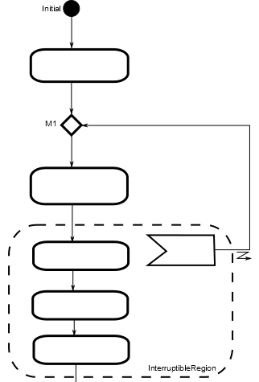
CONTEXT
The most suitable notation is Activity Diagrams (AD).
1- Define operational semantics of AD
2- Extend AD to create a DSL for PM
Notes:
First, I will explain how we managed operational semantics of AD.
Then I will extend AD to support project management.

Slide 6
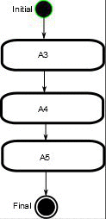
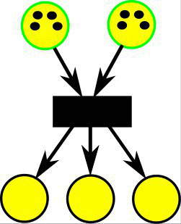
Context
We need Simulator for Activity Diagram
Simulator for Petrinet;
-Well studied, easy, less effort
But we can re-use Petrinet simulator
to animate Activity Diagram
Notes:
Explain what is PN briefly.

Slide 7
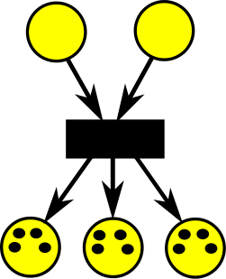
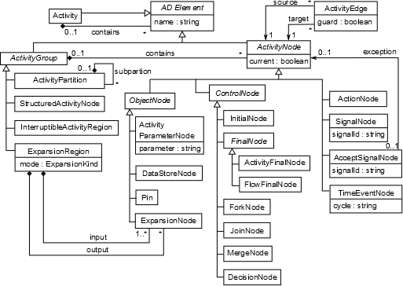
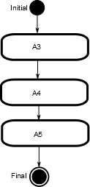

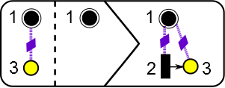
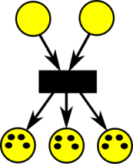
Context
Now we will transform Activity Diagram to Petrinet
using Model Transformation
A metamodel that can produce all Activity Diagrams
Another metamodel for Petrinet
With help of some rules
Notes:
NOTE TO SELF: metamodel defines instances, doesnot produce!

Slide 8
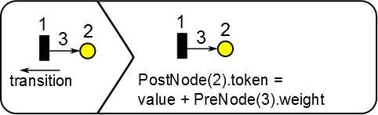
Context
While Petrinet is in simulation mode,
corresponding activity diagram will be animated.
At last, we will simulate Petrinet
again using Model Transformation

Slide 9
Rule based Model transformation
The model transformations we consider for this:
  Exogenous for AD to PN model transformation
  In-place for PN simulation
The rules consist of three parts:
  NAC LHS RHS
Source and target metamodels must be created.
We are using AToM³ as the modelling tool.
J. de Lara and H. Vangheluwe, “AToM3: A Tool for Multiformalism and Meta-Modelling,” in Fundamental Approaches to Software Engineering, ser. LNCS, R.-D. Kutsche and H. Weber, Eds., vol. 2306. Grenoble: Springer-Verlag, April 2002, pp. 174–188.
Notes:
---not generic links, call TRACEBILITY LINKS---
In-place for both AD to PN model transformation and PN simulation. Each transformation is executed on same model.
Exogenous means source and target have same metamodels.
Endogeous means source and target have different metamodels.
Explain LHS, RHS and NAC

Slide 10
Uml activity diagram (AD)
The semantics are mostly defined by natural language, so a precise formal semantics are needed
Our work deals with control flow of AD
Existing works formalized UML AD by using PN [Storrle04-05, Staines08]
  Most of them are focusing on basic constructs

Slide 11
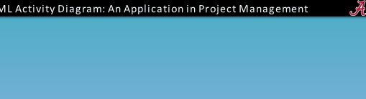
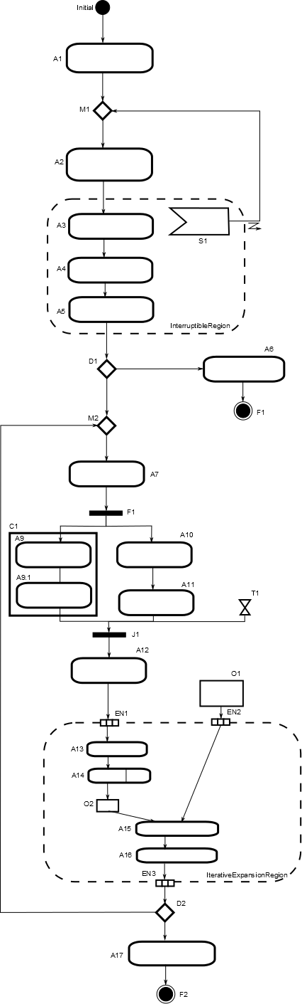
Uml activity diagram (AD) – cont’d
In this study, we deal with all UML AD constructs
Basic constructs such as:
  Action
  Fork
  Join
  Decision
  Merge
Advanced constructs such as:
  Activities
  Expansion Regions
  Interruptible Regions
  Object Nodes / Parameter Node
  Time Events
  Signal/Accepting Signal

Slide 12
Uml activity diagram (AD) – cont’d
The metamodel of UML AD and an instance model conforms to this metamodel
Instance model
AD metamodel
Notes:
This is a simplified UML AD metamodel but still a proper submodel. (Just took parts of it, I wont change anything)

Slide 13
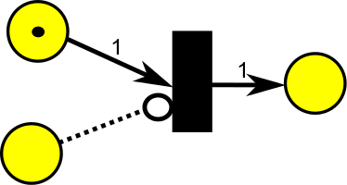
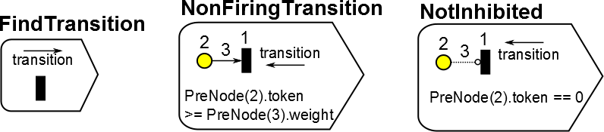
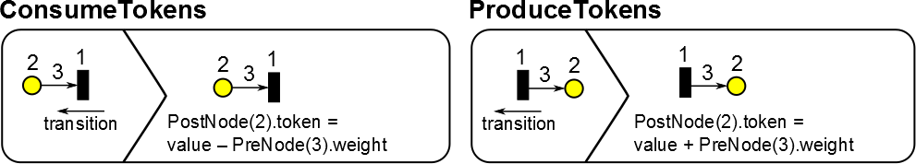
Petri nets (PN) & its simulation
The metamodel of the PN and an instance model
Simulation of PN using rule based model transformation
  Selection of a transition
  Apply token increase/decrease
Notes:
First part is selecting a fireable, not-inhibited transition.
A transition is fireable if input places with regular arcs have more than 0 token and input places with inhibitor arcs have 0 token.
After a transition is selected, the token will be consumed from input places and the tokens will be produced to output places.
NOTE: rules consist of only LHS are queries.

Slide 14
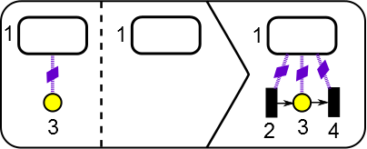
Model translation from AD to PN
Each element in AD is matched with PN counterparts by using rules.
Ex: Action element mapping rule
Notes:
Example is action element mapping. Each action element is mapped to an “entry” transition, a “processing” place and an “exit” transition. Other element mappings are justified in terms of their semantics.
This rule will find the pattern in LHS, ensure that NAC pattern does not exists.
Then it will apply the RHS to the instance model.
Other elements are matched also, and we get that result.

Slide 15
Model translation of advanced constructs
Interruptible Region
Notes:
NOTE: if there is a signal, it will provide token. If there is not, we have to create during simulation. And this simulates something happened.
Apply normal mapping rules first.
Now we will do other rules.
First one is adding an inhibitor from accepting signal (AS)’s place to the other transitions. That will provide us to block each transition if there is a token in the AS.
Then all places must have an inhibitor to the AS’s transition, and that is to ensure that we empty all tokens before executing AS’s transition.
Then to execute AS’s transition, we need to consume tokens from each place inside. We create another token consumption structure to each place.
Finally we can execute AS’s transition.

Slide 16
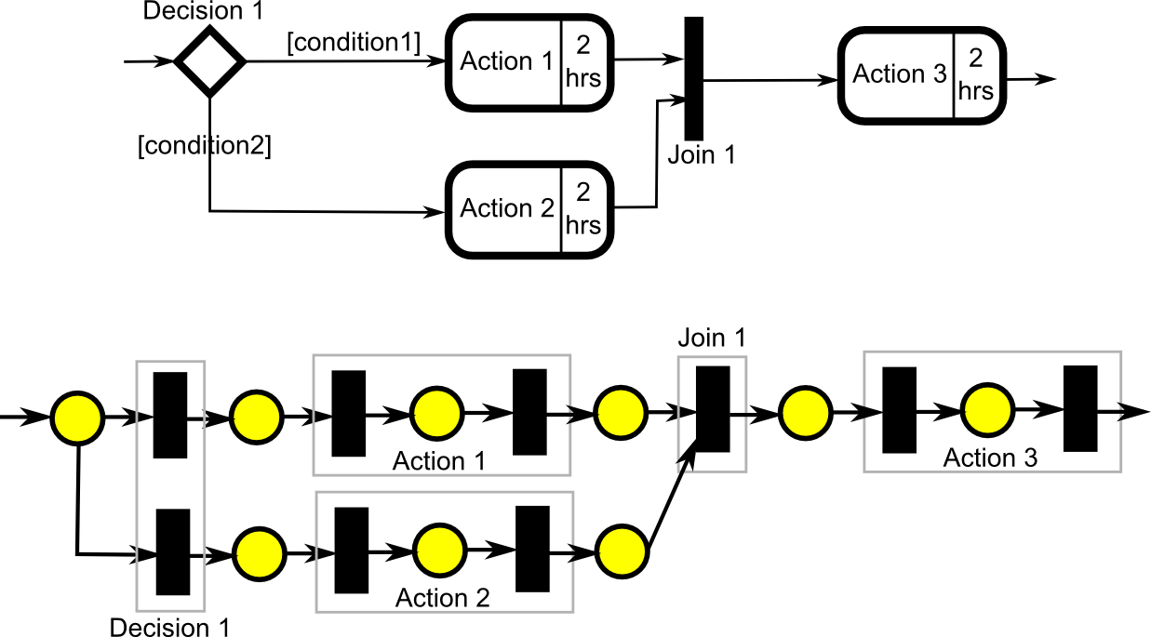
Analysis OF AD USING PN
We can verify AD by using underlying PN
Also export PN using PNML (Petri Net Markup Language) and apply static analysis technique to gain more information
  PIPE^{[1]} or CPN^{[2]} tools are used for that reason
[1] http://pipe2.sourceforge.net/ [2] http://cpntools.org/
Notes:
NOTE: Deadlock in PN yields to a problem in AD. Some of the problem are caused by non-restrictive metamodel of AD.
This analysis can be extended in this direction: PN has more complete model checking tools.
Here is an example of a syntactically valid but an incorrect design.

Slide 17
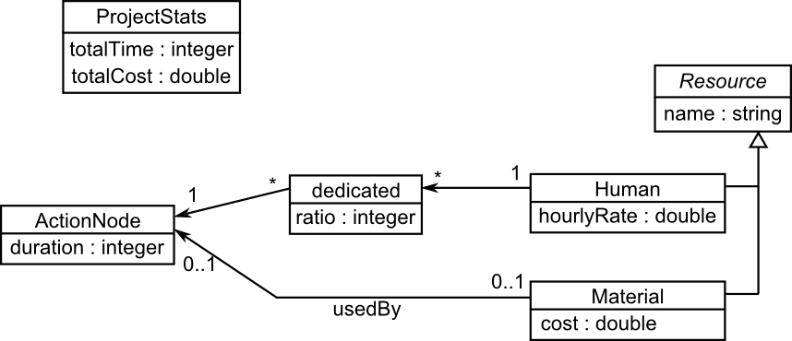
Dsl for pm

Slide 18
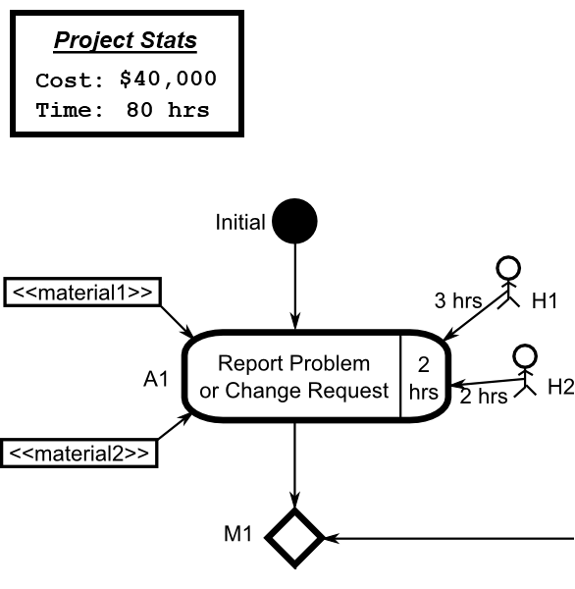
DSL for PM
We added more features to support project management.
Project stats is updated with current configuration of resources.
  Which can be re-allocated dynamically
  Project total time is the summation of actions durations.
  Project total cost is the summation of all costs of allocated/re-allocated resources
Metamodel
Instance

Slide 19
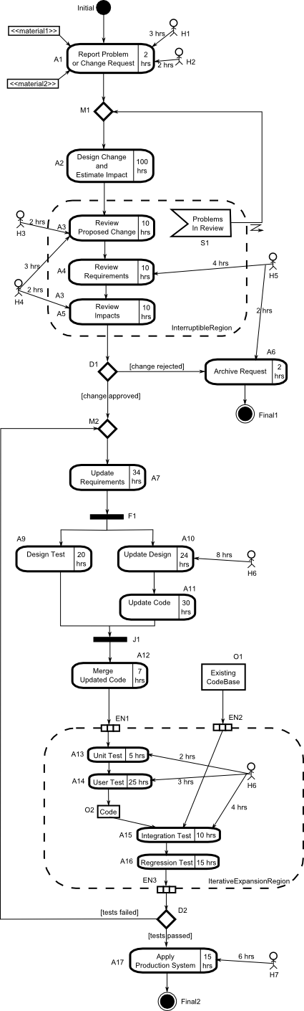
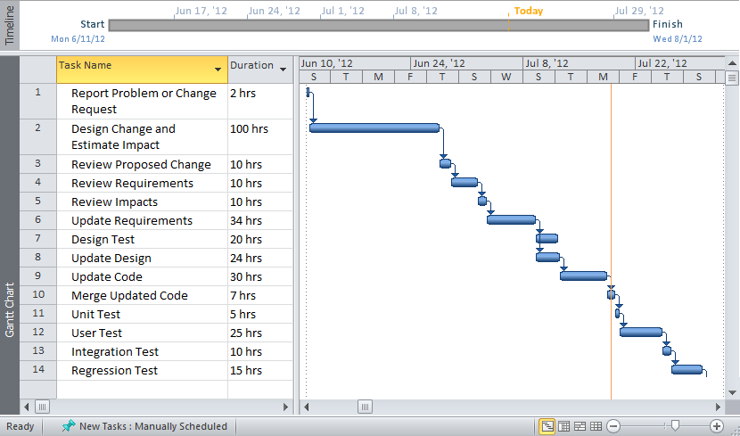
DSL for pm
Notes:
Advantages of DSL for PM over regular project management tools:
-The relationship between different activities is explicitly represented
-A central model can be re-used for scheduling, cost estimation and resource allocation
-The simulation facilitates debugging and understanding the overview of the project

Slide 20
SUMMARY
We applied rule based model transformation to translate AD to PN and simulate AD by simulating the PN.
DSL for PM can be used in requirement engineering process.
  Assist project managers in developing plans, assigning resources and tracking activities.
  We are not replacing classic project management tools, but improving them in planning phase.
We analyzed AD using PN counterparts.

Slide 21
We are planning to:
  Improve DSL for PM by interviewing members of some large projects
  Incorporate static PN analysis techniques and interpret them in terms of AD automatically?
  Make it better compatibility to work with other existing tools also.
    PM will plan the project in DSL for PM and may monitor the tasks in other tools without redesigning again.
  Evaluate DSL for PM with other project management tools.
    Empirical evaluation on users who will actually use both tools.

