Slide 1


A Unified Template for Model Transformation Design Patterns
Huseyin Ergin and
Eugene Syriani
Notes:
Talk intro here. Say everyone here knows MDE and MT, so I will directly go into the subject.

Slide 2
Problem (didn’t change)
Development of model transformation is still an error-prone and hard task.
One reason is the lack of a development process. ^{[1]}
  Design it before implement it.
Software developers have been designing using UML.
  With help of GoF design patterns.
Main goal is:
Unifying the existing model transformation design pattern templates, maybe with the help of some additional constructs.
[1] Guerra, E., de Lara, J., Kolovos, D., Paige, R., and dos Santos, O. (2013) Engineering model transformations with transML. Software and Systems Modeling, 12, 555–577.
Notes:
Refer to the implementation at the beginning.
Rule of thumb here is: “Design it before implement it”

Slide 3
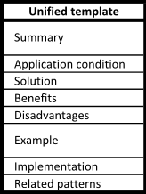
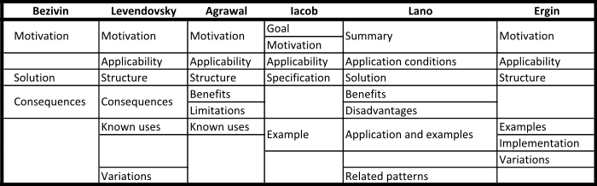
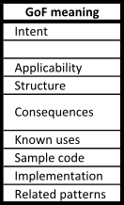
Existing Templates
Existing model transformation design pattern (MTDP) studies.
  Not all of them call themselves MTDP though.
  The separation between reusable idioms, patterns, design patterns.
But the inconsistency is clear.
Unification will help what is expected from a pattern and what are the outcomes.

Slide 4
Additional construct
GoF patterns have the structure field.
  Which makes the clear separation with other design pattern studies.
  In OMT (UML) design.
  The skeleton of the solution.
  Easy to understand by most developers.
We have proposed a language at ICMT 2014.
  DelTa.
  Assigning a graphical concrete syntax.
  Semi-automation while generating model transformation solutions.
DelTa structure of a MTDP is also in the unified template.

Slide 5
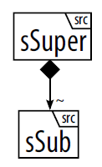
Sample design pattern
Top-down Phased Construction^{[1]}:
  Summary: This pattern separates the transformation into phases depending on how the target model is composed. The complete summary is found in [1].
  Application conditions: When there is a composition hierarchy in the source metamodel and the sub-element is mandatory in that relation.
[1]: Lano, K.; Kolahdouz-Rahimi, S., "Model-Transformation Design Patterns," Software Engineering, IEEE Transactions on , vol.40, no.12, pp.1224,1259, Dec. 1 2014

Slide 6
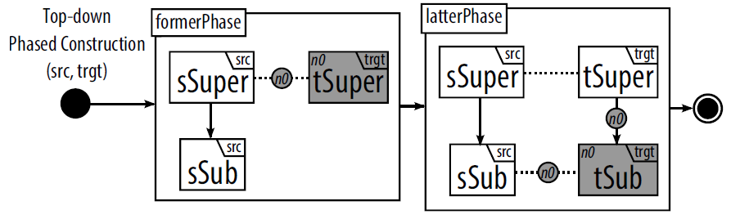
Sample design pattern
  Solution: The transformation is split into two phases. In the formerPhase rule, the target element corresponding to the super-element in the source is first created. In the latterPhase rule, target elements corresponding to the sub-elements in the source are then created.
  Benefits: This pattern increases the modularity of the rules, letting each rule create one layer of target elements.
  Disadvantages: Since the rules are broken into phases, that will increase the rule count.

Slide 7
Sample design pattern
  Examples: The UML class diagram to relational database diagrams can be considered a top-down phased construction, where we first use classes to create tables, and then use attributes to create columns.
  Implementation: The model transformation languages with explicit scheduling can create phases sequentially. The languages, that have implicit scheduling only, can refer to “simulating explicit rule scheduling” pattern.
  Related patterns: The pattern resembles entity relationship mapping pattern (many refs), when the entities are considered the top layer and relations are the layer below. There are also variations of this pattern that starts the construction starting from bottom.

Slide 8
Conclusion
Now we implement a semi-automatic way of generating transformations
  Starting with MoTif language, which is our favorite tool ☺
The unified template should help in:
  What developers are expected.
  How they describe a pattern.

Slide 9

Questions
Thanks for listening…

