Slide 1
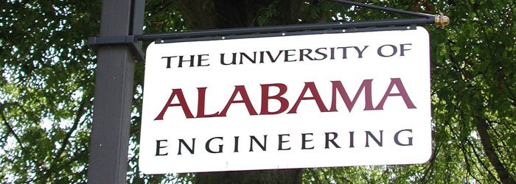
Design Patterns for Model Transformations
Proposal of Huseyin Ergin
Committee Members :
Dr. Eugene Syriani (advisor)
Dr. Jeffrey C. Carver
Dr. Jeff Gray
Dr. Ralf Lämmel
Dr. Randy K. Smith
Department of Computer Science
College of Engineering
University of Alabama

Slide 2
Background
Related Work
DelTa
MT Design Patterns
Planned Work
Conclusion
Notes:
MT = Model Transformation

Slide 3
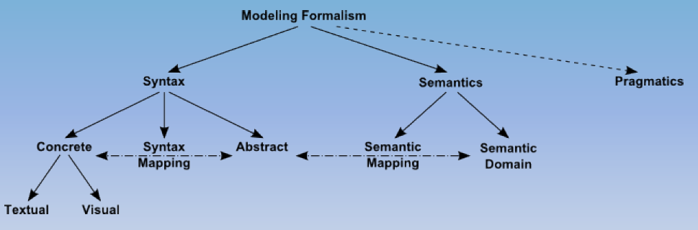
Background: MDE & MODEL TRANSFORMATION
Language Engineering adapted to model-driven engineering^{[1]}
In MDE, models are primary artifacts of development.^{[2]}
[1] David Harel, Bernhard Rumpe, "Meaningful Modeling: What's the Semantics of "Semantics"?," Computer, vol. 37, no. 10, pp. 64-72, Oct. 2004, doi:10.1109/MC.2004.172
[2] Robert France and Bernhard Rumpe. 2007. Model-driven Development of Complex Software: A Research Roadmap. In 2007 Future of Software Engineering (FOSE '07). IEEE Computer Society, Washington, DC, USA, 37-54. DOI=10.1109/FOSE.2007.14

Slide 4
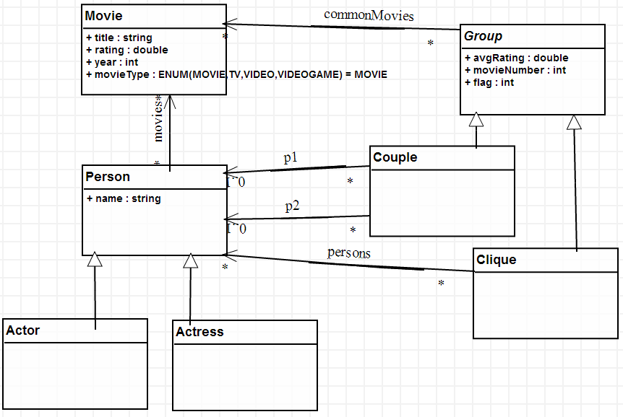
MDE in action
The problem (from TTC 2014):
  Write a transformation that works on IMDb as a model and identify all actor or actress couples which perform together in a set of at least three movies.^{[1]}
Step 1: Choose the modeling
environment.
  Environment: AToMPM^{[2]}
  MTL: MoTif^{[3]}
Step 2: Design a metamodel.
[1] http://www.transformation-tool-contest.eu/solutions/movie/ttc2014_submission_20.pdf
[2] Syriani, E., Vangheluwe, H., Mannadiar, R., Hansen, C., Van Mierlo, S., and Ergin, H. (2013) Atompm: A web-based modeling environment. MODELS’13: Invited Talks, Demos, Posters, and ACM SRC. CEUR-WS.org.
[3] Syriani, E. and Vangheluwe, H. “A Modular Timed Model Transformation Language,” Journal on Software and Systems Modeling, vol. 11, pp. 1–28, June 2011.

Slide 5
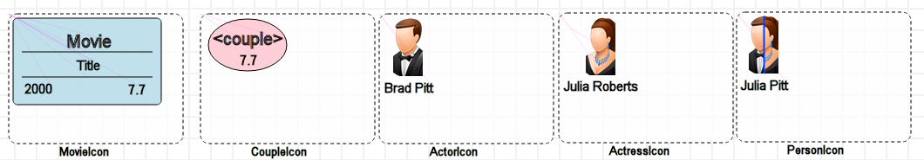
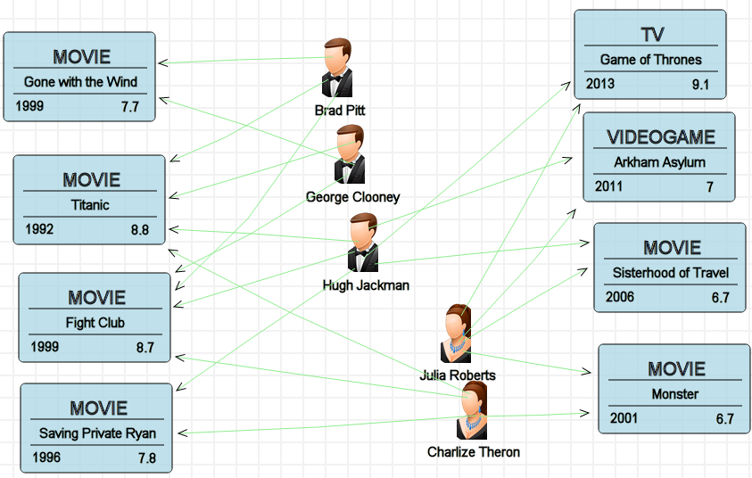
MDE IN ACTION
Step 3: Assign concrete syntax to elements.
Step 4: Create models.

Slide 6
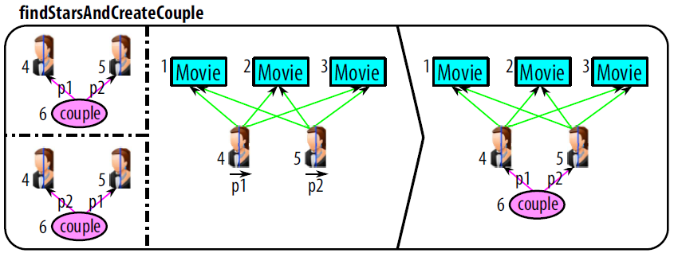
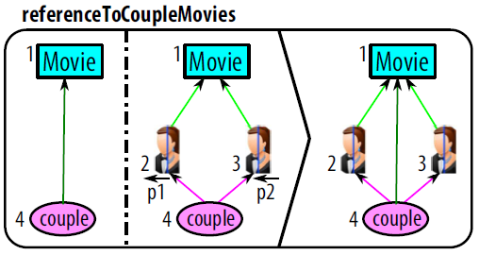
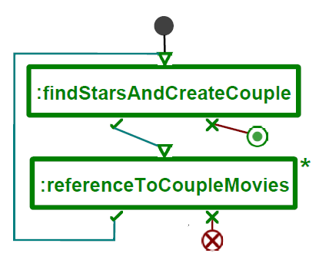
MDE IN ACTION
Step 5: Design rules to solve the problem.
Step 6: Design the scheduling
of the rules.
NAC
LHS
RHS
Notes:
Explaining the rule:
READ each rule as a sentence.
TRACEs in the “referenceToCoupleMovies” rule.
LHS: match the pre-condition pattern in the input model
RHS: replace/modify match to post-condition pattern
NAC: optional pre-condition pattern that inhibits the application of the rule
Scheduling is basically the order of the rules executed.
And it represents the control flow.

Slide 7
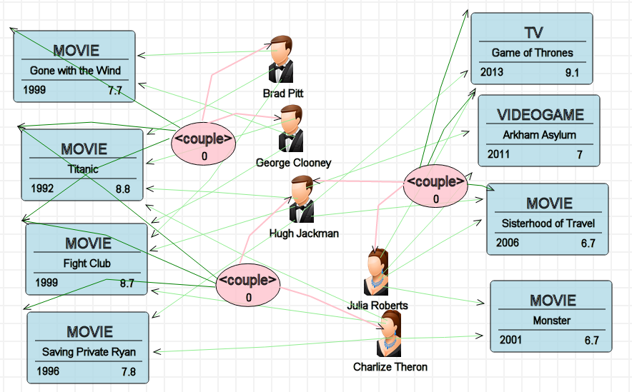
MDE IN ACTION
Step 7: Execute the transformation on the model.

Slide 8
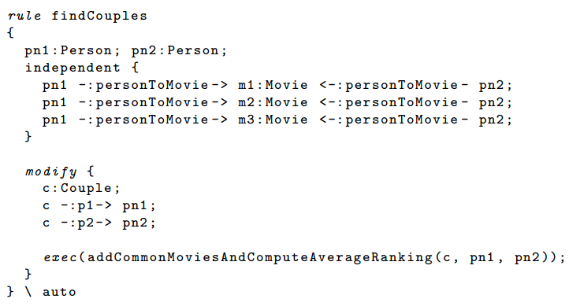
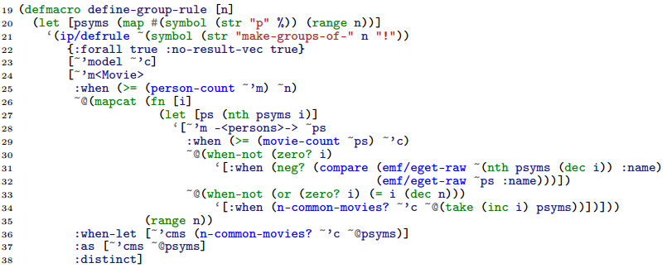
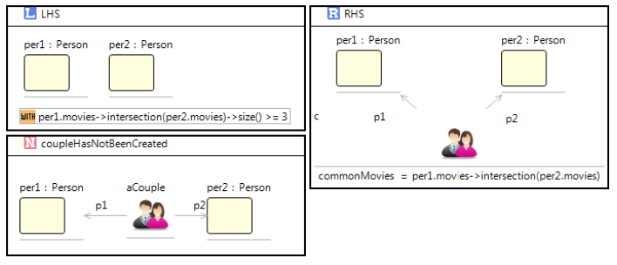
MDE IN ACTION
Excerpts from solutions in other MTLs.
  GrGen.NET^{[1]} FunnyQT^{[2]}
  e-Motions^{[3]}
[1] Geiß, R. and Kroll, M. (2008) GrGen. net: A fast, expressive, and general purpose graph rewrite tool. Applications of Graph Transformations with Industrial Relevance, pp. 568–569. Springer.
[2] Tassilo Horn. Model querying with funnyqt - (extended abstract). In Keith Duddy and Gerti Kappel, editors, ICMT, volume 7909 of Lecture Notes in Computer Science, pages 56–57. Springer, 2013.
[3] Rivera, J.E., Dur´an, F., Vallecillo, A.: On the behavioral semantics of real-time domain speciﬁc visual languages. In: WRLA. pp. 174–190 (2010)
Notes:
Explain it is not trivial to come up with these solutions

Slide 9
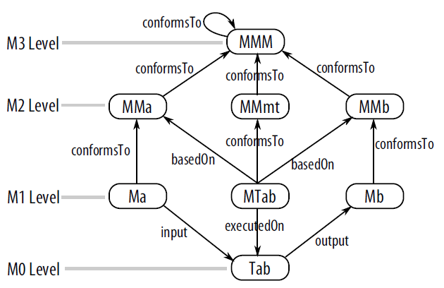
Background: MDE & Model Transformation
MDE use models to describe complex systems at multiple level of abstractions.
  A bridge vs. its built 1:100 prototype vs. its drawing on a paper.
MDE Schema^{[1]}
[1] Jouault, F., Allilaire, F., Bézivin, J., and Kurtev, I. (2008) ATL: A model transformation tool. Science of Computer Programming, 72, 31–39.
Notes:
In IMDb example, the source and target MMs are the same. Inplace.
Input and output may be same, which is called inplace.
Also there are different classifications, endogenous or exogenous, which means input having the same metamodel as output or not.

Slide 10
Background: Model Transformation
Relational vs. Graph-transformation-based ^{[1]}
  Relational (QVT, ATL etc.)
    Usually specifies the correspondence between source and target elements.
    Focuses on a subset of model transformations.
    More restrictions on how to create the transformation.
    Input model is read-only and output model is write-only.
  Graph-transformation-based (MoTif, Henshin, Viatra2 etc.)
    Works on graph structures that represent the models.
    Allows more flexibility like a general-purpose programming language.
    Allows in-place editing of models.
    Can have explicit scheduling structure.
This study focuses on graph-transformation-based model transformations.
[1] Czarnecki, K. and Helsen, S. (2006) Feature-Based Survey of Model Transformation Approaches. IBM Systems Journal, 45, 621–645
Notes:
There are roughly two approaches to produce a model transformation.
I focus on graph-transformation-based because relational is straight forward.

Slide 11
Background: design patterns
Design pattern
  “describes a problem which occurs over and over again in our environment and then describes the core of the solution to that problem, in such a way that you can use this solution a million times over, without every doing it the same way twice.”^{[1]}
Hundreds of design patterns in different areas
  Software architecture, real-time systems, distributed computing, embedded networks, metamodeling, model transformations.
Object-oriented design patterns are really popular among software developers.
[1] Gamma, E., Helm, R., Johnson, R., and Vlissides, J. (1995) Design Patterns: Elements of Reusable Object-oriented Software. Addison-Wesley, Boston, MA, USA.
Notes:
SAY THIS: No formal development process in Model Transformation
SAY THIS: Design patterns increase quality in software

Slide 12
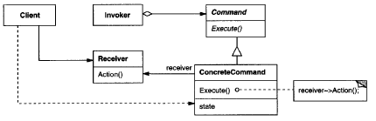
Background: design patterns
Example → Command Pattern ^{[1]}
  Intent: encapsulates a request as an object, lets requests to be passed as parameters and supports undoing.
  Structure:
Limitations of Design Patterns
  Tradeoff between reusability vs efficiency.
  Not clear how many design patterns are optimal in a project.
  Too many design patterns can mess up the code.
  Applying a design pattern is not automated.
[1] Gamma, E., Helm, R., Johnson, R., and Vlissides, J. (1995) Design Patterns: Elements of Reusable Object-oriented Software. Addison-Wesley, Boston, MA, USA.
Notes:
DONOT SPEND TOO MUCH TIME HERE!

Slide 13
Notes:
With a lot of diverse MTLs, development is not an easy task in model transformation.

Slide 14
Research problem
Development of model transformation is still an error-prone and hard task.
One reason is the lack of a development process. ^{[1]}
  Design it before implement it.
Software developers have been using UML.
  With help of GoF design patterns.
Main goal of my thesis is:
Helping model transformation developers in the design of model transformation through the use of design patterns.
[1] Guerra, E., de Lara, J., Kolovos, D., Paige, R., and dos Santos, O. (2013) Engineering model transformations with transML. Software and Systems Modeling, 12, 555–577.
Notes:
Refer to the implementation at the beginning.
Rule of thumb here is: “Design it before implement it”

Slide 15
Research Problem
Helping the model transformation developers in the design of model transformation through the use of design patterns
Requires:
Finding the appropriate language to define model transformation design patterns.
Identifying design patterns from existing transformation solutions.
Generating and detecting design patterns instances for a specific model transformation language.
Notes:
Now I will explain what I did in order to reach these goals.
First lets have some brief background information on Model Driven Engineering, Model Transformation and Design Patterns.

Slide 16
Related work
Existing model transformation design patterns.
  Agrawal et al.^{[1]}: transitive closure, leaf collector, proxy generator in GReAT.
  Iacob et al.^{[2]}: mapping, refinement, flattening, duality, node abstraction in QVT-R.
  Bezivin et al.^{[3]}: transformation parameters, multiple matching in ATL.
  Levendovszky et al.^{[4]}: helper constructs, optimized transitive closure in VMTS.
Design patterns vs reusable idioms.
Implementation in specific languages
[1] Agrawal, A. (2005) Reusable Idioms and Patterns in Graph Transformation Languages. International Workshop on Graph-Based Tools, ENTCS, 127, pp. 181–192. Elsevier.
[2] Iacob, M.-E., Steen, M. W. A., and Heerink, L. (2008) Reusable Model Transformation Patterns. EDOC Workshops, September, pp. 1–10. IEEE Computer Society.
[3] Bézivin, J., Jouault, F., and Paliès, J. (2005) Towards model transformation design patterns. Proceedings of the First European Workshop on Model Transformations (EWMT 2005).
[4] Levendovszky, T., Lengyel, L., andMészáros, T. (2009) Supporting domain-specific model patterns with metamodeling. Software & Systems Modeling, 8, 501–520.
Notes:
They are not actually design patterns. But most of them are idioms within that language, therefore can’t be generalized to other MTLs.

Slide 17
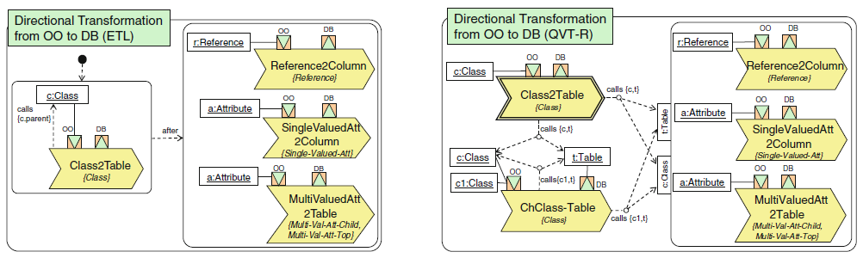
Related work
Language for Model Transformation Design Patterns.
  Lano et al.^{[1]}: used UML class diagrams and OCL constraints.
    Hinders the understandability of the patterns.
    Implementation is hard other than UML-RSDS language.
  Guerra et al.^{[2]}: proposed Rule Diagrams.
    Aims generating transformations.
    Each MTL needs its own Rule Diagram.
[1] Kevin Lano and Shekoufeh Kolahdouz Rahimi (2013) Constraint-based specification of model transformations. Journal of Systems and Software, 86, 412–436.
[2] Guerra, E., de Lara, J., Kolovos, D., Paige, R., and dos Santos, O. (2013) Engineering model transformations with transML. Software and Systems Modeling, 12, 555–577.

Slide 18
Finding the appropriate language to define model transformation design patterns.

Slide 19
DelTa
A language to express model transformation design patterns.
Features:
  Facilitate, reason, understand, document in a standard way^{[1]}
  Independent from existing model transformation languages (MTL).
  Play the role of UML for model transformation design patterns.
DelTa (Design pattern language for model Transformation)
  Offers concepts from existing MTLs.
  Abstracts away MTL specific concepts.
  Expresses design patterns rather than model transformations.
[1] Syriani, E. and Gray, J. (2012) Challenges for Addressing Quality Factors in Model Transformation. Software Testing, Verification and Validation, apr ICST’12, pp. 929–937. IEEE.
Notes:
Now, first I designed a language to express model transformation design patterns.
I could have used an existing MTL as a notation, however this can lead developers to think
the language itself is a transformation language and executable.
This is what I will present in 20 days in ICMT, which is a big conference in model transformation area.

Slide 20
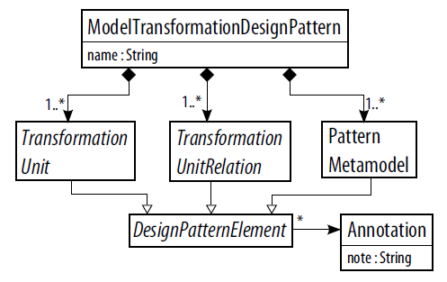
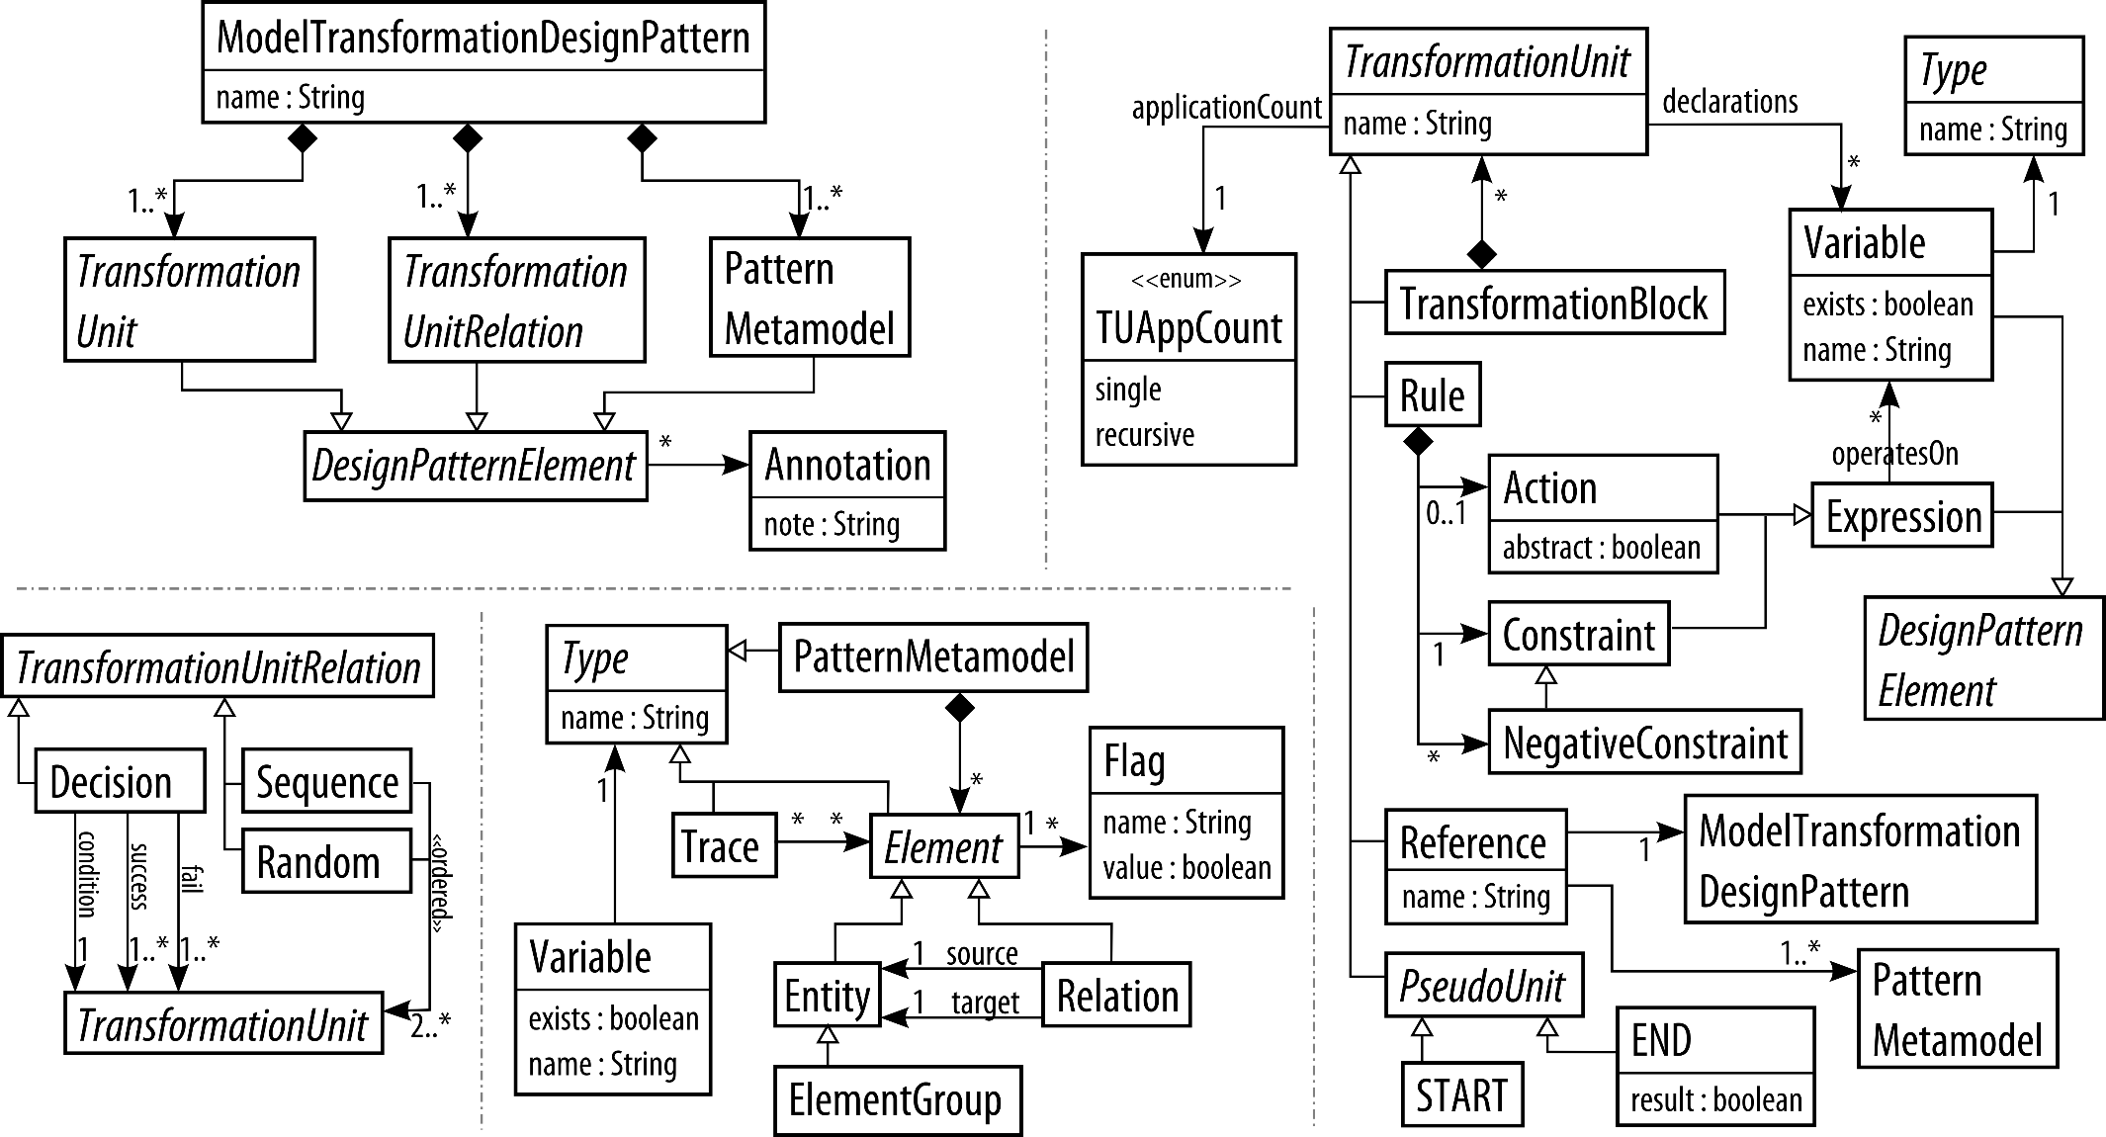
Delta metamodel
Notes:
What do we need for a model transformation design pattern? (like questions to self)
Just give concepts and give in details in concrete syntax.

Slide 21
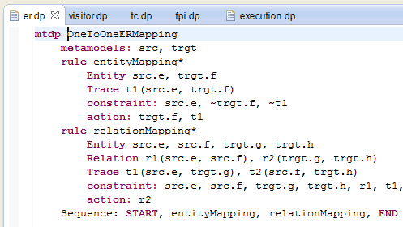
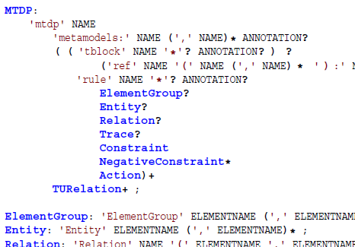
Delta textual syntax
A textual development environment for DelTa in Eclipse using Xtext
Notes:
Describe the textual syntax, sections etc.

Slide 22
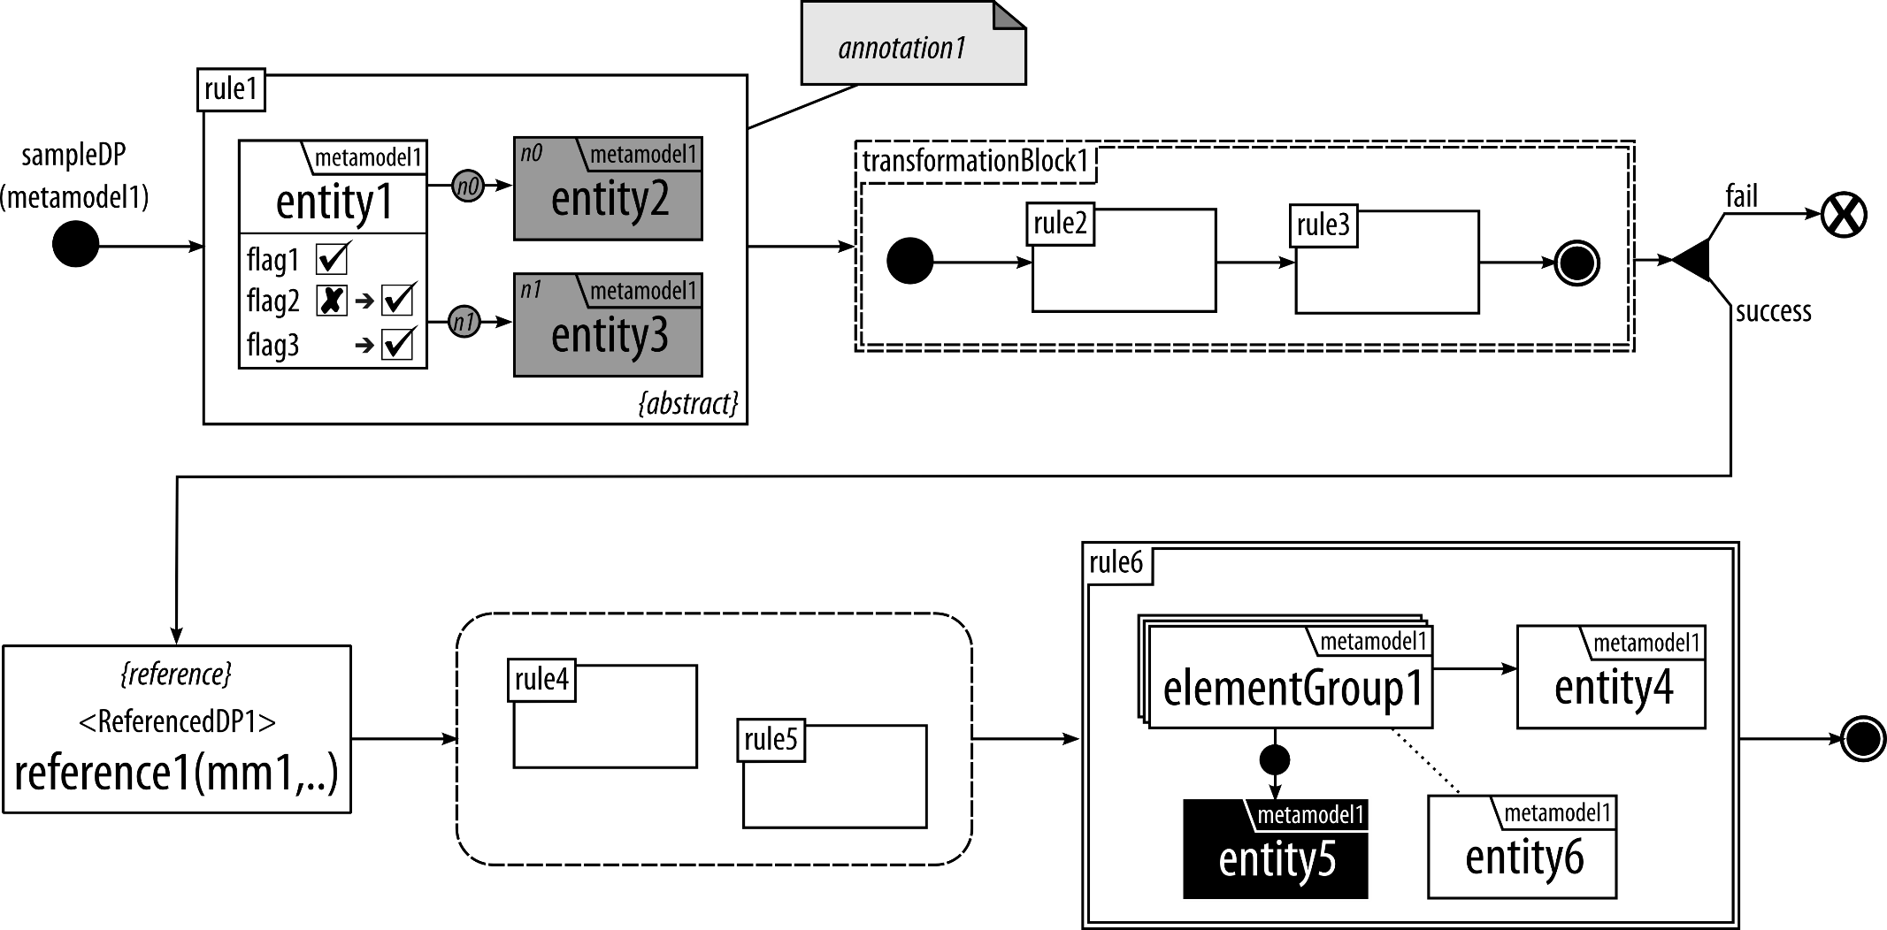
DelTa graphical syntax
Notes:
JUST READ THE RULES, not explain elements.
--------------------------------------------------
Explain the design pattern elements. And control flow. SEMANTICS.
Constraint of a rule is maximal. Give definition and in practice it is like a contravariance. (MAYBE make them show like popup while explaining)
Action of a rule is minimal.
Gray to be created
Black to be deleted.
More explanations here:
IMPORTANT: this is not model transformation.

Slide 23
Identifying design patterns from existing transformation solutions.
Notes:
I have shown how to identify a model transformation design pattern in the report in section 6.
Here I give the collection of MT design patterns, I have identified or redefined from existing studies.

Slide 24
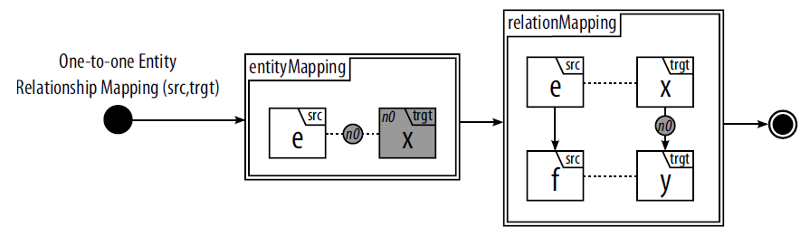
MT Design patterns
Entity Relation Mapping
  Motivation: The most commonly used pattern for exogenous transformations and creates corresponding elements of a source language in a target language with traceability links.
  Applicability: Usually when a transformation from one metamodel to a different metamodel.
  Structure in DelTa:
  Examples: Class diagram to relational database diagram.
Notes:
READ THE RULES…

Slide 25
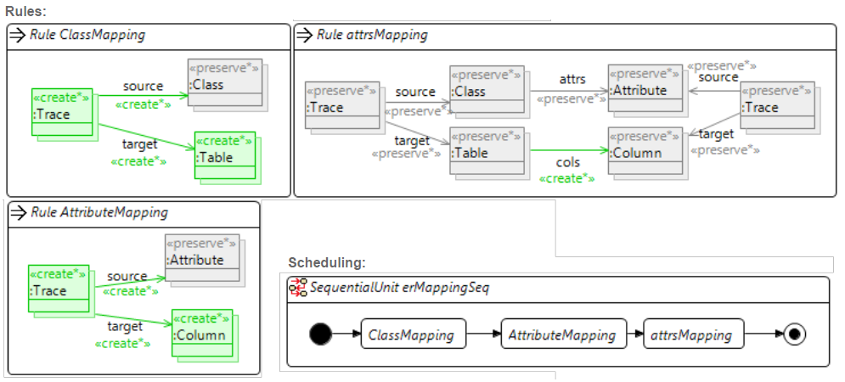
MT Design patterns
Entity Relation Mapping
  Implementation:
    Henshin^{[1]}
  Variations: The mapping can be one-to-many, many-to-many or many-to-one.
[1] Arendt, T., Biermann, E., Jurack, S., Krause, C., and Taentzer, G. (2010) Henshin: Advanced Concepts and Tools for In-Place EMF Model Transformations. MODELS 2010, LNCS, 6394, pp. 121–135. Springer.
Notes:
Do this for all other 5

Slide 26
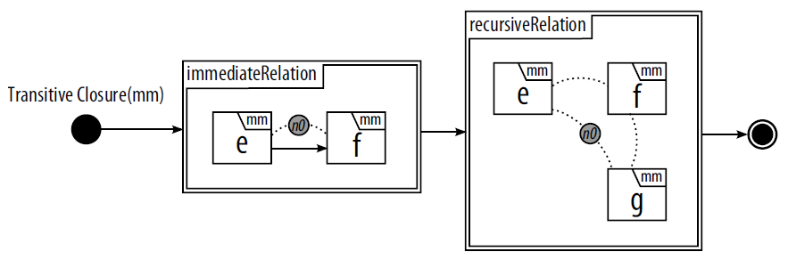
Mt design patterns
Transitive Closure
  Motivation: Analyzing reachability related problems with an inplace transformation.
  Applicability: The metamodels in the domain have a structure that can be considered as a directed tree.
  Structure in DelTa:
  Examples: Helps finding the lowest common ancestor or finding all superclasses of a class in UML class diagram.

Slide 27
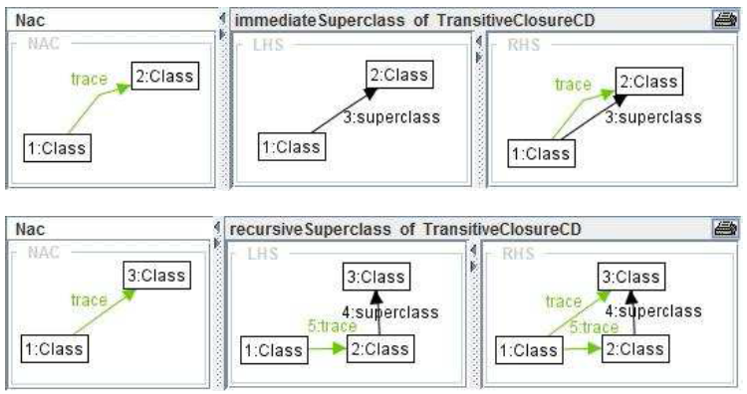
Mt design patterns
Transitive Closure
  Implementation:
    AGG^{[1]}
[1] Taentzer, G. (2004) AGG: A graph transformation environment for modeling and validation of software. AGTIVE, pp. 446–453. Springer.

Slide 28
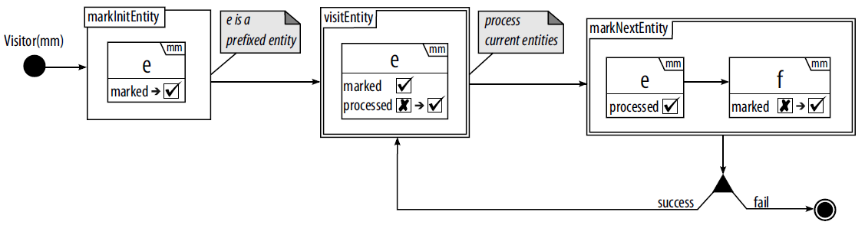
Mt design patterns
Visitor
  Motivation: Traversing all the nodes in a graph and processing each entity individually in a breadth-first fashion.
  Applicability: Problems that consist of or can be mapped to any kind of graph structure.
  Structure in DelTa:
  Examples: Computing the depth level of each class in a class diagram hierarchy

Slide 29
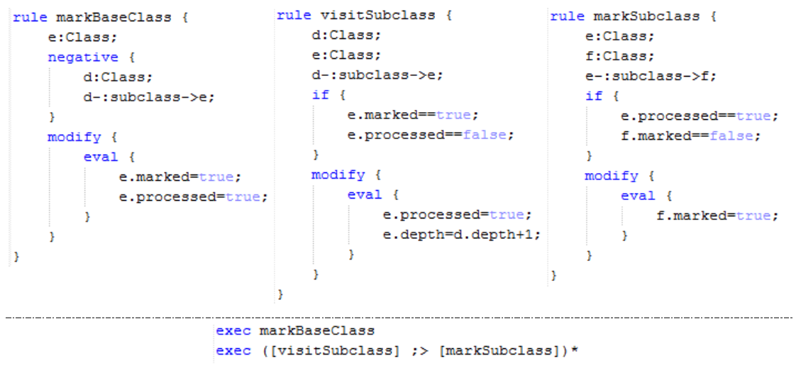
Mt design patterns
Visitor
  Implementation:
    GrGen.NET^{[1]}
  Variations: It is possible to change the traversal order.
[1] Geiß, R. and Kroll, M. (2008) GrGen. net: A fast, expressive, and general purpose graph rewrite tool. Applications of Graph Transformations with Industrial Relevance, pp. 568–569. Springer.

Slide 30
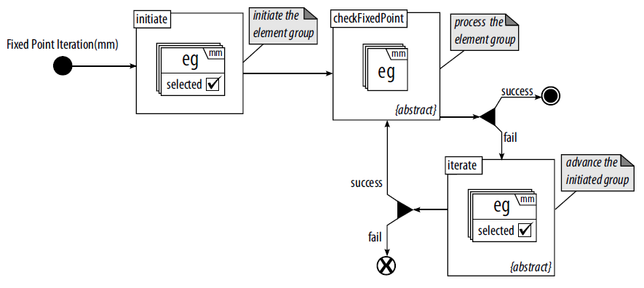
Mt design patterns
Fixed Point Iteration
  Motivation: Represents a “do-until” loop for model transformations.
  Applicability: When the problem can be solved iteratively until a fixed point is reached.
  Structure in DelTa:
  Examples: Finding lowest common ancestor, calculating equivalent resistance in an electrical circuit.

Slide 31
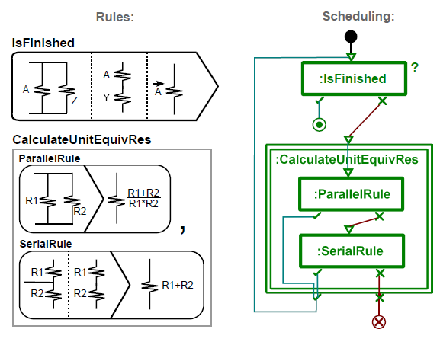
MT design patterns
Fixed Point Iteration
  Implementation:
    MoTif
  Variations: Initiate rule can be omitted if there is no initialization at the beginning.

Slide 32
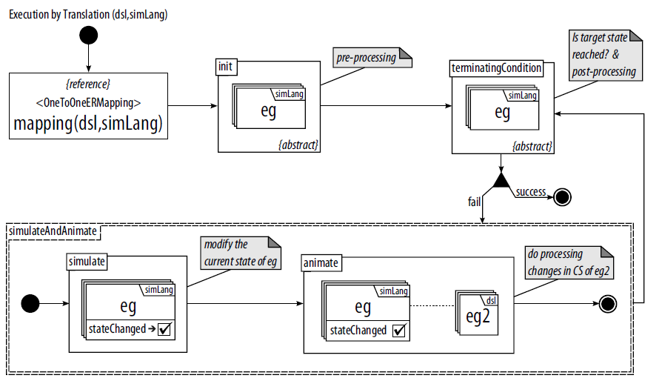
Mt design patterns
Execution by Translation
  Motivation: To execute a domain-specific language (DSL), often another well-defined semantics language is referred. This both saves time because the other language has already an execution engine.
  Applicability: When executing a DSL and have another language to rely on.
  Structure in DelTa:

Slide 33
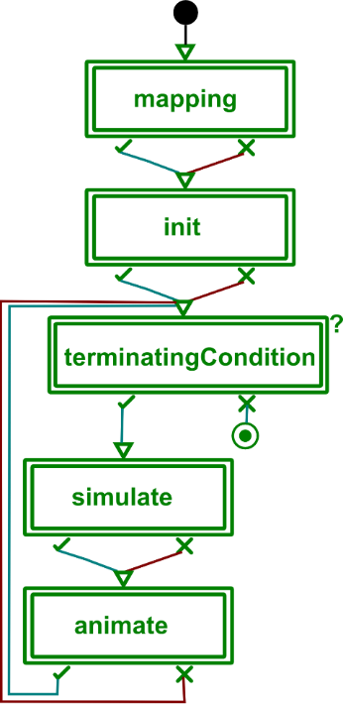
MT design patterns
Execution by Translation
  Examples: Executing the Finite State Automata by translating to Petrinets^{[1]}
  Implementation:
    MoTif
[1] Kühne, T., Mezei, G., Syriani, E., Vangheluwe, H., and Wimmer, M. (2010) Explicit Transformation Modeling. Models in Software Engineering, Lecture Notes in Computer Science, 6002, pp. 240–255. Springer Berlin Heidelberg.
Notes:
Just showing the overall trafo here. Rest is in report.

Slide 34
Generating and detecting design patterns instances for a specific model transformation language.
Notes:
I have shown how to identify a model transformation design pattern in the report in section 6.
Here I give the collection of MT design patterns, I have identified or redefined from existing studies.

Slide 35
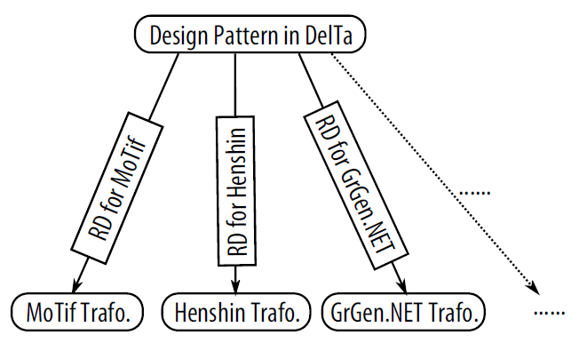
PLANNED work
Uses of DelTa
  The main question is how to auto-generate transformations using DelTa.
  MTLs are really diverse so DelTa is very abstract.
  I will try to use Rule Diagrams.
  Completion: 5%

Slide 36
Planned work
Detection of DelTa Design Patterns
  Automatic detection of DelTa design patterns in existing model transformation solutions.
  Inputs: The model transformation and list of DelTa Design Patterns.
  Output: List of DelTa Design Patterns found in the input model.
  DelTa is a DSL.
    Therefore, detection will be a model transformation itself.
  Completion: 30%

Slide 37
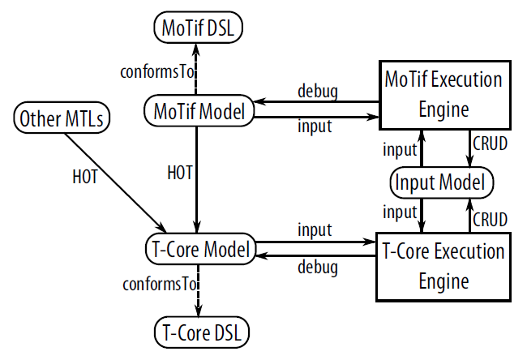
Planned work
Implementation of MoTif, DelTa and T-Core[1] in AToMPM
  Completion: 60%
[1] Syriani, E., Vangheluwe, H., and LaShomb, B. (2013) T-Core: a framework for custom-built model transformation engines. Software & Systems Modeling, 13, 1–29.
Notes:
-designing domain-specific modeling languages
-performing model transformations
-manipulating and managing models
Tcore is the underlying transformation primitives of MoTif

Slide 38
PLANNED work
Identification of New Design Patterns
  Systematic literature review of model transformation intents.
  All the papers that have model transformation case studies, examples, demonstrations between 2003-2013.
  Help me see how problems are solved in different languages and settings.
  Identification can be done in two methods:
    Solving different problems and coming up with a common solution.
    Analyzing existing examples.
  With more design patterns, classification is next.
  Completion: 50%

Slide 39
Planned work
Empirical Evaluation of DelTa
  An empirical experiment for real transformation developers.
  Research question focus on the usability of DelTa in developer’s point of view.
  A pilot study in our university.
    The main language will be MoTif.
  Main study is aiming Transformation Tool Contest 2015.
    Where real developers implement model transformations in many different MTLs.
    A case study will be provided for the contest.
  Outcomes are:
    Possible revisions to DelTa with respect to the feedbacks from the study.
    The experiences of DelTa with different languages.
  Completion: 5%

Slide 40
timeline
Fall 2014:
  Identification of new design patterns with Intents Study (3 terms).
  Designing DelTa modeling environment in AToMPM.
  Preparing empirical evaluation experiment and case study of DelTa.
  Conducting the pilot empirical evaluation on subjects.
Spring 2015:
  Uses of DelTa with Rule Diagrams.
  Paper with newly identified design patterns and revisions to DelTa as a result of initial test experiment.
  Preparing the paper for SoSym with DelTa in its final form and results of empirical evaluation.
  Detecting DelTa design patterns in MoTif transformations.
Summer 2015:
  Conduct empirical evaluation in TTC
  Writing dissertation.
Fall 2015:
  Dissertation defense & graduation

Slide 41
conclusion
Model transformation development is a hard task.
  And will be better with help of design patterns.
To help model transformation developers in the design phase, I have:
  Created DelTa: A language for model transformation design patterns
  Populated an initial collection of model transformation design patterns
  Been working on how to automatically generate transformation by DelTa specifications.
I have also implemented:
  MoTif and T-Core DSLs in AToMPM and execution engines in Python to help to detect DelTa design patterns

Slide 42
List of publications
Published
1. Eugene Syriani and Huseyin Ergin. Operational Semantics of UML Activity Diagram: An Application in Project Management. Requirement Engineering Conference 2012 Workshops, IEEE, Chicago, IL (September 2012)
2. Huseyin Ergin and Eugene Syriani. Identification and Application of a Model Transformation Design Pattern. ACM Southeast Conference 2013, Savannah, GA (April 2013)
3. Huseyin Ergin.Model Transformation Design Patterns.MODELS Conference 2013 Doctoral Symposium, Miami, FL (October 2013)
4. Eugene Syriani, Hans Vangheluwe, Raphael Mannadiar, Conner Hansen, Simon van Mierlo, and Huseyin Ergin. AToMPM: AWeb-basedModeling Environment.MODELS Conference 2013 Demonstrations, Miami, FL (October 2013)
Technical Report
5. Huseyin Ergin and Eugene Syriani. Implementations of Model Transformation Design Patterns Expressed in DelTa. Department of Computer Science, University of Alabama, SERG-2014-01 (February 2014)
Accepted & To Be Presented
6. Huseyin Ergin and Eugene Syriani. Towards A Language To Express Design Patterns for Graph- Based Model Transformation. International Conference on Model Transformation 2014, York, UK (July 2014)
7. Huseyin Ergin and Eugene Syriani. AToMPM Solution for the IMDB Case Study. Transformation Tool Contest 2014, York, UK (July 2014)
A.3 In Preparation & Planning
8. Huseyin Ergin and Eugene Syriani. Reuse of Model Transformation Design Patterns. Models Workshops
9. Huseyin Ergin and Eugene Syriani. DelTa: A Language for Model Transformation Design Patterns. Journal of Software and Systems Modeling (2015)
10. Huseyin Ergin and Eugene Syriani. Model Transformation Design Patterns in Action: Experiences with DelTa. Automated Software Engineering (2015)
11. Huseyin Ergin and Eugene Syriani. The Experiences on How To Generate Transformations Using DelTa. International Conference on Model Transformation (2015)
12. Eugene Syriani, Jeffrey Carver, Huseyin Ergin, and Ahmet AlZubidy. Model Transformation Intents: A Systematic Literature Review. Empirical Software Engineering Conference (2015)
13. Huseyin Ergin and Eugene Syriani. DelTa Case Study. Transformation Tool Contest (2015)
Notes:
Any questions?

