Slide 1

Increasing the Quality of Model Transformation with the Use of Design Patterns
Hüseyin Ergin
Advisor :
Committee Members :
Dr. Eugene Syriani
Dr. Jeff Gray
Dr. Nicholas Kraft
Dr. Richard Borie

Slide 2
Introduction
Model Transformation
Quality in Model Transformation
Design Patterns
Model Transformation Design Patterns
Challenges & Conclusion

Slide 3
Development Approach

Slide 4
Model Driven Engineering (MDE)
MDE is software development approach that uses abstraction between problem and software implementation [Stahl2006].
Models are first class citizens.
  A model captures some characteristics of the system and provides knowledge about it.
Each model conforms to a metamodel.
  Metamodel represents the essence of a modeling language.
Model transformation: An automated manipulation of models according to a specific intent [Amrani2012].
  Intent is the description of the goal behind the model transformation and the reason for using it.
  Some intents: Manipulation, Restrictive query, Optimization etc.
Stahl2006: T. Stahl, M. Voelter, and K. Czarnecki, Model-Driven Software Development: Technology, Engineering, Management. John Wiley & Sons, 2006.
Amrani2012: Amrani, M.; Dingel, J.; Lambers, L.; Lucio, L.; Salay, R.; Selim, G.; Syriani, E. & Wimmer, M. Towards a Model Transformation Intent Catalog MoDELS workshop on Analysis of model Transformation, 2012
Notes:
……Abstraction To bridge the gap between problem……
These abstractions are models.
This metamodel defines the elements and relations between these elements.
Manipulation: a simple atomic operation on a model
Restrictive query: for some information about a model
Optimization: Improving operational qualities of model
SYRIANI: Literature identified 20 intents.

Slide 5
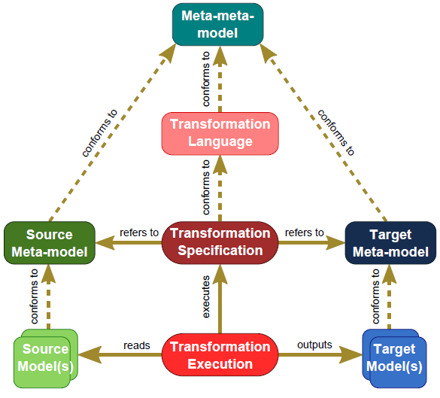
Model Driven Engineering – cont’d
Model transformation schema in MDE [Syriani2012]
Syriani2012: Eugene Syriani, Jeff Gray and Hans Vangheluwe. Modeling a Model Transformation Language. Domain Engineering: Product Lines, Conceptual Models, and Languages (2012)
Notes:
We have source models which have their own metamodels.
Target models which have their own metamodels.
And in the middle we have a transformation which conforms to a transformation language.
The transformation reads the source model and outputs the target model.
Therefore refers to both source and target metamodels.
SYRIANI: Transformation defined in metamodel level but executed on instance level.
We only write a transformation once for a pair of domains and this will fit for all instances.

Slide 6
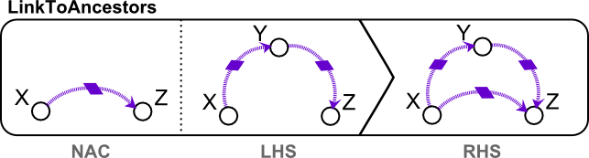
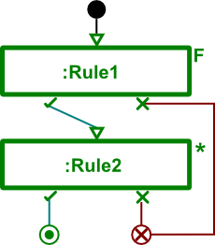
Motif Transformation language*
Rule-based transformation language.
Graphical transformation rules
Explicit rule scheduling
*: E. Syriani and H. Vangheluwe, “A Modular Timed Model Transformation Language,” Journal on Software and Systems Modeling, vol. 11, pp. 1–28, June 2011.
Notes:
Other types are template based, functional (Kermeta), imperative (Java).
Transformation rules are the smallest unit of a model transformation.
It is a description:
-that takes elements from source language
-transforms them to elements in target language
Scheduling is basically the order of the rules.
And it represents the control flow.
Rules can be represented with an F which means for all matches.
Asterisk (*) which means as long as it is applicable
Question mark (?) which means a query

Slide 7
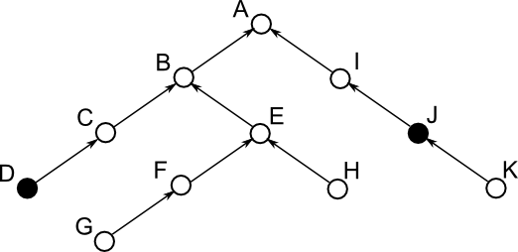
Illustration
Lowest Common Ancestor Problem [Aho1973]:
  In a tree structure find the lowest common ancestor of two given nodes.
  Solution using a naïve approach
Aho1973: A. V. Aho, J. E. Hopcroft, and J. D. Ullman, “On finding lowest common ancestors in trees,” in Proceedings of the fifth annual ACM symposium on Theory of computing, ser. STOC ’73. New York, NY, USA: ACM, 1973, pp. 253–265.
Notes:
A tree structure may be like that or with only child links downwards.
An example may be node D and node J.
And lowest common ancestor of node D and node J is node A in this case.
Now we will solve this problem step by step using MDE approach.

Slide 8
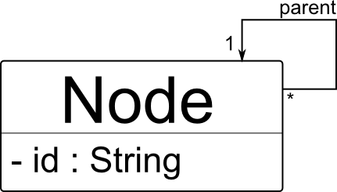
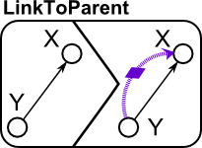
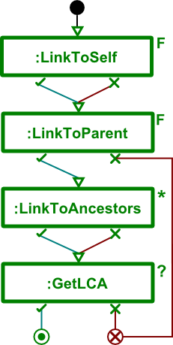

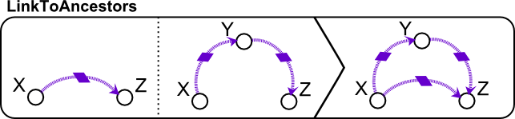
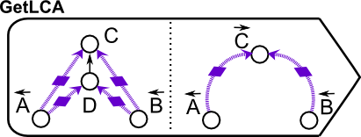
Illustration – cont’d
A metamodel for such a tree:
Rules Scheduling
Notes:
First we have to create a metamodel. All we need is a node element with parent link.
After metamodel, we have also our environment by generating (Most tools support this: Eclipse EMF, AtomPM etc).
Now to solve the question we will write our necessary rules.
Then we need the scheduling of these rules which is basically the order of rules.
SYRIANI: ANCESTOR LINKS instead of generic or temporary links

Slide 9

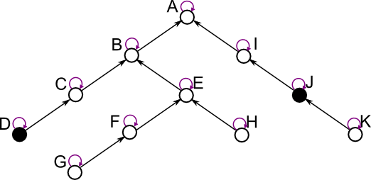
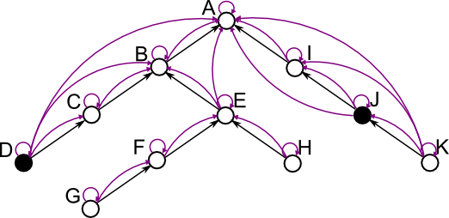
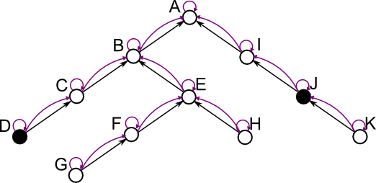
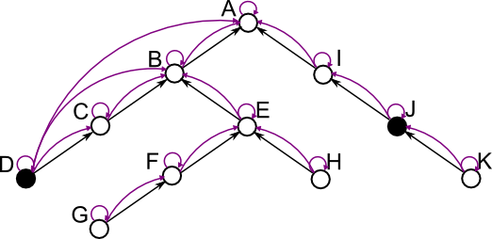
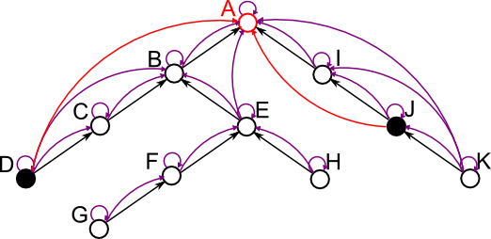
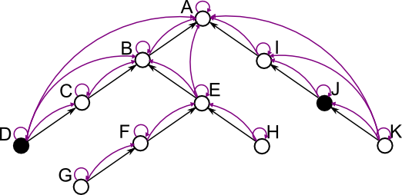
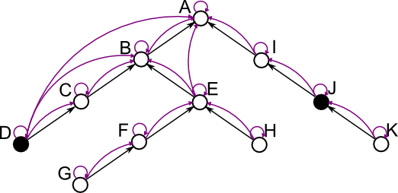
Illustration – cont’d
Notes:
The solution of the problem by applying the rules are here. Step by step.

Slide 10
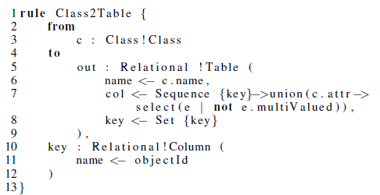
Other Model transformation languages
There are many model transformation languages
ATL [Jouault2008]: Atlas Transformation Language
  It only reads from a source model and writes to a target model.
    Unidirectional
  From and to parts: like LHS and RHS
  Textual representation
Jouault2008: F. Jouault, F. Allilaire, J. B´ezivin, and I. Kurtev, “ATL: A model transformation tool,” Science of Computer Programming, vol. 72, no. 1-2, pp. 31–39, June 2008.
Notes:
From is read only source pattern
To is write only target pattern

Slide 11
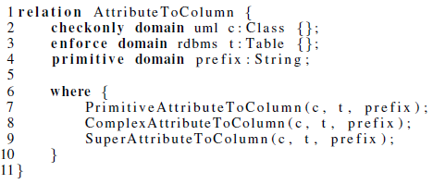
Other Model transformation languages
QVT [OMG2011]: Query View Transformation
  Set of relations among models
    Relations embodies a consistency between source and target models
    Implicit scheduling
    Declarative relations define an acausal mapping
  Textual representation of relations and patterns
OMG2011: Object Management Group. Meta Object Facility 2.0 Query/View/Transformation Specification. Jan 2011.

Slide 12
Development Approach
Evaluation
Notes:
Now we will see how we ensure quality

Slide 13
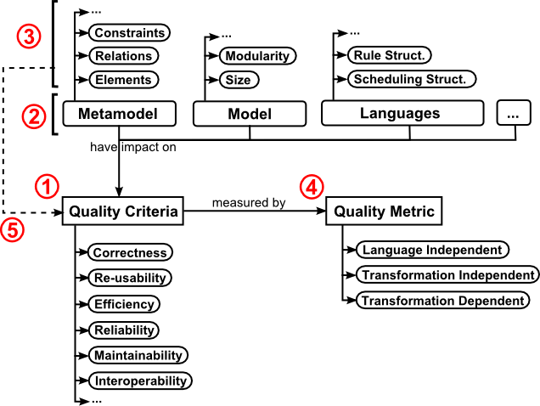
Quality framework for mde
Defined by Mohaghegi and Dehlen[*].
Result of adaptation to model transformation specifically.
*: P. Mohagheghi and V. Dehlen, “Developing a Quality Framework for Model-Driven Engineering,” in Models in Software Engineering, ser. Lecture Notes in Computer Science, H. Giese, Ed. Springer Berlin Heidelberg, 2008, vol. 5002, pp. 275–286.
Notes:
We need a quality framework to evaluate what we are doing.
This framework defines the quality of MDE step by step.
1- identify quality criteria
2- identify target objects that have impact on these criteria (all concepts related to model transformation)
3- identify properties of target objects
4- Specify how to evaluate criteria (a.k.a. specify metrics)
5- Specify links between criteria and properties (which property effects which criteria, how)
6-execute and evaluate metrics

Slide 14
metrics for model transformation languages
Metrics are always necessary for assessing the quality.
Divided into three categories [Amrani2012].
Language independent metrics
  Related with core model transformation components
  Example: Size of rules, number of rule applications etc.
Transformation independent metrics
  Focus on specific model transformation languages
  Example for QVT: number of enforced domains, number of ‘when’ predicates etc.
Transformation dependent metrics
  Specific to particular model transformation problems
Amrani2012: M. Amrani, L. Lucio, G. Selim, B. Combemale, J. Dingel, H. Vangheluwe, Y. Le Traon, and J. Cordy, “A Tridimensional Approach for Studying the Formal Verification of Model Transformations,” in Software Testing, Verification and Validation (ICST), 2012 IEEE Fifth International Conference on, april 2012, pp. 921 –928.
Notes:
In three categories.
Language independent: general software metrics such as Execution time, memory constraint can also be here.

Slide 15
Quality criteria for model transformation
These are the standard quality criteria from software engineering (e.g. ISO 9006)
Adapting them to model transformation.
Correctness:
  Output of the transformation must conform to metamodel
Re-usability:
  Unit rules or other reusable structures in a language
Efficiency:
  Underlying graph transformation, pattern matching make this criterion a must-to-satisfy
Some others: reliability, maintainability, interoperability etc.
Notes:
These are some of the quality criteria with respect to model transformation.
Quality criteria are the standard for software engineering
This is just adapting them to model transformation.

Slide 16
Design guidelines for quality-driven model transformation
Some steps as guidelines identified by Insfran et al. [Insfran2010]
Identifying and selecting alternative transformation rules
  Each alternative may satisfy different quality criteria
Refactoring transformation rules
  Large and complex rules have less flexibility and reusability
Avoiding conflict among rules
  The overlap in LHS of the rules will generate a conflict, which makes scheduling really important
Building the transformation model
  Build the transformation with quality criteria in mind and necessary rule modifications
Insfran2010: E. Insfran, J. Gonzalez Huerta, and S. Abrah ao, “Design guidelines for the development of quality-driven model transformations,” in Proceedings of the 13th international conference on Model driven engineering languages and systems: Part II, ser. MODELS’10. Berlin, Heidelberg: Springer-Verlag, 2010, pp. 288–302.

Slide 17
Discussion on
Quality Framework and design guidelines
Quality framework must be fully extended in terms of model transformation
  The framework proposed provides an initial study
Alternative transformations help increase some quality criteria
  But how to build alternative transformations is not mentioned.
  The quality difference of alternatives left to domain experts

Slide 18
Development Approach
Evaluation
Helpers

Slide 19
DESIGN PATTERNS
Everyone knows design patterns! [GoF]
They help us solve specific problems quick, painless and effective.
Why are they so useful?
  Well studied on more and more systems.
  Proven solutions to specific problems
  Derived from real life and industrial projects and experiences.
[GoF]: Eric Gamma, Richard Helm, Ralph Johnson, and John Vlissides, Design Patterns: Elements of Reusable Object-Oriented Software, 1st ed. Addison- Wesley Professional, Nov. 1994.
Notes:
Since everyone knows at least something about design patterns, I will pass quickly.

Slide 20
Limitations of design patterns
One of goals is to increase quality criteria such as reusability, readability, maintainability, efficiency.
  Each design pattern has its tradeoffs: reusability vs. efficiency.
  Visitor pattern traverse class structure in an efficient way but requires double more classes.
Not clear, how many design patterns are needed in a project?
  Probability to mess up the code
Application is not automated yet.
  Methods proposed for selecting a suitable set but not automated [Hasheminejad2012]
  Still manual decision of the designer
Nevertheless, given the importance of the quality they provide in software systems, their popularity is uncontested
Hasheminejad2012: S. M. H. Hasheminejad and S. Jalili, “Design patterns selection: An automatic two-phase method,” Journal of Systems and Software, vol. 85, no. 2, pp. 408–424, February 2012.

Slide 21
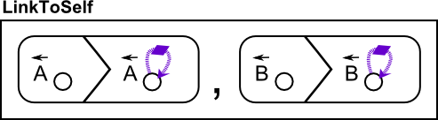
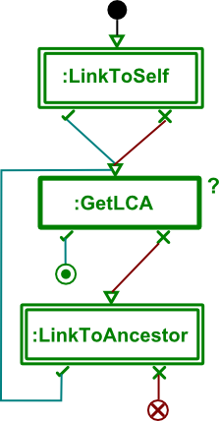
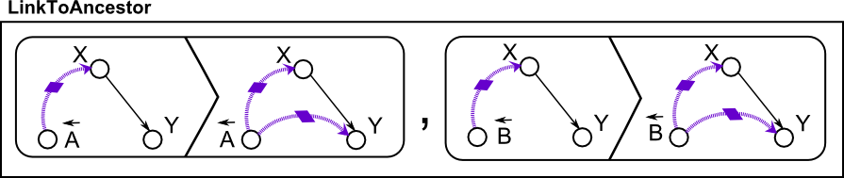
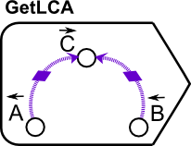
Combining design patterns with model transformation
Back to LCA example, now this solution uses ‘locality’
Focus in the area of input nodes, and check for a solution in every step
Rules Scheduling

Slide 22
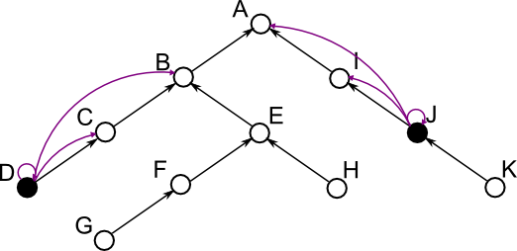
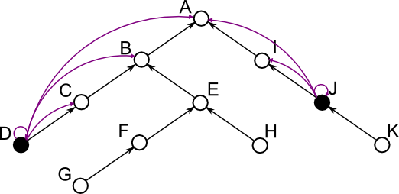
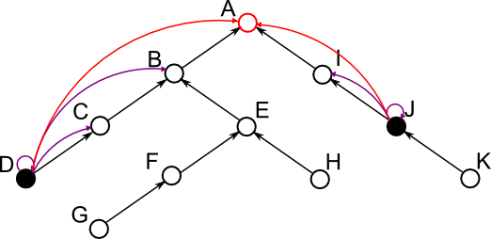
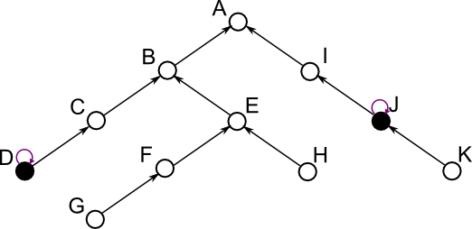
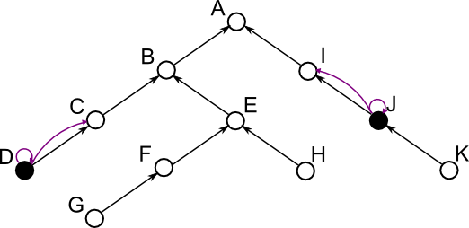
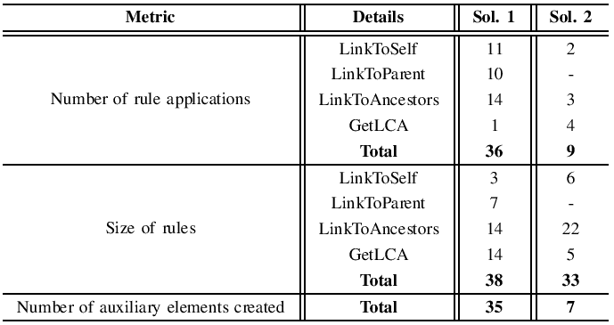
illustration
Notes:
Now the strategy is changed and we will check in every step for a solution
And if we cant find a solution, we will do one more step that will make us close to a solution and check again.
The metrics for both solutions are in table.
We can see the improvement in all three metrics.
Size of rules: the count of entities.
Number of auxiliary elements created: is the ancestor links (purple)

Slide 23
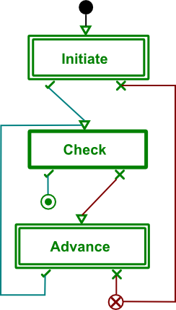
Generalize to a design pattern
The solution we applied can be generalized to be a design pattern for model transformations.
It has:
  An initialization phase
  A checking phase
  An advance phase
The structure is like:
Notes:
-Do the necessary initializations to the problem
-Check for a solution
-If solution is not found, do one more step that take us closer to the solution

Slide 24
Existing model transformation design patterns
Two studies in the literature [Agrawal2005, Iacob2008]
They focus on solution of some specific problems.
Agrawal preferred “Reusable Idioms and Patterns”
Iacob preferred “Reusable Model Transformation Patterns”
A total of 8 design patterns for model transformation.
Agrawal2005: A. Agrawal, “Reusable Idioms and Patterns in Graph Transformation Languages,” in International Workshop on Graph-Based Tools, ser. ENTCS, vol. 127. Rome: Elsevier, March 2005, pp. 181–192
Iacob2008: M.-E. Iacob, M. W. A. Steen, and L. Heerink, “Reusable Model Transformation Patterns,” in Proceedings of the Enterprise Distributed Object Computing Conference Workshops. Munich: IEEE Computer Society, Setpember 2008, pp. 1–10.
Notes:
These are the only studies that tries to give a design pattern in terms of model transformation
That look like a regular object-oriented design pattern.
I will discuss them after I gave all.

Slide 25
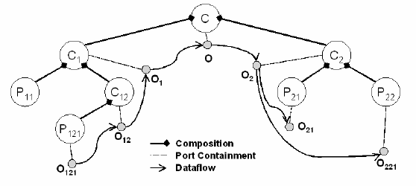
Existing model transformation design patterns – cont’d
Leaf Collector Pattern:
  Traversing and processing leafs in a hierarchy
Notes:
Agrawal’s design patterns
Starts from root and traverse the rest, if no further traversal that is leaf (process it), continue traversing

Slide 26
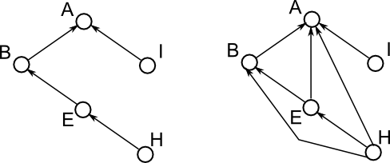
Existing model transformation design patterns – cont’d
Transitive Closure:
  Computing transitive closure of a graph recursively
Proxy Generator Idiom:
  Generate proxies in a distributed system
  Check the existence of a proxy
  If there is not a proxy, create it
  Associate the proxy with master
Notes:
Transitive closure: if two nodes have a path, then graph must have that edge.
Server/client like systems sometimes needs a proxy between them.

Slide 27
Existing model transformation design patterns
Mapping Pattern:
  One-to-one relations between source and target
  Example: UML Class Diagram to Java source code
Refinement Pattern:
  Provide a detailed information about a node
  Example: Google Maps, when we zoom, we see a detailed version of the same place.
Duality Pattern:
  Generates a semantic dual of input model
  Example: From Statecharts to UML activity diagram; they mean similar things in different structures.
Notes:
Iacob’s design patterns

Slide 28
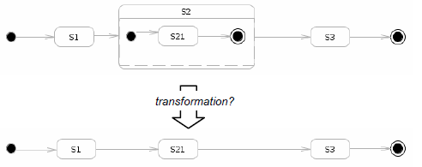
Existing model transformation design patterns
Node Abstraction Pattern:
  Eliminates nodes with certain criteria while keeping the relations
  Example: Filtering mechanism in some views
Flattening Pattern:
  Removes hierarchy from the input model
  Example: Hierarchical state charts to flat state charts
Notes:
In this problem, we can see some design patterns are applied.
The problem is hierarchical state charts to flat state charts.
1-Flattening pattern is obviously.
2- Mapping pattern for the rest of the nodes
3- Node abstraction pattern for initial and final nodes

Slide 29
Discussions on Existing model transformation design patterns
They don’t have a standard formalism
  Object-oriented design patterns have UML to specify.
The description of design patterns are not standard and have some problematic.
  Unlike object-oriented, fields are not clear in here; goal, description, applicability etc.
The quality issues are not taken into account.
  Design patterns are only introduced, no analysis.
They are abstract ideas that help solution of problem.
  They are not like step-by-step description of solution as in object-oriented.
  High level ideas.
Notes:
1- The design patterns are all described in a model transformation language.
3- they have only consequences

Slide 30
Development Approach
Evaluation
Helpers
Challenges

Slide 31
Identified challenges
Formalism:
  UML class diagram is a community-agreed standard to specify object-oriented design patterns.
  Due to few works, no common standard for model transformation design patterns.
  In LCA example, we showed the identified design pattern in terms of MoTif language.
    This can be extended to be more generic.
Benefits of having a formalism:
  Improvements in understanding, documenting and communicating.
  Independence from a particular model transformation language.

Slide 32
Identified challenges
Identifying the design patterns:
  The purpose is overcome any recurring problem to be solved again.
  One way is focusing on one problem and solving it in more efficient ways.
    That is what we did in LCA problem.
  Examining already existing model transformation problems and solutions.
Quality criteria and related metrics:
  Metrics should be analyzed and related to quality criteria
  Amstel did some works for relating ATL metrics. [Amstel2011]
Evaluation of design patterns
  After introducing a design pattern, it should be analyzed
  Pros and cons must be listed
Amstel2011: M. van Amstel, & M. van den Brand,
Using Metrics for Assessing the Quality of ATL Model Transformations
Proceedings of the Third International Workshop on Model Transformation with ATL (MtATL 2011), 2011, 742, 20-34

Slide 33
More and rigorous studies and a catalog for model transformation design patterns are needed.
Design patterns will help a model transformation methodology and increase quality of model transformation.
  Provide good practices to follow.
We need to focus on challenges starting from the formalism and identification of more design patterns.

