Slide 1


AToMPM Solution for the IMDB Case Study
Huseyin Ergin and
Eugene Syriani

Slide 2
modeling environment
The problem:
  Write a transformation that works on IMDb as a model and identify all actor or actress couples which perform together in a set of at least three movies.^{[1]} ie
    4 tasks and 3 extension tasks
Environment
  AToMPM^{[2]}
  MTL: MoTif^{[3]}
[1] http://www.transformation-tool-contest.eu
[2] Syriani, E., Vangheluwe, H., Mannadiar, R., Hansen, C., Van Mierlo, S., and Ergin, H. (2013) Atompm: A web-based modeling environment. MODELS’13: Invited Talks, Demos, Posters, and ACM SRC. CEUR-WS.org.
[3] Syriani, E. and Vangheluwe, H. “A Modular Timed Model Transformation Language,” Journal on Software and Systems Modeling, vol. 11, pp. 1–28, June 2011.

Slide 3
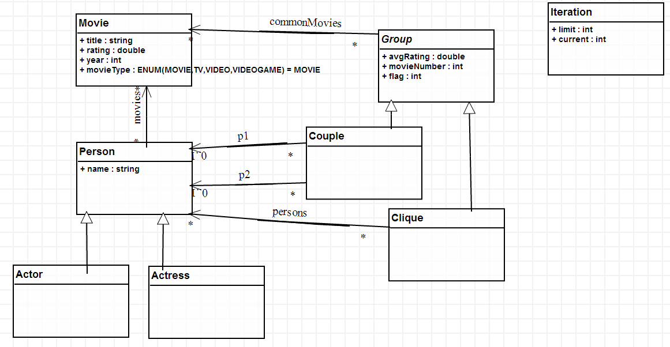
metamodel
Notes:
Since we don’t define variables etc as in a GPL, we are more attributes. Yes changing the original metamodels.

Slide 4
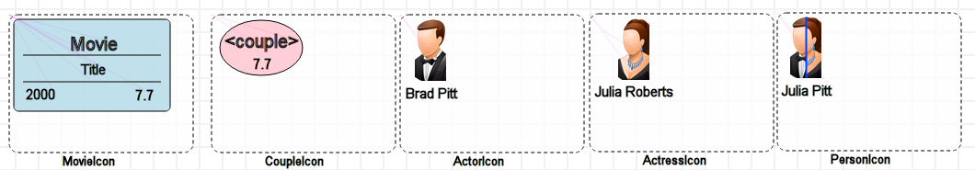
Concrete syntax
Assigning concrete syntax to elements.

Slide 5
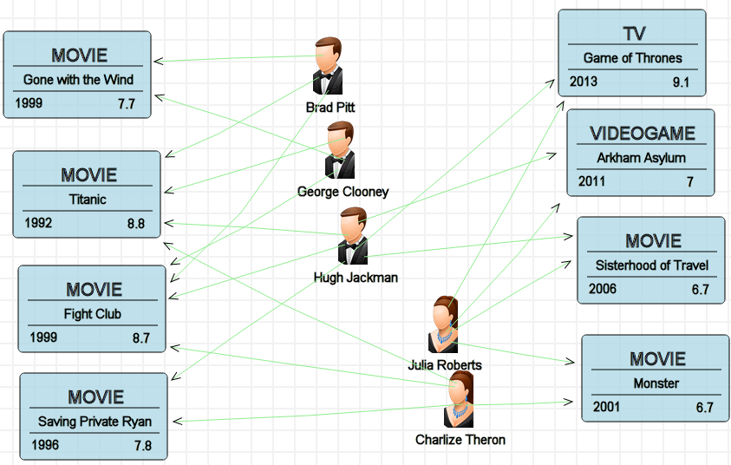
IMDB environment

Slide 6
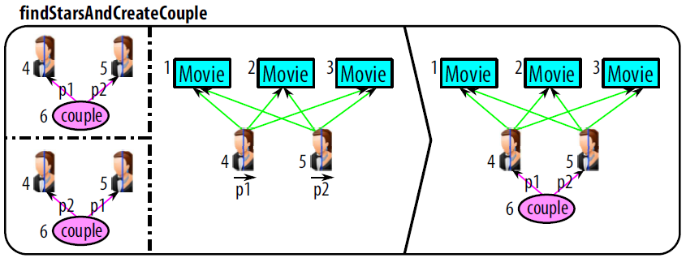
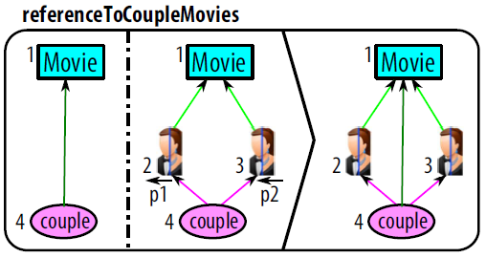
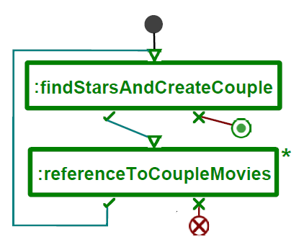
Rules & SCheduling
Rules (Task2)
Scheduling (Task2)
NAC
LHS
RHS
Notes:
This is also the Task1:

Slide 7
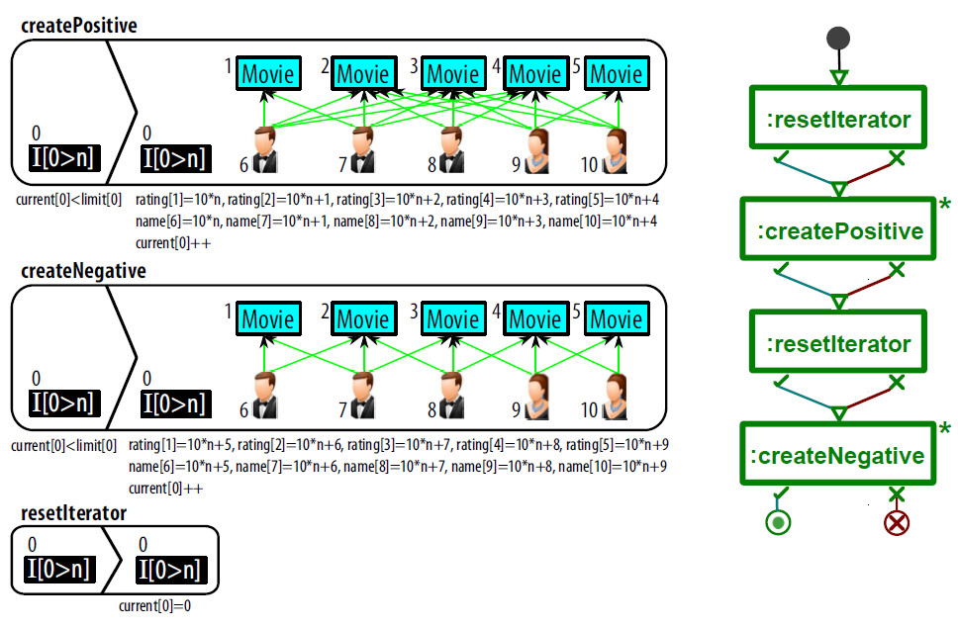
Task1: Generating test data

Slide 8
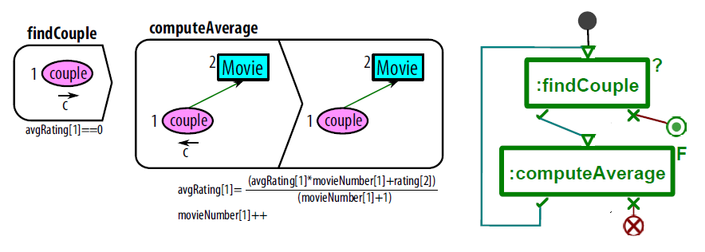
Task3: Compute avg rankings

Slide 9
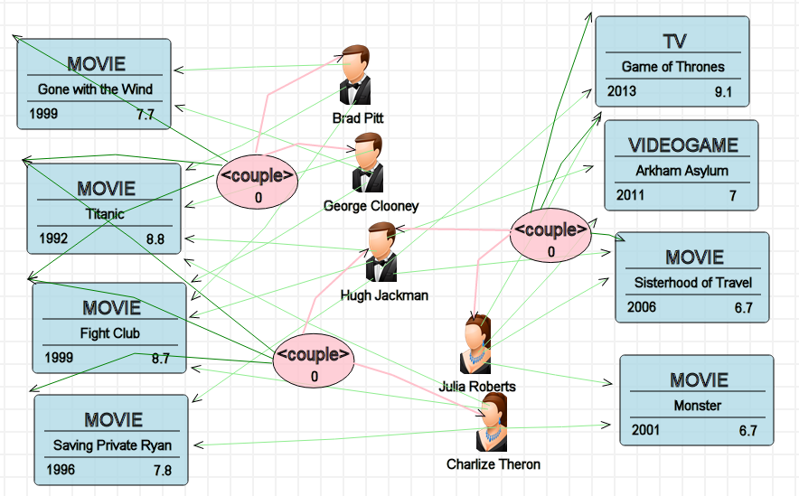
Transformation itself
Executing the transformation on the model.

Slide 10
feedbacks/Reviews
Scaling:
  Yes no scaling for now. We are on it though.
MoTif transformations
  Rules + Scheduling language
AToMPM is not headless now (with all its communication and graphical overheads)
Modifications to original MM
  Alternatively using an auxiliary MM
Debugging
  Step-by-step is possible.
Notes:
1-
2-Both are given in the paper.
3-Too many overheads and we are trying to reduce it now.
4-Mostly to solve problem easier
5-The current rule is highlighted and only its effects are applied to input model (of course, effects are not highlighted)

Slide 11

Questions
Thanks for listening…

