Slide 1
Data Science Capstone Project
Heriberto Encinas López

Slide 2
Introduction:
Analyze and then solve the following problem: Real state valuation.
The task of assigning a monetary value to a specific property based on its attributes.
Complex and dynamic problem that can be affected by a variety of external factors such as: the economy, neighborhood crime rates, geology, etc.
This problem is of interest for the two following groups:
1) Real state agencies: may help them achieve better profits when purchasing/selling a specific property
2) potential buyers (clients): may help make more appropriate decisions when purchasing/selling a specific property
Can we accurately predict the price of a given property using information such as, house age and/or location?

Slide 3
Data
“Real Estate Valuation Data Set”
From UCI Machine Learning Repository.
Multivariate data
414 instances.
7 attributes per instance
Associated with Regression tasks

Slide 4
Attribute name | Description | Attribute type
No | Instance number, identifier | Numeric: Integer
X1 transaction date | The date the transaction was made | Numeric: Real
X2 house age | House age in years | Numeric: Real
X3 distance to the nearest MRT station | Distance to nearest subway station | Numeric: Real
X4 number of convenience stores | Number of convenience stores | Numeric: Integer
X5 latitude | Latitude | Numeric: Real
X6 longitude | Longitude | Numeric: Real
Y house price of unit area | House price of unit area | Numeric: Real

Slide 5
Most of the attributes are real values
Few exceptions (integer).
Most of the attributes relate to location information.
Target value is a numeric (real) value which indicates the price per unit area for a given property.

Slide 6
Initial Data Processing
Initial transformations:
Checked the data was complete (no missing values),
Dropped the first column of our data, this column is just an identifier (does not provide any statistical insight)
After that we proceeded to analyze the basis statistical information for the data. The following table shows that information:

Slide 7
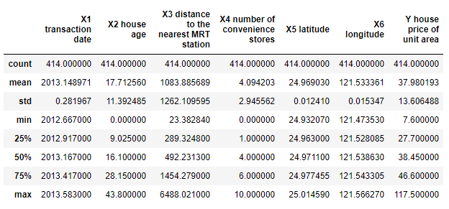

Slide 8
After that, we modified the names for all columns to make them easier to read and understand. The following names were chosen:
Original name | New name
X1 transaction date | date
X2 house age | age
X3 distance to the nearest MRT station | mrt
X4 number of convenience stores | stores
X5 latitude | latitude
X6 longitude | longitude
Y house price of unit area | price

Slide 9
Exploratory Analysis
Segment our data and explore each of its attributes to see how they relate to our target value.

Slide 10
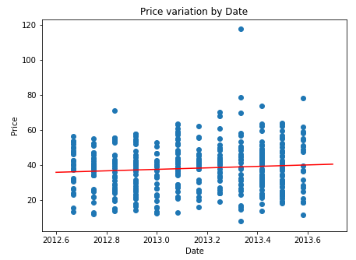
Date of Transaction

Slide 11
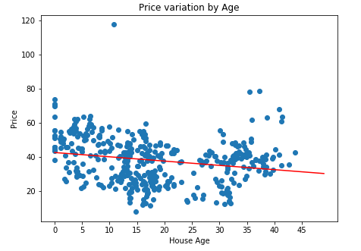
House Age

Slide 12
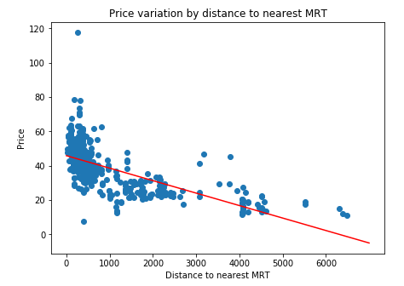
Distance to nearest MRT station

Slide 13
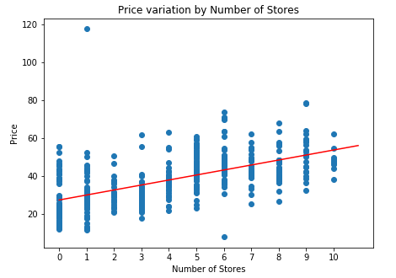
Number of convenience stores

Slide 14
Latitude and Longitude
Latitude and longitude values were modified first to addresses and then to city districts. I consider this attribute to be more meaningful than latitude and longitude values alone.
Latitude and Longitude
City District
Address

Slide 15
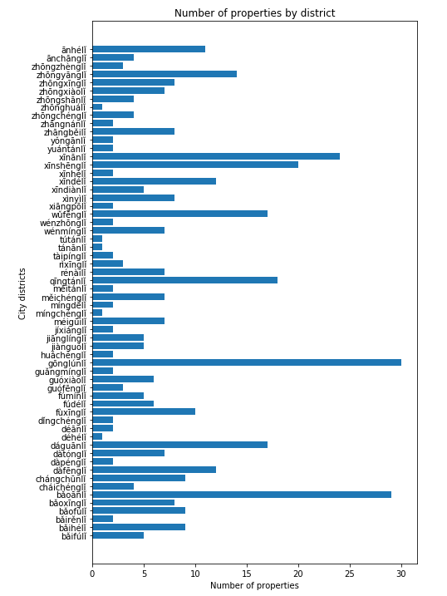

Slide 16
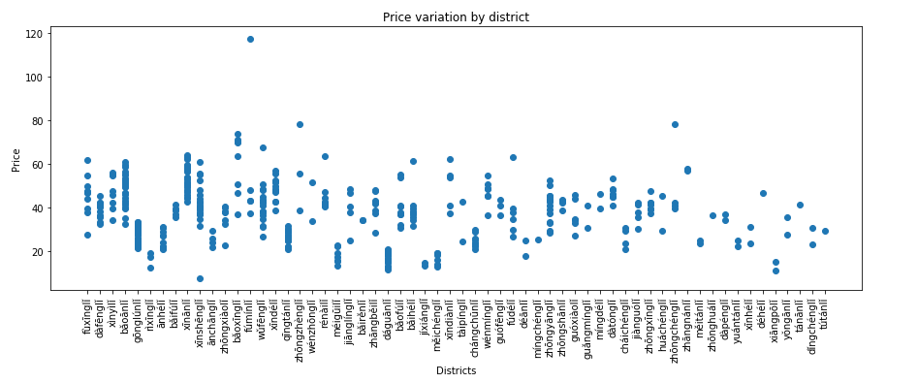

Slide 17
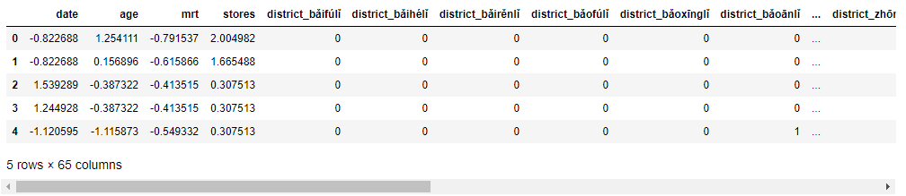
Final Data Preparation

Slide 18
Results
We were able to develop a significant model that is capable of explaining a decent percentage of variation within the data. It is possible that more complex models or more rich datasets achieve better results.
However, for our purposes we were able to find a model that performed well. To achieve better results I would suggest using more complex models such as K-Nearest Neighbors or Polynomial Regression.
The obtained results can be seen as the base to make further improvements, maybe using the well-known Sklearn library.

Slide 19
Discussion
After analyzing the information, I would make the following suggestions:
1. First, I would recommend focusing on those districts that we pinpointed as the most relevant when determining the price.
2. I would also recommend exploring the possibility of gathering data related to other factors such as: How many schools the district has? How close it is to other transportation services such as bus, or airport, etc.? Including more of these variables will provide us with a better look at the whole picture.
3. Instead of latitude and longitude values try to get more meaningful information such as neighborhood, city district, village, etc. Attributes that segment the data into more meaningful subsets

Slide 20
Conclusion
This is the conclusion to my capstone project. In this project we took information related to real state for different properties in the city of New Taipei in Taiwan. The data set was processed, relevant information was extracted, and a multi-linear regression model was built.
From these models several insights were obtained: The relevancy of some variables was confirmed as was previously suspected during the exploratory analysis phase. In addition to this, for the location variable, a group of highly relevant city districts was identified.
We were able to build a significant model that requires less information than what we initially had. Additionally, we were able to pinpoint those attributes that have the most impact on the final price.

