Slide 1
Detail Rancangan
Sistem Monitor Pembangkit Listrik Kombinasi Energi Terbarukan Berbasis Hidrogen

Slide 2
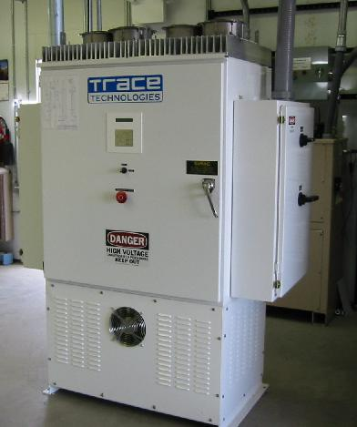
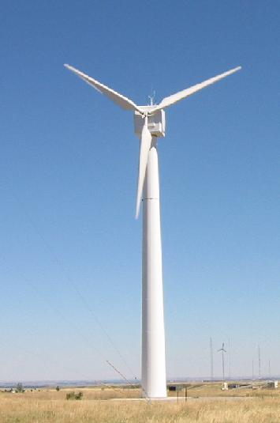



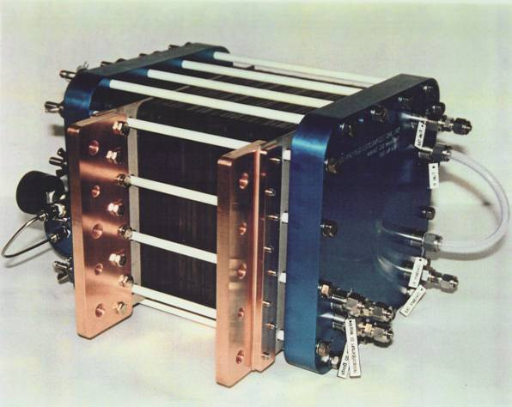


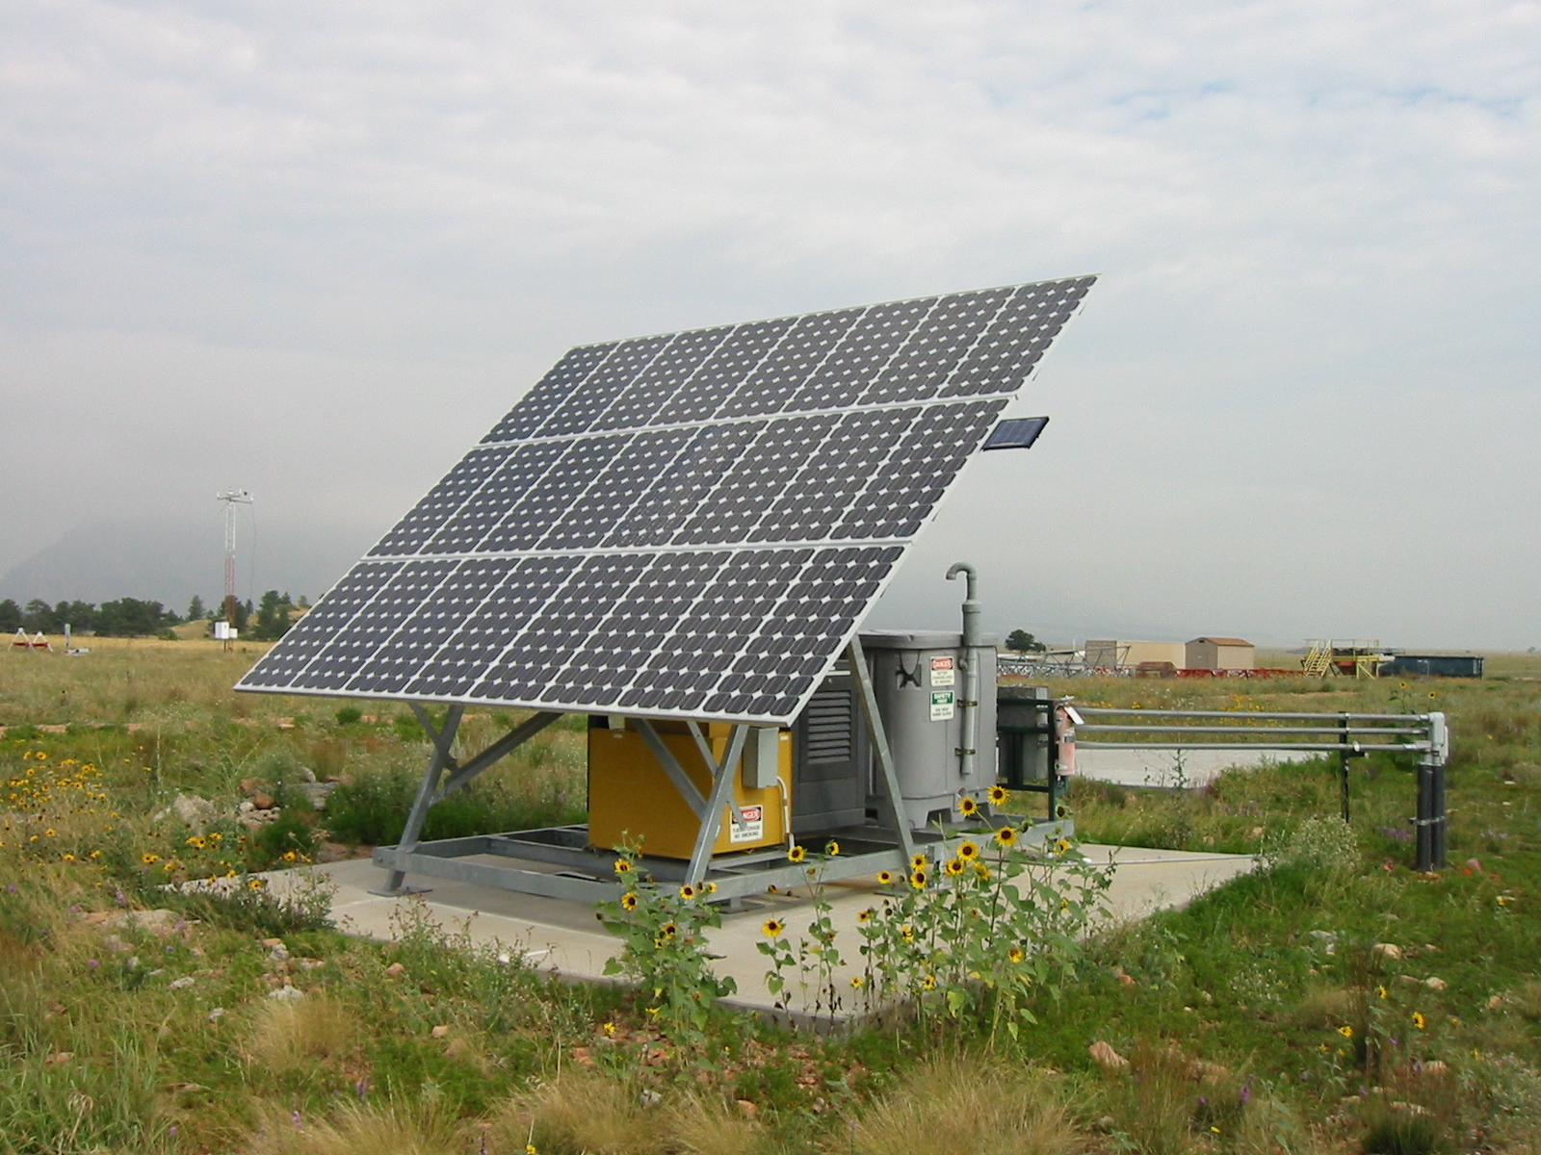




Sistem Pembangkit Listrik Berbasis Hidrogen
INV
Wind Gen.
WT
H₂
X
H₂ st
FC
O₂
EPU
Solar Panels
O₂ st
X
CU
Gen
Accu

Slide 3







Wind Gen.
INV
240 VDC
220 VAC
240 VDC
220VAC
INV. 1,5 kW
24VDC
Accu
step down transformer
ps
ps
H₂ storage
ps
Solar Panels
Belum terpasang
O₂ storage
Seri 20 panel, 240 Vdc
- Level detector
- Pump Relay
- Electronic amplifier of level detector

Slide 4
Jumlah dan Jenis Sensor Input
Wind turbine : anenometer(f to Vdc),rpm tranducer, wind vane, arus (Idc), voltage(Vdc) – 5
Solar cell : sensor radiasi, arus(Idc), voltage(Vdc) – 3
Accumulator: voltage (Vdc) – 1
Inverter : input (idc), output (Vac,Iac) - 3
Elektrolisis : input (Idc), output (h2 rate-flowmeter digital f to Vdc) – 2
Fuel cell: input sama dgn elektrolisis, flowmeter, output (Idc,Vdc) – 3 ditambah utk trafo ke dc : (Idc) – 1
Tank H2 : pressure gauge :manual – 1
Total input : 19 ( 18 + 1 man).

Slide 5
Kapasitas Maksimum Arus dan Voltage
Wind Turbine : Iac = 20 A, Vac = 350 V
Solar cell :
  sensor radiasi : dalam bentuk Idc = 0.5 A
  Arus beban : Idc = 4,5 A
  Voltage beban : Vdc = 280 V
Accumulator:
  voltage : Vdc = 280 V
Fuel cell:
  Flowmeter
  output : Idc = 40 A ; Idc = 6 A
Inverter :
  input : Idc = 25 A
  output :Vac = 220 V
  Iac = 25 A
Elektrolisis :
  input : Idc = 100 A
  output (h2 rate-flowmeter digital f to Vdc) : Vdc = mV

Slide 6
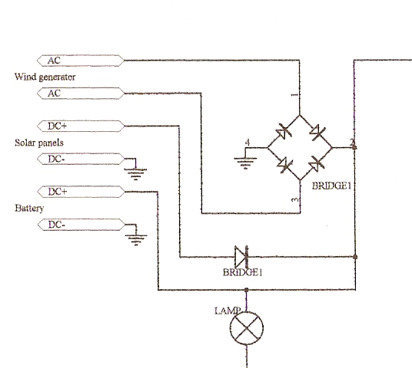
Wind turbine, anenometer, wind vane transducers
Iac = 20 A
A
V
V
Vac = 350 V
rpm tranducer
V
anenometer(f to Vdc),
V
wind vane
inverter

Slide 7

Solar cell
Idc = 5 A
A
V
Vdc = 280 V
Panel solar, 1 kW, 240 Vdc
Idc = 0.5 A
A
Accu 12 V x 20
Sensor radiasi

Slide 8
Fuel cell
Idc = 40 A
Idc = 6 A
A
A
dari flowmeter
220Vac to 240 V ac
V
INV. 1,5 kW
Vdc = 30 V

Slide 9
Elektrolisis
Idc = 100 A
A
flowmeter
to fuel cell

Slide 10
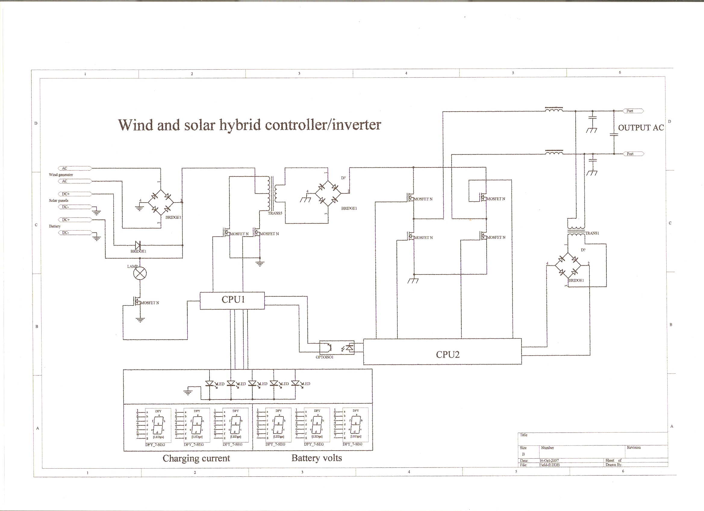

Slide 11
Meeting dgn Daun Biru Engineering
P.Furkan, Hatta Kosasih, Jessy Imam (DBE)
P.Imam, Sugiatno, Muryanto, Achiar Oemry

