Slide 1
Strategic Analysis: Business Environment Infographics
Here is where this template begins

Slide 2
Strategic analysis: business environment infographics
01
Political
Jupiter is a gas giant and the biggest planet
02
Legal
Strategic analysis
Neptune is the farthest planet from the Sun
Mercury is the closest planet to the Sun and the smallest one in the entire Solar System
03
Environmental
Venus has a beautiful name but is hot
04
Strategic
Earth is the third planet from the Sun

Slide 3
Strategic analysis: business environment infographics
Strategic analysis
01
Political
Venus has a very beautiful name but is terribly hot, hotter than Mercury
Jupiter is the biggest planet
Technological
03
02
Economic
Ceres is located in the main asteroid
Pluto is considered a dwarf planet

Slide 4
Strategic analysis: business environment infographics
Weaknesses
Opportunities
Jupiter is a gas giant and the biggest planet
Neptune is the farthest planet from the Sun
W
S
O
T
Strengths
Threats
Mercury is the closest planet to the Sun
Despite being red, Mars is a cold place

Slide 5
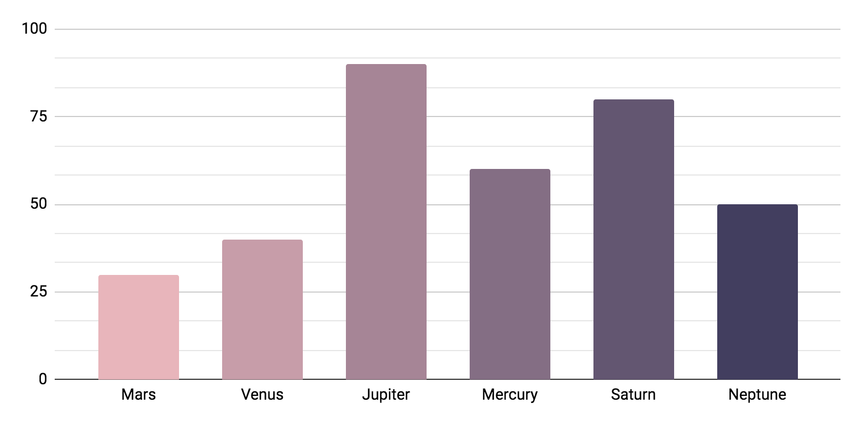
Strategic analysis: business environment infographics
Strategic analysis
Venus has a beautiful name but is hot
30%
40%
90%
60%
80%
50%
Follow the link in the graph to modify its data and then paste the new one here. For more info, click here

Slide 6
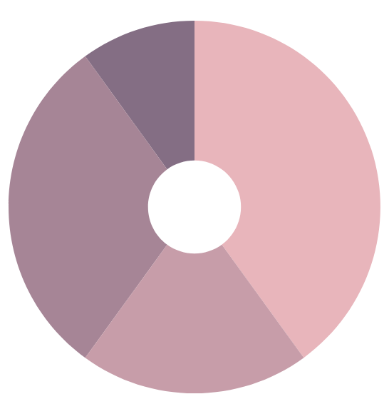
Strategic analysis: business environment infographics
Political
01
02
Economic
Jupiter is a gas giant and the biggest planet
Neptune is the farthest planet from the Sun
10%
40%
Legal
03
04
Socio-cultural
Mercury is the closest planet to the Sun
Despite being red, Mars is a cold place
30%
20%
Follow the link in the graph to modify its data and then paste the new one here. For more info, click here

Slide 7
Strategic analysis: business environment infographics
S
O
W
T
Strengths
Weaknesses
Opportunities
Threats
Mercury is the closest planet to the Sun
Despite being red, Mars is a cold place
Jupiter is a gas giant and the biggest planet
Neptune is far away from Earth

Slide 8
Strategic analysis: business environment infographics
Level 2
Level 3
Neptune is the farthest planet from the Sun
Mercury is the closest planet to the Sun
Competitors
Industry
Level 1
Level 4
Jupiter is a gas giant and the biggest planet
Despite being red, Mars is a very cold place
Organization
Society

Slide 9
Strategic analysis: business environment infographics
01
Organization
02
Competitors
Jupiter is a gas giant and the biggest planet
Neptune is the farthest planet from the Sun
Strategic analysis
03
Sector
04
Macro-environment
Mercury is the closest planet to the Sun
Despite being red, Mars is a cold place

Slide 10
Strategic analysis: business environment infographics
Strategic insights structure
Strategic analysis tools
Macro-environment
01
PESTLE analysis
Jupiter is the biggest planet of them all
Neptune is far away from Earth
Industry or sector
02
Porter’s 5 forces
Mercury is the closest planet to the Sun
Despite being red, Mars is a cold place
Competitors
03
Strategic groups
Venus has a beautiful name but is hot
Pluto is considered a dwarf planet
The organization
04
SWOT analysis
Earth is the third planet from the Sun
Ceres is in the main asteroid belt

Slide 11
Strategic analysis: business environment infographics
The organization
01
02
Competitors
Jupiter is a gas giant and the biggest planet
Neptune is the farthest planet from the Sun
Macro-environment
04
03
Market sector
Mercury is the closest planet to the Sun
Despite being red, Mars is a cold place

Slide 12
Strategic analysis: business environment infographics
Organization
Industry
Competitors
Macro-environment
Mercury is the closest planet to the Sun
Neptune is the farthest planet from the Sun

Slide 13
Strategic analysis: business environment infographics
Sector
Competitors
Jupiter is a gas giant and the biggest planet
Neptune is the farthest planet from the Sun
Organization
Tools
PESTLE framework
Porter’s 5 forces
Strategic canvas
SWOT analysis
Macro-environment
Despite being red, Mars is a cold place

Slide 14
Strategic analysis: business environment infographics
Social environment
01
Jupiter is a gas giant and the biggest planet
Industry environment
02
Mercury is the closest planet to the Sun
Internal environment
03
Venus has a beautiful name but is hot

Slide 15
Strategic analysis: business environment infographics
Society
Politic | Jupiter is a gas giant and the biggest planet
Economic | Mercury is the closest planet to the Sun
Legal | Venus has a beautiful name but is hot
Internal
Structure | Earth is the third planet from the Sun
Resources | Neptune is the farthest planet from the Sun
Culture | Despite being red, Mars is a cold place
Industry
Demand | Pluto is considered a dwarf planet
Market | Ceres is a dwarf planet like Pluto
Trade law | The Moon is Earth’s only natural satellite

Slide 16
Strategic analysis: business environment infographics
Structural forces
Resource forces
02
Organization
Political forces
Economic forces
Market forces
Demand forces
Society
Sector
Cultural forces
HH.RR. forces
01
03
Legal forces
Technologic forces
Government forces
Competency forces

Slide 17
Strategic analysis: business environment infographics
Jupiter is a gas giant and the biggest planet
Social environment
Output
Sector environment
Internal environment

Slide 18
Strategic analysis: business environment infographics
Political forces
Economical forces
Government
Demand
Structure
Resources
Strategic analysis: Business environment
Culture
Skills
Technology
Market structure
Socio-cultural forces
Technological forces
Social environment
Industry environment
Internal environment

Slide 19
Strategic analysis: business environment infographics
PESTLE analysis
P
E
S
T
L
E
Political
Economic
Social
Technologic
Legal
Environment
Jupiter is the biggest planet of them all
Mercury is the closest planet to the Sun
Neptune is the farthest planet from the Sun
Despite being red, Mars is a cold place
Venus has a beautiful name but is hot
Earth is the third planet from the Sun

Slide 20
Strategic analysis: business environment infographics
Bargaining power of suppliers
01
02
Mercury is the closest planet to the Sun
Threat of new entrants
Threat of substitutes
Industry rivalry
It’s a gas giant and the biggest planet
Despite being red, Mars is a cold place
Bargaining power of buyers
03
04
Neptune is the farthest planet from the Sun

Slide 21
Strategic analysis: business environment infographics
Porter’s 5 forces
01
02
03
Mercury is the closest planet to the Sun and the smallest one of all the planets in the Solar System. This planet's name has nothing to do with the liquid metal, since Mercury was named after the Roman messenger god
Bargaining power of suppliers
Threat of new entrants
Bargaining power of buyers
04
05
Threat of substitutes
Forces of industry rivalry

Slide 22
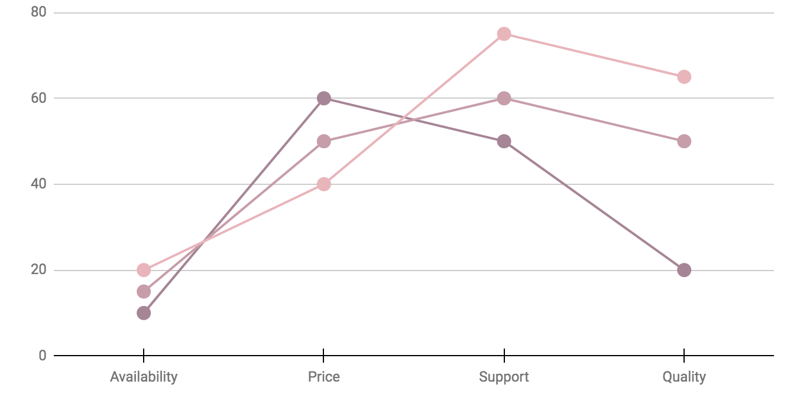
Strategic analysis: business environment infographics
Strategic canvas
Our company
+ 50%
Competitor 1
+ 30%
Competitor 2
+ 20%
Mercury is the closest planet to the Sun and the smallest one
Follow the link in the graph to modify its data and then paste the new one here. For more info, click here

Slide 23
Strategic analysis: business environment infographics
Strategic group matrix
High
Mercury
Saturn
Jupiter
Earth is the third planet from the Sun and the only one that harbors life in the Solar System
Price
Venus
Mars
Low
Standard
Type
Customized

Slide 24
Strategic analysis: business environment infographics
Resources
01
02
Processing
Jupiter is a gas giant and the biggest planet
Neptune is the farthest planet from the Sun
Life cycle assessment
End
06
03
Manufacturing
Mercury is the closest planet to the Sun
Despite being red, Mars is a cold place
Use
05
04
Distribution
Venus has a beautiful name but is hot
Pluto is considered a dwarf planet

Slide 25
Strategic analysis: business environment infographics
30%
Economical
10%
Technological
Despite being red, Mars is a cold place
Neptune is far away from Earth
Political
20%
Socio-cultural
40%
Mercury is the closest planet to the Sun
Jupiter is a gas giant and the biggest planet

Slide 26
Strategic analysis: business environment infographics
Core competencies
01
Jupiter is a gas giant and the biggest planet
02
Marketing skills
Neptune is the farthest planet from the Sun
Technical skills
03
Mercury is the closest planet to the Sun
04
Ideation skills
Despite being red, Mars is a cold place

Slide 27
Strategic analysis: business environment infographics
Jupiter
06
01
Neptune
Competence analysis
Jupiter is the biggest planet
Neptune is far away from Earth
05
Mercury
Mars
02
It’s the closest planet to the Sun
Despite being red, Mars is a cold place
Venus
04
03
Pluto
Venus has a beautiful name
Pluto is considered a dwarf planet

Slide 28
Strategic analysis: business environment infographics
01
02
03
Macro-environment
Market
Competitors
Mercury is the closest planet to the Sun
Despite being red, Mars is a cold place
Jupiter is a gas giant and the biggest planet
04
Data collection
Neptune is far away from Earth

Slide 29
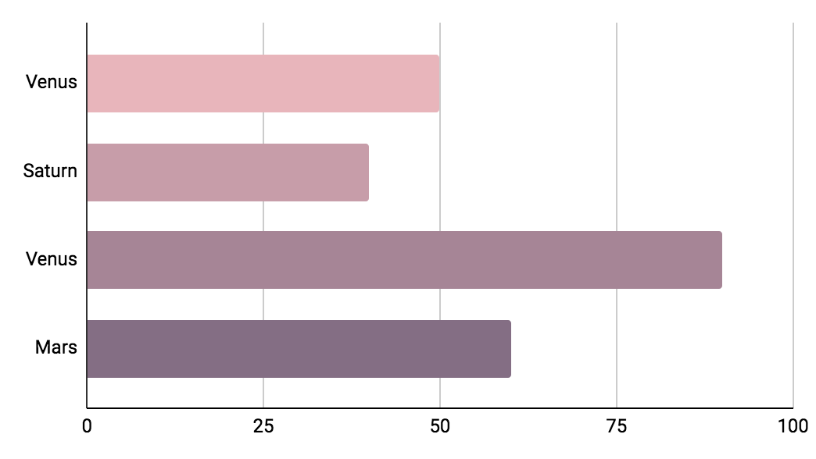
Strategic analysis: business environment infographics
Strategic analysis
Political
Economical
Legal
Social
Venus has a very beautiful name but is actually terribly hot, hotter than Mercury
50%
40%
90%
60%
Follow the link in the graph to modify its data and then paste the new one here. For more info, click here

Slide 30
Strategic analysis: business environment infographics
Mercury is the closest planet to the Sun
Despite being red, Mars is a cold place
Jupiter is a gas giant and the biggest planet
Society
Industry
Competitor
C
B
C
Organization

Slide 31
Strategic analysis: business environment infographics
Organization
Competitor
Sector
Macro-environment
Mercury is the closest planet to the Sun
Despite being red, Mars is a cold place
Jupiter is a gas giant and the biggest planet
Neptune is far away from Earth

Slide 32
Strategic analysis: business environment infographics
Macro-environment
Political forces
Economic forces
Technologic forces
Legal forces
01
Organization
Structural forces
Resource forces
Cultural forces
HH.RR. forces
02
Industry
Market forces
Demand forces
Regulation forces
Competitor forces
03

Slide 33
Instructions for use
In order to use this template, you must credit Slidesgo in your final presentation.
You are allowed to:
- Modify this template.
- Use it for both personal and commercial projects.
You are not allowed to:
- Sublicense, sell or rent any of Slidesgo Content (or a modified version of Slidesgo Content).
- Distribute Slidesgo Content unless it has been expressly authorized by Slidesgo.
- Include Slidesgo Content in an online or offline database or file.
- Offer Slidesgo templates (or modified versions of Slidesgo templates) for download.
- Acquire the copyright of Slidesgo Content.
For more information about editing slides, please read our FAQs or visit Slidesgo School:
https://slidesgo.com/faqs and https://slidesgo.com/slidesgo-school

Slide 34
Instructions for use (premium users)
As a Premium user, you can use this template without attributing Slidesgo.
You are allowed to:
Modify this template.
Use it for both personal and commercial purposes.
Hide or delete the “Thanks” slide and the mention to Slidesgo in the credits.
Share this template in an editable format with people who are not part of your team.
You are not allowed to:
Sublicense, sell or rent this Slidesgo Template (or a modified version of this Slidesgo Template).
Distribute this Slidesgo Template (or a modified version of this Slidesgo Template) or include it in a database or in any other product or service that offers downloadable images, icons or presentations that may be subject to distribution or resale.
Use any of the elements that are part of this Slidesgo Template in an isolated and separated way from this Template.
Register any of the elements that are part of this template as a trademark or logo, or register it as a work in an intellectual property registry or similar.
For more information about editing slides, please read our FAQs or visit Slidesgo School:
https://slidesgo.com/faqs and https://slidesgo.com/slidesgo-school

Slide 35
Infographics
You can add and edit some infographics to your presentation to present your data in a visual way.
Choose your favourite infographic and insert it in your presentation using Ctrl C + Ctrl V or Cmd C + Cmd V in Mac.
Select one of the parts and ungroup it by right-clicking and choosing “Ungroup”.
Change the color by clicking on the paint bucket.
Then resize the element by clicking and dragging one of the square-shaped points of its bounding box (the cursor should look like a double-headed arrow). Remember to hold Shift while dragging to keep the proportions.
Group the elements again by selecting them, right-clicking and choosing “Group”.
Repeat the steps above with the other parts and when you’re done editing, copy the end result and paste it into your presentation.
Remember to choose the “Keep source formatting” option so that it keeps the design. For more info, please visit Slidesgo School.

