Slide 1
Thesaurus of Cultural Heritage
Phil Carlisle
Edinburgh, November 28th 2016

Slide 2
Background
First mooted in 2001 as a joint effort between EH and RCAHMS
Paper presented at mda conference
‘Uber Thesaurus’
Monument types
Objects
Materials etc.
Ambitious scope - to cover the whole of human history in the Geographic British Isles from Boxgrove to Brexit

Slide 3
Seneschal, FISH and Arches
2013 – RCAHMS, RCAHMW and HE publish Thesaurus of Monument Types as linked data on heritagedata.org
2013 – FISH Terminology Working Group take over ownership of the former NMR thesauri.
2016 – HIAS Workpackage to deliver a reference data management tool

Slide 4
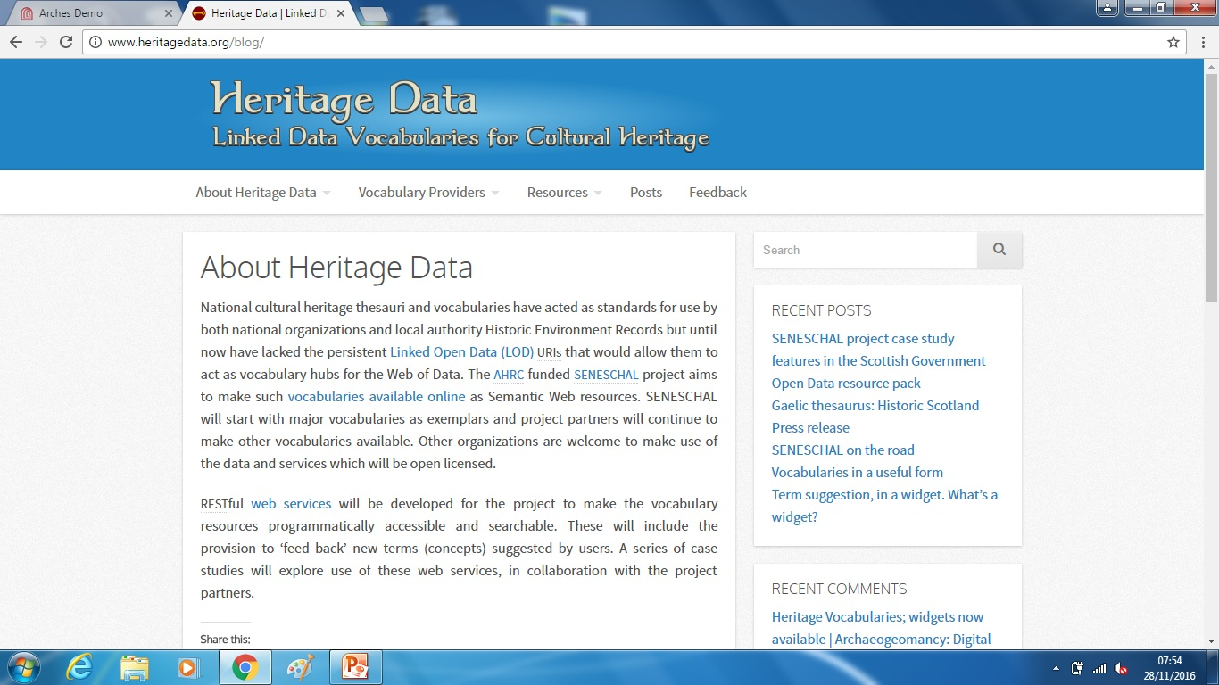
Linked Data

Slide 5
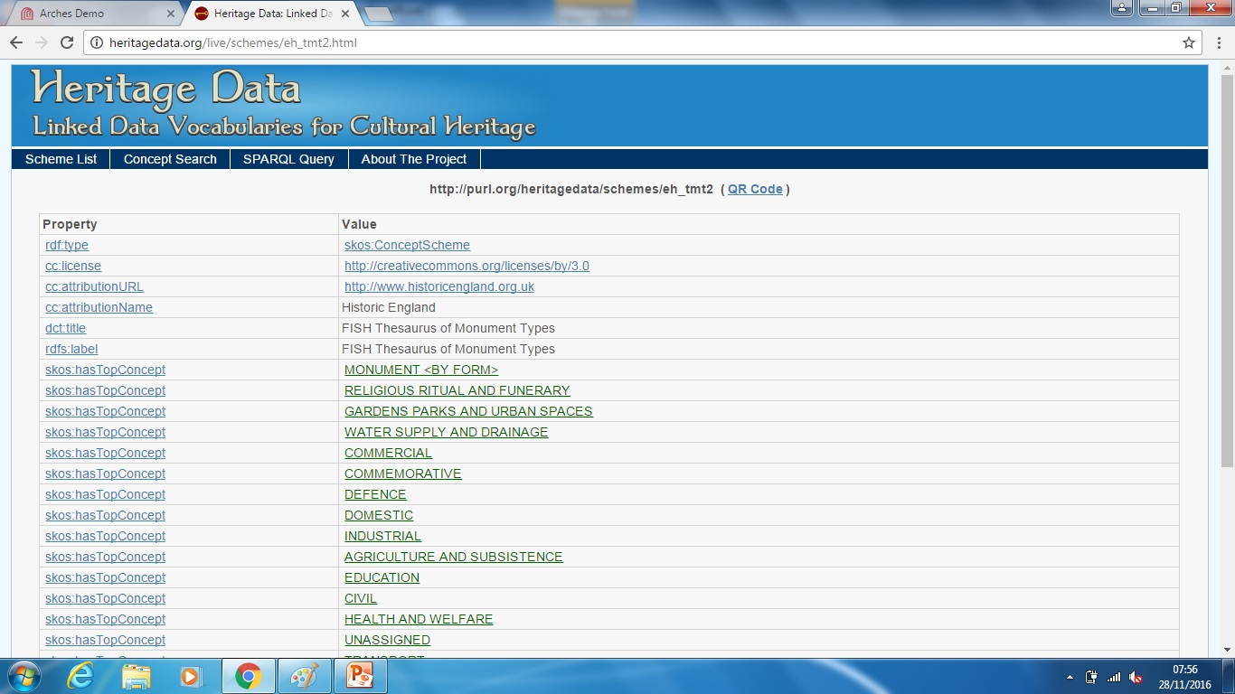
Linked Data (2)

