Slide 1

The proposed changes to OASIS & BIAB…
The HERALD Project

Slide 2
General changes
More up to date technology
Longer page timeouts, auto saves
Records ‘always open’
Review not validation
Versioning
Notes:
More up to date technologies
Longer page time outs, auto saves
Records always open
Review not validation
Versioning

Slide 3

Plus more projects from more widespread sources
Post-excavation specialists
Community groups
Archaeological contractors
Historic building specialists
Academics
HERs
Notes:
The new system will focus on both sides of the OASIS equation – more information in from different sources
the addition of buildings specific interface
Targeting academics, community groups and specialists – as creators of reports which should be in openly available
Also HERs can add information

Slide 4
Levels of OASIS data collection
Environmental
Human Bones
Geophysics
OASIS LITE
OASIS BASIC
OASISPLUS
Other modules:
Graveyards
C14
Bibliographic record & Report uploaded by HERs or contractors
Constitutes a basic HER record
Creates a rich metadata record for specialist / project specific recording
Notes:
Different amounts of information collected according to who is going to use the data collected

Slide 5







Register & ORCID
Organisation
e.g.Unit or HER
Joe Bloggs
Jane Doe
Anne Excavator
Notes:
New user registers
Added to organisation
User can get an ORCID id – helps for grouping reports

Slide 6
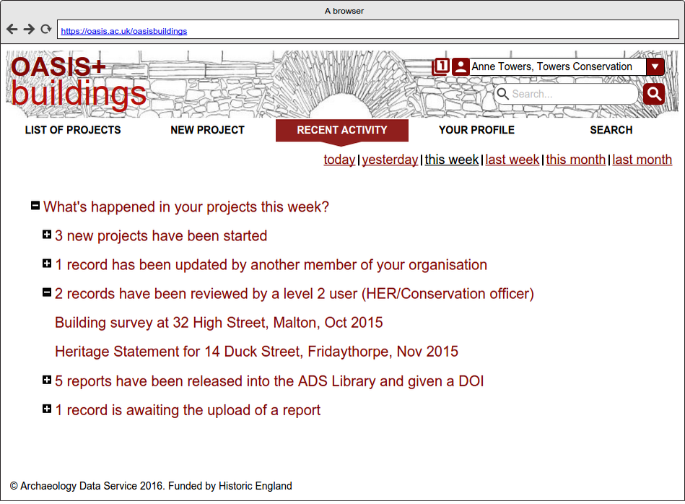
Recent activity updates
Notes:
Update page on login
Collated emails once a week/month

Slide 7
The records within the form
Form changes
Records started by HER
Records started by fieldworkers
Project location selects HER, Museum, Admin areas
Records can be deleted or marked as duplicates
Better boundary upload / drawing
Inclusion of monument locations
Notes:
Records started by HER and retrieved by fieldworkers
Records started by fieldworkers
Administrative areas, HERs and Museum/archive options preselected by location of project
Records can be deleted or marked as duplicates
Better boundary upload / drawing
Inclusion of monument locations

Slide 8
Organisation information pages
One for each organisation
Tells other OASIS users how this HER, Unit, Museum uses OASIS
Partly automatically completed shows the settings in OASIS – OASIS LITE/STANDARD
Also space for including area specific requirements, uploaded documents and links out to organisation web pages

Slide 9
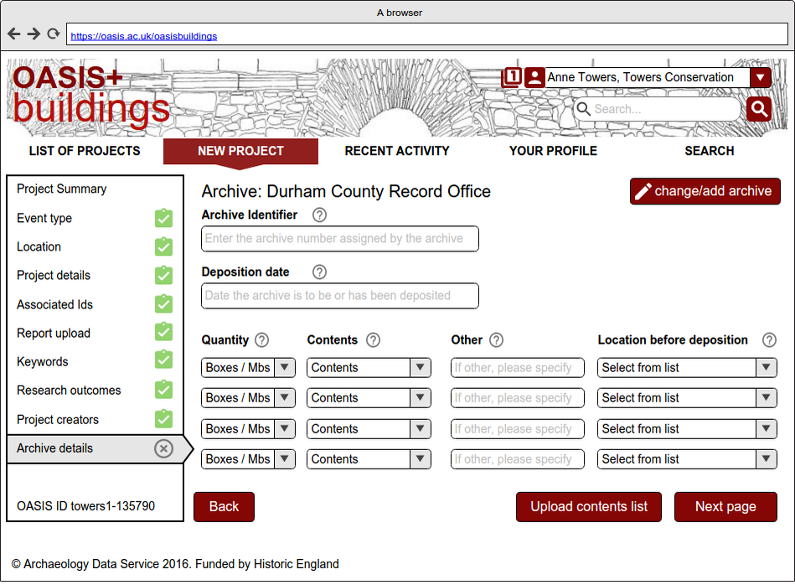
Archive section and museums
Notes:
Museum/archive access to the archive section and notification of archives expected and received

Slide 10
OASIS LITE : OASIS STANDARD
HER doesn’t review record
Full OASIS fields
Report goes straight through to ADS Library
Data collected to describe the report only
Enhanced Bibliographic record
Record intended to be used and reviewed by HER
Report waits until reviewed by HER
Notes:
Differences between OASIS LITE and STANDARD
What the differences mean
What areas of the form it doesn’t effect

Slide 11
OASIS LITE
Bibliographic
record
What
Where
When
Associated identifiers
project name
description
event type
monument
artefact
ecofact
grid reference
CDP
period
HER no.
site code
etc
museum accession no.

Slide 12





And enhancements to ADS Library/ BIAB….
Volunteers
Small publishers

Slide 13
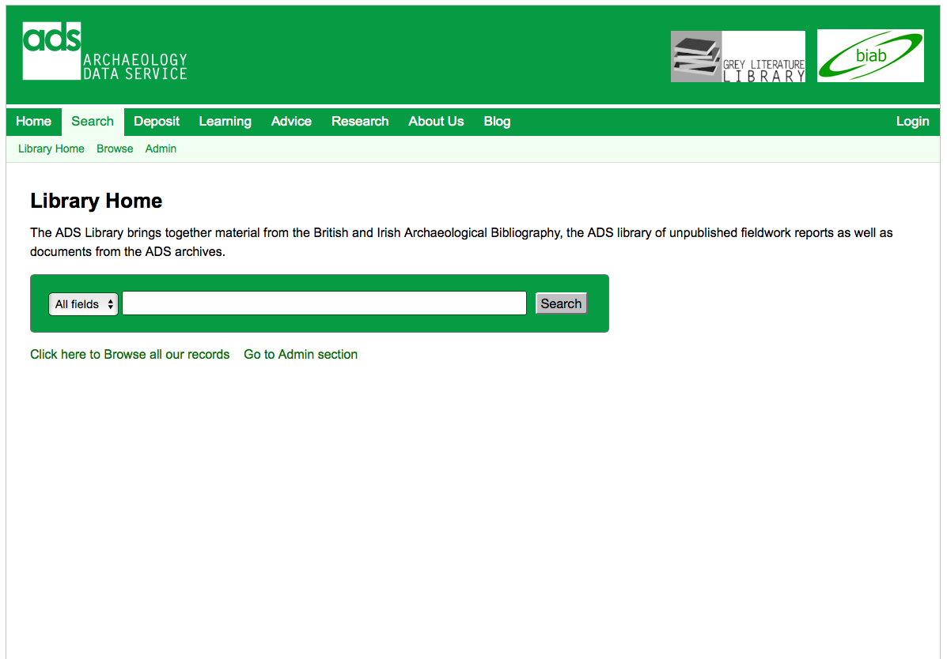

Slide 14
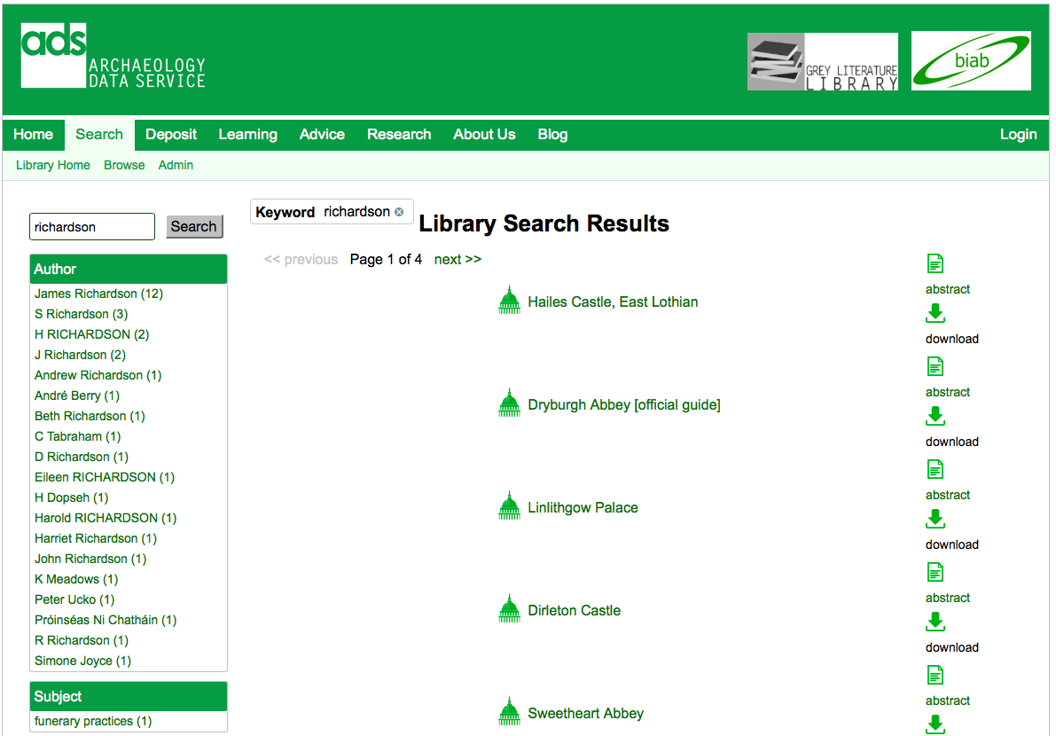

Slide 15
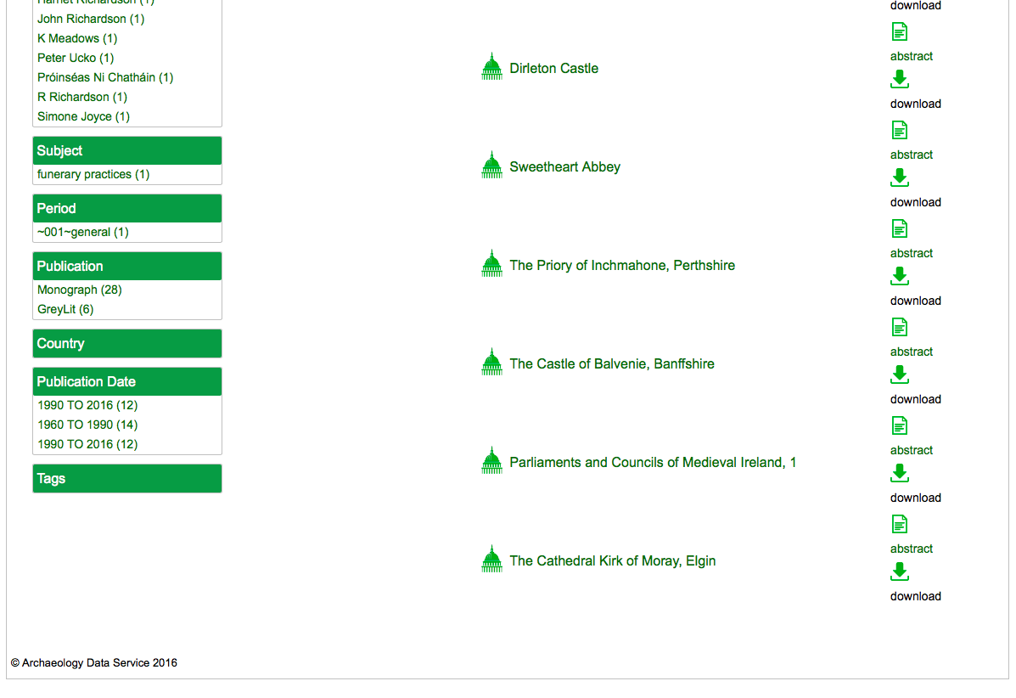

Slide 16
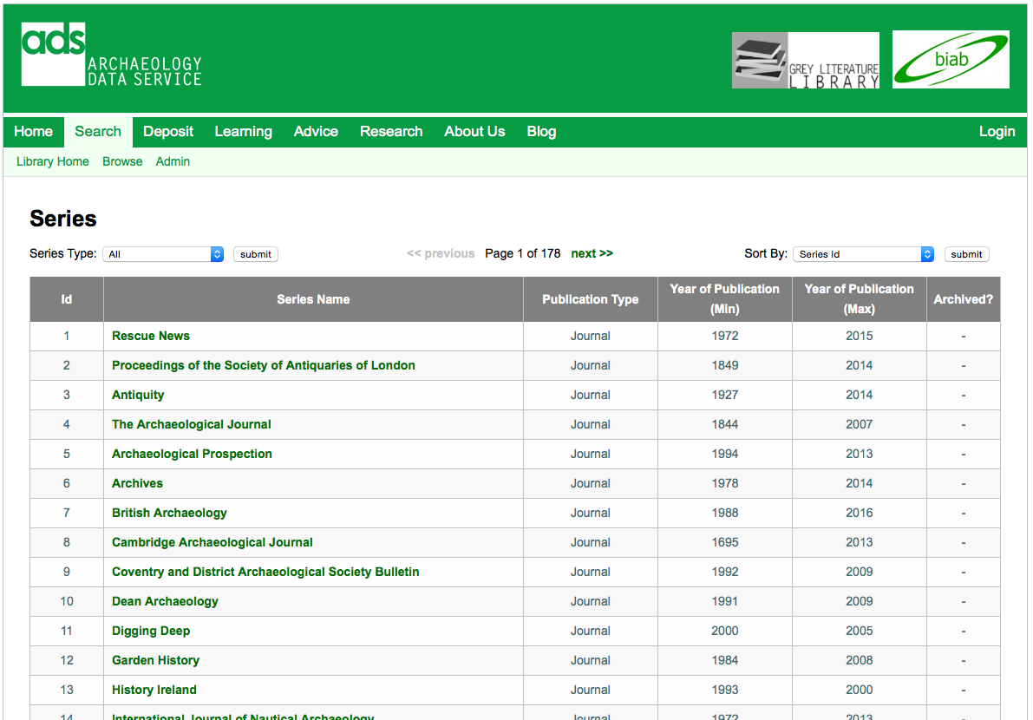

Slide 17
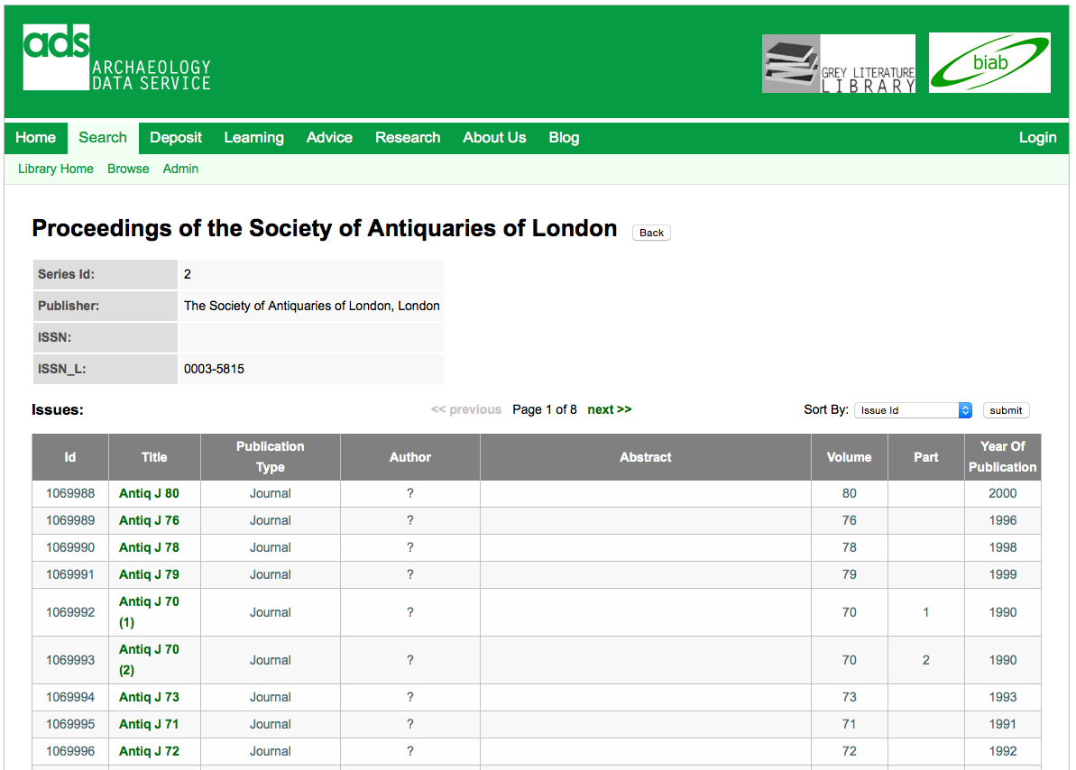

Slide 18
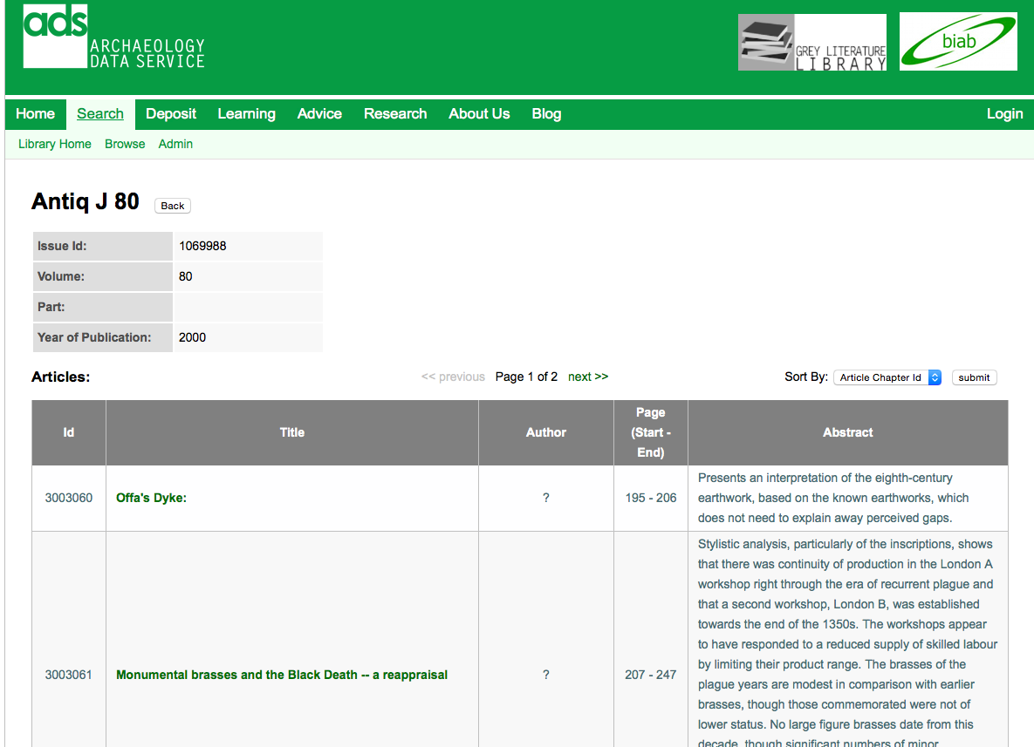

Slide 19
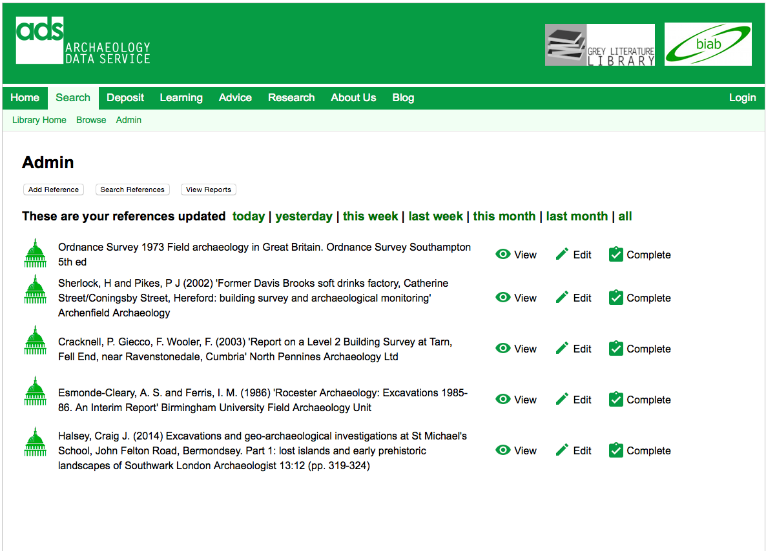

Slide 20
Joining it all up

Slide 21
Timescales
Functional specification January 2017
OASIS development starts March 2017
New form available in beta late 2018
OASIS Synchronisation projects planned in 2017 and implemented in 2018

Slide 22
Keeping up to date with OASIS
OASIS form and FAQs and documents are on the OASIS web site:
http://oasis.ac.uk
Subscribe to the OASIS Blog: http://archaeologydataservice.ac.uk/blog/oasis
Contact OASIS:
oasis@ads.ac.uk

