Slide 1
HERALD Project – A Brief Update

Slide 2


Overview
HERALD Stage 2
Buildings mock-up
The ADS Library
What next?
Notes:
In the last 6 months we’ve been very busy.
The HERALD Stage 2 project design was submitted to Historic England in February and thankfully it has been agreed that they will fund the redevelopment of the OASIS system. The Stage 2 HERALD project commenced at the beginning of April.
Just prior to April we completed a small sub-project that created a mock-up of the level -1 user recording form for historic buildings specialists – more on this in a minute.
There will be a series of milestones to meet as the project progresses. The first one being the completion of the ADS library, which some of you might have already seen a mock-up of on our website. Following a quick look at the mock-up for the library I’ll give a quick run down

Slide 3
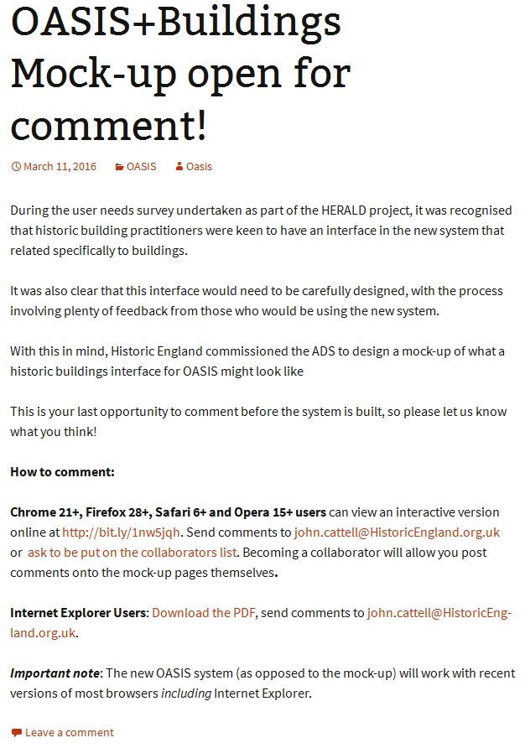
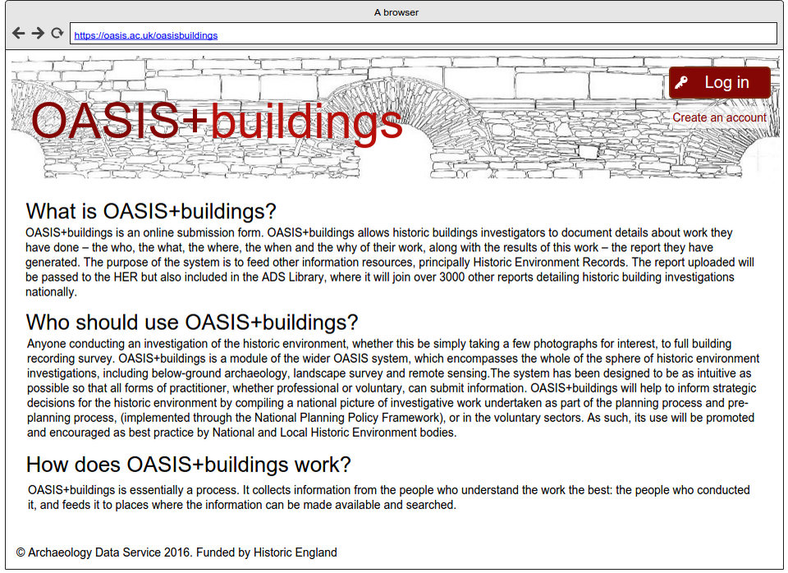
Historic Buildings
Notes:
A quick word on the buildings mock up.
As part of HIAS work package it was identified that the built historic environment community perhaps needed a clearer representation of what a redeveloped OASIS might look like for them. As a adjunct to the work we did as part of the stage 2 project design we created a mock up which has went up for comment on our blog.
I thought I would mention it as we didn’t publicise this widely through our own channels as these tend to reach the archaeological community and Historic England wanted to hear specifically from those not coming from that background. The comments on the mockup are being gathered by John Catell at Historic England and we look forward to hearing from them in due course.

Slide 4
ADS Library
Notes:
The first major developments of HERALD Stage 2 will be the creation and launch of the ADS-Library. Which will bring together BIAB, the Grey Literature Library, our journal back runs and documents in archives held by the ADS. For ‘outside’ resources (journals, monographs, etc.) the system will link to DOIs where available.

Slide 5
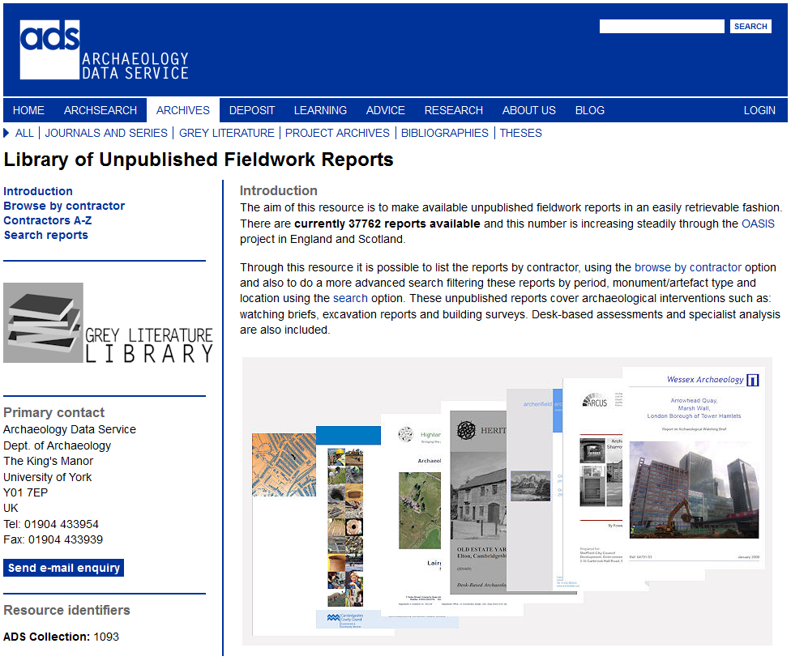
Notes:
So at the moment this is what you get when you visit the website – a series of tabs that let you search different parts of our collections.
Grey literature on this page….

Slide 6
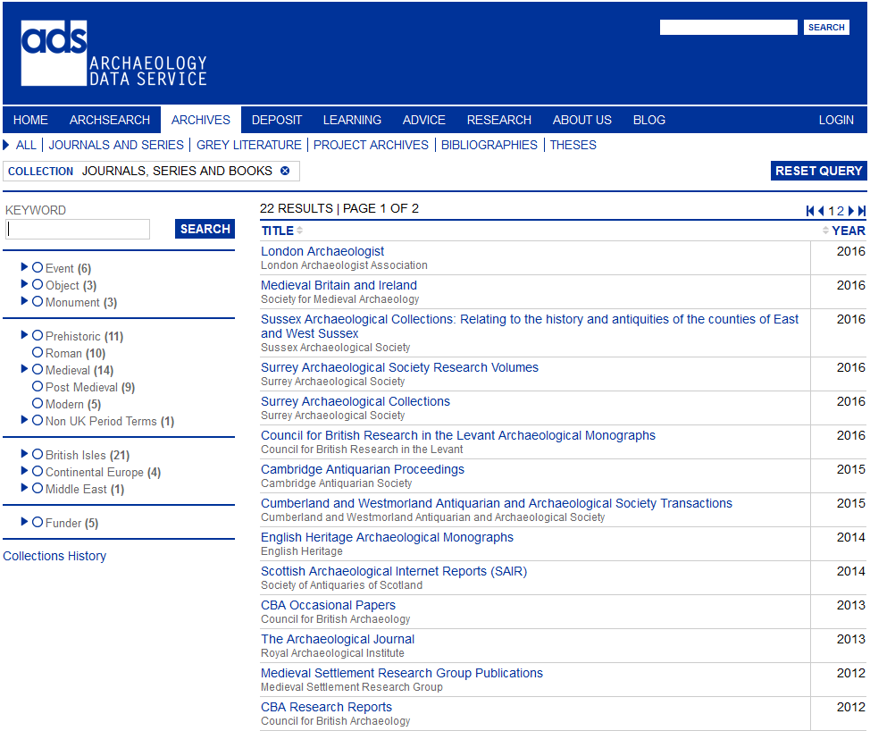
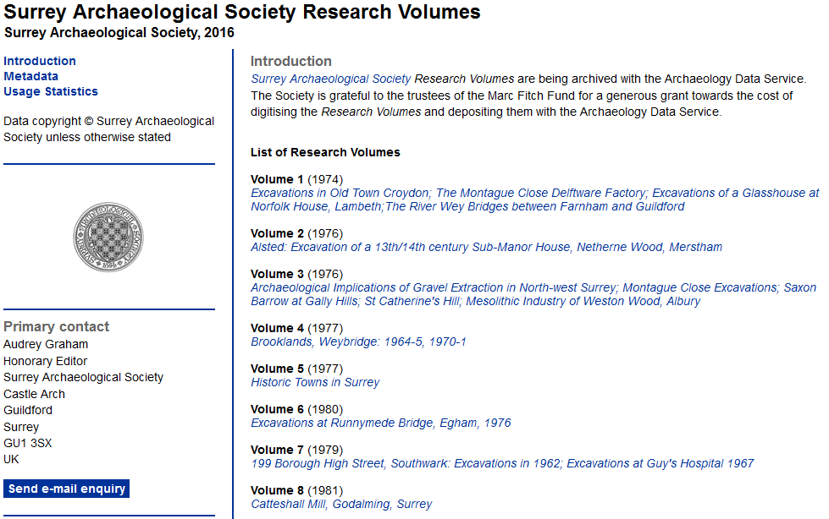
Notes:
Journals you have this page, and sub pages

Slide 7
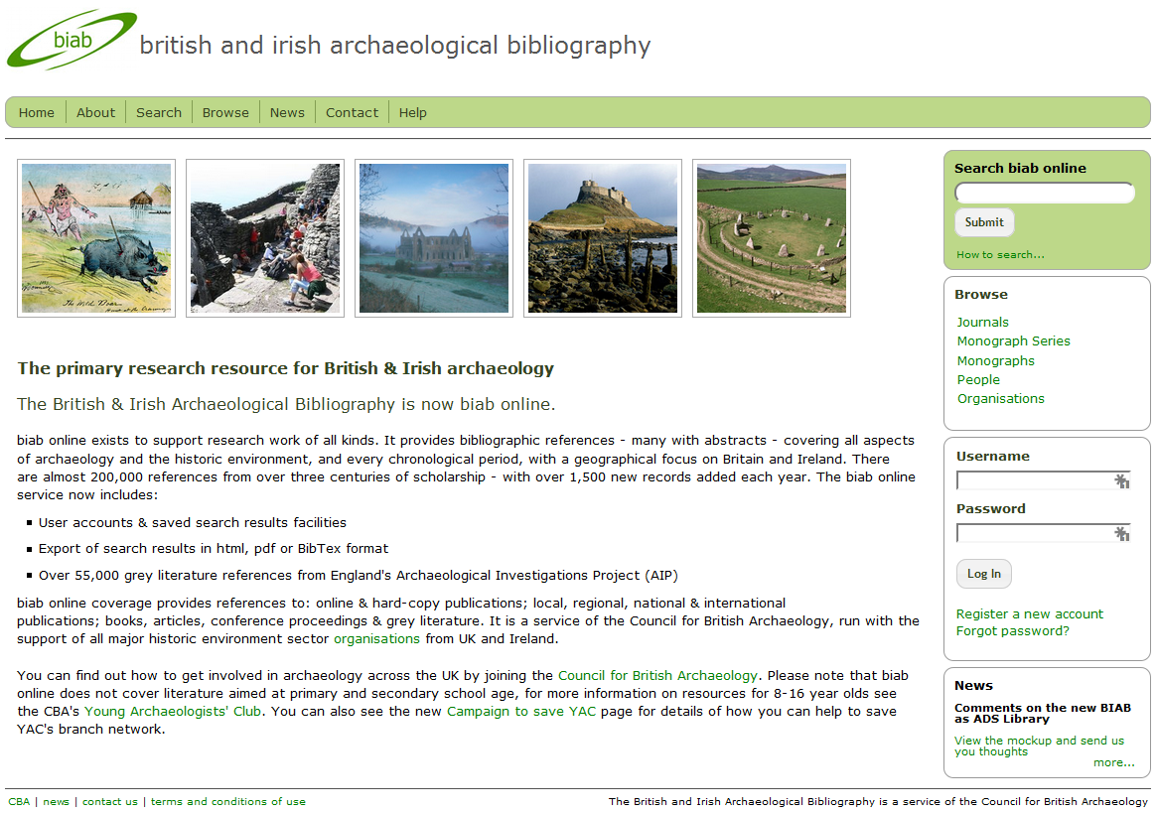
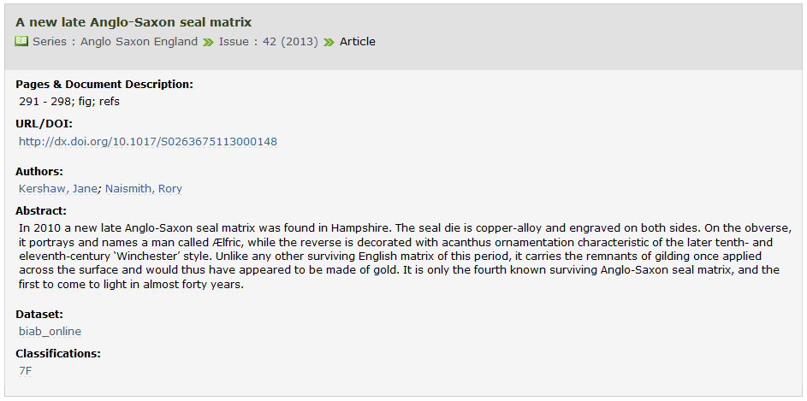
Notes:
And then for bibliographic information you have BIAB.

Slide 8
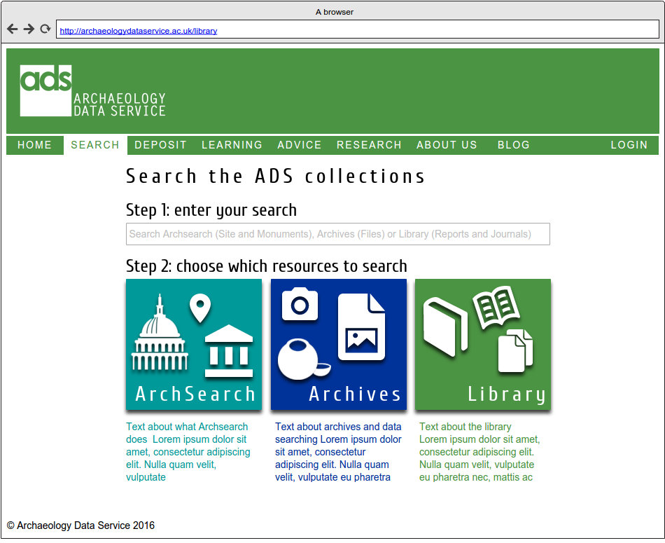
Notes:
The idea behind the new library is to bring these resources all together.
A new search & browse interface will have a new data structure to take in bibliographic and geographic information ( this latter is subject to it being provided by publishers) as well as subject and period terms. We are currently designing the interface which will integrate with current ADS website.
It will be accessible via a ‘library’ tab / button like the one of the right-hand side.
The next few slides illustrate what it might look like. These are all currently available for comment on our website. I’ll put the link up at the end, or you can find it via the OASIS Blog.

Slide 9
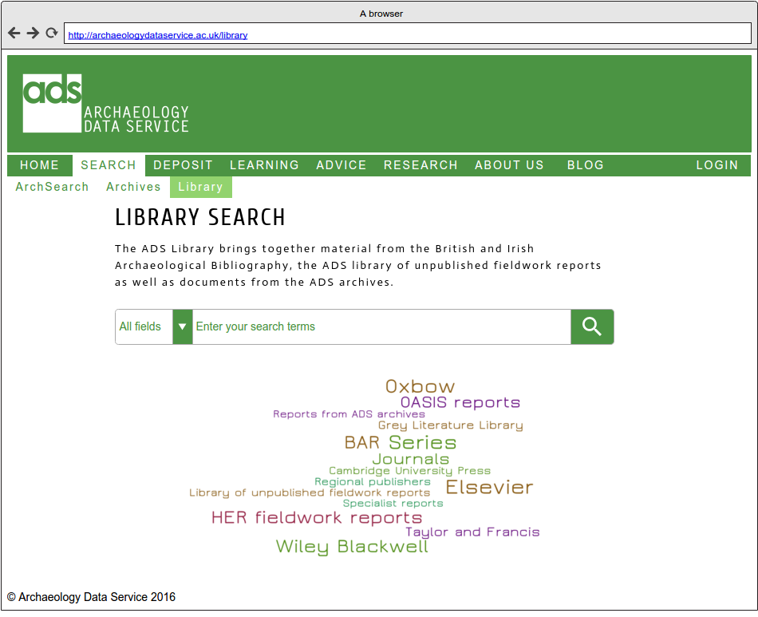
Notes:
If you select the Library Resource you’ll be brought to a screen like this. The thinking behind it is that the look and feel will be a bit like what you’d have in a traditional library catalogue so it’s fairly intuitive.

Slide 10
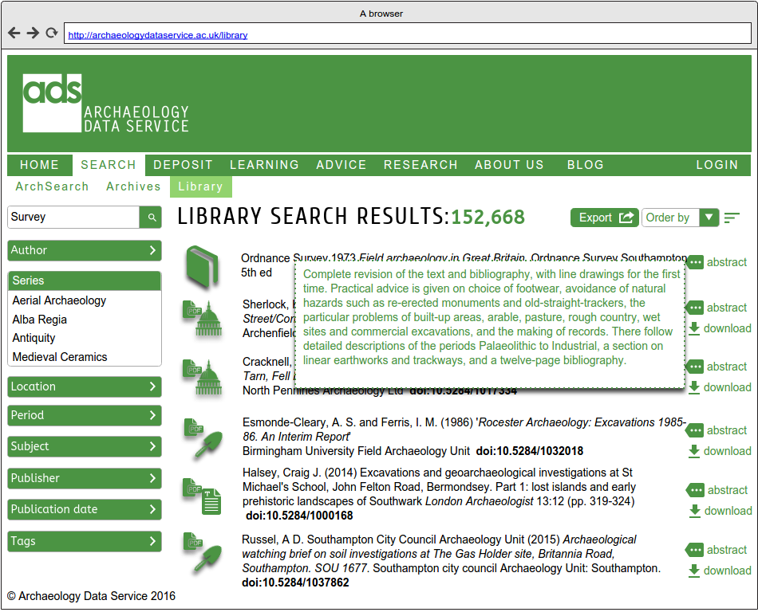
Notes:
And according to what you search you should get something like this: the bibliographic data and abstract where available. And some download options for people who keep their bibliographies in things like Endnote, bibtext or whatever. CSV is likely to be one option, so HERs could potentially have a way to import records as well.

Slide 11
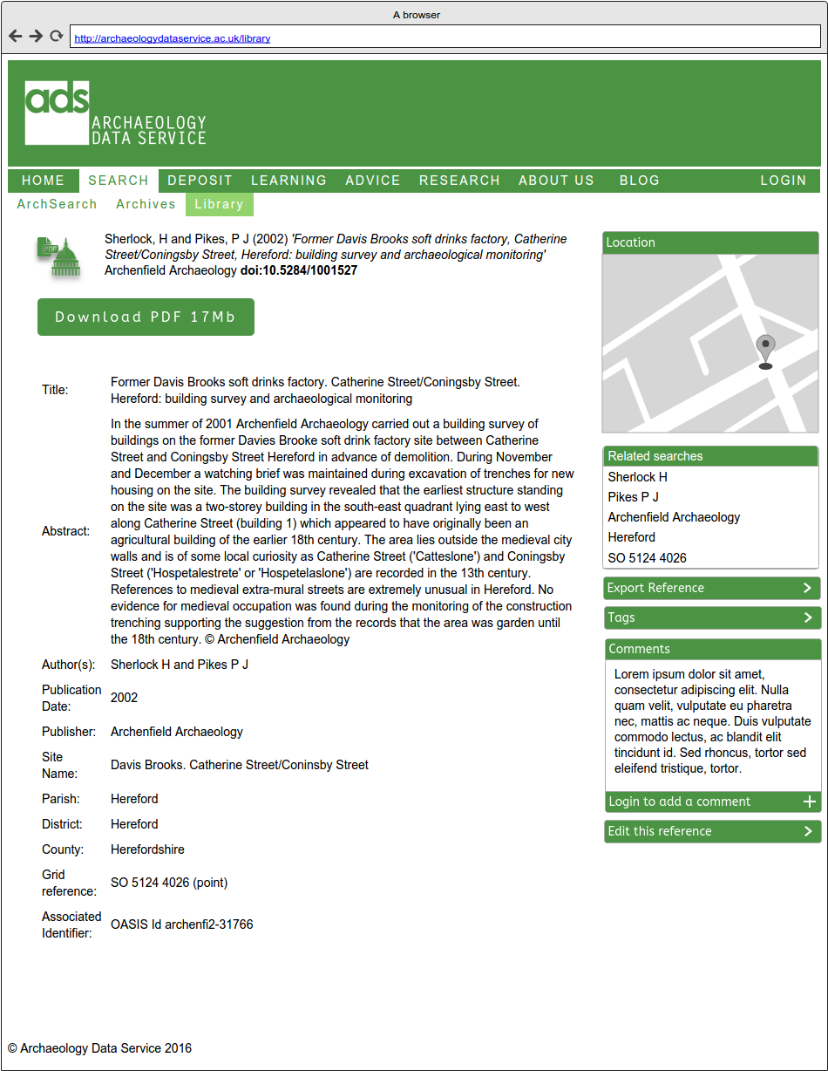
Notes:
This is what a full record looks like, we hope to try and integrate in as much spatial information as we can, where sensible we can potentially depict this in a map.
It looks pretty straight forward – but there’s plenty going on underneath the bonnet.
The idea will be for us to harvest data from the larger publishers of journals and monographs, and where we don’t have material to download, but there is a DOI then we can link out to items held elsewhere.
However, we have also been considering how local journals and publications might get into such a system. They’re unlikely to be able to set of ftps, or other technologies to automatically transfer data to us, so they would need some means to add this information into the system. So there’s a dedicated system for data entry that users can log into and enter their material.

Slide 12
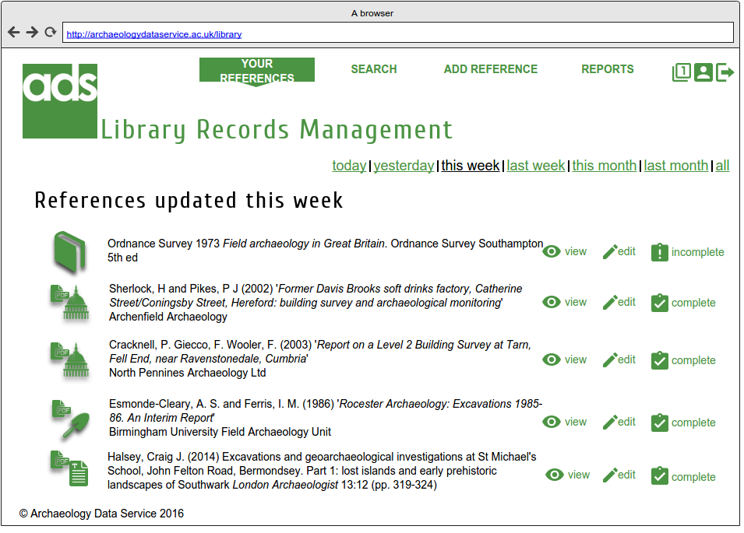
Notes:
This is the admin page for that system. The rest of the data entry side is on the mock-up online and it’s a bit too long to go into now but, I recommend having a look if you’re interested.
The new system should be out in Autumn, there’s a little bit of time for some last minute comments.

Slide 13
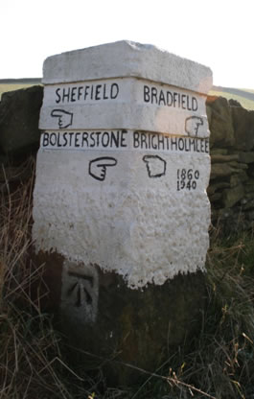
Where next?
OASIS Functional Specification – December
OASIS Build February – Nov 2017
OASIS Plus March 2018
‘alpha’ – summer 2018
beta – Autumn 2018.
Notes:
After autumn, the next major milestones will be the finalisation of the functional specification for the system in December and hopefully it’s agreement in January 2017. This will be followed by a build stage for the main form lasting until November 2017 and the OASIS Plus modules by March 2018. It is anticipated that first sight of the system, or the ALPHA version, as we’re calling it, will be June 2018, with the BETA version out in October 2018.
There’s also a HERALD stage 3 being planned, which we hope will run concurrently with stage 2. This will include things like publicity and training, but also we hope it will include a collaboration with a few HERs to look at the possibility of building some syncing tools for HERs. Jo is going to ask for some volunteers for via HER forum in due course.

Slide 14
Contact
Jo Gilham, HERALD Project Manager
Jo.gilham@york.ac.uk
Library mock up: http://archaeologydataservice.ac.uk/archives/view/library_mockup/demo_1_1.cfm
or
http://archaeologydataservice.ac.uk/blog/oasis
Notes:
In the meantime any questions are best going straight to Jo, as I am just the go-between at this stage in the proceedings.

