Slide 1
Forum on Information Standards in Heritage management committee Feb ‘18
Proposal to create a FISH management group on the new HE funded digital network
‘Open Workspace for Heritage’
on Knowledge Hub www.khub.net

Slide 2

Open Workspace for Heritage
Paid for by HE
1,000 members
Lots of groups for
Course participants
Project teams
Sector committees
Open Workspace for Heritage
For all those working to protect and care for the historic environment.

Slide 3


FISH management group
Restricted group (need to apply to join)
Sharing / storing meeting papers (Library)
Collaboration on draft standards (Wiki)
Discussion between meetings (Forum)
Not a replacement for FISH@JISCmail
Notes:
What is proposed: a restricted group to support the activity of the FISH / HEIRNET committee, replacing the FISH-MEMBERS@JISCMail group (not active since 2015).
The Group would have access to all the features of a Knowledge Hub group to support group work. It will be restricted (new members have to be invited, or apply to join)

Slide 4
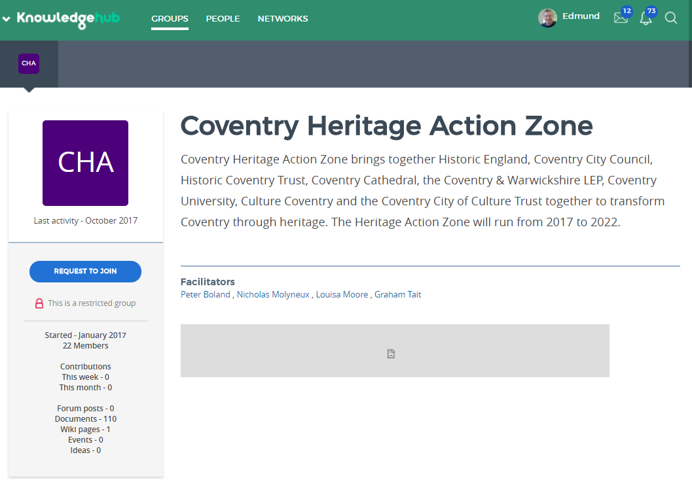


GROUPS PEOPLE NETWORKS
Forum on Information Standards in Heritage
Description of FISH committee…
Notes:
Mock up of what the group would look like to a non member

Slide 5
Benefits for Group members
Ready-made collaboration space
Higher visibility
Easier to curate / keep track of what was decided and when
Access to training and support from HE

Slide 6
Commitment from Groups to Open Workspace for Heritage
Each member must complete a profile
Each Group must contribute an activity at least once a year on Open Workspace e.g.
Lead a discussion
‘Meet the expert’ type interview

