Slide 1


Scottish Spatial Data Infrastructure
Iain McKay
Head of Spatial Information
Improvement Service
@iainwk

Slide 2
What is the Improvement Service?
10 years old in 2015 with a staff of around 50
Works on behalf of COSLA/SOLACE, local government in Scotland
Provides a wide range of services for Councils and Elected Members
Focus on collaborative projects and IT development including
myaccount (identity verification)
Improving Outcomes
Organisation Development
Support to Heads of Planning Scotland
Community Planning
Spatial Information Programme
http://www.improvementservice.org.uk/

Slide 3
Overview
Background to the Scottish Spatial Data Infrastructure
Introduction to the Spatial Information Service / Spatial Hub
An overview of ScotLIS (Scottish Land Information Service)
A look at Inspire
What are the key Issues and Challenges?

Slide 4
Spatial Information Service – Origins
One Scotland Gazetteer
2003 MGF2 Funded - c£10M provided to create a national address asset to underpin improved service delivery
All 32 councils working to a common standard was essential and required considerable effort in networking
Completed in 2006-7 and widely used within councils and by external users e.g. ePlanning, Energy Performance Certificates and Emergency Services
Approach by OS for inclusion of OSG in AddressBase products has widened the uptake, including commercial usage.

Slide 5

Scottish Spatial Data Infrastructure
It started with the GI Strategy for Scotland -
“One Scotland - One Geography” 2006-2011
Strategy Objective 2
“Ensure that everyone can use the most up-to-date and accurate geographic information about Scotland that can be delivered with best use of resources”
Strategy Objective 3
“Develop and promote the means whereby geographic information can be shared, within the practical limits of best value, so as to give a high quality and knowledge “return” from each set of data”
..and the recommendations of the McClelland Report (2011)
Shared procurement of (spatial) datasets
Shared procurement/development of software/applications
Changing procedures, organisational design and resourcing to
enable delivery cost effective delivery of ICT applications (SDI)
-
Notes:
5

Slide 6
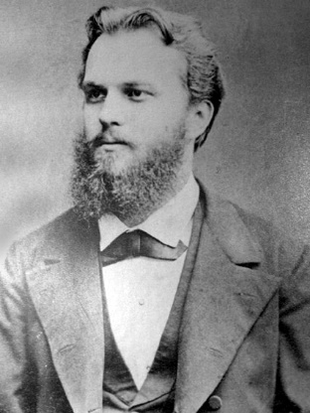
How has the Scottish SDI been developed?
So far it appears to be largely by using the Jirecek approach.
Konstantin Jirecek (1854-1918) Czech historian, politician, diplomat, and Slavist. He was the founder of Balkan Studies and Byzantine* Studies.
*Byzantine: “excessively complicated, and typically involving a great deal of administrative detail”
“We, the unwilling, led by the unknowing, are doing the impossible for the ungrateful. We have done so much, for so long, with so little, we are now qualified to do anything with nothing.” K Jirecek
Notes:
6
Greek-speaking continuation of the eastern half of the Roman Empire

Slide 7





Local Government leads with Spatial Hub
Data goes via CKAN and Python to Cloud server
Supplier uploads dataset as
WFS or shapefile
Data is conflated in FME and written to PostGIS
Registered user accesses WFS or WMS URL with token
Data is reviewed and published as WFS and WMS via GeoServer
Notes:
7

Slide 8
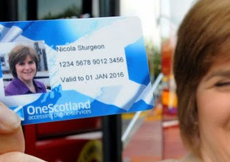
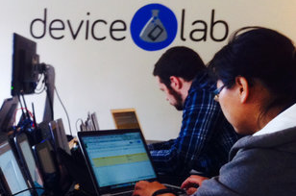
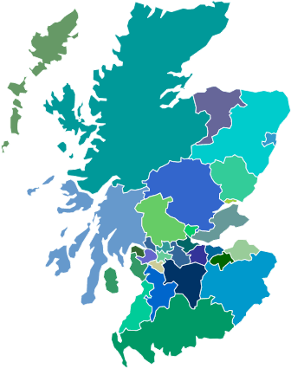


End Users (Customers)
Public Sector
Local government
National government
Stakeholder Organisations
Data Service Developers
Value Added Applications
Red Kites nesting sites, brilliant. At last some useful data!
General Public
Statutory Notification
Citizen Engagement
Private Sector
Support investment decisions
Regulatory reporting

Slide 9


(Why) Is INSPIRE Relevant?
It’s a statutory obligation so we have to get on with it – so let’s use it!
Local government will incur costs but gain very little benefit
Notes:
9
Only time Chief Exec has heard of Spatial Information!
Doctrine of Additional Burdens – England and Wales c£5k per authority
What would you do with £5K?

Slide 10
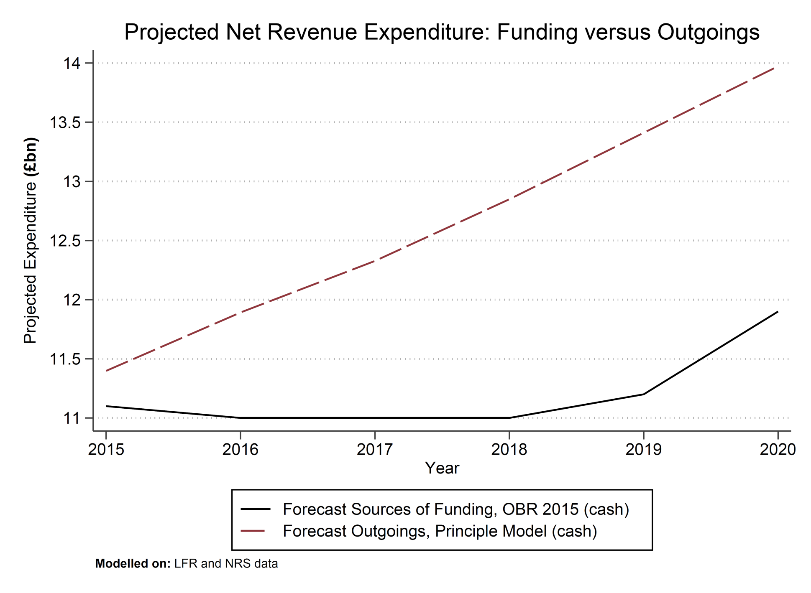
Cost / Benefit for INSPIRE ?
Potential INSPIRE Benefits
EU Level
UK Level
BENEFITS
Scottish Level
Time for Max Inspire Effort
COSTS
Regional Level
Council Level
Figure by Bregt (2012)
Notes:
10

Slide 11




Scottish Land and Property Information Service
What might a Scottish Land and Property Service look like?
Data Providers
RoS
LAs
SAA
OS
Util
MetaData
Menu
Scottish SDI
Web Services
What Data?
Portals
ScotLIS
SE Web
Community
Users
Notes:
11

Slide 12
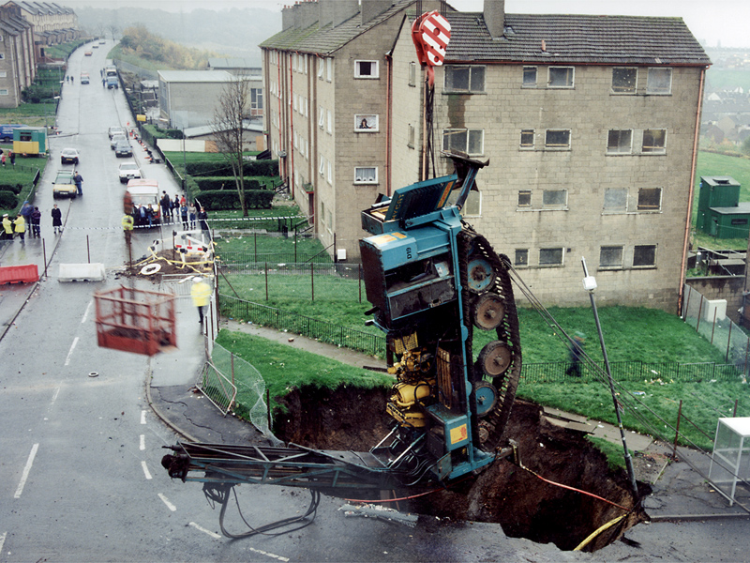
History of ScotLIS
Originated from an RICS idea to celebrate the Millennium - Domesday 2000
Broad Range of Partners
Registers of Scotland
Local Government - Glasgow City Council
Ordnance Survey
BGS / Coal Authority
Two pilots were delivered
Bridge of Allan (demonstrator) & Glasgow (Web Based)
Funded as a pilot – but never made it into a fully functioning service
Technology wasn’t advanced enough
Lack of Referencing Framework for Land and Property
Notes:
12

Slide 13

Domesday Book or Great Survey (1088)
Business Case
Project Boards
Working Groups
Third Party IPR
Took 18 months to complete !
Open Data?
Secure Buy In from Stakeholders
Technology Options
Notes:
13

Slide 14
Spatial Information Service – Progress
The Spatial Information Service now has:-
seven staff in place with the a blend of subject and technical experience
taken over the custodianship of the One Scotland Gazetteer
engaged with OS and others in a collaborative approach to the proposed Emergency Service Gazetteer
a cloud hosted technical infrastructure running open source software
established communication and procedures with the majority of the 32 councils
created a prototype portal to allow uploads and publication of data, compatible with the Scottish SDI metadata and Data.gov catalogue
contributed national spatial data and technical expertise for the newly developed Community Council Portal

Slide 15
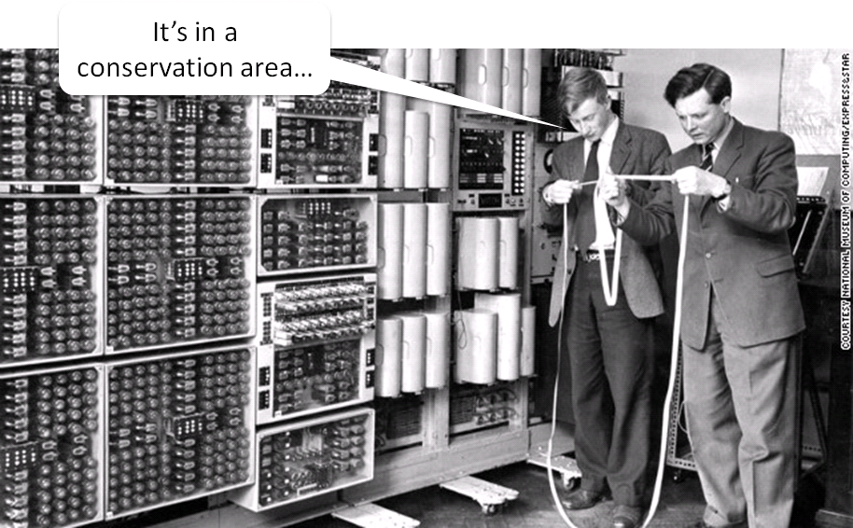
IS Spatial Information Service - Challenges
Strategic
Engagement at all levels
Managing expectations
Sustainability of the service – Funding model
Operational
Identify data custodians within organisations
Agree procedures and licensing issues with OS and other data owners
Harmonise metadata and publication standards with other parties (eg. INSPIRE, SSDI)
Legacy of outdated technology

Slide 16




Spatial Data – Challenge of locating data
Think about the organisation structure
Cell based
Information passed on “need to know” basis
Information only goes up or down one level
Information never passes across cells
Very difficult to trace data owners
Notes:
16

Slide 17
Benefits and Drivers
Local Government benefits from :-
Meeting INSPIRE obligations
Minimal interference with existing business process
Reduced overheads in dealing with requests for data from third parties
Issues such as data exemptions would be dealt with at centre
Free up time for more interesting things
Citizens, Public and Private Sector benefits from :-
Better information to build better services
Availability of national layers of consistent and current data
Opportunities from access to OpenData
Notes:
17

Slide 18

OpenData & Consequences
Arguments for open data:
Opendata will lead to business opportunites
SMEs and others will create employment
Businesses and employees will pay taxes
The country will reap great benefits
Reality:
Opendata could lead to business opportunites
SMEs and others might create employment
Businesses and employees might pay taxes
The UK Treasury will reap great benefits
Jobs in local government which create this high value data are being cut
Data Quality will suffer over time
Poorer services because poorer information to base decisions

Slide 19
Open Data – Property Enquiry Certificates
PECs part of the conveyancing process – mostly local government sourced information
Annually there are 150,000 property transactions in Scotland
Average cost of PEC £100
Annual Market c £15M
2014-2015 Scottish local government earned £500k from PEC
Private searchers must then have made over £14M revenue (based on largely on data from Scottish local government)
Scottish local government is facing the most severe budget reductions to date.
Oh Yes! we’ve got to prepare our data for Inspire

Slide 20
Returning Revenues to Local Government
Notes:
Based on generating some income from the known market for spatial data in the land and property market
2.5% share of the market in 2017-18 and increasing this to 5% and then 7.5% in each of the following years
The assumption is that the property market remains static. This should be noted as being speculative but with cooperation from local government and licensing partners could be achievable

Slide 21
IS Spatial Information Service Update - Conclusion
However by setting up the Spatial Information Service we intend to make all of this happen through what is a transformational approach to managing spatial information
Success will be measured against:
Consolidating funding model – reducing grant funding
32 Councils plus 2 National Park Authorities active on IS Spatial Hub, within one year.
Deliver local authority dataset for ScotLIS launch in October 2017
Meet INSPIRE obligations for Scottish LG by 2020
Productive and sustainable relationships with strategic partners (eg. OS, RoS, SG)
Use of Open Source Software by default – minimal software costs
Totally funding One Scotland Mapping Agreement by 2020

Slide 22

Questions
@iainwk
Iain.mckay@improvementservice.org.uk

