Slide 1
Furthering our Understanding - developing English Research Frameworks
Dan Miles (Historic England)
FISH-HEIRNET meeting Edinburgh 29th November 2016

Slide 2
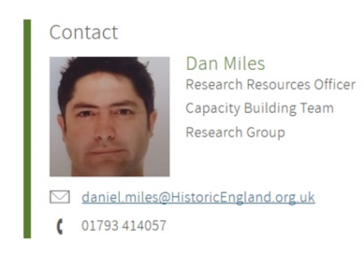

I am the Research Resources Officer
Notes:
2
Develop:
Up to date knowledge bases
Research questions
Support:
The planning system
Expertise - Local Authority & Commercial archaeologists
Coordinate & promote:
The best research value & public benefit from the planning system
Sectoral collaboration & partnership working

Slide 3
What I do…
Develop Research Frameworks
Develop Reference Resources – eg online reference collections
Develop models/systems to make these more accessible & useful

Slide 4
Why?
Support decision making in the English planning system (NPPF)
Get the best research value & public benefit out of the planning system
Promote sectoral collaboration & inclusion

Slide 5
Current Projects

Slide 6
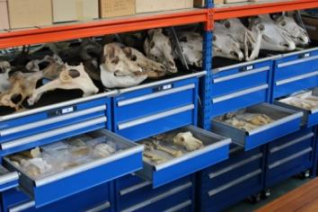
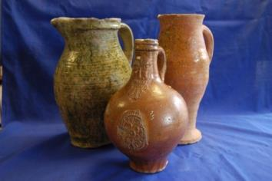
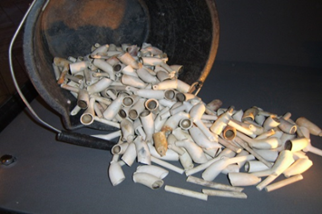
Making Reference Resources available online
Building a national Zooarchaeological reference resource
Enhancing the Worcestershire on-line ceramic reference resource
Clay Tobacco Pipes for field archaeology

Slide 7
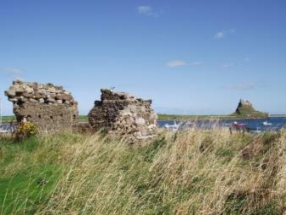
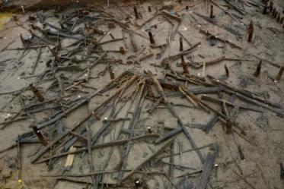
Updating Regional Research Frameworks
North West
North East
East of England
Notes:
The first step is building the community – for WIKIs to work this is an important and difficult step – probably seen in the SCARF review
These RFs are regional – to be managed but will allow county/local engagement at different levels so to promote buy in from county societies etc…

Slide 8
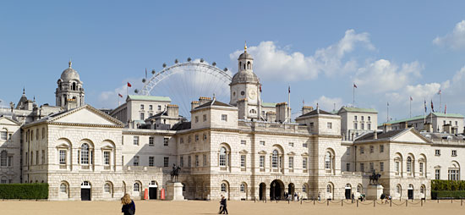
Developing a National Framework and Research Agenda for the Historic Built Environment

Slide 9
Fitting the pieces together
Completing the Research Cycle

Slide 10
Knowledge creation
Capacity
building
Sector expertise
Planning decision
Investigation
Information
Information & Knowledge Cycle
Notes:
I wanted to show my role in a graphic
Access to information in peach melba and the knowledge cycle in green

Slide 11
Research Frameworks
Research Agendas
Period/area syntheses
Typologies
Reference collections
Knowledge creation
Capacity
building
Sector expertise
Planning decision
Investigation
Information
Reports
Publications
Guidance
Training
Research Resources
OASIS
HERs
PAS
Written scheme of
Investigation
Research questions
Assessment of Significance
Notes:
Labelled up – the flow of information, knowledge creation
From investigations – through the HERs, OASIS etc into the grey lit library, collated synthesised – creating RFs, other syntheses eg UAD research Assessments
Eg other syntheses eg the Roman Rural project, Ipswich ware etc….
And these compliment other capacity building ventures eg guidance and training in supporting sectoral expertise – the LAS, the contractors to help them make write reports, assess significance, etc supporting the planning decision and then the investigations – wsi s etc….

Slide 12
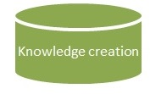
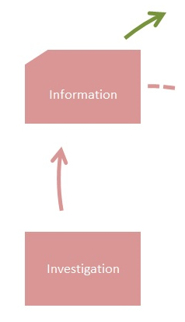
Improving access to information
HIAS
HERALD Project
OASIS redesign
Digital Library
Notes:
This is the Heritage Information Access Strategy and HERALD stuff that Jo will talk about

Slide 13

Improving access to information
HIAS
HERALD Project
OASIS redesign
Digital Library
Notes:
This is the Heritage Information Access Strategy and HERALD stuff that Jo will talk about

Slide 14
But then what happens to the information?
How do we “further understanding” from the grey lit reports/journal articles etc…?
How do we update our knowledge from the research questions asked in investigations?
Notes:
In reports no one reads

Slide 15
We have a suite of Research Frameworks that contain:
Resource Assessments / Syntheses – providing the context / understanding of HER “dot on map" info
Research Agendas – research questions that provide a research basis for investigations
Notes:
Regional & national etc….

Slide 16
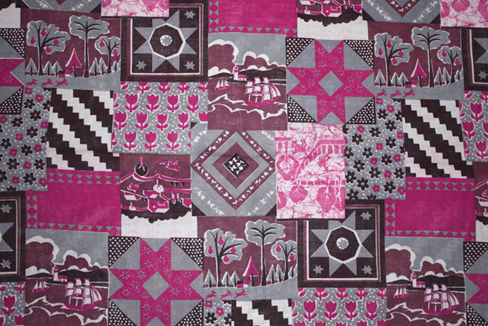
But
“Patchwork” of static, inaccessible & unconnected frameworks

Slide 17
The challenge is…
How do we update them with new information?
How do we make them more accessible and fit for purpose?
How do we link them together?

Slide 18
What we are doing about it…
1 Developing the content – updating RFs
2 Referencing & linking to OASIS/Digital Library
3 Developing a digital platform to host, update and connect them together

Slide 19
Developing the content – updating Research Frameworks
NE
NW
EofE

Slide 20
Updating Research Frameworks
Adding metadata (controlled vocabularies) to research themes & questions
Linking regional frameworks
Being more inclusive- community involvement

Slide 21
Referencing & linking to OASIS/Digital Library
Referencing RFs in OASIS form
Adding a “what we found out” OASIS form section that will populate BIAB “abstracts” & RFs

Slide 23
Developing a digital platform
Building a wiki based platform – updatable RFs
Adding different RF content
Searchable (location/theme/ question etc..)
“Uploader” - OASIS & ADS Digital Library records
Standards driven – controlled vocabulary
Notes:
This is essential – we don’t want a number of disparate and isolated research frameworks – we want them to be linked up – on the same web platform
The content/agendas etc are owned by the communities but the underlying infrastructure needs to have standards eg terminologies etc to allow cross searching and linking to OASIS/Grey Lit Library

Slide 24
Developing a governance model of the platform
Vision of communities of practice managing their own content
Governance and funding model of sustaining the platform to be examined

Slide 25

Completing the Research Cycle

