Slide 1


NRHE to HER Data Reconciliation and Supply
Project title: NRHE to HERs Research & Development Phase
Supporting the delivery of the Heritage Information Access Strategy (HIAS)
Aims:
To allow the accessioning of data currently held in the National Record of the Historic Environment (NRHE) into the appropriate Historic Environment Records (HERs), providing a solution suitable for all HERs regardless of their data management technologies.
To build, test and refine a prototype toolkit and methodology.
To examine the resources needed to transition the data from the NRHE to HERs.
Project Executive: Dr Gillian Grayson acting as Convenor of the Forum on Information Standards in Heritage (FISH)
Project Lead, Team and Assurance Officer drawn from

Slide 2
NRHE to HER Data Reconciliation and Supply
We are GIS and data specialists, based in the Brecon Beacons National Park, with 36 staff including 6 archaeologists
We focus on environment and conservation, aiming to deliver clear benefits for the historic and/or natural environment through every project
Our applications and services are used by nearly all local authorities in the UK, many central government departments and agencies, and almost every major conservation agency and charity
We develop and support the “HBSMR” product, used by c.75% of HERs in the UK. One of several OTS systems, but unusual in that the operation and management of HBSMR is governed by a legal partnership agreement with Historic England, who also own part of the product
I am by background a natural scientist, then archaeologist and HER Officer, and I now lead the heritage services team at exeGesIS

Slide 3


NRHE to HER Data Reconciliation and Supply
Previous project led by Devon Council (Graham Tait) had brief “to identify possible methods of transferring data from the NRHE to the HERs”
Exegesis were engaged to contribute to the technical options appraisal
We scoped three possible mechanisms, considered at a workshop in November 2014:
  Full automated import
  Managed/supervised import
  Manual accessioning

Slide 4
NRHE to HER Data Reconciliation and Supply
The workshop concluded that the overall proposal was viable, and that option 3 “manual accessioning” was preferred
E-conference on HER Forum discussed same topics, reaching the same conclusions
Led to final report, then to invitation to submit project design for a prototyping project
Exegesis were asked to manage the project and deliver the technical platform for the prototype
We are now completing Stage 6 (of 10)

Slide 5
NRHE to HER Data Reconciliation and Supply
Stage 1: develop website and load NRHE data
Design goals:
For methodical transfer of 500,000 records from the NRHE to HERs
Map and list-based access to records
Downloadable GIS data
Clear record details for copying and pasting
Captures concordance and monitors rate of progress
Clear display of and filtering by status to monitor progress
NRHE
New website
HBSMR
HBSMR
HBSMR
HBSMR
Other
HBSMR
Historic Environment Records
Other
HBSMR
Other
HBSMR
HBSMR

Slide 6
NRHE to HER Data Reconciliation and Supply
Stage 1: data supply issues
Took months, and was highly problematic.
Our original specification…
Non-spatial data from NRHE/AMIE should be supplied as a comma-separated values file for each table/view, with: all strings quoted, no line-wrapping, dates in ISO8601 format; plus documentation including details of the character encoding and line endings, a comprehensive data dictionary for the provided data sufficient to permit every data item to be clearly explained to end users, and details of row counts for each provided table. Spatial data relating to provided records should be supplied in an appropriate ESRI vector format (e.g. file geodatabase), in EPSG:27700, with a shared identifier cross-referencing the non-spatial records, and with full documentation of attributes. The spatial and non-spatial exports should include only fields and records that should be transferred to HERs, plus any system identifiers needed to relate data from different tables and control values needed to render data correctly. Data should be de-normalised where possible to reduce numbers of tables, but original coded values should be included where these may be useful to the HER (for example identifiers from thesauri). The export should include all records that would ultimately be transferred to HERs (not just a sample). The export process should be documented and repeatable with absolute consistency.
… this could only be met in parts, and Historic England staff struggled with the tools available to export the required volumes of records. The tools and approach were inappropriate.

Slide 7
NRHE to HER Data Reconciliation and Supply
Stage 1: data supply
Supply comprised:
Monuments attribute data as 9 regional files in “MIDAS XML” format (but not valid MIDAS XML). Many records were duplicated across these files.
Events attribute data as 17 CSV files. Most of these contained different facets of the data, shadowing the original relational structures; some were continuation files (i.e. the same units of information divided horizontally for unknown reasons).
Spatial data as a single ESRI Personal Geodatabase (mdb) containing four feature classes:
  AMIE_Event_Points (142792 features)
  AMIE_Monument_Points (207052 features)
  AMIE_Monument_Lines (6512 features)
  AMIE_Monument_Polygons (230479 features)
A shared integer identifier linked GIS feature to textual records (usually).
No documentation was provided, but most of the content was readily understandable once we had analysed the unique values in each element (though this would have been problematic if we had not worked with AMIE data before and were not deeply familiar with the subject matter).

Slide 8
NRHE to HER Data Reconciliation and Supply
Stage 1: data processing
We imported all supplied data into a SQL Server 2014 database via various transformation and cleaning processes.
Spatial data was imported using our “GISquirrel” product.
Monument and Event data were amalgamated into a single table, with the main payload in an XML field plus various key attributes in “conventional” fields (the “HOB_UID” etc).
142862 Event records were imported.
398932 Monument records were imported.
For fast simple filtering we decided on a faceted search interface; this required extracting and/or generating typed “tags” for the following:
  Is the record mapped? Yes/no
  Record type: monument/event
  LPA: (list of LPAs) – generated by spatial intersection with OS bdyln subset.
  HER area: (list of HER areas). We buffered each HER area by 100m for this purpose, to ensure each HER can readily filter to see records within and extremely close to their territory, and accommodate 6-fig NGRs.
  National Park area: (list of NPAs) – generated spatially
  County (from the AMIE data rather than spatial)

Slide 9
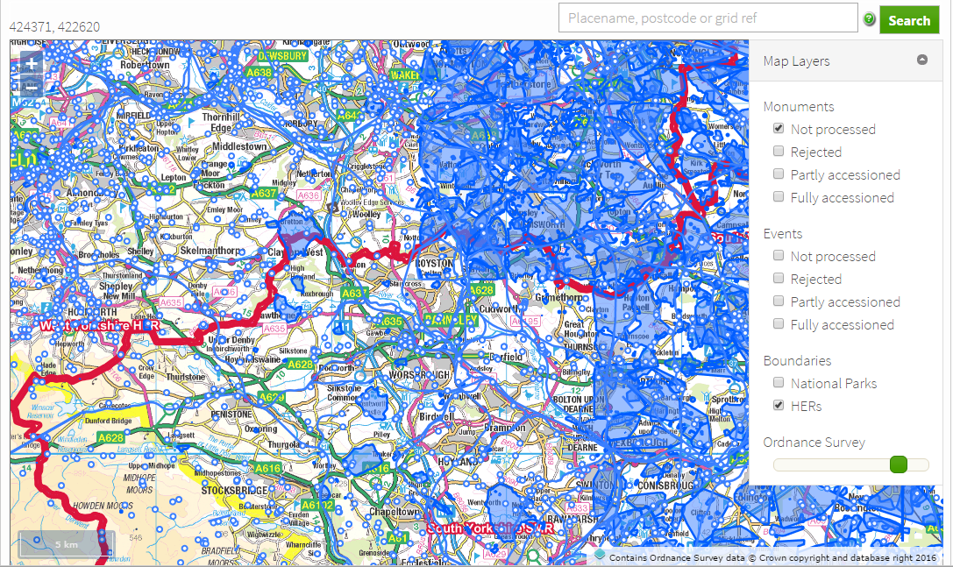
NRHE to HER Data Reconciliation and Supply
Stage 1: the website - interactive map

Slide 10
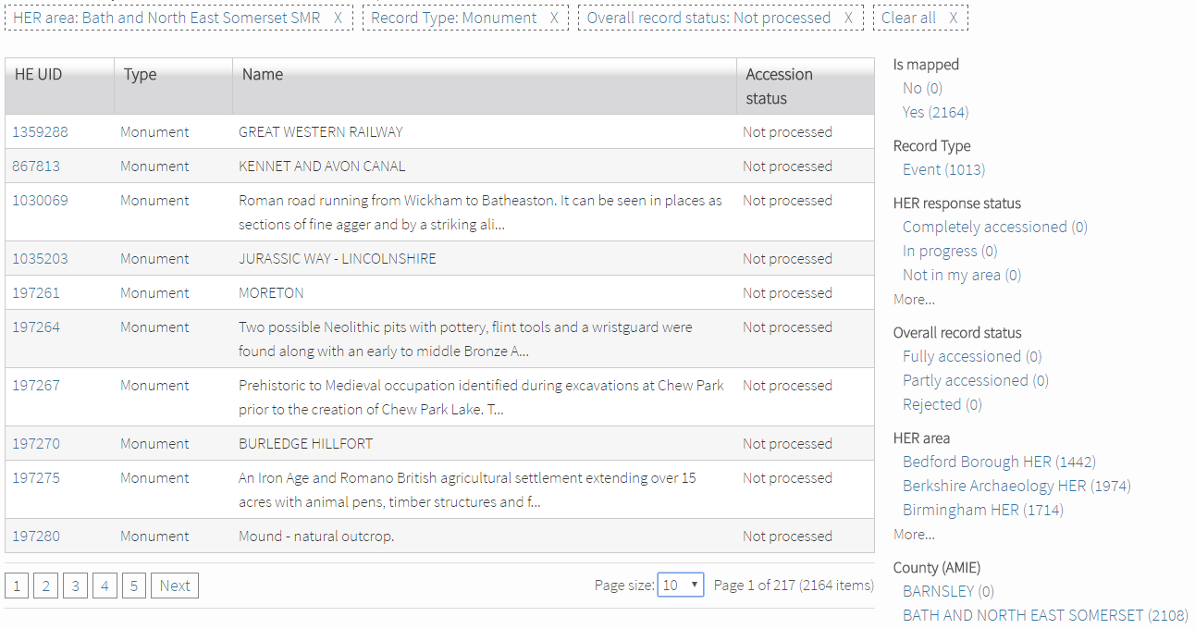
NRHE to HER Data Reconciliation and Supply
Stage 1: the website – records list with faceted filtering

Slide 11
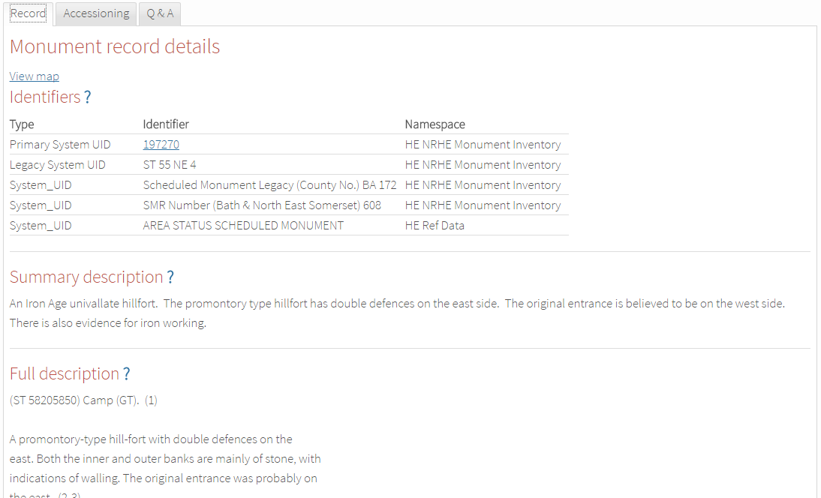
NRHE to HER Data Reconciliation and Supply
Stage 1: the website – record details (with help links)

Slide 12
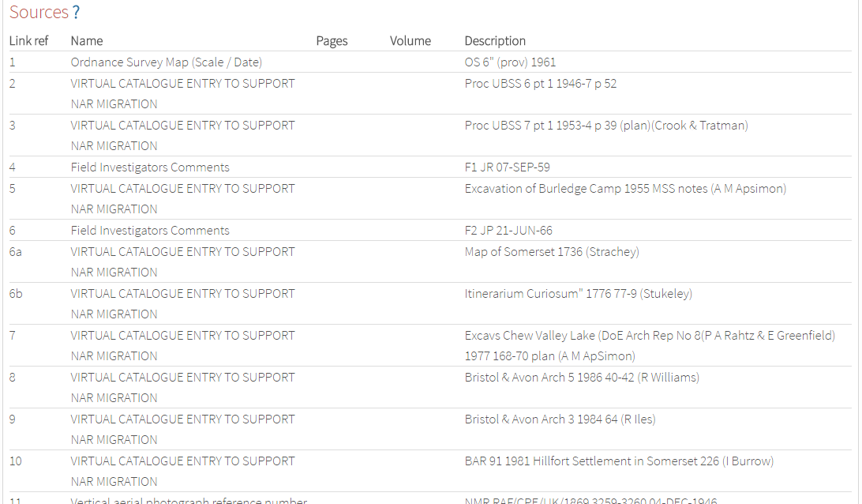
NRHE to HER Data Reconciliation and Supply
Stage 1: the website – record details (continued)

Slide 13
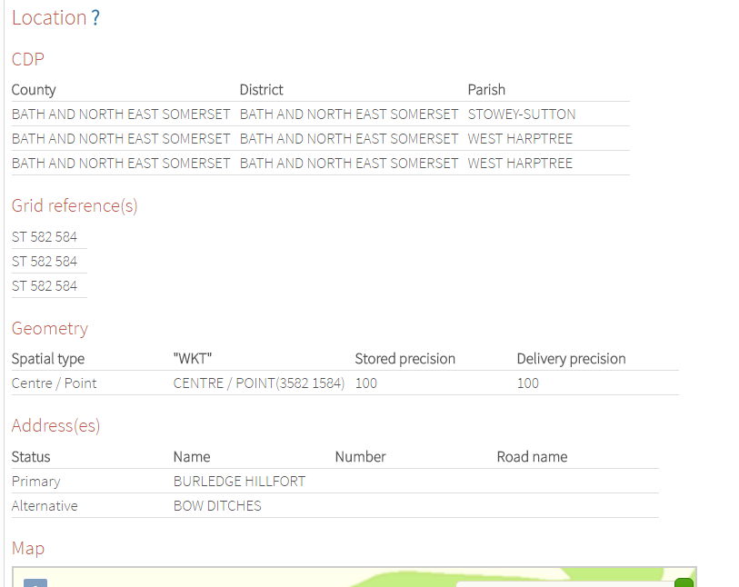
NRHE to HER Data Reconciliation and Supply
Stage 1: the website – record details (continued)

Slide 14
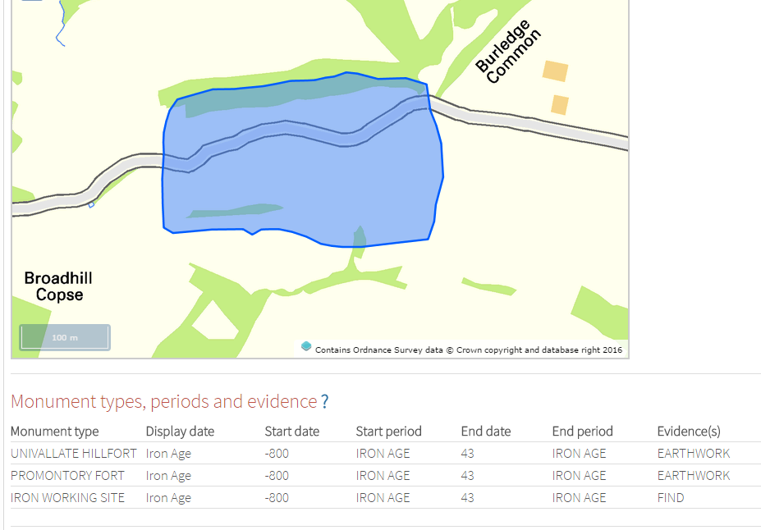
NRHE to HER Data Reconciliation and Supply
Stage 1: the website – record details (continued)

Slide 15
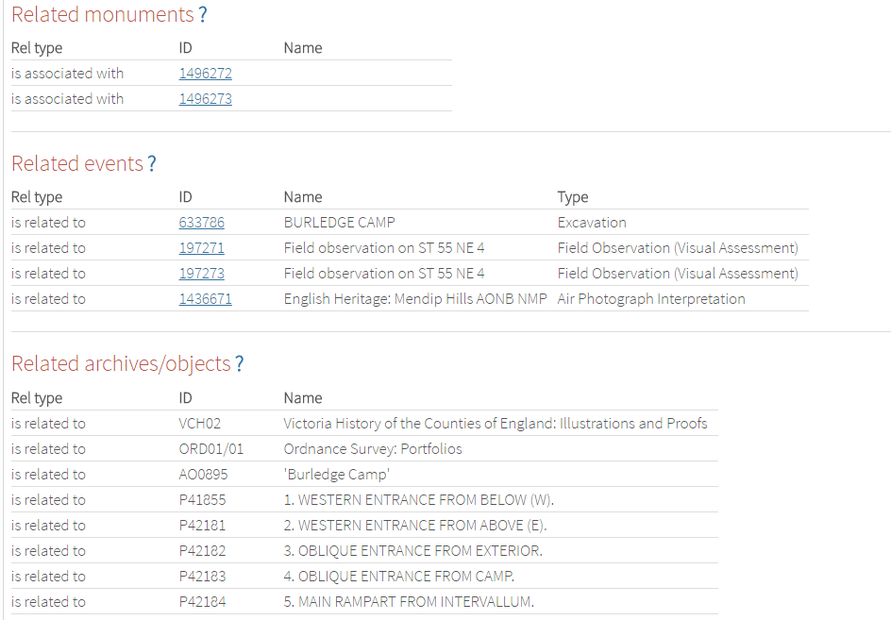
NRHE to HER Data Reconciliation and Supply
Stage 1: the website – record details (continued)

Slide 16
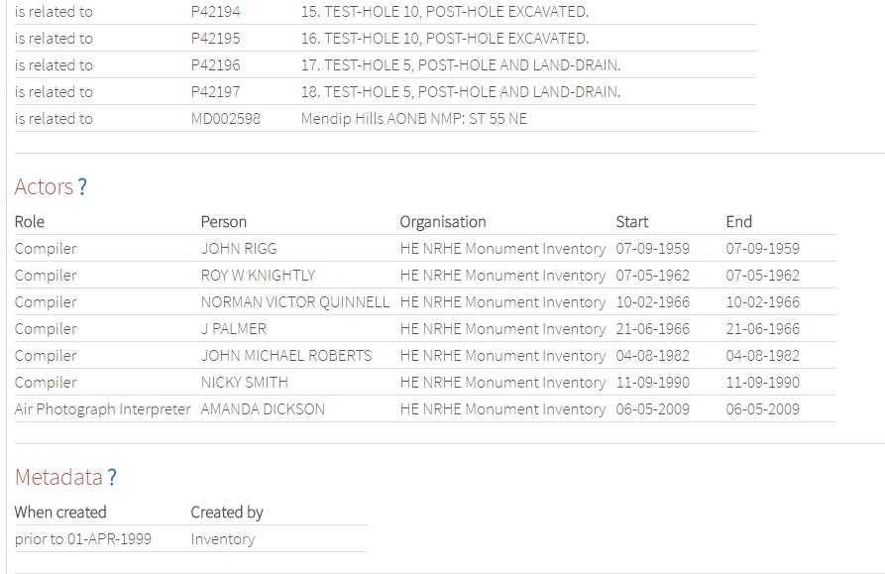
NRHE to HER Data Reconciliation and Supply
Stage 1: the website – record details (continued)

Slide 17
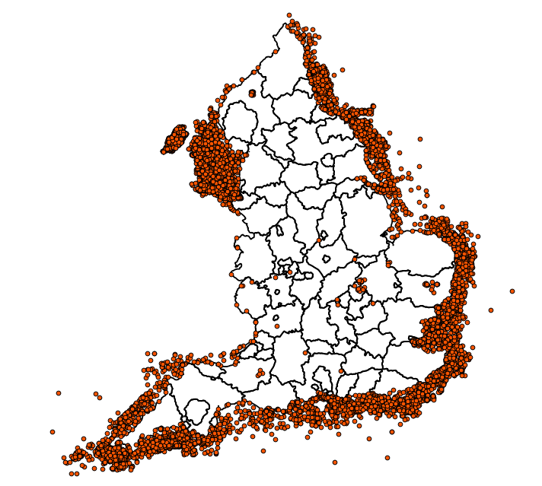
NRHE to HER Data Reconciliation and Supply
Stage 1: data supply issues during import and configuration
c.35K records in the GIS dataset but not in the attribute data. Most (but not all) of the excess points were maritime records; all were removed.
Superimposed and nearly identical polygons for many monuments (found by random inspection, e.g. 1577822).
Mismatches between GIS and attribute datasets
Record metadata is partial/missing (e.g. data visible on Pastscape but missing from data supplied)
Badly formed coordinate data for Events. E.g.
  383121,218782
  383,218
  18251,6304
Duplicate records in the Events GIS dataset.
Cross-references to Events that were not in the supplied data, plus records in related tables that did not match a supplied Event.

Slide 18
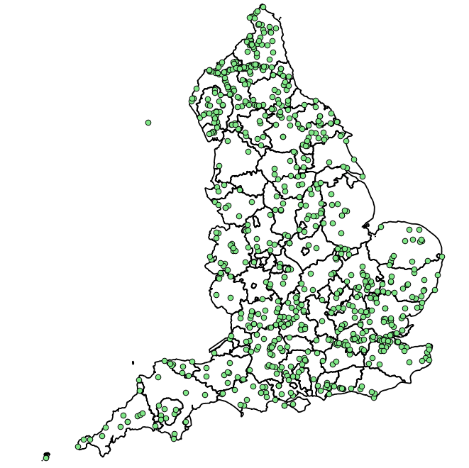
NRHE to HER Data Reconciliation and Supply
Stage 1: data supply issues continued
Degrading merge of Event dates and culture-historical periods.
Mismatches between GIS and textual datasets (including having 762 GIS points without matching textual data).
Inappropriate usage of various MIDAS XML elements (e.g. identifiers without values indicating legal status).
Cross-referencing to legacy identifiers of designation records, but none to current identifiers.
Missing Source Originator in supplied data for Monuments.
Mixed up and duplicated CDP and grid reference data in the Monuments MIDAS XML.
Incoherent WKT data in the MIDAS XML, e.g. <wkt srs="EPSG:27700">LINEAR(4489 4436)</wkt>
Strange Monument Actor organisations, e.g. George Gilbert Scott belonged to the organisation “HE NRHE Monument Inventory”
Event actors comprising only a role.

Slide 19
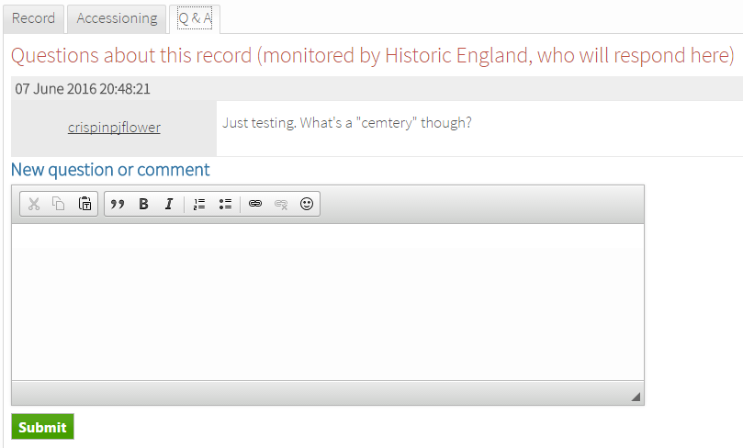

NRHE to HER Data Reconciliation and Supply
Stage 1: the website – record Q&A with email notifications

Slide 20
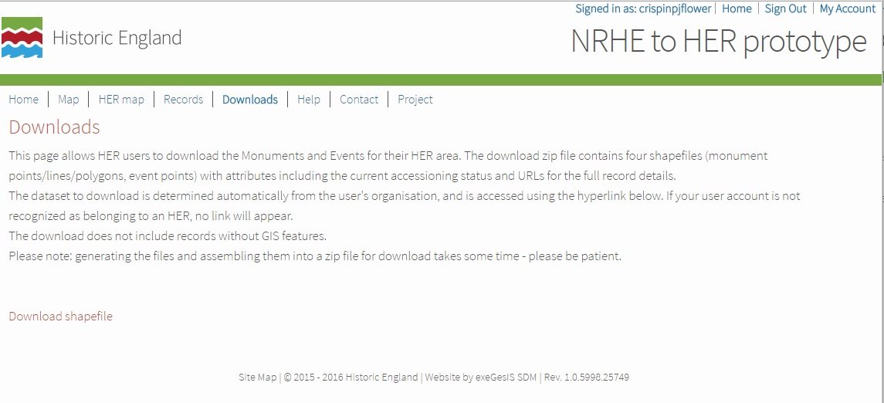
NRHE to HER Data Reconciliation and Supply
Stage 1: the website – shapefile download for HER area (with status)

Slide 21
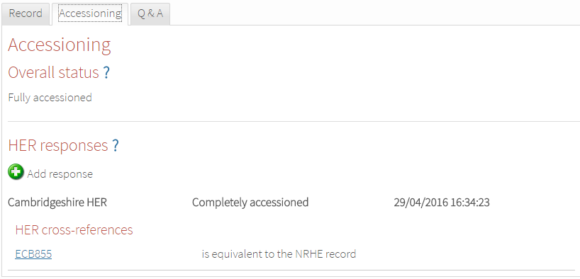
NRHE to HER Data Reconciliation and Supply
Stage 1: the website – accessioning – a processed record in 1 HER area

Slide 22
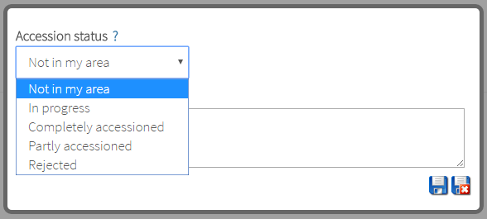
NRHE to HER Data Reconciliation and Supply
Stage 1: the website – accessioning – adding a response

Slide 23
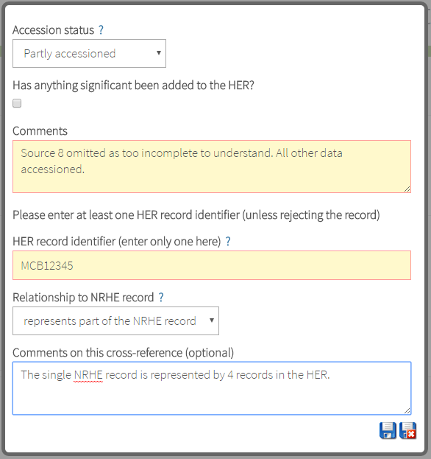
NRHE to HER Data Reconciliation and Supply
Stage 1: the website – accessioning – conditional questions

Slide 24
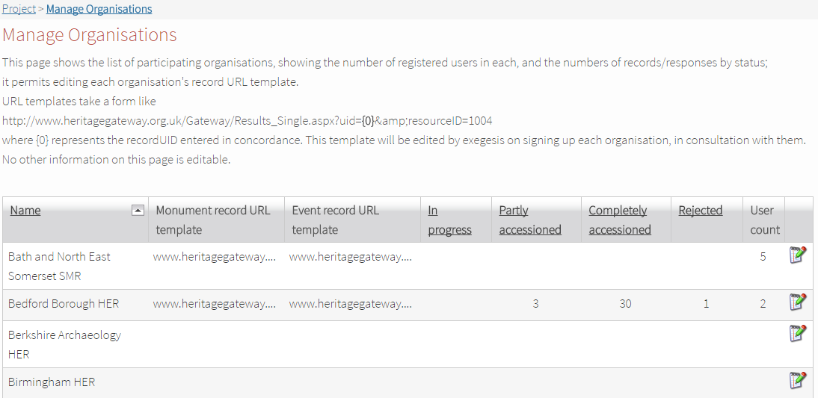
NRHE to HER Data Reconciliation and Supply
Stage 1: the website – accessioning – UID link templates

Slide 25
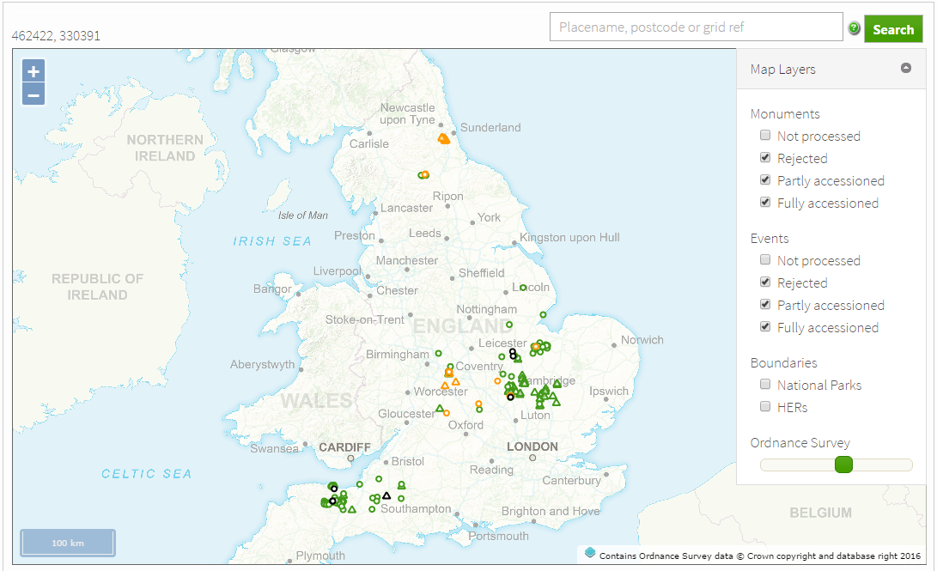
NRHE to HER Data Reconciliation and Supply
Stage 5: first phase of testing with real use by HERs (1 day x 6 HERs)

Slide 26
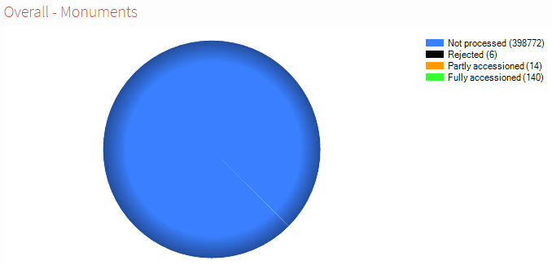
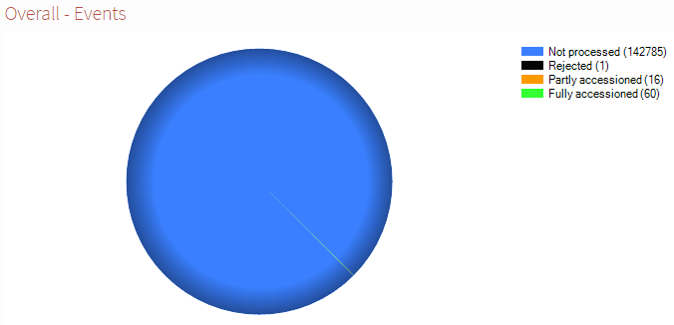
NRHE to HER Data Reconciliation and Supply
Stage 5: first phase of testing with real use by HERs (1 day x 6 HERs)

Slide 27
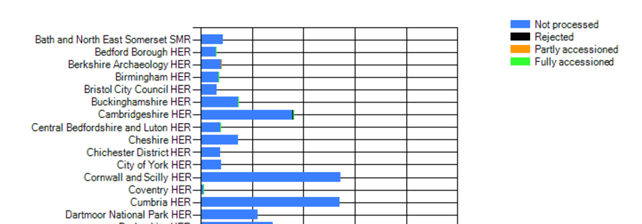
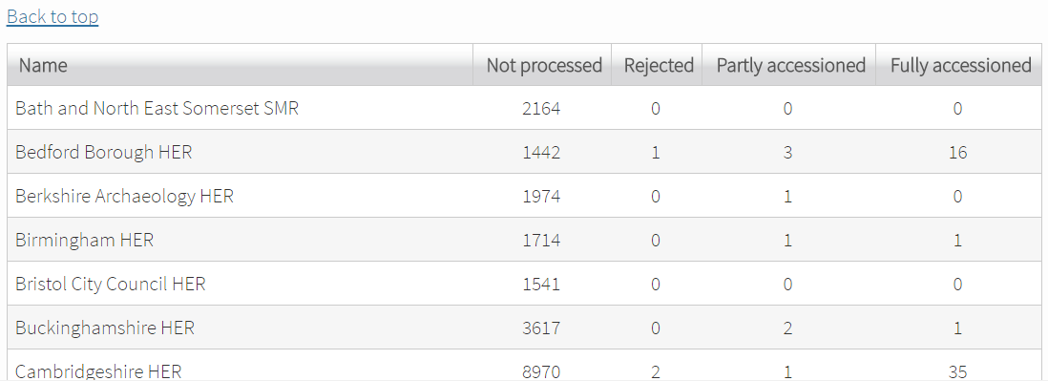
NRHE to HER Data Reconciliation and Supply
Stage 5: first phase of testing with real use by HERs (1 day x 6 HERs)

Slide 28
NRHE to HER Data Reconciliation and Supply
Stage 5: first phase of testing – lessons learned
The first phase of testing was very successful – all participants found the process straightforward. Most felt that real benefit had been derived even from these few hours. There was much discussion of the most efficient strategies to adopt.
A series of suggestions were discussed at a recent meeting in Swindon, leading to Stage 6 revisions, including:
Add a second map with layers based on each HER’s own response, rather than the overall status (so there are now two maps showing different views of progress).
Add a new response of “Not in area”.
Permit filtering on the HER’s own response status (including records flagged as “in progress”) as well as overall status.
Add the Event Type and Start Date into the info popup in the map.
Add new tick box “has anything significant been added to the HER?”.
Revise the logic that calculates the overall status from the responses, to work better for records that span >1 HER.
Change record details tab title to show the UID first.
These changes have been completed, and are now in testing.

Slide 29
NRHE to HER Data Reconciliation and Supply
Stage 7: second phase of testing
The next phase of testing starts on 20th June, and will involve 25 HERs each undertaking accessioning for 2 days. The HERs are all signed up on the site and awaiting their instructions. They were selected to fulfil these criteria:
HERs running a bespoke HER system (as many as possible of 20 HERs; all will be invited)
10 HBSMR HERs
An urban (modern urban area) HER
A rural HER
An HER based in a two-tier authority
An HER based in a unitary authority
A coastal HER
An HER not based in a Local Authority
An HER based in a National Park
An HER that identifies itself as an Urban Archaeological Database (UAD)
A “Small” HER (that has less than 1 full-time-equivalent HER Officer role)
A “Large” HER (that has more than 1 full-time-equivalent HER Officer role)

Slide 30
NRHE to HER Data Reconciliation and Supply
Stages 8-10: gathering feedback, analysis, reporting and handover
After the Stage 7 testing, structured feedback will be collected by questionnaire and telephone interviews, and the observed progress analysed.
The project will be presented to the HER Forum.
We (the project team) will assess the requirements for converting the “prototype” technical platform and associated guidance and procedures into “the real thing”, including measures needed to address the data supply issues, running costs, required support services etc.
We will write a final report, including recommendations for a subsequent implementation and transition plan.
We will provide all source code for the website to Historic England.

Slide 31

NRHE to HER Data Reconciliation and Supply

