Slide 1
Array
2nd

Slide 2
Topics
배열 정렬
2차원 배열
실습 환경 세팅
수업 예제 코드 동작 확인

Slide 3
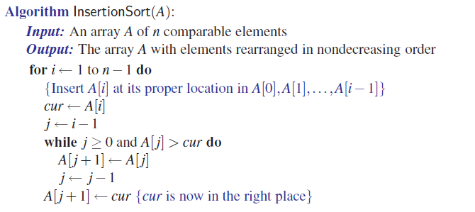
배열 정렬 – InsertionSort (삽입정렬)

Slide 4
InsertionSort
void insertionSort(char* A, int n)
{// sort an array of n characters
for (int i = 1; i < n; i++)
{// insertion loop
char cur = A[i]; // current character to insert
int j = i - 1; // start at previous character
while ((j >= 0) && (A[j] > cur))
{
// while A[j] is out of order
A[j + 1] = A[j]; // move A[j] right
j--; // decrement j
}
A[j + 1] = cur;// this is the proper place for cur
}
}

Slide 5
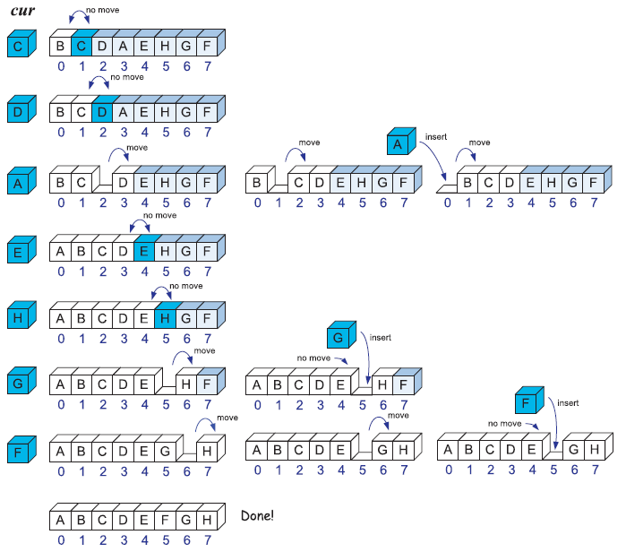
InsertionSort
void insertionSort(char* A, int n)
{// sort an array of n characters
for (int i = 1; i < n; i++)
{// insertion loop
char cur = A[i]; // current character to insert
int j = i - 1; // start at previous character
while ((j >= 0) && (A[j] > cur))
{// while A[j] is out of order
A[j + 1] = A[j]; // move A[j] right
j--; // decrement j
}
A[j + 1] = cur;// this is the proper place for cur
}
}

Slide 6
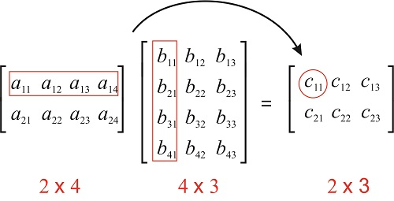
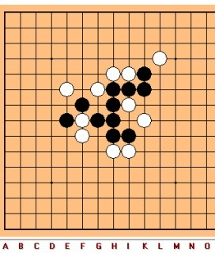
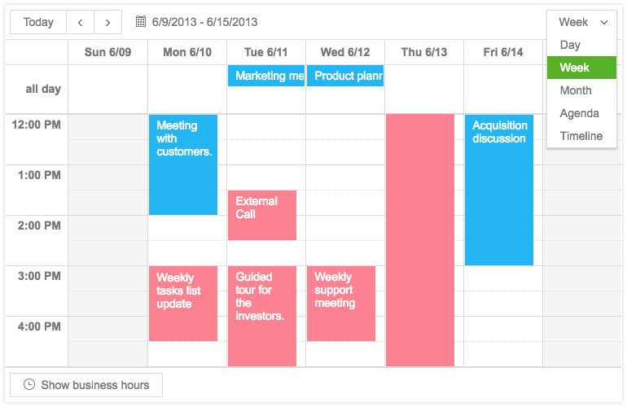
2차원 배열 (two-dimensional array)
One-dimensional array: int A[10];
Two-dimensional array: int M[2][4];
Applications
Matrices calculations
2D Positional games: e.g., Tic-Tac-Toe
Scheduler
int schedule[nDays][nHours];

Slide 7
2D Array cont. – Dynamic Allocation
배열 동적 할당
행렬 동적 할당
int* A = new int[length];
A[0] = 5;
...
delete[] A;
// n X m matrix
int** M = new int*[n];
for (int i = 0; i < n; i++)
M[i] = new int[m];
...
for (int i=0; i < n; i++)
delete[] M[i];
delete[] M;
Standard Template Library (STL) → vector class
#include<vector>
using namespace std;
...
vector< vector<int> > M(n, vector<int>(m));
cout<< M[i][j] << endl;

Slide 8
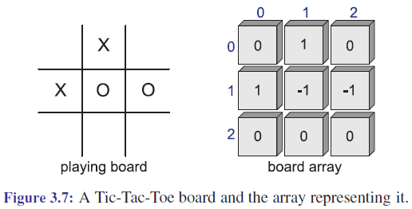
Tic-Tac-Toe

Slide 9
Tic-Tac-Toe cont.
#include <cstdlib> // system definitions
#include <iostream> // I/O definitions
using namespace std; // make std:: accessible
const int X = 1, O = -1, EMPTY = 0; // possible marks
int board[3][3]; // playing board
int currentPlayer; // current player (X or O)
void clearBoard() { // clear the board
for (int i = 0; i < 3; i++)
for (int j = 0; j < 3; j++)
board[i][j] = EMPTY; // every cell is empty
currentPlayer = X; // player X starts
}

Slide 10
Tic-Tac-Toe cont.
void putMark(int i, int j) { // mark row i column j
board[i][j] = currentPlayer; // mark with current player
currentPlayer = -currentPlayer; // switch players
}
bool isWin(int mark) { // is mark the winner?
int win = 3*mark; // +3 for X and -3 for O
return ((board[0][0] + board[0][1] + board[0][2] == win) // row 0
|| (board[1][0] + board[1][1] + board[1][2] == win) // row 1
|| (board[2][0] + board[2][1] + board[2][2] == win) // row 2
|| (board[0][0] + board[1][0] + board[2][0] == win) // column 0
|| (board[0][1] + board[1][1] + board[2][1] == win) // column 1
|| (board[0][2] + board[1][2] + board[2][2] == win) // column 2
|| (board[0][0] + board[1][1] + board[2][2] == win) // diagonal
|| (board[2][0] + board[1][1] + board[0][2] == win)); // diagonal
}

Slide 11
Tic-Tac-Toe cont.
int getWinner() { // who wins? (EMPTY means tie)
if (isWin(X)) return X;
else if (isWin(O)) return O;
else return EMPTY;
}
void printBoard() { // print the board
for (int i = 0; i < 3; i++) {
for (int j = 0; j < 3; j++) {
switch (board[i][j]) {
case X: cout << "X"; break;
case O: cout << "O"; break;
case EMPTY: cout << " "; break;
}
if (j < 2) cout << "|"; // column boundary
}
if (i < 2) cout << "\n-+-+-\n"; // row boundary
}
}

Slide 12
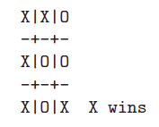
Tic-Tac-Toe cont.
int main() { // main program
clearBoard(); // clear the board
putMark(0,0); putMark(1,1); // add the marks
putMark(0,1); putMark(0,2);
putMark(2,0); putMark(1,2);
putMark(2,2); putMark(2,1);
putMark(1,0);
printBoard(); // print the final board
int winner = getWinner();
if (winner != EMPTY) // print the winner
cout << " " << (winner == X ? 'X' : '0') << " wins" << endl;
else
cout << " Tie" << endl;
return EXIT_SUCCESS;
}

Slide 13
Next
실습 환경 세팅
수업 예제 동작 확인

