Slide 1
Analysis of Algorithms
Input
Algorithm
Output

Slide 2
Seven Important Functions

Slide 3
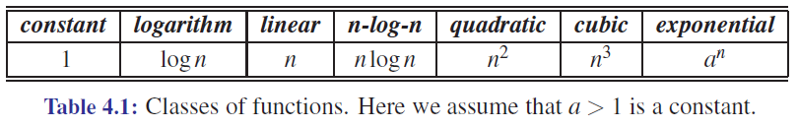
Seven Important Functions
Seven functions that often appear in algorithm analysis:
Constant ≈ 1
Logarithmic ≈ log n
Linear ≈ n
N-Log-N ≈ n log n
Quadratic ≈ n²
Cubic ≈ n³
Exponential ≈ 2^{n}
In a log-log chart, the slope of the line corresponds to the growth rate
in order of the growth rate

Slide 4
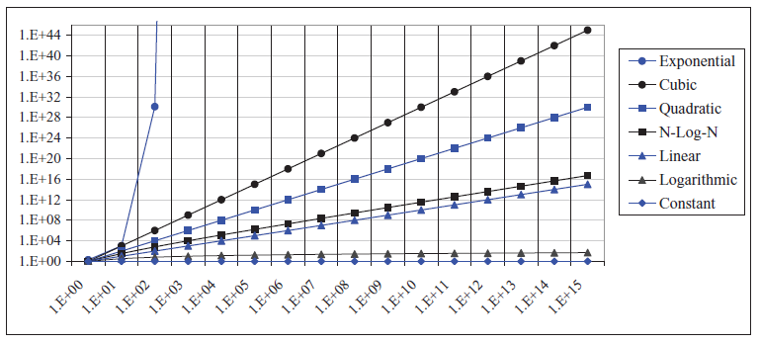
Growth Rates in a log-log chart

Slide 5
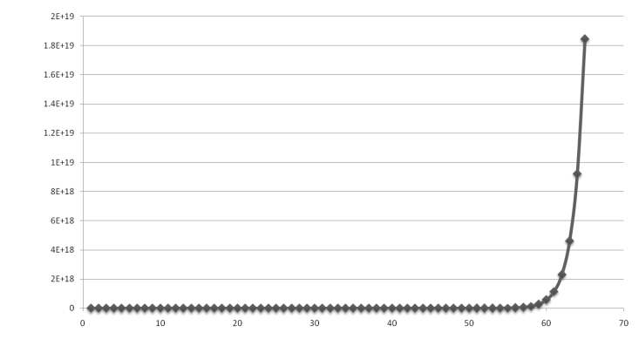
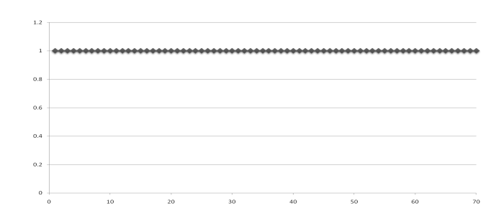
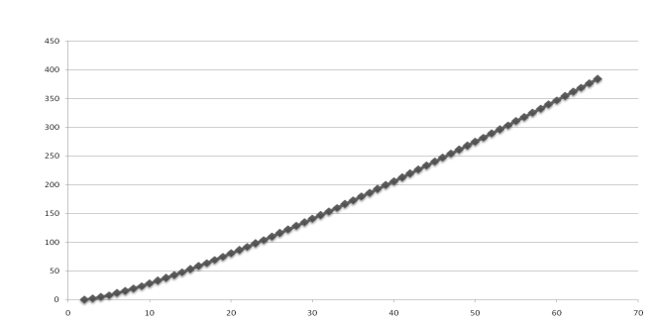
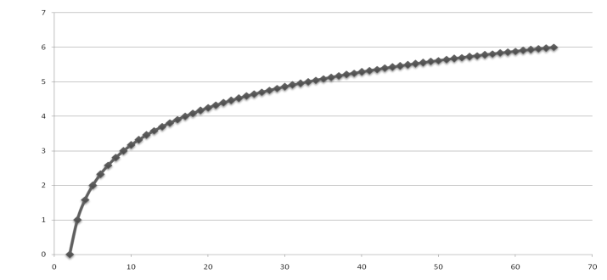
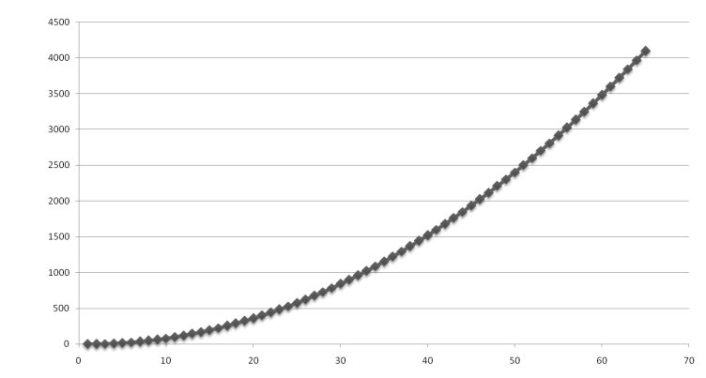
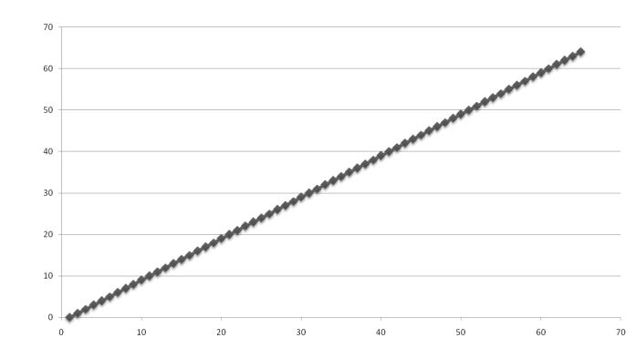
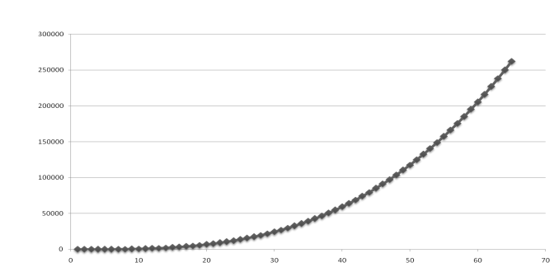
Functions Graphed Using “Normal” Scale
g(n) = n lg n
g(n) = 1
g(n) = 2^{n}
g(n) = n²
g(n) = lg n
g(n) = n
g(n) = n³

Slide 6
Analysis of Algorithms

Slide 7
Running Time
Most algorithms transform input objects into output objects.
The running time of an algorithm typically grows with the input size.
Average case time is often difficult to determine.
We focus on the worst case running time.
Easier to analyze
Crucial to applications such as games, finance and robotics

Slide 8
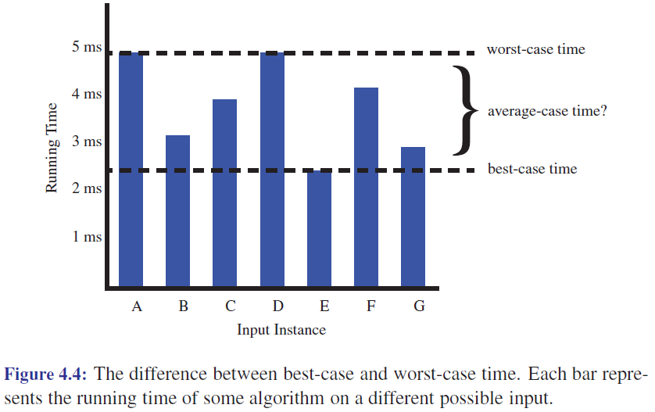
Why worst-case time?

Slide 9
Experimental Studies
Write a program implementing the algorithm
Run the program with inputs of varying size and composition
Use a method like clock() to get an accurate measure of the actual running time
Plot the results

Slide 10
Limitations of Experiments
It is necessary to implement the algorithm, which may be difficult
Results may not be indicative of the running time on other inputs not included in the experiment.
In order to compare two algorithms, the same hardware and software environments must be used

Slide 11
Theoretical Analysis
Uses a high-level description of the algorithm instead of an implementation
Characterizes running time as a function of the input size, n.
Takes into account all possible inputs
Allows us to evaluate the speed of an algorithm independent of the hardware/software environment

Slide 12
Pseudocode
Example: find max element of an array
High-level description of an algorithm
More structured than English prose
Less detailed than a program
Preferred notation for describing algorithms
Hides program design issues
Algorithm arrayMax(A, n)
Input array A of n integers
Output maximum element of A
currentMax ← A[0]
for i ← 1 to n − 1 do
if A[i] > currentMax then
currentMax ← A[i]
return currentMax

Slide 13
Pseudocode Details
Control flow
if … then … [else …]
while … do …
repeat … until …
for … do …
Indentation replaces braces
Method declaration
Algorithm method (arg [, arg…])
Input …
Output …
Method call
var.method (arg [, arg…])
Return value
return expression
Expressions
Assignment (like = in C++)
Equality testing (like == in C++)
n² Superscripts and other mathematical formatting allowed

Slide 14
The Random Access Machine (RAM) Model
A CPU
An potentially unbounded bank of memory cells, each of which can hold an arbitrary number or character
2
1
0
Memory cells are numbered and accessing any cell in memory takes unit time.

Slide 15
Primitive Operations
Basic computations performed by an algorithm
Identifiable in pseudocode
Largely independent from the programming language
Exact definition not important (we will see why later)
Assumed to take a constant amount of time in the RAM model
Examples:
Evaluating an expression
Assigning a value to a variable
Indexing into an array
Calling a method
Returning from a method

Slide 16
Counting Primitive Operations
By inspecting the pseudocode, we can determine the maximum number of primitive operations executed by an algorithm, as a function of the input size
Algorithm arrayMax(A, n)
# operations
currentMax ← A[0] 2
for i ← 1 to n − 1 do 2n
if A[i] > currentMax then 2(n − 1)
currentMax ← A[i] 2(n − 1)
{ increment counter i } 2(n − 1)
return currentMax 1
Total 8n − 2

Slide 17
Estimating Running Time
Algorithm arrayMax executes 8n − 2 primitive operations in the worst case. Define:
a = Time taken by the fastest primitive operation
b = Time taken by the slowest primitive operation
Let T(n) be worst-case time of arrayMax. Then a (8n − 2) ≤ T(n) ≤ b(8n − 2)
Hence, the running time T(n) is bounded by two linear functions

Slide 18
Growth Rate of Running Time
Changing the hardware/ software environment
Affects T(n) by a constant factor, but
Does not alter the growth rate of T(n)
The linear growth rate of the running time T(n) is an intrinsic property of algorithm arrayMax

Slide 19
Why Growth Rate Matters
Slide by Matt Stallmann included with permission.
if runtime is... | time for n + 1 | time for 2 n | time for 4 n
c lg n | c lg (n + 1) | c (lg n + 1) | c(lg n + 2)
c n | c (n + 1) | 2c n | 4c n
c n lg n | ~ c n lg n + c n | 2c n lg n + 2cn | 4c n lg n + 4cn
c n² | ~ c n² + 2c n | 4c n² | 16c n²
c n³ | ~ c n³ + 3c n² | 8c n³ | 64c n³
c 2^{n} | c 2 ^{n+1} | c 2 ^{2n} | c 2 ^{4n}
runtime
quadruples
when problem
size doubles

Slide 20
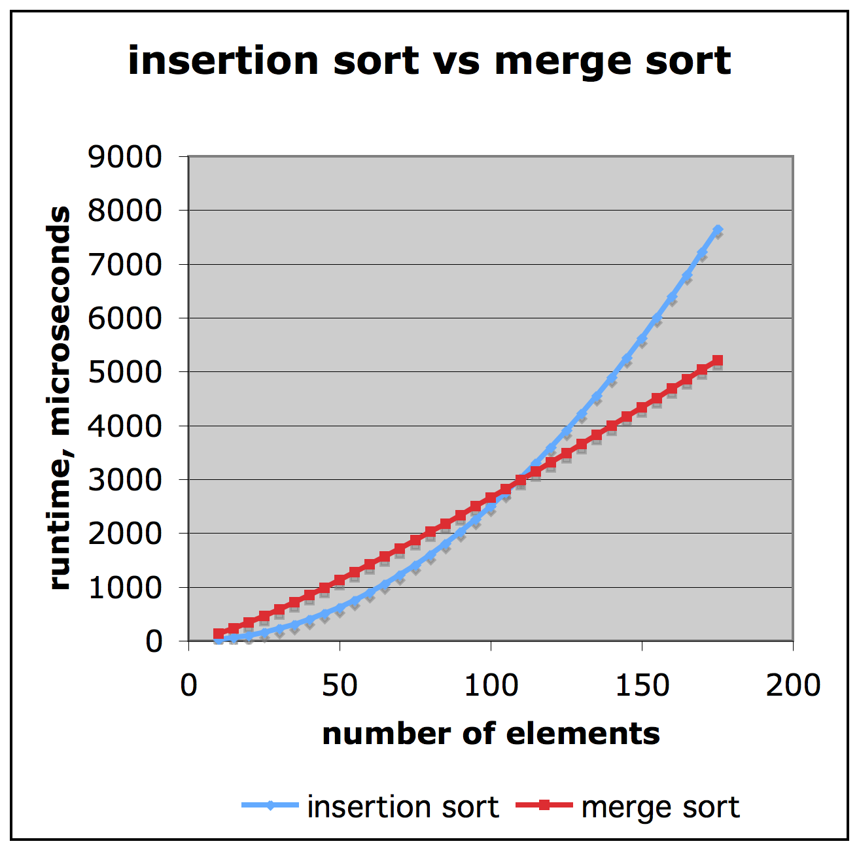
Comparison of Two Algorithms
Slide by Matt Stallmann included with permission.
insertion sort is
n² / 4
merge sort is
2 n lg n
sort a million items?
insertion sort takes
roughly 70 hours
while
merge sort takes
roughly 40 seconds
This is a slow machine, but if
100 x as fast then it’s 40 minutes
versus less than 0.5 seconds

Slide 21
Constant Factors
The growth rate is not affected by
constant factors or
lower-order terms
Examples
10²n + 10⁵ is a linear function
10⁵n² + 10⁸n is a quadratic function

Slide 22
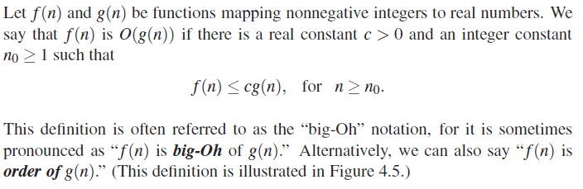
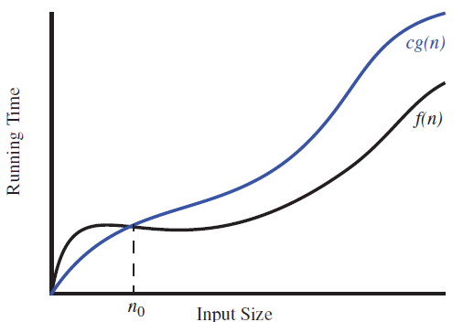
Big-Oh Notation

Slide 23
Big-Oh Notation
Given functions f(n) and g(n), we say that f(n) is O(g(n)) if there are positive constants c and n₀ such that
f(n) ≤ cg(n) for n ≥ n₀
Example: 2n + 10 is O(n)
2n + 10 ≤ cn
(c − 2) n ≥ 10
n ≥ 10/(c − 2)
Pick c = 3 and n₀ = 10

Slide 24
Big-Oh Example
Example: the function n² is not O(n)
n² ≤ cn
n ≤ c
The above inequality cannot be satisfied since c must be a constant

Slide 25
More Big-Oh Examples
7n-2
7n-2 is O(n)
need c > 0 and n₀ ≥ 1 such that 7n-2 ≤ c•n for n ≥ n₀
this is true for c = 7 and n₀ = 1
3n³ + 20n² + 5
3n³ + 20n² + 5 is O(n³)
need c > 0 and n₀ ≥ 1 such that 3n³ + 20n² + 5 ≤ c•n³ for n ≥ n₀
this is true for c = 4 and n₀ = 21
3 log n + 5
3 log n + 5 is O(log n)
need c > 0 and n₀ ≥ 1 such that 3 log n + 5 ≤ c•log n for n ≥ n₀
this is true for c = 8 and n₀ = 2

Slide 26
Big-Oh and Growth Rate
The big-Oh notation gives an upper bound on the growth rate of a function
The statement “f(n) is O(g(n))” means that the growth rate of f(n) is no more than the growth rate of g(n)
We can use the big-Oh notation to rank functions according to their growth rate
 | f(n) is O(g(n)) | g(n) is O(f(n))
g(n) grows more | Yes | No
f(n) grows more | No | Yes
Same growth | Yes | Yes

Slide 27
Big-Oh Rules
If is f(n) a polynomial of degree d, then f(n) is O(n^{d}), i.e.,
Drop lower-order terms
Drop constant factors
Use the smallest possible class of functions
Say “2n is O(n)” instead of “2n is O(n²)”
Use the simplest expression of the class
Say “3n + 5 is O(n)” instead of “3n + 5 is O(3n)”

Slide 28

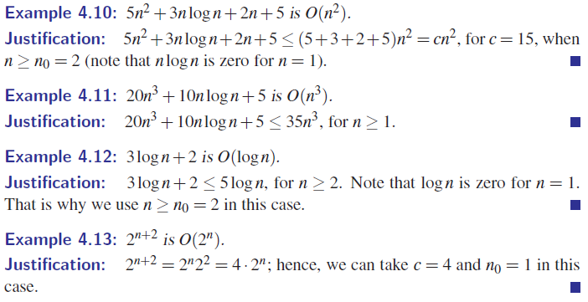
examples

Slide 29
Asymptotic Algorithm Analysis
The asymptotic analysis of an algorithm determines the running time in big-Oh notation
To perform the asymptotic analysis
We find the worst-case number of primitive operations executed as a function of the input size
We express this function with big-Oh notation
Example:
We determine that algorithm arrayMax executes at most 8n − 2 primitive operations
We say that algorithm arrayMax “runs in O(n) time”
Since constant factors and lower-order terms are eventually dropped anyhow, we can disregard them when counting primitive operations

Slide 30
Computing Prefix Averages
We further illustrate asymptotic analysis with two algorithms for prefix averages
The i-th prefix average of an array X is average of the first (i + 1) elements of X:
A[i] = (X[0] + X[1] + … + X[i])/(i+1)
Computing the array A of prefix averages of another array X has applications to financial analysis

Slide 31
Prefix Averages (Quadratic)
The following algorithm computes prefix averages in quadratic time by applying the definition
Algorithm prefixAverages1(X, n)
Input array X of n integers
Output array A of prefix averages of X #operations
A ← new array of n integers n
for i ← 0 to n − 1 do n
s ← X[0] n
for j ← 1 to i do 1 + 2 + …+ (n − 1)
s ← s + X[j] 1 + 2 + …+ (n − 1)
A[i] ← s / (i + 1) n
return A 1

Slide 32
Arithmetic Progression
The running time of prefixAverages1 is O(1 + 2 + …+ n)
The sum of the first n integers is n(n + 1) / 2
There is a simple visual proof of this fact
Thus, algorithm prefixAverages1 runs in O(n²) time

Slide 33
Prefix Averages (Linear)
The following algorithm computes prefix averages in linear time by keeping a running sum
Algorithm prefixAverages2(X, n)
Input array X of n integers
Output array A of prefix averages of X #operations
A ← new array of n integers n
s ← 0 1
for i ← 0 to n − 1 do n
s ← s + X[i] n
A[i] ← s / (i + 1) n
return A 1
Algorithm prefixAverages2 runs in O(n) time

Slide 34
Relatives of Big-Oh
big-Omega
f(n) is Ω(g(n)) if there is a constant c > 0
and an integer constant n₀ ≥ 1 such that
f(n) ≥ c•g(n) for n ≥ n₀
big-Theta
f(n) is Θ(g(n)) if there are constants c’ > 0 and c’’ > 0 and an integer constant n₀ ≥ 1 such that c’•g(n) ≤ f(n) ≤ c’’•g(n) for n ≥ n₀

Slide 35
Intuition for Asymptotic Notation
Big-Oh
f(n) is O(g(n)) if f(n) is asymptotically less than or equal to g(n)
big-Omega
f(n) is Ω(g(n)) if f(n) is asymptotically greater than or equal to g(n)
big-Theta
f(n) is Θ(g(n)) if f(n) is asymptotically equal to g(n)

