Slide 1
Stacks 2

Slide 2
Template (템플릿)
Templates allow functions and classes to operate with generic types (i.e., types to-be-specified-later).
Templates allow a function or class to work on many different data types without being rewritten for each one.
Function templates
Class templates

Slide 3
Function template
Overloading
Template
float funcAbs(float var) {
if (var < 0.0)
var = -var;
return var;
}
int funcAbs(int var) {
if (var < 0)
var = -var;
return var;
}
template<typename T>
T funcAbs2(T var) {
if (var < 0)
var = -var;
return var;
}

Slide 4
Class template
template<typename T>
class Data {
private:
T data;
public:
Data(T data) : data(data) {}
void ShowInfo() {
cout << data << endl;
}
};
클래스 정의 내부에서 구현 (i.e., 선언과 구현 동시) 할 경우

Slide 5
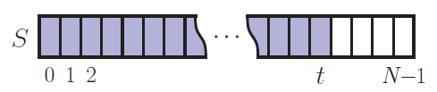
Array-based Stack in C++
template <typename E>
class ArrayStack {
private:
E* S; // array holding the stack
int cap; // capacity
int t; // index of top element
public:
// constructor given capacity
ArrayStack( int c) :
S(new E[c]), cap(c), t(-1) { }
void pop() {
if (empty()) throw StackEmpty
(“Pop from empty stack”);
t--;
}
void push(const E& e) {
if (size() == cap) throw
StackFull(“Push to full stack”);
S[++ t] = e;
}
… (other methods of Stack interface)

Slide 6
Array-based Stack
template <typename E>
class ArrayStack {
enum { DEF_CAPACITY = 100 }; // default stack capacity
public:
ArrayStack(int cap = DEF_CAPACITY); // constructor from capacity
int size() const; // number of items in the stack
bool empty() const; // is the stack empty?
const E& top() const throw(runtime_error); // get the top element
void push(const E& e) throw(runtime_error); // push element onto stack
void pop() throw(runtime_error); // pop the stack
private: // member data
E* S; // array of stack elements
int capacity; // stack capacity
int t; // index of the top of the stack
};

Slide 7
Array-based Stack
template <typename E> ArrayStack<E>::ArrayStack(int cap)
: S(new E[cap]), capacity(cap), t(-1) { } // constructor from capacity
template <typename E> int ArrayStack<E>::size() const
{
return (t + 1);
} // number of items in the stack
template <typename E> bool ArrayStack<E>::empty() const
{
return (t < 0);
} // is the stack empty?

Slide 8
Array-based Stack
template <typename E> // return top of stack
const E& ArrayStack<E>::top() const throw(runtime_error) {
if (empty()) throw runtime_error("Top of empty stack");
return S[t];
}
template <typename E> // push element onto the stack
void ArrayStack<E>::push(const E& e) throw(runtime_error) {
if (size() == capacity) throw runtime_error("Push to full stack");
S[++t] = e;
}
template <typename E> // pop the stack
void ArrayStack<E>::pop() throw(runtime_error) {
if (empty()) throw runtime_error("Pop from empty stack");
--t;
}

Slide 9
Example use in C++
* indicates top
ArrayStack<int> A; // A = [ ], size = 0
A.push(7); // A = [7*], size = 1
A.push(13); // A = [7, 13*], size = 2
cout << A.top() << endl; A.pop(); // A = [7*], outputs: 13
A.push(9); // A = [7, 9*], size = 2
cout << A.top() << endl; // A = [7, 9*], outputs: 9
cout << A.top() << endl; A.pop(); // A = [7*], outputs: 9
ArrayStack<string> B(10); // B = [ ], size = 0
B.push("Bob"); // B = [Bob*], size = 1
B.push("Alice"); // B = [Bob, Alice*], size = 2
cout << B.top() << endl; B.pop(); // B = [Bob*], outputs: Alice
B.push("Eve"); // B = [Bob, Eve*], size = 2

Slide 10
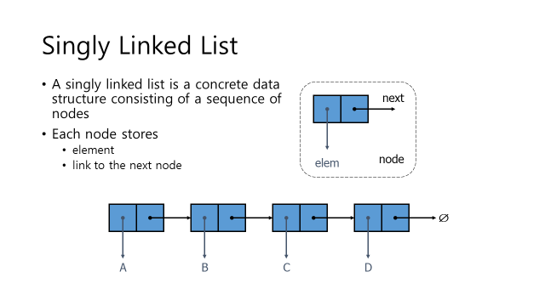
Linked List based Stack
uses a singly-linked list

Slide 11
Generic Singly Linked List - Node
template <typename E>
class SNode { // singly linked list node
private:
E elem; // linked list element value
SNode<E>* next; // next item in the list
friend class SLinkedList<E>; // provide SLinkedList access
};

Slide 12
Generic Singly Linked List
template <typename E>
class SLinkedList
{
public:
SLinkedList(); // empty list constructor
~SLinkedList(); // destructor
bool empty() const; // is list empty?
const E& front() const; // return front element
void addFront(const E& e); // add to front of list
void removeFront(); // remove front item list
private:
SNode<E>* head;
};

Slide 13
Generic Singly Linked List
template <typename E>
SLinkedList<E>::SLinkedList() // constructor
: head(NULL) { }
template <typename E>
SLinkedList<E>::~SLinkedList() // destructor
{
while (!empty()) removeFront();
}
template <typename E>
bool SLinkedList<E>::empty() const // is list empty?
{
return head == NULL;
}

Slide 14
Generic Singly Linked List
template <typename E>
const E& SLinkedList<E>::front() const // return front element
{
return head->elem;
}
template <typename E>
void SLinkedList<E>::addFront(const E& e) { // add to front of list
SNode<E>* v = new SNode<E>; // create new node
v->elem = e; // store data
v->next = head; // head now follows v
head = v; // v is now the head
}
template <typename E>
void SLinkedList<E>::removeFront() { // remove front item
SNode<E>* old = head; // save current head
head = old->next; // skip over old head
delete old; // delete the old head
}

Slide 15
Linked List based Stack – class 선언부
typedef string Elem; // stack element type
class LinkedStack { // stack as a linked list
public:
LinkedStack(); // constructor
int size() const; // number of items in the stack
bool empty() const; // is the stack empty?
const Elem& top() const throw(runtime_error); // the top element
void push(const Elem& e); // push element onto stack
void pop() throw(runtime_error); // pop the stack
private: // member data
SLinkedList<Elem> S; // linked list of elements
int n; // number of elements
};

Slide 16
Linked List based Stack
LinkedStack::LinkedStack()
: S(), n(0) { } // constructor
int LinkedStack::size() const { return n; }// number of items in the stack
bool LinkedStack::empty() const { return n == 0; } // is the stack empty?

Slide 17
Linked List based Stack
// get the top element
const Elem& LinkedStack::top() const throw(runtime_error) {
if (empty()) throw runtime_error("Top of empty stack");
return S.front();
}
void LinkedStack::push(const Elem& e) { // push element onto stack
++n;
S.addFront(e);
}
// pop the stack
void LinkedStack::pop() throw(runtime_error) {
if (empty()) throw runtime_error("Pop from empty stack");
--n;
S.removeFront();
}

Slide 18
Reversing a Vector using a Stack
template<typename T>
void reverse(vector<T>& V) {
ArrayStack<T> S(V.size());
for (int i = 0; i < V.size(); i++)
S.push(V[i]);
for (int i = 0; i < V.size(); i++) {
V[i] = S.top();
S.pop();
}
}

Slide 19
Thank you!

