Slide 1
Queues 02

Slide 2
Topics
Stack and Queue as a Linked List
Circularly Linked List (환형 링크드 리스트)
Circularly Linked List based Queue

Slide 3
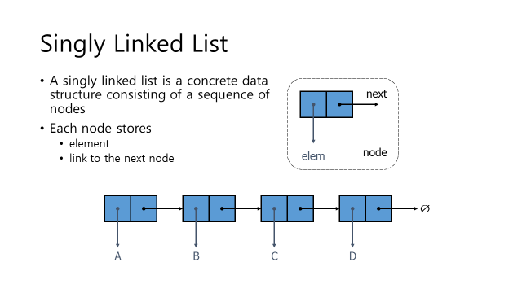
Singly Linked List review
class StringLinkedList {// a linked list of strings
public:
StringLinkedList();// empty list constructor
~StringLinkedList();// destructor
bool empty() const;// is list empty?
const string& front() const;// get front element
void addFront(const string& e);// add to front of list
void removeFront();// remove front item list
private:
StringNode* head;// pointer to the head of list
};

Slide 4
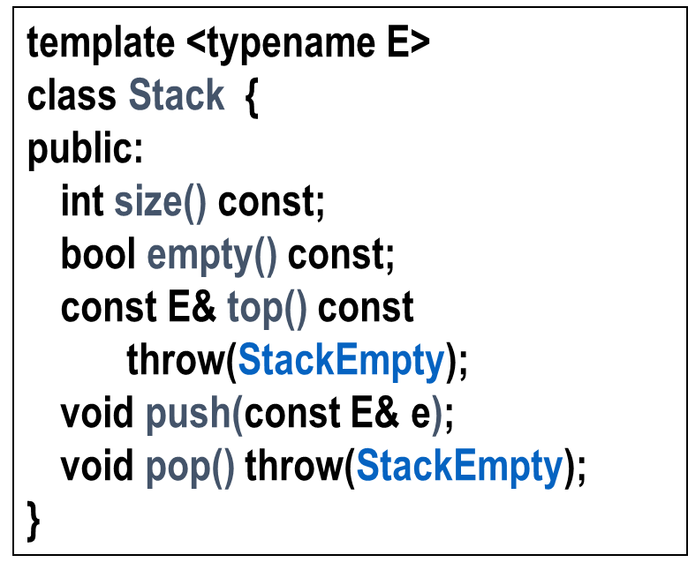
Stack as a Linked List (§ 5.1.3)
We can implement a stack with a singly linked list
The top element is stored at the first node of the list
The space used is O(n) and each operation of the Stack ADT takes O(1) time
nodes
(head)
(tail)
t
∅
elements

Slide 5
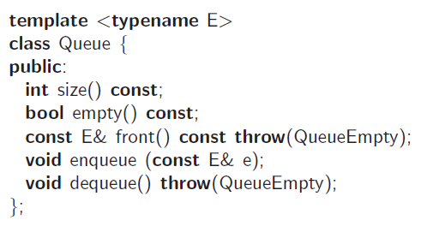
Queue as a Linked List
We can implement a queue with a singly linked list
The front element is stored at the first node
The rear element is stored at the last node
The space used is O(n) and each operation of the Queue ADT takes O(1) time
r
nodes
f
∅
elements

Slide 6
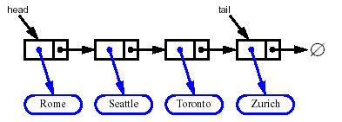
Removing at the Tail
Removing at the tail of a singly linked list is not efficient!
There is no constant-time way to update the tail to point to the previous node

Slide 7
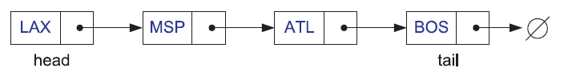
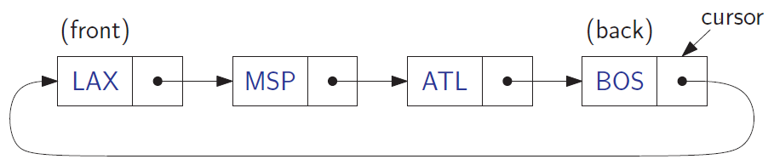
Circularly Linked List

Slide 8
Circularly Linked List

Slide 9
Circularly Linked List

Slide 10
Node of Circularly Linked List – e.g., string
typedef string Elem; // element type
class CNode { // circularly linked list node
private:
Elem elem; // linked list element value
CNode* next; // next item in the list
friend class CircleList; // provide CircleList access
};

Slide 11
Circularly Linked List Class
class CircleList { // a circularly linked list
public:
CircleList(); // constructor
~CircleList(); // destructor
bool empty() const; // is list empty?
const Elem& front() const; // element at cursor
const Elem& back() const; // element following cursor
void advance(); // advance cursor
void add(const Elem& e); // add after cursor
void remove(); // remove node after cursor
private:
CNode* cursor; // the cursor
};

Slide 12
Constructor and Destructor
CircleList::CircleList() // constructor
: cursor(NULL) { }
CircleList::~CircleList() // destructor
{
while (!empty()) remove();
}

Slide 13
Simple member functions
bool CircleList::empty() const // is list empty?
{
return cursor == NULL;
}
const Elem& CircleList::back() const // element at cursor
{
return cursor->elem;
}
const Elem& CircleList::front() const // element following cursor
{
return cursor->next->elem;
}
void CircleList::advance() // advance cursor
{
cursor = cursor->next;
}

Slide 14
Insertion
void CircleList::add(const Elem& e) { // add after cursor
CNode* v = new CNode; // create a new node
v->elem = e;
if (cursor == NULL) { // list is empty?
v->next = v; // v points to itself
cursor = v; // cursor points to v
}
else { // list is nonempty?
v->next = cursor->next; // link in v after cursor
cursor->next = v;
}
}

Slide 15
Removal
void CircleList::remove() { // remove node after cursor
CNode* old = cursor->next; // the node being removed
if (old == cursor) // removing the only node?
cursor = NULL; // list is now empty
else
cursor->next = old->next; // link out the old node
delete old; // delete the old node
}

Slide 16
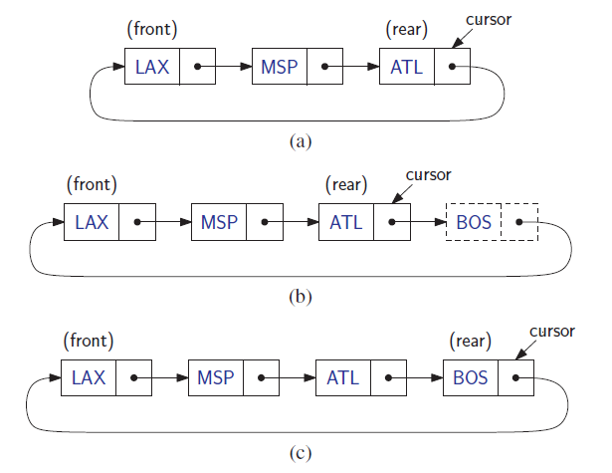
Queue with a Circularly Linked List - enqueue

Slide 17
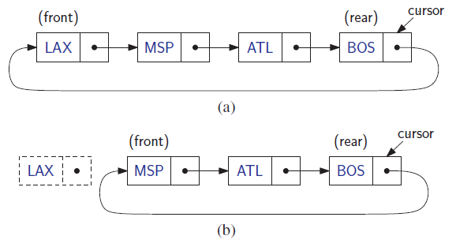
Queue with a Circularly Linked List - denqueue

Slide 18
LinkedQueue
typedef string Elem; // queue element type
class LinkedQueue { // queue as doubly linked list
public:
LinkedQueue(); // constructor
int size() const; // number of items in the queue
bool empty() const; // is the queue empty?
const Elem& front() const throw(QueueEmpty); // the front element
void enqueue(const Elem& e); // enqueue element at rear
void dequeue() throw(QueueEmpty); // dequeue element at front
private: // member data
CircleList C; // circular list of elements
int n; // number of elements
};

Slide 19
Constructor and Accessors
LinkedQueue::LinkedQueue() // constructor
: C(), n(0) { }
int LinkedQueue::size() const // number of items in the queue
{
return n;
}
bool LinkedQueue::empty() const // is the queue empty?
{
return n == 0;
}
// get the front element
const Elem& LinkedQueue::front() const throw(QueueEmpty) {
if (empty())
throw QueueEmpty("front of empty queue");
return C.front(); // list front is queue front
}

Slide 20
Enqueue and Dequeue
// enqueue element at rear
void LinkedQueue::enqueue(const Elem& e) {
C.add(e); // insert after cursor
C.advance(); // ...and advance
n++;
}
// dequeue element at front
void LinkedQueue::dequeue() throw(QueueEmpty) {
if (empty())
throw QueueEmpty("dequeue of empty queue");
C.remove(); // remove from list front
n--;
}

