Slide 1
Array Lists

Slide 2
The Array List ADT
The Vector or Array List ADT extends the notion of array by storing a sequence of objects
An element can be accessed, inserted or removed by specifying its index (number of elements preceding it)
An exception is thrown if an incorrect index is given (e.g., a negative index)
Main methods:
at(integer i): returns the element at index i without removing it
set(integer i, object o): replace the element at index i with o
insert(integer i, object o): insert a new element o to have index i
erase(integer i): removes element at index i
Additional methods:
size()
empty()

Slide 3
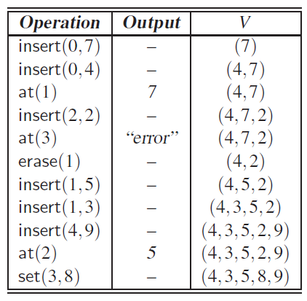
Example of Array List (Vector) ADT operations

Slide 4
Array-based Implementation
Use an array A of size N
A variable n keeps track of the size of the array list (number of elements stored)
Operation at(i) is implemented in O(1) time by returning A[i]
Operation set(i,o) is implemented in O(1) time by performing A[i] = o
A
0
1
2
i
n

Slide 5
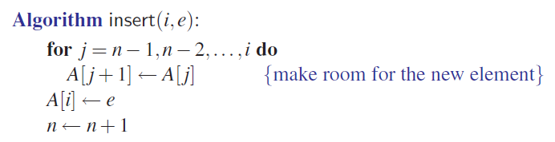

Slide 6
Insertion
In operation insert(i, o), we need to make room for the new element by shifting forward the n − i elements A[i], …, A[n − 1]
In the worst case (i = 0), this takes O(n) time
A
0
1
2
i
n
A
0
1
2
i
n
A
o
0
1
2
i
n

Slide 7
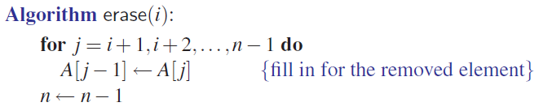
Element Removal
In operation erase(i), we need to fill the hole left by the removed element by shifting backward the n − i − 1 elements A[i + 1], …, A[n − 1]
In the worst case (i = 0), this takes O(n) time
A
o
0
1
2
i
n
A
0
1
2
i
n
A
0
1
2
i
n

Slide 8
Performance
In the array based implementation of an array list:
The space used by the data structure is O(n)
size, empty, at and set run in O(1) time
insert and erase run in O(n) time in worst case
If we use the array in a circular fashion, operations insert(0, x) and erase(0, x) run in O(1) time
In an insert operation, when the array is full, instead of throwing an exception, we can replace the array with a larger one

Slide 9
Growable Array-based Array List
In an insert(o) operation (without an index), we always insert at the end
When the array is full, we replace the array with a larger one
How large should the new array be?
Incremental strategy: increase the size by a constant c
Doubling strategy: double the size
Algorithm insert(o)
if t = S.length − 1 then
A ← new array of
size …
for i ← 0 to n−1 do
A[i] ← S[i]
S ← A
n ← n + 1
S[n−1] ← o

Slide 10
Comparison of the Strategies
We compare the incremental strategy and the doubling strategy by analyzing the total time T(n) needed to perform a series of n insert(o) operations
We assume that we start with an empty stack represented by an array of size 1
We call amortized time of an insert operation the average time taken by an insert over the series of operations, i.e., T(n)/n

Slide 11
Incremental Strategy Analysis
We replace the array k = n/c times
The total time T(n) of a series of n insert operations is proportional to
n + c + 2c + 3c + 4c + … + kc =
n + c(1 + 2 + 3 + … + k) =
n + ck(k + 1)/2
Since c is a constant, T(n) is O(n + k²), i.e., O(n²)
The amortized time of an insert operation is O(n)

Slide 12
Doubling Strategy Analysis
We replace the array k = log₂ n times
The total time T(n) of a series of n insert operations is proportional to
n + 1 + 2 + 4 + 8 + …+ 2^{k} = n + 2^{k + 1} − 1 =
3n − 1
T(n) is O(n)
The amortized time of an insert operation is O(1)
geometric series
2
4
1
1
8

