Slide 1
Airbnb RESTful API

Slide 2
Whoami
Herlianto
ilham Junius

Slide 3
Agenda
Product Description
Software Design
Technology Stack
Code Quality
Workflow & Collaboration
Deployment
Team Challanges

Slide 4
Airbnb RESTful API
Jadikan Kamar Kosong Anda Lebih Berharga

Slide 5
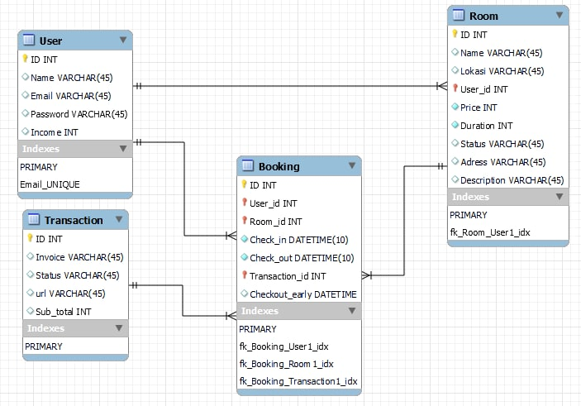
ERD

Slide 6
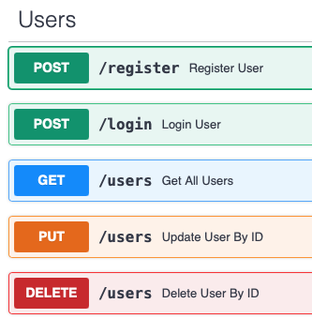
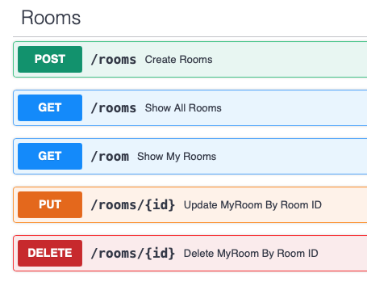
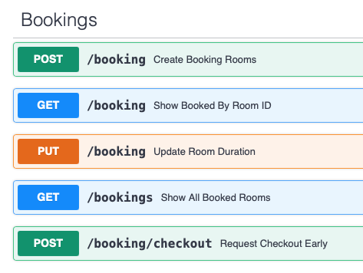
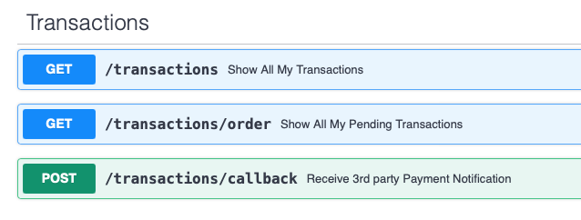
ENDPOINT

Slide 7
Technology Stack
Deployment
Backend
Collaboration
Payment Partner

Slide 8
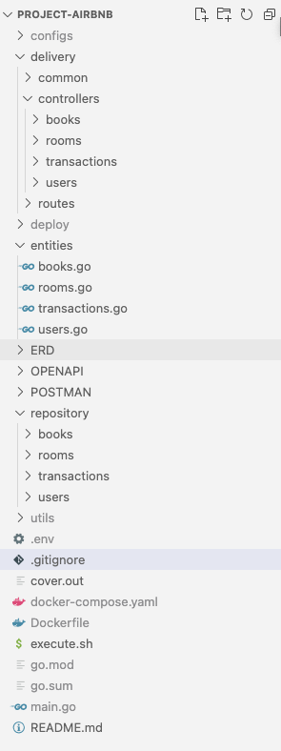
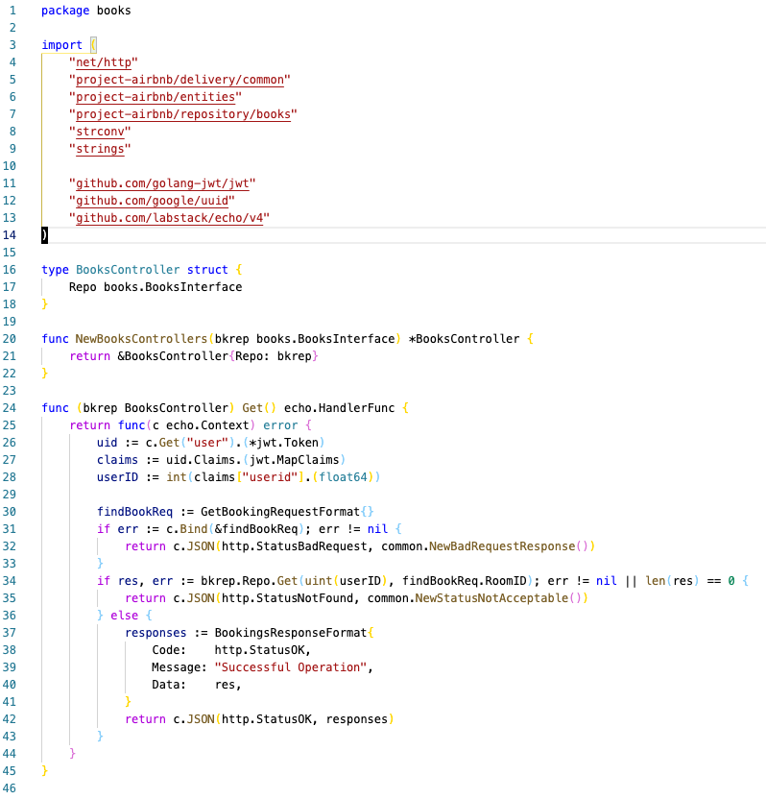
Code Quality

Slide 9
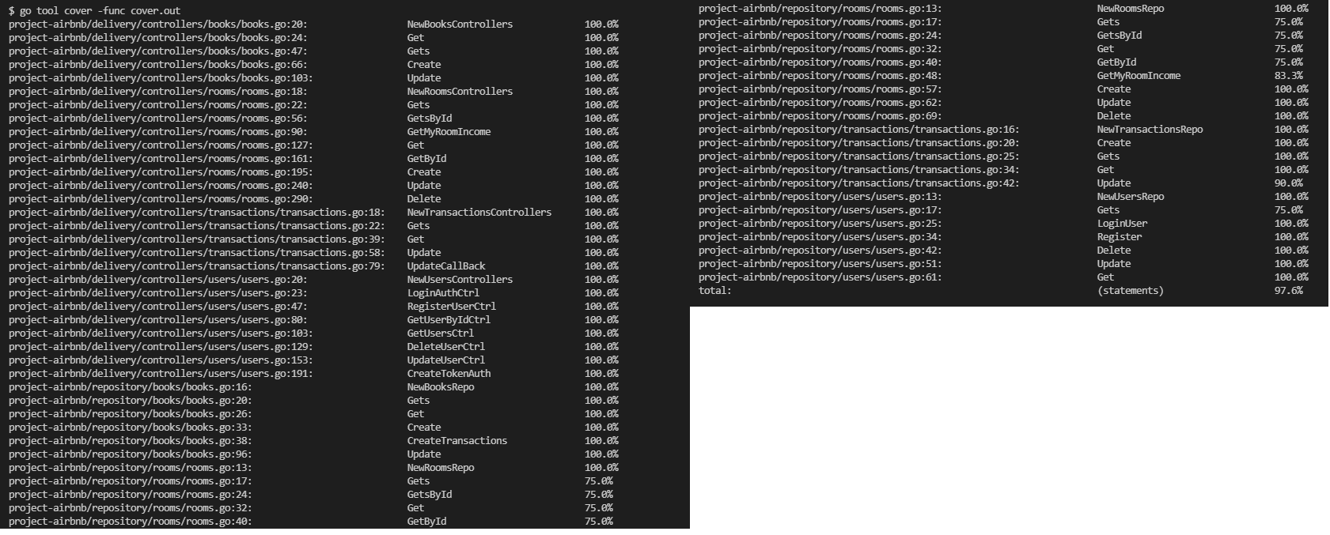
ALMOST 98% COVERAGE

Slide 10
Workflow

Slide 11
OUR PLANNING

Slide 12
TEAM CHALLENGES
Internet problem
new feature request need time to understand
deployment problem ( 1 team member got banned from AWS)
power failure
reach 100% coverage on test unit

Slide 13
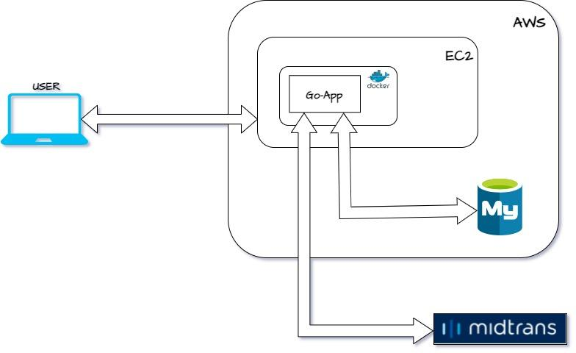
High Level Architecture

