Slide 1


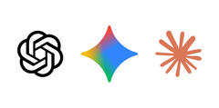

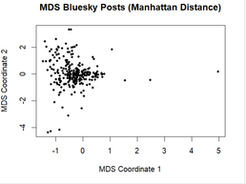

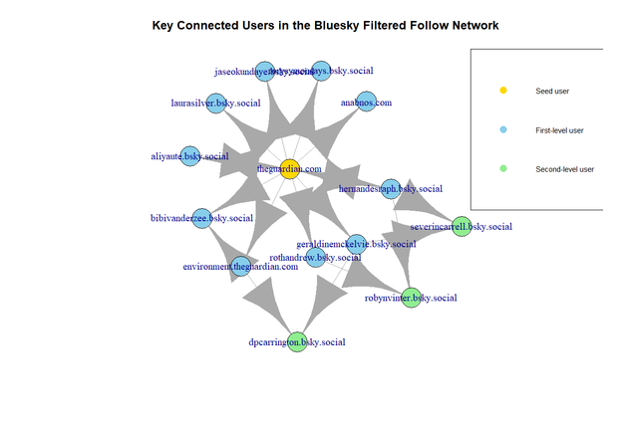
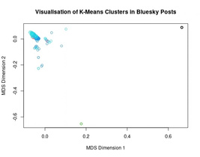
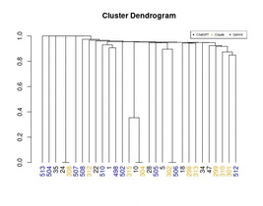
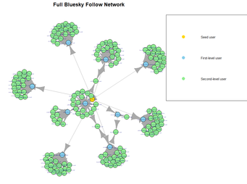
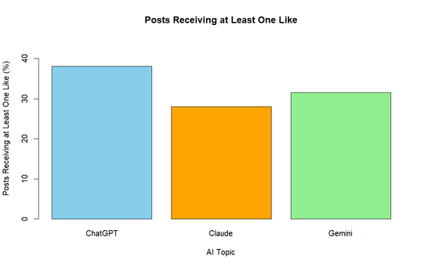
Generative AI Discussions on Bluesky
Group 19 • Tim Carino - Arend Chandra - Yat Cheng • COMP3020
Aim:
Investigate how generative AI is discussed on Bluesky through engagement, text content, clustering and user-network structure.
Text/Content Analysis & Visualisation
What words and themes are most prominent in Bluesky discussions about generative AI?
Data Collection
Bluesky via atrrr
• ChatGPT: 297 posts
• Claude AI: 200 posts
• Google Gemini: 200 posts
• 697 posts total
Non-Weighted Word Frequency: (Top 20 Decreasing Order)
googl, use, code, model, read, anthrop, can, like, say, just, ask, openai, work, know, make, data, bill, percent, agent, help.
TF-IDF Weighted Word Frequency: (Top 20 Decreasing Order)
opensubstackcompubthebulwa, read, googl, percent, bylin, discount, fell, bill, use, code, applenewsaacblbqqui, incroy, japanaicojpmedia, huh, olhardigitalcombri, source, anthrop, watch, say, artificialintellig.
Data preparation
Posts were combined into a text corpus and cleaned by removing URLs, numbers, punctuation, English stop words, AI topic names and additional unwanted words, then converted to lowercase and stemmed.
Manhattan Multi Dimensional Scaling revealed points to be pushed towards the left of the visualisation. This suggests that posts discussing AI share similar words and language.
Clustering
Can generative-AI posts be grouped into meaningful clusters based on similarities in their textual content?
Network analysis
Which users are the most structurally important within a Bluesky follow network surrounding generative-AI discussions?
Using K-Means Clustering, 323 Sampled Posts were separated into 5 clusters.
The clustering contained 5 clusters, 3 of them very close together.
The graph shows some degree of separation, but not clear enough to be distinct groups.
Using Hierarchical (Single) Clustering, 10 Posts from each topic (ChatGPT, Claude, Gemini) were selected and were grouped into 32 clusters by similarity.
The Dendrogram suggests meaningful clusters are difficult to find due to many posts being merged at very high distances to each other.
The sampled Bluesky follow network contained 177 users and 182 directed edges, with a low density of 0.0058, indicating a sparse network. bibivanderzee.bsky.social had the highest degree centrality (22), while theguardian.com had the highest closeness and betweenness centrality (323). Overall, most users had relatively few connections, while a small number of accounts occupied more structurally important positions.
From both methods of clustering it is indicated that meaningful groups aren’t formed clearly despite some degree of separation as only a very small amount of posts were clearly separated while others cannot be grouped based on textual similarity alone.
The full network is sparse and branch-like, with most users having few connections and a small number linking the wider network together.
Hypothesis testing
Is receiving at least one like independent of the generative-AI topic being discussed (ChatGPT, Claude AI or Google Gemini)?
Hypotheses:
H0: AI topic and receiving at least one like are independent.
HA: AI topic and receiving at least one like are associated.
A chi-squared test of independence was used to compare AI topic with whether a post received at least one like. The test produced χ² = 5.84 with a simulated p-value ≈ 0.058.
Finding:
Because p > 0.05, we fail to reject H₀. There was insufficient evidence that receiving at least one like was associated with the AI topic discussed.
ChatGPT had the highest observed engagement rate (38.0%), followed by Gemini (31.5%) and Claude (28.0%). However, these differences were not statistically significant.

