Slide 1
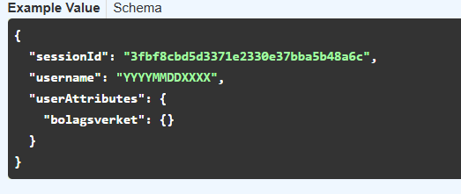
Bank id
eID API Documentation grandid.login

Slide 2
Rate limit:
Fixas via Azure api managment
<policies>
<inbound>
<base />
<rate-limit-by-key
calls="10"
renewal-period="60"
counter-key="@(context.Request.Url.Query.GetValueOrDefault("personnr",""))" />
</inbound>
<backend>
<base />
</backend>
<outbound>
<base />
</outbound>
<on-error>
<base />
</on-error>
</policies>

Slide 3
Access
Function nivå, dvs det subscribas på i azure

