Slide 1
Incorporating Statistical Software Into the Classroom
Demonstration of R
Kelly Fitzpatrick, CFA
Assistant Professor of Mathematics
County College of Morris
Kfitzpatrick@ccm.edu

Slide 2
Global Objective
“The ability to take data- to be able to understand it, to process it, to extract it, to visualize it, to communicate it- that’s going to be a hugely important skill in the next decades, not only at the professional level but even at the education level for elementary school kids, for high school kids, for college kids. Because now we really do have essentially free and ubiquitous data. So the complimentary scarce factor is the ability to understand that data and extract value for it.” Hal Varian, professor at University of California at Berkeley and Chief Economist for Google

Slide 3
Mathematics Department Objective
The Department of Mathematics at the County College of Morris will fully integrate the use of statistical software into their statistics courses by Fall 2014.
The use of statistical software will enhance the education of our students and prepare them for both the professional world and/or their future educational goals.

Slide 4
Will Technology Change the Classroom?
Thomas Edison believed the motion picture would change education in the traditional classroom setting and eliminate the need for books. (1913)
Will our students learn more?

Slide 5
5 Reasons to use R
You can control large data sets with one identifier
You have control over formatting and design
Open source code
Bring numbers/concepts to life for your students
Computer programming is a desired skill
http://www.r-project.org/

Slide 6
3 Fiscal Reasons to use R
FREE for the Students
FREE for the Professors
FREE for the College
http://www.r-project.org/

Slide 7
Why Corporations use R
R has less reporting requirements to the FDA
Analysis is reproducible
Analysis is faster
http://www.r-project.org/

Slide 8

Resources for Training
Book: Data Analysis and Graphics using R- An Example-Based Approach
Authors: John Maindonald and John Braun
https://www.codeschool.com/courses#all
https://www.coursera.org/course/rprog Hosted by: John Hopkins University
R has build in tutorials

Slide 9
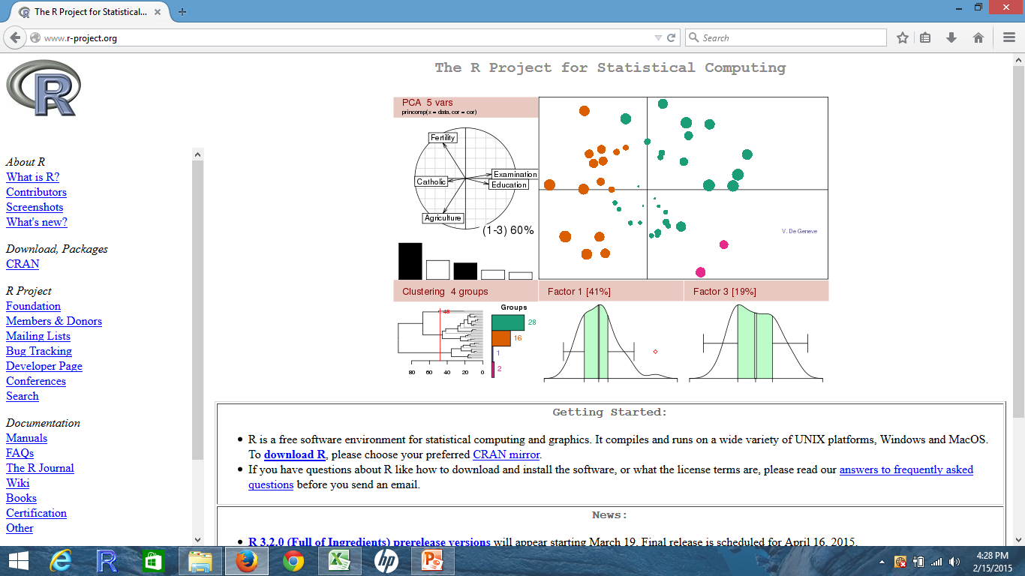

Slide 10
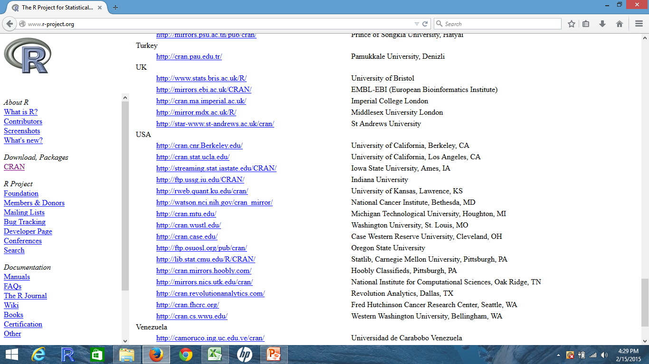

Slide 11
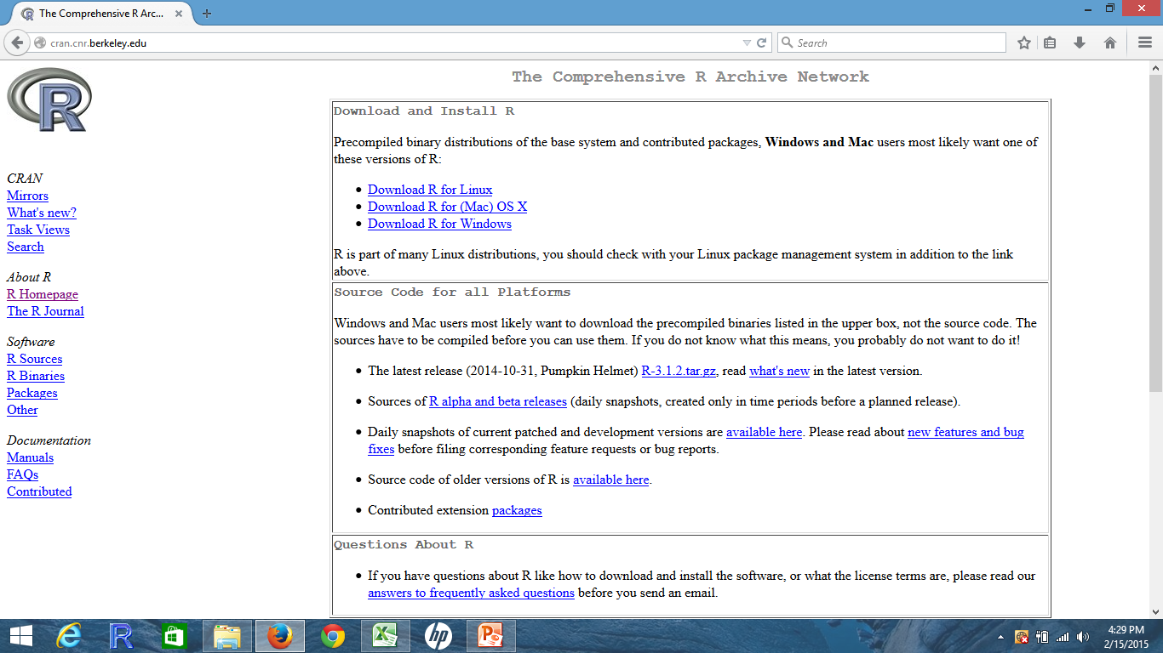

Slide 12
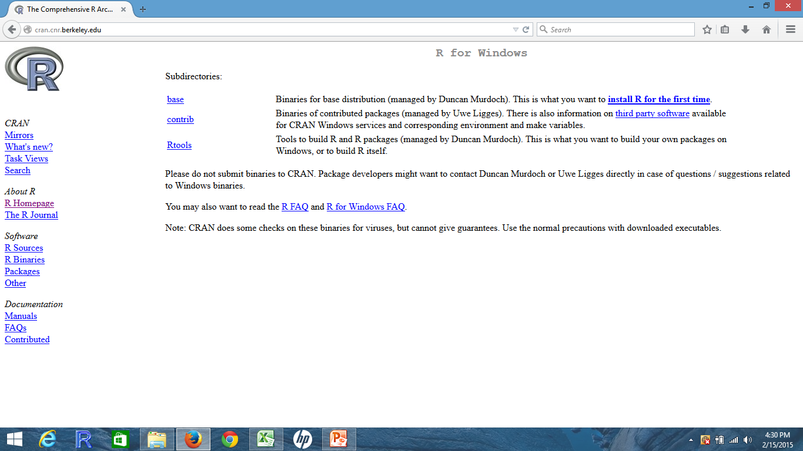

Slide 13
Pick 5 numbers between 1 to 100
{3,10, 24, 29, 33}

Slide 14
Your students will pick their:
Birthday (kids, parents, loved ones)
Age (kids, parents, loved ones)
Lucky Numbers
Sports Players Number/ Sports Records
Phone Number, House or Address Numbers
R Code Random Number Generation
choose(100,5)
SRS<-sort(sample(1:100,5,replace=FALSE))
library(gtools)
outcomes<-combinations(n=20,r=5,v=1:20,repeats=TRUE)

Slide 15

Sports Statistics
Baseball statistics correlation analysis- Output from R
R Code:
data <- read.csv(“C:/file path.csv")
BaseballCorrMatrix<-cor(data[2:8])
write.csv(BaseballCorrMatrix, file =“C:/path.csv”)

Slide 16
Graphs in R Snowfall in New York City- Stem and Leaf Plots
R Code:
title=“Snowfall in NY City 1990 to 2013”
data=c(25,13,25,53,12,76,10,6,13,16,35,4,49,43,41,40,12,12,28,51,62,7,26,57)
stem(data,scale=2)
0 | 467
1 | 0222336
2 | 5568
3 | 5
4 | 0139
5 | 137
6 | 2
7 | 6

Slide 17
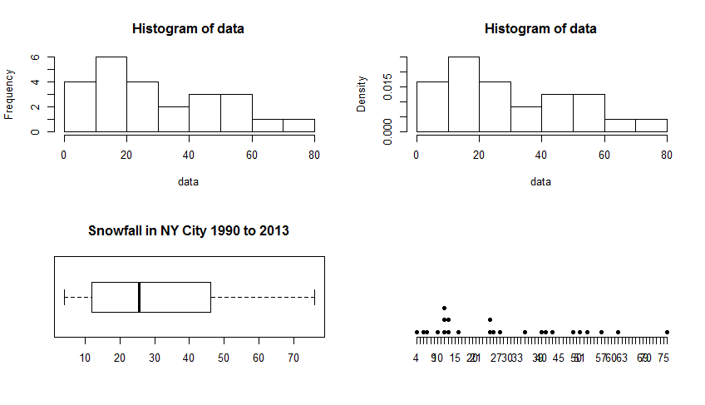
Graphs in R Code:
par(mfrow=c(2,2))
hist(data,breaks=10)
hist(data,breaks=10,prob=TRUE)
boxplot(data, horizontal=TRUE,main=title)
stripchart(data, method = "stack",pch=19, offset = 1, frame.plot = FALSE, at = .05)

Slide 18
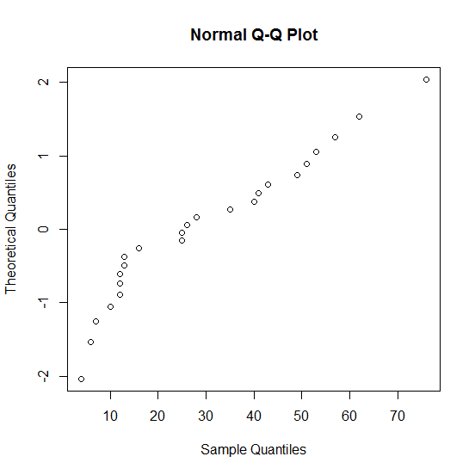
Normality Plots in R Snowfall in New York City
R code:
qqnorm(data, datax=TRUE)

Slide 19
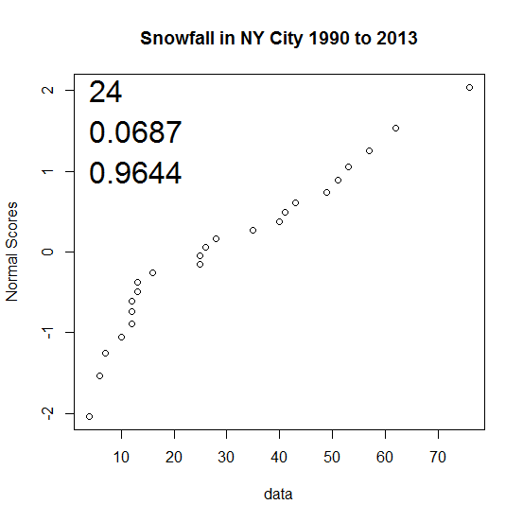
Customized Normality Plot in R
NS<-qnorm(ppoints(length(data)))
correl<-round(cor(sort(data),NS),digits=4)
plot(sort(data),NS, main=title ,xlab="data", ylab="Normal Scores")
text(min(data),1,correl, adj = 0,cex=2)
text(min(data),1.5,round(shapiro.test(data)$p.value,5),adj=0, cex=2 )
text(min(data),2,length(data), adj = 0, cex= 2)
Ho = Data is ND
Ha = Data is not ND
α = .10 | α = .05 | α = .01
0.966 | 0.957 | 0.938
Not ND | Yes ND | Yes ND
Critical Value Test:
If R calculated > cv data is ND
Shapiro Test:
If the p-value < α, the data is not ND

Slide 20
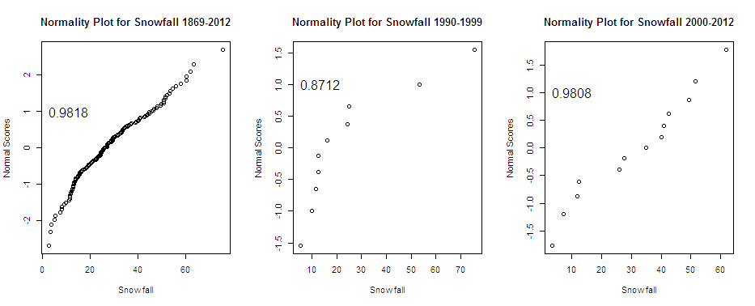
Looking at Normality Plots for different time periods
Not ND at α = .10, .05, .01
Not ND at α = .10, .05 or .01
Yes ND at α = .10, .05 or .01

Slide 21
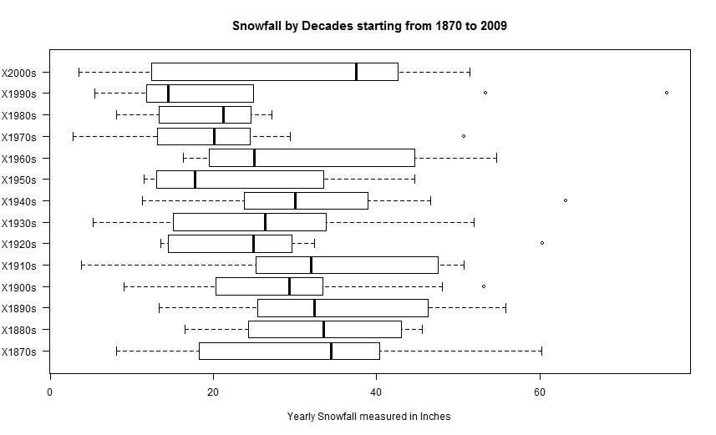
Looking at Boxplots for different time periods

Slide 22
Hypothesis Testing in R
Determine at a 5% significance level if the average snowfall from 1990 to 2013 is different then the historical average (1869 -1989) of 28 inches a year.
R Code for Student’s T-test:
t.test(data, alternative = c("two.sided"), mu = 28, conf.level = 0.95)
One Sample t-test
t = 0.4394, df = 23, p-value = 0.6645
alternative hypothesis: true mean is not equal to 28
95 percent confidence interval:
21.20134 38.46532
sample estimates:
mean of x
29.83333
If the p-value < alpha reject the Null .6645>.05 Do Not Reject the Null
Conclude: The average yearly snowfall from 1990 to 2013 is not different from the historical mean.

Slide 23
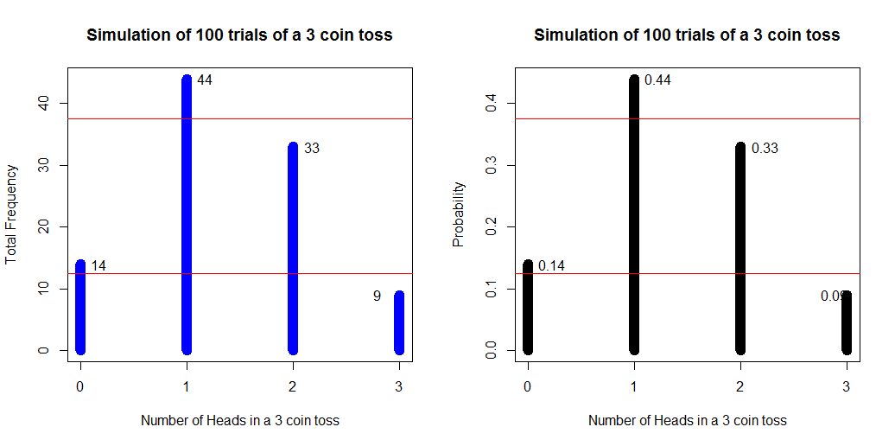
n= 100 | Classical/Theoretical | Theoretical | Simulated | Empirical/Simulation
P(E) | Probability | Frequency | Frequency | Probability
P(0) | 0.125 | 12.5 | 14 | 0.14
P(1) | 0.375 | 37.5 | 44 | 0.44
P(2) | 0.375 | 37.5 | 33 | 0.33
P(3) | 0.125 | 12.5 | 9 | 0.09

