Slide 1
Web Programming #2 HTML
Herman Kabetta, M.T.
hermanka.github.io

Slide 2
Introduction HTML
HTML stands for HyperText Markup Language.
HTML is the skeleton of all web pages. It’s often the first language learned by marketers and designers and is core to front-end development work.
HTML provides structure to the content appearing on a website, such as images, text, or videos. Right-click on any page on the internet, choose “Inspect,” and you’ll see HTML in a panel of your screen.
You can layer HTML with CSS and JavaScript to create visually compelling and dynamic websites

Slide 3
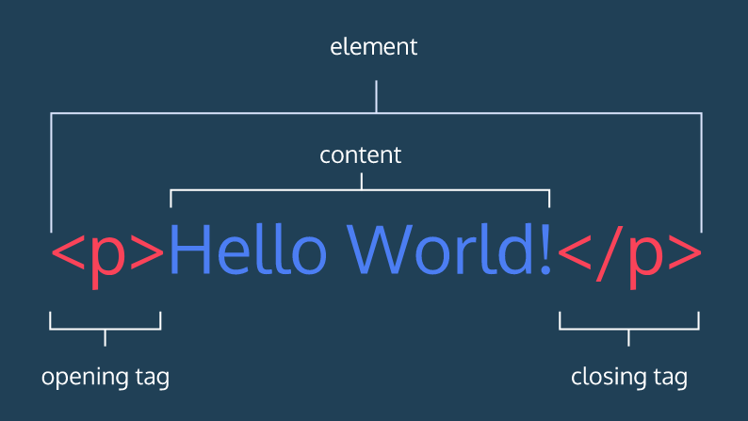
HTML Anatomy
More tags :
https://w3schools.com/tags/

Slide 4
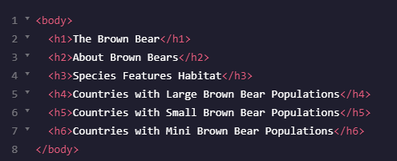
Headings

Slide 5
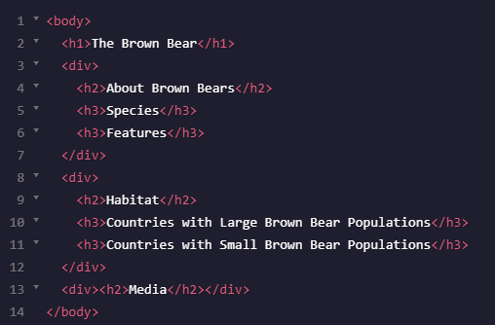
Division

Slide 6
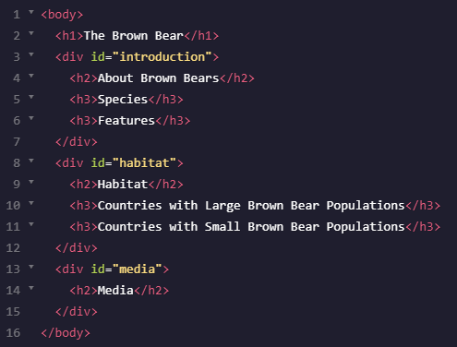
Attributes
Attribute Name
Attribute Value
More attrbutes :
https://developer.mozilla.org/en-US/docs/Web/HTML/Attributes

Slide 7
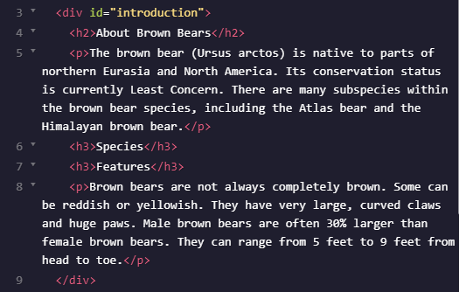
Paragraph

Slide 8
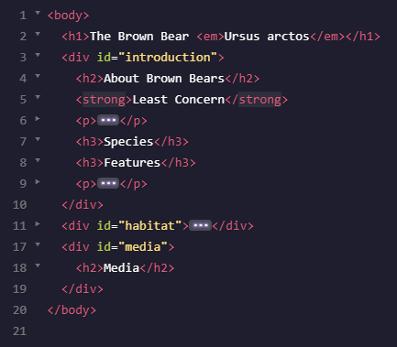
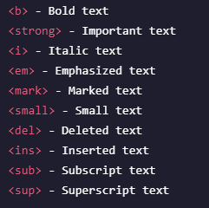
Styling & Formatting Text

Slide 9
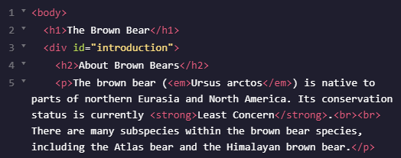
Line Breaks

Slide 10
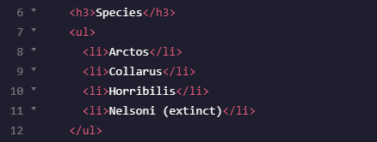
Unordered Lists

Slide 11
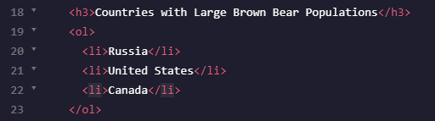
Ordered Lists

Slide 12
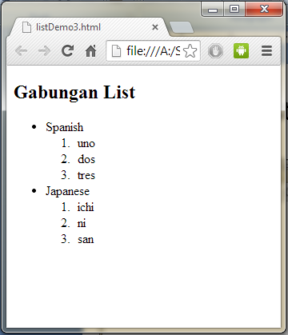
Lists Exercise

Slide 13

Images

Slide 14
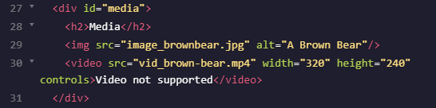
Videos

Slide 15
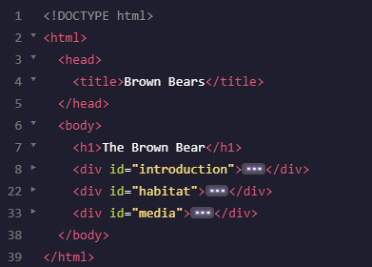
HTML Standards

Slide 16

Linking Another Websites

Slide 17

Linking Pages

Slide 18
Link Exercise
Bagaimana cara membuat sebuah gambar menjadi link yang dapat di klik.

Slide 19

Comments

Slide 20
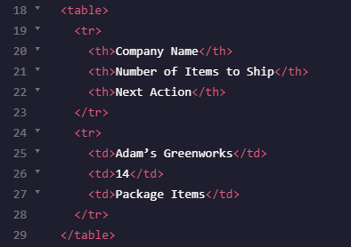
Tables

Slide 21
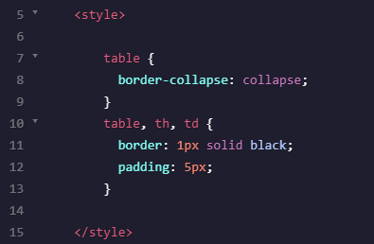
Styling Tables
place inside <head>

Slide 22
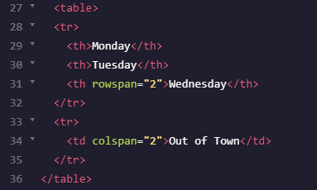

Spanning Rows & Cols

Slide 23

Spanning Rows & Cols - Exercise

Slide 24
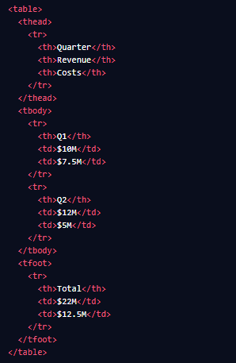
Table Head, Body, Foot

Slide 25
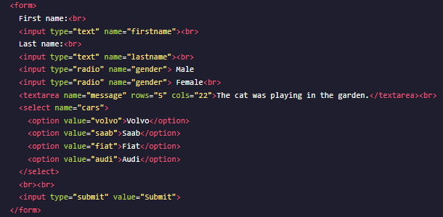
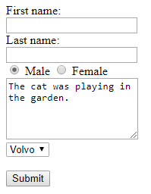
Forms

Slide 26
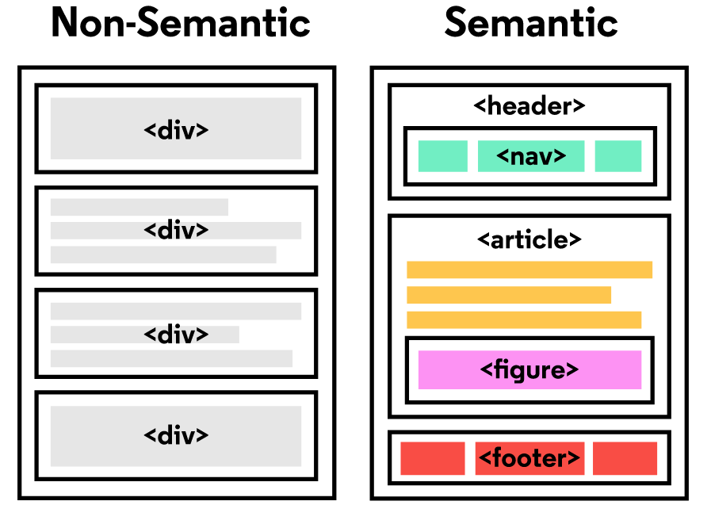
Semantic HTML
The word semantic means “relating to meaning,”
so semantic elements provide information about the content
between the opening and closing tags.

Slide 27
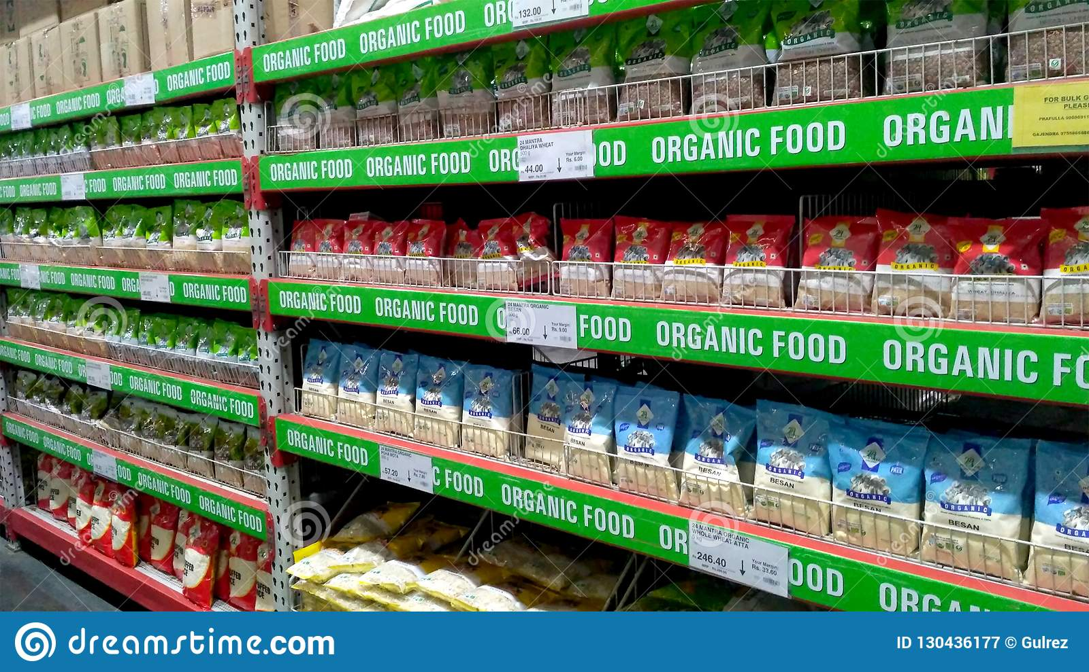
Semantic HTML
Why use Semantic HTML?
Accessibility: Semantic HTML makes webpages accessible for mobile devices and for people with disabilities as well. This is because screen readers and browsers are able to interpret the code better.
SEO: It improves the website SEO, or Search Engine Optimization, which is the process of increasing the number of people that visit your webpage. With better SEO, search engines are better able to identify the content of your website and weight the most important content appropriately.
Easy to Understand: Semantic HTML also makes the website’s source code easier to read for other web developers.

Slide 28
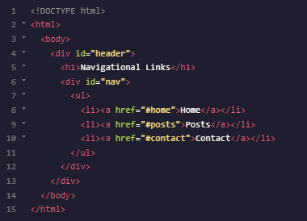
Semantic HTML: Header & Nav
<header>
<nav>

Slide 29
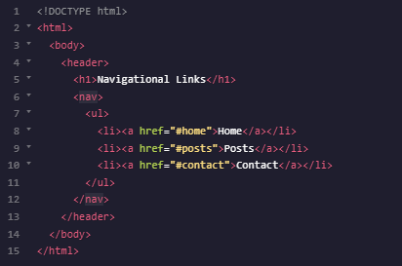
Semantic HTML: Header & Nav

Slide 30
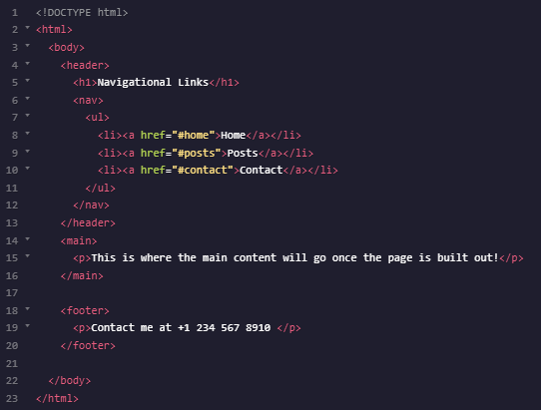
Semantic HTML: Main & Footer

Slide 31
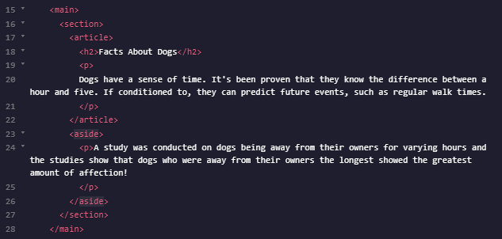
Semantic HTML: Section, Article & Aside

Slide 32

Semantic HTML: Figure

