Slide 1

Human Gut Microbiome Viewed Across Age and Geograpy
T. Yatsunenko, F. E. Rey, M. Manari et al.
Hermann Pauly

Slide 2
Reminder: original results
Introduction
Methods
Results
Discussion
Intrapersonal diversity increases with age
Children develop adult microbiome in first three years
Populations can be discriminated by compositon
Functional differences based on age, origin
Heritability low

Slide 3
Methods applied
Introduction
Methods
Results
Discussion
Notes:
Sequencer here: 12x multiplexed, 220GB of data
split: demultiplexing by keeping barcode labels for samples => seperated samples
picking: search for known microorganisms in database, assign taxonomy
rarefaction: randomly sample subsets => get species richness
Now duck, I'm going to throw bullet points at you

Slide 4
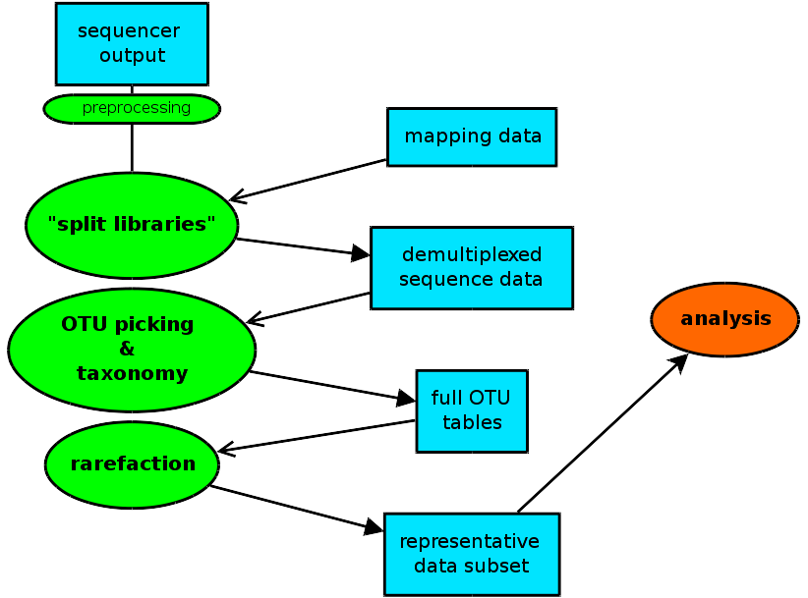
Processing: qiime workflow
Introduction
Methods
Results
Discussion
Notes:
Sequencer here: 12x multiplexed, 220GB of data
split: demultiplexing by keeping barcode labels for samples => seperated samples
picking: search for known microorganisms in database, assign taxonomy
rarefaction: randomly sample subsets => get species richness
Now duck, I'm going to throw bullet points at you

Slide 5
Metadata file
Statistical analysis
Introduction
Methods
Results
Discussion
Not provided
Extracted from supplementary data
R 3.1.0
Package cluster
Challenge: picking of groups
Heavy use of metadata file
Notes:
Sequencer here: 12x multiplexed, 220GB of data
split: demultiplexing by keeping barcode labels for samples => seperated samples
picking: search for known microorganisms in database, assign taxonomy
rarefaction: randomly sample subsets => get species richness

Slide 6
Results of reproduction
Introduction
Methods
Results
Discussion
Notes:
Measure: number of observed OTUs
OTU: group unknown micro-organisms, genetic similarity (here: 97%)

Slide 7
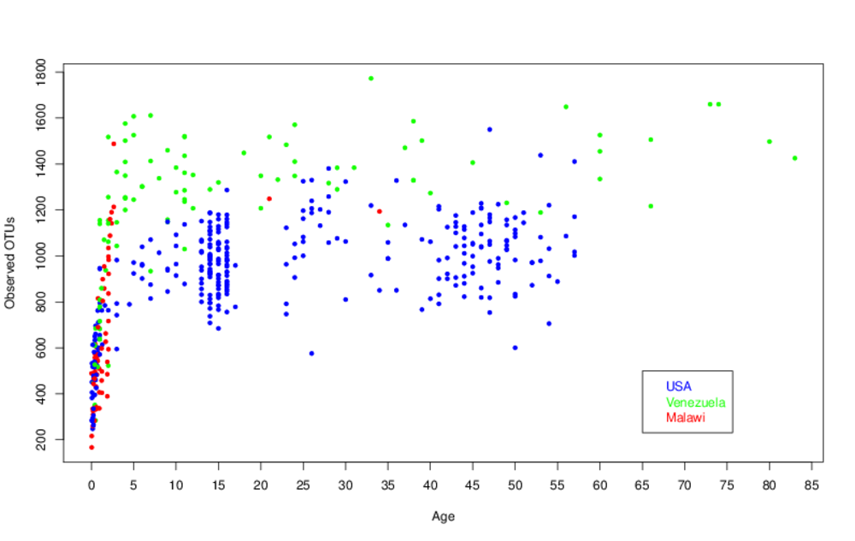
Bacterial diversity with age
Introduction
Methods
Results
Discussion
Notes:
Measure: number of observed OTUs
OTU: group unknown micro-organisms, genetic similarity (here: 97%)

Slide 8
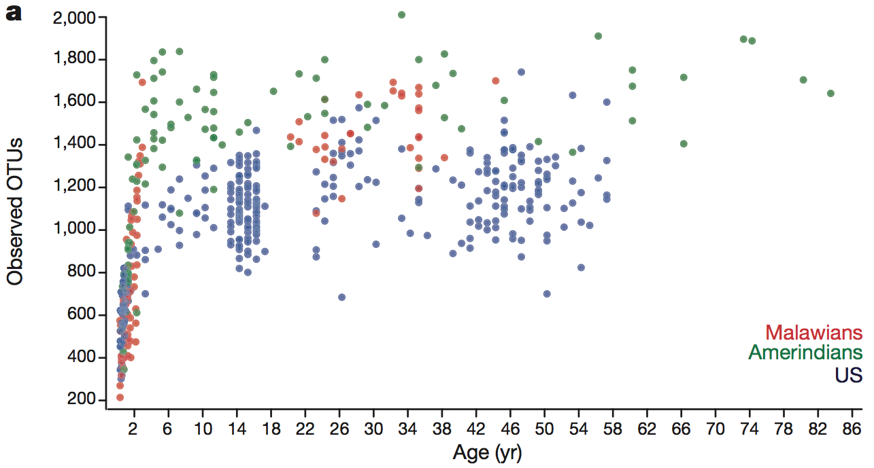
Bacterial diversity with age
Introduction
Methods
Results
Discussion
Measure: number of observed OTUs
Mode: OTUs vs age
Result: close match, but what happened to the Malawians?
Notes:
Random processes in rarefaction
=> very good match

Slide 9
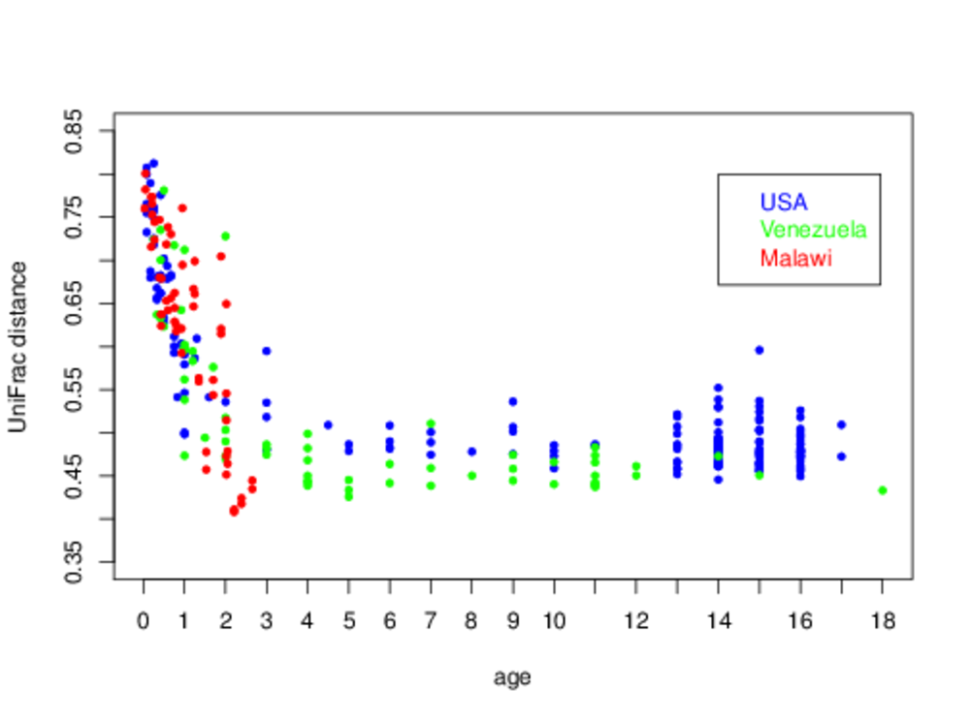
Development towards adult composition
Introduction
Methods
Results
Discussion
Notes:
Measure: UniFrac distance
fraction of shared brances on phylogeny tree
Plotted: „each child versus all adults of same country“
No exact description
=> guess: each child vs mean of adults

Slide 10
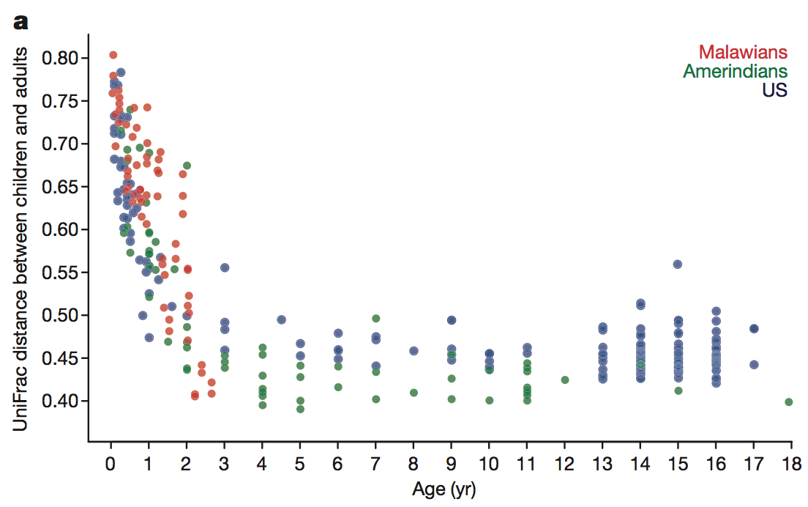
Development towards adult composition
Introduction
Methods
Results
Discussion
Measure:
UniFrac distance
Mode:
each child vs all adults of same country
Result:
virtually identical
Notes:
Random processes in rarefaction
=> very good match

Slide 11
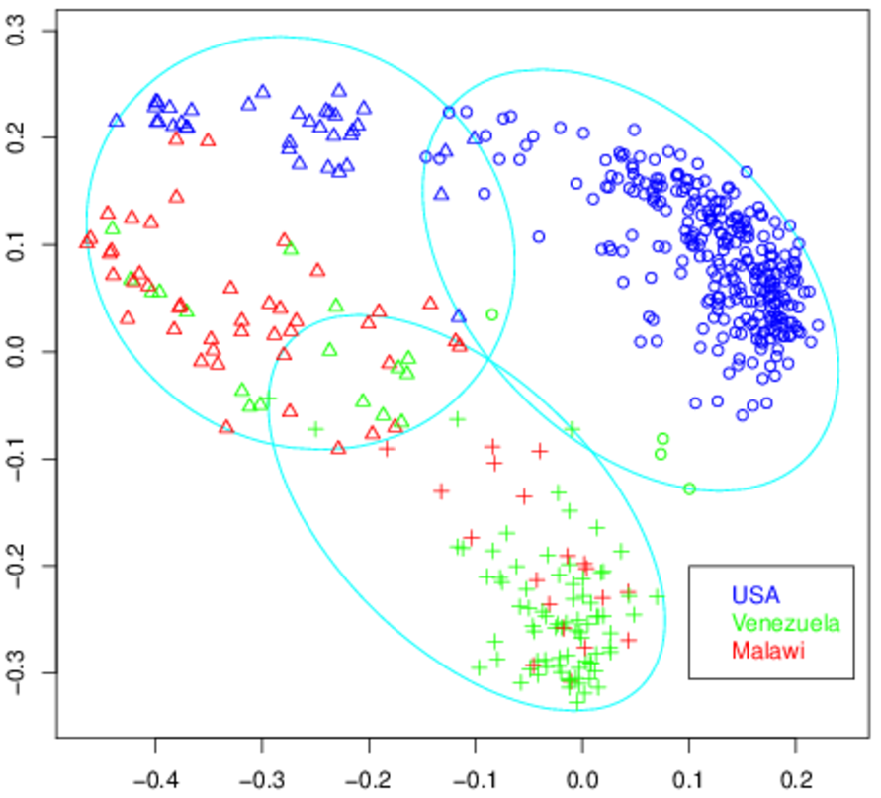
PCoA analysis
Introduction
Methods
Results
Discussion
Notes:
principal coordinates: virtual measures from multidimensional data, for clustering
method: Partitioning Around Medoid (pam)
here: symbols --> cluster, color --> origin
clustering: Random Forest stronger?
again: random sampling (rarefaction), random starting points (pam)

Slide 12
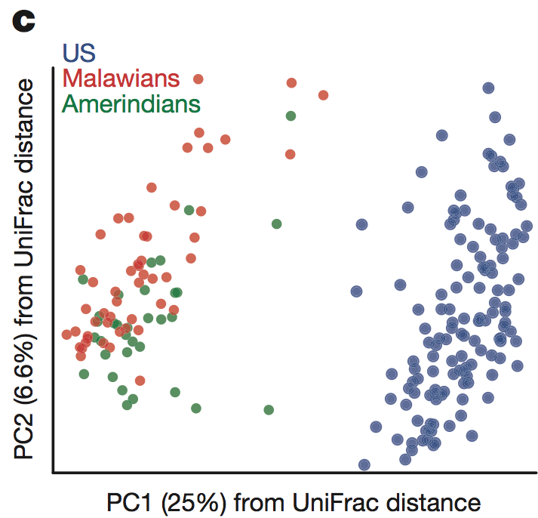
PCoA analysis
Introduction
Methods
Results
Discussion
Measure: UniFrac distane
Contingency table analysis: 84.1% correct
Visually: Difference to USA even stronger
Improved clustering possible?
Notes:
clustering: Random Forest stronger?
again: random sampling (rarefaction), random starting points (pam)

Slide 13
Discussion and outlook
Introduction
Methods
Results
Discussion

Slide 14
Problems encountered
Introduction
Methods
Results
Discussion

Slide 15
Acknowledgements

