Slide 1
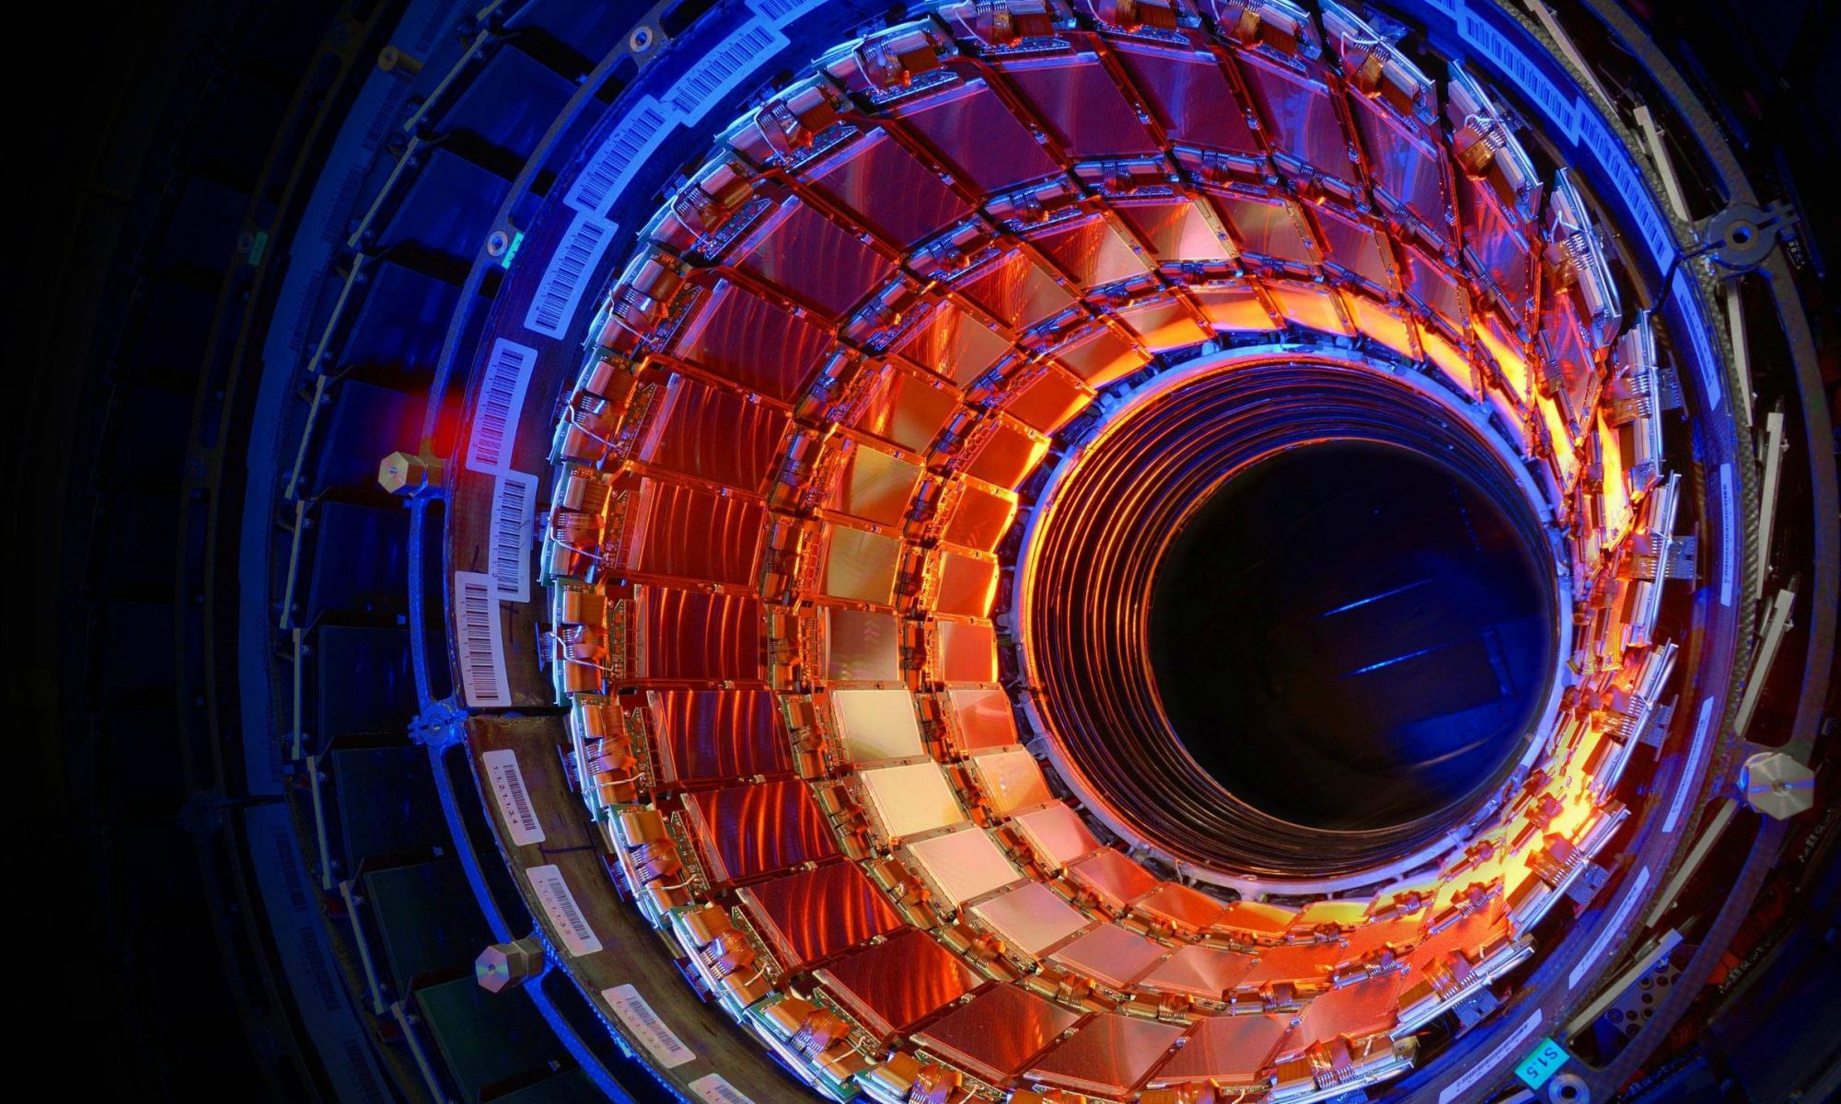
‘A Brief History of Time’
Stephen Hawking
Hermann Käbi
Tallinn Secondary School of Science
2021

Slide 2
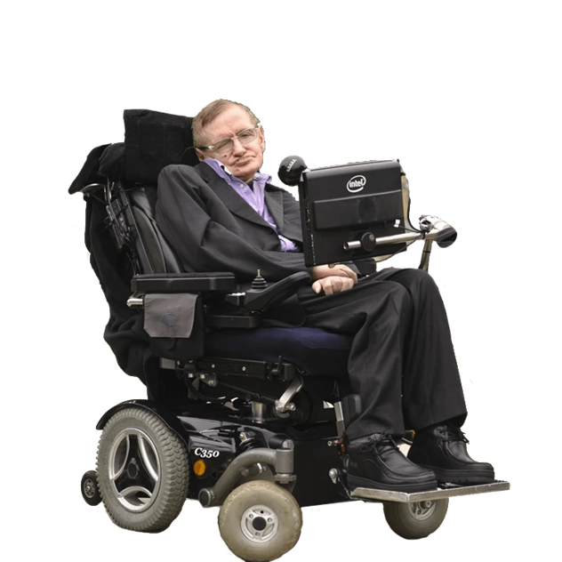
About the author
Dr Stephen William Hawking (1942-2018)
Englist astrophysicist, theoretical scientist and author
Black holes, Hawking radiation, information paradox
Fundamental Physics Prize in 2013
A Brief History of Time (1988), The Universe in a Nutshell (2001)
The Theory of Everything (2014)
Fig. 1. Stephen Hawking
Notes:
8 January 1942 – 14 March 2018

Slide 3
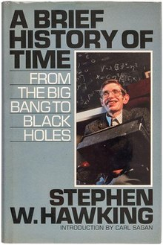
A Brief History of Time
Published in 1988
Over 25 million copies sold
Written for the general public
Discusses complex physical topics
Fig. 2. A Brief History of Time
Notes:
What topics? Black holes, arrows of time, imaginary time, Hawking radiation, quantum physics including the uncertainty principle

Slide 4
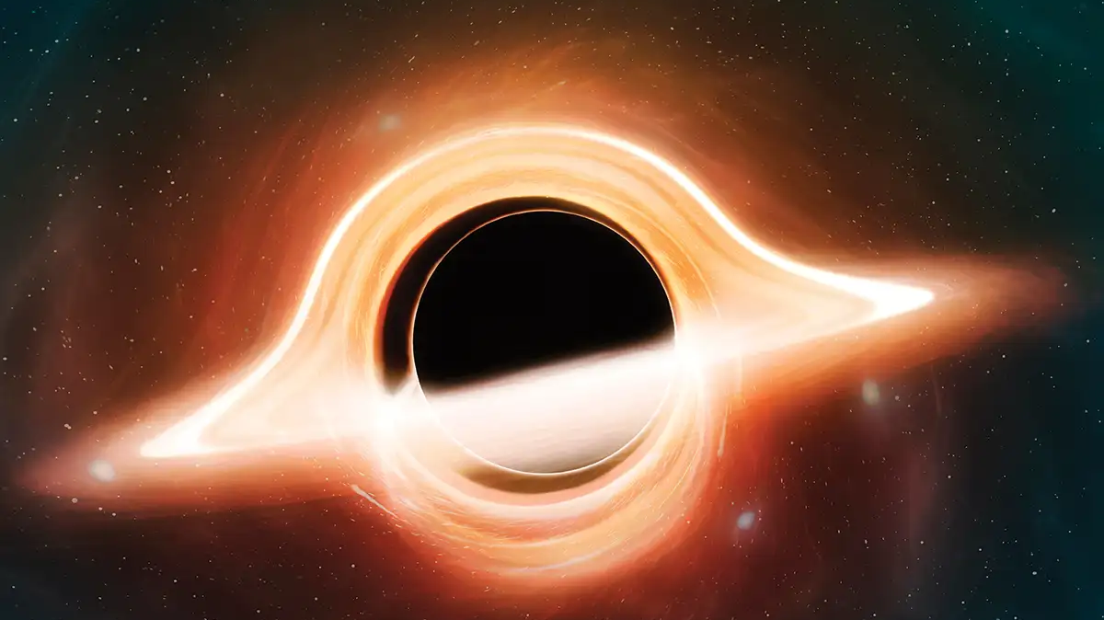
A brief summary
Divided into 12 dependent chapters
History of physics
Einstein’s relativity theories
Heisenberg’s uncertainty principle
Elementary particles
Black holes
The origin and fate of the universe
Theory of everything/GUT
Essays of physicists
Fig 3. Black hole

Slide 5
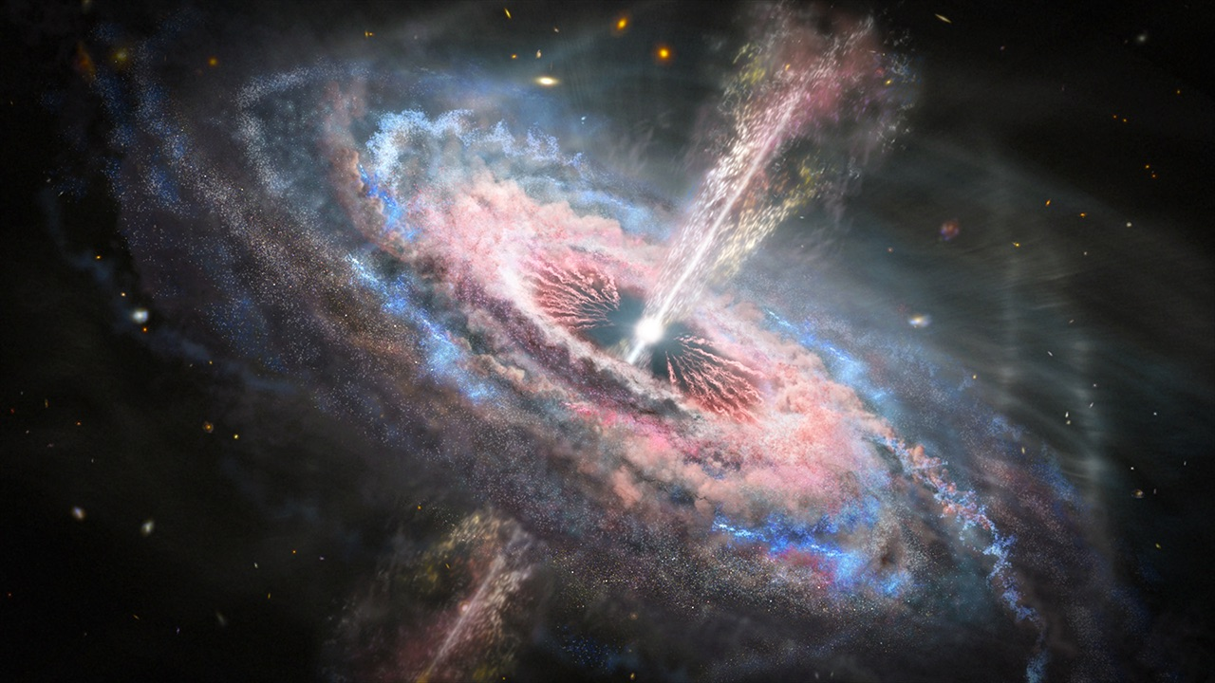
Main purpose of the book
Explain how far we have come in our understanding of the universe
Reminder of how important logical thinking is
Explain the concepts of the universe
Fig 4. Quasar

Slide 6

Changing the world
Stephen Hawking
Invaluable contributions to science
Inspiration not to give up
Popularising science among children
A Brief History of Time
Sunday Times bestseller list
Changed people’s interest in physics
Fig 5. Signature
Notes:
It was in the Sunday Times bestseller list for 237 weeks
With Lucy Hawking, he wrote the George series

Slide 7
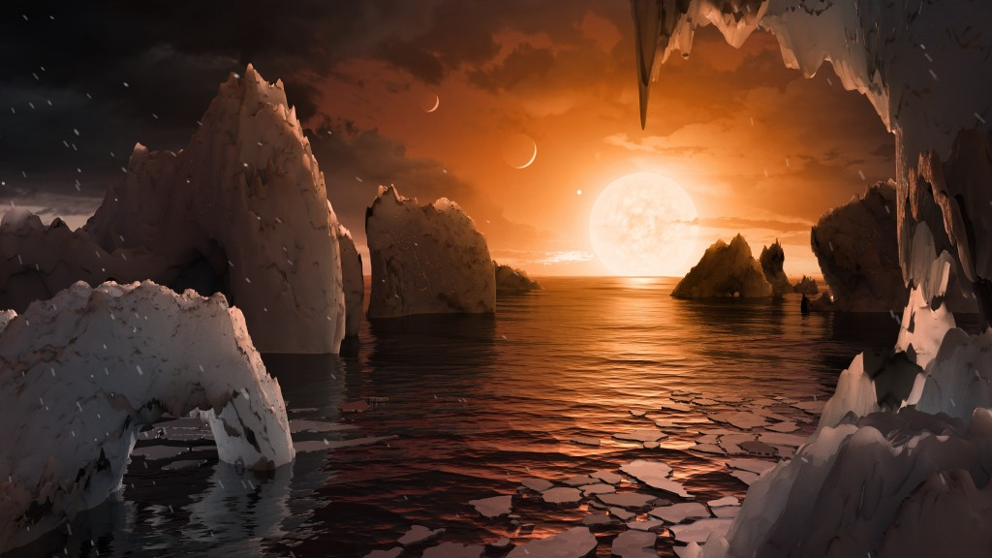
Conclusion
My thoughts on the book
Recommendation
Fig 6. TRAPPIST-1 system
Notes:
Thoughts: Really interesting, quite difficult to understand, great ideas and concept
Recommendation: Recommend for especially physics-lovers

Slide 8
Used content
Wikipedia (2021) A Brief History of Time. [Fig. 1, Fig. 2] . Viewed: https://en.wikipedia.org/wiki/A_Brief_History_of_Time
David Nield (2021) A 'Black Hole Laser' Could Finally Shine a Light on Elusive Hawking Radiation. [Fig. 3]. Viewed: https://www.sciencealert.com/this-black-hole-laser-could-be-what-we-need-to-study-an-elusive-type-of-radiation
Amit Malewar (2021) Unlocking the secrets of the early universe using quasars. [Fig. 4]. Viewed: https://www.techexplorist.com/unlocking-secrets-early-universe-using-quasars/39782/
Wikipedia (2021) Stephen Hawking. [Fig. 5] . Viewed: https://en.wikipedia.org/wiki/Stephen_Hawking
SPACE.com (2017) What Would Life Be Like on the TRAPPIST-1 Planets? [Fig. 6]. Viewed: https://www.space.com/35811-life-on-trappist-1-earth-like-exoplanets.html

Slide 9
Thanks for listening!

