Slide 1
Investment Strategies to Mitigate Sequence of Return Risk Sponsor: T. Rowe Price November 29th, 2018 Massachusetts Institute of Technology
Chen Fan, Ellie Liu, Haocheng Tang, Jonathan Martinez, Rachel Chen, Viktor Hermann

Slide 2
question posed
Many Defined Contribution Plan investors use a Target Date Fund as their primary investment strategy. These strategies are designed to de-risk into retirement in order to mitigate SORR. Your goal is to propose ways to improve upon glidepath strategy in order to mitigate SORR. What is the mechanism by which your proposed strategy further addresses SORR? Which approaches are most effective? In addition to an investment strategy, you will need to assume a withdrawal strategy for portfolio. The withdrawal strategy should be constant in $ amounts regardless of assumed investment strategy.

Slide 3
AGENDA
SORR – A Short Introduction
Methodology
Utility Maximization with Static Glidepaths
Utility Maximization with Dynamic Glidepaths
Conclusion

Slide 4
SORR – A Short Introduction
Methodoly
Utility Maximization with Static Glidepaths
Utility Maximization with Dynamic Glidepaths
Conclusion

Slide 5
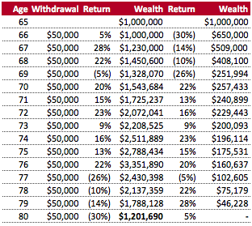
Impact of SORR
Sequence of return risk (SORR) refers to the risk an investor is exposed to due to possible changes in the order in which returns occur.
Assumptions:
Returns are same in all scenarios
Withdrawal is a fixed $ amount, not percentage of remaining balance
Distribution of wealth:
30% equity / 70% fixed income
Conclusion:
Sequence of returns matter
Bad returns in beginning over proportionately decrease wealth
SORR management paramount

Slide 6
SORR – A Short Introduction
Methodology
Utility Maximization with Static Glidepaths
Utility Maximization with Dynamic Glidepaths
Conclusion

Slide 7
steps to follow
1
Definition of SORR
2
Simulate Return Paths
3
Glidepaths (Static)
Glidepaths (Dynamic)
4
Maximize Utility Coverate Ratio (vs. Wealth)

Slide 8
Definition of SORR
To maximize our object function, we first need to define our SORR measure. SORR has no defined metric in the literature.
Bad return → wording change
$$SORR= \frac{\# Worst returns in first 10 years}{\# Total total bad returns }$$
Key Observations:
SORR ranges from 0 to 1
The higher SORR, the more bad returns accumulate in the beginning
Compounded return in first 10 years explains 77% of final retirement outcome⁽¹⁾
Notes: (1) Pfau, W. D. (2013), The Lifetime Sequence of Returns: A Retirement Planning Conundrum, p. 6.

Slide 9
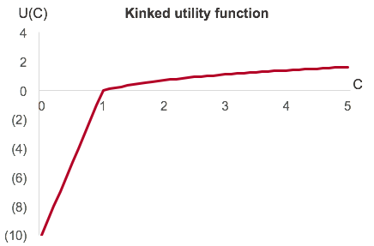
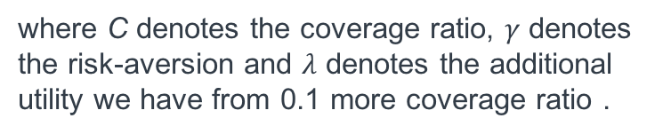
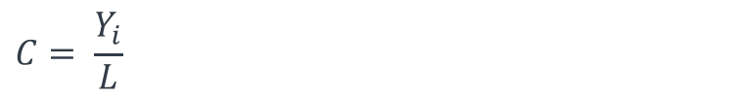
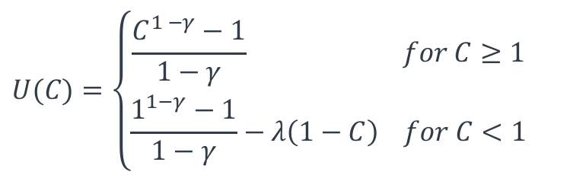
utility Coverage Ratio
Our maximization function is a kinked utility function. Our additional marginal utilitity is much higher if we do not fully cover our estimated lifetime.
(1)
$$U(C)=\left\{\begin{aligned}\frac{C^{1 −γ}−1}{1−γ} for C≥1 \\ \frac{1^{1−γ}−1}{1−γ}−λ\left(1−C\right) for C<1\end{aligned}\right.$$
where C denotes the coverage ratio, $γ$ denotes the risk-aversion and $λ$ denotes the additional utility we have from 0.1 more coverage ratio .
(1)
$$C= \frac{Y_{i}}{L}$$
where Y_{i} denotes the number of years covered by retirement plan and L denotes the number of years in retirement
Notes: (1) Based on Estrada, J. & Kritzman, M. (2018), Evaluating Retirement Strategies: A Utility-Based Approach. pp. 5-6.

Slide 10
SORR – A Short Introduction
Methodology
Utility Maximization with Static Glidepaths
Utility Maximization with Dynamic Glidepaths
Conclusion

Slide 11
Approach and Assumptions
Approach:
Define a current income level and a constant $ withdrawal
Define 3 different glidepaths (conservative, moderate, aggressive) and 3 different SORR exposure (bad returns early, random, late)
Using Monte Carlo simulation, detect distribution of coverage ratio and object function
Understand rationale, sensitivity and implications of observed data
Assumptions:
Choice of glidepath is static, i.e. once you choose a given asset allocation, you will not deviate from it no matter the market development⁽¹⁾
SORR is constant for projected period and can be observed ex ante
Monthly withdrawals are constant over time⁽²⁾
Notes: (1) Current market approach. (2) Monthly withdrawal as well as returns are inflation-adjusted.

Slide 12
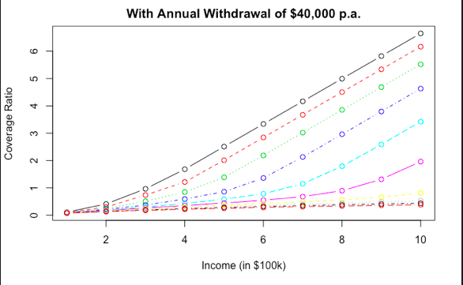
Income level sensitivity

Slide 13
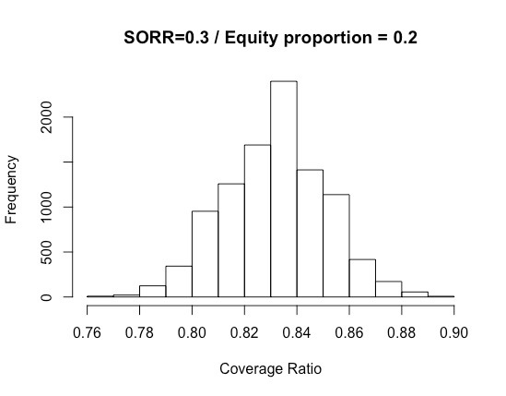
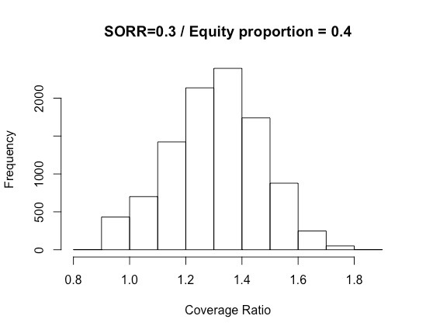
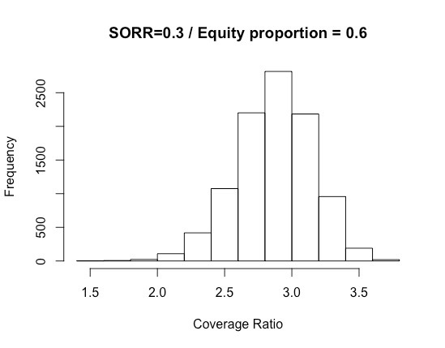
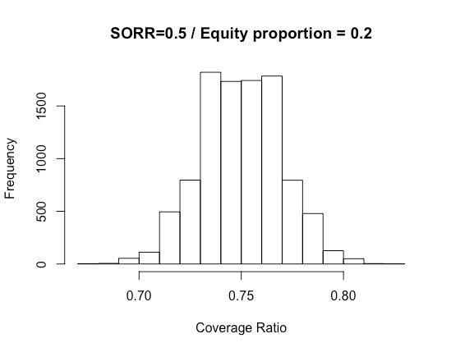
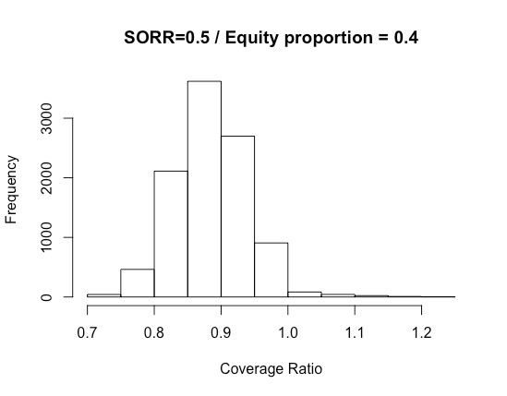
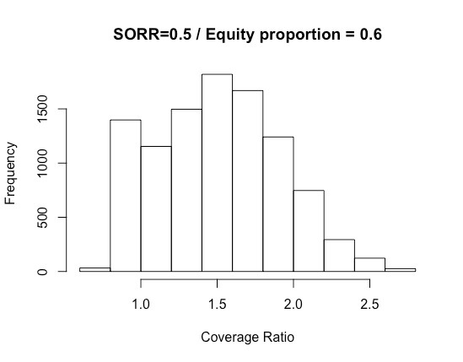
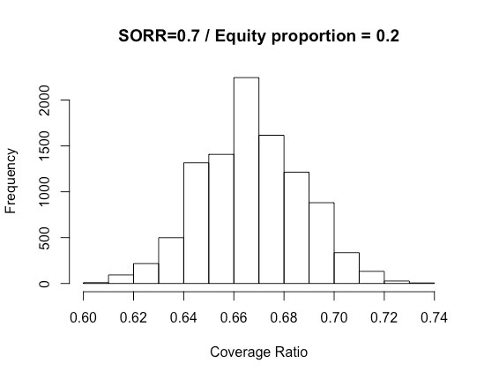
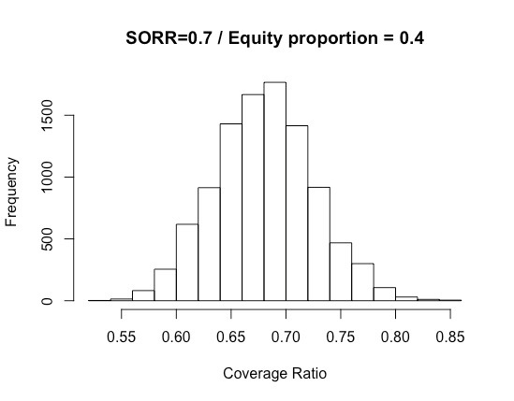
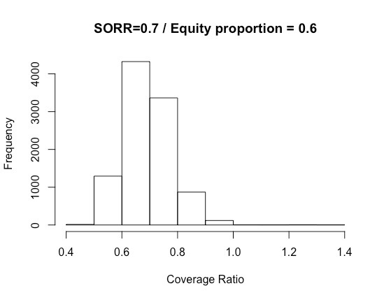
Coverage ratio distribution
 |  | Glidepath
 |  | Conservative (Equity = 0.2) | Moderate (Equity = 0.4) | Aggressive (Equity = 0.6)
Timing bad return | Early (SORR = 0.3)
 | Random (SORR = 0.5)
 | Late (SORR = 0.7)
To-Dos:
Adjust numbers for inflation
Do distribution of utility function → find a rationale for gamma and lambda
Plot utility functions
Find a way to maximize coverage ratio and utility function with glidepaths
Try to justify reason for forward-looking SORR → maybe we should use backward-looking (?)
Think about ways to incorporate income level
Can we compute sensitivity? (and fat tails)
Somewhere talk about fat tail risk? → maybe a way to mitigate those?

Slide 14
utility Coverage ratio
 |  | Glidepath
 |  | Conservative (Equity = 0.2) | Moderate (Equity = 0.4) | Aggressive (Equity = 0.6)
Timing bad return | Early (SORR = 0.3)
 | Random (SORR = 0.5)
 | Late (SORR = 0.7)

Slide 15
SORR – A Short Introduction
Methodology
Utility Maximization with Static Glidepaths
Utility Maximization with Dynamic Glidepaths
Conclusion

Slide 16
Coverage ratio distribution
 |  | Glidepath
 |  | Conservative (Equity = 0.2) | Moderate (Equity = 0.4) | Aggressive (Equity = 0.6)
Timing bad return | Early (SORR = 0.3)
 | Random (SORR = 0.5)
 | Late (SORR = 0.7)
Can we compute sensitivity? (and fat tails)
Somewhere talk about fat tail risk? → maybe a way to mitigate those?

Slide 17
utility Coverage ratio
 |  | Glidepath
 |  | Conservative (Equity = 0.2) | Moderate (Equity = 0.4) | Aggressive (Equity = 0.6)
Timing bad return | Early (SORR = 0.3)
 | Random (SORR = 0.5)
 | Late (SORR = 0.7)

Slide 18
SORR – A Short Introduction
Methodology
Utility Maximization with Static Glidepaths
Utility Maximization with Dynamic Glidepaths
Conclusion

Slide 19
conclusion

Slide 20
Thank you

