Slide 1
Data Analysis
Frequency Response

Slide 2
Frequency Response: Definitions Monthly Snapshot Capacity Impact
Agenda

Slide 3
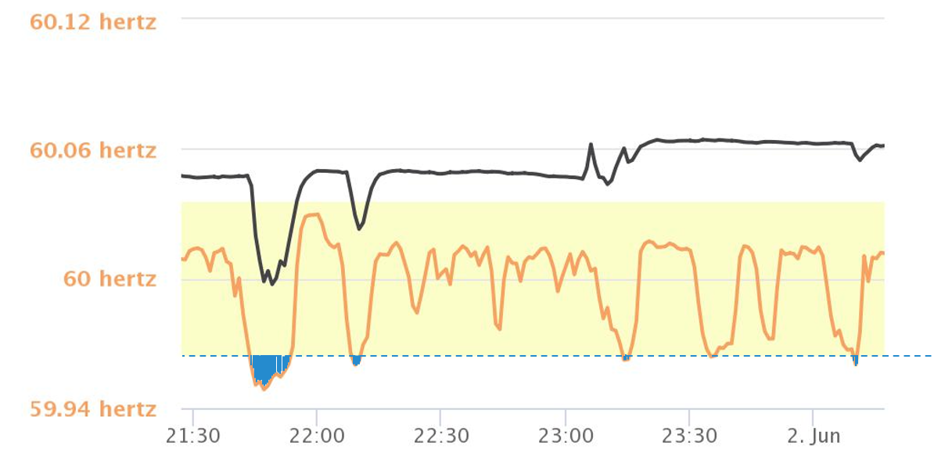
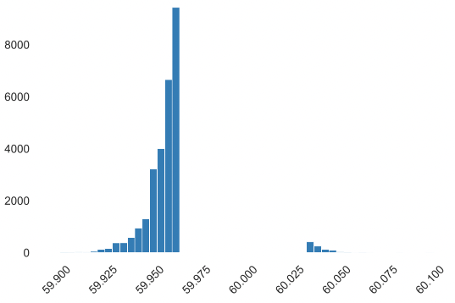

Frequency Response – Definitions
Dead band (yellow highlighted area):
59.964 Hz < f < 60.036 Hz
Frequency Response: occurs when frequency falls outside of the dead band
Response: frequency base response (active control) required to bring frequency response back to within dead band
Frequency Events
# of events*
frequency
*meter reading data - sample from May ‘22

Slide 4
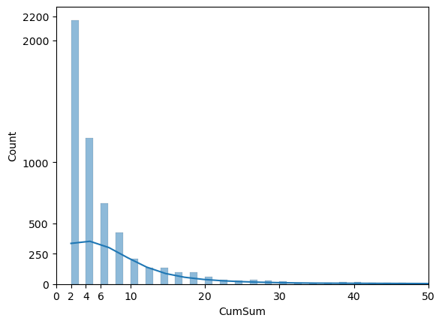
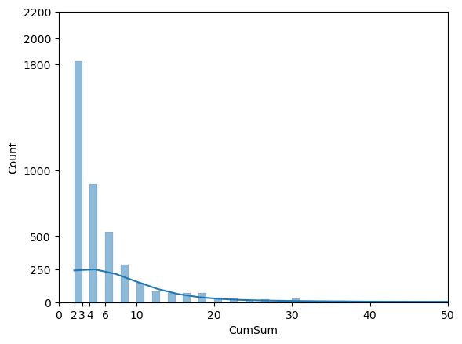
Frequency Response – Monthly Snapshot
2022 - May
2022 - June
Duration and # of unique events:
Duration (seconds)

Slide 5
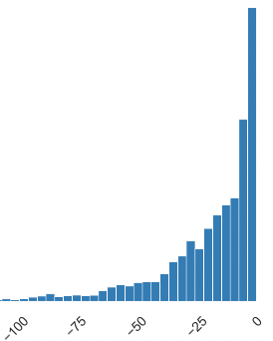
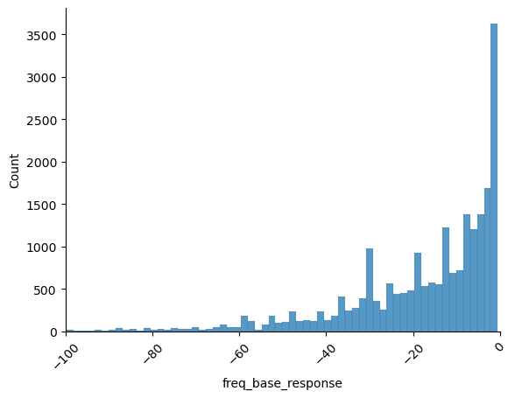
Frequency Response – Capacity impact
2022 - May
2022 - June
Freq. Event Statistics | % Nominal Power
Median | 13.25
Mean | 20.33
Mode | 2.02
Min | 0.48
Frequency Base Response (MW)
Freq. Event Statistics | % Nominal Power
Median | 12.00
Mean | 18.48
Mode | 2.02
Min | 0.47
Frequency Base Response (MW)
# of events
# of events
Freq. Event Statistics | Duration (sec)
Median | 4
Mean | 10
Max | 508
Min | 2
Freq. Event Statistics | Duration (sec)
Median | 4
Mean | 10
Max | 534
Min | 2
% of Total capacity impacted by PFR:
0.445%
% of Total capacity impacted by PFR:
0.3%

Slide 6
Thank You

