Slide 1

TEAM FOUR
PREPARED FOR: SKY’S THE LIMIT
BY: CHRIS LEE-SHANOK, HERMAN BADWAL, MICHAEL YU, RANDALL HO AND TAN NGUYEN

Slide 2
TYPES OF USERS
Focused on four types of users of the web application
  Organizations applying for multiple laptops
  Donors donating laptops
  Administrators fulfilling laptop requests
  Individuals applying for single laptops

Slide 3
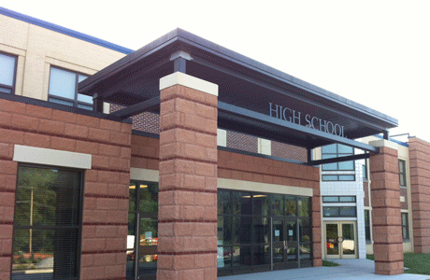
ORGANIZATION PERSONA
EXAMPLE: UNIONVILLE HIGH SCHOOL
Easy to use interface for making batch requests
Real-time updates to their request
Minimal repetitive entering of information

Slide 4








DONOR PERSONA
Make it convenient to donate laptops
Want to know if their donations make a difference
Get recognition for contributions

Slide 5

ADMINISTRATOR PERSONA
Streamline the distribution and donation process
Use more efficient means of communication with clients

Slide 6

BLUEMIX AND BLUEMIX SERVICES
Bluemix as our Platform as a Service – easily test and deploy your app. Add services as you need them.
Use of Track & Plan, Delivery Pipeline, Cloudant, Twilio Services

Slide 7
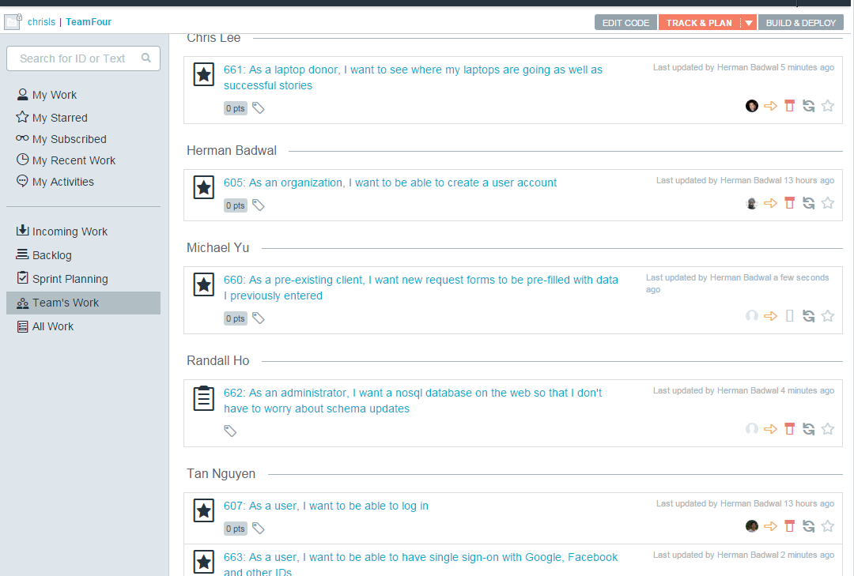
DEVOPS: TRACK & PLAN
Easy to track and plan your work
Keep a history of previously completed work
Prioritize work appropriately
Keep your ‘to do’ list all in one place
Keep conversations away from snail mail and into actual measurable work

Slide 8
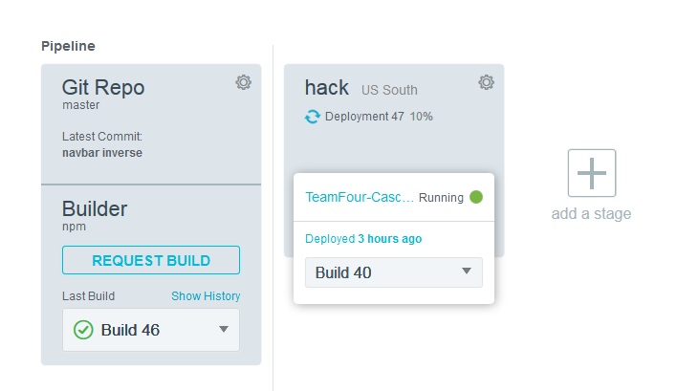
DEVOPS SERVICE: DELIVERY PIPELINE
Automatically Build and Deploy your application to Bluemix after ‘pushing’ your application to a Git Repository on DevOps Services.
Run unit tests with the build to ensure your changes don’t cause regressions

Slide 9

TWILIO INTEGRATION
After clients verify their numbers, when their requests are updated they can automatically be sent an SMS message.
Useful especially since some clients have cell phones, but lack laptops.

Slide 10

CLOUDANT INTEGRATION
Easy-to-use UI provided + tutorials
Schema-less NoSQL database, especially useful if you’re unsure of how the data will evolve
Contains a built-in history
Database as a Service – database is managed for you; no configuration required!
Data redundantly distributed over multiple machines – by someone else

Slide 11

DESIGN
Node backend using Express framework
  Very modular and easy to maintain using the Model-View-Controller Design Pattern (separating out concerns into different files to make it easily understandable).
  Lower memory requirements with Node due to its asynchronous nature for same scalability as a highly multi-threaded app

Slide 12
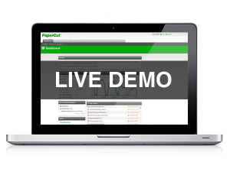

Slide 13

FUTURE WORK
Feed of Happy customers
Automate charity id verification
Allowing a non-technical Admin to modify forms through an Admin panel
Separation of organization and individual accounts
Optimize our Database for quicker querying and scalability

Slide 14


Slide 15


